Slide 1

Bioremediation of pollutants from pharmaceutical residual waters with solid wastes and their chemical modifications
2nd International Conference on Green Chemistry
Orlando, September 16th 2015
Dr. Abel E. Navarro
Science Department, Borough of Manhattan Community College, CUNY

Slide 2
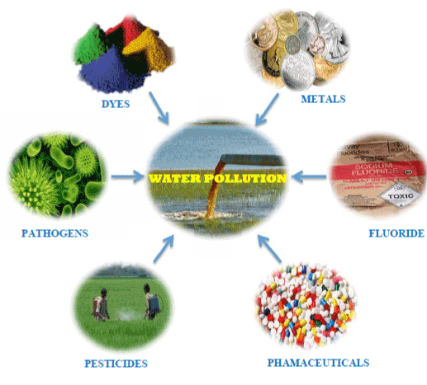
PROBLEM
Pharmaceutical Products
US-EPA has listed pharmaceutical products as pollutants of emerging concern.
Develop resistance in microbes.
Change normal behavior of animals and alter ecology.
Convert into other more toxic substances.
Increase the BOD and COD.
Yahoo Images

Slide 3
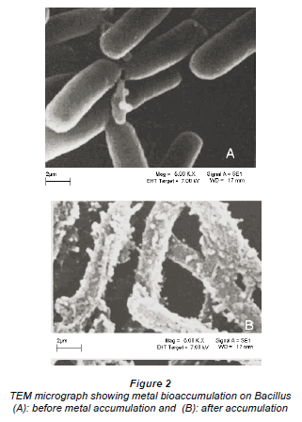
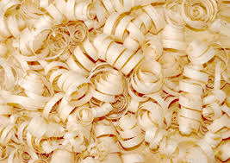
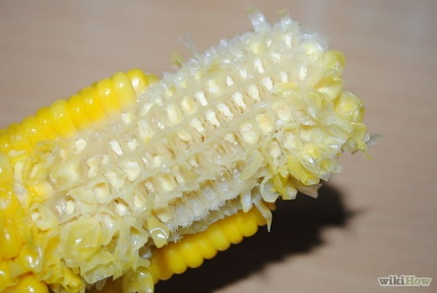
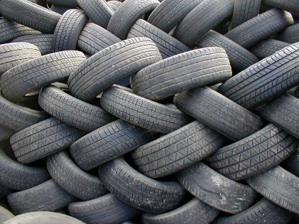
BIOREMEDIATION
Use of biological techniques to remove pollutants from air, soil and water.
Bioaccumulation: Living organisms
Biosorption: Dead biomass
Yahoo Images

Slide 4
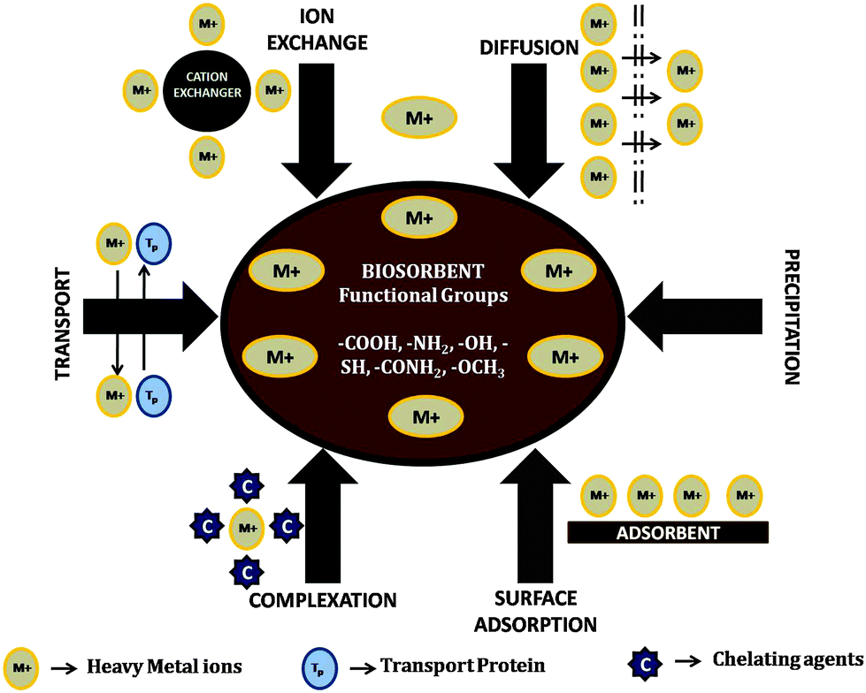
Yahoo Images

Slide 5
ADVANTAGES
Competitive performance.
Pollutant selectivity.
Cost effectiveness.
Pollutant recovery.
No sludge generation.

Slide 6
OUR ADSORBENTS
Why? High content of functional organic groups such as alcohol (fiber and carbohydrates), carboxylic acids and amines (structural polysaccharides).
Why? Easy preparation and massive collection.
Massive collection from tea industries (i.e. Arizona and other bottled tea-based drinks). Algae line up shores of beaches representing an extra expense.

Slide 7
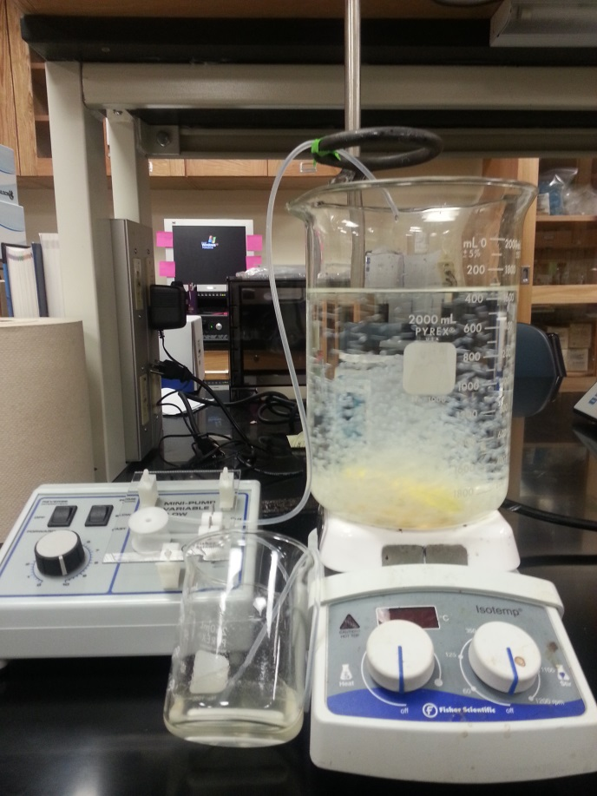
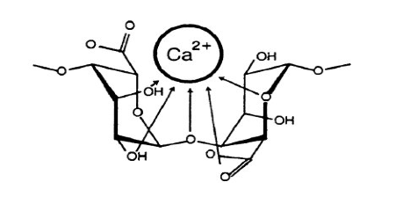
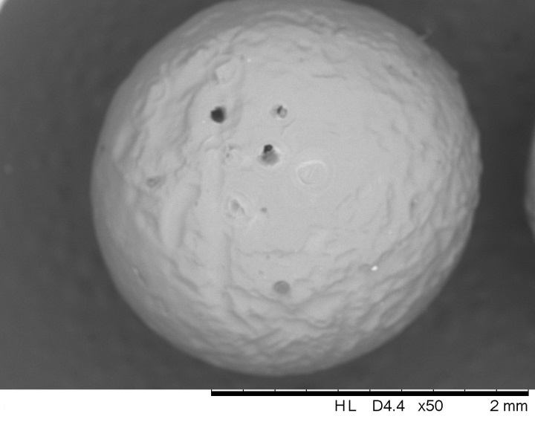
ALGINATE BEADS
Alginate and other polymers gelify in contact with divalent cations (Calcium ions).
High porosity and stability.
Encapsulating matrix
Kim et. al. (2013) Trends in Chromatog., 8, 97-108

Slide 8
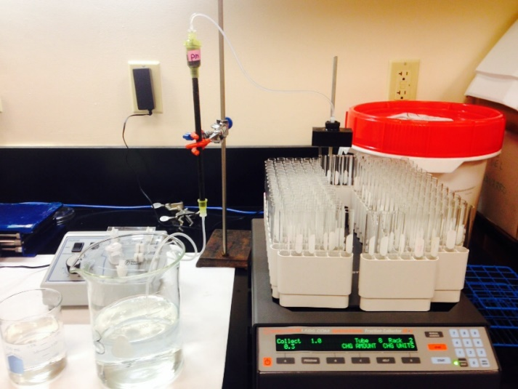
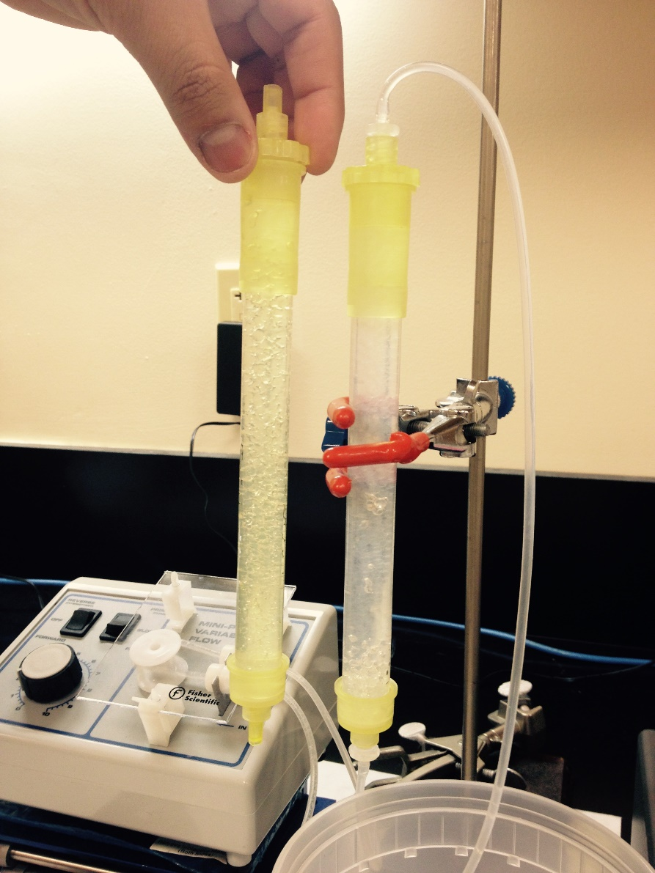
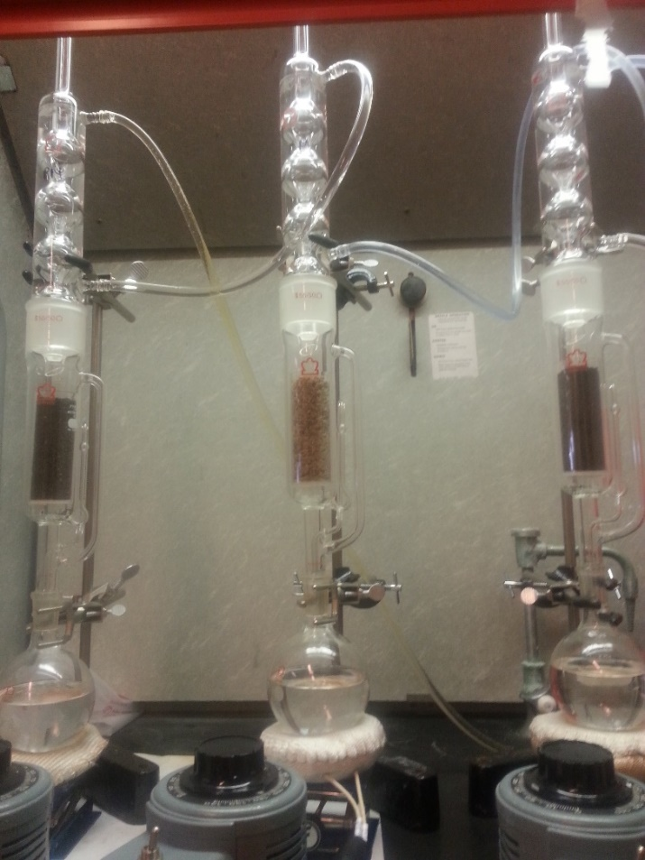
METHODOLOGY

Slide 9
CHEMICAL MODIFICATIONS:
Carboxylation, thiolation and sulfonation

Slide 10
RESULTS
Characterization of the Adsorbents
TGA: Temperature resistance and presence of volatile compounds
Potentiometric titration: Determines the presence of acidic functional groups.
Naidoo et al. (2015) Desalination and Water
Treatment, under review.
Unpublished work

Slide 11
RESULTS
Characterization of the Adsorbents
FTIR: Identify functional groups.
Next: Specific surface area, porosity, SEM, EDX, same analyses after adsorption.
Table 1: Acidic Group content (mmol/g) of all the adsorbents
ADSORBENT | C_{COOH} (mmol/g) | ADSORBENT | C_{COOH} (mmol/g) | ADSORBENT | C_{COOH} (mmol/g)
CM | 1.36 | GT | 1.72 | PM | 1.4
TCM | 1.48 | TGT | 1.88 | TPM | 2
SCM | 1.76 | SGT | 1.92 | SPM | 1.48
CCM | 1.08 | CGT | 1.72 | CPM | 1.36
Unpublished work

Slide 12
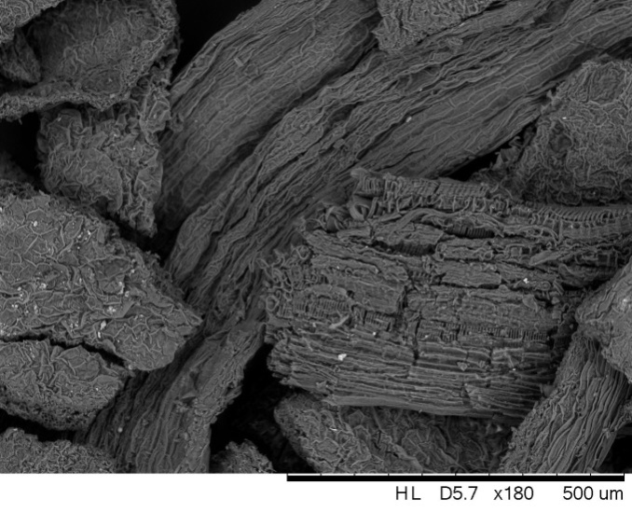
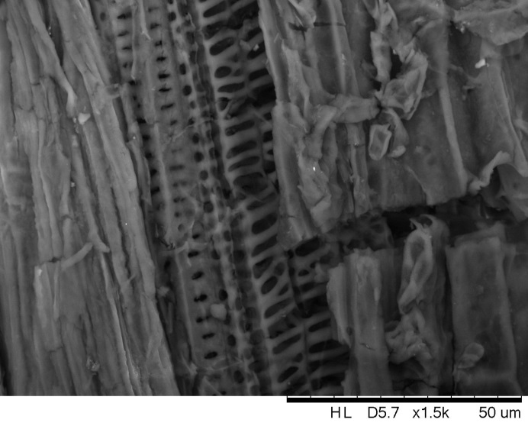
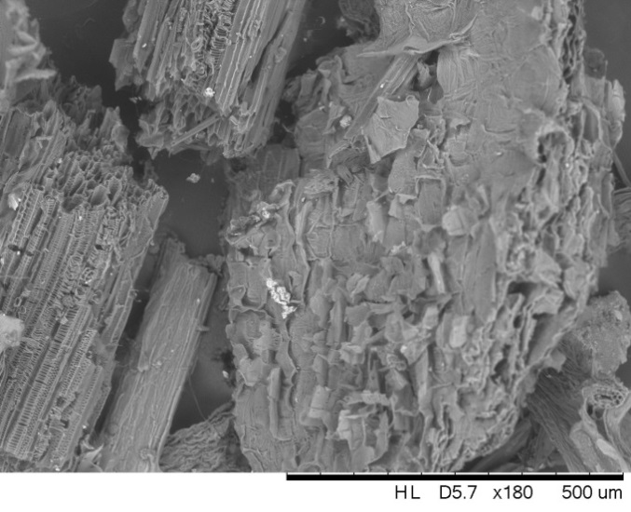
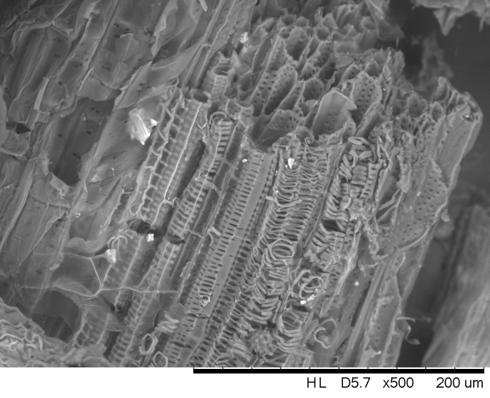
RESULTS-SEM
PM
CM
Zahir et al. (2014) Front. Environ. Sci., 2(28), 1.

Slide 13
RESULTS-FTIR
Zahir et al. (2014) Front. Environ. Sci., 2(28), 1.
Kostadinova et al. (2014) J Environ. Analyt. Toxicol., 4, 240.

Slide 14
RESULTS-pH EFFECT
pH Effect
Ionization of adsorbent’s surface and metals
Adsorption of Enrofloxacin onto hydrogels
Adsorption of Penicillin G onto PM and derivatives
Japhe et al. (2015) J. J. Environ. Sci. 2, 1. Unpublished work

Slide 15
RESULTS-pH EFFECT
Adsorption of Penicillin G onto Marine algae
Adsorption of caffeine with hydrogel beads
Unpublished work
Zarzar et al., (2015) J. Environ. Anal. Chem., in press

Slide 16
RESULTS- MASS EFFECT
Adsorbent Dose:
To minimize the dose of biomass to remove the maximum amount of pollutant – SUSTAINABLE.
Chemically-modified adsorbent: save reagents and purification.
Adsorption of Enrofloxacin onto hydrogels
Adsorption of Penicillin G onto marine algae
Japhe et al. (2015) J. J. Environ. Sci. 2, 1. Unpublished work

Slide 17
RESULTS- MASS EFFECT
Adsorption of Caffeine onto hydrogels
Adsorption of Penicillin G onto PM and derivatives
Zarzar et al. (2015) J. Environ. Anal. Chem, in press Unpublished work

Slide 18
ISOTHERM
Isotherms were modeled by Langmuir, Freundlich, Dubinin-Radushkevich and Temkin theories.
Important parameters: thermodynamics, equilibrium, affinity.

Slide 19
RESULTS-SALINITY
Salinity Effect:
Decreases adsorption due to competition for the adsorption sites.
Higher the charge, the stronger the effect.
Adsorption of Enrofloxacin ontto AB hydrogel
Adsorption of Caffeine with hydrogels
Zarzar et al. (2015) J. Environ. Anal. Chem, in press

Slide 20
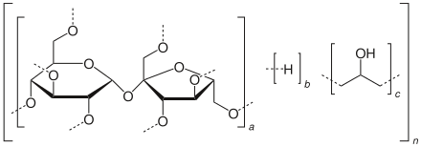
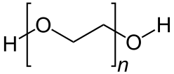

RESULTS-CROWDING AGENT
Challenge in Remediation: Real Conditions.
Crowding Agent: SDS, Ficoll, Polyethylene glycol.
Steric Hindrance, access to active sites
Ficoll
Polyethylene glycol
Adsorption of Penicillin with hydrogels
Adsorption of Enrofloxacin onto marine algae
Unpublished work
SDS

Slide 21
RESULTS-SECONDARY POLLUTANTS
Selectivity of adsorbent in the presence of other pollutants.
Heavy metals have shown high affinity towards biosorbents.
Similar adsorption mechanism? Same active site?
Adsorption of Enrofloxacin onto marine algae
Adsorption of Penicillin with hydrogels
Adsorption of Penicillin onto marine algae
Unpublished work

Slide 22
RESULTS-ADSORPTION KINETICS
Time reduces costs and manpower.
Adsorption reaches equilibrium in 45min (Enrofloxacin) and 20min (caffeine).
Pseudo-First Order Kinetics
Pseudo-Second Order Kinetics
ln (q_{e –} q) = ln q_{e} – k₁ t
t/q = 1/k₂q_{e}² + 1/q_{e *} t
Adsorption of Enronfloxacin onto hydrogels
Adsorption of Caffeine with hydrogels
Japhe et al. (2015) J. J. Environ Sci, 2:1
Zarzar et al. (2015) J. Environ. Anal. Chem, in press

Slide 23
CONTINUOUS-FLOW EXPERIMENTS
Scaled-up processes to purify a larger volume of contaminated water. Mini-scale was run with a column of 15cm x 2cm at a flow of 5mL/min.
Column with Enrofloxacin is shown.
Columns reached saturation quickly.
Change flow and diameter of
columns for a higher efficiency.

Slide 24
CONTINUOUS-FLOW EXPERIMENTS WITH HEAVY METALS
Column tests with Cu(II) at pH 6, room temperature, flow 5mL/min. Mass of adsorbent 1.8-2g. Initial Cu concentration 100ppm.
Chemically-modified adsorbents are expected to display higher adsorption.
Deionized water confirmed that Cu was tightly bound to the adsorbents.

Slide 25
WHAT IS NEXT?
First , can we recycle the adsorbent?
Yes, adsorbents have been used in up to 5 cycles of adsorption/desorption with small changes in adsorption.
To be studied:
Characterization tests show that modified adsorbents shift thermal stability, FTIR shows damage of hydrocarbon chains. SEM images show changes in the morphology of the materials.
Can these new materials be converted into biofuels?

Slide 26
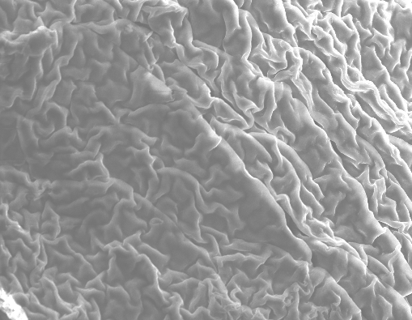
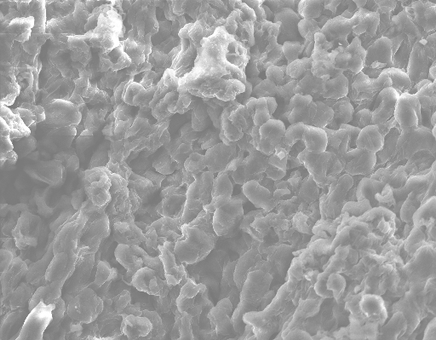
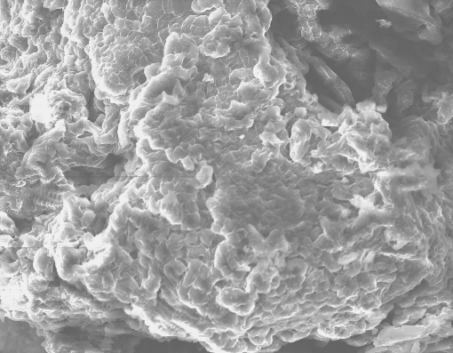
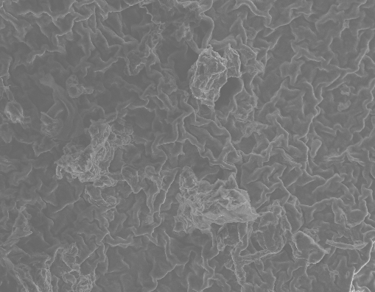
SEM images of modified adsorbents
GT
CGT
SGT
TGT

Slide 27
CONCLUSIONS
Tea leaves, marine algae and hydrogels have proven to be promising adsorbents for pharmaceutical products (antibiotics and caffeine). They also serve as scaffold for chemical modifications.
pH has a strong effect on the adsorption. Likewise, salinity and crowding effects have a negative impact.
Incorporation of active functional groups enhance the adsorption of pollutants on modified-tea leaves.
These pollutant-loaded adsorbent could be potentially converted into biofuels due to the better exposure of cellulose and hemicellulose

Slide 28


Acknowledgements
Group Members:
Aharon Zarzar
Tenzing Japhe
Kateryna Zhdanova
Michelle Lo
Minyeong Hong
Funding:
CSTEP, BMCC Faculty Development Grant, C3IRG, MCC-Puerto Rico and the Center or Renewable Energy and Sustainability.

