Slide 1

(3rd International AIDS/HIV Nov. 30, 2015)
DNA Methylation Profiling can Classify
HIV-associated Lymphomas
Yukihito Ishizaka
Dept. of Intractable Diseases,
National Center for Global Health and Medicine

Slide 2
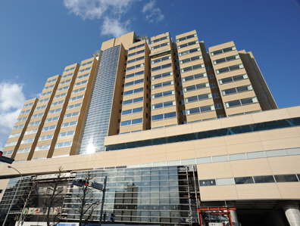
National Center for Global Health and Medicine
(NCGM)
・In 1980s, Hemophilia patients in Japan were infected with HIV-1, which was contaminated in blood products.
(Medical malpractice!)
・Approximately 1800 individuals were infected, and 1200 persons are still suffering from the infection.
・Although immunological status is well controlled, persistent infection causes chronic clinical symptoms that include tumorigenesis, cardiovascular diseases and metabolic disorders.
・ Our mission is taking care of these patients and keeping better QOL.
Notes:
2

Slide 3
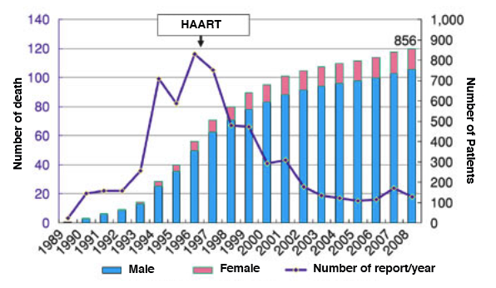
Patients’ prognosis is
dramatically improved after ART
HAART (Highly Active Anti Retroviral Therapy)
AIDS Committee of Japan , 2010

Slide 4
Malignancy is now the major cause of death
AIDS-defining diseases 36%
(Non-Hodgkin lymphoma 10%)
Other tumors (lung, stomach, colon, etc.） 17%
Hepatitis 15%
Myocardiac infarction 8%
Suicide 5%
Others 4%
Int J Epidemiol 34 , 2005

Slide 5
HIV-positive patients are at high risk of malignancy
Tumors
Incidence rate
Non-Hodgkin lymphoma
DLBCL
BL
PCNSL
Cervical cancer
X 21
X 115
X 74
X 6
JAMA 305, 2011
DLBCL: Diffuse large B cell lymphoma
BL: Burkitt lymphoma
PCNSL: Primary central nervous system lymphoma
Etiology of malignancy remained unknown.

Slide 6
Question 1
HIV-1 associated lymphomas
?
Non-HIV-1 lymphomas

Slide 7
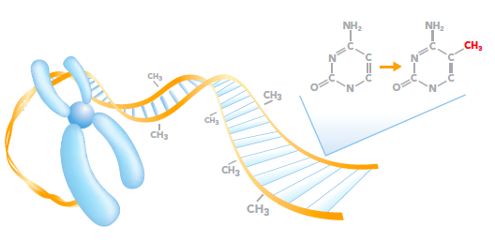
DNA-methylation pattern can characterize tumors
・The 5’-carbon of cytosine in CpG dinucleotide is epigenetically
modified by a methyl residue.
Unmethylated
Gene expression
Gene
Methylated
Gene expression repressed
Gene

Slide 8
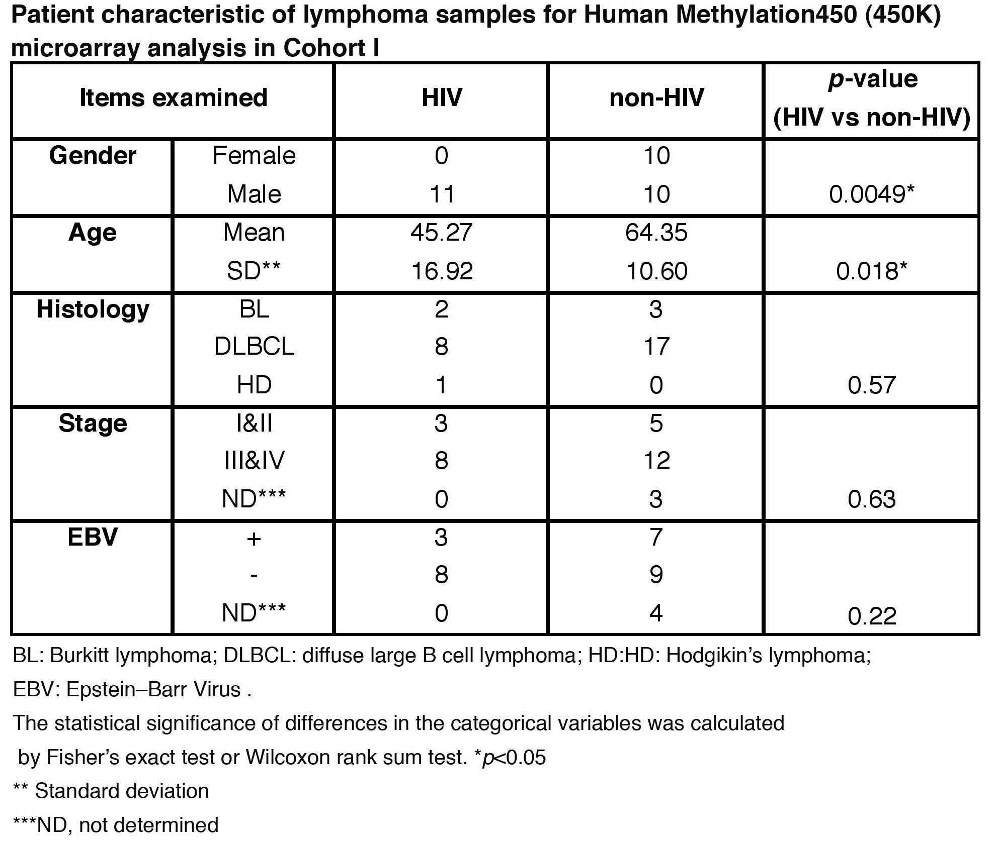
Clinico-pathological features of cohort I
HIV-1 positive lymphomas: 11 cases
Non-HIV lymphomas
: 20 cases

Slide 9
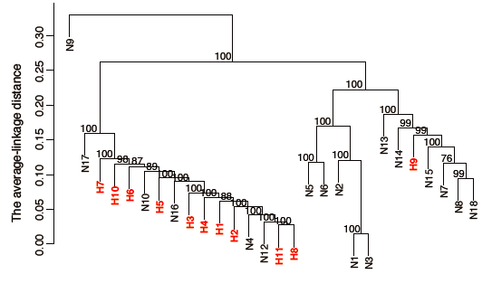
HIV-associated lymphomas have
unique DNA methylation patterns
CGI
CpG island
Group1
Group2
TSS1500,TSS200
,5’UTR,1stExon
Hierarchical clustering
Red: HIV-positive
Black: HIV-negative

Slide 10
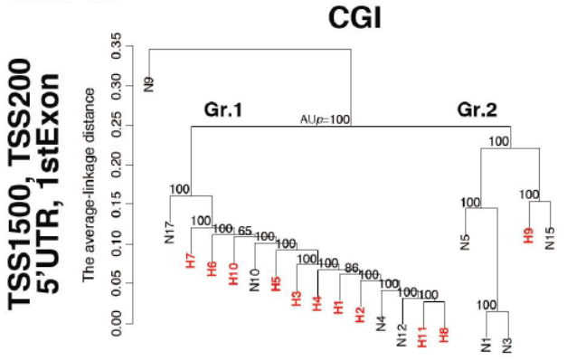
Methylation patterns adjusted by “Gender”
are also different among two groups
CpG island
Red: HIV-positive
Black: HIV-negative

Slide 11
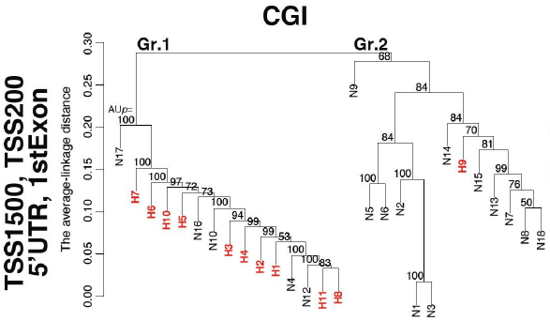
Methylation patterns adjusted by “Age”
are also different
Red: HIV-positive
Black: HIV-negative

Slide 12
Answer to Question 1
HIV-1 associated lymphomas
X
Non-HIV-1 lymphomas
DNA methylation pattern in peripheral blood B cells.
Two of 10 HIV-1 positive patients analyzed possessed
dramatic changes of DNA methylation pattern.

Slide 13
Question 2
What is the cause of
differential patterns of DNA methylation?
・ Most of HIV-associated lymphomas are B cells.
There are some exogenous factors.
Viral proteins
(Tat, Vpr, Nef)
Cytokines

Slide 14
Question 2
What is the cause of
differential patterns of DNA methylation?
・ Most of HIV-associated lymphomas are B cells.
There are some exogenous factors.
Viral proteins
(Tat, Vpr, Nef)
Cytokines

Slide 15
Vpr is a candidate viral protein of malignancy
t
a
t
g
a
g
v
i
f
r
e
v
n
e
f
v
p
u
5
'
L
T
R
3
p
o
l
vpr
e
nv
'
L
T
R
1. A virion-associated nuclear protein of 96 amino acids.
2. Vpr is important for macrophage infection.
3. Vpr induces various genomic instabilities, which include
・DNA double-strand breaks
・Premature sister chromatic separation
・Retrotransposition
4. Vpr is present in circulating blood.

Slide 16
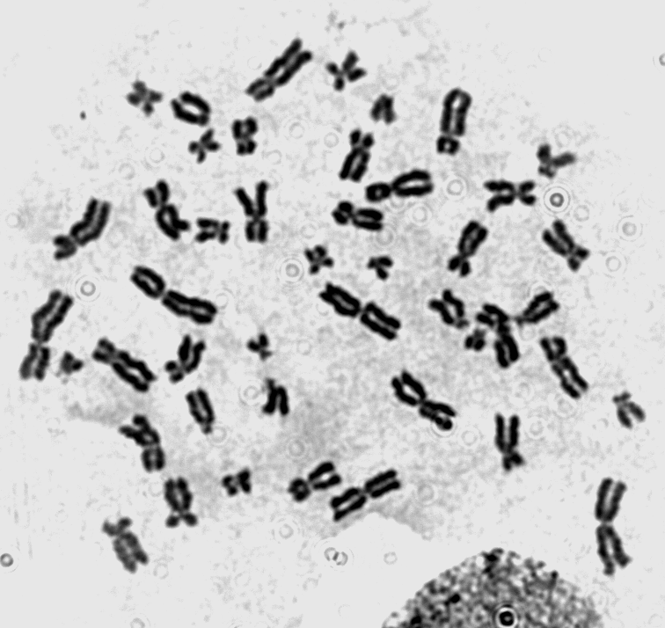
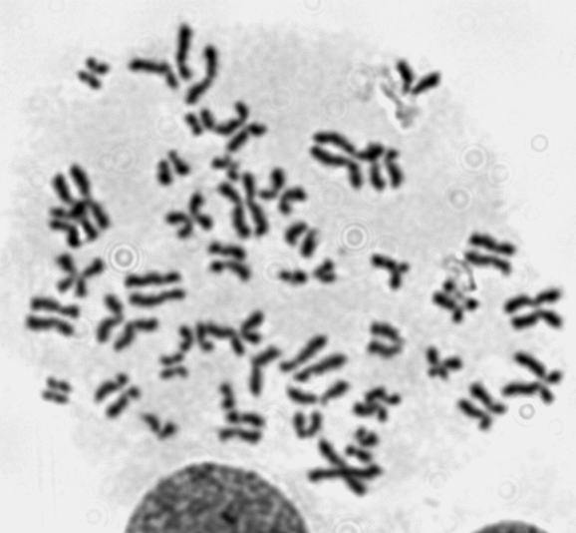
Premature Sister Chromatid Separation
in HIV-infected Patient (PCS)
~1 %
10 %
Healthy Volunteer
HIV+
“PCS is a hallmark of aneuploidy”
(Shimura et al. AIDS 19, 2005)

Slide 17
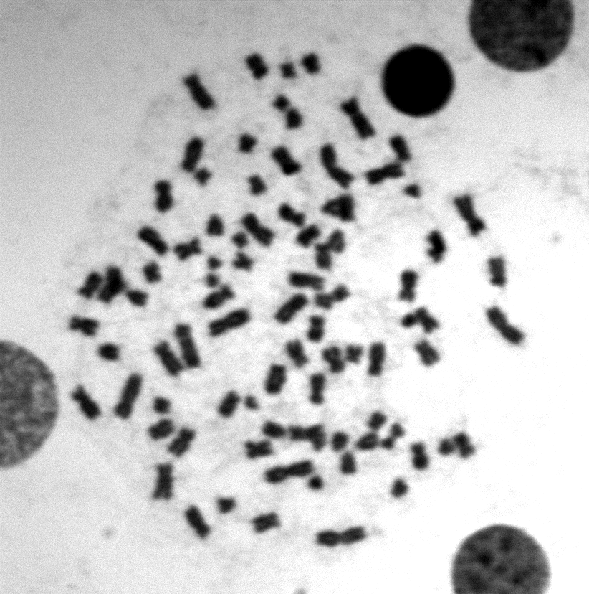
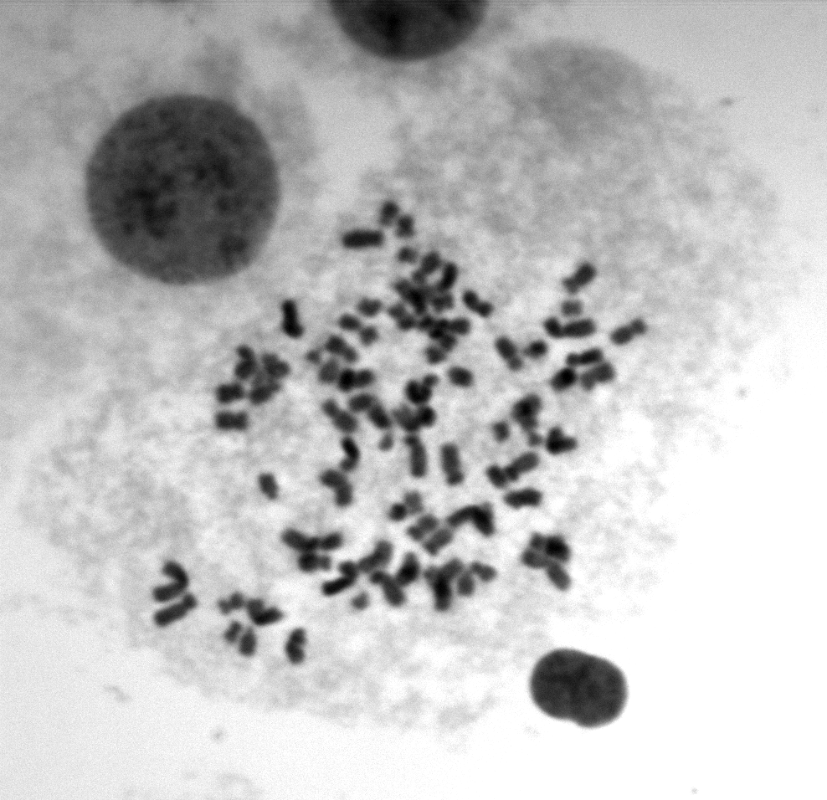
Anueploidy in HIV-1 infected cells
P-1
P-6
Numbers of
chromosomes
85
75
5 μm
(Shimura et al. AIDS 19, 2005)
Notes:
As PCS is a hall mark of aneuploidy, ……
We think that It is important to identify the mechanism involved.

Slide 18
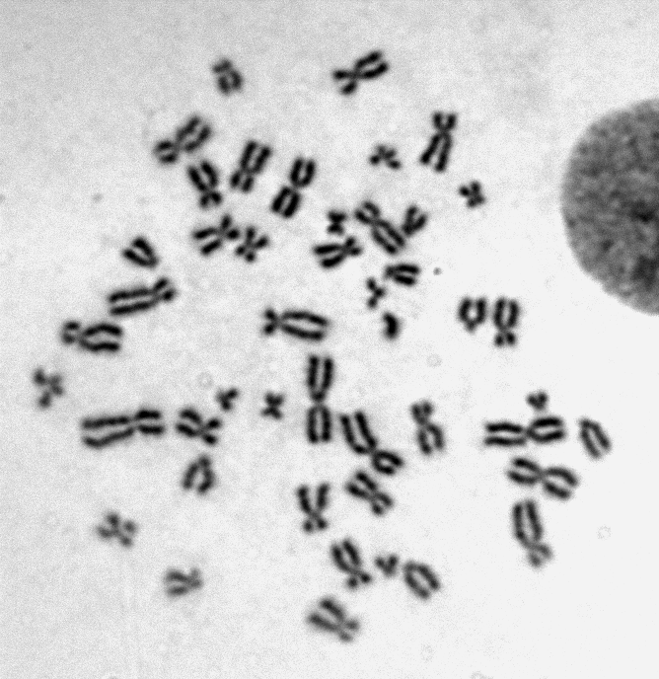
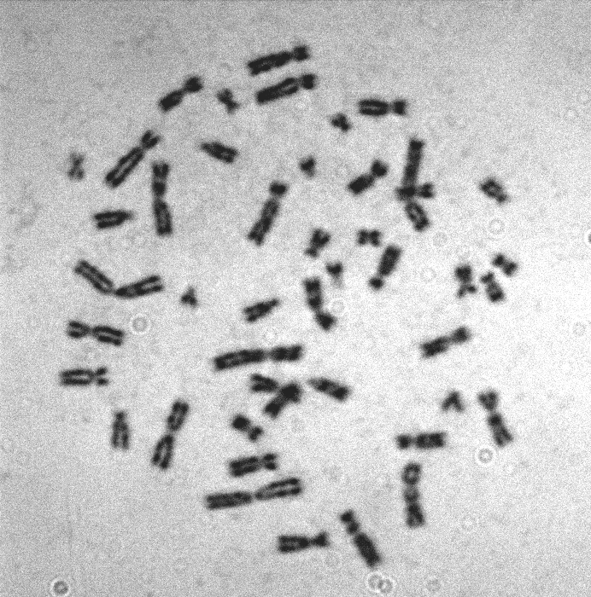
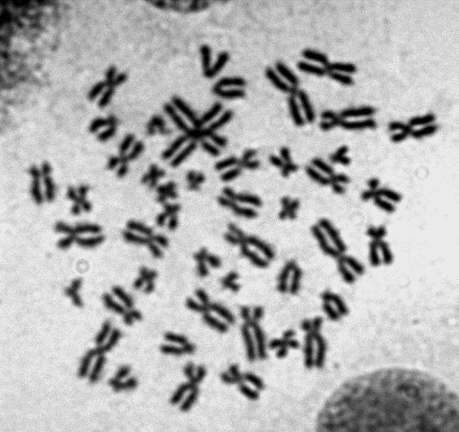
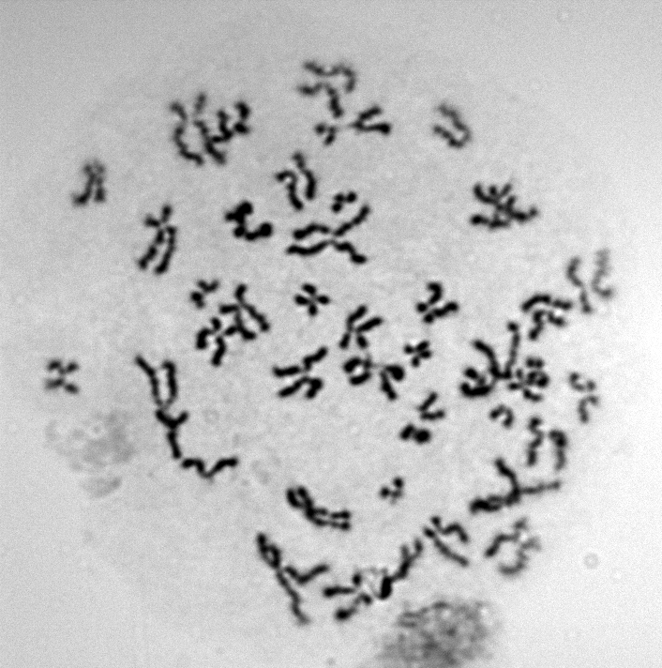
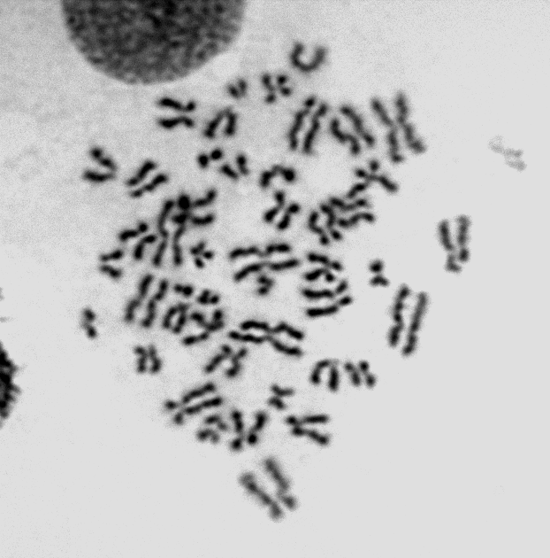
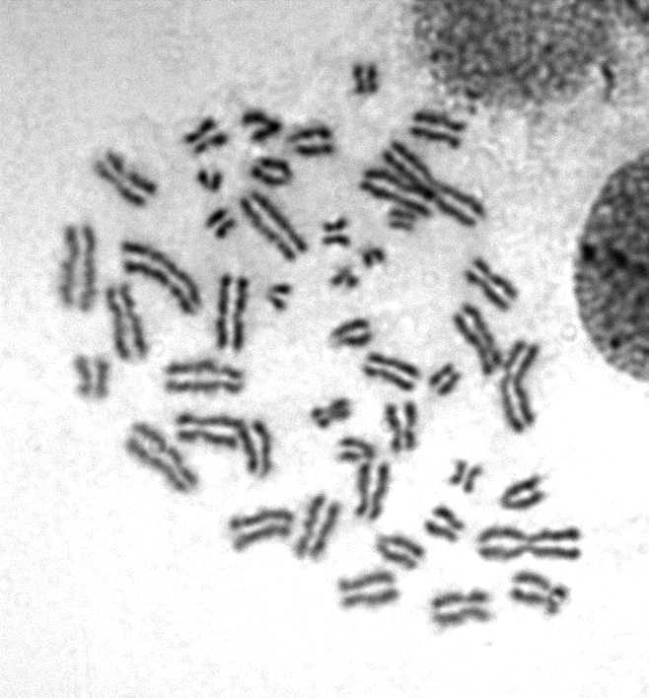
HIV-1 Infection in vitro promotes PSC in healthy blood cells
a
z
c
b
a/+
b/+
c/+
Shimura et al. AIDS 19, 2005

Slide 19
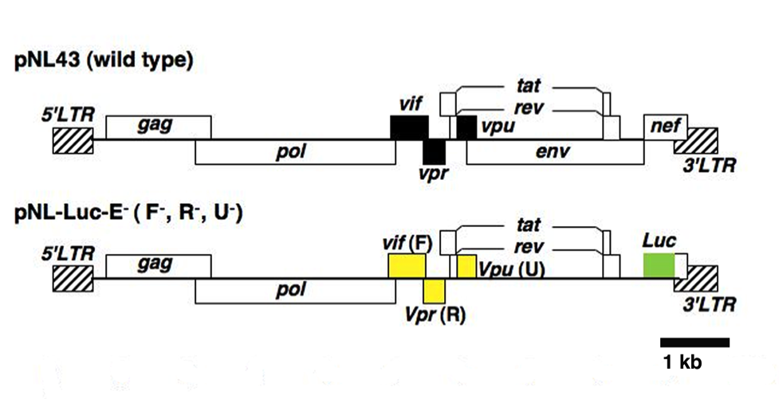
What is responsible gene for PCS ?
Notes:
We introduced mutations only in to accessory genes with no influence on the rate of infection.
Nef
Env
We used VSV-G psuedotyped viruses to perform a single round replication assay.

Slide 20
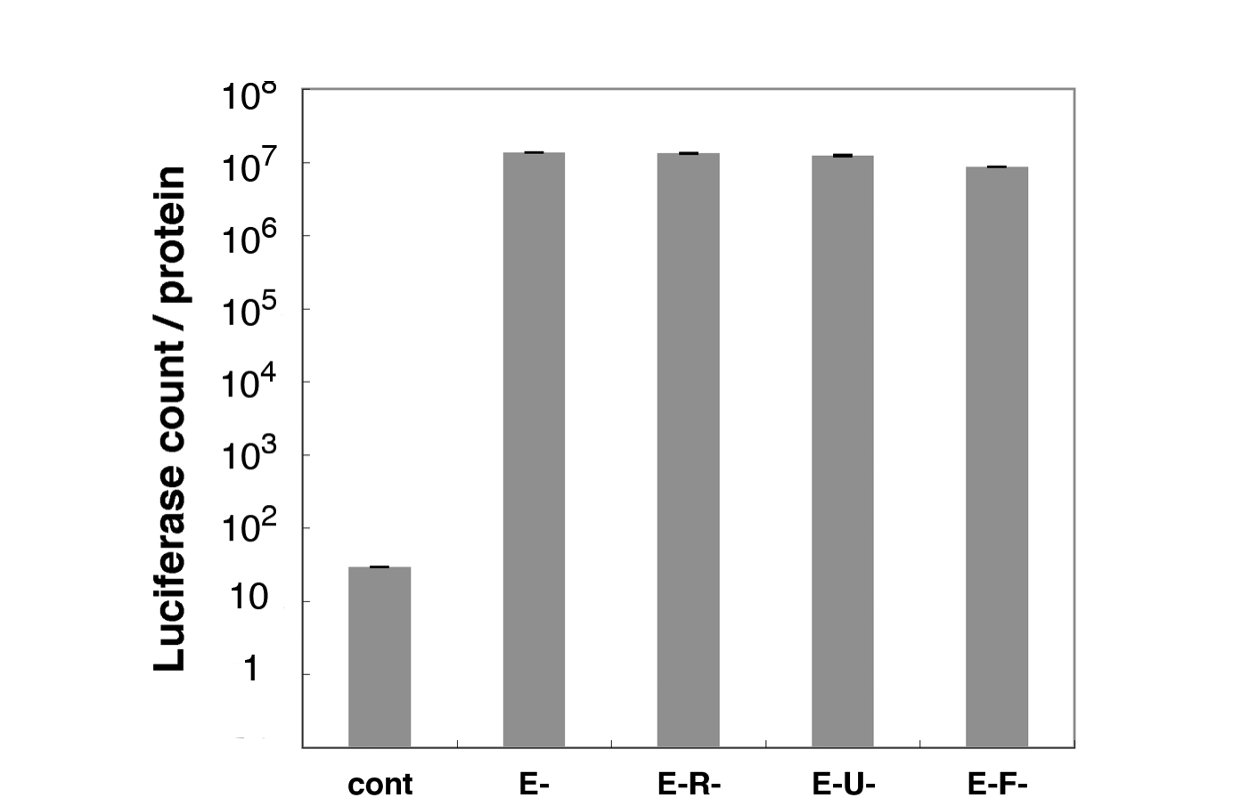
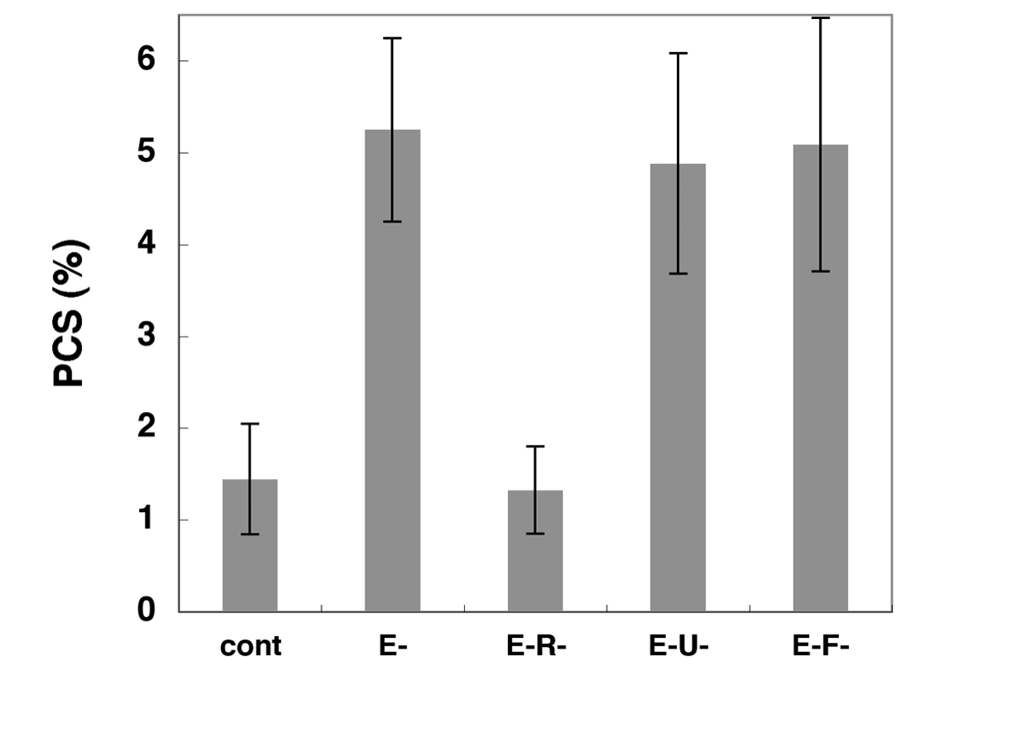
vpr is responsible for HIV-induced PCS
Frequency of PCS
Luciferase Activity
-
vpr
-
vpr
vpu
vif
vpr
vpr
vpu
vif
No infection
Defective mutants
No infection
Defective mutants
84 hrs post infection
MOI; 0.007
Notes:
Vpr is responsible for HIV-1-associated PCS.

Slide 21
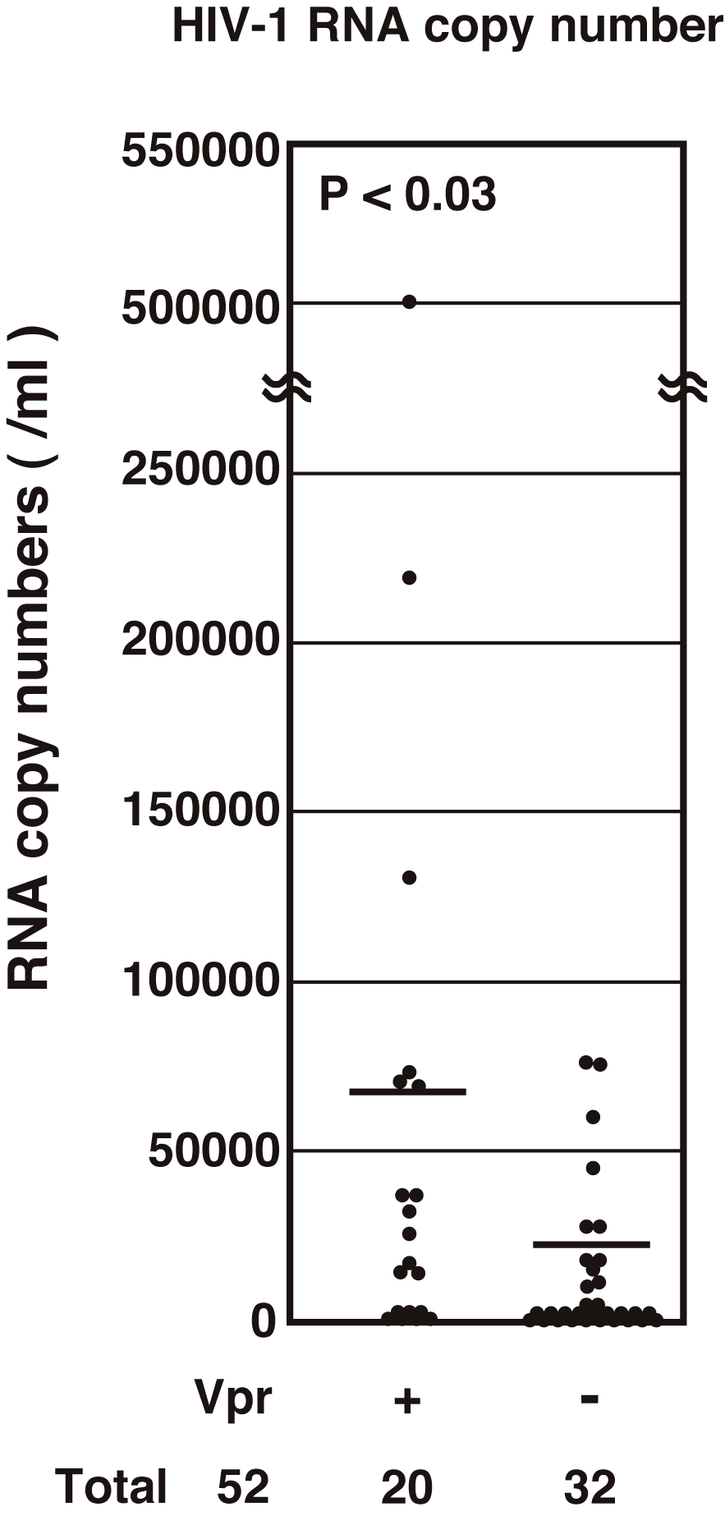
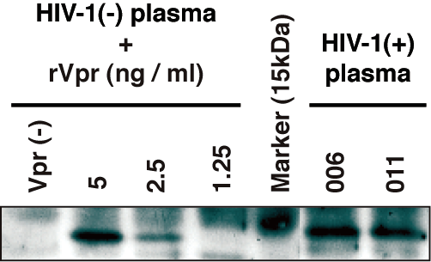
Vpr is present in plasma of HIV-positive patients
(Hoshino S et al., AIDS Res Hum Retrovir, 23, 391, 2007)
P < 0.05
Control plasm
+
rVpr (ng / ml)
Patients
0
5
2.5
1
M
1
2
HIV-1 RNA copies (/ml)
Concentration is nM level.
Vpr
+
-
Cases 52
20
32
(〜40%)

Slide 22
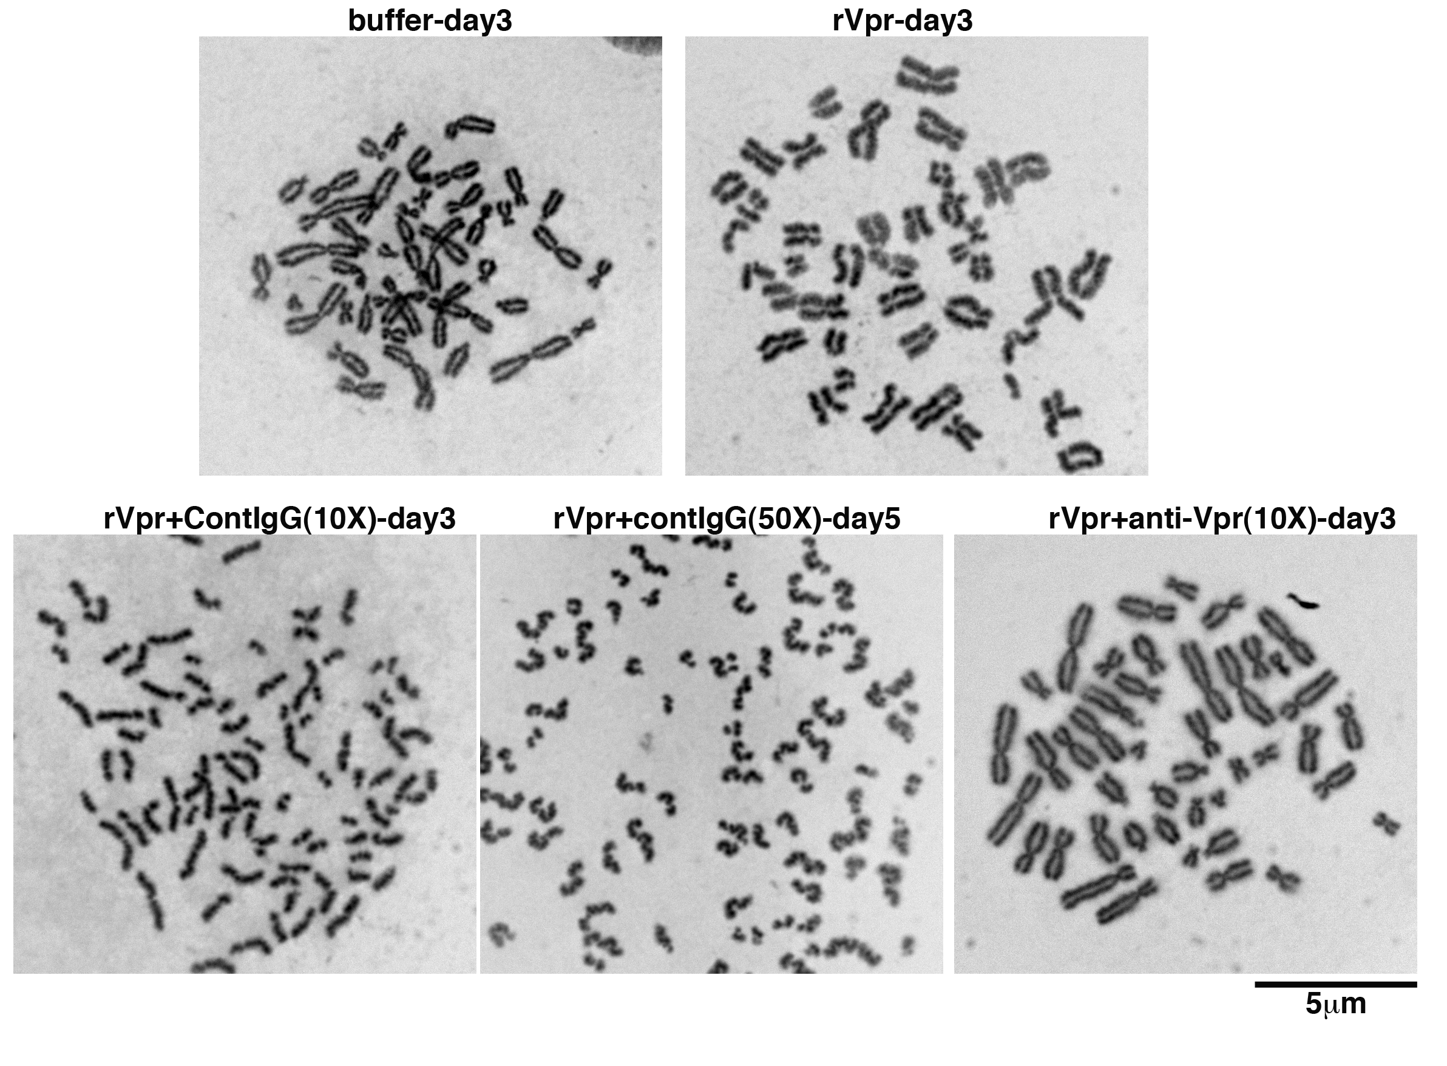
Exogenously added ｒVpr also induces PCS
ｒVpr
PCS?

Slide 23
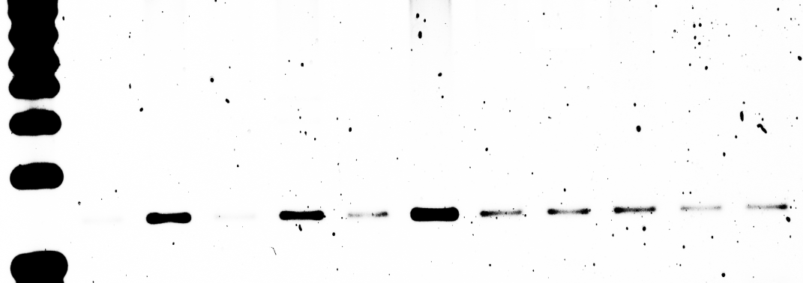
Vpr in patients’ plasma is biologically active!
Exp-1. 6 /15 plasma samples were positive for retrotranposition (RTP)
Exp-2. The activity of RTP was neutralized by anti-Vpr MoAb.
HIV patients
Healthy Vol
Mo-Ab
１
2
3
A
B
V
V
V
Mr
C
C
C
U
C
V
C
V
β-actin
Mr
1
8
1
6
3
3
12
4
3
3
3
RI
C, control IgG; V, anti-Vpr monoclonal Ab
x10 dilution
(Iijima K, Retrovirology, 2013)

Slide 24
Current Question
Is plasma Vpr “really”
a candidate factor related to malignancy?
1. Monitoring plasma Vpr.
2. Correlation of Vpr titer and DNA methylation.

Slide 25
Newly developed ELISA system can
monitor plasma Vpr
*
His-tag
Vpr
Capture: polyclonal peptide antibody
Healthy
Patients
16/40
Detector: recombinant chick-
derived MoAb (B34)
16/40
(>40%)

Slide 26
Summary
1. HIV-associated lymphomas are different from non-HIV lymphomas.
2. HIV has Vpr that induces genomic instability.
3. Plasma Vpr is detectable in more than 40% of the patients.
4. Next issue is to compare plasma Vpr and DNA methylation pattern.
5. We can use a humanized recombinant monoclonal Ab to Vpr.
better prognosis and QOL of the patients

Slide 27
Collaborators
National Center for Global
Health and Medicine (NCGM)
Tokyo Metropolitan Cancer
and Infectious Disease Center,
Komagome Hospital
Dept. of Intractable Diseases
Akihito Matsunaga, Masao Oka
Kenta Iijima, Mari Shimura
Dept. of Pathology
Tsunekazu Hishima
Div. of Hematology, Internal Med.
Shotaro Hagiwara
The University of Tokyo
Dept. of Human Genetics
Maria Yamasaki
AIDS Clinical Cencer
Junko Tanuma, Shinichi Oka
Grad. School of Frontier Sci.
Lui Yoshida
Dept. of Pathology
Makoto Mochizuki
National Institute of
Infectious Diseases
Dept. of Clin. Res. and Info.
Noriko Tanaka
Dept. of Infectious Pathology
Kenzo Tokunaga

