Slide 1
Taking testing as a new prevention strategy for HIV infection towards three 90%
Yan Jiang M.D, Ph.D
National HIV/HCV Reference laboratory,China CDC

Slide 2
90-90-90 by 2020
According to the latest guildline of WHO, 90% of all people living with HIV know their status is the critical step for controlling new HIV infections.

Slide 3
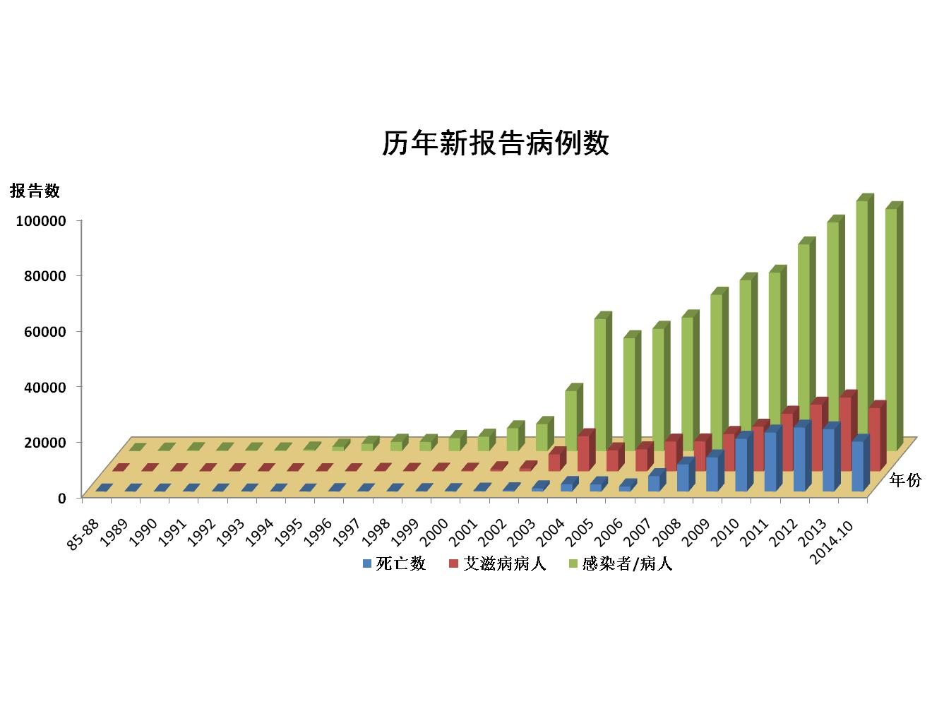
The number of HIV/AIDS is still rising
By the end of October 2014, there were 497,000 people reported in China were living with HIV/AIDS, including 199,000 AIDS. Total AIDS deaths increased to 154,000 .
Number of new cases reported (1985-2014)
Reported case
Year
Mortality
AIDS
HIV/AIDS
Notes:
In recent years the number of China's growth rate of AIDS has decreased, but thehuge population base, the number of AIDS patients is still rising.

Slide 4
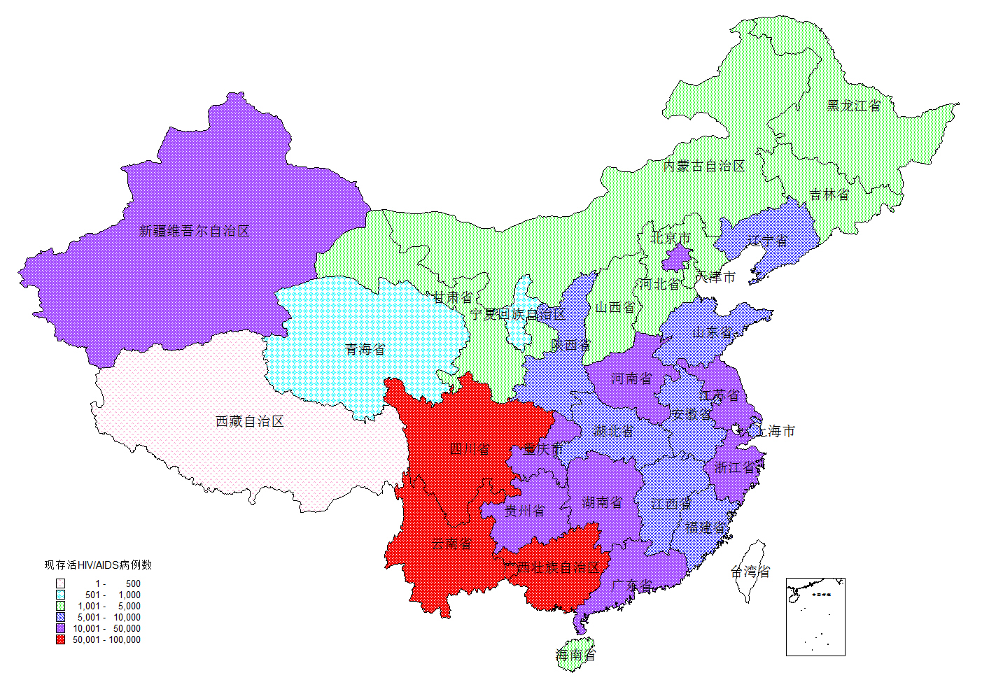
The features of the HIV epidemic
Despite an overall low prevalence, some areas have high HIV prevalence, such as Yunnan, Sichuan, and Guangxi. These three provinces account for 42.5% of Chinese HIV cases.

Slide 5
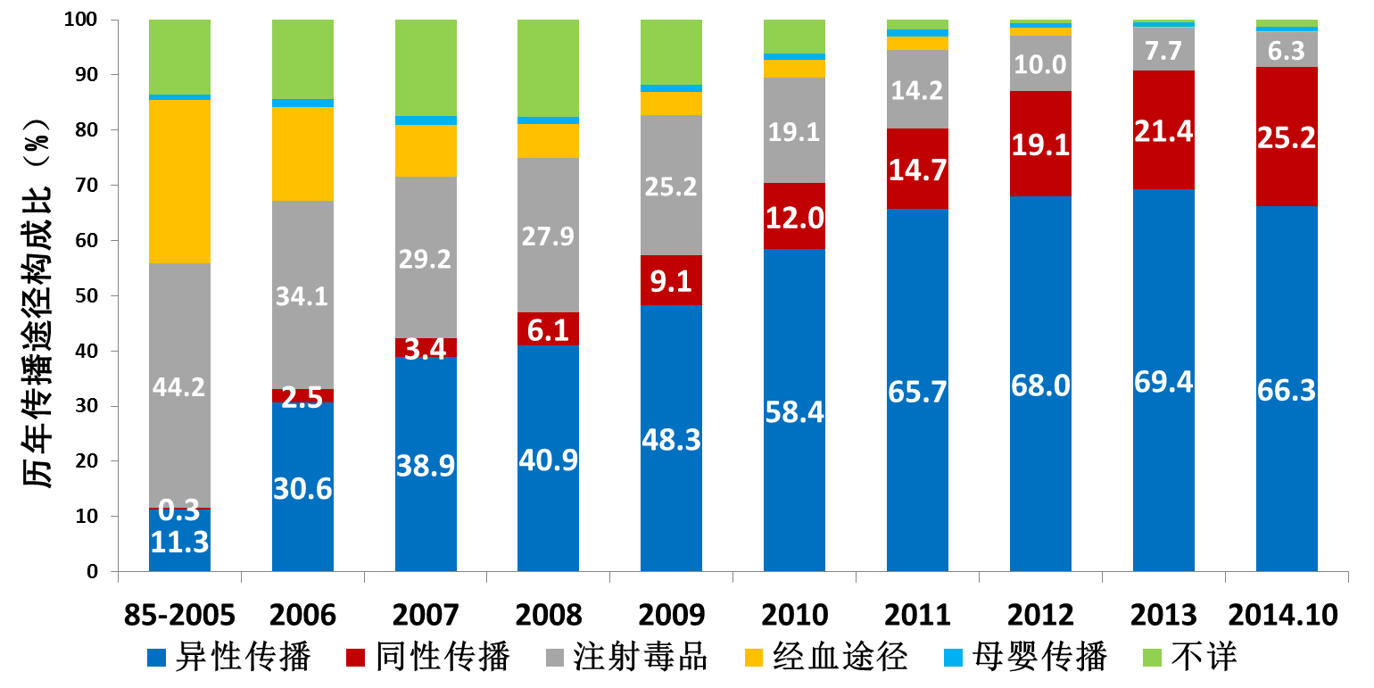
The features of the HIV epidemic
It is estimated that only 54% of the 810,000 individuals living with HIV/AIDS in mainland China were aware of their status.
The proportion of transmission routes(%)
Heterosexual
Homosexual(MSM)
Injection Drug Use
Blood
Mother-to-child
Unknown

Slide 6
The features of the HIV epidemic
There are big differences between the city and the countryside.
In some big cities, MSM accounts for 51.1% of the new HIV diagnoses, up to 80% in Changchun, Harbin, Shenyang and Beijing.
In small and medium-sized cities, heterosexual transmission accounts for 60.8%, while MSM accounts for 32.2%.
In most countryside area, heterosexual transmission accounts for 75.7%, up to 90% in Guangxi and Guizhou province.

Slide 7
Treatment as Prevention (TAP)
Possible
Testing as Prevention (TAP)
Possible?

Slide 8
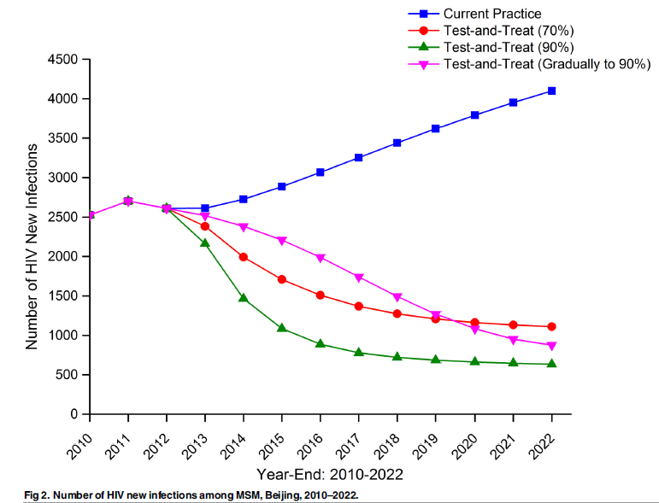
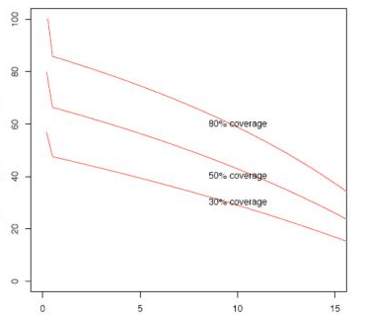
Based on the mathematical model study, it is reported that the coverage rate and frequency of testing were negative correlated with new HIV infections
Reduction in incidence(%) versus mean
interval between HIV tests (years) (Africa)
Number of HIV new infections among MSM
Beijing,2010-2022 (China)
Reduction in equilibrium incidence
Percentage reduction in incidence
Internal between tests (yrs)
Dodd PJ, et al. AIDS, 2010, 24(5)
Luo S, et al. Plos One, 2015, 10(6)

Slide 9
National program of rapid testing for MSM population from an NGO of Xian city
(2013 to 2015）
MSM at NGO
↓ 2013 (610)
↓ 2014 (1201)
↓ 2015 (630)
Questionnaire RT testing(RT-ELISA-WB)
Testing: RT at MSM group, TA by local CDC screening laboratory
if positive, sent sample to do WB testing
Lab QC：PT 3 times per year provided by NARL

Slide 10
MSM population from an NGO of Xian city
(2013 to 2015）
Having HIV testing last year? Response from 2441 persons
↓yes ↓no
1898（77.8%） 543（22.2%）
↓ test ↓ test
93+（4.9%） 62+（ 11.5%） p<0.01
The HIV infection rate of MSM who received HIV test in the past year was significantly lower than that without testing, showing the testing is the protective factor for preventing HIV infection.
(to be published)

Slide 11
Treatment as Prevention (TAP)
Positive population:
Treatment→ Viral load ↓ → prevention
others infection
Testing as Prevention (TAP)
Population without tested:
Testing→ positive → treatment
Testing→ negative → behavior change
↓
decrease seroconversion

Slide 12
MSM of Beijing Youan Hospital STD clinic
(2014-10-1 to 2015-10-30)
9126
↓ test
8470 -（92.81%） 656 +（7.19%）
↓ testing education
1354
↓ retest, 2.78 times/person/year
Seroconversion 7 persons (incidence 0.52%)
(To be published)

Slide 13
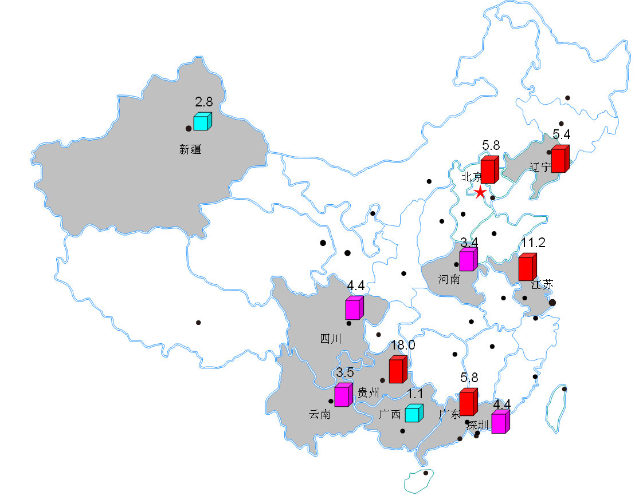
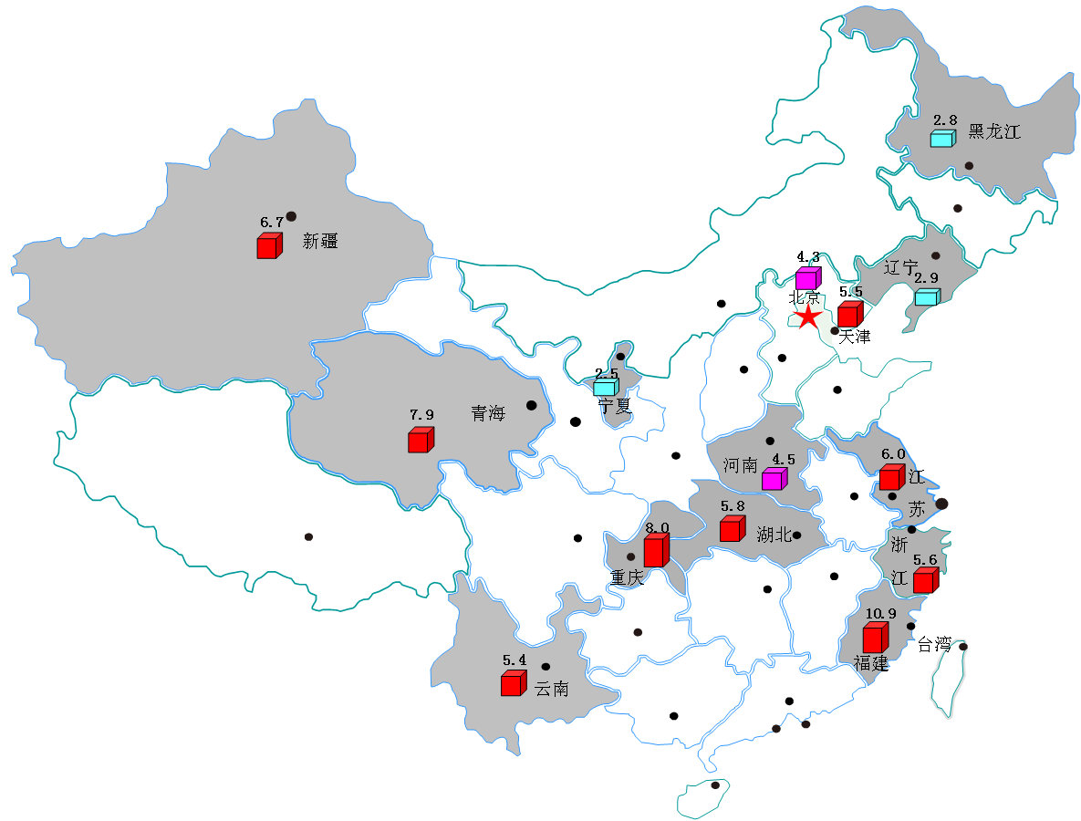
Incidence of MSM population based on Meta analysis
Incidence from national cohort study
5.8（3.3-10.0)/100PY
Incidence from
BED-CEIA assay
5.3（4.5-6.2)/100PY

Slide 14
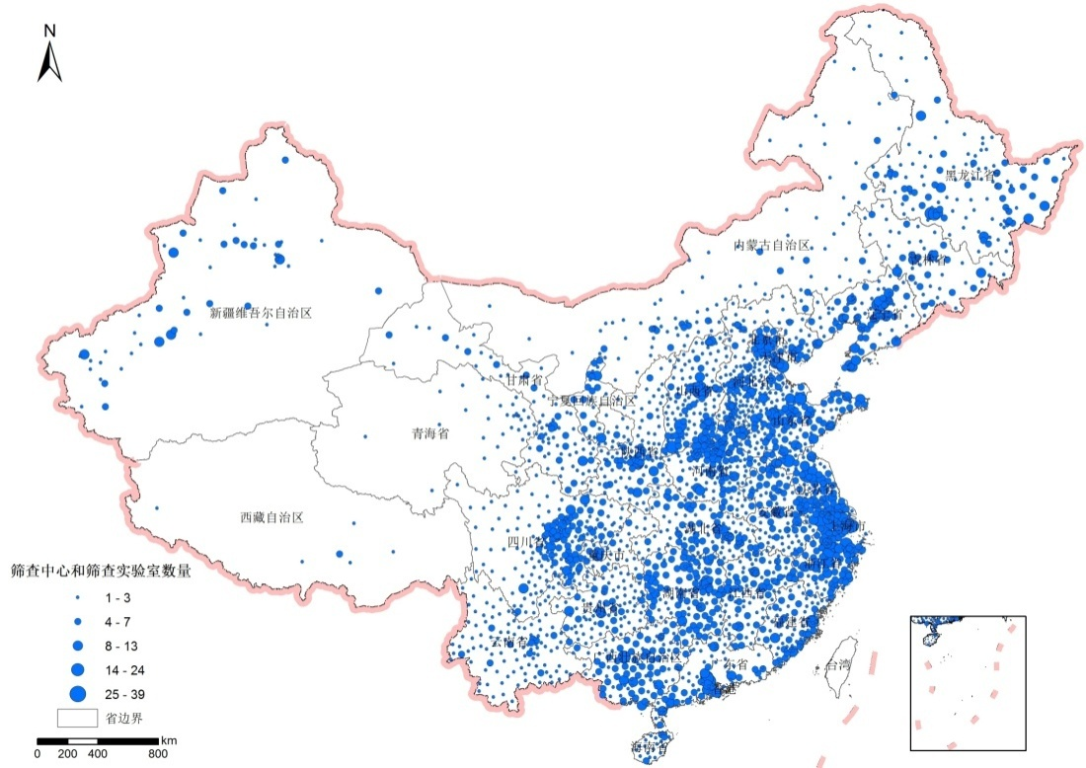
Over 10000 HIV screening lab,
Over 10000 RT points
Free testing police
Notes:
累计报告感染者/病人2万人以上6个省份： 云南、广西、河南、四川、新疆、广东，占全国的79%
累计报告病人超过3,000人的8个省份： 河南、云南、广西、广东、新疆、安徽、四川和湖北，占全国的80%。
2009年新报告HIV/AIDS超过3000人以上6个省份： 云南、广西、四川、广东、新疆、河南，占全国的74%。

Slide 15
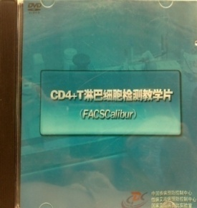


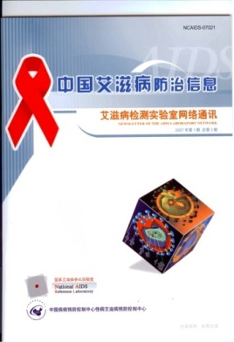




Guidelines
2006 National Guideline for HIV/AIDS Detection and Management
Guideline for QC/QA of CD4+ T Cells Testing
Newsletter of the HIV/AIDS Laboratory Network
Guideline for Test and QC/QA of HIV-1 Viral Load,
Training on CD4 testing technology
National Guideline for HIV/AIDS Detection, Training on Early Infant Diagnosis
National Guideline for HCV Detection
Protocol on HIV New Infection Detection, PEP training materials
Guideline for QC/QA of Drug Resistance Detection
2015 National Guideline for Detection of HIV/AIDS
Notes:
According to the Guidelines of WHO,UN, integrated with the specific conditions in China
Updating every 5 years, version 2015
Changing “confirmatory” to “supplemental”
“confirmatory”: WB/RIBA
“supplemental”: WB/RIBA, NAT
Testing algorithms for different populations
WB/RIBA
NAT
Alternative algorithm (EIA/RT)

Slide 16
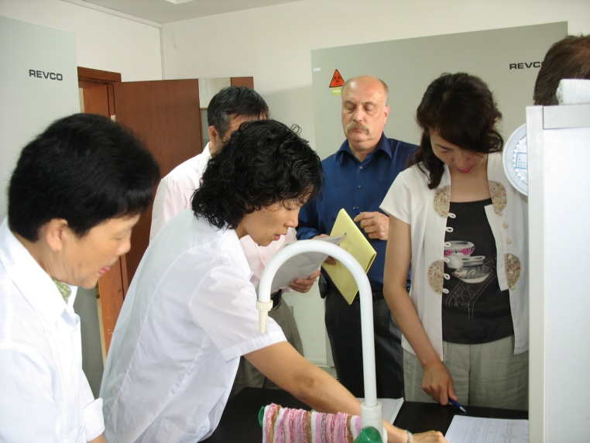
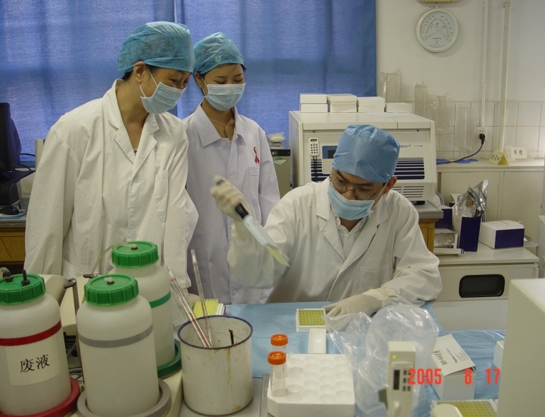

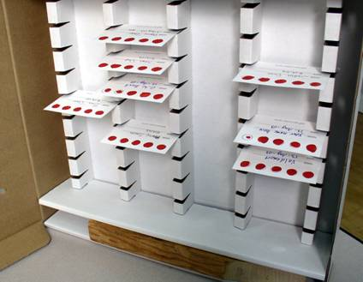
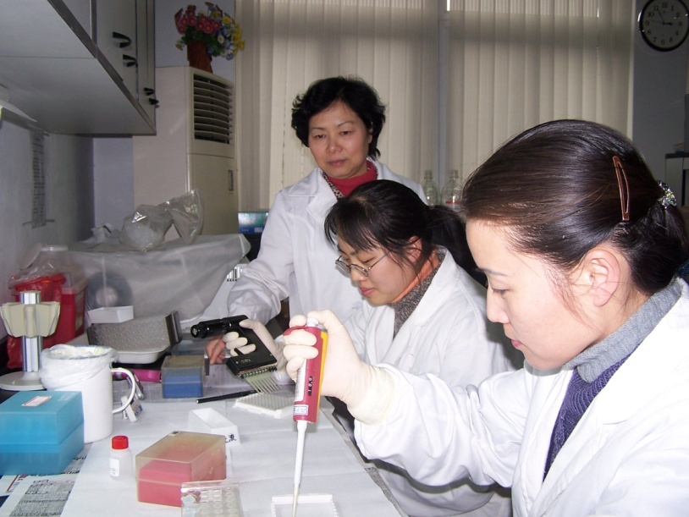
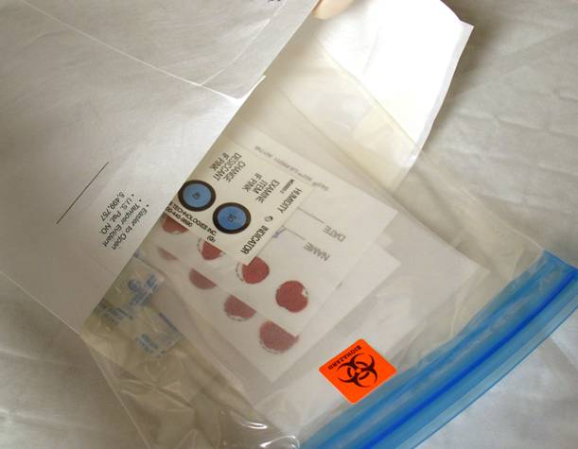
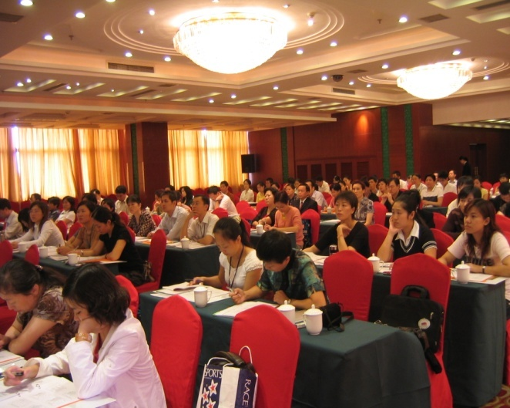
Training
Notes:
Updated the lab staff technology, knowledge, Share the information and experiences of HIV/HCV from different provinces.

Slide 17
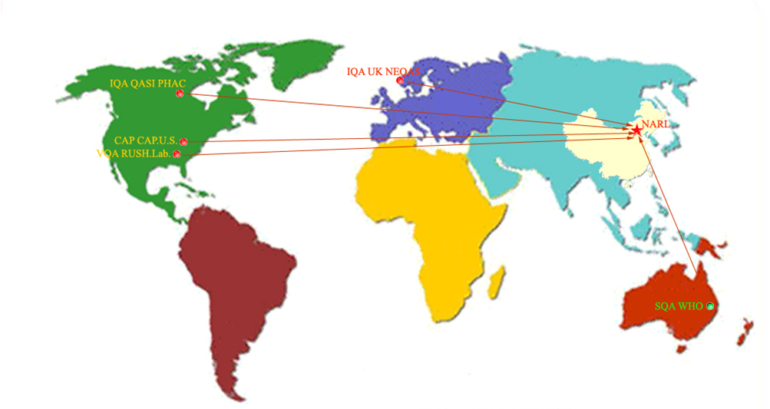
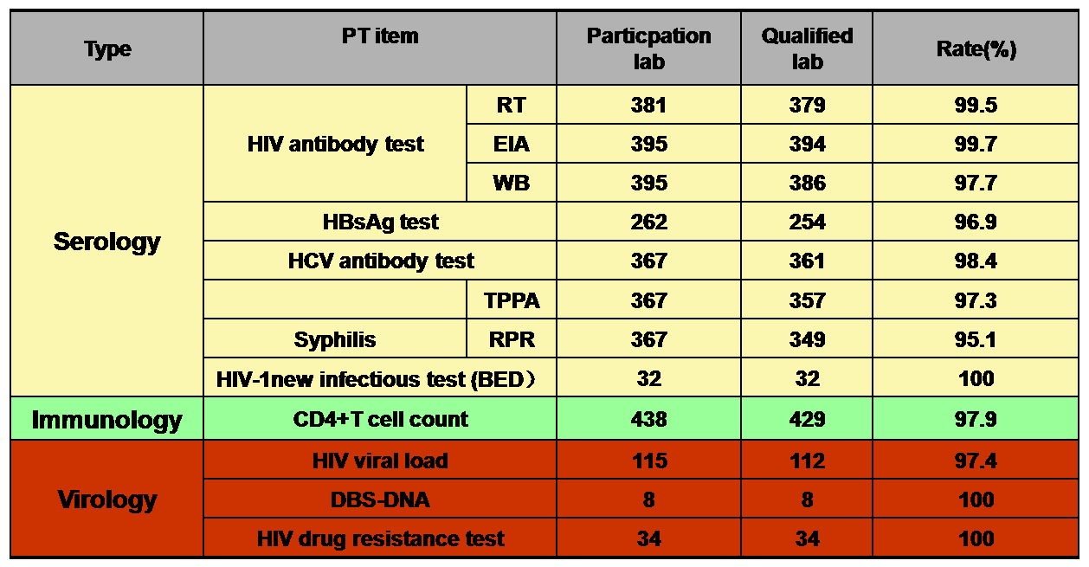
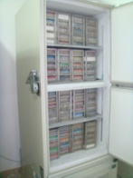
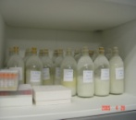
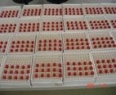

Proficiency testing
International PT Programs：
SQA：CAP，WHO， US-CDC
IQA: CAP，QASI，UK NEQAS,
VQA：CAP，US-CDC，RUSH Lab
National PT Programs：

Slide 18
Sensitivities of the EIA/CLIA kits for HIV Ab (2003-2014)
Criteria line

Slide 19
Challenges：
Lower testing rate
Lower known rate
Notes:
累计报告感染者/病人2万人以上6个省份： 云南、广西、河南、四川、新疆、广东，占全国的79%
累计报告病人超过3,000人的8个省份： 河南、云南、广西、广东、新疆、安徽、四川和湖北，占全国的80%。
2009年新报告HIV/AIDS超过3000人以上6个省份： 云南、广西、四川、广东、新疆、河南，占全国的74%。

Slide 20
Questionnaire for MSM population on line
Did you have HIV test last year
Response 14,991
yes
4,245 (28.3%)
No
10,746 (71.7%)
For students, testing is only 2.9%
(Data from 2 universities of Guangxi province)

Slide 21
Lower rates for people know their HIV status （National surveillance sites）

Slide 22
VCT
PITC
Surveillance sites
Self collection? Internet based testing?

Slide 23
Because of privacy, stigma and discrimination, the MSM population are reluctant to receive HIV test. Under the above background, we develop the Internet-based anonymous HIV urine testing, a new opotion for MSM population.
The model refers to home collection of urine, transferred the sample to laboratory by mail, performed and interpreted in the professional laboratory, enquired the testing results online.

Slide 24
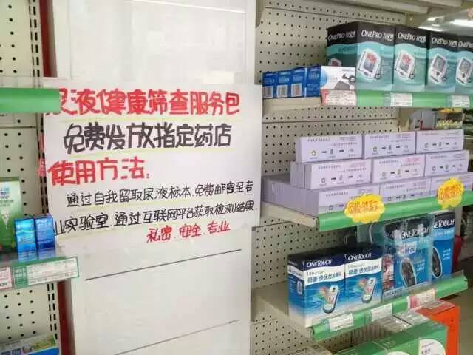
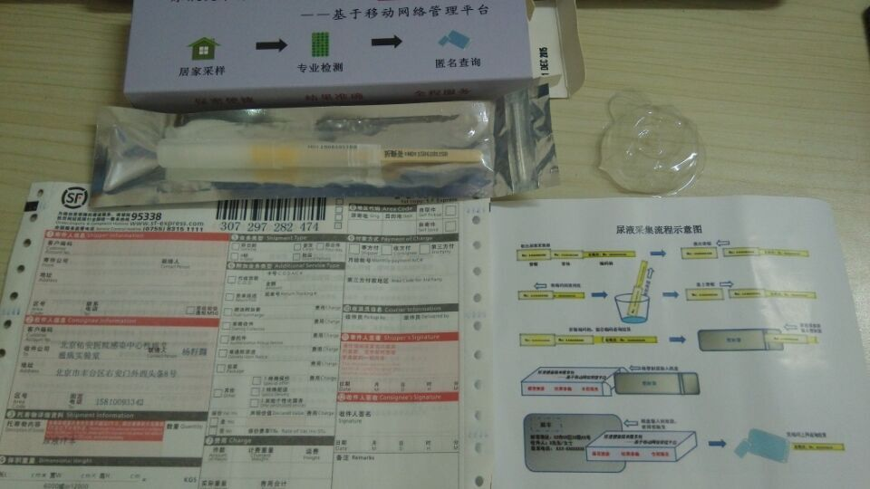

On line investation ,acceptability is 60.1%
(Blood is 73.6%, oral is 60.63%)
Taking urine collection tube
at Beijing pharmacy
↓ Mail
Laboratory
↓ test
Check results on line
acceptability is 91.1%
Taking urine collection tube at NGO group
↓ Providing the tube to group
The urine will be tested at central lab
↓
Results → group → MSM
acceptability is 100%

Slide 25
300 urine collection tubes at pharmacy
↓from 2015-8-1 to 2015-10-30
275 were taken (all of the persons are young man)
↓214
HIV laboratory of Beijing Youan hospital (77.81%,214/275)
↓ ↓
1 without urine 213 with urine ↓ ELISA 1 time/week
input results ↓ to computer
screening positive 18.78%（40/213）
Results known 92.49%（197/213）
(To be published)
Notes:
汇报主要围绕以下7个部分展开。

Slide 26
Internet based urine testing is an effective way to prompt MSM population to involve in HIV testing actively.
This new model may effectively expand the coverage for testing, prevent further transmission, finally reduce new HIV infections.
Need more work

Slide 27
Figure 1. sample processing and qulitative results
blood and urine (1306)
blood+ urine+ (274)
blood- urine- (1011)
blood+ urine- (12)
blood- urine+ （9）
WB
WB
Pooled nucleic
acid test
WB+ (273)
WB±(1)
WB+ (9)
WB- (3)
Nucleic acid- (9)
Viral load test
Viral load test
Viral load +（3500000Copy/mL）
Nucleic acid- (2)
Nucleic acid+ (2500000Copy/mL) (1)

Slide 28
Agreement of urine and blood samples
Urine | Serum
 | ＋ | － | total
＋ | 270 | 9 | 279
－ | 7 | 856 | 863
total | 277 | 865 | 1142
Sensitivity：94.34-95.96%
Specificity：95.39-99.63%
2th Chinese AIDS conference 2015

Slide 29
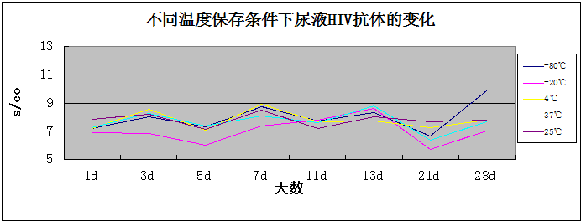
Results of urine HIV antibody testing with ELISA before and after mail（positive sample）
After mail | Before mail
 | ＋ | － | 合计
＋ | 94 | 0 | 94
－ | 1 | 4 | 5
合 计 | 95 | 4 | 99
kappa：0.886
(To be published)

Slide 30
Next step
More work for internet + T
How to linking patients to
Doctors
90 - 90 - 90

Slide 31
Thanks for
NARL Xia Feng, Yi Lv, Yu Tan
Jun Yao, Maofeng Qiu, Wenge Xing, Yao Xiao, Pinliang Pan
You An hospital Hao Wu, Tong Zhang
Beijing CDC Hongyan Lu
Xian CDC Shengli Wei
NGO-Jingjing Tongxin
Beijing Renaikanglian Internet technique company

