Slide 1
Balance of Cellular and Humoral Immunity Determines the Level of Protection by HIV Vaccines in Rhesus Macaque Models of HIV Infection
1

Slide 2
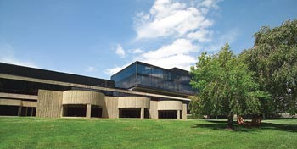
Profectus BioSciences, Inc.
Profectus is a clinical-stage biotechnology company developing vaccines for Ebola/Marburg, and other biodefense targets, as well as HIV, HPV, HSV, HCV and Chikungunya.
777 Old Saw Mill Road
Tarrytown, NY
6411 Beckley Street
Baltimore, MD

Slide 3
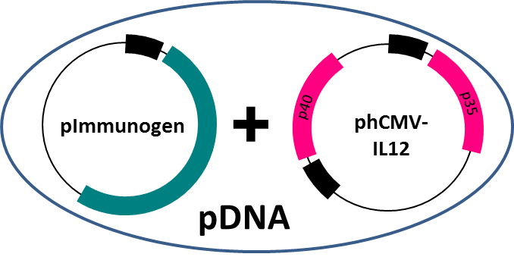
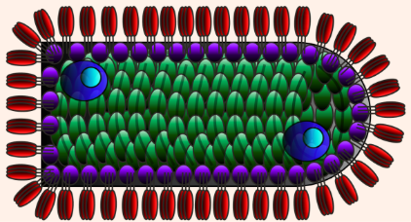

Technology to tailor the vaccine response to the target

Slide 4
The FLSC Subunit Mimics an Early Conformational Change in the HIV-1 Env Trimer Induced During Viral Entry
CD4 Binding Site
D1D2 Domains of CD4
gp120
CCR5 Binding Site
Flexible peptide linker
Conformational Change in the HIV-1 Env Trimer During Viral Entry
CD4 binding
gp120 Co-receptor site exposure
Co-receptor binding
Bridging pre-bundle
(gp41 exposure)
Fusogenic pre-bundle
(nascent pore)
CD4
Env
6-Helix bundle
(post fusion)

Slide 5
How the FLSC works?
Chronic viruses hide their vulnerable parts
Altering envelope structure (envelope-receptor)
changes how the antigen is presented to the immune system
enhances the immunogenicity of the conserved “vulnerable parts”
expands epitope diversity in Ab responses

Slide 6
Are transition state/CD4i epitopes ever immunoreactive during infection?
Structural analyses and molecular models of soluble antigens were interpreted to indicate “No”…
But-
Antibodies to transition state epitopes mediate potent ADCC activity against cell-bound virions and against chronically infected cells
Guan, Lewis et al., PNAS 2013, Ferrari et al., J. Virol. 2012; Bonsignori et al., J. Virol. 2012; Veillette et al. J. Virol. 2014
A number of nonhuman primate studies link protection from infection with antibody specificities (including CD4i) and functions that lie outside the sphere of direct virion neutralization.
Fouts et al, PNAS 2015; Barouch, Michael et al Nature 2012; Alpert et al Plos Pathogen 2012; Sun, Letvin et al, J Virol 2011; Xiao, Robert-Guroff et al J Virol 2010; Florese, Robert-Guroff et al, J Immunol 2009; Hidajat, Robert-Guroff et al J Virol 2009; DeVico et al, PNAS 2007, Hessel, Burton et al Nature 2007; Gomez-Roman, Robert-Guroff et al, JAIDS 2006; Banks et al, AIDS Res Hum Retroviruses 2002

Slide 7
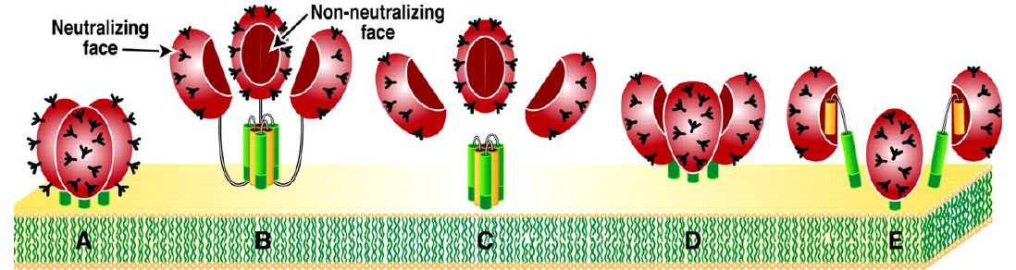
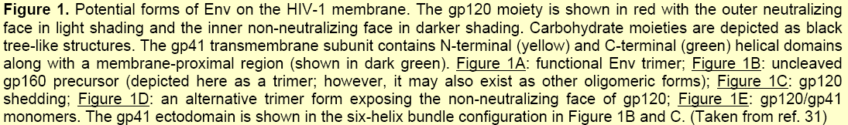
Envelope targets for antiviral Abs
Moore, et al, 2006, JV, 80:2515

Slide 8
Evidence that FLSC can protect

Slide 9
Group | # | Immunogen | Dose | Adjuvant | Dose
1 | 4 | Gp120(BaL) | 300 ug | QS21 | 100 ug
2 | 4 | Chemically crosslinked gp120(BaL)-shCD4 | 300 ug | QS21 | 100 ug
3 | 4 | rhFLSC | 300 ug | QS21 | 100 ug
4 | 4 | Soluble human CD4 (D1-D4) | 300 ug | QS21 | 100 ug
5 | 4 | Naive
0
4
24
115
119
135
171
weeks
= i.m. immunization (subunit/adjuvant)
= single i.r. challenge, 600 TCID₅₀ SHIV_{162P3}
= stop tracking viral load
= sacrifice

Slide 10
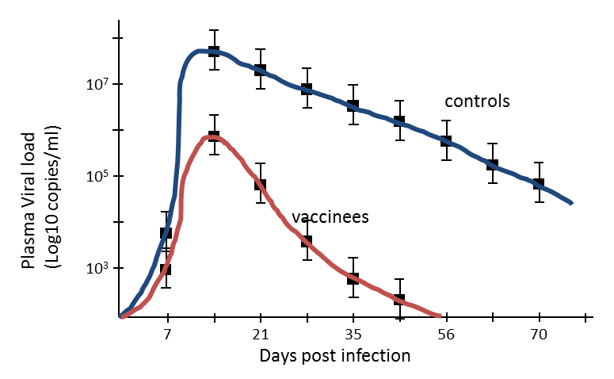
Vaccine efficacy in high dose challenge model

Slide 11
Identified relationship between lower viral set point and higher CD4i Ab titers

Slide 12
Survival analysis using the repeat exposure macaque model.
100
vaccine
75
% of macaques
remaining uninfected
control
50
protection
25
0
1
3
5
7
9
11
13
15
17
19
# of i.r. SHIV_{162P3} exposures
Adapted from Kim et al., J. Med. Primatology 35:210-216 (2006).

Slide 13
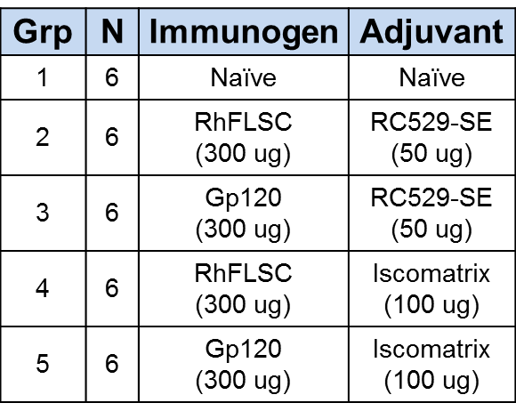
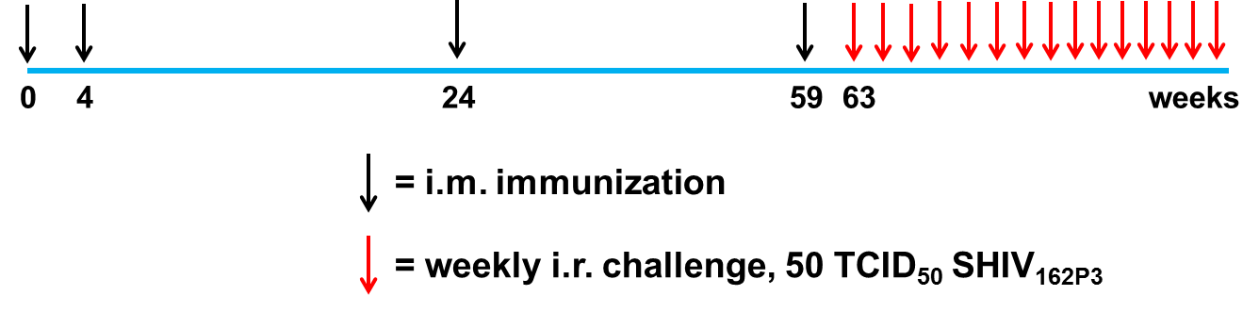
Study 1 Design (powered to detect >82% protection i.e. “slam dunk”)
RC529: Squalene, glycerol, phosphatidyl choline and synthetic monophosphoryl lipid A emulsion
Iscomatrix: Saponin-ISCOM

Slide 14
One simple formulation, rhFLSC/RC529, trended towards better protection, but not a “slam dunk”
Challenge outcome rhFLSC/RC529 group vs all other groups
Challenge outcome all groups

Slide 15
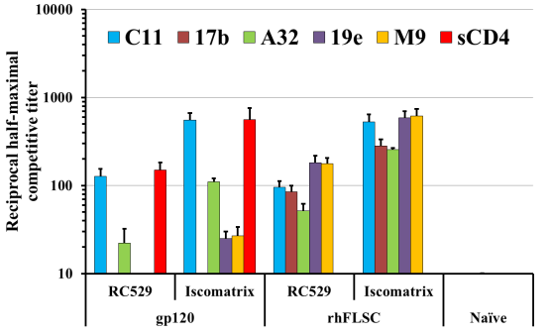
Immunization with rhFLSC induces antibodies to CD4i epitopes
CD4i MAbs = 17b, A32, 19e, M9 and N12-i2 (next slide)

Slide 16
Animals with higher anti-CD4i antibody titers resisted infection…..
Meta analysis of all 24 vaccinated animals where 100% of naïve animals became infected within four challenges

Slide 17
But protection was lost if there were too many T cells…

Slide 18
Removing animals with high T cell responses reveals that protection tracks with….
FLSC titer
ADCC
Competitive A32 titer

Slide 19
Suggesting a relationship between ADCC, IFN-γ Elispots, and protection: A zone of immune balance
# challenges to infection

Slide 20
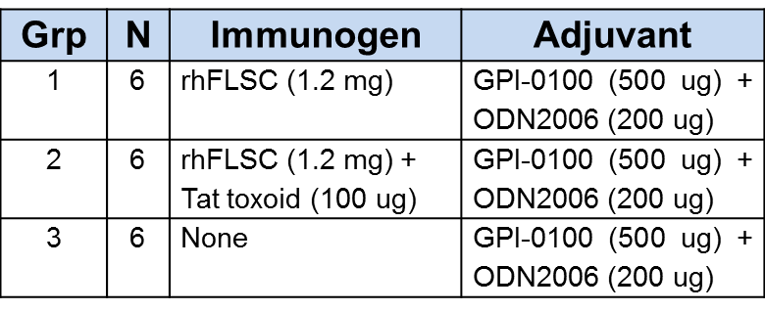
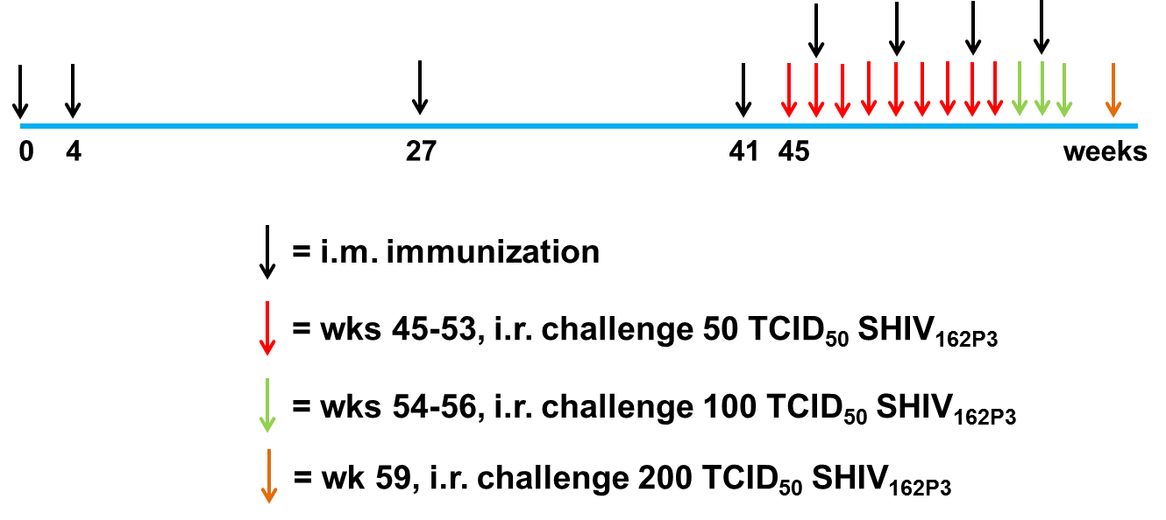
Study 2: Different Study, same story

Slide 21
Key differences from 1st study
included Tat in one of the immunogen formulations
used higher rhFLSC vaccine dose (1200 ug)
used a different adjuvant (GPI-0100)
employed multiple dosing throughout the challenge phase to prolong durability
increased the challenge dose over time

Slide 22
Addition of Tat toxoid eliminated protection conferred by rhFLSC
p = 0.030
Kaplan-Meier Log Rank p = 0.030

Slide 23
ADCC highest in rhFLSC (protected) group

Slide 24
Tat toxoid enhanced T cell responses

Slide 25
Immune balance in protected group

Slide 26
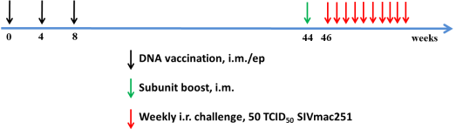
Study 3: Different model, same story
(powered to detect 75% efficacy)
Grp | N | SIVsmE543 DNA Vaccine | Genetic Adjuvant | Subunit/Al(OH)₃
1 | 8 | Empty | None | None
2 |  | rhFLSC + gag/pol | Empty | rhFLSC(CCG7V)
3 |  |  | LTA1
4 |  |  | Rhesus IL-12
5 |  |  | LTA1 + rhesus IL-12

Slide 27
Key differences from 1st and 2nd study
uses SIV_{mac251} challenge (neutralization resistant batch with high quasi-species diversity (2.1%))
Antigens derived from SIV_{smE543} (gag/pol), and SIV_{smE660} (env)
DNA prime/protein boost protocol
Adds IL-12 and heat labile enterotoxin (LTA1) as genetic adjuvants

Slide 28
GENEVAX® IL-12
huIL-12
Naturally produced by MΦ and DC
Drives differentiation of Th1 cells that support CD8⁺ CMI responses
Drives ADCC
GeneVax® IL-12
Induces CD4⁺ and CD8⁺ T_{CM}
Long lived
High expansion potential
PD-1, CTLA-4, and LAG-3 not up regulated – resistant to anergy
CD28 and CD127 up regulated – block tolerance and apoptosis
GeneVax IL-12® clinical status
Safe and well tolerated
Adjuvant active in humans
p40
p35
pPBS-Ckine-005
28

Slide 29
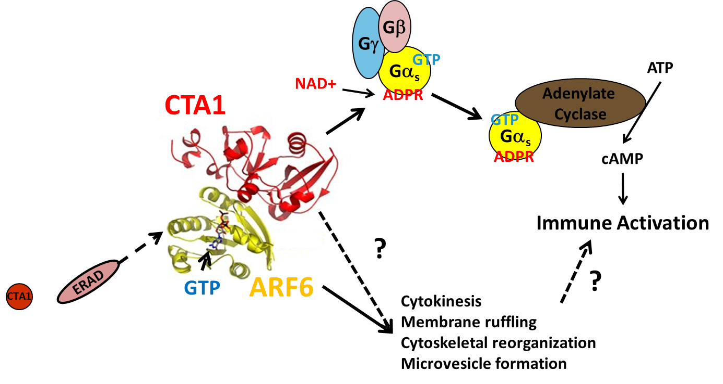
LTA1/CTA1 Mechanism of Action
ER

Slide 30
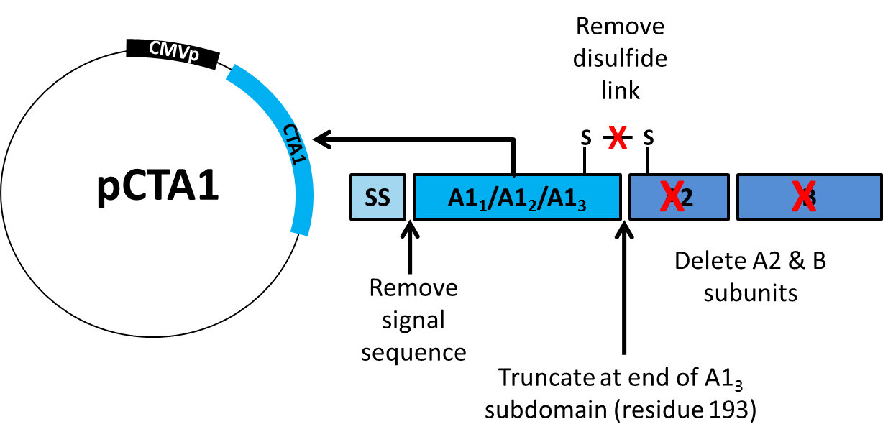
Profectus CTA1 Genetic Adjuvant

Slide 31
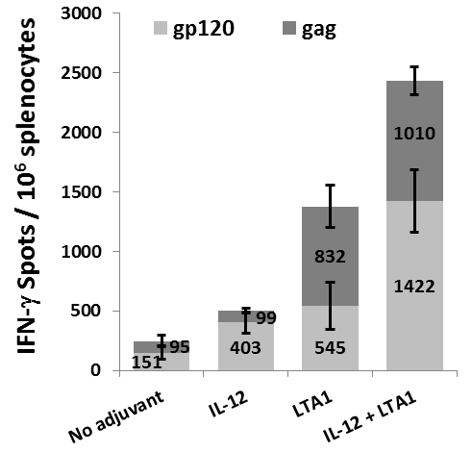
Additive adjuvant effects between IL-12 & LTA1

Slide 33
Inclusion of IL-12 in the prime yields 76% efficacy
*
* The addition of 51 historical controls of naïve macaques that received the same SIVmac251 challenge virus stock, at the same dose, administered by the same technical staff in the same animal facility within 1 year of the start of the challenge phase of this study

Slide 34
LTA1 and IL-12 combination enhances T cell responses

Slide 35
Inclusion of IL-12 during DNA prime enhances ADCC

Slide 36
But…you need immune balance

Slide 37
Does the FLSC induce protection?
Yes, if you induce a CD4i response above a threshold, ADCC, and without an overabundance of T cells.
(immune balance)

Slide 39
Our goal…..
Improve potency & durability of Fc-mediated protection with the right balance of supportive CD4+ T cells

Slide 40
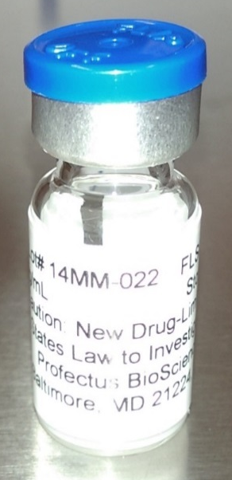
Preclinical Development of IHV01
HEK-293 Master Cell Bank created and released
FLSC Drug Substance –
cGMP manufactured and released, yield ~ 1g/L
12 month DS stability at -20ºC
Label Drug Product released (Alum formulated FLSC)
AlPO4 formulation with >95% adsorption
9 month DP stability at 5ºC
Standard Rabbit Toxicology – complete
NHP Immunotoxicology Study (FDA requested) – complete
No evidence of deleterious auto-anti-CD4 responses induced by FLSC or rhFLSC immunization

Slide 41
Released IHV01
~ 3400 vials at 300 µg/mL of formulated drug product
800 labeled, 1888 unlabeled in cGMP storage at Sherpa Clinical Packaging
700 set aside for release testing, clinical retains, and stability at Catalent RTP
125 g of unformulated FLSC [Clinical Grade] is available for future studies

Slide 42
Planned Phase 1 Clinical Testing of IHV01
Group | Admin Route | N** Vaccine / Control | Vaccine Dose | Vaccination Schedule in Months (Days)
 |  |  |  | 0 | 1(28) | 2(56) | 6(168)
1 | IM | 15 | 0.25 mL (75 µg) | FLSC AIP04 | FLSC AIP04 | FLSC AIP04 | FLSC AIP04
 |  | 5 | 0.25 mL | saline | saline | saline | saline
2 | IM | 15 | 0.5 ml (150 µg) | FLSC AIP04 | FLSC AIPO4 | FLSC AIPO4 | FLSC AIP04
 |  | 5 | 0.5 mL | saline | saline | saline | saline
3 | IM | 15 | 1.0 mL (300 µg) | FLSC AIP04 | FLSC AIP04 | FLSC AIP04 | FLSC AIP04
 |  | 5 | 1.0 mL | saline | saline | saline | saline
TOTALS |  | 60

Slide 43
Planned Phase 1 Clinical Testing of IHV01
Primary endpoint: Safety* and Tolerability
Secondary endpoint: Immunogenicity
Immune Response Measure | Measures of an immunogenic dose of FLSC (3 or 6 months post vaccination)
Serum antibody titer to FLSC and gp120 (BaL) via ELISA | >80% of vaccinees exhibiting geometric mean titers to FLSC that are 3 SD above background, and/or
Competitive serum titers to CD4i and other epitopes (A32, 17b, 19e, N12-i2, and others) via ELISA | >60% of vaccine responders exhibiting competitive binding titers to CD4i epitopes that are 3 SD above background
*A trial is ongoing to measure fluctuations in CD4+ T cell counts over time in healthy volunteers

Slide 44
Exploratory clinical trials to learn how to reach this goal
+ New Adjuvants
+ DNA prime w/ Genetic Adjuvants
(IL-12 or IL-15)
FLSC
Subunit
+ rVSV (or other virus) prime

Slide 45











Acknowledgements
John Eldridge
Terry Higgins
Marc Tremblay
Kenneth Bagley
Jennifer Schwartz
Ilia Prado
Kate Bobb
Wenlei Zhang
Anthony Devico
George Lewis
Robert Redfield
Bruce Gilliam
Robert Gallo
Michael Jenkins
Rob Gustines
Ian Collins
Amy Austin
Greg Bleck
Jie Di
Lani Kroopnick
Brian Woodrow
Pamela Keith
Ranajit Pal
Anthony Cristillo
Jessica Livesay
Lindsey Galmin
Ron Salerno
Kerin Ablashi
Peter Patriarca
Kelly Reich
Melanie Hartsough
Darrick Carter
Erik Iverson
Steve Reed
Deborah Weiss
Jim Treece
Funding:

