Slide 1
The Ascorbate Radical as a Universal Group Transfer Catalyst in Inflamed Tissue
3rd International Conference on Hematology & Blood Disorders
November 2-4, 2015 Atlanta, Georgia USA
Robert M. Davidson M.D. Ph.D. FAIS*
Ann Lauritzen, Stephanie Seneff,
Stephen D. Kette, Glyn Wainwright,
Anthony Samsel, and Sydney J. Bush
*Fellow, The American Institute of Stress
Physician and Medical Researcher, Kilgore, Texas, USA
Email: patrons99@yahoo.com
1

Slide 2
OVERVIEW: Central Hypothesis
The Ascorbate radical is a Biological Group Transfer Catalyst in Inflamed Tissue
Sulfuryl group transfer (transsulfurylation)
Phosphoryl group transfer (transphosphorylation)
Nitrosyl group transfer (transnitrosylation)
Acyl group transfer (transacylation)
Glycosyl group transfer (transglycosylation)

Slide 3
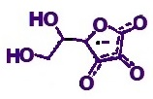
CONCEPTUAL OVERVIEW:
Sulfuryl group transfer
Phosphoryl group transfer
Nitrosyl group transfer
Acyl group transfer
Glycosyl group transfer

Slide 4
DEFINITION:
CATALYST / CATALYSIS / AUTOCATALYSIS -
“A substance that increases the rate of a reaction without modifying the overall standard Gibbs energy change in the reaction; the process is called catalysis. The catalyst is both a reactant and product of the reaction.”
“Catalysis can be classified as homogeneous catalysis, in which only one phase is involved, and heterogeneous catalysis, in which the reaction occurs at or near an interface between phases. Catalysis brought about by one of the products of a reaction is called autocatalysis. Catalysis brought about by a group on a reactant molecule itself is called intramolecular catalysis.”
Source:
PAC, 1996, 68, 149

Slide 5
SOLVENT EFFECTS
DEFINITION: Heterogeneous Phase Catalysis
Marcus’ “on water” heterogeneous phase catalysis
Exogenous Interfacial Water Stress (EIWS) Theory of Inflammation and Disease

Slide 6
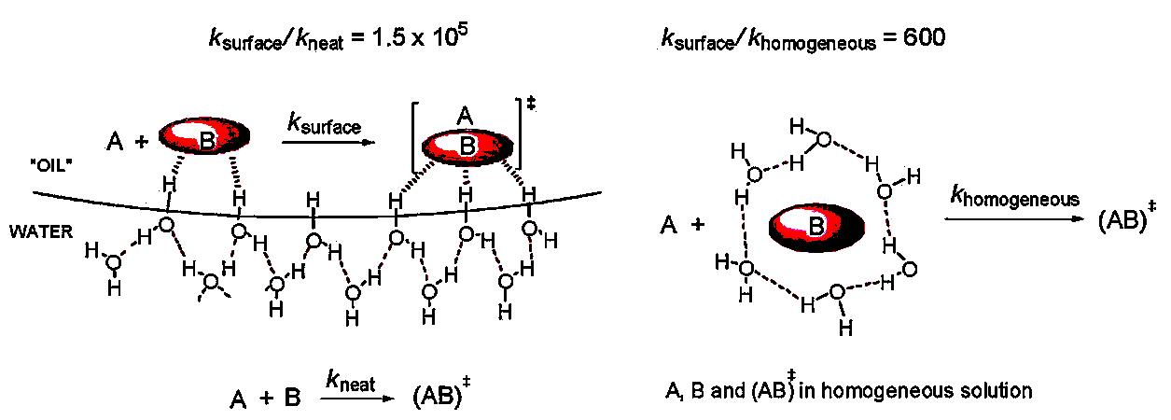
Marcus’ “On-Water” Heterogeneous Phase Catalysis
SOURCE:
Jung, Y. and Marcus, R.A. (2007). On the Theory of Organic Catalysis “on Water”. Journal of the American Chemical Society, 129, 5492-5502.

Slide 7
THE INITIAL COMMON PATHWAY
Exogenous Interfacial Water Stress (EIWS)
Inflammation
Disease
Davidson, Robert M.; Seneff, Stephanie. 2012.
Entropy 14, no. 8: 1399-1442.
Davidson, R.M.; Lauritzen, A.; Seneff, S. 2013.
Entropy 2013, 15, 3822-3876.
7

Slide 8
Five routes to the Ascorbate radical
Radical-scavenger route
AscH⁻ + R˙ ⇆ Asc˙⁻ + RH
Dismutation route
2 Asc˙⁻ + H⁺ ⇆ AscHˉ + DHA
Hydated electron route
DHA + e aq⁻ ⇆ Asc˙⁻
Transition metal-catalyzed route
AscH⁻ + Cu²⁺ ⇆ Asc˙⁻ + Cu¹⁺ + H⁺
“slow and continuous” radical-scavenger route
Asc 2-S + Asc˙⁻ + H⁺ ⇆ [Asc 2-S]˙⁻ + AscH⁻

Slide 9
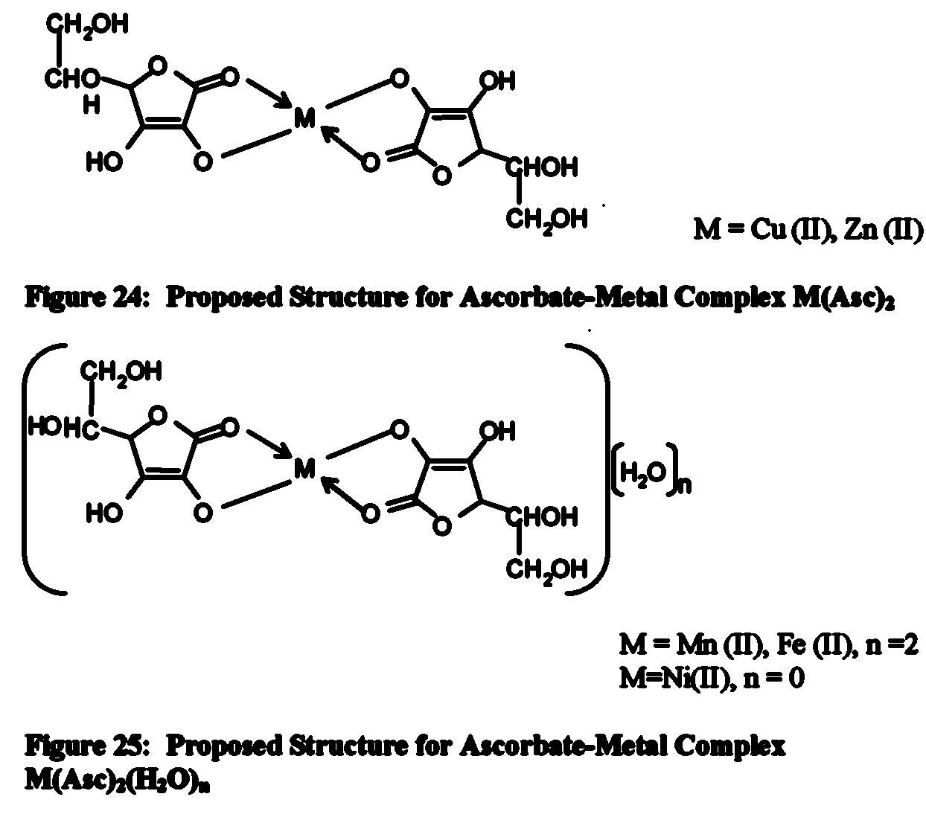
Copper-Ascorbate Complex
Source:
L. Amudat, Ph.D.
Dissertation, 2010

Slide 10
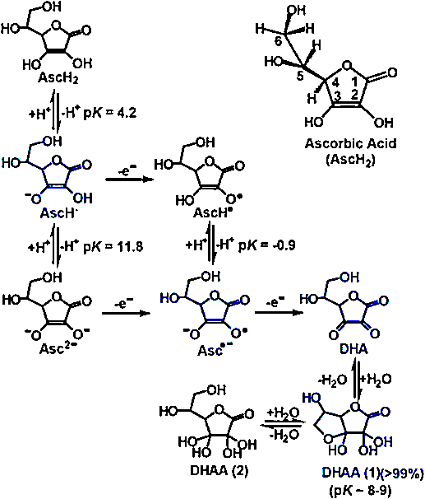
The Basics of Ascorbic Acid Chemistry
Source:
Du, J., Cullen, J.J.
and Buettner, G.R.
(2012). Ascorbic acid: chemistry, biology and the treatment of cancer. Biochimica et biophysica acta, 1826, 443-457.

Slide 11
Important Chemical Attributes of Ascorbate
Both Ascorbic Acid (a di-acid) and Sodium Ascorbate (a mono-acid) possess two reducing equivalents, in vivo.
Because the pKa values of Ascorbic acid are 4.2 and 11.8, Ascorbic acid (AscH₂) exists primarily as an Ascorbate anion (AscH⁻), at physiological pH (SOURCE: Du et al. 2012).
AscH₂ readily oxidizes to Dehydro-ascorbate (DHA) in a two step reaction:
(a) Ascorbate anion (AscH⁻) looses one electron, forming the Ascorbate radical,
(b) Ascorbate radical can loose another electron becoming DHA
Ascorbate radical has several possible fates in vitro.
  (a) It can loose another electron and become DHA,
  (b) gain an electron and proton to regenerate the Ascorbate anion (AscH⁻),
  (c) react with another radical and form a stable compound, or
  (d) two ascorbate radicals can dismutate to form one Acorbate anion and one DHA molecule.
  SOURCE: http://www.sigmaaldrich.com/life-science/cell-culture/learning-center/media-expert/ascorbate.html#Chemical_Attributes

Slide 12
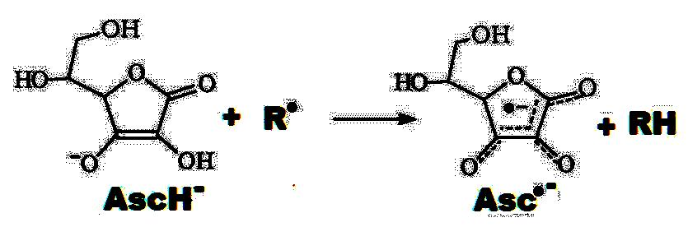
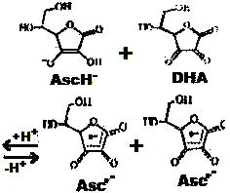
Two Major Routes to the Ascorbate Radical
Radical-Scavenger Route
Dismutation Route

Slide 13
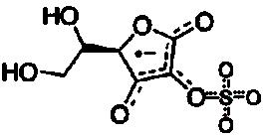
Our Proposal for a Universal Sulfurylation Factor
WE PROPOSE: 2-O-sulfate L-ascorbate radical plays a central role in the "universal nonspecific mesenchymal reaction", which has also been referred to as the Sanarelli-Shwartzman phenomenon.
Chiral
Paramagnetic
Quasi-aromatic
Takebayashi, J., Kaji, H., Ichiyama, K., Makino, K., Gohda, E., Yamamoto, I. and Tai, A. (2007). Inhibition of free radical-induced erythrocyte
hemolysis by 2-O-substituted ascorbic acid derivatives. Free Radical Biology and Medicine, 43, 1156-1164.
Verlangieri, A.J. and Mumma, R.O. (1973). In vivo sulfation of cholesterol by ascorbic acid 2-sulfate. Atherosclerosis, 17, 37-48.
Cabral, J., Haake, P. and Kessler, K. (1998). Rearrangement of 3-Acyl Derivatives of L-Ascorbic Acid. Journal of Carbohydrate Chemistry, 17, 1321-1329.
13

Slide 14
Routes to the 2-O-Substituted L-Ascorbate Derivative Radicals
Putative Direct S_{R}N₂ Route:
Asc radical + PAPS Asc 2-S radical + PAP
Asc radical + ATP Asc 2-P radical + ADP
Takebayashi’s Indirect “slow and continuous” Radical-scavenger Route:
Asc 2-S + R. Asc 2-S radical + RH
Asc 2-P + R. Asc 2-P radical + RH

Slide 15
A Novel Alternative Route ?
Asc radical + endogenous electrophilic
“sulfuryl” donor
Sunlight Nitric oxide synthase
(NOS)
Asc 2-S radical

Slide 16
Acidolysis, defined:
ACIDOLYSIS: noun ac·i·dol·y·sis \ˌa-sə-ˈdä-lə-səs\
“any chemical reaction analogous to hydrolysis in which an acid plays a role similar to that of water”
Some Important Corollaries to our Hypothesis:
‘Hydro’-lases can act as ‘transfer’-ases in a relatively hydrophobic environment. Acidolysis is catalyzed by the Ascorbate radical during inflammatory stress!
The hydrophobic effect and heterogeneous catalysis enable the 2-O-substituted-L-ascorbate radicals to “acidolyze” biological nucleophiles. Consider lipases, phosphatases, sulfatases, behaving in an anabolic capacity during the SSP.

Slide 17

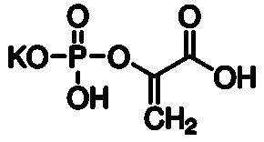
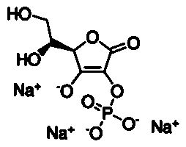
What do they have in common?
Dopamine-4-phosphate ester
Phosphoenol
pyruvate
2-O-Phosphate-
L-ascorbate

Slide 18
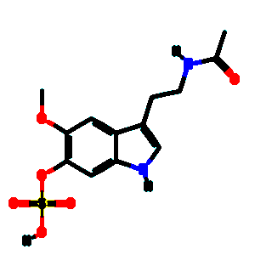
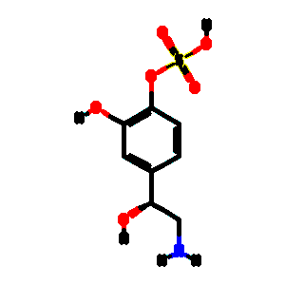
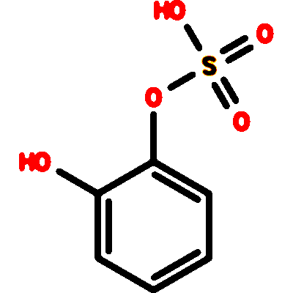
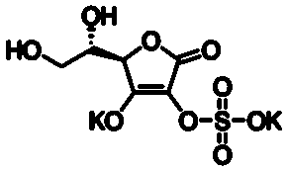
What do they have in common?
Noradrenaline sulfate
Melatonin sulfate
Catechol sulfate
2-O-Sulfate L- ascorbate

Slide 19
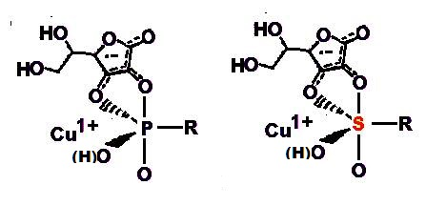
Putative Ascorbate Derivate radicals as
"reactive transient" group transfer factors

Slide 20
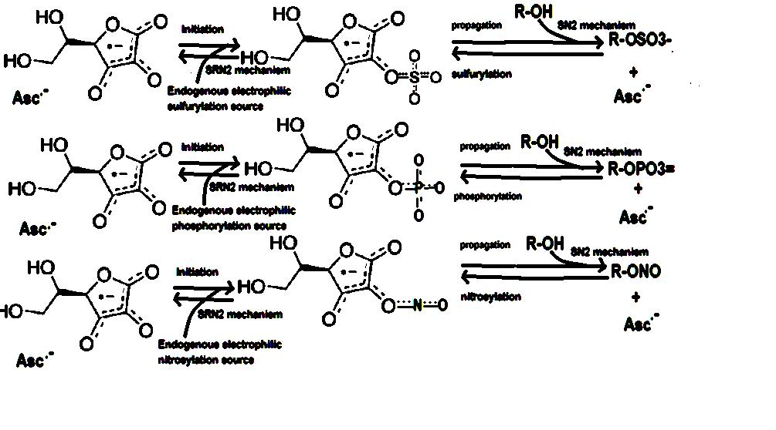
Initiation, Propagation, Termination of
Radical Chain Reactions

Slide 21
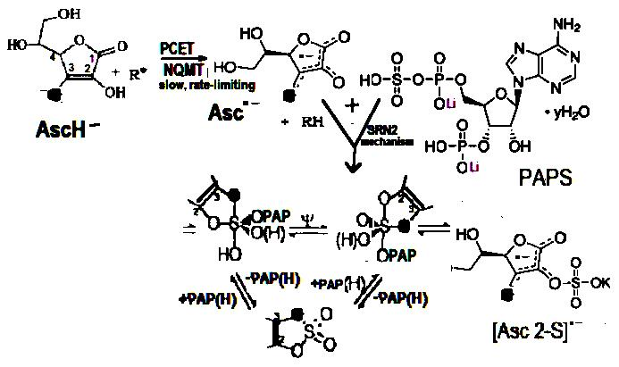
Preformed ATP and PAPS as "penultimate" electrophilic phosphoryl and sulfuryl sources

Slide 22
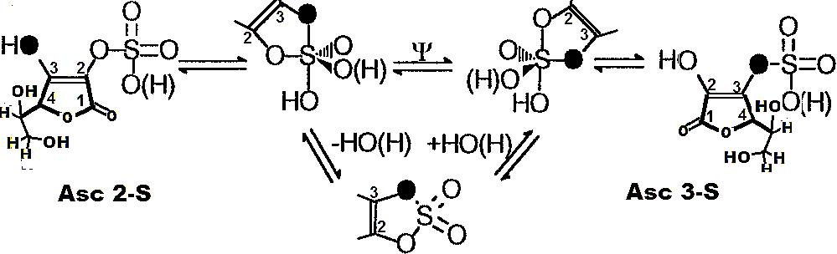
How to "flatten the free energy landscape" in biological group transfer reactions
Berry pseudorotation; spin-correlated radical pairs; pH-dependent speciation of e aq's; e aq's "assist“; ELF EM energy "assist“; Cu¹⁺ "assist"

Slide 23
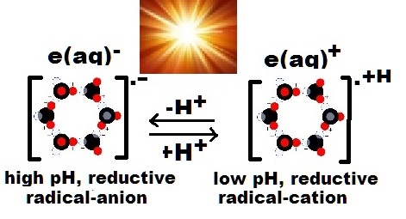
Our Proposal for pH Dependent e(aq) Speciation
Mizuse, K. and Fujii, A. (2013). Characterization of a Solvent-Separated Ion-Radical Pair in Cationized Water Networks: Infrared Photodissociation and Ar-Attachment Experiments for Water Cluster Radical Cations (H2O)n+ (n = 3–8). The Journal of Physical Chemistry A, 117, 929-938.
Larsen, R.E., Glover, W.J. and Schwartz, B.J. (2010). Does the hydrated electron occupy a cavity? Science, 329, 65-69.

Slide 24
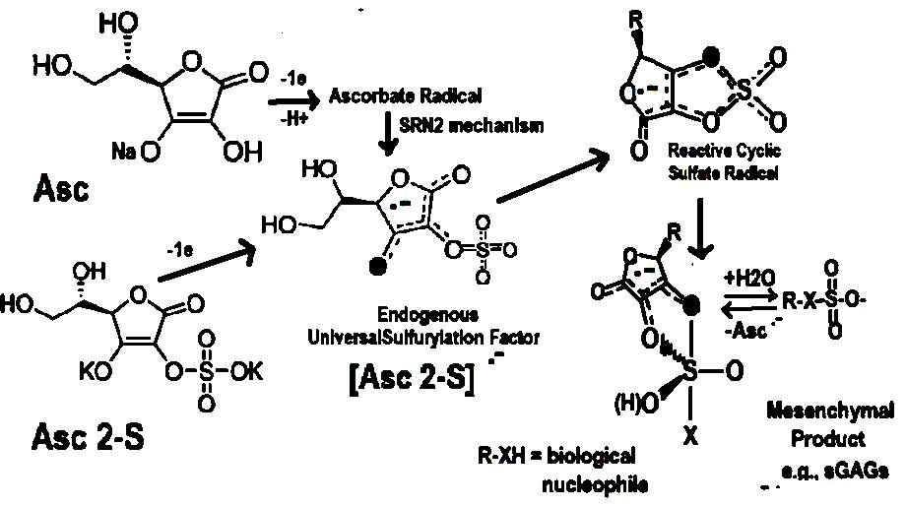
Proposed Route to Acid Mucopolysaccharides in the SSP

Slide 25
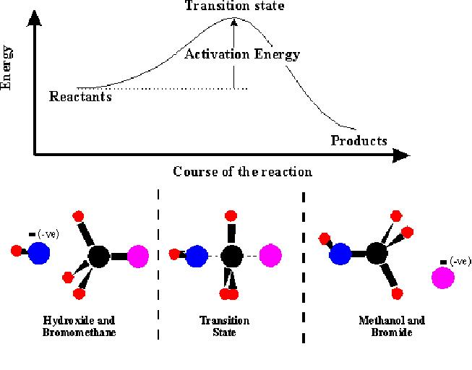
Transition-state Theory

Slide 26
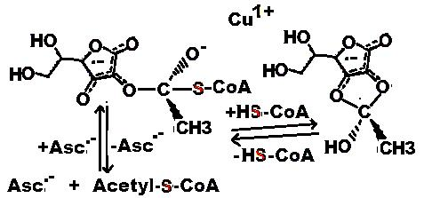
Ascorbate Radical as a
Transacylation Catalyst

Slide 27
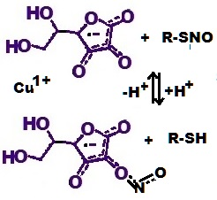
Ascorbate Radical as a
Transnitrosylation Catalyst

Slide 28
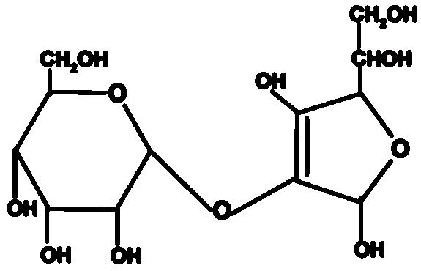
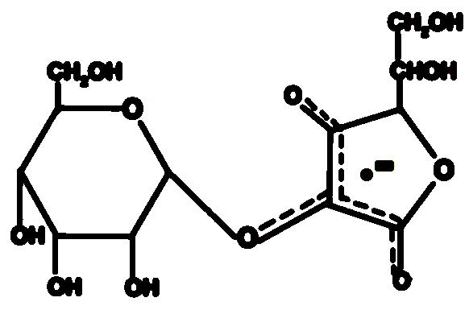
Ascorbate Radical as a Transglycosylation Catalyst
Proposed 2-O-glucosyl
L-Ascorbate Radical
(group transfer factor)
2-O-glucosyl- L-Ascorbate
(a natural product)

Slide 29
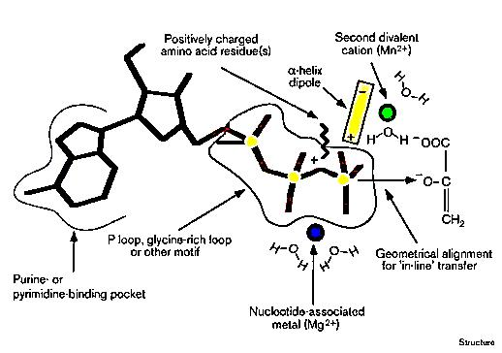
Pyruvate Kinase is Instructive

Slide 30
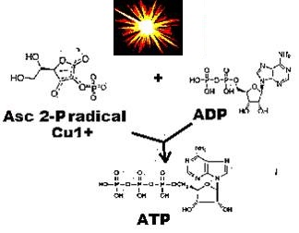
The Ascorbate Radical as a Photophosphorylation Catalyst ?

Slide 31
Conclusion:
The Ascorbate radical, and the putative Ascorbate derivative radicals, provide:
(a) lifelong biological group transfer catalysis, in inflamed tissue,
(b) and lifelong modulation of redox kinetics
31

Slide 32
THANK YOU !
32

