Slide 1


Sustainability through Catalysis: Making Fuels and Chemicals from Biomass
Mahdi Abu-Omar
Department of Chemistry
and School of Chemical Engineering

Slide 2
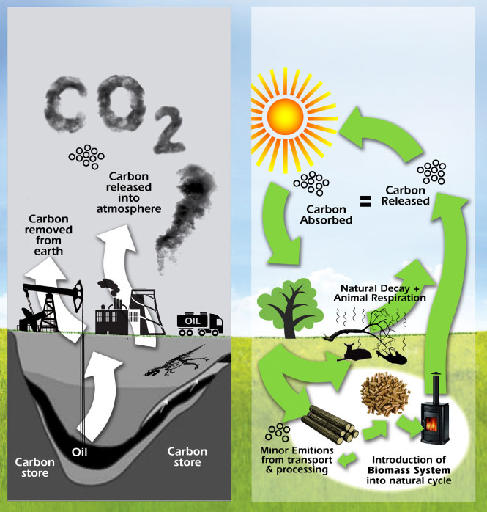
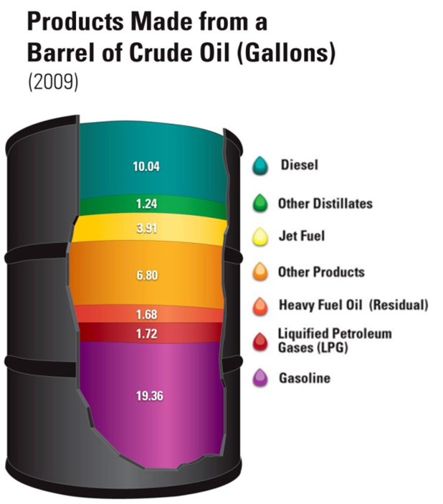
A Barrel of Oil
Energy Information Administration, “Oil: Crude Oil and Petroleum Products Explained” and Annual Energy Outlook 2009 (Updated February 2010).
http://www.evecosolutions.co.uk/biomass-boiler.html

Slide 3
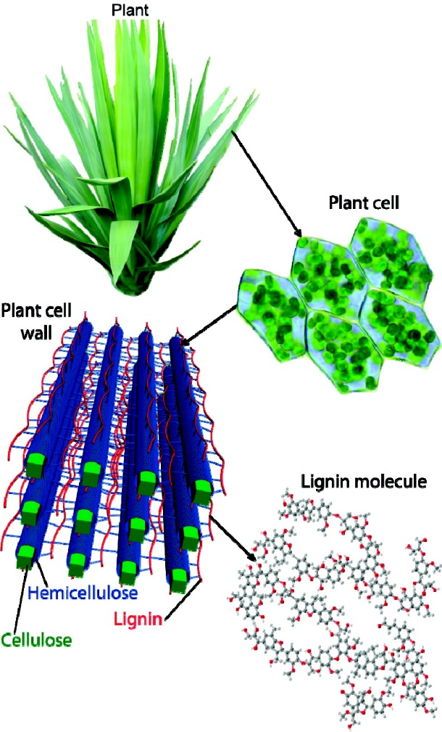
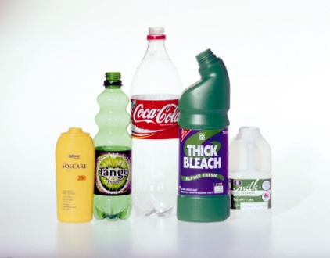

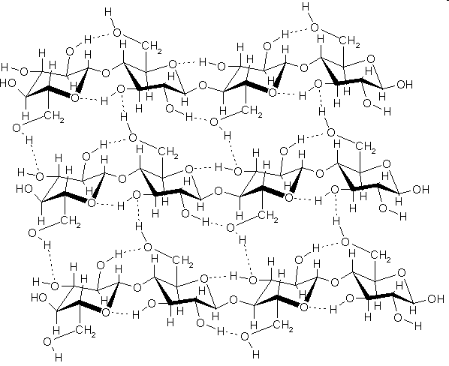

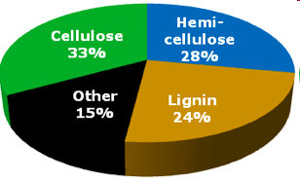
Moving towards sustainability
Zakzeski et al Chem. Rev. 2010, 110, 3552-3599.

Slide 4
Process Integration
Biomass availability potential = 498 Million metric tons/yr
Liquid fuel use in the USA, 2013 =12.75 Mbbl/day
Stand alone Biomass
δ_{ng}=10%
~30% of transportation by integrated process with 63% GHG emission reduction and ~2 tcf NG
Emre Gencer and Rakesh Agrawal
Petroleum
Biomass
Other
Natural Gas
Integration

Slide 5
Lignin: Rich in energy but underutilized
Linkage Types
β-O-4
5-5
α-O-4
β-5
8-8
Lignin accounts for 37% of the carbon in biomass

Slide 6
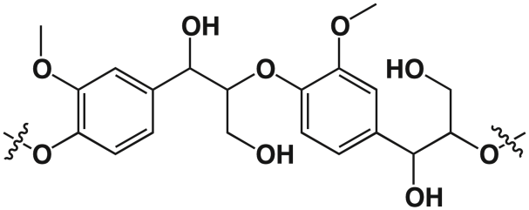
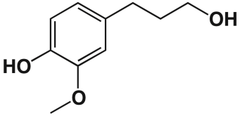
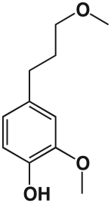
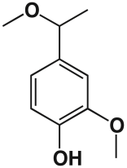
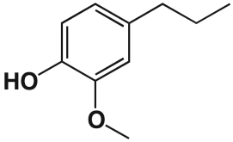
Catalytic depolymerization and HDO
5% wt. Zn-Pd/C
300 psi H₂
150 °C, MeOH
A
181 [M-H]⁻
A
C
B
195 [M-H]⁻
ISTD
B
C
165 [M-H]⁻
Abu-Omar et al. Chem. Sci. 2013, 4, 806-813.

Slide 7
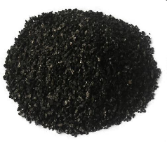
Catalyst characterization
Pd K-edge Fourier transform XAS
Pd NP 3-4 nm
Pd Foil
0.04
Zn/Pd/C Catalyst
0.02
FT[k² * Chi(k)]
0.0
0.0
-0.02
-0.04
0
1
2
3
4
R [Å]
Abu-Omar et al. Chem. Sci. 2013, 4, 806-813.

Slide 8
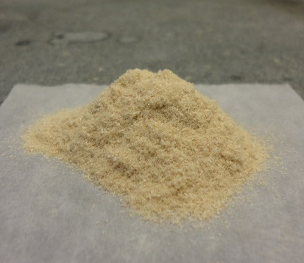
Catalytic depolymerization of native lignin
5 wt% Cat.
30 bar H₂, 200 °C
Yield 54%
1-20 g biomass
Wild Type Poplar
Intensity
Time/ min
Abu-Omar et al. Green Chem. 2015, 17, 1492-1499.
(Highlighted in Science 2015, 347, 1111.)

Slide 9
Carbohydrate residue is intact
85-95%
Gasoline
Sugars
Ethanol

Slide 10
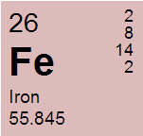
Platform chemicals
Fufurals and levulinic acid
• Iron is earth abundant and cheap.
• Lewis and Brønsted acid.

Slide 11
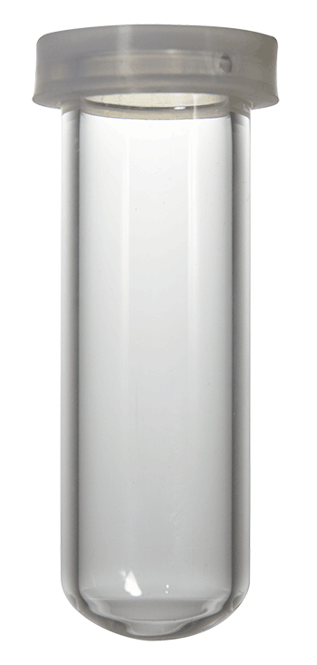
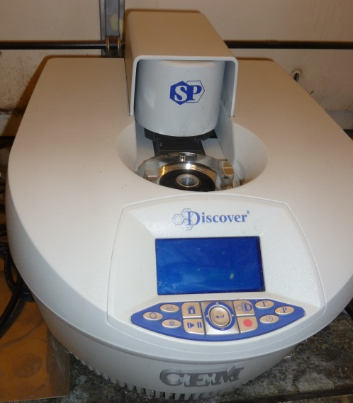
Reaction conditions
Glucose, fructose, or HMF = 0.25-1.00 M
FeCl₃(H₂O)₆, Fe₂(SO₄)₃, or Fe(SO₄) = 0.01-0.10 M
Water (monophasic) or Water:Me-THF (biphasic)
Microwave heating or conventional (140 °C)
Quench periodically and analyze by HPLC & ¹H NMR (organic phase)
23

Slide 12
Speciation of iron confirmed
UV-vis
Operando XANES

Slide 13
Kinetics: HMF to LA
k₃ = 0.48 x 10⁻³ s⁻¹
k₄ = 0.23 x 10⁻³ s⁻¹
@ pH = 1.1 and [Fe] = 0.10 M

Slide 14
Kinetics: Fructose
k₂ = 2.2 x 10⁻³ s⁻¹
k₅ = 1.0 x 10⁻³ s⁻¹
k₃ = 0.48 x 10⁻³ s⁻¹
k₄ = 0.23 x 10⁻³ s⁻¹
@ pH = 1.1 and [Fe] = 0.10 M

Slide 15
Kinetics: Fructose
k₁ = 0.053 x 10⁻³ s⁻¹
k₂ = 2.2 x 10⁻³ s⁻¹
k₅ = 1.0 x 10⁻³ s⁻¹
k₃ = 0.48 x 10⁻³ s⁻¹
k₄ = 0.23 x 10⁻³ s⁻¹
@ pH = 1.1 and [Fe] = 0.10 M

Slide 16
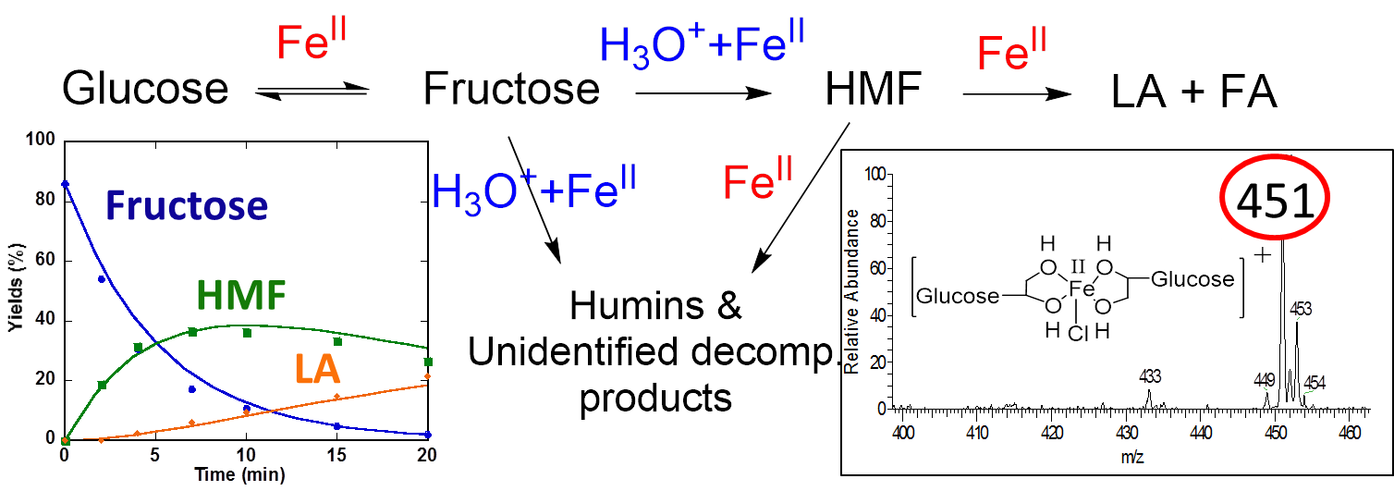
Lewis versus Brønsted acid catalysis
H₃O⁺
H₃O⁺
Abu-Omar et al, Org. Chem. Front. 2015, 2, 1388 - 1396.

Slide 17
Monophasic versus biphasic
Effect of Me-THF solvent
Observed rate const. (x10³)/ s⁻¹ | k₂ | k₃ | k₄ | k₅
Water | 2.2 | 0.48 | 0.23 | 1.0
Water:Me-THF | 3.3 | 0.07 | 0.06 | 0.065
@ pH = 1.1 and [Fe] = 0.10

Slide 18
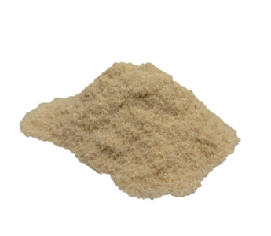

Utilization of the Entire Biomass
HDO
Depolymerization
Dehydration
Cellulose
Solid
Residue

Slide 19
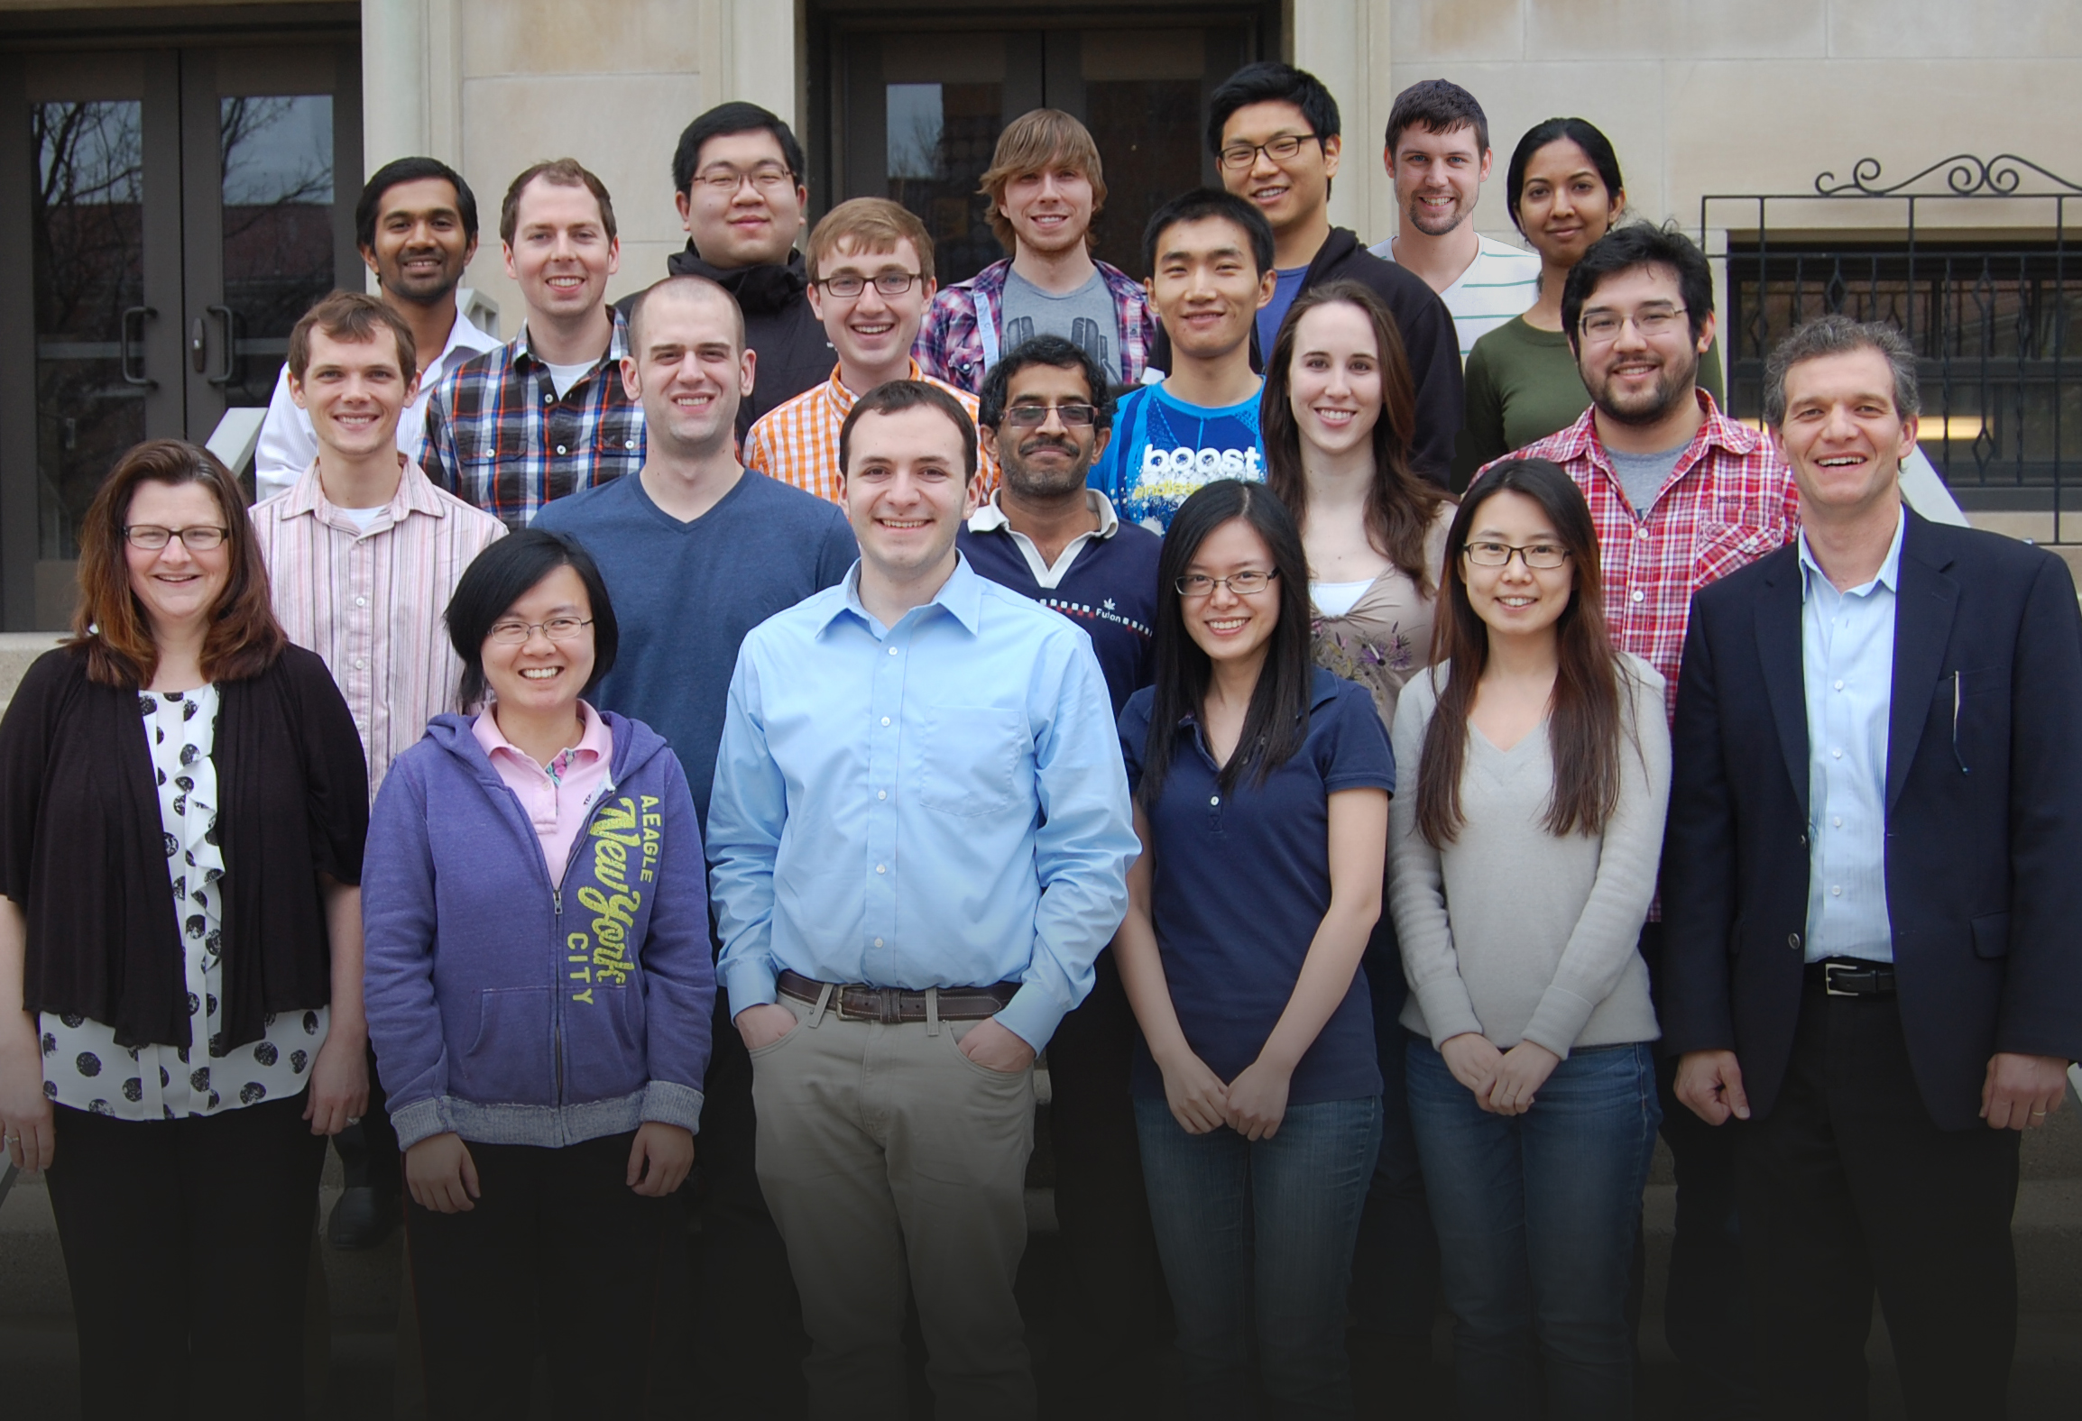


Acknowledgment
Research scientist
  Dr. Basudeb Saha
Postdoc
  Dr. Trenton Parsell
Graduate Students
  Dr. Ian Kelin (Ph.D. 2015)
  Dr. Christine Bohn (Ph.D. 2014)
  Yuan Jiang
  Hao Luo
$upport
  C3Bio, EFRC, U.S. Department of Energy, Office of Science, Award no. DE-SC0000997
  Spero Energy, Inc.
Collaborators
  Nate Mosier (Purdue University)
  Hilkka Kenttämaa (Purdue University)
  Clint Chapple (Purdue University)
  Rick Mielan (Purdue University)
  Fabio Ribeiro (Purdue University)
  Rakesh Agrawal (Purdue University)
  Jeffrey Miller (Purdue/ANL)
Notes:
19
19

