Slide 1
Green pharmaceutical chemistry: target-directed evolution of plant secondary metabolism
John Littleton MD, PhD
Dustin Brown PhD
JL is Professor, University of Kentucky
Chief Science Officer, Naprogenix Inc, Lexington, Kentucky
(COI/financial interest disclosure)

Slide 2
The concept
Plants have evolved defensive bioactive compounds targeted on specific proteins (e.g. in insects).
Why not re-direct plant evolution toward metabolites acting on target proteins that are important to us?
Express “our” target protein in the plant cell
Link its activity to plant cell death
Mutants which survive will be overproducing metabolites that inhibit our target protein.

Slide 3
The human dopamine transporter (hDAT) is a pharmaceutical target protein
Regulates DA in synapses in the brain
Target in Parkinson’s Disease. hDAT accumulates neurotoxins.
Plants evolved inhibitors of the insect DAT as anti-feedants.
We want them to evolve toward inhibition of the human DAT
MPP+
ROS
hDAT
Cell Death
Toxic substrate MPP+
Used as PD model
MPP+

Slide 4
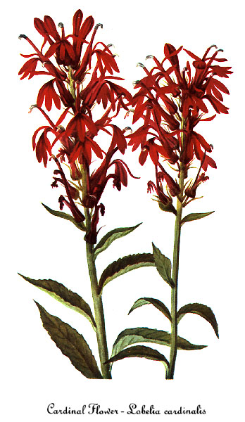
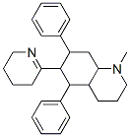
First, find your plant species
High throughput screening of 1000 native species extracts. Lobelia cardinalis contains a novel DAT inhibitor
Complex, binitrogenous decahydroquinolone alkaloid with no total chemical synthesis.
Low yields in wild type plant
Poor lead for conventional combinatorial chemistry
PERFECT example for target directed evolution!
Lobinaline

Slide 5
Now we put the target protein (the human DAT) into the plant cell
ROS
MPP+
ROS
MPP+
hDAT
Cell Death
Cell Death
hDAT
MPP+
MPP+
MPP+
MPP+
The transgenic plant cells are now susceptible to cytotoxicity caused by MPP+ and are “rescued” by hDAT inhibitors.

Slide 6
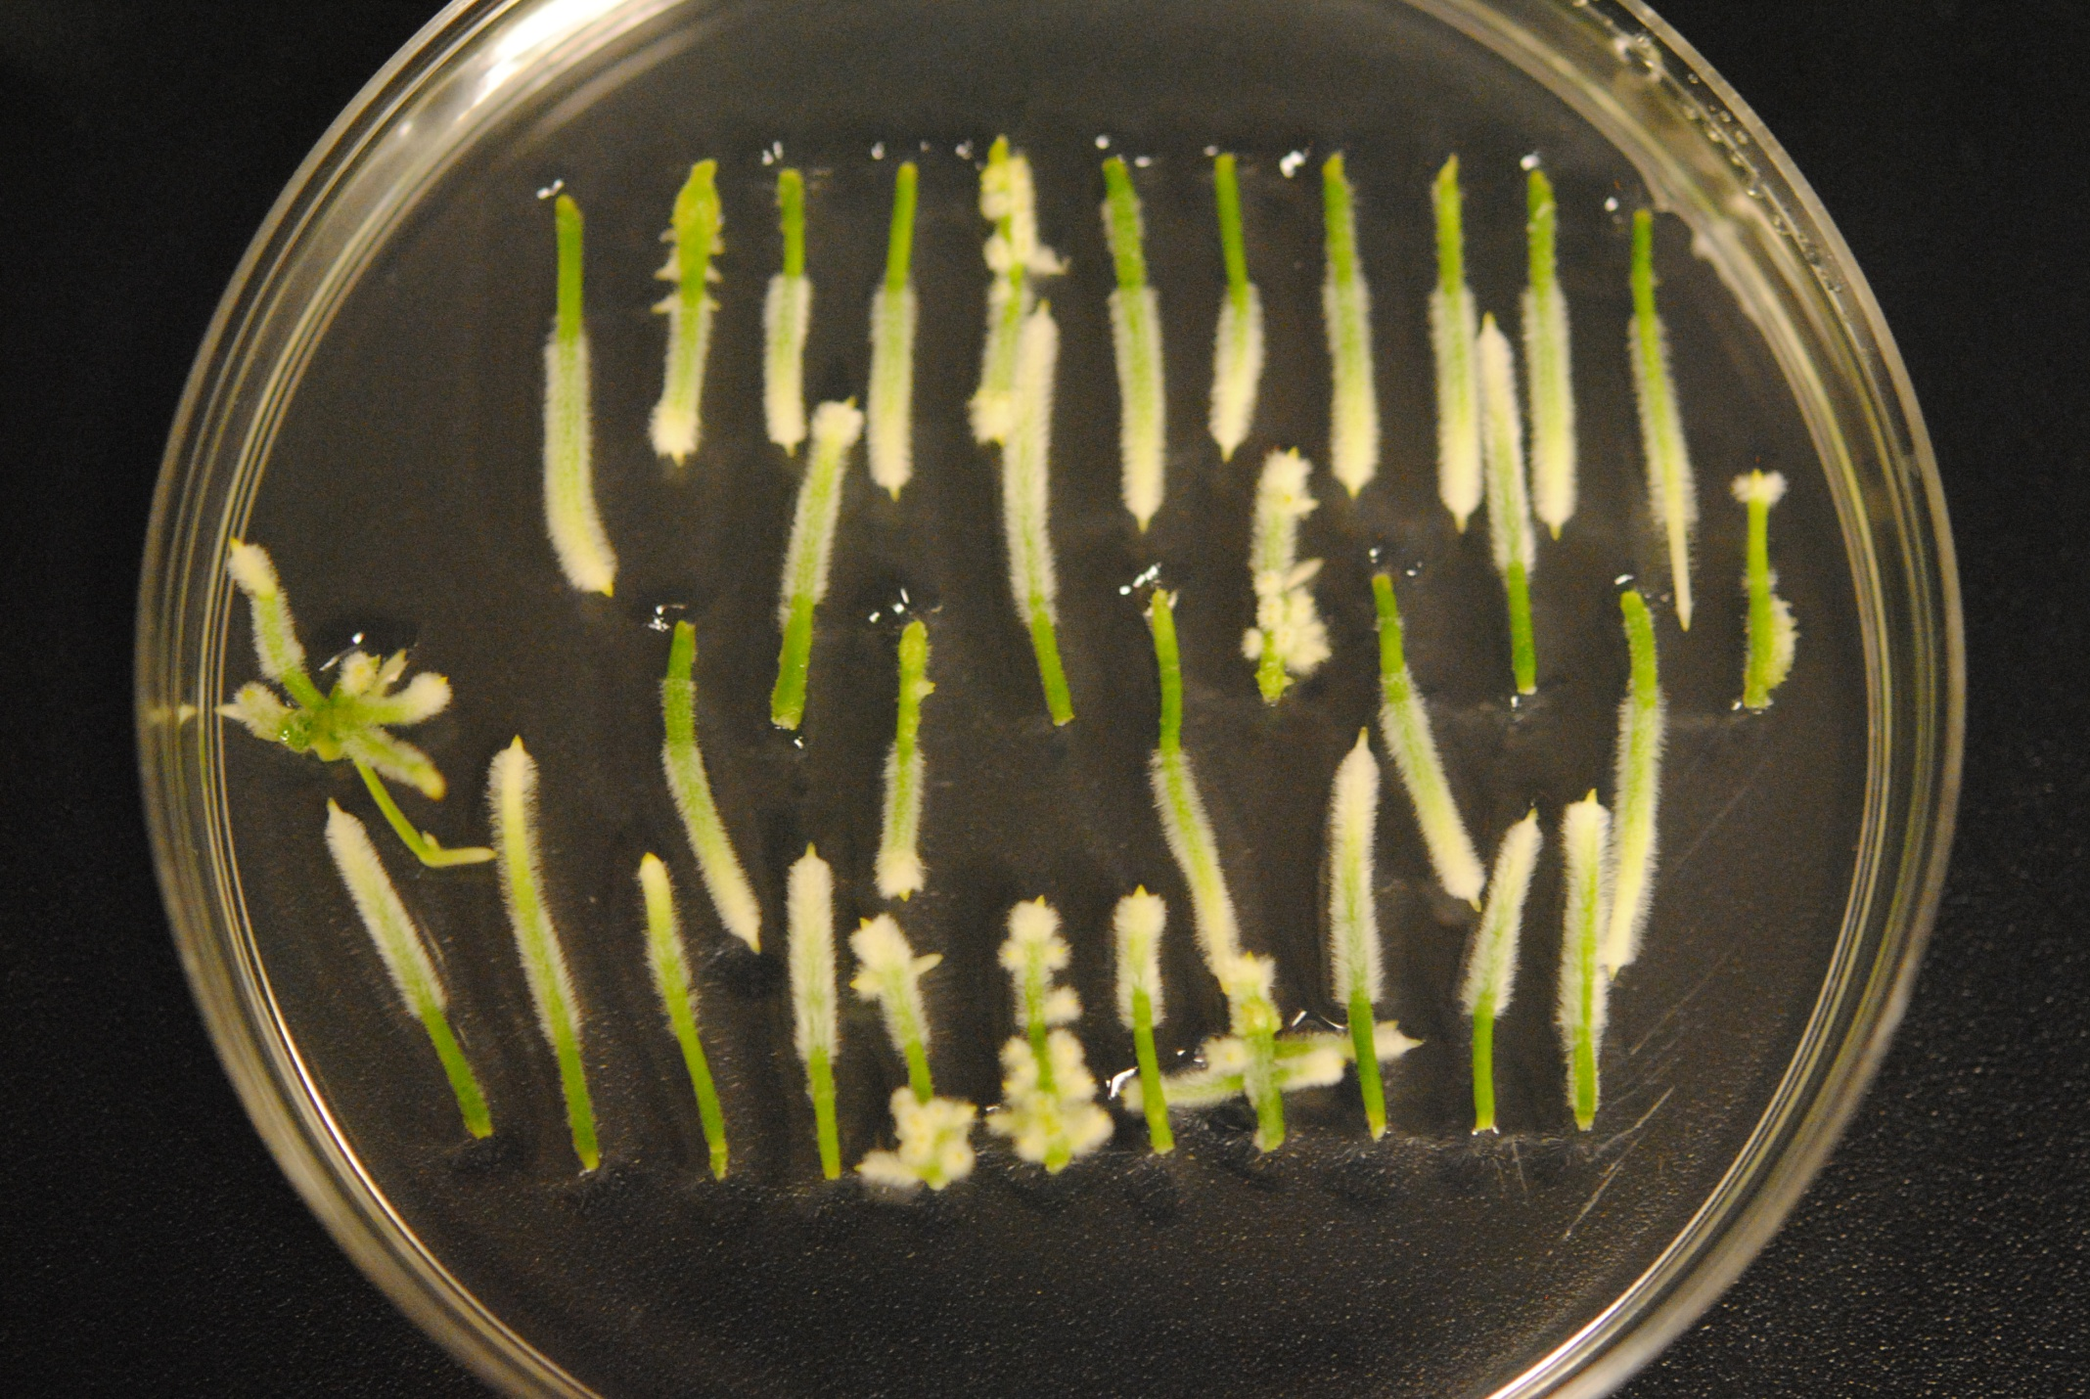
This is what hDAT transgenic L. cardinalis hairy roots look like
No effect on growth/ survival in normal medium.
On selection in MPP+ mutants which overproduce hDAT inhibitors should survive, most others should die.

Slide 7
So now we generate a population of mutant transgenic plant cells and select them for survival in MPP+
Toxin
ATM
ATM
A
DAT
DAT
Toxin
DAT
Cell death
B
Plant cell Express human DAT GOF Mutagenesis Select in toxin
Survivors should be enriched in mutants which overproduce
Surviving mutants may be overproducing
(A) inhibitors of the hDAT
or (B) inhibitors of the cytotoxic mechanism

Slide 8

The MPP+-resistant subpopulation of mutants is generated under selection
(minimizes contribution of elicitation/acclimation)
Transgenic hDAT line
A. rhizogenes-mediated ATM
MPP+-resistant mutant HR emerging
Normal medium
Normal medium
100uM MPP+
Primary non-mutant HR always dies
Primary hDAT transgenic HR
Secondary transgenic mutant HRs emerging
Secondary transgenic mutant HRs emerge rarely

Slide 9
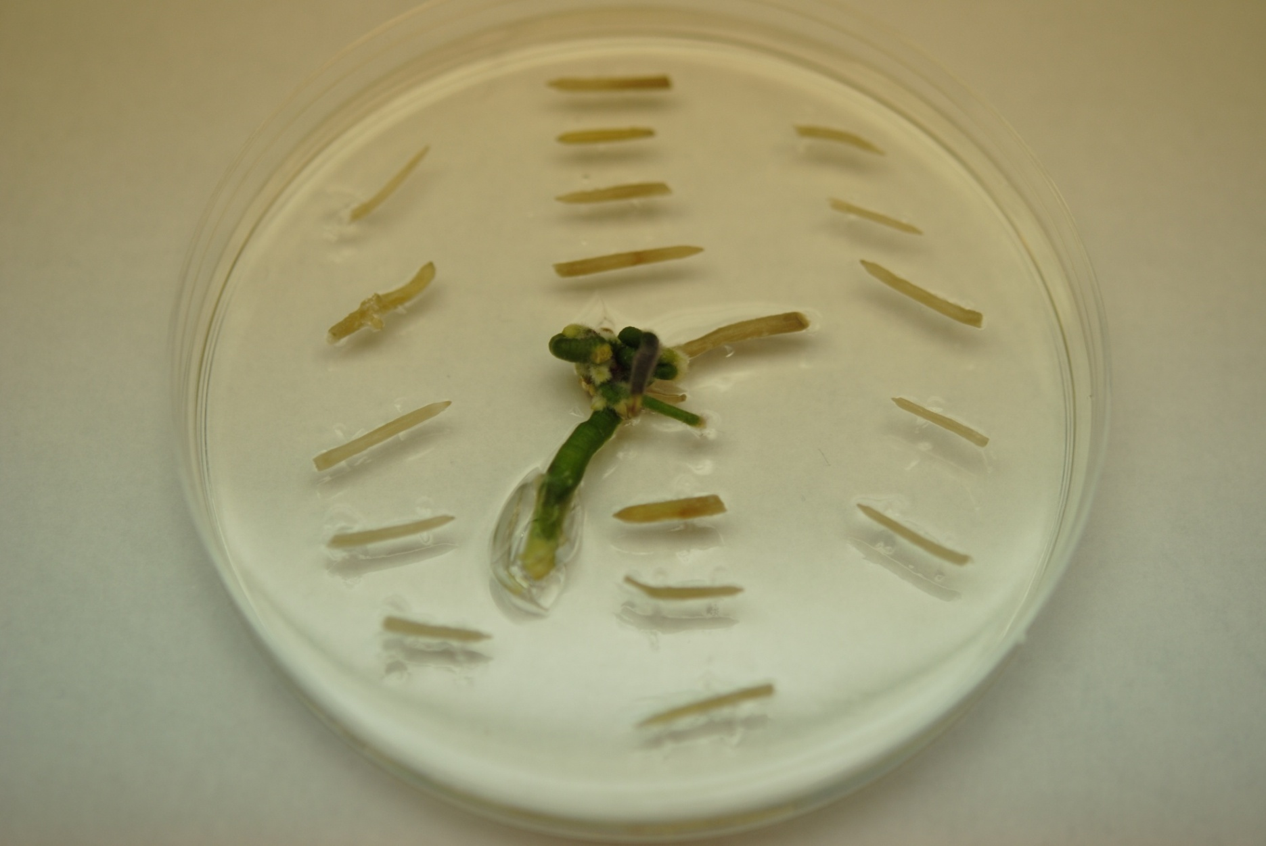
So hairy roots which emerge must have some mutation which confers resistance to MPP+
Intense selection pressure 1/300 mutants survive
4 months selection on MPP+ to ensure a stable phenotype
2 months off MPP+ before screening extracts
120 MPP+-resistant hairy root extracts analyzed for DAT inhibition and lobinaline content (GC/MS) compared with other populations

Slide 10
Real data - inhibition of the DAT by extracts from different culture populations
Proof of concept! Pharmacological phenotype optimized for desired activity on target protein
Wild-type and non-mutant transgenic controls
A single round of mutation/selection on ~5% of the plant genome!

Slide 11
Pharmacological and GC/MS analysis of the MPP+-resistant populationof Resistance
A. Increased inhibitory activity on the DAT 58 mutants
21 Lobinaline overproduction
8 Polyunsaturated fatty acids (mainly linoleic acid)
9 Linoleic acid and squalene
20 contain putatively “novel” DAT inhibitors
B. Increased synthesis of cytoprotective metabolites 41 mutants
15 Squalene overproduction
26 contain putatively “novel” cytoprotective metabolites
C. Mechanism of resistance undetermined 10 mutants
Mutation in cytoprotective genes?
Notes:
15 squalene
8 PUFA
9 squalene and PUFA

Slide 12
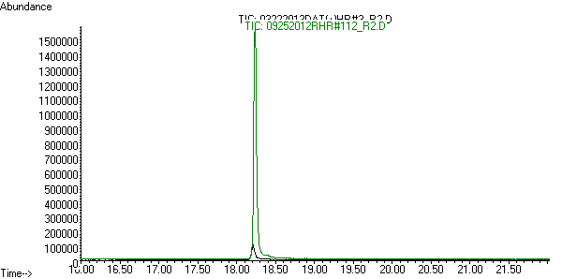
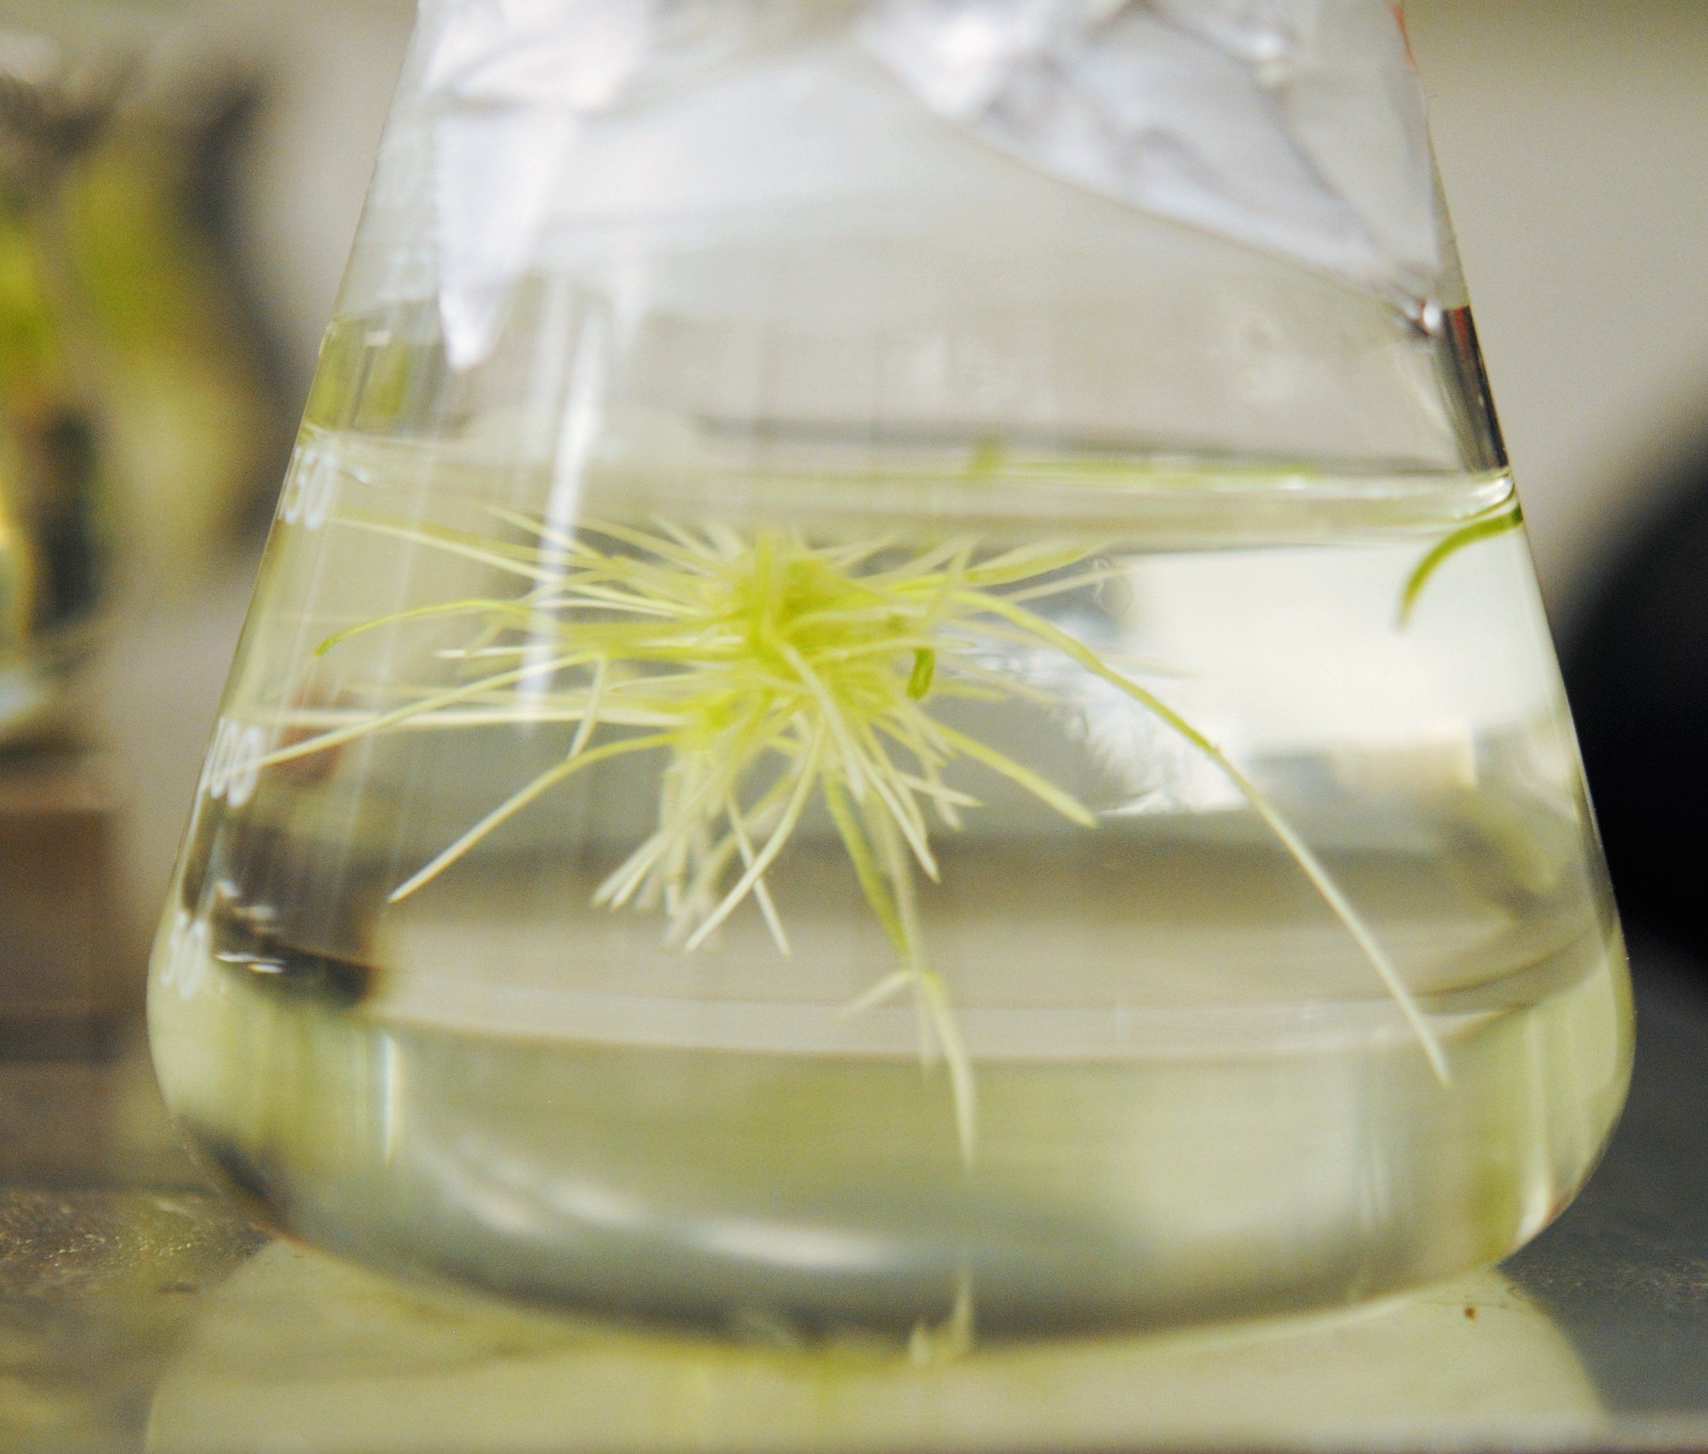
Production of lobinaline in mutants in liquid culture
Lobinaline
Mutantt
Wild-type
Mutant 380 overproducing lobinaline 20x wild-type

Slide 13
We did not expect to see increased PUFAs and squalene – but we should have………
Linoleic acid
Inhibits the DAT and MPP⁺-induced cytotoxicity in neurons
Squalene
Inhibits cytotoxicity of DAT substrates in vivo
Supports hypothesis that compounds which protect the plant cell will also protect mammalian neurons

Slide 14
What about the “novel” DAT inhibitors?
GC peaks not seen in wild-type plant or cultures
Some probably lobinaline derivatives – similar RT, MW and MS, but no match in the database
The alkaloid below is similar to lobeline- found in L. inflata but not by us in L. cardinalis
CH₃
N
H₃C
CH₃
O
OH
1-[1,2,5,6-tetrahydro-6-(2-hydroxybutyl)-1-methyl-2-pyridinyl]-2-Butanone

Slide 15
But other novel peaks appear to be unexpected alkaloid structures
Speculative - not great MS matches, but must be complex alkaloids not detectable in wild-type

Slide 16
Proof of concept for the technology
Identified plant species and active compound
Expressed functional target protein in plant cells
Devised selection procedure
Created resistant mutant population
Analyzed pharmacologically for desired activity at target
Analyzed chemically for known active compound
Products are mutants
With increased yields of active compounds
Generating extracts “optimized” as medicines
Containing “novel” active metabolites?

Slide 17
Acknowledgements
Charles Darwin
Dustin Brown Greg Gerhardt
Trent Rogers Joe Lutz
Samir Gunjan Jatinder Sambi
Baochun Li Grace Poole
Kiran Siripurapu
Cindy Burklow
Funding: Mostly SBIRs and STTRs to Naprogenix from NIAAA, NCI, NCCAM, plus KTRDC, KSTC, KSEF
Thanks for listening!

