Slide 1

Analysis of the transport of the individual gas mixture components in Polymers of Intrinsic Microporosity and PIM-based Mixed Matrix Membranes
John Jansen
Institute on Membrane Technology, ITM-CNR, Rende (CS), Italy.
September 26-28, 2016 - Valencia, Spain
1

Slide 2


CNR Institute on Membrane Technology
Preparative
Preparation and characterization inorganic, metal, polymeric and mixed matrix membranes
Membranes for fuel cells and hydrogen production
Catalytic membranes and membrane reactors
Processes
New membrane-based unit operations (crystallizers, emulsifiers, strippers, scrubbers, adsorbers, etc.)
Study and development of integrated membrane systems in industrial cycles in agro-food, tanning, textile fields, etc.
Membranes for agro-food and bio-medical applications
Membranes for gas and vapour separation
Membranes for nano-, ultra- and microfiltration
Fundamentals
Modeling and simulation of membrane structures
Study of basic transport phenomena
Mediterranean
Sea
23 Jan 2016
20 km from ITM
Rende (CS)
ITM-CNR Headquarters
5 Mar 2016
45 km from ITM
Sunny Southern Italy

Slide 3
Membranes for gas and vapour separation
Asymmetric membrane preparation
  Integrally skinned membranes
  Porous supports and thin film composites
Basic transport studies in dense membranes
  Traditional glassy and semi-crystalline polymers
  Block copolymers
  Amorphous glassy perfluoropolymers (High Free Volume)
  Polymers of intrinsic microporosity (High Free Volume)
  Ionic liquid-based membranes
Mixed matrix membranes
  MOFs, Zeolites, CNTs, graphene

Slide 4
Introduction
Experimental
Results and discussion
Conclusions

Slide 5



Introduction : transport in membranes
Gas transport in dense membranes
Feed mixture
e.g. CO₂ /CH₄
Membrane
(selective barrier)
Retentate
Enriched in methane
CH₄ > CO₂
Permeate
Enriched in CO₂
CO₂ > CH₄
(not 100% selective)

Slide 6

Membrane as a black box(?)
Process engineering approach: correlation between input and output.
Knowledge about the membrane material not necessarily needed
Materials science approach: Look inside and know what happens at molecular level.
  How to improve the membrane performance
  Why things go wrong when they go wrong
  What to expect when used under different conditions
→ For better membranes, further basic studies of the transport are needed…
?
Notes:
In chemical engineering we tend to see membranes as a black box and we do not want to see what is inside the box.
What matters is only the correlation between what goes in and what comes out.
However, if you do not know what happens inside the box, you do not know:
How to improve the membrane performance
Why things go wrong when they go wrong
What to expect when used under different conditions

Slide 7
Context of the work
Pure gas permeability data of novel membrane materials are common but mixed gas permeation data are relatively rare.
Individual diffusion data not common, diffusion data in mixtures are extremely rare or inexistent.
Aim: development of a technique that is able to analyse the diffusion coefficients of individual species in a gas mixture during permeation experiments.
Notes:
Normally we express the performance of a membrane simply in terms of permeability and selectivity, but with the proper measurements we can obtain a lot more information.

Slide 8
Non-stationary permeation
p₁
Immediately after exposure of the membrane to the gas or to the vapour, an equilibrium concentration is reached at the interface of the membrane and the gas phase at the feed side.
Subsequently, the permeant starts diffusing into the membrane and if p₁ >> p₂ a linear concentration profile will be reached in the membrane after some time.
The speed with which the stationary state is reached depends on the diffusion coefficient.
C₁
C₁= S × p₁
Feed
Permeation time
Pressure (external)
Concentrazion (internal)
3 stages of permeation:
3) Stationary
2) Transient
1) Penetration
C₂
p₂
Permeate
0
Mass transport vs. time:
Generally p₁>>p₂
[Crank J, Park GS, Diffusion in Polymers Academic Press, London, 1986]

Slide 9
Permeation curve: expansion of series
Baseline slope (leaks)
Offset
(starting
pressure)
Stationary
Transient
Penetration

Slide 10
Introduction
Experimental
Results and discussion
Conclusions

Slide 11
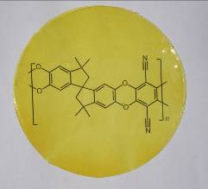
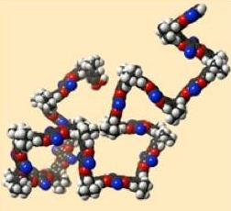
High Free Volume glassy polymers
Polymers of Intrinsic Microporosity
The start:
P. Budd, N. McKeown et al.
Chem. Commun. 10, 2004, 230–231.
PIM-1
Highly contorted rigid structure
Poor chain packing, high free volume and high permeability (and solubility)
May strongly interact with the penetrants

Slide 12

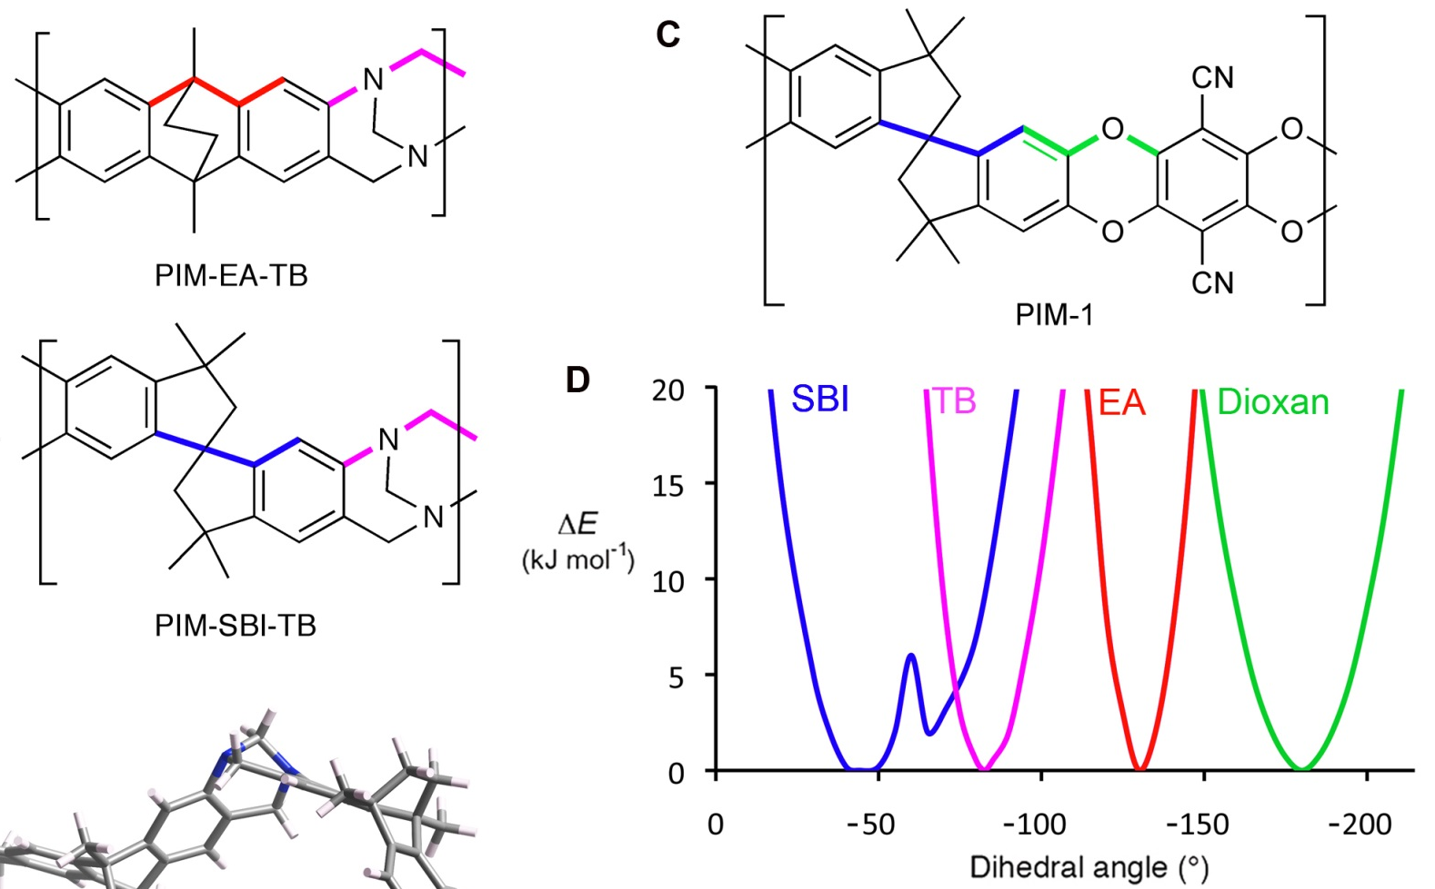

Chain Rigidity and Chain Packing
Highly contorted stiff polymer chains
→ Inefficient chain packing
→ High free volume
→ High permeability
PIM-EA-TB
M. Carta et al., Science 2013, 339, 303-307.

Slide 13
PIM structural variations (1)
Functional
groups
Carboxy-PIM-1
PIM-Tetrazole
M. Guiver, Macromolecules 2009
M. Guiver, Nature Mater. 2011
PIM-1
P. Budd, N. McKeown et al.
Chem. Commun. 10, 2004, 230–231.
Thioamide-PIM-1
Amine-PIM-1
C. Mason, P. Budd et al., Macromolecules, 2011, 44, 6471-6479
C. Mason, P. Budd et al., Macromolecules, 2014, 47, 1021-1029

Slide 14
PIM Structural variations (2)
Contortion
site
SBF-PIM-1
IR-579a
PIM-1
PIM-SBI-TB
PIM-EA-TB
Backbone
groups
Carta, McKeown, Jansen et al.,
Science, 339, 2013, 303-307.

Slide 15
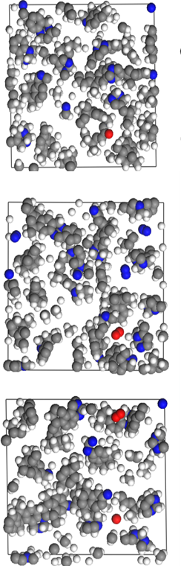
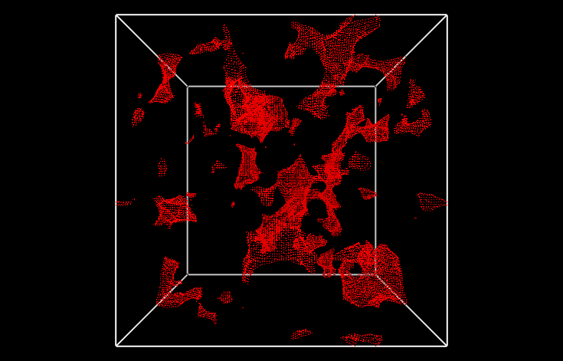
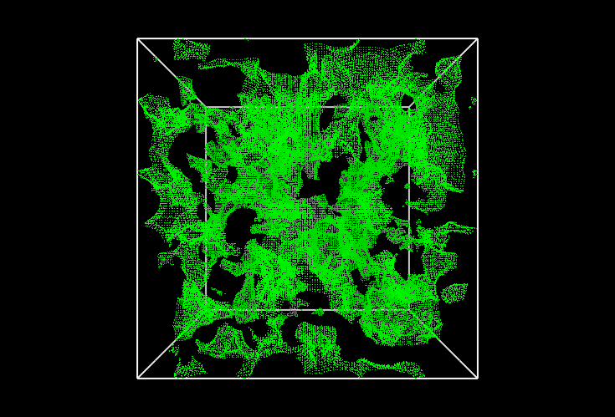
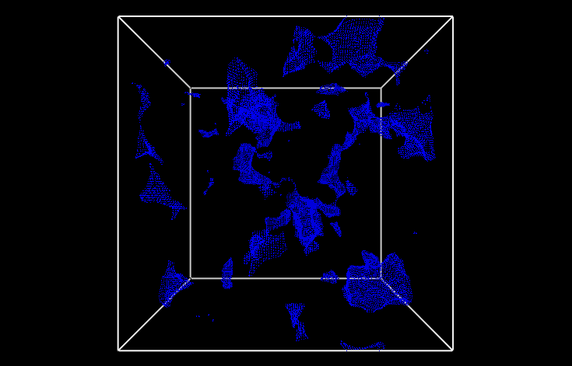
Free volume modelling
Bulk / Slice model
O₂ probe
Free volume model
Sorption
&
Diffusion
Positronium probe
Isolated FVE
Interconnected FVE
Smaller molecules ‘see’ a larger and more interconnected free volume
→ Diffusion selectivity (O₂ vs. N₂)
Affinity with the polymer allows a higher concentration
→ Solubility selectivity (e.g. CO₂ vs. N₂)
N₂ probe
E. Tocci et al., Macromolecules 2014, 47, 7900-7916.

Slide 16
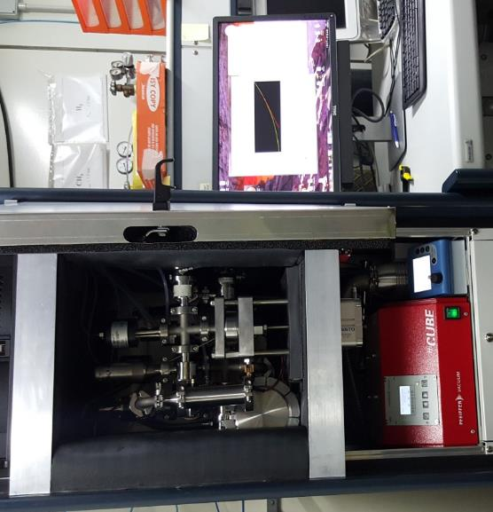
Permeation:
1) Fixed volume - variable pressure setup
Traditional time lag instrument based on dead end cell and gas pressure analysis

Slide 17
Permeation setup – fixed V, variable p
Pressure increase measurement in fixed volume setup:
Pure gas permeation
Max. 8 gases
1 liquid (vapour)
Controlled temperature
Variable Pressure
< 1.3 bar
Sampling:
> 25 pts./second
Pneumatic valves:
short reaction times
Jansen et al., Polymer 48 (2007) 2619

Slide 18
Pure gas setup - Instrumental time lag
PIM membrane IR-579a
Perforated aluminium foil
Small instrumental time lag (<0.1s) due to delay in reaction time of valves and pressure sensor.
→ Constant for all gases and usually negligible, except perhaps for He and H₂.

Slide 19
Permeation:
2) Fixed pressure - variable volume setup
Mixed gas permeation instrument based on a cross-flow cell and gas composition analysis

Slide 20
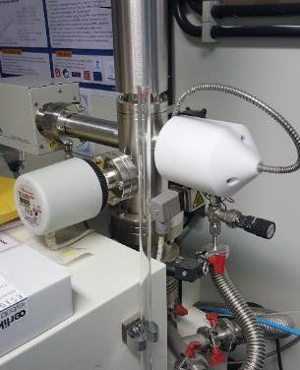
Mixed gas setup with cross-flow cell
Gas chromatography:
Slow, discontinuous analysis
Micro-GC faster, but less flexible
Bubble Flow Meter
Retentate
BPC
Alternative
→ In-line Mass spectrometric analysis
Feed
Traditional
gas analyser
(GC, GC-MS, Micro GC)
Permeate
MFC
N₂
MFC
O₂
MFC
CH₄
MFC
CO₂
Sweep
MFC
Ar
Bubble Flow Meter
O₂
CO₂
N₂
CH₄
Ar
Excess

Slide 21
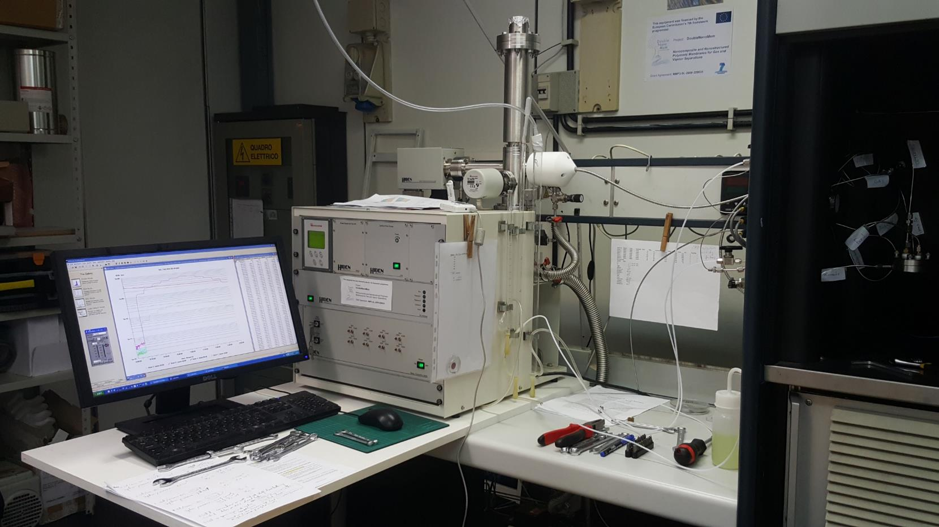
Quadrupole MS residual gas analyzer
Quadrupole Mass Spectrometer for residual gas analysis
0.1 – 10 pt/s sampling time
Max. 200 AMU
Argon Sweeping gas (15-50 ml/min)
Mass flow controllers for Ar, N₂, O₂, CO₂, CH₄
Pressure controller 0-5 bar (1-6 bara)
Maximum 5 independent channels (alternatingly)
Q-RGA
!
Membrane cell
Channel selection
B. Flaconneche et al., Oil Gas Sci. Technol. 56 (2001) 245–259.

Slide 22
System optimization : quick gas switch
PURGE
Position 1
Independent
6-Way valve
Bubble FM
MFC
N₂
MFC
O2
MFC
CH4
MFC
CO2
Retentate
BPC
1
MS SV1
6
2
Purge
Feed
MS SV3
5
3
Bubble FM
4
Permeate
MS SV2
Bubble FM
MFC
Ar Purge
MFC
Ar
Sweep
TEST
Position 2
6-Way valve
MFC
CO2
Bubble FM
MFC
N₂
MFC
O2
MFC
CH4
Retentate
BPC
1
MS SV1
6
2
Test
Feed
MS SV3
5
3
Bubble FM
4
Permeate
MS SV2
Bubble FM
MFC
Ar Purge
MFC
Ar
Sweep

Slide 23
Effect of dead volumes in the system
TEST
Position 2
6-Way valve
MFC
CO2
Bubble FM
MFC
N₂
MFC
O2
MFC
CH4
Retentate
BPC
1
MS SV1
6
2
Test
Feed
MS SV3
5
3
Bubble FM
4
Permeate
MS SV2
MS SV2
Bubble FM
MFC
Ar Purge
MFC
Ar
Sweep
Limitation: every part of the plant has dead volume causing delay in the gas analysis

Slide 24
Introduction
Experimental
Results and discussion
Conclusions

Slide 25
Time lag analysis
Sample IR-579a As cast
5% CO₂, 95% N₂
Feed gas on

Slide 26
Time lag analysis (differential signal)
Sample IR-579a As cast
5% CO₂, 95% N₂
CO₂
N₂
Feed gas on

Slide 27
Integration of differential signal
Sample IR-579a As cast
5% CO₂, 95% N₂
Feed gas on

Slide 28
Time lag
Sample IR-579a As cast
52% CO₂, 48% CH₄
Clearly slower kinetics for CH₄
5% CO₂, 95% N₂
Θ
CO₂
Θ
CO₂
Θ
N₂
Θ
CH₄

Slide 29
Steady state permeation
5% CO₂, 95% N₂
52% CO₂, 48% CH₄
Pressure-independent
No hysteresis
Pressure-dependent
Slight hysteresis

Slide 30
Correction for instrumental time lag
Assumption:
Every part of the setup has its characteristic reaction times and we must correct for this to ‘isolate’ the real time lag related to the transport in the membrane.

Slide 31
Alternative: Time lag vs (Thickness)²
TEST
Position 2
6-Way valve
MFC
CO2
Bubble FM
MFC
N₂
MFC
O2
MFC
CH4
Retentate
BPC
1
MS SV1
6
2
Test
Feed
MS SV3
5
3
Bubble FM
4
Permeate
MS SV2
MS SV2
Bubble FM
MFC
Ar Purge
MFC
Ar
Sweep
For the membrane:
For the whole system:
Can we describe our system with just one additional delay term?

Slide 32
Instrumental time lag: Θ vs (Thickness)²
Mixed gas setup
Comparison: Pure gas setup
CO₂
N₂
O₂
Instrumental time lag, Θ₀

Slide 33
Instrumental time lag: Θ vs (Thickness)²
Mixed gas setup
Validation: Pinhole in Aluminium foil
CO₂
N₂
O₂
Θ₀
Instrumental time lag, Θ₀

Slide 34
Gas Permeability of PIM-1/UiO-NH₂ MMMs
Mixed Matrix Membrane with Metal Organic Frameworks
Gas mixture : 52% CO₂, 48% CH₄
Detailed quantitative diffusion analysis of pure gases and mixtures is in progress
UiO-NH₂ MOFs

Slide 35
Introduction
Experimental
Results and discussion
Conclusions

Slide 36
Conclusions
Mass spectrometry allows quick in-line permeate gas analysis during membrane gas permeation experiments.
Short analysis times enable visualization of transient phenomena of the individual components in gas mixtures.
Accurate correction of the instrumental time lag is possible and is needed for determination of the effective diffusion coefficient.
The method is suitable to study time-dependent and anomalous phenomena such as coupling effect, dilation, aging etc..
Outlook
Further minimization of the dead volume to optimize the response times
Effect of pressure, gas composition; aging studies
Check of Helium sweeping gas to reduce interference

Slide 37





Acknowledgements: Financial support
CNR (Italy) / FCT (Portugal) bilateral collaboration program 2015-2016.
FP7 Project: M⁴CO₂ - Energy efficient MOF-based Mixed Matrix Membranes for CO₂ Capture.
Contract ENERGY-2013-1608490
CNR (Italy) / CAS (Czech Republic) bilateral collaboration program 2016-2018.

Slide 38






Acknowledgements
Institute on Membrane Technology, Rende, IT
  Paola Bernardo
  Elisa Esposito
  Alessio Fuoco
  Marcello Monteleone
  Elena Tocci
University of Chemistry and Technology Prague (former ICT), Prague, CZ
  Karel Friess
  Kryštof Pilnácek
  Marek Lanč
Institute of Chemical Process Fundamentals, Prague 6 - Suchdol, CZ
  Pavel Izák
  Zuzana Sedláková
Universidad Nova de Lisboa, Lisbon, Por
  Joao Crespo
  Carla Brazinha
  Sofia Fraga
The University of Manchester
  Peter Budd
  Christopher R. Mason
  Alexandra F. Bushell
  Louise Maynard-Atem
  Bekir Satilmis
  Kane W.J. Heard
  …….
University of Edinburgh, UK
  Neil B. McKeown
  Mariolino Carta
  C. Grazia Bezzu
  Ian Rose
Others . . . . .

Slide 39

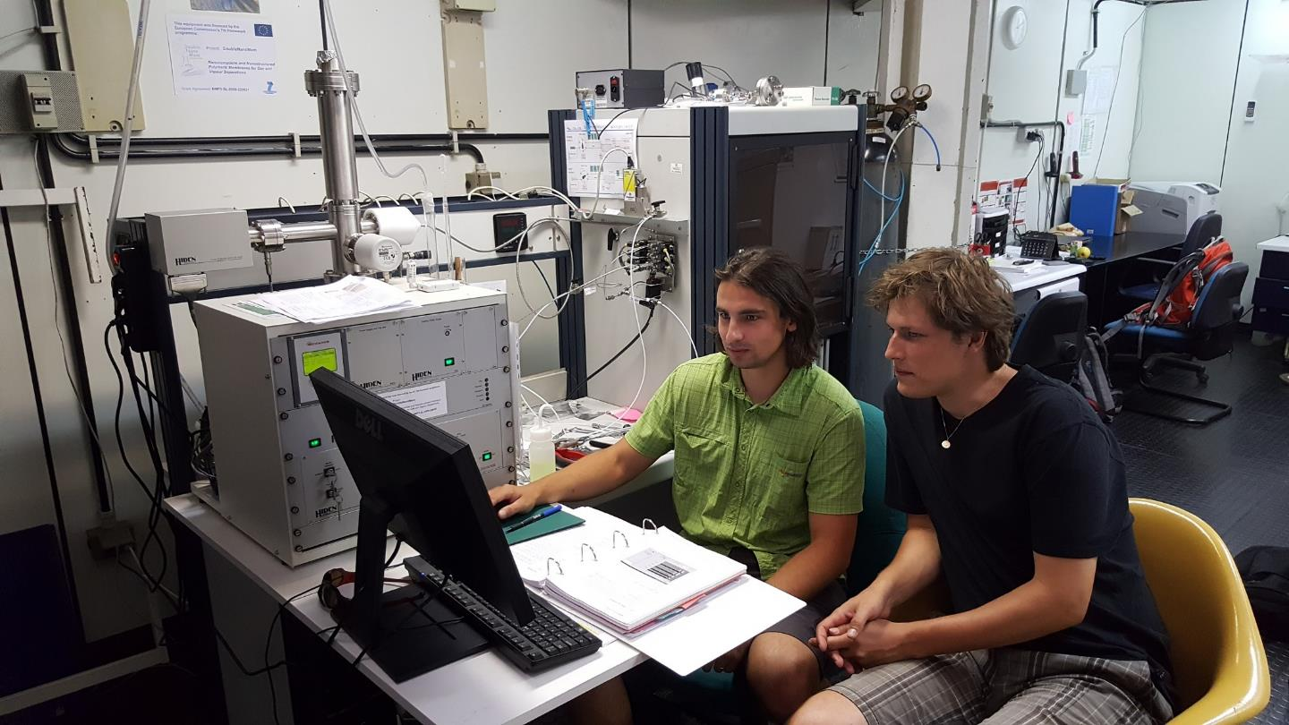
Acknowledgements : EC Erasmus+
Thank you for your attention !
? ? ? Questions ? ? ?
Marek Lanč
UCT Prague
2016
Krystof Pilnáček
UCT Prague
2012

