Slide 1
An ARQ Retransmission Scheme for Real-Time Video Multicasting over Mobile Communication Networks
Tsang-Ling Sheu
Department of Electrical Engineering
National Sun Yat-Sen University
Kaohsiung, Taiwan

Slide 2
Outline
Introduction
Related Work
ARQ Retransmission
Simulation and Discussion
Conclusion

Slide 3
Introduction
Motivation
Video Streaming on a Mobile Communication Network
High bit error rate due to noise and interference
No retransmission scheme for multicasting a video stream
Proposed Solution
Integrate retransmission requests from MS in a multicast group to reduce extra bandwidth requirements
To meet delay constraint of a retransmitted packet
Buffer and retransmit erroneous packets in the last hop
Consider different decoding rates of MS

Slide 4
Related Work
Authors | Pros | Cons
Jinhe Zhou | Unequal Error Protection (UEP) for I/B/P frames to improve retransmission efficiency Use cross-layer solution | 1. Use end-to-end retransmission, no good for real-time 2. Retransmission is determined by application layer. It requires extra overhead to read frame type in RTP headers
James She | Consider retransmitting I/B/P frames for different levels of video quality Consider waiting time and scheduling time at BS buffer | The authors did not consider the time constraints in playout buffer at MS
Jiang Yu | Retransmission does consider delay constraint of each MS | It did not consider network condition, such as PLR It did not consider extra bandwidth required for packet retransmission
A. Nafaa and A. b. Jantan | It considers error burst pattern caused by interferences and noise among neighboring MS Retransmit packets using one-hop Proxy to save delay time | Proxy may require large buffer It did not consider delay constraints for Retransmission timeout

Slide 5
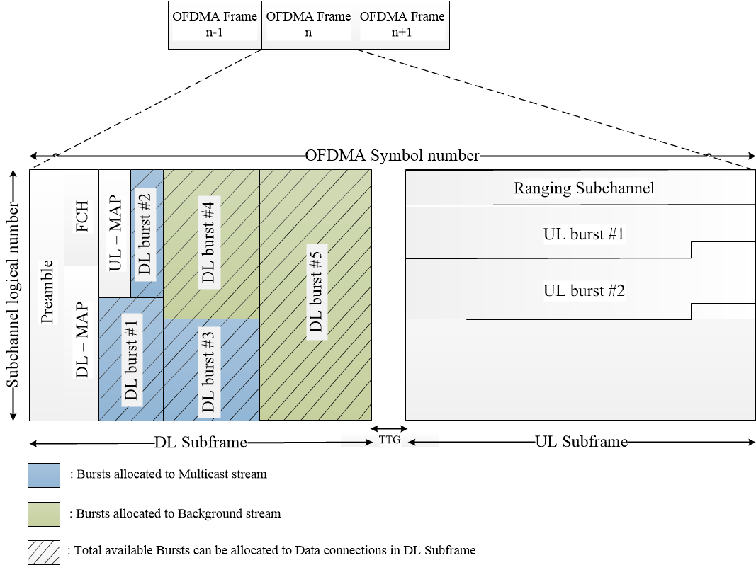
An OFDMA frame

Slide 6
System Architecture

Slide 7
Retransmission
IP camera
Send feedback
Packet error
BS
Interference
Transmission Buffer
Retransmit Packet
Send feedback
Retransmission Buffer
Packet error
Video Stream Packet
Feedback
Interference

Slide 8
Three conditions for the proposed ABR
ABR (ARQ Block Retransmission)
Real-time constraints
SACK threshold
Extra bandwidth

Slide 9
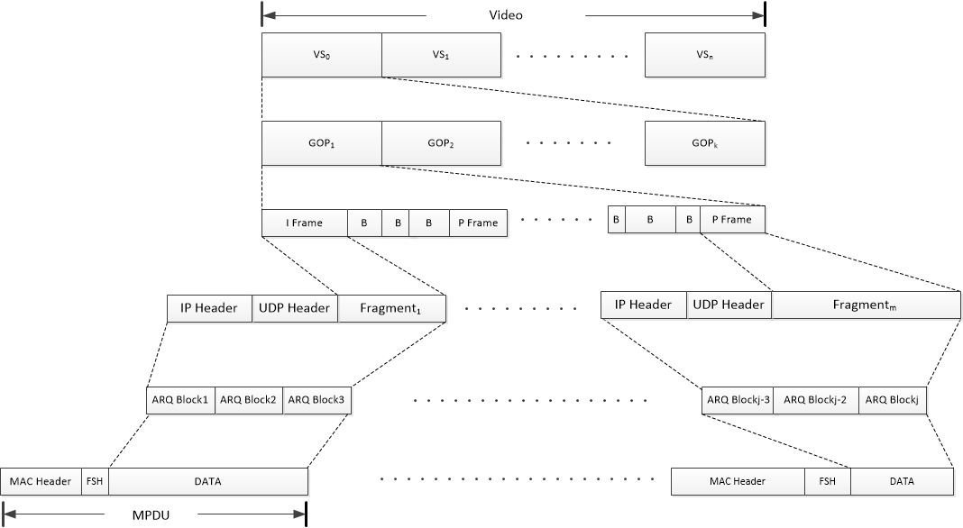
The Proposed ABR
An IP Fragment is segmented to a number of ARQ blocks (AB)
Every AB has a block sequence number (BSN)
MS uses ARQ feedback (AF) message to report to BS
Video Slice
GOP
I/B/P frames
IP Fragments
ARQ Blocks
MPDU

Slide 10
Modified ARQ Header
Fragmentation sub-header (FSH)
Use 3-bit reserved field
Repeated: to number the repeated BSN
ARQ feedback header
Repeated, Map Size, HOL time
ACK bit map
Use bit map to record all AB
1: Successful $({SACK}_{bsn}=1$)。
0: failed (${SACK}_{bsn}=0$)。

Slide 11
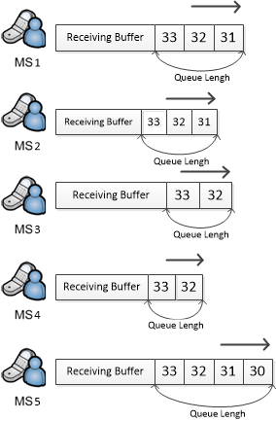
The Proposed ABR (1/2)
Packet error
IP camera
BS
Interference
34
34
34
34
34
37
36
35
34
Check if connection is enable ARQ
Divide into ARQ blocks

Slide 12
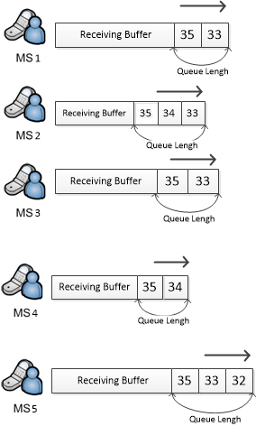
The Proposed ABR (2/2)
Check BSN and Repeated number
Send ARQ feedback
IP camera
Feedback
SACK₃₄ = 0
BS
Feedback
SACK₃₄ = 1
36
Feedback
SACK₃₄ = 0
Feedback
SACK₃₄ = 1
Feedback
SACK₃₄ = 0

Slide 13
Retransmission Delay
Retransmission Delay : | $$T_{R}≤T_{HOL_MS}$$
 | $${T_{R}=T}_{Feedback}+T_{HOL_BS}+T_{ARQ}$$
Round-Trip Time : | $RTT= T_{ARQ}+T_{Feedback}≅2×T_{ARQ}$

Slide 14
Threshold
$$∆ =\frac{{SUM}_{bsn}^{SACK}}{N_{MS}}$$

Slide 16
Simulation
Use NS-3
Traffic generator
Generate I/B/P frames
Convert I/B/P frames to ARQ blocks
ARQ block retransmission (ABR) modules

Slide 17
Simulation Topology
Parameters | Settings
Frame Duration | 10 ms
Duplexing mode | TDD
DL/UL | 1:1
Modulation | 16-QAM
Max packet length | 1,500 bytes
ARQ block size | 1,024 bytes
video stream FPS | 50 FPS
video stream GOP | 10
MS ID | I frame | B frame | P frame | Decoding rate
1 | 30,488 bytes | 1,524 bytes | 7,622 bytes | 2.5 Mbps
2 | 36,585 bytes | 1,829 bytes | 9,146 bytes | 3.0 Mbps
3 | 42,683 bytes | 2,134 bytes | 10,671 bytes | 3.5 Mbps
4 | 48,780 bytes | 2,439 bytes | 12,195 bytes | 4.0 Mbps

Slide 18
Traffic generator

Slide 19
HOL time

Slide 20
Round-trip time

Slide 21
Percentage of Retransmitted BW vs Multicast BW for different error rates (for I/B/P frames)

Slide 22
Percentage of Retransmitted BW vs Multicast BW for different error rates (for I frames only)

Slide 23
Improved Video Quality Indicator (1/2)

Slide 24
Improved Video Quality Indicator (2/2)

Slide 25
Conclusion
$∆_{threshold}$ (for a fixed bit error rate)
For a large $∆_{threshold}$
$Retransmission should be invoked when a large percentage of$
the same erroneous blocks among MS appears
Bit error rate and decoding bit rate (for a fixed $∆_{threshold}$)
When bit error rate is low and decoding bit rate is high, video quality can be improved more significantly by using the proposed ABR

Slide 26
Thank you
Q & A

