Slide 1
Cultural Competence of Nurses Working in Elderly Care in an Acute Hospital in the UK
A Quantitative Study
Sukdeep Dhadda
4th Year MNursSci
Notes:
Thanks for giving me this opportunity to present to you all.

Slide 2



Background

Slide 3
Background
In 2011, individuals from Black & Minority Ethnic (BME) groups accounted for 13% (7.5 million) of the UK population, compared with 4.3% (1.9 million) in 1951 (ONS, 2013).
Simultaneously, the UK continues to be an ageing population, with individuals over the age of 65 accounting for 16% (9.2 million) of the population of England & Wales in 2011 (ONS, 2013a).
These statistics have a range of implications for healthcare and service provision.
Cultural Competence (CC) is one approach which has been suggested as a strategy to improve quality of healthcare and reduce inequalities for all patients.
Notes:
Justification

Slide 4
Literature Context
Cultural Competence (CC) - “a set of congruent behaviours, attitudes, and policies that come together in a system, agency, or among professionals that enables effective work in cross-cultural situations” (Cross et al, 1989, p.4).
The goal of CC is “neither to overemphasize nor underestimate the effects of culture in the healthcare encounter, but to understand the influence of cultural factors on healthcare and health outcomes and to work with factors in optimizing the services provided” (Xakellis, 2004, p.141).

Slide 5
Literature Context
Culture is defines as “the integrated pattern of human behaviour that includes thoughts, communications, actions, customs, beliefs, values, and institutions of a racial, ethnic, religious, or social group” (Cross et al, 1989, p.3).
Individuals’ life experiences, culture and social circumstances all impact on the way in which they adjust to growing old (Andrew and Boyle, 2008).
‘Triple Jeopardy’: age + race + poverty (poor social circumstances & isolation) = health inequality (Norman, 1985).
Notes:
In terms of elderly care specifically…

Slide 6
Aims
This study sought to assess the knowledge, skills, attitudes and practice of nurses towards the issue of culture, in order to assess their level of cultural competence and explore the possible impact upon healthcare provision within the speciality of elderly care.

Slide 7
Method
Methodology: Quantitative Research
Sample: Registered Nurses & Healthcare Assistants working within Healthcare of Older People (HCOP)
Data Collection: Cultural Competence Assessment Tool (CCATool)*
Ethics: Clinical Audit Registration
Data Analysis: Coding, SPSS
Notes:
One of the objectives of my research was to actually use a validated CC self-assessment tool. …

Slide 8
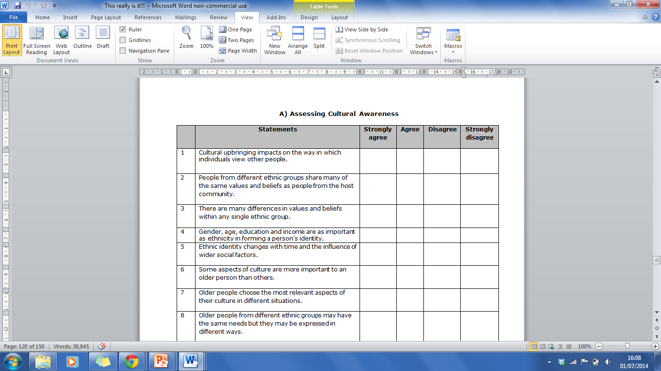
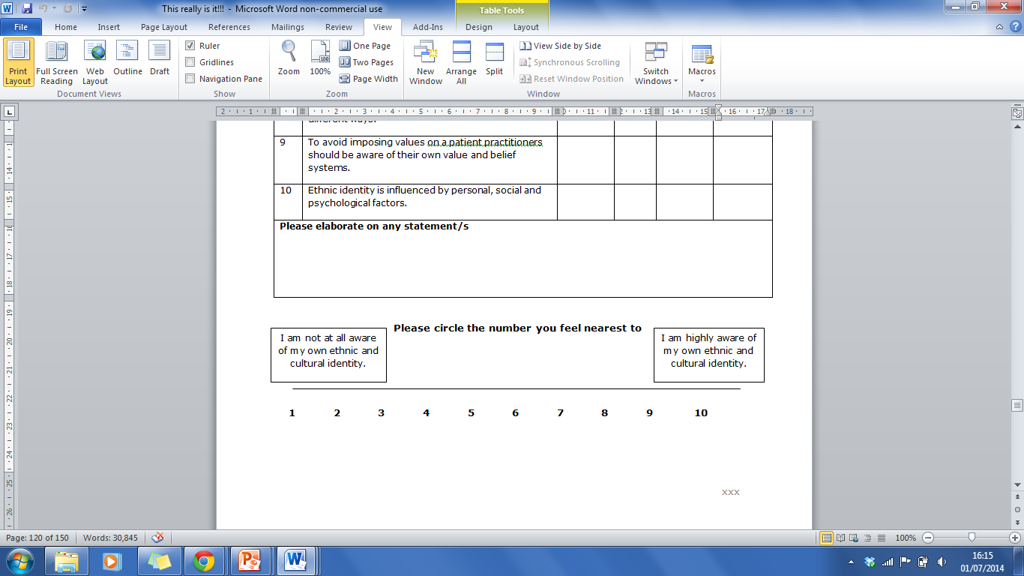
Data Collection
Figure 1: The Papadopoulos, Tilki and Taylor Model for Developing Cultural Competence (Papadopoulos et al, 1998)
Figure 2: Section A of the RCTSH CCATool for elderly care (Papadopoulos, 2010)
Notes:
English -> Danish -> English

Slide 9
Method
Methodology: Quantitative Research
Sample: Registered Nurses & Healthcare Assistants working within Healthcare of Older People (HCOP)
Data Collection: Cultural Competence Assessment Tool (CCATool)
Ethics: Clinical Audit Registration
Data Analysis: Coding, SPSS

Slide 10
Results: Demographics
Ward | No. of Staff | Response Rate (N) | Response Rate (%) | % of Total
Ward 1 | 36 | 14 | 38.9 | 17.3
Ward 2 | 37 | 12 | 32.4 | 14.8
Ward 3 | 25 | 11 | 44 | 13.6
Ward 4 | 23 | 15 | 65.2 | 18.5
Ward 5 | 32 | 16 | 50 | 19.8
Ward 6 | 37 | 10 | 27 | 12.3
Other | - | 3 | - | 3.7
Table 2: Response rate for individual
Table 1: Demographic characteristic of participants

Slide 11
Results: Scores
Figure 3: The frequency and distribution of CC Scores achieved.

Slide 12
Results: Scores
No participants were culturally incompetent, or culturally competent.
65 members of staff were culturally aware; 13 were culturally safe. (N.B. 3 participants were excluded from data analysis due to high volumes of missing data.)
Only 3 statistically significant results were found between participants demographic characteristics and levels of CC.
Instructions for Determining Levels of Competence
Cultural Competence (Practice)
A score of ten in all of the four stages (a perfect score) = Cultural Competence.
Cultural Safety
A score of five or more in cultural awareness, and all the generic statements in the other stages correct= Cultural Safety.
Cultural Awareness
A score of five or more in cultural awareness, without necessarily having all the generic statements in the other stages correct = Cultural Awareness.
Cultural Incompetence
A score of less than five in cultural awareness, whatever the score in the other stages = Cultural Incompetence.
Papadopoulos, I., Middlesex University, London.

Slide 13
Implications for Nursing: Rationale for a Nursing Practice Framework
What are the implications of the fact that there were only 3 significant results?
Why is it important to nursing practice that the participants only achieved scores that meant that they were culturally aware and culturally safe, and not culturally competent?

Slide 14
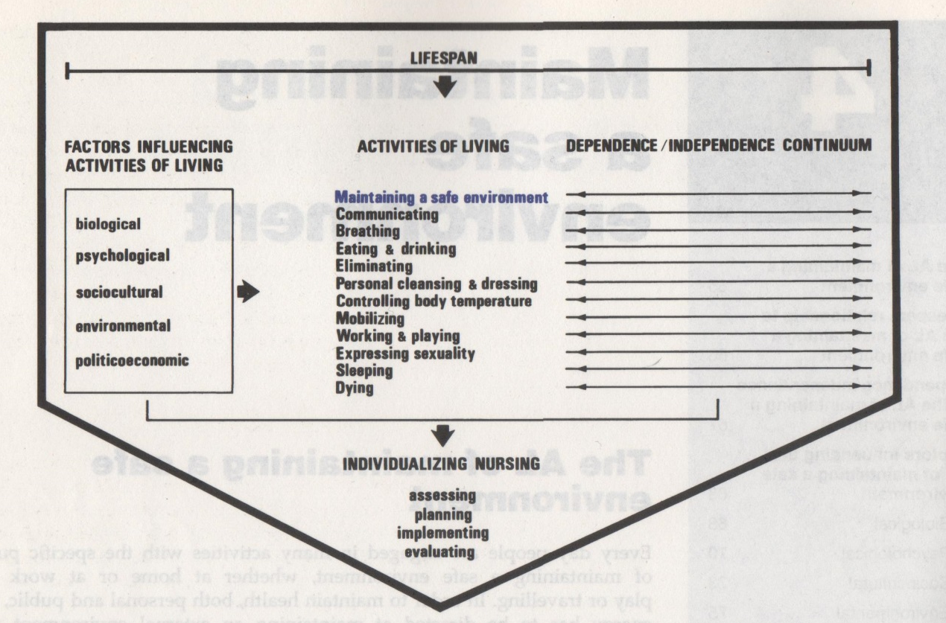
Towards a CC Clinical Nursing Framework…
The Roper, Logan and Tierney Activities of Living model for nursing (1980)

Slide 15
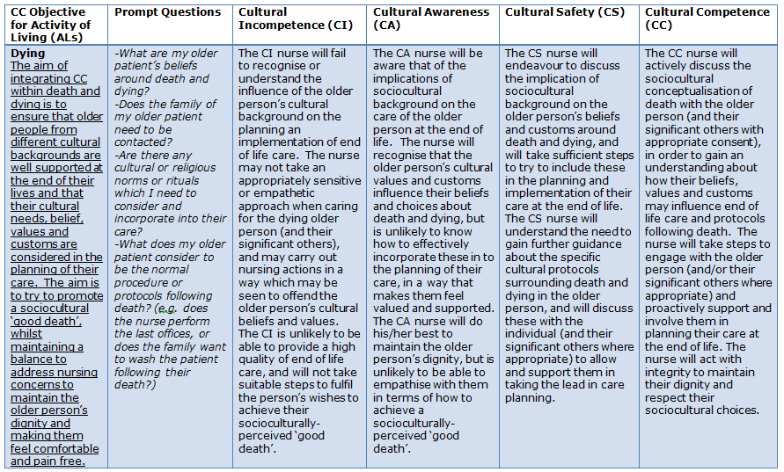
Implications: Towards a CC Clinical Framework

Slide 16

Looking forward…

Slide 17
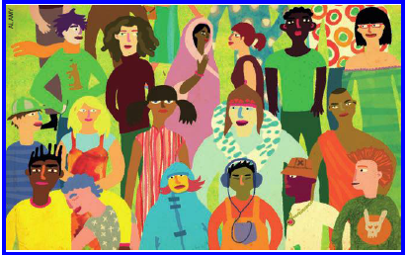
Thank you for listening…

