Slide 1
8th Global Summit and Expo on Healthcare (Healthcare Middle East 2016) Nov 17-19, 2016 Dubai, UAE
Theme: Innovating, Collaborating, Partnering for creating Healthier Communities
PC - Pankaj Gupta
TL – Sreedhar Singamala

Slide 2
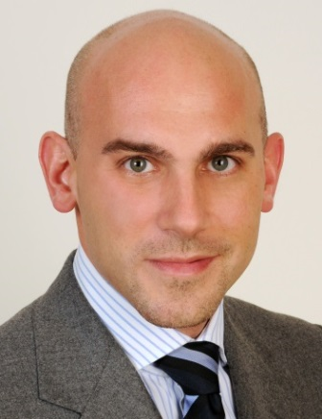
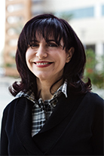
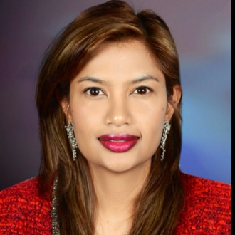
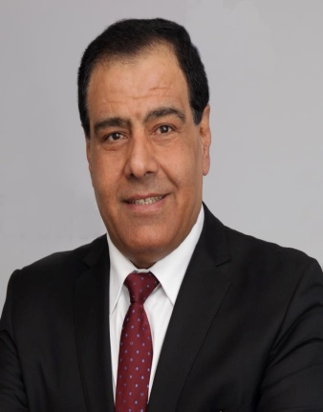
Rajaa Mohammad Al-Raddadi Vice President Saudi Epidemiology Association KSA
Tobias Stock,
Director Supply Chain, Global Medical Solutions (GMS) Abu Dhabi, UAE
Dr. Kinda Khalaf Associate Chair, Dept of BME Khalifa Uni, UAE
Dr. Subashnie Devkaran
Vice President- American College of Healthcare Executives MENA
Dr. Izzeldin Abuelaish
Professor of Public Health University of Toronto, Canada
Organizing Committee

Slide 3
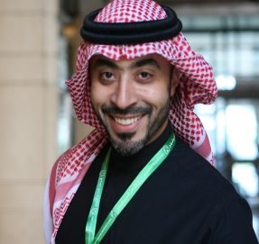
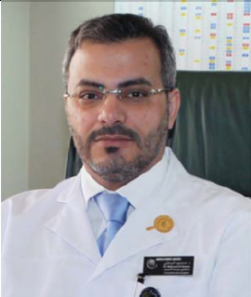
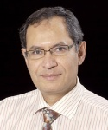
Abdulaziz Abdulbaqi
Director of Quality and patient safety International medical center, KSA
Chenchen Wang Director of the Center for Complementary and Integrative Medicine Tufts University , USA
Al Yamany M CEO, KFMC, KSA
Organizing Committee

Slide 4
Total Abstracts | 05
Total Registrations
Total Revenue
OCM | 8
Positive replies | 17
Awaiting for funds
Conference Updates

Slide 5
Data collection from Science direct
University data collection
Indexing Sites
BMC data collection
Data collection from journals
Journals Task
Sponsors data collection-700
Social Media postings
Task Done

Slide 6
Followup mails for speakers/ workshop confirmation
Exhibitors and sponsorships
Collaborations and Associations
Connecting professionals & students through Social networking sites
Collecting university details for sending invitations
Followup mails for positive replies.
Plan of Action

Slide 7
Month | Dec | Jan | Feb | Mar | Apr | May
Target
Achieved | - | - | - | - | - | -
Total Revenue- $
Monthly conference Revenue status

