Slide 1
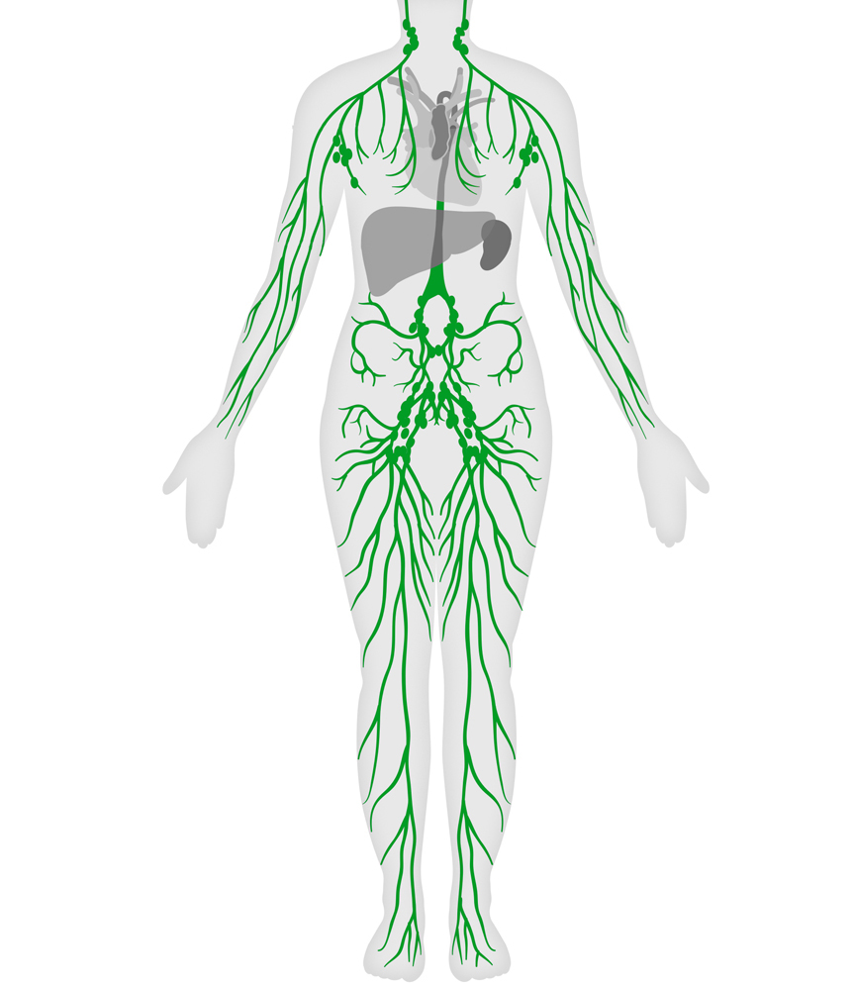
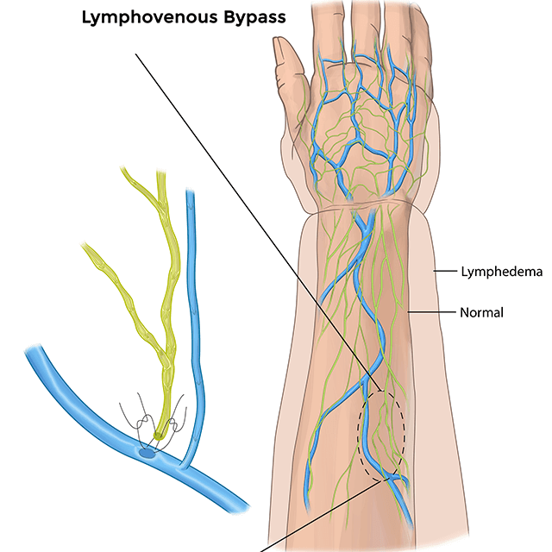
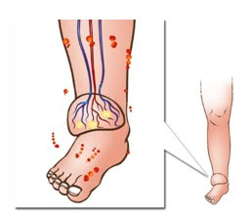
Current Surgical Options for Management of Secondary Lymphoedema
Mohammad Hosain, Consultant Plastic Surgeon, Wye Valley NHS Trust, UK
Introduction
Results
Lymphedema is a chronic debilitating condition that causes significant impact on quality of life with physical, social and psychological morbidity. Unfortunately, till today, there is no definite or curative treatment for this debilitative condition.
In our literature search we found, recent advance in microsurgery giving the promising results with lymphoedema management. Although, till today, most of the lymphoedema cases are treated with conservative management, however surgical options can be an adjunct or for refractory and advanced cases.
Surgical option | Indication | Advantage | Disadvantage
LVA | Stage 1-early stage 2 Pitting oedema with responsive to conservative therapy but symptoms plateaued or worsening | Simple procedure. Can be done as day case. About 61% volume reduction, 91% of symptom relief, 94% satisfaction, 90% improved QoL. Some can discontinue compressive therapy. Reduce rate of cellulitis. Less complication | Not a cure. May need multiple procedure. Less effective stage 3-4 disease (17% volume reduction and 19% recurrence). Needs functioning of partial functioning lymphatics. Minor complication e.g., infection, lymphorrhoea, blockage
VLNT | As above with secondary to surgery/RT to LN basin Can be done in absence of lymphatics | 22-81% volume reduction Can be done to prevent lymphedema. 56% can discontinue compression therapy Stimulate lymphangiogenesis. Reduce rate of cellulitis. Improve QoL, function and satisfaction. | Not a cure. May need multiple procedure (36%). Less effective in stage 3-4. Can cause donor lymphedema as part of complications.
Liposuction | Stage 2-4 with no pitting oedema. Minimal or no improvement with conservative therapy. Severe functional impairment with excess tissue. | Safe and quick. Significant volume reduction. Reduce rate of cellulitis. Improve function, QoL and satisfaction. Minimal scar. | Not a cure. Need for continual compression therapy. Re-accumulation can happen.
Excision | Advanced- stage 3-4. Functional impairment. | Significant volume reduction. Easy to perform Functional improvement | Massive blood loss and fluid shift. Flap loss Skin graft failure Infection, delayed healing. Poor cosmesis
Combination | VLNT Can be done with Liposuction or LVA | Better results. Can discontinue compression therapy. Reduce cellulitis. | Donor site morbidity. Needs expertise Long operating time
Conclusion
Aim
There is no single best answer. Proper evaluation of stages, site, causes of lymphedema as well as patient motivation are paramount. Early stage pitting lymphedema with functioning or partially functioning cases, LVA or VLNT or combination can be effective. In advanced non-pitting, non-functioning cases Liposuction or combination with VLNT can be used. Excision option now a days were less popular surgical option of lymphedema management.
Aim of this study is to see the current surgical management of secondary lymphoedema and explore the trends of management with recent advent of supermicrosurgery.
Methods
A PubMed and Google scholar search were performed from January 2015 to January 2020. The keyword search were (((((lymphedema) AND surgical management) AND outcome) AND lymphovenous anastomosis) AND lymph node transfer) AND volume reduction. 78 papers were found related to search. Among them 28 relevant papers were shortlisted and read through. 18 of these were excluded as 13 were less relevant, three were not written in English and two of these were unable to open.
Remaining 10 publications were included and analyzed.
Correspondence:
Mohammad Hosain,
MBBS, MRCS, MSc, FRCS Plast
Wye Valey NHS Trust, UK.
Email - drmozaffor@gmail.com
Table : Current surgical options of Lymphoedema management

