Slide 1
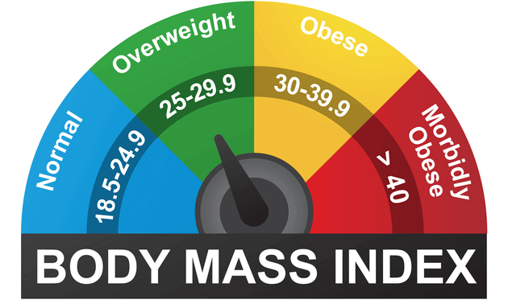
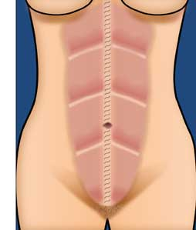
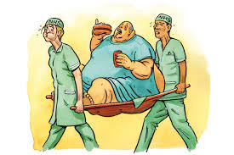

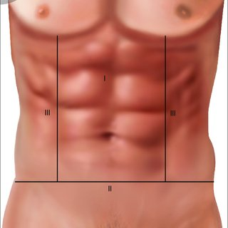

The Impact of High BMI on AWR with panniculectomy
Mohammad Hosain MBBS MRCS MSc FRCS Plast
Consultant Plastic Surgeon,
Wye Valley Plastic Surgery Unit, United Kingdom.
Acknowledgements
Introduction
Results
Obesity and abdominal wall thickness has been associated with a significant increase in major post operative complications. So, patients with high BMI needed proper pre-operative optimisation to reduce the complications.
More than half of the complications were wound related (52%). Second most common were respiratory (24%). [Fig 1]
The mean age of the patients were 52 years (27-85 years) Complications were 5 times more in >40 years age group. [Fig 2]
Two third patients were female with no significant difference in rate of complications.
75% of patients had some co-morbidities with 37% complication rate compared to healthy patients 26%. 14% patients were diabetic with nearly double complication rates.[Fig 3]
  2/3 patients were non-smoker with no significant difference in complication rate (32% vs 42%)
  Mean awaiting time for operation was 42 weeks with no noticeable changes in BMI during these time. Non obese patient shows lowest complication rate. [Fig 4]
  The amount of tissue excision was much higher in class 3 obese patients (1.4 kg- 18 kg). Transverse panniculectomy was common in lower BMI whereas vertical was more common in higher BMI. [Fig 5]. Patients with >40 BMI needed significant ITU support (45%) compared to none for non obese patients. No significant difference noted in total hospital stay.
Aim
At the largest AWR centre in the UK we examine a 5-year experience of impact of BMI on complications and investigate how we can modify surgical approach in obese patients to minimise the morbidities in AWR.
Conclusion
BMI is one of the important factors needed to be taken in to account to perform AWR. Specially if the BMI is >40, special measures should be taken including availability of ITU support.
Methods
Data was collected retrospectively from AWR database for 153 consecutive patients who underwent AWR performed by a single Plastic Surgeon and General Surgeon Consultant pair, between November 2015 to March 2020. Patients were divided into 4 groups on the basis of BMI : <30 (nonobese), 30-34.9 (class I obese), and 35-39.9 (class II obese), and >40 (Class III obese). We compared post-operative outcomes between these 4 groups.
  Fig:1: % of Different complications
Correspondence:
Fig 4: BMI vs Complication rate
Mohammad Hosain,
Plastic Surgery Unit, Wye Valley NHS Trust. United Kingdom.
Email - drmozaffor@gmail.com
Results
Fig2: Complications related to age <40=6%, >40 =30%
Acknowledgement
Mike Scott, Chris West, Emma Snashall
Merseyside Plastic Surgery Unit, UK
Total of 153 patients who have available data was evaluated.
The range of BMI was 16.6 to 55.4 with mean of 30.5 (SD 6) on the day of operation, whereas it was 17-54.4 with mean 30.9 (SD 5.9) on first clinic visit, indicates no significant difference.
Overall complication rate was 35%.
Fig 5: BMI vs Panniculectomy types
Fig 3: DM vs Complications

