Slide 1
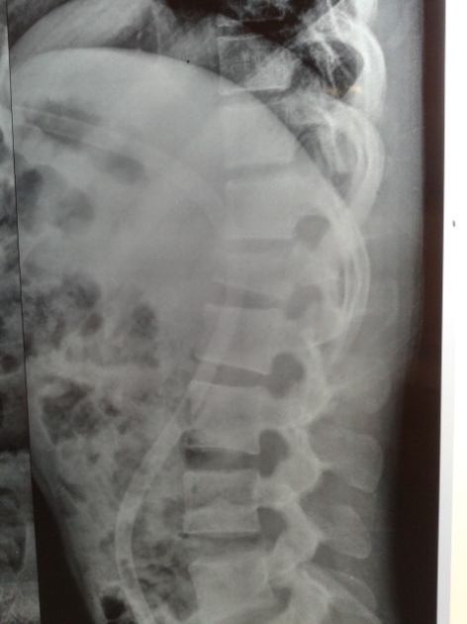
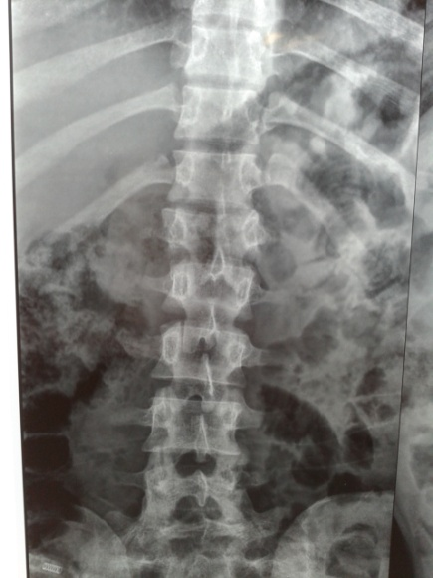
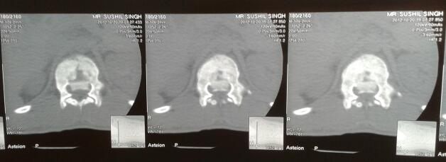
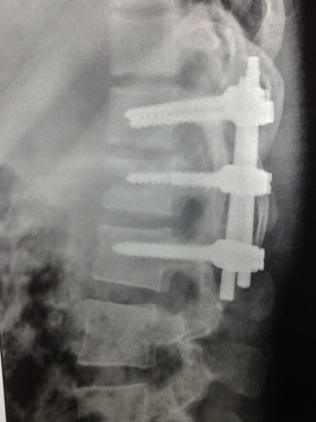
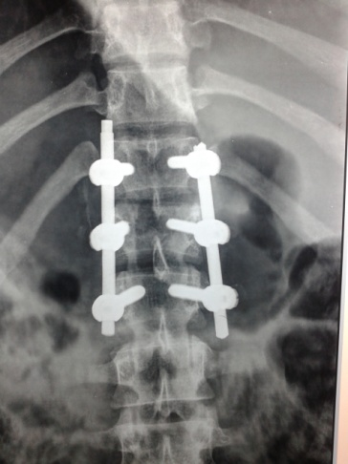
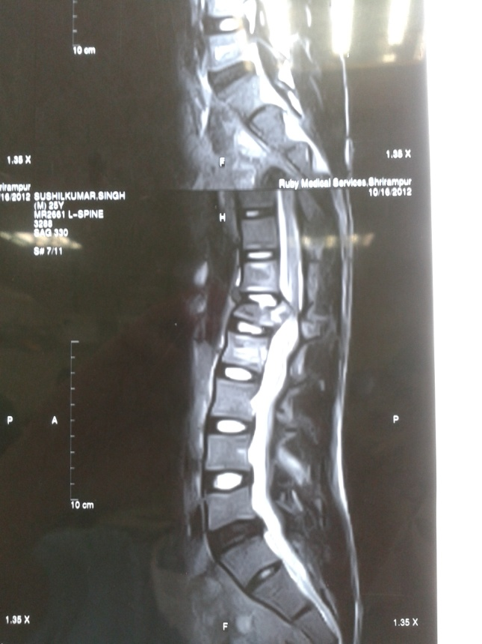
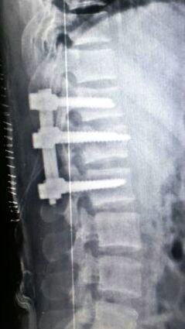
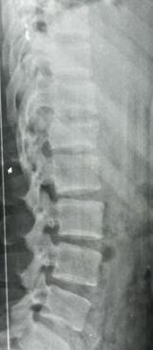
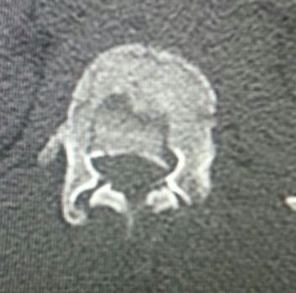
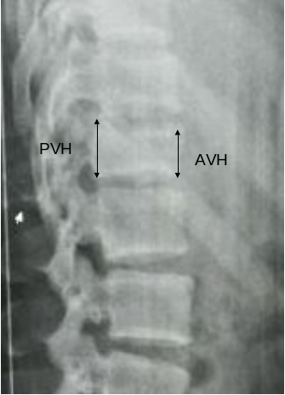

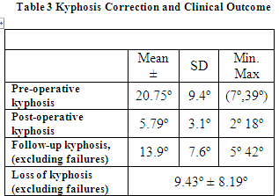

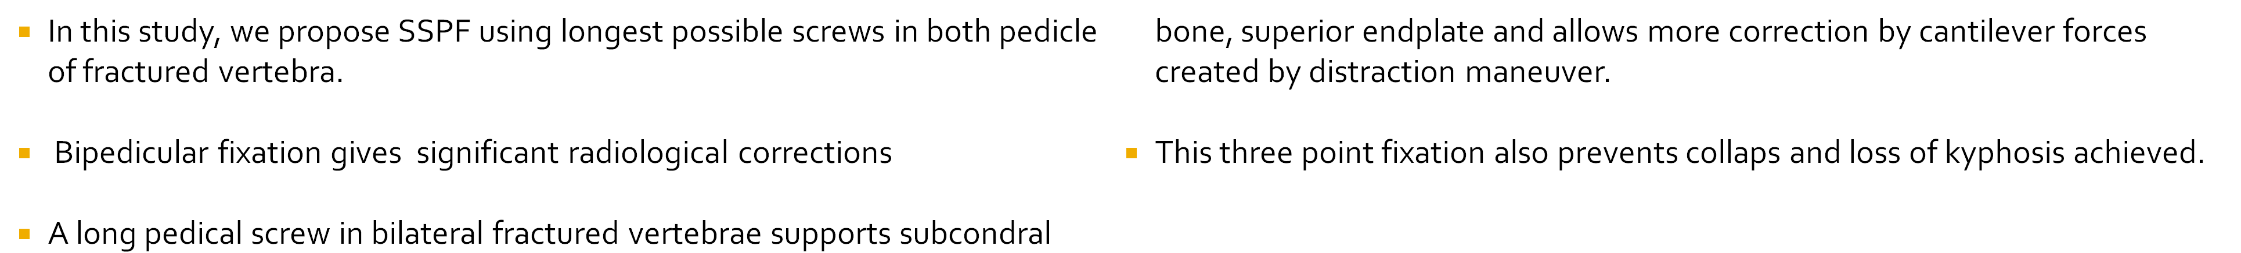
Bipedicular fixation of affected vertebra in thoraolumbar brust fracture
Gaurav maddheshiya
Case 1
NIMS Medical college, Jaipur
INTRODUCTION
Burst fractures accounting for greater than 50% of all thoracolumbar trauma¹.
SSPF (Short Segment Pedicular Screw Fixation ) is Standerd Method
Failure of SSPF can be attributed to inadequate fixation points on the vertebrae and insufficient anterior column support ²
In this study, we propose SSPF using longest possible screws in both pedicle of fractured vertebra.
A long pedical screw in bilateral fractured vertebrae supports subcondral bone, superior endplate and allows more correction by cantilever forces created by distraction maneuver.
This three point fixation which also prevents long term collaps and loss of kyphosis .
MATERIAL & METHODS
1 months post op showing reduction
A retrospective chart, review of cases (October 2014 and December 2018)
N= 25
Inclusion in the study required confirmed thoracolumbar fracture by plain radiographs, computed tomography, and magnetic resonance imaging.
Surgical indications
1.50% loss of vertebral body height
2.kyphosis progressing 20% or more
3.50% of canal involvement
4.Posterior ligametous complex injury.
Case 2
Frankel Scale^{.5} Preoperatively & Postoperatively
Fracture classification by Magerl et al.
Plain radiographs 1.Anterior vertebral height (AVH)
2.Posterior vertebral height (PVH)
3.Kyphotic angulations using the
traditional Cobb method.⁶
Fracture score : Gaines load-sharing classification.⁷
Clinical outcome :Oswestry Disability Index.⁸⁻⁹
Patients were evaluated at 1,3,6, and 12 month intervals following surgery.
18 months implant removal
A mean of 15.2° of kyphosis correction was attained from pre-operation to post-operation (P < 0.0001). Although there was a 15° average improvement of kyphosis post-fixation, loss of correction over time was nearly 8°, resulting in a 7° mean correction of kyphosis (Table 3).
SURGICAL PROCEDURE
The senior author performed all surgeries in this study.
Pedicle screws were placed at one level above and below the fracture site .
Fracture level screws were inserted at the same time with the other screws prior to compression/distraction, and were included into the lordosing distracting maneuver.
Both the fractured pedicels were inserted and care is taken to insert longest possible screws so that they can support subcondral bone and superior end plate of fractured vertebrae.
Kyphosis correction achieved by cantilever forces created by distraction and compression maneuver.
Visualization Laminotomy performed for confirmation of indirect decompression achieved by distraction maneuver when indicated by the presence of compression over neural tissue in MRI.
No Fusion was performed in all
Radiographs | Mean | ± SD | Min. | Max.
Anterior vertebral height (AVH) loss (%)
At injury Post-surgery Review | 38.00 6.12 12.4 | 14.2 3.1 18.7 | 8 0 0 | 72 18 22
Loss of mid-sagittal diameter
At injury Post-surgery | 32.8 12.6 | 12.10 4.1 | 8 0 | 47 14
A mean loss of AVH on post operative radiograph was 6.12% & maintained 12.4% at the time of review (P < 0.0001). Similarly there was 32.8 % midsggital hight loss at time of injury , which was improved to 0nly 12.6 % as compare to intitial hight loss (P < 0.0001).

