Slide 1

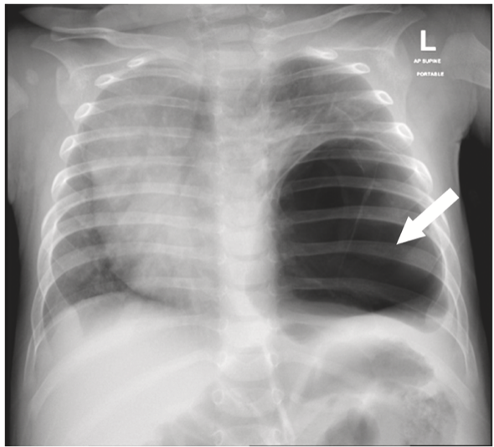
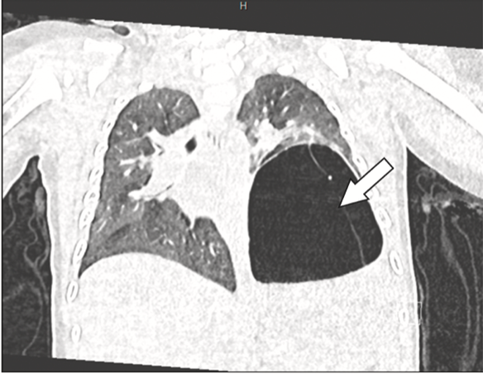
Thoracoscopic resection of a type I pleuropulmonary blastoma:
A case report
Maithah Alkaabi, Najla Saleh Ben Ghashir, Tamer Hamed Ibrahim, Deepak Kishore Kaltari,
Iftikhar Jan Suleman *
Introduction
As PPB is uncommon, it may not be suspected when a child presents with the first episode of pneumonia-like symptoms. However, repeated episodes should trigger a deeper investigation.
There are no pathognomonic radiologic signs of PPB. Type I PPB appears as a single, large, cystic mass, without calcifications or rib erosions or calcifications [6]. It can also present as pneumothorax or hydropneumothorax [7]. CT of the thorax is the preferred imaging modality to further evaluate most lung anomalies. Type I PPB usually appears as a single cyst or multiple air-filled cystic lesions, while type II presents with air or fluid-filled cysts intermixed with solid areas. Type III demonstrates low attenuation with ho- mogenous or heterogenous enhancement [6]. The definitive diagnosis of PPB can only be done by pathology analysis, and a high index of suspicion for PPB must be considered in any child presenting with a cystic lung lesion [7,8]. The management of PPB depends on the type and stage of the lesion. For type I PPB, a complete resection is usually curative. If residual tumor is confirmed, adjuvant chemotherapy is required. For type II PPB that are less than 10 cm in diameter, complete resection of the tumor plus chemotherapy is required. In case of type-II PPB larger than 10 cm in diameter and type III PPB, tissue biopsy followed by neoadjuvant chemotherapy is the preferred approach [8]. Radiation therapy may also be necessary if the tumor cannot be removed surgically or if it is resistant to chemotherapy [2]. High dose consolidation therapy with autologous stem cell rescue is recommended for recurrent PPB [7]. Historically, a thoracotomy was always done for the surgical resection of cystic lung lesions. Recent advances in minimally invasive surgery have allowed a gradual transition to thoracoscopy for the resection of lung lesions [10]. Because PPB is a malignant tumor, complete resection is essential, and successful thoracoscopic resections of PPB have been reported [10].
Pleuropulmonary blastoma (PPB) is a rare malignant tumor that can arise from the lung tissue, pleura, diaphragm, and mediastinal structures. It is divided into three types based on its characteristics: type I (completely cystic), type II (cystic and solid), and type III (solid tumors) [1]. It mostly occurs in children and tends to exhibit non-specific symptoms. Imaging studies can orient the diagnosis, but the definitive diagnosis is based on microscopic examination. Prognosis and treatment of PPB varies based on the type and stage of the tumor [2]. We present a case of a type I PPB that manifested as respiratory distress and was completely resected thoracoscopically.
Case report
A full term 5-months-old previously healthy infant was brought to the emergency department with cough, fever, and intermittent episodes of shortness of breath. On physical exam, he showed nasal flaring and reduced breath sounds on the lower left hemithorax. Chest radiography showed a large air-filled cystic lesion on the left lower hemithorax causing mass effect and severe mediastinal shift, with severe compression of the right lung (Fig. 1). A computerized tomography with intravenous contrast (CT) of the chest revealed a large air-filled cyst with thin internal septations in the left middle and lower hemithorax. The differential diagnosis included a congenital cystic pulmonary malformation (CPAM), a cystic bronchopulmonary sequestration, a type I PPB, or a bronchogenic cyst (Fig. 2). No abnormal systemic blood vessels were identified in the cystic lung lesion. A respiratory viral panel returned positive for parainfluenza type 3, and the respiratory culture grew Streptococcus pneumoniae and Moraxella catarrhalis. Once the patient was deemed safe for an operation, he was taken to the operating room for a thoracoscopy. We placed a bronchial blocker on left main stem bronchus and intubated the right main stem bronchus. A large cystic mass was attached to the left lower lung lobe. Upon opening the wall of the mass, it was apparent that there were tortuous blood vessels within the wall. A complete resection of the cystic mass was accomplished with a combination of cautery and endo-staplers. A small wedge of the lower lobe was also resected. No grossly residual lesion was seen after the resection. A chest tube was left in place. The patient recovered uneventfully. The pathology analysis confirmed a type I PPB with clear margins.
Conclusion
Cystic lung lesions in the pediatric population are primarily benign. However, rare malignant conditions like PPB should be included in the differential diagnosis. Thoracoscopic resection of type I PPB is possible.
Discussion
Primary tumors of the lungs are uncommon in children. In neonates and infants the most prevalent are pleuropulmonary blastoma, infantile fibrosarcoma, and fetal lung interstitial tumor. In older children, the most prevalent ones are inflammatory myofibroblastic tumor (IMT), carcinoid, and PPB [3]. PPB is a rare and sometimes aggressive intrathoracic neoplasm that occurs mainly in children under four years of age. It is classified into three subtypes based on its morphology: type I (cystic), type II (mixed solid and cystic), and type III (solid) [1]. A clinicopathologic study of 50 cases of PPB conducted at St. Paul Children's Hospital showed that type I is the least common, representing only 14% of all PPB, and tends to affect very young children. The average age at presentation for types I, II, and III was 10, 34, and 44 months respectively [3]. A study involving 45 children diagnosed with PPB found that 25% of them had either other malignancies, or a sibling with a history of PPB. The associated malignancies were medulloblastomas, thyroid dysplasia and thyroid cancer, germline malignancies, and leukemia, among others [4]. In another study, 11 families with multiple cases of PPB were found to have a heterozygous germline mutations in the DICER1 gene. The loss of this gene in the embryonic lung epithelium was observed to affect the regulation of factors that stimulate mesenchymal proliferation [5]. In our patient DIECER1 gene study was negative.
The clinical presentation of PPB varies depending on the child's age and the type of PPB. Two common presentations are respiratory distress and recurrent pneumonia. Respiratory distress can range from mild to severe and is the result of the mass effect caused by the lesion. Pneumothorax may also occur if a cyst opens into the pleural space. Type II and Type III PPB may present with signs and symptoms of pneumonia, including fever, cough, fatigue, and loss of appetite.
Fig. 1. Chest radiography showing a large macrocystic structure in the left lower hemithorax causing severe mediastina shift and compression of the right lung.
Fig. 2. CT scan of the chest: large cyst with thin internal septations in the left middle and lower hemithorax. Severe right-sided mediastinal shift.
References
[1] Mlika M, Anjum F, Mezni F.E. Pleuropulmonary blastoma - StatPearls - NCBI bookshelf. Pleuropulmonary blastoma - StatPearls - NCBI bookshelf. 2023, January 23. https://www.ncbi.nlm.nih.gov/books/NBK534211/.
[2] Pleuropulmonary blastoma - symptoms, causes, treatment | NORD. (n.d.). National organization for rare disorders https://rarediseases.org/rare-diseases/ pleuropulmonary-blastoma/.
[3] Priest J.R, McDermott M.B, Bhatia S, Watterson J, Manivel J.C, Dehner L.P. Pleuropulmonary blastoma: a clinicopathologic study of 50 cases. Cancer 1997;80 (1):147–61.
[4] Priest J.R, Watterson J, Strong L, Huff V, et al. Pleuropulmonary blastoma: a marker for familial disease. J Pediatr 1996 Feb;128(2):220–4.
[5] Hill D.A, Ivanovich J, Priest J.R, Gurnett, et al. DICER1 mutations in familial pleuropulmonary blastoma. Science 2009 Aug 21;325(5943):965.
[6] Shyamkumar N, Athyal R, Govindarajulu G, Narayan V, Rangad F, Govil S, et al. Pneumothorax preceding pulmonary blastoma in a child. Australas Radiol 2001, August 15;45(3):387–9.
[7] Oliveira C, Himidan S, Pastor A.C, Nasr A, Manson D, et al. Discriminating preoperative features of pleuropulmonary blastomas (PPB) from congenital cystic adenomatoid malformations (CCAM): a retrospective, age-matched study. EU J Pediatr Surg 2011 Jan;21(1):2–7.
[8] Pierce J.M, LaCroix P, Heym K, Bowman W.P, Margraf L, Iglesias J, et al. Pleuropulmonary blastoma: a single-center case series of 6 patients. J Pediatr Hematol Oncol 2017 Nov;39(8):e419–22.
[9] Alba Ganarin, Alberto Sgrò, Garcia Magne Miguel, Volpe Andrea, et al. Thoracoscopy versus thoracotomy for congenital lung malformations treatment: a single center experience. Pediatr Pulmonol 2021 Jan;56(1):196–202.
[10] Garcia A, Borczuk A.C, Rothenberg S.S, Aspelund G. Thoracoscopic lobectomy for type I pleuropulmonary blastoma in an infant. Fingeret A. Pediatr Surg Int
2014 Feb;30(2):239–42.
[11] Knight S, Knight T, Khan A, Murphy A.J. Current management of pleuropulmonary blastoma: a surgical perspective. Children 2019 Jul 25;6(8):86.

