Slide 1
Introduction to Oilfield Chemicals
Oil Field Chemical
Chemical Production Chemistry
Prepared by : Ahmed AL Dhuhoori
Zirku Corrosion Engineer
ADNOC OFFSHORE

Slide 2
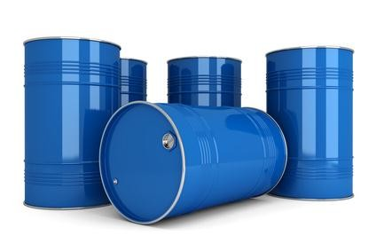
The Need Of Chemical ?
 General problems with the oil production
Problems caused by fouling, souring
Problems caused by physical properties – foaming, emulsion, viscous flow
Problems caused by incompatibility of mixing fluids
Problems that affect the structural integrity of the facilities
and safety of workforce?
Environmental issues

Slide 3
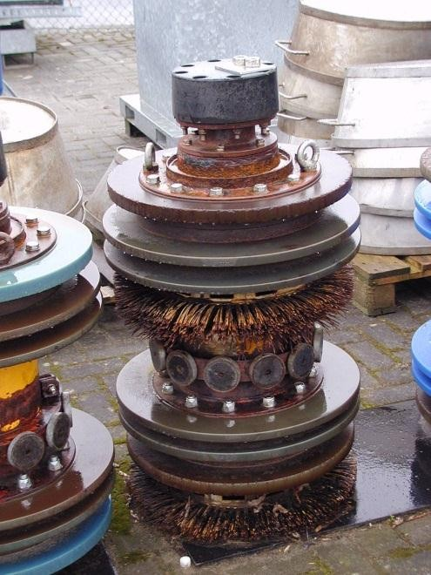
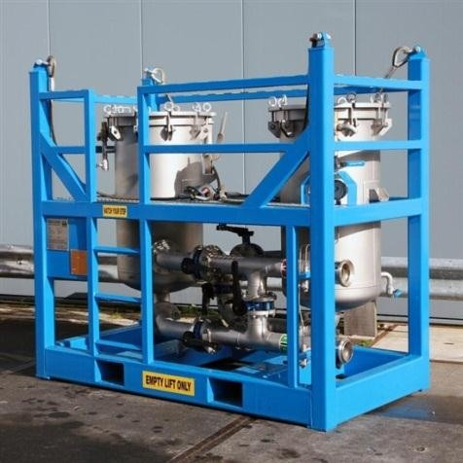
How To Solve Chemical Problem
 Non-chemicals solutions
Choice of materials
Process parameters, mixing ratios
Pigging of flow lines
Mechanical solutions for removal of gases
Filtration

Slide 4
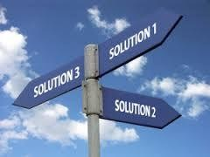
How To Solve Chemical Problem
 Chemical solutions
Scale and Corrosion Inhibitors
Scavengers to remove dissolved gases
Biocides
Demulsifier
Coagulants
Antifoam

Slide 5
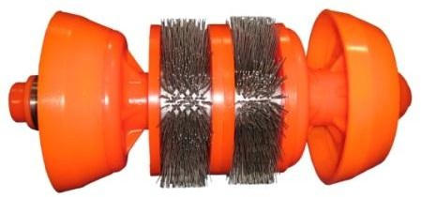
Chemical Injection Solution
 Only trace amount of residual chemical will remain in the solution
 These chemicals can be injected as batch or continuous
continuous
Biocide Injection
Slug dose

Slide 6
Production Chemical Typical Package uses in Oil Field
Chemical Type | Minimum Rate (ppm) | Maximum Rate (ppm)
Chlorination | 1 | 3
Coagulant | 4 | 16
Anionic polyelectrolyte | 1 | 2
Cationic polyelectrolyte | 1 | 2
Oxygen Scavenger | 2 | 10
Anti foam | 0.5 | 2
Biocide – A and B | 200 | 1500
Scale Inhibitor | 5 | 15
Corrosion Inhibitor | 25 | 30

Slide 7
Production Water Impurity and How to Track
Constituent | Difficulties caused | Means of treatment
Turbidity | Increase in suspended solids Deposits in water lines and process equipment | Coagulation and settling and filtration
Hardness | Chief source of scale in heat exchange equipment | Softening, distillation, chemical treatment, surface active agents
Alkalinity | Foaming, increase in pH, scaling tendency of water | Softening, acid treatment
Iron | Source of deposit in water lines | Coagulation, filtration
Oxygen | Corrosion | De-aeration, oxygen scavenger
Hydrogen sulfide | Souring, safety | Aeration, chlorination
Conductivity | Increased in dissolved solids, corrosivity | Any process which will reduce dissolved solids, demineralization

Slide 8
Production Chemical Typical Package uses in Oil Field
Constituent | Difficulties caused | Means of treatment
Suspended solids | Plugging of injection wells, cause deposits in flow lines | Filtration, coagulation
Carbon dioxide | Increase in the corrosivity of water, carbonate scale | Aeration, separator

Slide 9
Introduction to Oilfield Chemicals
Sea Water Injection in Abu Dhabi X Fields

Slide 10
Stages in Oil Production
 Primary production:
Reservoir energy is used to produce the oil and gas.
The average recovery of OOIP is 12 to 15%
 Secondary Production:
Pressure is maintained to the reservoir by water or gas injection.
This stage recovers an additional 15 to 20% OOIP.
 Tertiary Production:
This stage recovers an additional 10 to 15% OOIP.

Slide 11
Purpose of Water Injection
 To boost up the pressure of X North , Y South , Z Central And W Oil Fields , and Two More Miduiam Fields A and B Fields.
 To increase the crude production
 To enhance the ultimate recovery from the depleted reservoirs of B Oil Field

Slide 12
Seawater Analysis→ Please Elaborate for X Field
Parameters | Unit | Results
Sodium | mg/l | 14566
Calcium | mg/l | 123
Magnesium | mg/l | 1870
Potassium | mg/l | 553
Strontium | mg/l | 8
Barium | mg/l | 0.5
Sulfate | mg/l | 4100
Carbonate | mg/l | 0.1
Bicarbonate | mg/l | 138
Chloride | mg/l | 27114
pH |  | 7.6
Dissolved oxygen | ppm | 7
Total suspended solids | mg/l | 50 to 200

Slide 13
Purpose of Seawater Treatment
 Avoid plugging of sub-surface formation
 Keep the injection well tubing and surface equipment
clean of Fouling with Suspended Solids and Bacterial Growth (MIC)
 Prevent corrosion of piping and process equipment by Additive of Corrosion Inhibitor and Biocides to Kill Bacteria

Slide 14
Treated Water Specification
 TSS - 0.2 mg/l
 98% removal of particles greater than 2 microns
 Dissolved oxygen – 10 ppb OR less
 Oil in water - < 0.1 ppm
 SRB population - < 100 on serial dilution
Treated Water Goes to Various Processes
De Aerated Coolum + Fin Filter Vessels

Slide 15
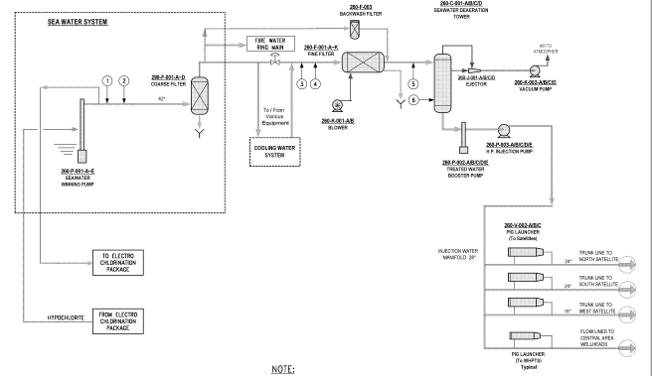
WATER Injection Typical Chemical Injection
Coagulant
Filtration Aid
Anti Foam
Biocide Injection
Scale Inhibitor
Oxygen Scavenger
 | Scale Inhibitor | Coagulant | Filtration Aid | Oxygen Scavenger | Anti Foam | Catalyst | Organic Biocide A | Organic Biocide B
Fluid | Neutralized Phospoate | Cationic Polyamine Coupond | Fermic Chloride | Ammonium Bisulfate | Cobalt Chloride | Cobalt Chloride | Gluteraldehyde in Oxyganated alcohol | Formaldehyde qualerray ammonium Phosphonus compound
Product | ADACP SI-4077 | ADCAP SI-1068 | FeO3 40% | Ammunium Biosulfate ADCAP-CR-11 | NALCO EC 29029 A | CoCl2 | EMO-314A | EMO-320A
pH Consecration | 6 to 9 | 3 to 6 | 0.7 | 3 to 6 | 10 to 11 | As Per Dilution % | 4.03 | 5.13
Specific Gravity | 1.0 to 1.1 | 1.1 to 1.2 | 1.44 | 1.3 to 1.4 | 1.07 | - | 1.068 | 1.04
Viscosity Mpa.s/20C | <20 | 1.000 |  | 4.5 | - | - | 2.77 | 1.76
solubility | Water Soluble | Water Soluble | Water Soluble | Water Soluble | Water Soluble | Water Soluble | Water Soluble | Water Soluble
Appearance | Clear pale brown liquid | Clear Amber | Clear Yellow Liquid | Clear yellow Liquid | Colorless | Dark Maroon | Colorless | Colorless
Dilution Recommended | No | 10% | 25% | Carrying Water | Carrying Water | 20% in Carring Water | No | No

Slide 16
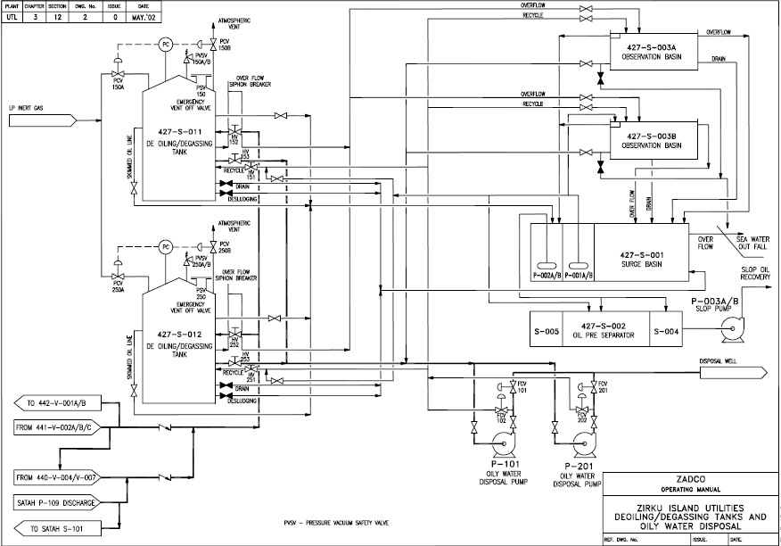
Disposal Injection to the Deep Well

Slide 17

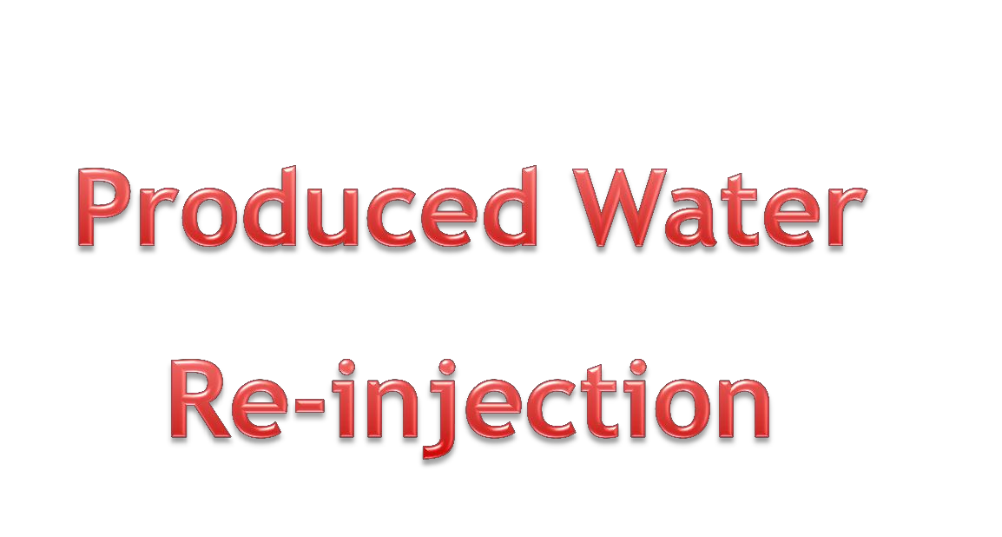

Slide 18
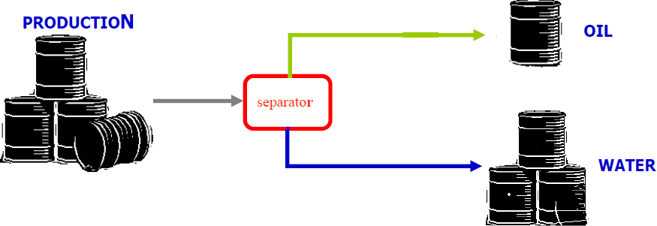
Produced Water for Re-injection
 World-wide 75% of production is water.
 On average, asume X Field is 10% water, and thus X Field produces close to 150 Thousand bbl/day Water 600 Thousand bbl/day of oil.

Slide 19
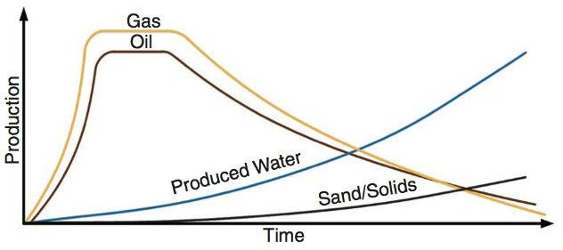
Produced Water for Re-injection
 As oil-field matures, production of water increases.
 Composition of produced water varies from field.
An Example of Water Cut Value to simulate the water cut trend for the Oil Fields

Slide 20
Produced Water disposal
There are different ways of disposing produced water.
 Seepage pits
 Evaporation pits / lined pits
 Injection for disposal
 Irrigation
 Industrial use
 Produced water Re-injection for pressure support

Slide 21
Produced Water disposal
The main contaminants of produced water are...
 High TDS
 Oil and grease
 Suspended solids
 Dispersed oil
 Organic compounds
 Heavy metals
 Dissolved gases
 Bacteria

Slide 22
Why Produced Water is Complex?
 It is produced from various production zones
 It is produced at different temp, pressures, mixing
ratios
 It contains scale forming ions
 It is hot and corrosive
 Contains NORMS
 Quality of effluent water depends on the plant
condition

Slide 23
Why Produced Water is Complex?
 It contains dissolved gases (H₂S and CO₂)
 Salinity is extremely high
 It has abundance of major and minor inorganic hydrocarbons
 Contains residual chemicals
 Contains biological species
 Suspended solids are higher than the seawater

Slide 24
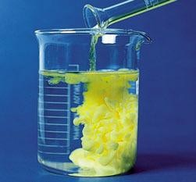
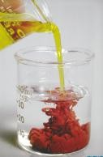
Compatibility issues
Water incompatibility issue is more likely due to ---
 Release of acid gases such as a CO₂ and H₂S
 Change in pH
 Change in temp and pressure conditions
 Mixing with other process fluids

Slide 25
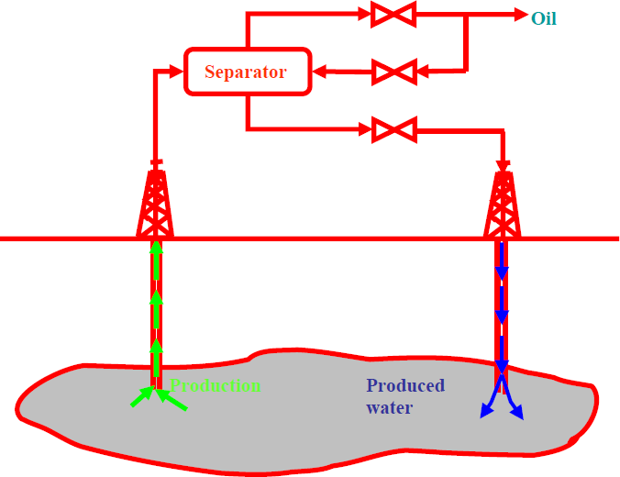
Produced Water disposal
The benefits of produced water re-injection are...
 Disposal of produced water
 Pressure maintenance
 Environmental friendly
 Economic advantage
 Meets new regulations

Slide 26
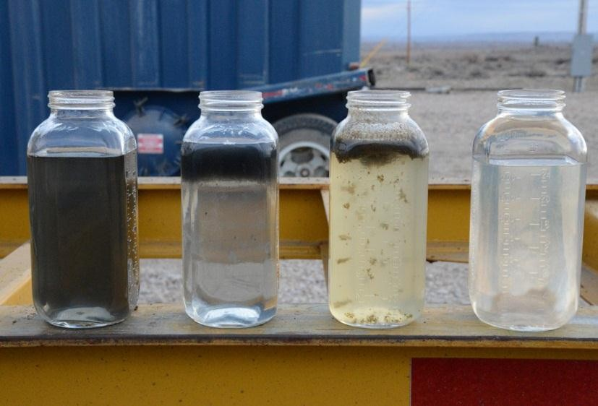
Produced Water treatment
The main steps for produced water treatment are...
 Removal of oil and grease
 Clarification
 Removal of suspended solids
 Removal of dissolved gases
 Chemical treatment

Slide 27
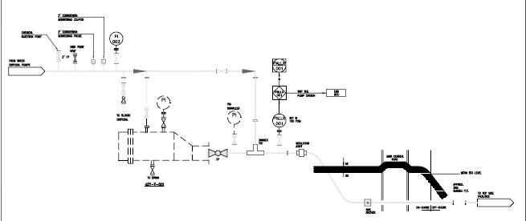
Disposal Well Typical Example

Slide 28
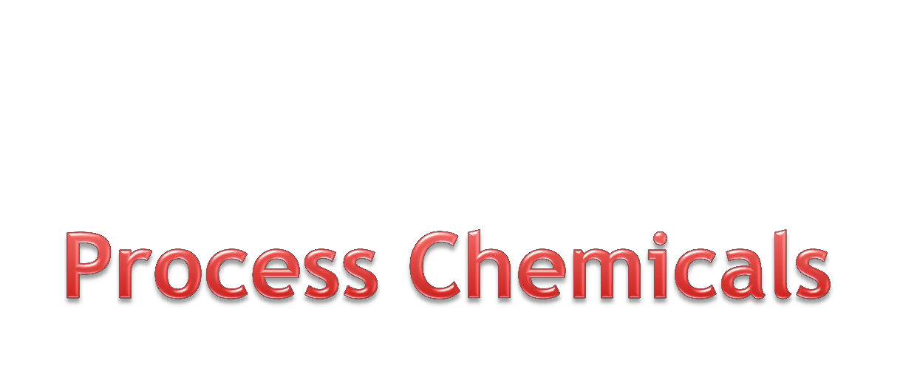
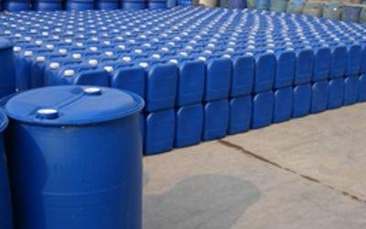
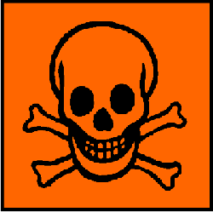

Slide 29
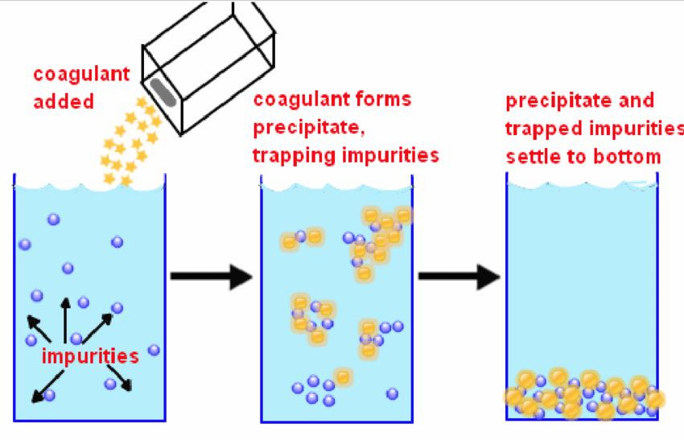
Process Terminologies
 Coagulation
In this process, finely divided particles of turbidity capable of remaining in suspension are combined by chemical means into masses sufficiently large to effect rapid settling.
Filtration without coagulation will not remove the fine particles.
Fe₂(SO4)₃ + Ca(OH)₂ 2 Fe(OH)₂ + 3 CaSO₄
Ferric sulfate

Slide 30
Process Terminologies
 Flocculation
In this process, coagulated particles are brought together to form larger and more readily settable masses, through simple agitation. Flocculation is promoted by slow mixing, which brings the flocs gently together; too high a mixing velocity tears them apart, and they seldom re-form to their optimum size and strength.
Flocculation not increases the size of floc particles, but it also
affects the physical nature of the floc.

Slide 31
Process Terminologies
 Classification of particles
> 100 micron – visible particles, settle able
10 to 100 micron – turbidity
< 10 micron – colloidal
0.1 to 10 micron – visible by light microscope
< 0.1 micron – electron microscope is required for detection

Slide 32
Process Terminologies
 Poly electrolytes
The term refers to all organic polymers which are used for clarification whether they function as primary coagulant or flocculent.
Types
Anionic : ionize the water solution to form negative sites
Cationic : ionize the water solution to form positive sites

Slide 33
Chemicals in Oil Industry
 Scale Inhibitors
The well flow contains several different contaminants, such as salts, chalk and traces of radioactive materials. As pressure and temperature change, these may precipitate and deposit in pipes, heat exchangers, valves and tanks. As a result, they may clog up or become stuck.
The scale inhibitor prevents the contaminants from separating out. Scale or sediment inhibitor is applied to wellheads and production equipment. It is used to prevent the deposition of mineral scale that may occur in the pores of rock formations, in downhole pipe work, surface treating facilities, and refineries.

Slide 34
Chemicals in Oil Industry
 Corrosion Inhibitors
Aqueous acids are used to stimulate production from reservoirs. Such acids expose oil production systems to the possibility of corrosion. Thus corrosion inhibitors are required to protect the downhole pipework and vessels of oil production facilities
Corrosion inhibitor is also injected in export pipelines and storage tanks. Exported oil can be highly corrosive, leading to corrosion of the inside of the pipeline or tank. The corrosion inhibitor protects by forming a thin film on metal surfaces.

Slide 35
Chemicals in Oil Industry
 Biocides
Biocides are also preventive chemicals that are added to prevent microbiological activity in oil production systems, such as bacteria, fungus or algae growth.
Particular problems arise from the growth of sulfate reducing bacteria that produces hydrogen sulfide and clogs filters.
They are water-soluble and are removed with the water from crude.
Typical uses include diesel tanks, produced water (after hydrocyclones), and slop and ballast tanks

Slide 36
Chemicals in Oil Industry
 Oxygen Scavengers
Often used to mitigate corrosion problems in water injection systems, in hydrotesting and drilling

Slide 37
Chemicals in Oil Industry
 Emulsion Breakers
Production of oil usually involves the coproduction of large quantities of water. Water and oil cannot mix to form a true solution. Natural surfactants present in the oil or water, other chemicals such as corrosion inhibitors combined with the shearing effect from turbulent flow and pumps may create emulsions.
Furthermore, small drops of oil can disperse in water and small water drops can disperse in oil. Such systems are called emulsions; oil-in-water (o/w) and water-in-oil (w/o), respectively. The drops are held suspended by electrostatic repulsion, and will form a distinct layer between the oil and water. Sand and particles are normally carried out by the water extracted in water treatment.
However, the emulsion can trap these particles and sink to the
bottom as a sticky sludge that is difficult to remove during operation. Although the emulsion layer will eventually break down naturally, it takes time, too much time. An emulsion breaker, or demulsifier, is added to prevent formation and promote breakdown of the emulsion layer by causing the droplets to merge and grow.

Slide 38
Chemicals in Oil Industry
 Antifoam Agents
Foaming problems occur in many oilfield and refinery processes.
The sloshing motion inside a separator causes foaming. This foam covers the fluid surface and prevents gas from escaping. Foam also reduces the gas space inside the separator, and can pass the demister and escape to the gas outlet in the form of mist and liquid drops. An antifoam agent is introduced upstream of the separator to prevent or break down foam formation by reducing liquid surface tension

Slide 39
Chemicals in Oil Industry
 Hydrogen Sulfide Scavengers
Hydrogen sulfide in produced oil and gas poses safety and corrosion concerns. Scavengers bind the H2S in a form that is stable in the liquid phase. They can be added at oil production facilities or in transit in a pipeline or tanker
 Mercaptan Scavengers
Low molecular weight (C1-C3) mercaptans have offensive odors and are toxic. It is necessary to remove and neutralize them. Mercaptan scavengers either oxidize the offending species or convert them to less volatile molecules

Slide 40
Cost of Chemicals
 The cost of process chemical additives is considerable.
 A typical example is antifoam, where a concentration of about 150 ppm is used. With a production of 40,000 bpd, about 2,000 liters (500 gallons) of antifoam can be used. At a cost of USD 2.5 per 100 liter, (~$10 per gallon) in bulk, antifoam alone will cost some $5,000 per day.

