Slide 1
DEAD LEG MANAGEMENT PROJECT
ZIRKU PROCESS PLANT
Prepared by : Ahmed AL Dhuhoori
Zirku Corrosion Engineer
ADNOC OFFSHORE

Slide 2
Background
Majority of plant consequence events piping leaks have been due to corrosion associated with dead legs.
This Includes control valve bypasses , heat exchanger bypasses and other infrequently uses bypass lines/ Intermittently operated piping and vent/drains which does not have flushing arrangement
Earlier failure statistics with in ZADCO facilities indicate that majority of leaks in plants are occurring at interconnecting piping systems out of which 70-80% due to dead leg and small bore piping . this situation systems to address these concerns and mitigate the associates risks as part of the drive to ensure that all production facilities are available to support long return business requirements.
The objective of the study is reviewing the practices at zirku Dead Legs Management and to discuss gaps / Scope for improvement and way forward.

Slide 3
DEADLEG DEFENITION
Dead Leg is a section of Pipework which contains corrosive hydrocarbon and / water under stagnant condition (either permanently or intermittently) where there is no measureable flow.
In Zirku Facilities Corrosion related leaks were recorded and analysed for mitigation . Dead leg Identification was carried out in plan twice and list prepared for periodical flushing and inspection / elimination of dead leg piping.

Slide 4
Practise of Dead Leg Management System
1- Inspection is being carried as part of DLMS
Dead Leg have been identifies as integrity thread Location along with the related pressure piping system
Stagnant Flow location like Future Extension , Drain valve / Sample Points High Point Vents , Level bridles / Instrument connections , Valve bypass . Upstream nozzle of PSV, Spare Pump Piping, in which specific ITL’s (integrity Threat Locations) was marked for UT/RT. Inspection.
The Dead Legs are identified and tabulated by ZRPRD/ZRFIP Team and subjected to periodical Flushing Program as a corrosion Mitigation Prevented measure by ZRPRD
2- Elimination/ Removal of Dead Leg
Modification of Pipe Work : Relocated isolation valves as close as possible to the active steam .
Upgrade of dead leg piping Material of Construction (MOC) and increasing the Thickness/Piping schedule.
Dead Legs Inspection and mitigation issues are covered in Various document and procedures , There is no specific COP (Code of Practise) is Available to manage the dead leg so related documents are used:
  Inspection Management System Manual
  Topside Piping Systems
  Mothballing procedures
  Ultrasonic Thickness gauging

Slide 5
Code Of Practice CP-059
  Code Practise CP-059 Dead Leg management System covers comprehensively all the issues related to dead legs, Few salient points are mentioned bellow
Criteria & methodology to identify dead legs.
Equations to calculate the probability and consequence of failure and rank the risks
Adequate Coverage of Inspection and Mitigation options
Detailed Guidelines with examples.
Inspection intervals are based Consequence Category and Grade
Roles and Responsibilities

Slide 6
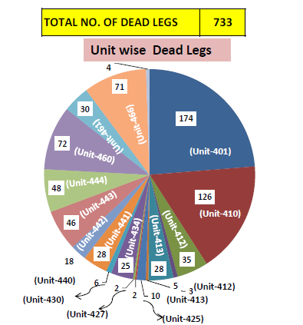
DEAD LEG IDENTIFICATION SUMERY

Slide 7
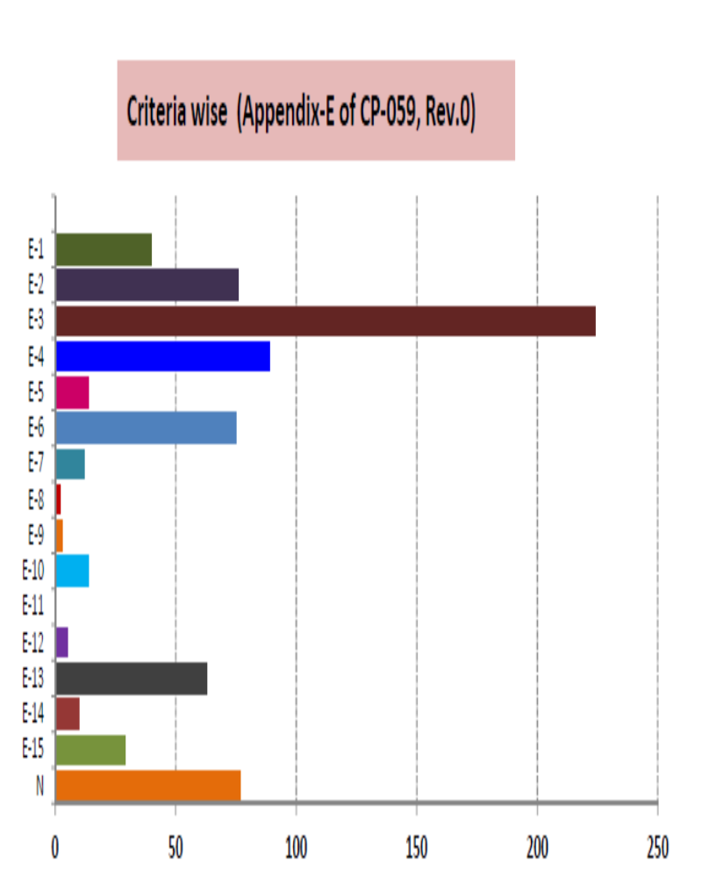
DEAD LEG CRITERIA DISTRBUTION
Selection Criteria According to Code of Practice CP-059
Criteria | Description
E-1 | Equipment Maintenance Drain Line
E-2 | Control Valve By-Pass Line
E-3 | Drain Lines Connected to Process Piping
E-4 | Bleed Connection Of DBB (Double Block & Bleed Arrangement)
E-5 | Inlet Line of PSV (Connected in Gas Phase) on Equipment
E-6 | PSV outlet line connected to Flare
E-7 | PSV outlet line connected to Flare
E-8 | PSV outlet line routed to Atmosphere
E-9 | BDV (Blow Down System) Inlet/outlet line
E-10 | Equipment De pressuring line/De-pressuring line for piping Block in Section
E-11 | Future Tie-in connection on Water Injection Header on all WHT
E-12 | Drain and Vent lines on Pig Launcher/Receiver
E-13 | Piping and Standby Pump/Compressor/Rotation Mercenary
E-14 | Piping to Standby Filter Drier/Heat Exchangers/ Static Equipment
E-15 | Equipment By Pass
N | Non Operational Dead Leg

Slide 8
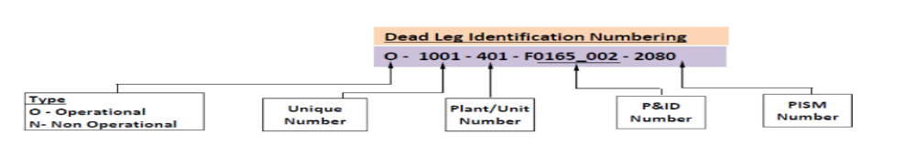
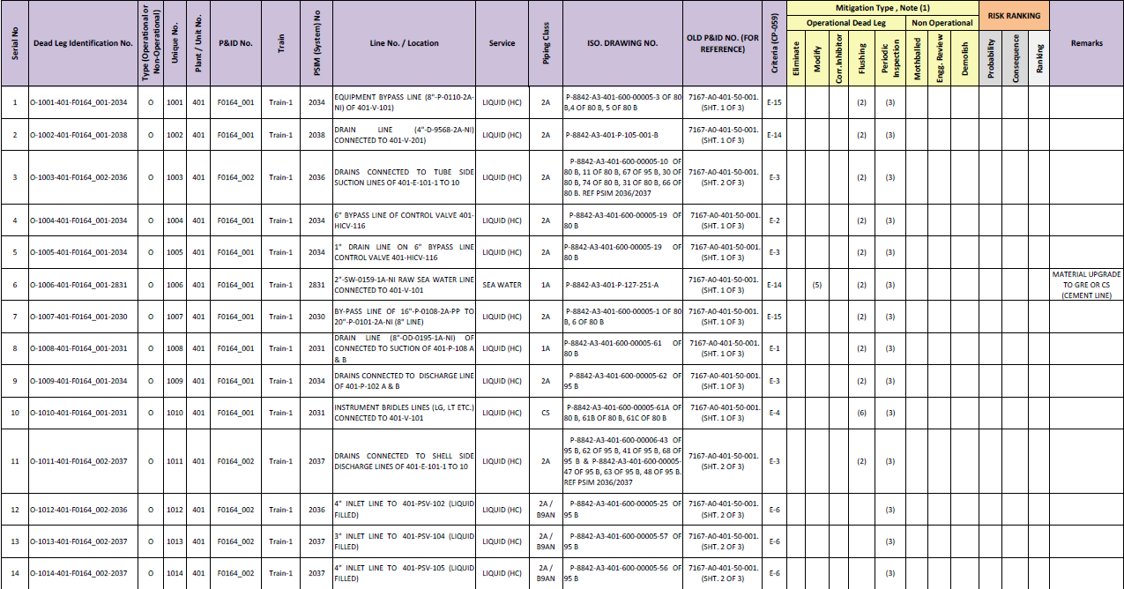
DEADLEG IDENTIFICATION MASTER SHEET

Slide 9
DEAD LEG MITIGATION STRATEGY
Mitigation Type shall be finalized based on Risk Ranking category (High , Medium Low.
PMs for Flushing shall be raised in MAXIMO . Flushing Interval to be decided based on Risk Ranking, Those having flushing facility available.
PMs for Periodic inspection shall be raised in MAXIMO. Interval to be decided based on Risk Ranking.
Non-Operational dead legs shall have Engineering Review . PMs shall be raised in MAXIMO.
Facility Modification Request shall be raised, those identified during site verification.
Equipment Instrument Bridles shall be flushed during instrument calibration as per ZRPRD existing practice.
Non-Operational dead legs already Mothballed. PMs shall be raised in MAXIMO

Slide 10
Thanks for Attention
Questions

