Slide 1

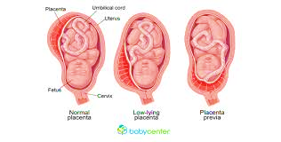
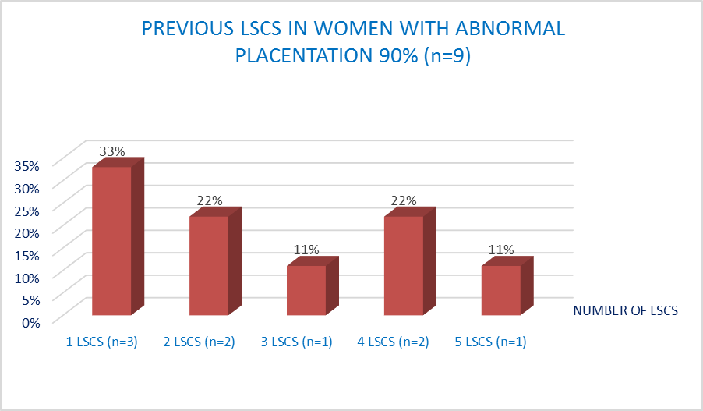
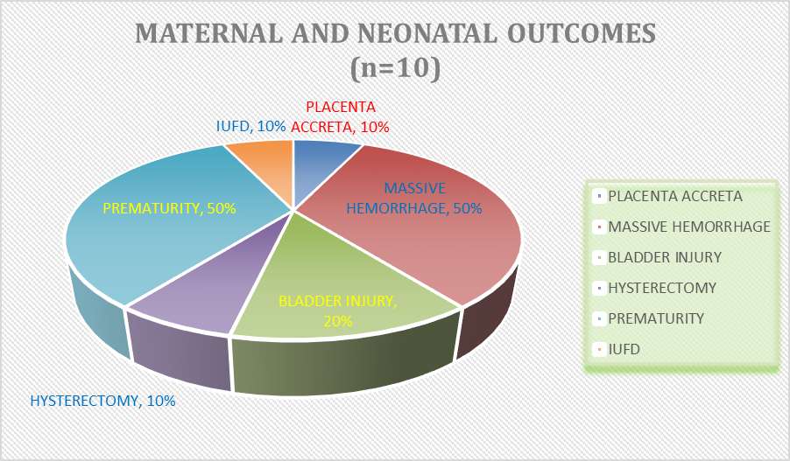
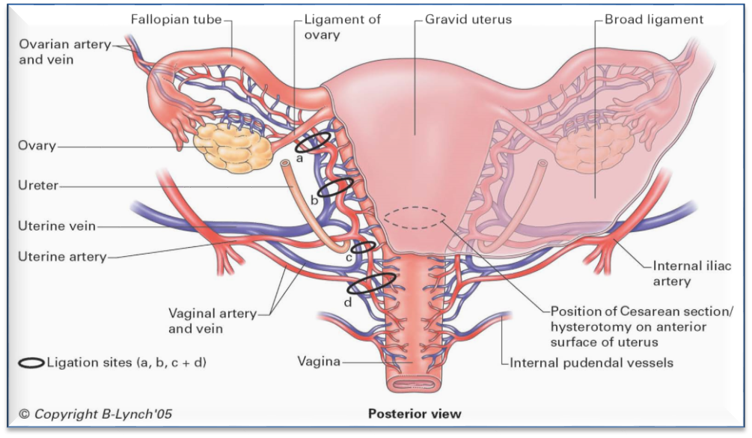
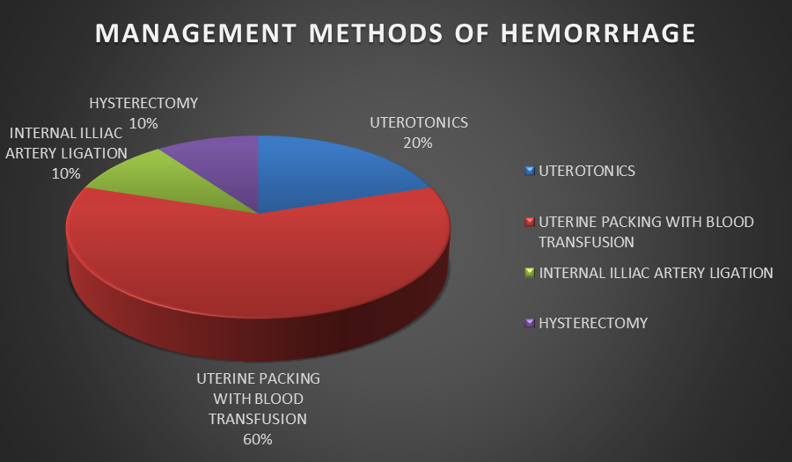
SPECTRUM OF PLACENTA PRAEVIA MAJOR: RATE AND RELATIONSHIP WITH MATERNAL AND NEONATAL OUTCOMES
Gul-e- Irum S¹, Shereen H²
^{1,2} MATERNITY HOSPITAL – DR SULAIMAN AL HABIB MEDICAL GROUP – OLAYA BRANCH, RIYADH, KINGDOM OF SAUDI ARABIA
INTRODUCTION:
Placenta previa complicates around 0.3–0.5% of pregnancies [1].
Surgical complications include hysterectomy, massive hemorrhage requiring blood transfusion [3,4], injury to bladder, ureters & other viscera, and Renal failure [5, 6].
OBJECTIVE:
To determine different variables of placenta previa major and morbidly adherent placenta (accreta) and their relationship to maternal and neonatal outcomes.
MATERIALS AND METHODS:
Observational descriptive study, conducted in Maternity hospital, Dr Sulaiman Al Habib Medical Group, Riyadh, KSA, over a period of 2 years (2017-2018).
Inclusion: All booked patients, admitted to OB-GYN department, with abnormal placentation, during study duration.
Data Collected:
  Prevalence of placenta previa major and placenta accreta.
  Maternal Outcome: Massive hemorrhage (>2 L) requiring transfusion, Bladder injuries, Cesarean hysterectomies, Maternal mortality, Association with previously scarred uterus, Outcome of Medical & Surgical management options.
  Neonatal outcomes: Prematurity, IUGR, Fetal demise, Perinatal mortality and NICU admissions.
  Data analysis using SPSS package in the form of percentages (relative frequencies) of variables. Chi square test - significance. A P valve of less than 0.05 was considered statistically significant.
RESULTS:
Prevalence of Abnormal Placentation: 0.12% (Patients per number of deliveries/year, 10/8200)
Mean age of women: 31.9 + 3.12 years
Primi P- 1/10 (10%) Multi P- 9/10 (90%)
Women with previous scar (lscs)- 9/10 (90%)
Maternal Outcome:
  Placenta Accreta 1/10 (10%), (P value 0.011)
  Massive hemorrhage requiring transfusion 5/10 (50%) (P valve 0.010)
  Bladder injury 2/10 (20%) (Both with pervious scar) (P value 0.034)
  Cesarean Hysterectomy 1/10 (10%) (P value 0.002)
  Management options:
    Simple uterotonics (methergine, cytotec, pabal) 2/10 (20%)
    Uterine packing and blood transfusions 6/10 (60%)
    Internal iliac artery ligation 1/10 (10%)
    No maternal death
  Out of 8 relationships measured, 6 were found to be statistically significant
  Relation of abnormal placentation with Hysterectomy ( P value 0.002)
  Relation of abnormal placentation with Hemorrhage ( P value 0.010)
  Relation of previous scar with Bladder injury (P value 0.034)
  Relation of previous scar to Hemorrhage (P value 0.044)
  Relation of previous scar to Hysterectomy (P value 0.011)
Neonatal Outcome:
  IUFD at 33 weeks 1/10 (10%)
  Premature delivery 5/10 (5
CONCLUSION:
Despite small number of patients we have noted significantly high prevalence of morbidly adherent placenta.
Morbidly adherent placenta has significant association with Massive bleeding & Cesarean Hysterectomy
Previous scars are significantly associated with CS Hysterectomy, Major blood loss and Bladder injuries
However, we recommend further studies with larger number of patients to further evaluate the associations.
REFERENCES:
1- Iyasu S, Saftlas AK, Rowley DL, Koonin LM, Lawson HW, Atrash HK. The epidemiology of placenta previa in the United States, 1979 through 1987. Am J Obstet Gynecol. 1993; 168:1424–29.
2- Marshall NE, Fu R, Guise JM. Impact of multiple cesarean deliveries on maternal morbidity: a systematic review. Am J Obstet Gynecol. 2011; 205(3):262.e1–8.
3- Rouse DJ, MacPherson C, Landon M, Varner MW, Leveno KJ, Moawad AH, et al. Blood transfusion and cesarean delivery. Obstet Gynecol. 2006; 108(4):891–97.
4- Jang DG, Sun KS, Shin JU, Choi YJ, Ko HS, Park IY, et al. Maternal outcomes according to placental position in placental previa. Int J Med Sci. 2011; 8(5):439–44.
5- Hudon L, Belfort MA, Broome DR. Diagnosis and management of placenta percreta: a review. Obstet Gynecol Surv. 1998; 53:509–17.
6- O’Brien JM, Barton JR, Donaldson ES. The management of placenta percreta: conservative and operative strategies. Am J Obstet Gynecol. 1996; 175:1632–38.
About the Author:
DR GUL-E-IRUM SAADAT
MBBS, MRCOG UK
Senior Registrar - Dr Sulaiman al Habib Medical Group
E mail: irumdr123@gmail.com
Mob : +966551580147
DR SHEREEN MONEM HASSAN
Registrar - Dr Sulaiman al Habib Medical Group
E mail : shereen.monem@yahoo.com

