Slide 1
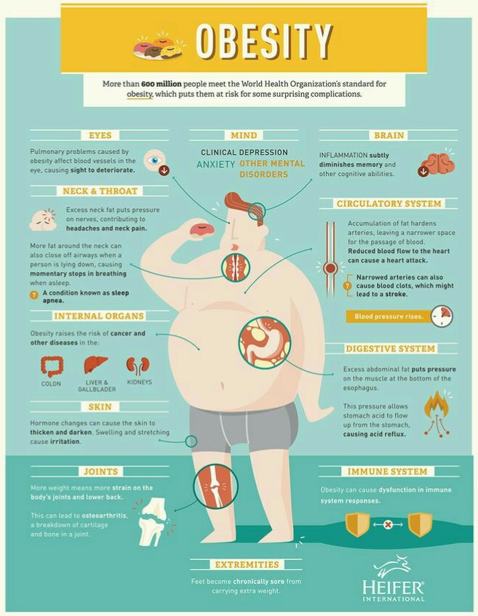
"Obesity" you never want to taste. Change your diet habit today.
Obesity and undesirable and discontentional physical state for an individual. Which comes along with a high BMI range (ratio of fat percentage according to height) and numerous physical and mental complications.
Main reasons which leads a person to obesity are,
- extra calorie consumption on daily basis
- unhealthy diet habit
- comfort eating
- clingy lifestyle, lackings of physical activities
- genetics like "Prader-Will Syndrome"
- special physical condition like Thyroiditis
Whaterver the cause is, the common thing over all obese is desire of cutting the extra fat of body and getting a good physic.
Obesity is a complicated physical state it brings many health problems like,
- Hypertension
- Type-II diabetes
- Back and joint pain
- Fatigue, Sweating
- Snoring, Breathlessness etc
However obesity increase the risk of CHD (Cardio Health Diseases), Stroke, High blood cholesterol and so on.
Apart from these physical complications obesity also perish an individuals mental health. People who suffers from obesity has a low self esteem, mental disturbance and feelings of isolation.
Now if think about the treatment of obesity first thing comes in mind is "Diet". Nowadays obesity becomes No-1 health issue among modern and high raise countries. Research says that calorie intake increase over past 40 years among USA, Asia and Sahara Africa. In US most of these extra calories coming from an increase in carb consumption rather than fat. Primary source of this carb is sweetened beverages. It became 25% of RDA (Regular Dietary Allowances). Other changes on diet habit promoting obesity are,
- forthcomingness of food
- 2-3 times bigger portion size
- increase in meat intake
- execessive sugar consumption
- liquid calorie intake throughout carbonated beverages and alcohol
Particularly at a time diet is the main cause and cure of obesity. Obese people should take low carb, low fat and high protein along with lots of green leafy vegs, citrus fruits and 3-4 liters water on their diet. A proper and healthy diet with adequate physical activities will help you to win over obesity.
Citation : "Trends in intake of energy and micronutrients - United States " by Wright JD, Kennedy Stephenson J, Wang CY, McDowell MA, Johnson CL
"Physiology and Behavior - Sugar-sweetened beverages and and risk of obesityand type-II dibetes : epidemiologic evidence" by Hu,F; Malik V
Image Source : Pinterest
Written by : Ms. Tasnim Sathi, a student of Department of Food and Nutrition, College of Home Economics, University of Dhaka, Bangladesh

