Slide 1
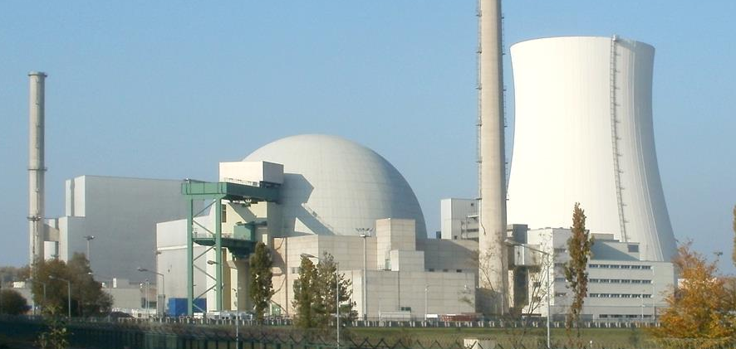
AEGIS® Reactor Pump Protection Ring
Protect Face Seal from Electrical Erosion

Slide 2
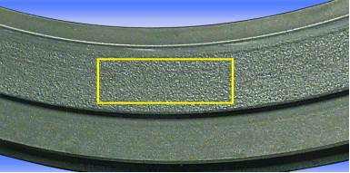
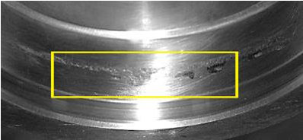
Electrical erosion damage to face seal surfaces

Slide 3
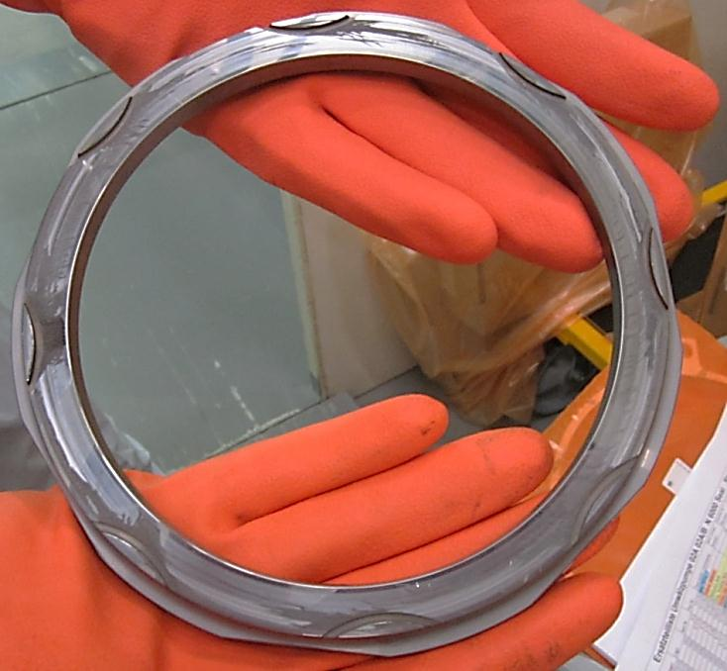
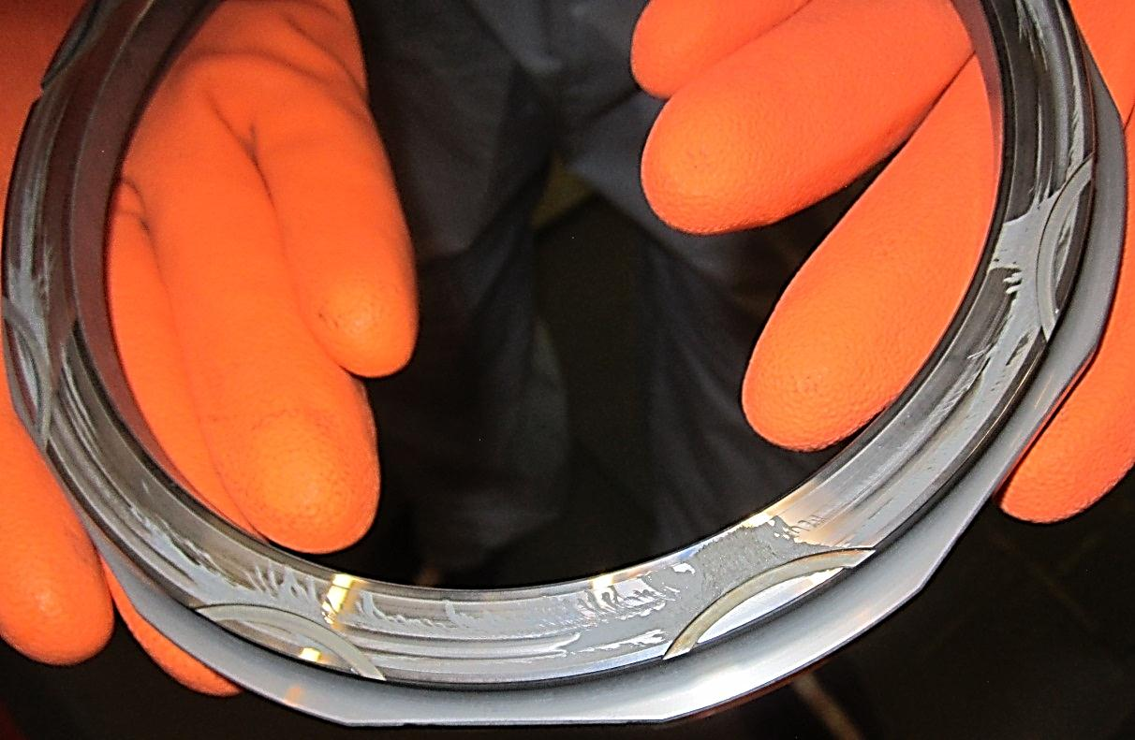
A – Pump (Swiss Power Plant)
August 2014
Second or top stage seal
Tungsten carbide rotating seal face
Operating time:
September 2013 – August 2014

Slide 4
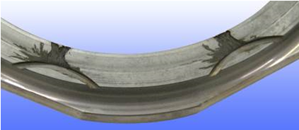
Mitigating face seal electrical erosion:
Critical to minimizing uncontrolled radioactive leaks; unplanned reactor shutdown.
Prevents millions of dollars in downtime.
Solution: Grounding the shaft of Reactor Coolant and Recirculation Pumps (RCP/RRP) is critical to controlling potential shaft voltage which may otherwise cause electrical erosion of the pump’s face seal.

Slide 5
Manufacturing Design for Nuclear Power Stations:
AEGIS® PRO RPPR shaft grounding system:
Custom-engineered integrated solution
Specifically designed and manufactured to mitigate electrical face seal erosion.
Each AEGIS® PRO RPPR design meets individual plant requirements
Achieved through close coordination between AEGIS® engineering and nuclear power station engineers.

Slide 6
Electrical Erosion in RCP/RRP Face Seals:
“No matter how challenging it looks we will find a place to install the ring!”

Slide 7
Electrical Erosion in RCP/RRP Face Seals:

Slide 8
Reliability Between RCP/RRP Maintenance Cycles:
AEGIS® PRO RPPR is a maintenance-free circumferential conductive microfiber shaft grounding ring system which ensures reliable conductive contact from the rotating shaft to ground.
It is designed to provide 100% shaft grounding contact during operation from one maintenance cycle to the next with no degradation in performance.
Maintaining performance in subsequent cycles is accomplished by replacing the AEGIS® RPPR Ring as part of planned maintenance during shut down periods.

Slide 9
Application Specifications:
Ease of Installation | AEGIS rings are designed to minimize hot area time during installation, typically with minimal or no modification to, and no removal of, existing installed equipment.
Shaft Surface Finish: | The shaft must have a smooth surface which does not contain any holes, keyways, protrusions, engravings or other rough markings where the AEGIS® PRO RPPR conductive micro fibers touch the shaft surface. Surface roughness of Ra 100 micro-inch finish or better before the application of AEGIS® Colloidal Silver Shaft Coating (CS015). Shaft surface must be conductive and be free of any coatings or finishes that reduce conductivity. In most cases the standard steel shaft finish is suitable for the AEGIS® PRO RPPR shaft grounding ring installation. Prepare the shaft and apply AEGIS® CS015 per guidance prior to installing AEGIS® PRO RPPR ring.

Slide 10
Application Specifications cont.:
Fiber Flexibility: | AEGIS® PRO RPPR Rings are constructed with conductive microfibers designed to bend and flex without breaking. Multiple rows of fibers are distributed 360 degrees surrounding the shaft surface to provide maximum contact. Fiber length is designed with an optimal shaft overlap. Little or no frictional axial or radial fiber pressure applied to shaft. Extremely light contact only. Designed for minimal friction with no reduction in system performance.
AEGIS® PRO RPPR Ring Maintenance/ Reliability: | The AEGIS® PRO RPPR Ring does not require maintenance during normal operation and is designed to ensure 100% reliable fiber contact to the rotating shaft during the normal operational cycle of the system.

Slide 11
Application Specifications cont.:
AEGIS® PRO RPPR Ring System Materials: | Components are designed to meet combustible material requirements: Ring frame, mounting brackets and hardware: 304 Stainless Steel. Alternate ring frame and bracket materials may be used when requested by the customer and validated by AEGIS® engineering department.

Slide 12
Application Specifications cont.:
Environmental Factors: | Oil and Grease on Shaft: Small amounts of oil and/or grease are acceptable if the shaft surface remains conductive. Fibers are designed to maintain contact with the motor shaft and “sweep” oil away from surface. Dirt/Dust: Small amounts of dust and/or small particles are acceptable. Fibers “sweep” particles from shaft surface during operation. Shaft surface must remain conductive. Maximum temperature rating: 410°F (210°C); Minimum temperature rating: -112°F (-80°C) Humidity: 0 to 100% with non-condensing conditions - Verify application specific acceptable humidity with AEGIS® Engineering Ambient pressure [bar]: No limitation on static ambient pressure

Slide 13
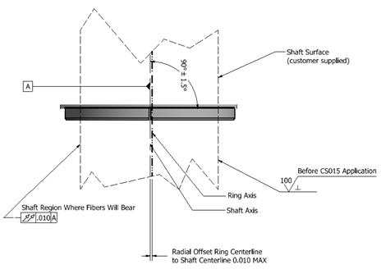
Application Specifications cont.:
Operating Tolerances: | ±1.5° and 0.010” [0.25mm] Total Indicator Runout in area where AEGIS® Ring is installed. Directional rotation: Shaft may be operated in clockwise or counter clockwise rotation and may change directional rotation without limitations.

Slide 14
Application Installation Notes:
Installation Guidance: | AEGIS® Engineering will provide installation guidance and include applicable requirements on the drawings provided to the customer.
Shaft Conductivity: | AEGIS® Colloidal Silver Shaft Coating PN CS015 must be applied to the shaft surface per installation guidelines.
Bonding Straps | The AEGIS® PRO RPPR ring should be connected to earth ground with AEGIS® HFGS bonding straps specified in the assembly drawings.

Slide 15
Application Installation Notes:
Standard Structural Design | We verify that our AEGIS® PRO RPPR rings are suitable to: Withstand a 4.5g static load in any direction with a substantial safety factor against mechanical detachment Withstand a minimum sustained 2g combined non-resonant dynamic load with deflections small enough to have no impact on the PRO RPPR service life We provide premium locking hardware to guard against loosening due to vibration even when used in a challenging vibration and thermal cycling environment. Installation bolts should be tightened to the torque specified on the assembly drawing. The customer is responsible for verifying suitability of the proposed AEGIS® PRO RPPR ring design for their operating environment. Contact AEGIS® engineering for further guidance as needed.

Slide 16
Application Installation Notes:
Low Voltage Threshold | There is no lower voltage threshold for function of the AEGIS® PRO RPPR. Note: The presence of an alternate path to ground from the motor shaft will always decrease the electrical damage due to shaft voltage, and the lower the impedance of that path, the more protection it will provide against electrical damage. AEGIS® PRO RPPR rings are specifically designed to offer a low impedance alternate path to ground.
Installation Validation Using Ohm Meter Resistance Measurement | Reading should be <2 ohms between the shaft surface at the PRO RPPR and the bonding location. Note: This is not a check of the impedance of operating ring; it is only a validation that the ring has been installed properly from an electrical standpoint.

Slide 17
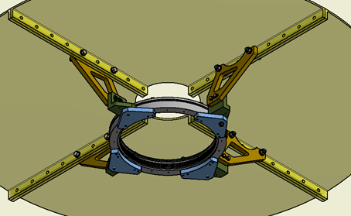
Design Example #1:

Slide 18
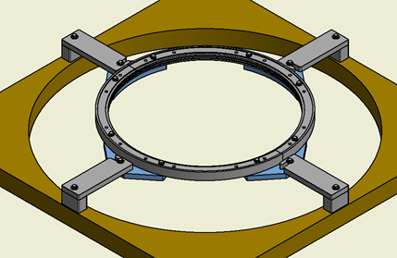
Design Example #2:
Note: Final design will be custom tailored to your application needs.

Slide 19
Mitigating Electrical Face Seal Erosion
with AEGIS® RPPR Shaft Grounding Ring
It all comes down to reducing voltage across the seal.
Improves the safe operation of reactor recirculating pumps by diverting electrical currents away from the face seals.
AEGIS® RPPR provides 100% reliable operation from one maintenance cycle to the next.
Custom engineered to integrate into your specific RRP system for installation during a planned shut down.
Can save millions of dollars in unplanned shutdown costs!

