Slide 1

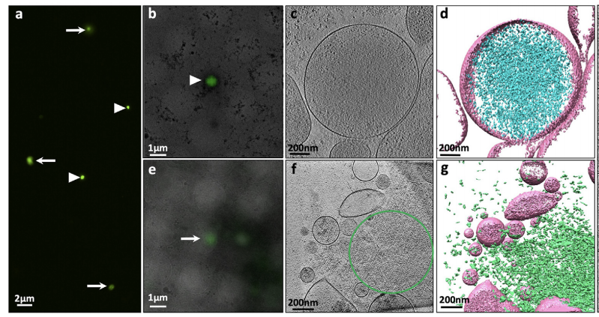
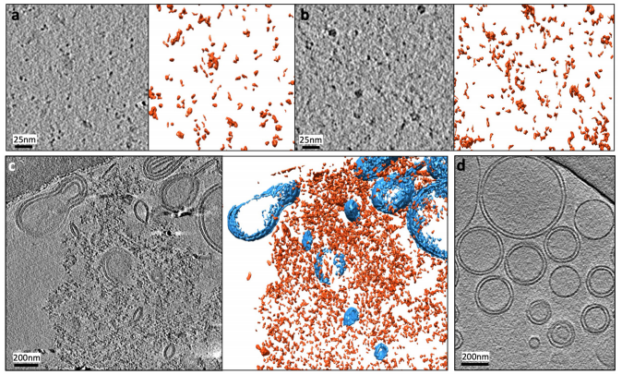
Structural insight into transmissive mutant huntingtin species by correlative light and electron microscopy and cryo-electron tomography
Xuyuan Kuang
Abstract
Statement of the Problem: Aggregates of mutant huntingtin (mHTT) containing an expanded polyglutamine (polyQ) tract are hallmarks of Huntington's Disease (HD). Studies have shown that mHTT can spread between cells, leading to the propagation of misfolded protein pathology. Therefore, the structure of transmissive mHTT species, and the molecular mechanisms underlying their transmission is important to ameliorate HD.
Methodology & Theoretical Orientation: PC12 HD cell model was generated which express truncated mHTT exon1 containing polyQ97 tagged with EGFP(mHTTex1-EGFP). After induction of mHTTex1-EGFP, the pellet generated by centrifugation of conditioned medium was resuspended in the same volume of fresh media to induce seeding activities. Extracellular mHTT proteins present in the conditioned medium were imaged by correlative light and electron microscopy (CLEM) and cryo-electron tomography (cryo-ET) to characterize the structures and seeding propensity. We further developed an in vitro reconstituted system consisting of preformed liposomes and synthetic polyQ peptides to mimic the interaction between polyQ and cell membrane which is made up of lipids.
Findings: We identifified two types of aggregation-prone granules in conditioned medium from PC12 cells expressing a mHTT N terminal fragment: densities enclosed by extracellular vesicles (EVs), and uncoated, amorphous mesh works of heterogeneous oligomers that co-localize with clusters of EVs. In vitro assays confirmed that liposomes induce condensation of polyQ oligomers into higher-order assemblies, resembling the uncoated meshworks observed in PC12 conditioned medium.
Recent publications
Conclusion & Significance: Our findings provide novel insights into formation and architecture of transmissive mHTT proteins, and highlight the potential role of EVs as both carriers and modulators of transmissive mHTT proteins.
(1) Biochemical and Biophysical Research Communications. 2021,560:99-104 (2)Proceedings of the National Academy of Sciences of the United States of America. 2019,116(32): 17316-17322 (3)Cell Adhesion Migration.2014;8(5):493-498. (4)Microscopy and Microanalysis.2021, 27(S1), 2826-2830. (5)Structure. 2021, publish online. (6)Journal of fungi (Basel, Switzerland). 2021, 7(2), 120. (7)World J Gastroenterol. 2017;23(10):1787-1795 (8)Clinal Experimental Metastasis. 2014;31(5):535-541.
(9)Zhonghua Gan Zang Bing Za Zhi. 2016;24(6):417-421.
I graduated from Central South University for Ph.D. and M.D. on 2014. From 2017-2020, I studied in Institute for Quantitative Biomedicine, Rutgers University as postdoctoral fellow. I now work in Xiangya Hospital in China as physician and assitant professor in rehabilitation specialized in use of hypberbaric oxygen therapy for neurodegenerative diseases as well as anti-aging.
My previous research focuses on charactering the structures of macromolecular machinery in their cellular context using three-dimensional (3D) cryo-electron tomography (cryoET) and correlative light and electron microscopy (CLEM). Structures of intracellular macromolecular complexes are usually heterogeneous and dynamic, relying largely on interactions with other cellular components. Using cryoET to determine the structure of cellular machinery inside the cell avoids damage to the complexes during purification, captures snapshots of the complex while in action, and provides information on cross-talk of the complexes with their cellular partners during biological processes.
BIbliography

