Slide 1


Presenting author details
¹Department of Mechanical Engineering Universidad de Guanajuato México. DICIS Universidad de Guanajuato
Campus Salamanca Km 3.5 de la Carrretera Salamanca Valle de Santiago, Comunidad Palo Blanco Salamanca Gto. C.P 36885
Tel 464 6479940 ext. 2441.
Bárbara González Rolón has completed his Ph.D. in Materials Science at 1997 from México in Universidad Autónoma de México. She is the Director of Materials Laboratory of DICIS Universidad de Guanajuato México. She has published more than 43 papers in reputed journals and has been serving as an editorial board member of repute.

Slide 2
Statement of the Problem:
The industrial activity in our days produces large amounts of mixtures of diverse substances. We have the wastes of cuprous solutions dumped in aqueous bodies and the earth. Currently, there are chemical methods for the recovery of copper present in those solutions [1]. The problem arises in the economic costs of applying these methods within the industries that produce these polluting solutions [2]. The application of patent methods for the recovery of Cu as nanoparticles is another of the investigations that are taking place [4]. The restoration of copper to produce coatings are methods to be applied in the recovery of copper from contaminating solutions [5].

Slide 3
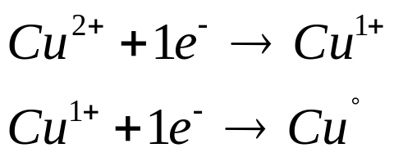
RECOVERY OF ELECTROLYTIC CU FROM CONTAMINATED CUPROUS SOLUTIONS
The method we present is for the recovery of copper in solutions where ionic, Cu¹⁺, and Cu²⁺ are present with other substances.
This method is of easy application. It consists of using the electrochemical table to find an element that works as an anode with a solution that has ions of copper. The pH of the solution will be measured and adjusted to pH 2 with acetic acid, and the temperature will be 24°C. In these conditions, the anode is immersed in the solution. The effect of the potential difference will reduce the ions. Copper is recovered.
The reactions that occur:
The particle size obtained depends on the rate of reduction of the copper.

Slide 4
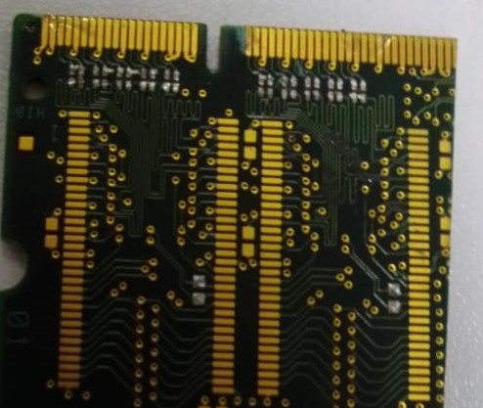
Method Aplication
Waste PCB, in the contact lines and the holes, are formed with a thin layer of Cu, and the edges are protected with Au

Slide 5
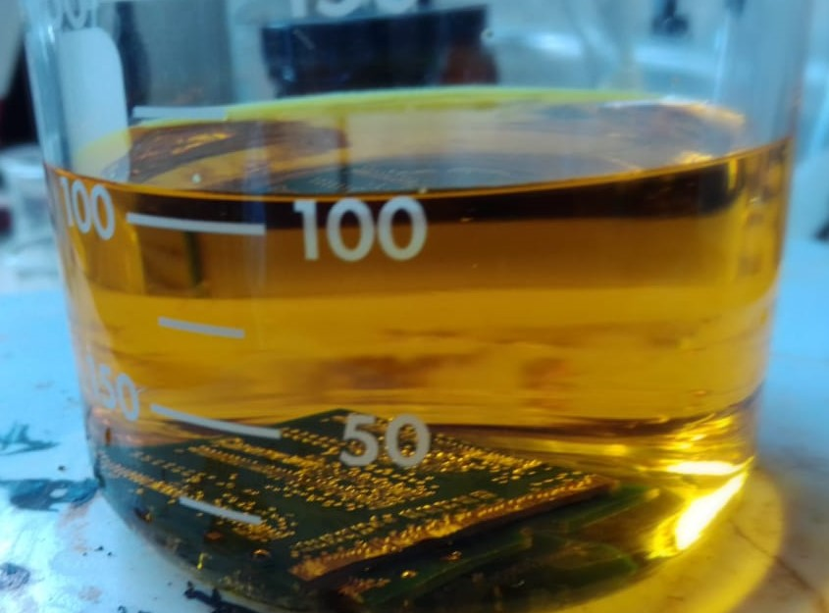
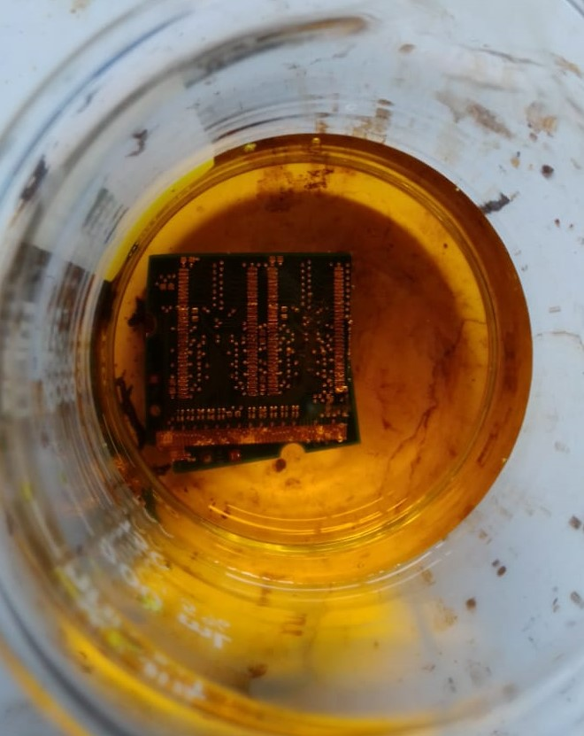
Recovery of Au and Cu by the Proposed Method
Method application
The printed circuit tablets are immersed in a solution with a Ph2 left at 24°C 30°C 1h.

Slide 6
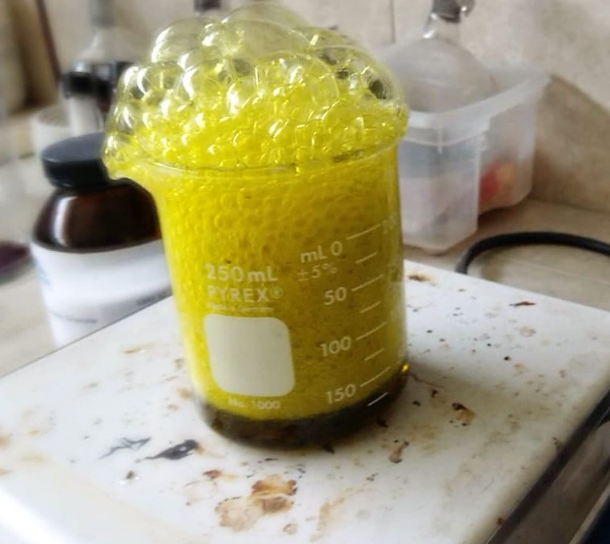
In the solution with Ph 2, the tablets reach the temperature of 24°C to 30 °C for 1h

Slide 7
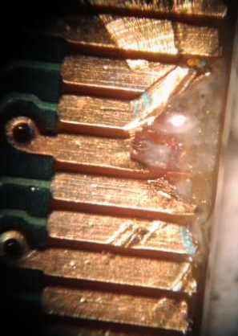
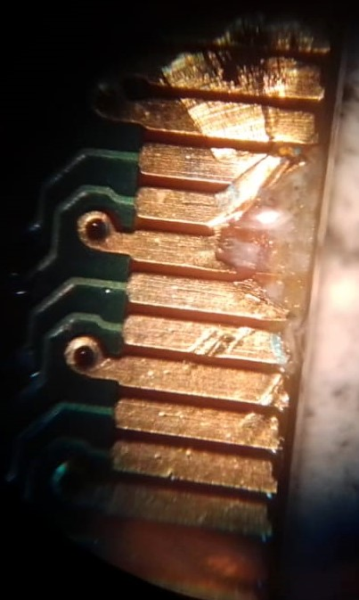
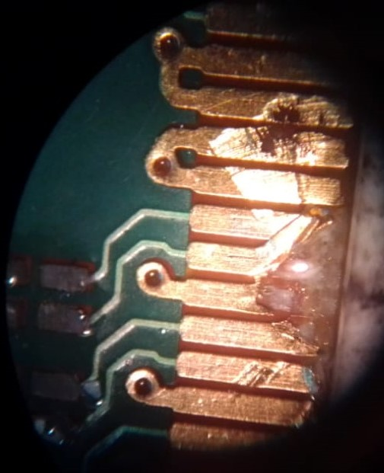
The tablet after 1h is removed and observed under the microscope at 10x
Au
Cu
Cu
Cu

Slide 8
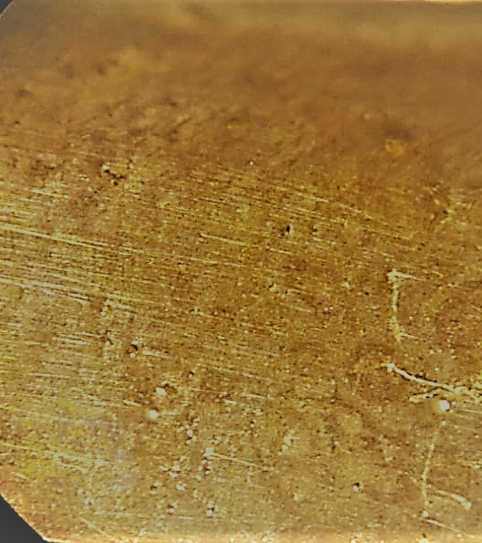
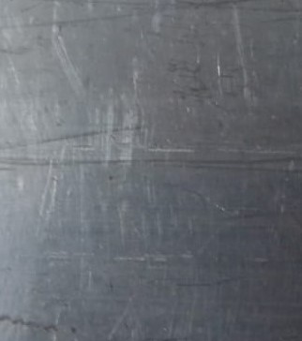
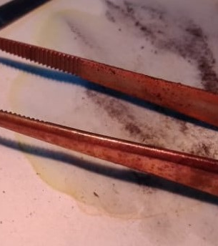
Metals are coated with Cu when they are immersed in solution after ionization of like Cu 1+ or Cu 2+ in solution. The immersed metal provides the electrons necessary to reduce copper and adhere to its surface.

Slide 9
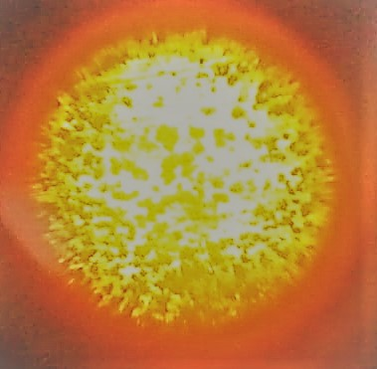
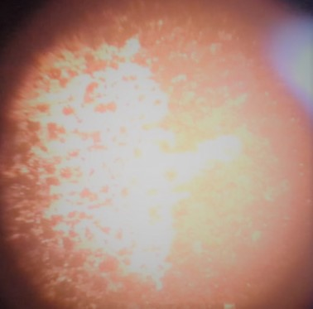
Microscope images at 100 x of the Cu deposited on the different surfaces

Slide 10
Recent Publications
[1] R.D.van der WeijdenªJ.MahabirªA.Abbadi^{b}M.A.Reuterª (2002) “Copper recovery from copper(II) sulfate solutions by reduction with carbohydrates” ELSEVIER Hydrometallurgy Vol. 64, No. 2, p.p.131-146. https://doi.org/10.1016/S0304-386X(02)00031-2.
[2]Yi-HsuanChouªKwang-HoChoo^{b}Shiao-ShingChen^{c}Jui-HsuanYu^{d}Ching-YuPengªChi-WangLiª(2018) “Copper recovery via polyelectrolyte enhanced ultrafiltration followed by dithionite based chemical reduction: Effects of solution pH and polyelectrolyte type” ELSEVIER Separation and Purification Technology Vol. 198. p.p 113-120
https://doi.org/10.1016/j.seppur.2017.02.008
[3] S.ChellammalS.RaghuP.KalaiselviG.Subramanian (2010) “Electrolytic recovery of dilute copper from a mixed industrial effluent of high strength COD” ELSEVIER Journal of Hazardous Materials. Vol. 180, No. 1–3, p.p. 91 -97.https://doi.org/10.1016/j.jhazmat.2010.03.103
EP3040140A1European Patent Office
[4] Inventor Xingye ZHANG Yanlin Song (2014) Method of preparing nano-copper powder and nano-copper powder prepared with the same Patent. B22F9/24 Making metallic powder or suspensions thereof using chemical processes with reduction of metal compounds starting from liquid metal compounds, e.g. solutions Institute of Chemistry CAS
[5] Inventor마사토 구리하라 마사토미 사카모토 (2016) Coated metal microparticle and manufacturing method thereof
B22F9/24 Making metallic powder or suspensions thereof using chemical processes with reduction of metal compounds starting from liquid metal compounds, e.g. solutions

Slide 11
Doing more for the environment will save us.
Thanks
barbara@ugto.mx

