Slide 1
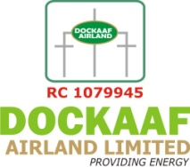
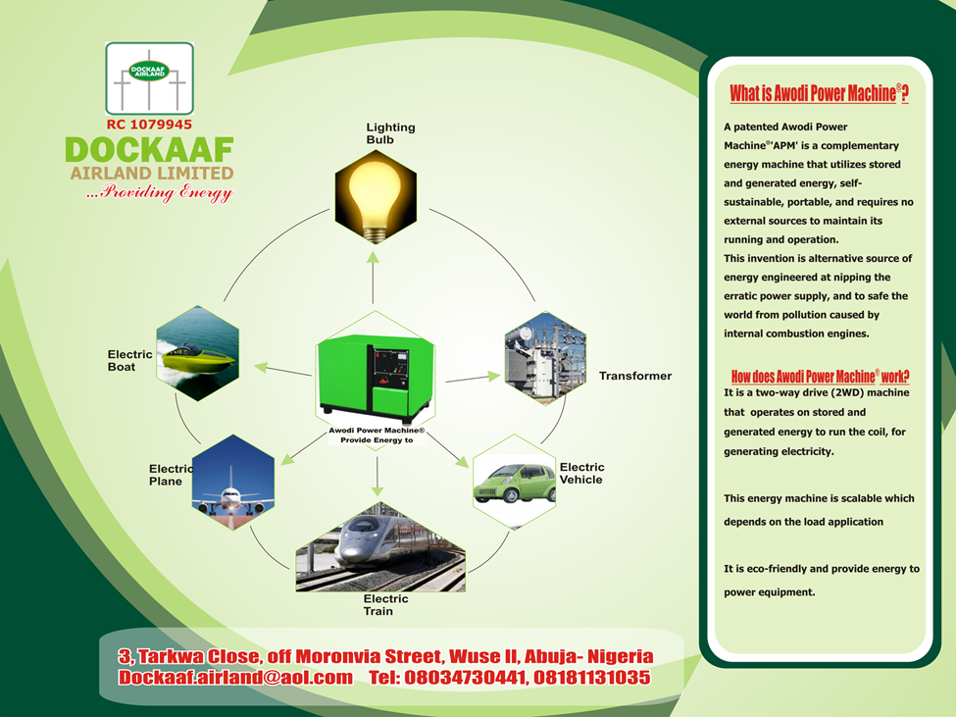
  THE ROLE OF AWODI POWER MACHINE INVENTION®
Suite 1B, Bassan plaza, Opp Total house , CBD, Abuja
Dockaaf.airland@gmail.com
+234 (0) 803 473 0441+234 (0) 805 824 3884

Slide 2

PRIVATE COMPANY INVOLVEMENT IN COST EFFECTIVE POWER PROJECT
Dockaaf Airland Ltd, other energy efficiency and renewable energy stakeholders, Jaad & 4Stones Ltd partnership would develop robust energy solutions for the country.
Modern energy services are crucial to human well-being and to a country’s economic development, It is on record that globally over 1.3 billion people are without access to electricity and 2.7 billion people are without clean cooking facilities, more than 95% of these people are either in Sub-sahara Africa or developing Asia and 84% are in rural areas.
Nigeria less than 30% of her population has no access to adequate electricity supply and it is expected that these people would remain without access to electricity till 2030.
Let's joint to develop the nation 252GW electricity that is required for 36 millions homes alone at 4kw in Nigeria. Since Nigeria history power generation remains at ebb for the entire country; the served, underserved and unserved communities, small and medium businesses with high tariffs imposed on customers.
Current power generation update in Nigeria, source http://nesistats.org/ 3,052MW

Slide 3
We have secured a patent right over this invention and provide details of the patent registration below:
AWODI POWER MACHINE ®
Organisation: World Intellectual Property Organisation
(WIPO)
Date of Filing: 20th August 2012
Application Number: PCT/IB2012/001617
Publication Date: 27th February 2014
----------------------------------------------
Institution: Nigeria Trademark, Design and Patent Registry
Date of filing: 26th June 2014
Registration Number: NG/PT/CN/2014/314
Nigeria granted patent: 20th January 2015
European Patent No.: 12769704.3-1804
Date: 8th January 2015

Slide 4
Benefits of Awodi power Technology for power station
No sources of fossil fuel is required and other transportation logistics
Free from pollution
The management of unclear plant and waste is highly risky
Cheaper operating cost.
Low installation and investment cost
Low transmission cost
It can be located near the load centers
It is possible to generating large power in order of 10000 MW
Commissioning of Awodi power station requires less period of time
1. Solid waste
Conversion to energy
Can we guarantee its sustainable and cost effective?
2. Hydro power station
Require special site and it is capital intensive
3. Fossil fuel power plant
Pollution, high operational cost, fossil fuels transportation challenges
4. Nuclear power plant
Can we manage radioactive elements effectively without posing threats on the environment?

Slide 5
What are expectations from Awodi Power Machine®?
Creating value for customers.
The new product ensure better environment.
It has competitive advantage over fuel generator sets/ plant that are noisy and pollute the environment.
The uniqueness of the product defers from mechanical engines (that depends on fossil fuels) will make us maintained its acceptability and market leadership.
APM would create jobs through the manufacturing and marketing processes.
It would also propel speedy industrial growth for both developed and developing Nations in various sector.
It is patent protected! The exclusive rights to Awodi Power Machine® will be held
by Friday Agenyi Awodi

Slide 6
Summary
Awodi Power Machine® is a brilliant and great invention with high market acceptability, because It is a multipurpose power machine, an alternative fuel generator sets and mechanical engines (internal combustion engines).
The patented Awodi Power Machine® is one of the solutions at ameliorating erratic and low power supply and eventually elimination of noise and air pollution that emanate from mechanical engines.
It will provide availability at a comparative market price and will be affordable by everyone and all will enjoy value for their money.

Slide 7
Our Prayer
Visit is require to ODM or production engineering company.
Investment on mass production will jointly address the adverse effects of over reliance on infinite fossil fuels that birthed climate and global warming issues that pose threats to the entire world creating enabling business environment
The business offer opportunity to investor’s resources in order to achieve her required objectives, standard and conducive business environment for all stakeholders.
Please accept the assurances of our highest regards for your esteemed office and kind disposition.

