Slide 1
PGDMT
HAIR DYE POISONING
Dr. NANCY SARAL MARY.J.J
M.B.B.S.,MEM PG II RESIDENT
MMHRC
© IST & TICEM

Slide 2
An estimated 1 million people worldwide die by suicide every year. According to WHO, 381 suicide cases are reported daily in India.
In India most of the suicide is committed by poison mainly pesticide. Nowadays Hair dye poisoning is also emerging mainly among the female. Age group of 15 to 45yrs.
One of the widely chosen means of suicide is Poisoning in south India mainly among middle class people in our country.
Trend of Consuming hair dyes for suicide has increased.
It is less costly and widely available.

Slide 3
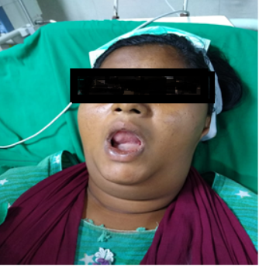
A 20 -year-old female presented to ED with Alleged H/o intentional consumption of hair dye poisoning (content of para phenylene diamine, propylene glycol, resorcinol, sodium lauryl sulphate liquid, light liquid paraffin, herbal extracts along with preservatives and perfumes) about 100 ml at her residence around 12p.m.
she had facial swelling with edema of lips. Swelling of neck and tongue. stridor was present and difficulty in speaking.
No H/o Altered sensorium/ Seizure/ Decreased urine out put/ Dark color urine/ vomiting/ Blurring vision.
On receiving
BP: 110/80 mmHg
PR: 100/min
Temp: 98.2°F
Spo2: 98 % with oxygen by mask
CBG: 146mg/dl
GCS: E4 M6 V4 14/15

Slide 4
GENERAL EXAMINATION:
Patient was conscious, oriented, afebrile
On exposure facial swelling with edema of lips, swollen neck and tongue.
No external Injury
SYSTEMIC EXAMINATION
CVS: S1S2 (+), No added sounds
RS: B/L AE (+), No added sounds
CNS: B/L PERL, NFND
P/A: Soft, mild epigastric tenderness with no organomegaly
P/R: Normal
P/V: Normal
COMORBITIES: NIL; PREVIOUS MEDICAL/SURGICAL HISTORY: NIL
INVESTIGATIONS:
ABG, Beta-HCG, CBG, ECG, USG, Complete metabolic panel, Sr. Calcium , CPK Total , urine myoglobin , LFT , RFT, Peripheral smear, Chest Xray was ordered.

Slide 5
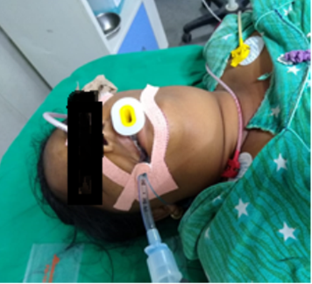
Airway & Breathing : In order to protect the airway, patient was intubated and put her
on mechanical ventilator.
Circulation: IV line is secured, and hypotension is corrected by IV fluid bolus.
Decontamination: Gastric lavage was done to the patient with activated charcoal.
Laryngeal edema and ARDS: she was treated with injection hydrocortisone 200 mg stat and Neb.Adrenaline inhalation and antihistamines for angioneurotic edema.
Enhanced Elimination : Forced Diuresis by giving Isotonic saline + sodium bicarbonate+ Lasix.
Initial ABG SHOWED SEVERE METABOLIC ACIDOSIS for which she was treated with Inj.Sodium bicarbonate stat dose followed by sodium bicarbonate infusion pump.
Dispatch: Patient was shifted to ICU

Slide 6
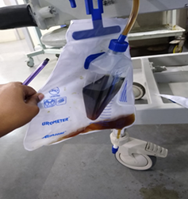
On the 2nd day, the patient developed dark coloured urine with a decreased urine output and pedal edema.
Laboratory investigations revealed
Blood urea of 180 mg/dl (7 – 30 mg/dl)
Serum creatinine of 5.6 mg/dl (0.7 – 1.2 mg/dl)
Serum creatinine phosphokinase (CPK)1750 U/L (Male: 39 – 308U/L & Female: 26- 192U/L)
URINE MYOGLOBIN was positive.
The liver function tests were normal and peripheral smear did not reveal evidence of hemolysis.
Ultrasonography of abdomen showed normal size and echo texture of both kidneys.
The chest x-ray and electrocardiogram were also normal.

Slide 7
Patient was treated with Inj.Hydrcortisone and anti histamine in view of stridor and respiratory distress which resolved after 2 days of treatment.
On the 3rd day, she developed rhabdomyolysis and ARF. Her Blood urea and creatinine levels were elevated and ABG shows severe metabolic acidosis.
She was managed initially with forced alkaline diuresis and in view of severe metabolic acidosis and hyperkalemia she received 3 sittings of hemodialysis.
Acute renal failure resolved over 6 days with dialysis.
She was clinically improved and extubated and put on NIV to prevent further atelectasis of both lungs and transferred on High Flow Mask and graded clinically and discharged home on 9th day of admission after obtaining counselling.

Slide 8
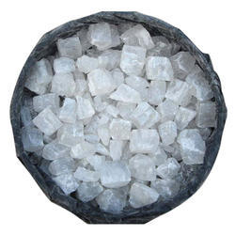
PARAPHENYLENE DIAMINE (PPD) (C6H4(NH2)2
  Main component. Aromatic amine. Not found in nature. Toxic substance since 1924. PPD is banned in certain countries like Germany, France, Sweden, Sudan, etc .
  Derivative of para nitro Aniline (coal-tar derivative). White in color which turns brown when exposed to air.
  On Oxidation it produces- Bandrowski’s base – Anaphylactic, Mutagenic and Toxic Properties.
  Severity of the poisoning is directly proportional to the Concentration of PPD.
  PPD – Severe Angioneurotic Edema, Rhabdomyolysis and Intravascular Hemolysis.
LETHAL DOSE :
  Severity of the poisoning Increases with the Dose.
  7 to 10 gms. 3gms sufficient to cause systemic complication.

Slide 9
RESORCINOL
  Phenolic Derivative, Corrosive.
  Seizure, Lethargy, Coma, Death
  Nausea, Dyspnea, Hypotension, Diaphoresis, Salivation, Methemoglobinemia, Pulmonary edema
PROPYELENE GLYCOL
  Metabolic Acidosis, CNS depression, Arrythmia, Renal dysfunction
  EDTA Ethylene diamine tetra acetic acid Sodium - Hypocalcemia ( due to rhabdomyolysis)
NEPHROTOXIC COCTAIL
  PPD + Resorcinol + Propylene Glycol.

Slide 10
PATHOPHYSIOLOGY:
  Paraphenylene diamine : Severe Angioneurotic Edema, Rhabdomyolysis and Intravascular Hemolysis.
  Rhabdomyolysis :
  Leakage of calcium ions from Smooth ER, followed by continuous contraction and irreversible change in muscle structure.
  Rhabdomyolysis along with Hypovolemia and PPD metabolites causes Acute Renal Failure.
  Propylene glycol: Hyperosmolarity, increased anion gap, Metabolic acidosis, Cns depression, Arrythmia and Renal dysfunction.
  Resorcinol: eye, skin, oral and gastrointestinal injuries, Renal toxicity.

Slide 11
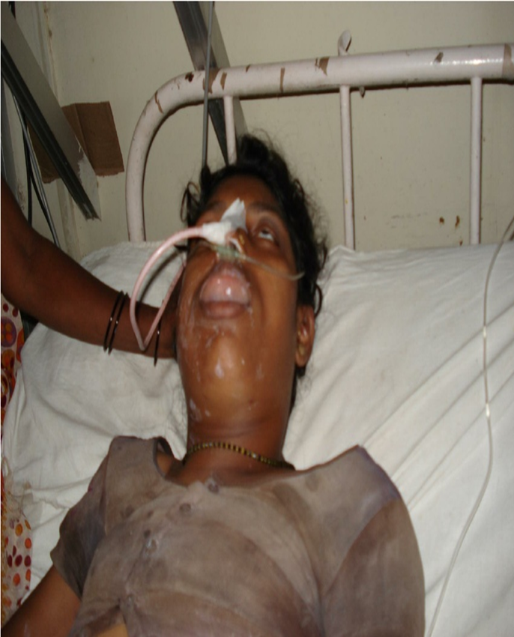
PHASE 1 :
Vomiting
Gastritis
Severe Edema of Face, Neck, Tongue, Pharynx and Larynx with Respiratory Distress –Stridor
Hypertension
Vertigo
Convulsions

Slide 12
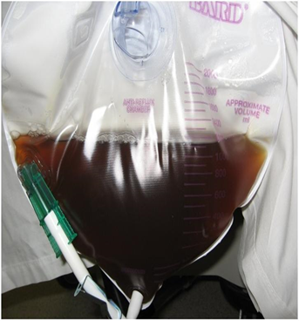
PHASE 2:
Hemolysis
Rhabdomyolysis : Chocolate brown colour of the urine
ARF
Hypocalcemia

Slide 13
PHASE 3 :
Muscular Edema
Multiorgan Failure
Shock

Slide 14
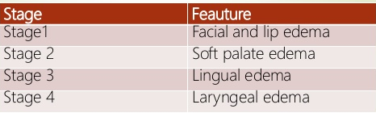
STAGES OF ANGIOEDEMA
Cricopharyngeal edema + Laryngeal edema Asphyxia Respiratory distress Hypoxia Respiratory failure
CAUSE OF DEATH
  Respiratory Obstruction
  Renal Failure
  Arrythmia
  ARDS

Slide 15
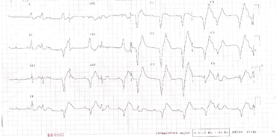
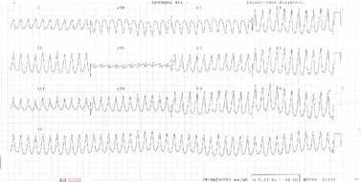
  ECG shows non specific changes with frequent premature ventricular complex suggesting myocarditis after hair dye ingestion
  ECG shows ventricular tachycardia suggesting myocarditis after hair dye ingestion

Slide 16


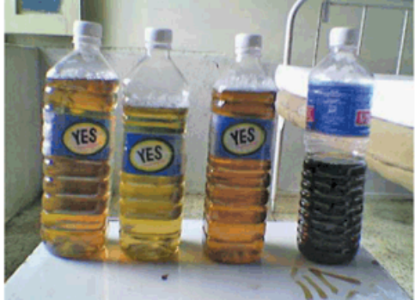
DIAGNOSIS
History of consumption or materials got from the scene
Clinical Features
RFT
Serum Calcium
CPK
PPD can be diagnosed by thin layer chromatography on silica gel ( solvent system benzene, ethyl acetate or hexane acetate) and sprayed with 0.2% solution of potassium dichromate as chromogenic reagent to give a pinkish brown spot
Myoglobinuria: urine dip stick or urine color change
urine dip stick
Thin layer chromatography
urine color change

Slide 17
TREATMENT :
No specific Antidote
Treat the complications
Gastric Lavage is useful within 1 hr of presentation
Activated Charcoal (1g/kg)
Mainly Symptomatic and Supportive

Slide 18
Emergency – Airway protection : Intubation or Tracheostomy
Medical Treatment : Steroids - Inj.Hydrocort 200 mg iv stat followed by100 mg 6th hourly if not Infusion. Methylprednisolone 125mg 6th hourly and Antihistamines
Epinephrine should be considered in stabilizing the patient
Aggressive fluid resuscitation to prevent AKI
Rhabdomyolysis : Isotonic saline , Dialysis in Oliguria
Alkaline Diuresis: Isotonic saline, Sodium bicarbonate (20meq 8th hourly) and diuretics
Myocarditis : cardiac monitoring

Slide 19
CONCLUSION
  In Pediatric also accidental ingestion of Hair dye poisoning the management is same.
  Mortality depends on the amount of hair dye ingested, the time interval between consumption and intervention, hyperkalemia, hypocalcemia, and hyperphosphatemia; and mortality rates varied between 0.03% and 60%.
  Whenever Stridor due to upper airway edema, Rhabdomyolysis, Haemoglobinuria Myoglobinuria, ARF develops in a poisoning Hair dye poisoning should be considered.
  Early Diagnosis & Intervention will save a life.
  In addition, Community awareness & Health education.

Slide 20
Remembering the fact that there is no specific antidote for PPD , the patient must be managed by watching like a hawk.
In conclusion, hair dye poisoning is a life-threatening emergency which requires life saving emergency resuscitation and early management of anaphylaxis. Early recognition of rhabdomyolysis , early prevention of acidosis , early initiation of forced alkaline diuresis prevents ARF minimizing the need for dialysis.
We are uncertain of the time of development of Renal Failure following ingestion of PPD and hence all patients should be monitored in hospital for development of renal and other complications.
HAIR DYE POISONING :
KILLS THE KIDNEY , HITS THE HEART , CUFFS THE TRACHEA

Slide 21

THANK YOU…….

