Slide 1

DIAGNOSING SHOCK IN ER
SEARCHING FOR THE HOLY GRAIL
Dr Madiha Ismail
Senior Instructor
DEM

Slide 2
Outline
Shock- quick review
Historical review of diagnostic modalities
Why EUS
Which protocol to follow
How to obtain the images
Bringing it all together
Conclusion

Slide 3
Shock- A quick review
Many critically ill patients suffer from circulatory shock¹
At increased risks of MODS, long-term morbidity and mortality²
Early recognition and appropriate treatment of shock decreases mortality³
Categorized into 4 types
[1] E. Rivers, B. Nguyen, S. Havstad et al., “Early goal-directed therapy in the treatment of severe sepsis and septic shock,” The
New England Journal of Medicine, vol. 345, no. 19, pp. 1368– 1377, 2001.
[2] F. Sebat, A. A. Musthafa, D. Johnson et al., “Effect of a rapid response system for patients in shock on time to treatment and mortality during 5 years,” Critical Care Medicine, vol. 35, no. 11, pp. 2568–2575, 2007.

Slide 4
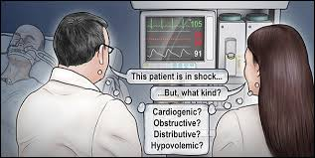
CASES
69 yr old gentleman k/c IHD, COPD s/p CABG with c/o sudden SOB low grade fever ……BP is 80/50
50 yr old lady k/c CA breast chemo, XRT 2 yrs ago recently underwent TKR now with SOB…..
BP 75/40

Slide 5
“Somewhere between ABC and CBC, [there’s scope to] lose a lot of patients…”
—Dr Amal Mattu MD

Slide 6
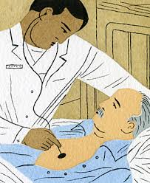
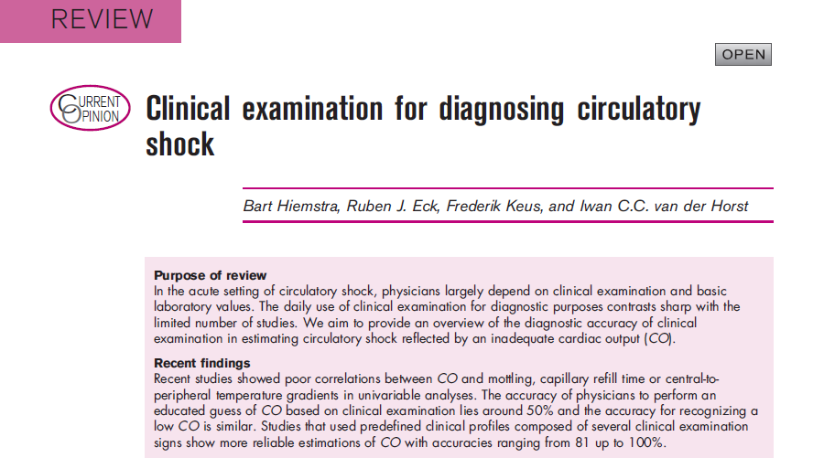
How to diagnose ???
Clinical Examination

Slide 7
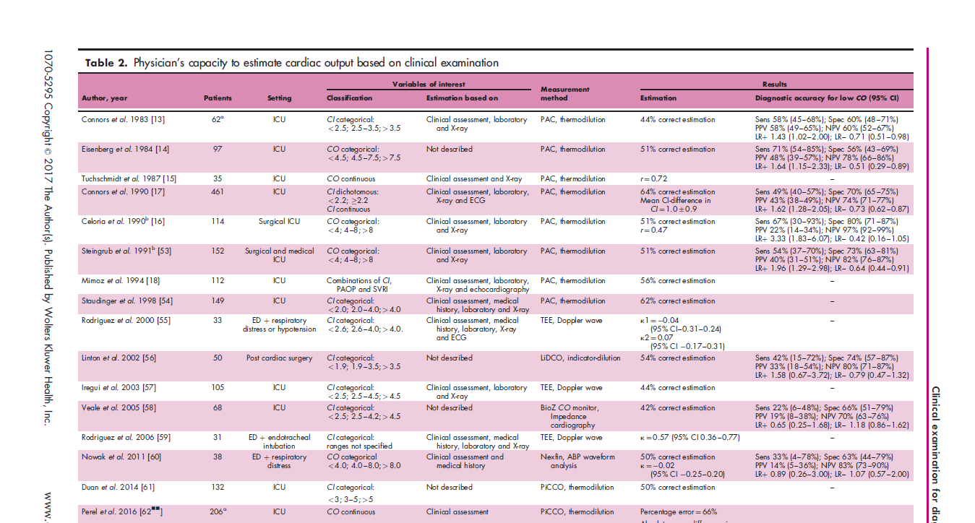
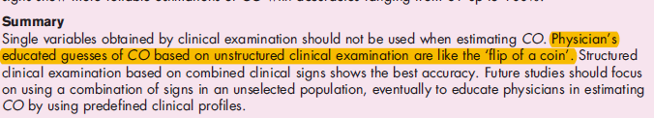

Slide 8
Invasive monitoring-CVP
Has it’s LIMITATIONS in
Valvular heart disease
Right heart failure
Poor lung compliance
Arrhythmias.

Slide 9
“The ‘equilibrium’ that people see in me is really an illusion. I am as flawed as anyone. It’s only that I seem to have the knack of hiding.”
      Erich Segal, Doctors

Slide 10

So the Quest of Holy Grail continued

Slide 11

IDEA

Slide 12
“a real physician almost never seeks another doctor’s help. For they all are painfully aware of just how little anybody understands about curing the sick.”
                Erich Segal,

Slide 13
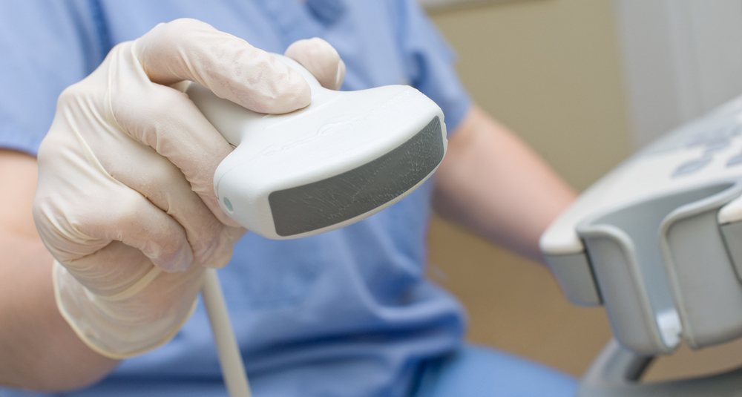
WHAT WILL FILL THE GAP

Slide 14
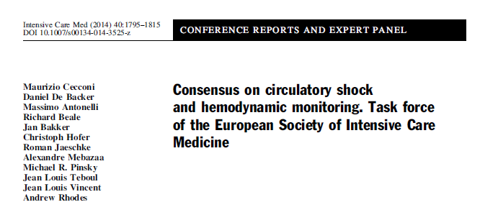
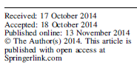
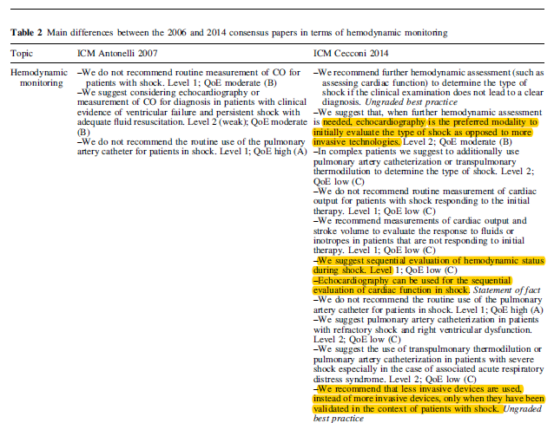

Slide 15
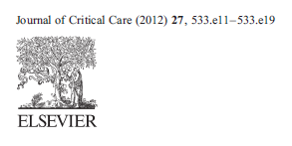

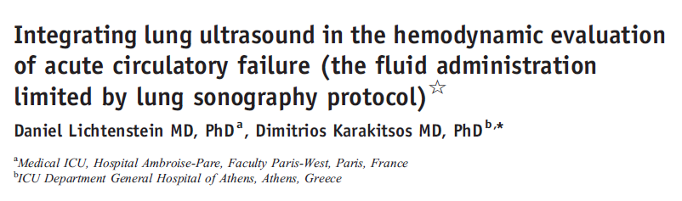
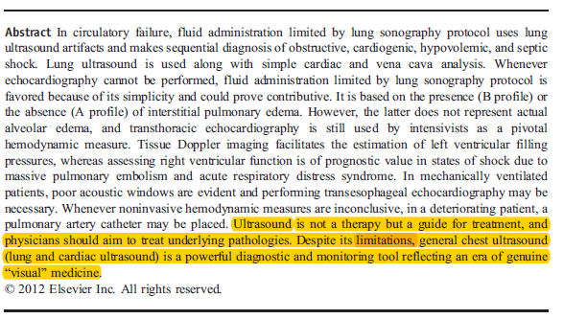

Slide 16

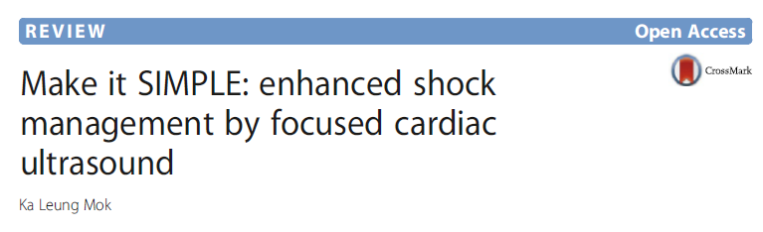
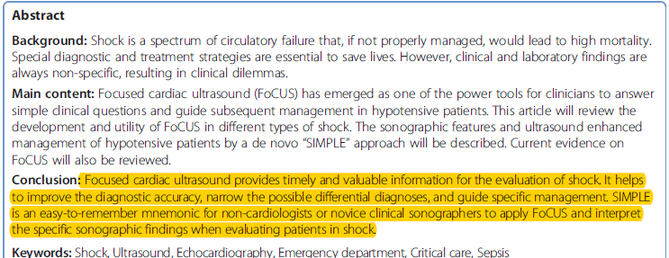

Slide 17
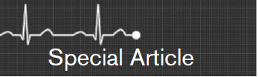
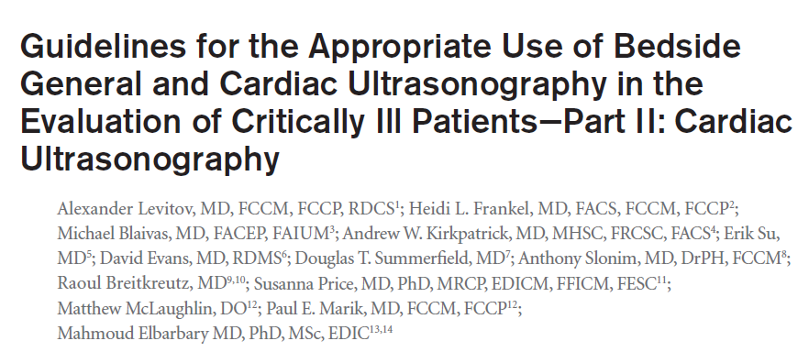


Slide 18
US in ED (EUS)
Non cardiologist using US since 1980’s
Myron et al 1988 “Echocardiography performed by emergency physicians: impact on diagnosis and therapy”¹
ED physicians picked pericardial effusion with 96% sensitivity and 98% specificity in a study done on 515 patients.²
A large prospective study showed 86% agreement in LV fx assessment by ED physicians and cardiologist³.
CVP assessment 86% agreement⁴.
Mayron R, Gaudio FE, Plummer D, Asinger R, Elsperger J. Echocardiography performed by emergency physicians: impact on diagnosis and therapy. Ann Emerg Med 1988;17:150–4.
2. Mandavia DP, Hoffner RJ, Mahaney K, Henderson SO. Bedside echocardiography by emergency physicians. Ann Emerg Med 2001;38:
377–82.
3. Moore CL, Rose GA, Tayal VS, Sullivan DM, Arrowood JA, Kline JA.Determination of left ventricular function by emergency physician
echocardiography of hypotensive patients. Acad Emerg Med 2002;9:186–93.
4. Randazzo MR, Snoey ER, Levitt MA, Binder K. Accuracy of emergency physician assessment of left ventricular ejection fraction and central
venous pressure using echocardiography. Acad Emerg Med 2003;10: 973–7.

Slide 19
