Slide 1


Slide 2
Case Report
Esthetic Prosthesis

Slide 3
Fixed/Removable using Precession Attachment

Slide 4
By:
Ahmed H. Abdelfattah

Slide 5
Introduction

Slide 6
Many individuals seek dental treatment for esthetic reasons before other factors, that is, the desire to look more attractive by improving the smile.
The first choice is always Implant solution, but unfortunately sometimes it’s difficult to use, especially if the patient refuse this solution.
So, remaining teeth can help aesthetics by preserving alveolar bone form. Teeth can be incorporated into a restoration using copings, or precision attachments with fixed bridge. Precision attachments significantly enhance the retention of removable partial dentures.

Slide 7
Their use eliminates the need for visible retentive and support components, especially in esthetic areas. Hinge type of attachments resists any lateral tipping, rotational, and sliding forces. The use of “ fixed bridge” connected to the attachment made the attachment have strong retention derived from good properties for abutment teeth. In this study we aim to use precession attachment design to make prosthodontic appliance that more comfortable, and esthetically acceptable than traditional design of removable partial denture.

Slide 8
Case Report

Slide 9
A 34 years old male was referred with a chief complaint of dissatisfaction of his situation and the previous dental treatment he had received before.
Medical History
Patient is medically free and have no allergy to any medication or material.
Dental History
Patient has missing of anterior and posterior teeth with gingival inflammation due to the old removable denture.

Slide 10
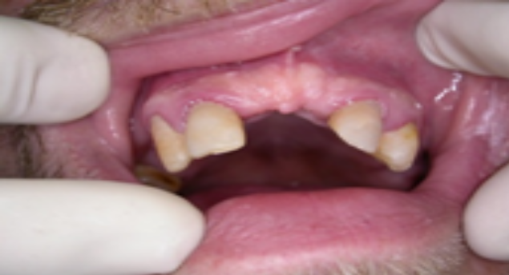
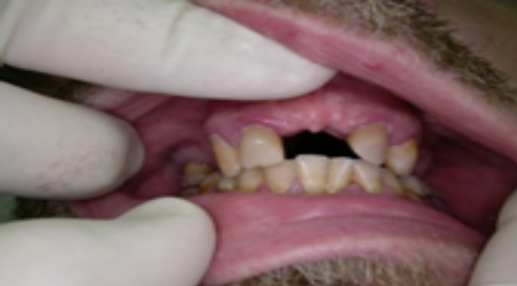
He removed the denture for a period of time which cause slight deviation of lateral incisors mesially, and canines inclined palatally due to the forces exerted on them from the old prosthesis.
A thorough intraoral examination and x-ray review was done for the patient to decide the treatment plan.

Slide 11
Treatment Plan

Slide 12
After careful analysis of the clinical problems of this case, the possible design which would provide both an acceptable aesthetic, and functional results, was the posterior removable denture attached to anterior fixed prosthesis using the precession attachment device.
The treatment plan decided will be:
1. Gingival treatment for the mild gingivitis
2. Root canal treatment for lateral incisors to adjust their inclination during preparation for the anterior fixed bridge.

Slide 13
3. Preparation of lateral incisors and canines for fixed bridge anteriorly to restore the missing two central incisors and attach the posterior removable prosthesis using precession attachment. Provisional restorations will be used for esthetic reason and helping in the gingival treatment after rubber impression.
4. Fabrication of fixed PFM bridge anteriorly carrying the male portion of the precession attachment for the posterior removable prosthesis, then another rubber impression will be taken while the fixed prosthesis in position.
5. Finalization of the removable prosthesis.

Slide 14
Step by Step Treatment

Slide 15
1. Gingival and periodontal treatment: scaling and root planning was done, in two visits.
2. Root canal treatment for the two lateral incisors using one visit rotary technique was done.
3. Primary impression by alginate for preparing the provisional bridge was taken.
4. Preparation of the two lateral incisors and the two canines (1 - 1.5 mm), for adjusting the path of insertion, was done.
5. Final impression by silicone rubber base material (3M) for the maxilla, rubber bite for inter occlusal distance depending on the last molars as stopper, was taken.

Slide 16
6. Relining of the previously fabricated provisional bridge, adjustment of the relined bridge and then temporary cemented.
7. Try in for the final porcelain bridge carrying the male portion of the attachment distal to canines both sides, adjustment and rubber impression while the bridge in place was taken to finalize and adjusting the removable appliance.
8. Temporary cementation for the provisional bridge for finalizing the appliances, was done.
9. Final try in for the bridge and the attached removable appliance done first, then permanent cementation of the bridge, insertion of the removable appliance over the male part attachment of the bridge, and giving the instructions to the patient how to remove and insert the removable part and how to clean well the appliances.

Slide 17
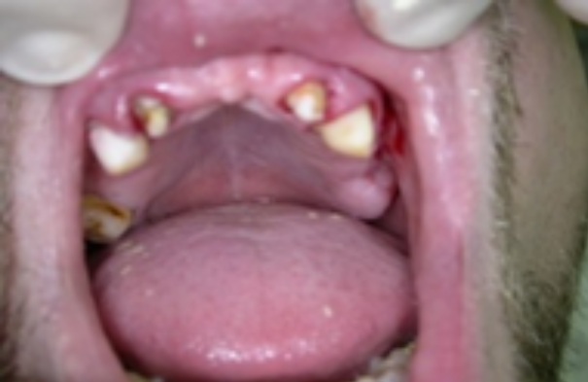
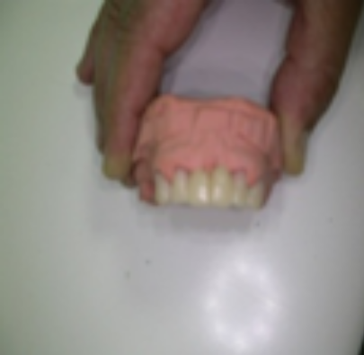
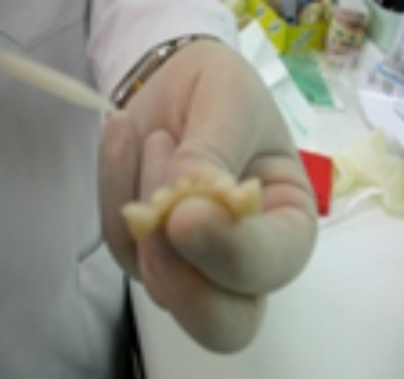
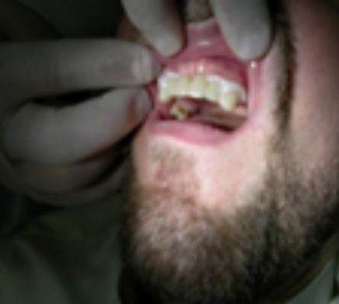
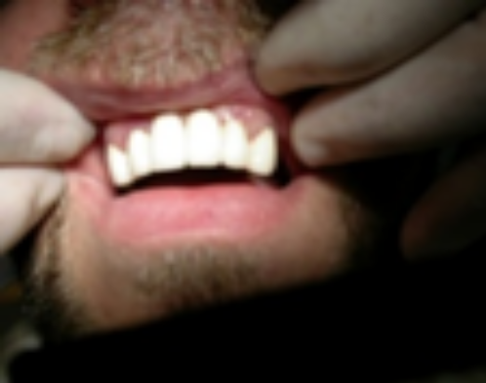
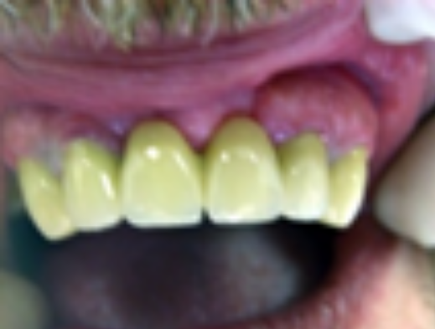
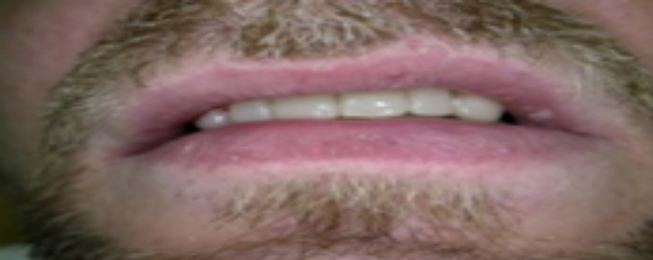

Slide 18
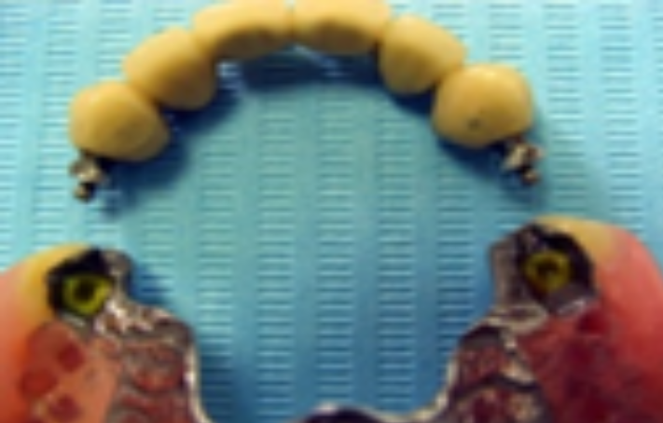
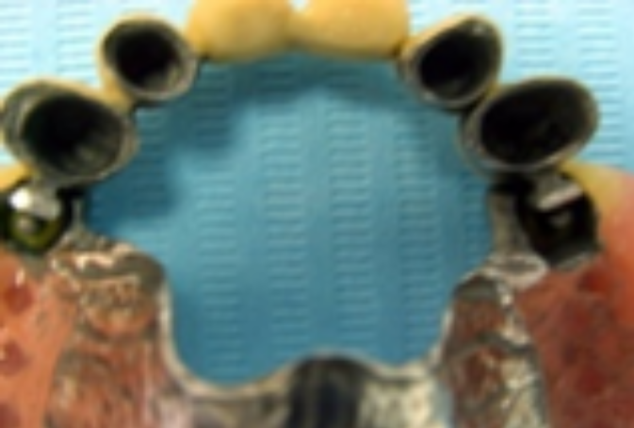
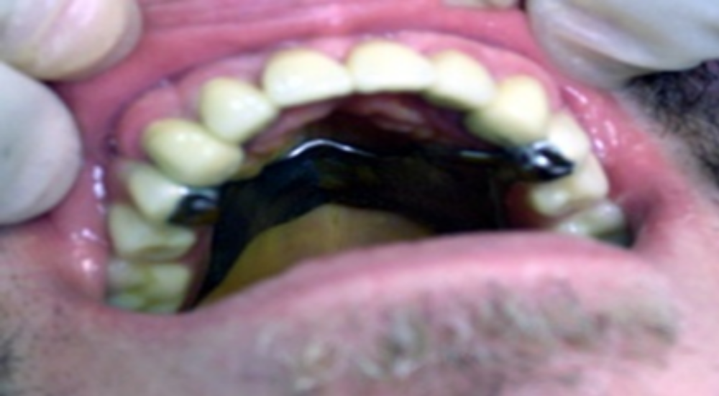

Slide 19
10. Follow up must be done after one week first, then monthly for 6 months, after which every 3 months.( follow up period 6 years till now).

Slide 20
Discussion

Slide 21
This treatment option using fixed prosthesis with hinge attachments RPD has been achieved as an alternative treatment to conventional denture, as the patient refused to have implant for many reasons.
The patient in this clinical report was satisfied with function, esthetics, and decreased compression of the edentulous ridge in function.
These results depend on the patients remark, that an improvement in chewing efficiency, and function was observed. Chewing movements became more balanced, stabilized, and regular than those executed with previous RPDs.

Slide 22
Apart from improving aesthetic and retention of removable partial denture, the availability of the precision attachments have made designing of removable partial denture becomes more flexible.
Finally the patient was so happy by the new appliances and he said that he becomes young and healthy as before.

Slide 23
Conclusion

Slide 24
With proper case selection and treatment planning, removable partial denture still has a good place as a treatment option in replacing missing teeth.
Precision attachment can be used to improve retention and aesthetic of vitallium alloy removable partial denture, if attached to fixed prosthesis.
Maintenance, and recall patient should be for routine oral hygiene every 3 months to be sure of oral hygiene done by the patient.

Slide 25
Thank You

