Slide 1
Blackbox Attacks on the Cloud

Slide 2
Glad to have you here!
Something about me:
Love to break things, especially “hype” tech.
OSCP, CEH, CPTC, PenTest+, eWPT, ECIH

Slide 3

What is Cloud?
Basically resources accessed within the Internet:
Multiple Cloud Deployment Models:
  Private
  Public
  Hybrid
Some reasons why people move to the Cloud:
  Mobility
  Scalability
  Risk Transference

Slide 4
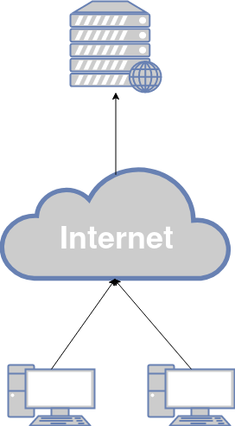
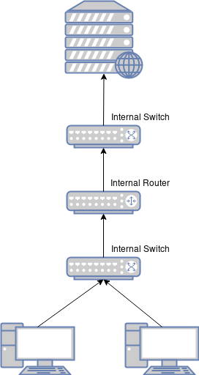
Cloud v.s. On-Premise
Cloud
Order from a restaurant
On-Premise
Cooking yourself

Slide 5
Types of Cloud Services
Infrastructure as a Service (IaaS)
Platform as a Service (PaaS)
Software as a Service (SaaS)
Example: Amazon EC2
Example: Heroku
Example: Slack
1
2
3

Slide 6
Risks for Cloud Services
IaaS
Misconfigured network services
Exposed critical protocols
Exploitation of unpatched/out-of-date environment
Network & Transport Layers DoS/DDoS (L3/L4)
PaaS
Backdoors injection
Virtualization Risks
Resource Sharing: Broken Access Controls, Information Disclosure, Lateral Movement
SaaS
Web-based Exploitation
Virtualization Threats
Application Layer DoS/DDoS (L7)

Slide 7
Cloud Pentesting v.s. Security Audit
Cloud Pentesting
Finding and exploitation of vulnerabilities and security misconfigurations of Cloud deployment
From an external unauthenticated perspective
Cloud Sec. Audit
Finding security misconfigurations and missing controls based on pre-defined baselines and best practices
Using authenticated reader/high-level account

Slide 8
Cloud Security Audit
CIS Benchmarks: https://downloads.cisecurity.org/
CSA Cloud Controls Matrix: https://cloudsecurityalliance.org/research/cloud-controls-matrix/
Automation makes it easier!
  Tools & Resources: https://github.com/CyberSecurityUP/Awesome-Cloud-PenTest

Slide 9
Blackbox Cloud Pentesting
Enumeration of Storage - S3 Buckets, Google Buckets, Azure Blob:
  site:*.s3.amazonaws.com
  Secret Key Exposure - https://github.com/zricethezav/gitleaks
Password Spraying
Phishing for Admin Console Access

Slide 10
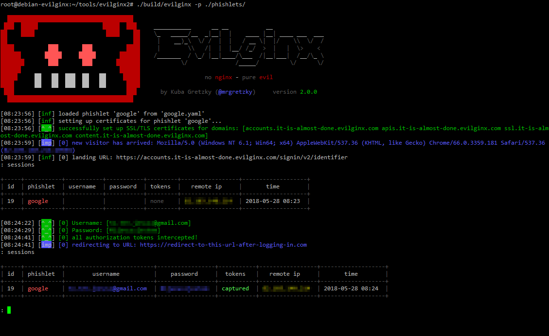
Beware of the Mighty Phishing!
Let me introduce my friend, Evilginx2

Slide 11
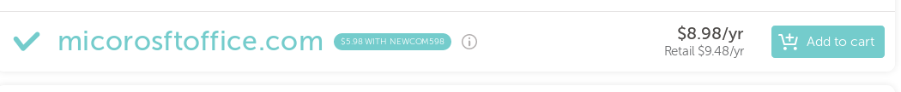
Beware of the Mighty Phishing!
Acquire good domain name (cloud related)
Use Evilginx2 -> bypass MFA -> console

Slide 12
Cloud-based Subdomains Takeover
Through non-registered CNAME records
Mostly pointing to CDNs or Cloud-based Services:
  Azure Traffic Manager (*.trafficmanager.net)
  S3 Storage Buckets (*.s3.amazonaws.com)
  Cloudfront CDN (*.cloudfront.net)
  Azure Default Web Domain (*.azurewebsites.net)

Slide 13

DEMO TIME!!!!!

Slide 14
Breaking into Azure Active Directory
Initial Recon:
  Check if a company is using Azure AD: https://login.microsoftonline.com/getuserrealm.srf?login=username@target.onmicrosoft.com&xml=1
  Username Enumeration (Default “feature” in O365 portal)
Password Spraying:
  Through Legacy Authentication Endpoint
  Bypass IP-based Lockout through address rotating
  Avoid Detection

Slide 15
Breaking into Azure Active Directory
Compromise Deployed VMs
Extract Values within the Key Vault
Dump Azure AD Connect Credentials
Azure Account Hijacking through Compromised Local Endpoint

Slide 16
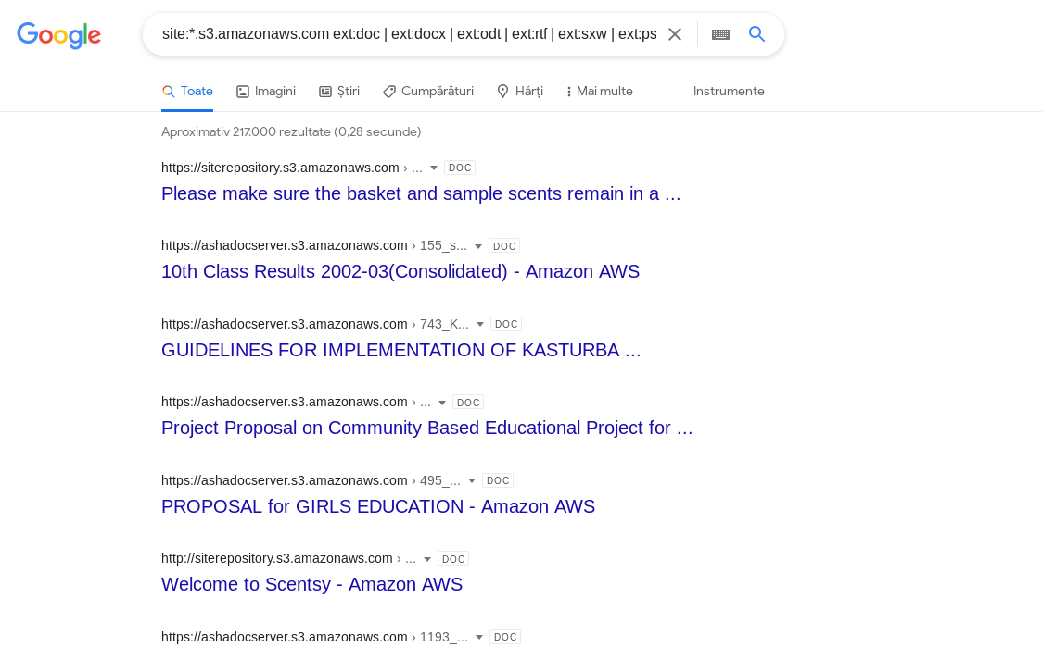
Breaking into AWS
Gaining access to admin console
  Most common: leaked AWS API through public source code, cached pages, etc.
  https://github.com/odomojuli/RegExAPI
Using Google Dorks to search sensitive data in S3 buckets
  Documents
  site:*.s3.amazonaws.com ext:doc |
ext:docx | ext:odt | ext:rtf | ext:sxw |
ext:psw | ext:ppt | ext:pptx |
ext:pps | ext:csv

Slide 17
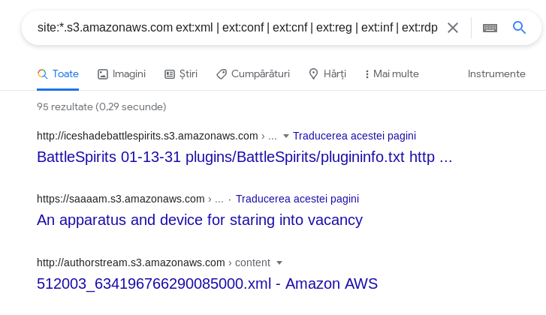
Breaking into AWS
  Configuration-related Data
site:*.s3.amazonaws.com ext:xml | ext:conf | ext:cnf | ext:reg | ext:inf | ext:rdp | ext:cfg | ext:txt | ext:ora | ext:ini | ext:env

Slide 18
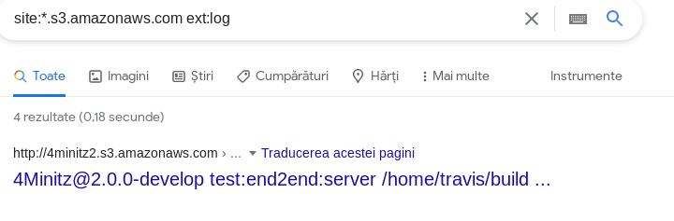
Breaking into AWS
  Log Files
site:*.s3.amazonaws.com ext:log

Slide 19
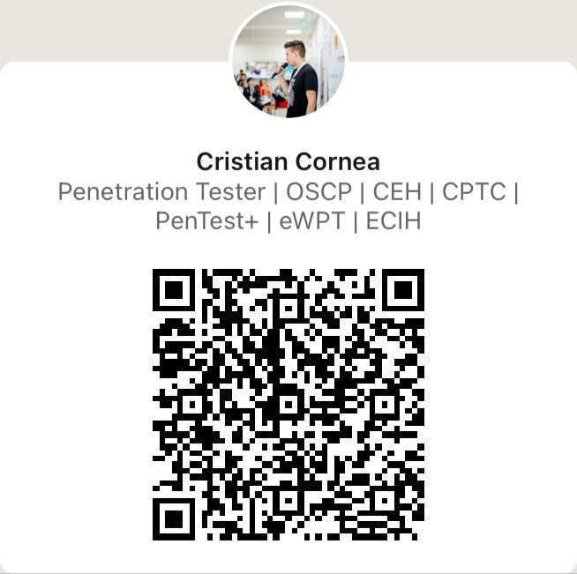
Thanks!
Any questions?
You can find me on LinkedIn:

