Slide 1
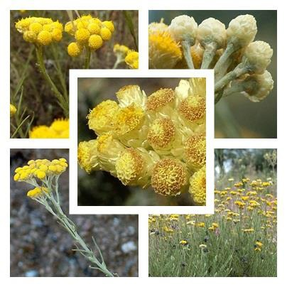
In vitro Antioxidant and Anti inflammatory Activities of the Extracts of Helichrysum stoechas (L.) Moench
Hafsa Boubekeur . Sarra Hellal
hafsa.boubekeur@univ-msila.dz
Introduction
The genus Helichrysum contains about 500–600 herbaceous and shrub species widely distributed in Southern Europe, Africa (including Madagascar), South Asia, South India, Siri Lanka and Australia. Despite the great interest of this genus, little is known about the species Helichrysum stoechas which is generally aromatic, perennial, having dense leaves with rustic flower heads. Immortelle has been used to treat wounds and respiratory conditions. The objective of this study is the determination of the secondary metabolites of Helichrysum stoechas harvested in the mountain of common dirah in Bouira and the study of their antioxidant and anti inflammatory activities
Materials and methods
Helichrysum stoechas was collected in the region of dirah [boiura]. The aerial part was dried in the shade and pulverized into a dry powder. 20g of aerial part were stirred in 200 ml of 80% ethanol and extracted by sxhelet for 6 hours [1]. After evaporation, the yield obtained is 12.25% for EtOH
The total contents of phenols, flavonoids and tannins were estimated by Folin Ciocalteu, aluminum trichloride and by the reaction with vanillin.
Antioxidant properties were evaluated by the methods of DPPH, H2O2, FRAP and TAC.
The anti-inflammatory properties were evaluated by the stabilization method of the membrane of human red blood cells [2] and the protein denarturation test [3]
Results and discussion
Antioxidant activity and dosage
Anti-inflammatory activity
Table 1: Content of polyphenols, flavonoids, tannins and antioxidant activity of the ethanol extract of Helichrysum stoechas and standards
IC50(µg/ml) |  |  | (mg AAE/g) | (mg AGE/g) | (mg AGE/g) | (mg AQE/g) | (mg ATE/g)
Extraits /test | DPPH | H202 | FRAP* | CAT | Polyphenol | Flavonoide | Tannin
EtOH(S) | 25,13±0,64 | 72,75±0,40 | 83,939±0,578 | 103,57±0,10 | 235,67± 3,4 | 61,45± 1,6 | 109,733±5,9
BHT | 45.41±0.64 | - | - | 85,447±0,61 | - | - | -
A ascorbique | - | 32,90±0,68 | 99,176±0,76 | - | - | - | -
A gallique | - | - | - | 110,437±0,15 | - | - | -
Figure 1: Determination of IC50 values ​​of ethanolic extract and diclofenac sodium by various anti-inflammatory methods.
The EtOH (S) of Helichrysum stoechas is found rich of polyphenolic compounds and to possess significant antioxidant activity (Table 1). Profiles of figure.1 show that EtOH (S) has concentration dependent anti- inflammatory activity and inhibited membrane alteration and the BSA protein denaturation very significantly (p<0.001 ) compared to standard diclofenac. Results show that The EtOH (S) is more efficient than standard diclofenac. This in vitro assay indicate that this plant extract is a significant source of natural anti- inflammatory agents which might be helpful in preventing the progress of various inflammatory diseases
Conclusion
Our study showed that Helichrysum stoechas is rich of total polyphenols, flavonoids and tannins, with antioxidant activity greater than the standard and a considerable anti-inflammatory effect.
References
1- Amirah DMRP & Maksudur R K. (2012). Comparison of extraction techniques on extraction of Gallic acid from stem bark of Jathropha curcas. J. Applied Sci., 12(11): 1106-1111.
2- Sumathi S. & Anuradha R. (2016). In vitro anti-inflammatory activity of flower extract of Couroupita guianensis aubl. Innov J Ayruvedic Sci, 4(3): 16-18.
3- Jayaprakasam R. & Ravi T.K. (2012). Evaluation of anti arthritic activity of the root extract of Acalyphaindica linn. Using in vitro techniques. IJPP , 2(6):169-173.

