Slide 1

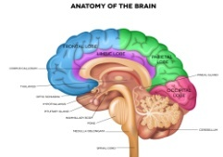
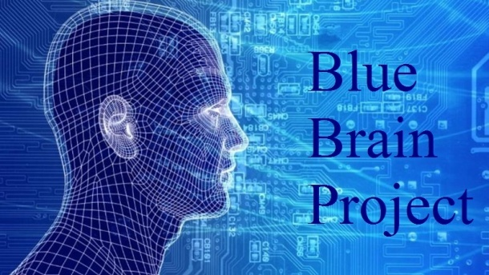
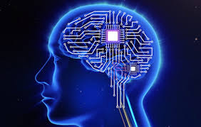
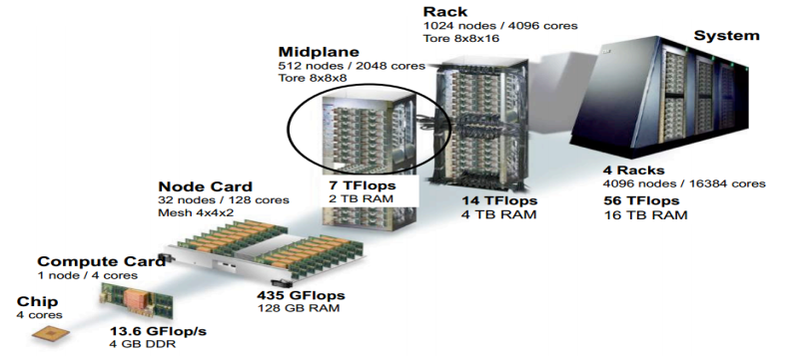
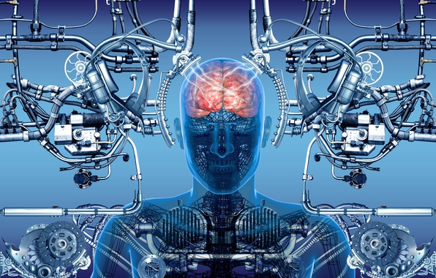
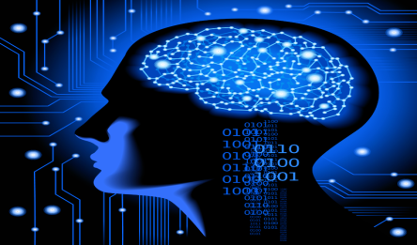
Blue Brain Project
Tanveer Alam Ansari
B.Tech(BioTech) 4th Semister, Department Of Biotechnology, Invertis University, Bareilly
Introduction
Could a simulated brain start to think, feel and experience the world as if it were an organic, human brain?
Technology is growing faster than everything. If possible, IBM’s “BLUE BRAIN”, an artificial brain that can think, respond, take decision, and keep anything in memory, would be the first virtual brain of the world.
Why Blue Brain?
After the death of a person, virtual brain will act as a person so we will not lose the knowledge, intelligence, personalities, feelings and memories that can be used for the development of the human society.
Certain super brains like that of Steve Jobs, or Stephen Hawkings could be interfaced with computer to develop super computers.
Objectives
IBM’s blue brain project will search for insights into how human beings think and remember.
Scientists think, the blue brain could also help to cure the Parkinson's disease.
Natural Brain
Input
  1. Neurons
  2. Sensory cells
Interpretation
Memory
Conclusion
We become dependent upon the computer systems.
Others may use technical knowledge against us.
Computer viruses will pose an increasingly critical threat.
Possibilities of human cloning.
Virtual Brain
Input
1. ANN(Artificial Neural Network) with silicon chip
2.Electric impulses
Interpretation
Memory
Requirements
8,096 CPUs at 700 MHz each of which can map one or two simulated brain neurons
256 to 512 MB memory/processor
100 kilowatts power consumption
Processor should be very high processing power
22.8 TFLOPS peak processing speed
C++ software and Linux
Uploading Human Brain
The uploading is possible by the use of small robots known as the NANOBOTS.
These robots are small enough to travel throughout our circulatory system.
Will monitor activity of brain by traveling into the spine and brain.
They will provide an interface with computer .
Brain Simulation
Simulating human brain by reverse engineering and combining biological studies to digital technology using concept of Artificial Neural Network (ANN)

