Slide 1


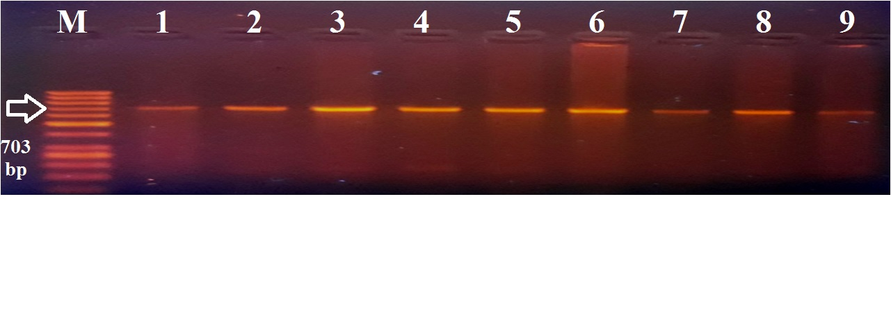
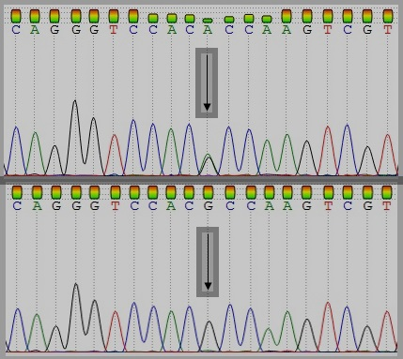

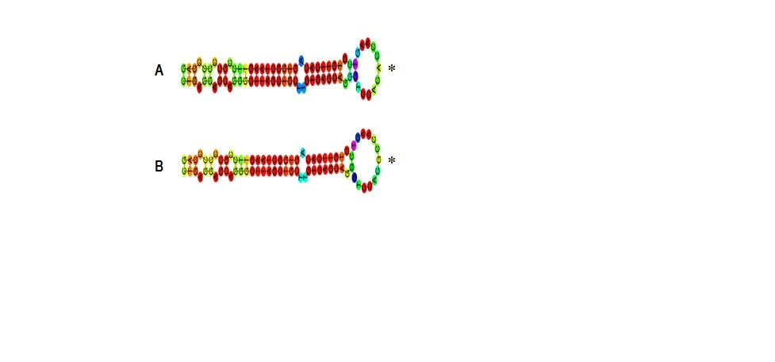
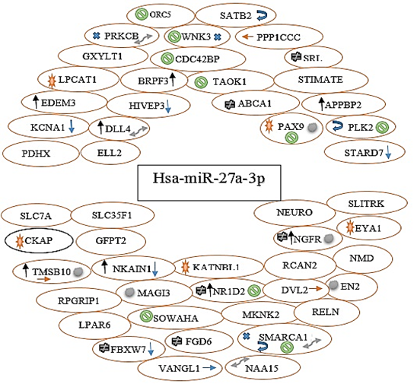
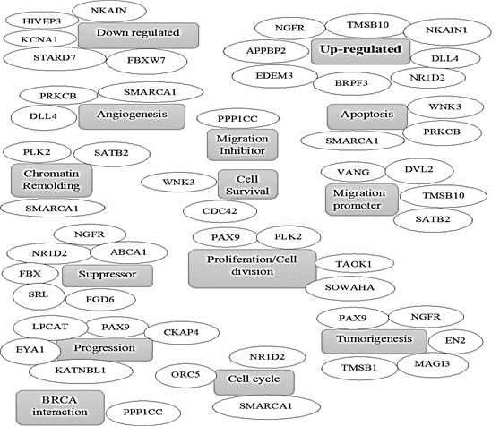
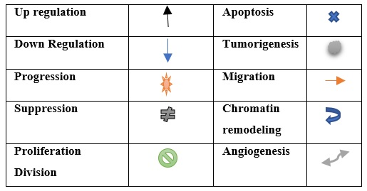
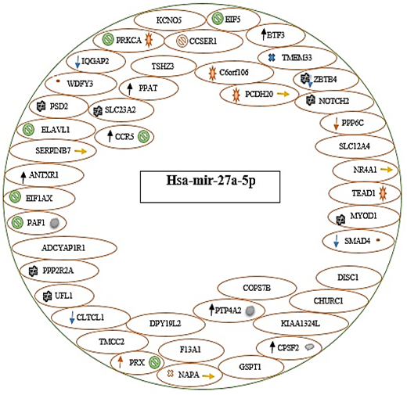
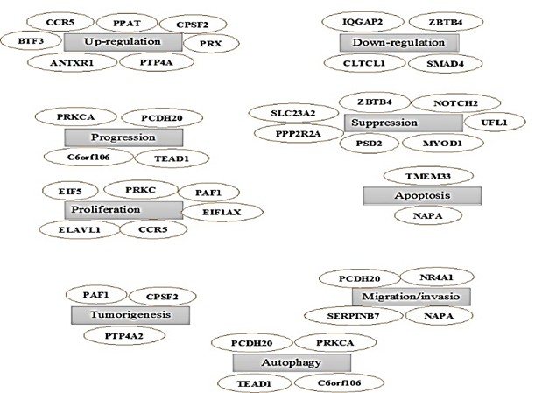

    SNP within MIR27a gene and its implications
    in Breast Cancer
Mushtaq Ahmad and Aftab A. Shah
Department of Biotechnology, University of Malakand
Abstract
Results
MicroRNAs (miRNAs) are short RNA molecules usually 20-24 nucleotides long. They functions by regulating the expression of other genes and play an important role in various diseases including breast cancer (BC). Mutations within MIR27a gene have been linked with breast cancer. In this study we found cancer associated SNP rs895819 in hsa-mir-27a cluster in stage IV BC patients in Pakistan. Structure analysis revealed changes in the terming loop of the precursor microRNA which is the site of action of the microRNA processing enzyme (DICER). The change in structure of microRNA affects its maturation process and leads to deregulation. Deregulated miRNAs influence the expression of its target genes. Several tools are being used to identify potential targets for crucial miRNA genes. In the present study, 11 online target prediction tools were used to investigate target genes that may be regulated by the mature form on MIR27a (hsa-mir-27a-3p and has-mir-27a-5p). After filtering, a total of 52 target gene were found for hsa-mir-27a while for hsa-mir-27a-5p, 45 targets were determined. These target genes were further explored for their potential role in BC. It was found that the target genes are involved in vital biological processes in cancer development, such as tumorigenesis, apoptosis and angiogenesis, cell proliferation and division, cancer progression, metastasis and tumor inhibition. The SNP rs 895819 in MIR27a changes its structure effecting its maturation resulting in deregulation of several genes that are vital for BC development and progression. Mir-27a can be used as a promising new strategy for anti-breast cancer therapy.
PCR Product of hsa-mir-27a
Chromatogram of the Sequenced Region in hsa-mir-27a
Plan of Work
Pre-clinical data collection
Blood sample collection
DNA Extraction
Identification of OncoMirs
Designing gene specific primers
Amplification of the Onco-Mirs
Centroid structures of mutant and wild mir-27a precursor
11. Contribution in breast cancer
12. Comparative Structural analysis of wild and mutated Mir-27a
13. Prediction of target genes
Purification of PCR products
Sanger Sequencing
Sequencing data Analysis
Search for SNPs
The Figure illustrates the centroid structures of wild (A) and variant (B) hsa-mir-27a respectively. the alleles position in the structures are marked by an asterisk
14. Identification of specific role in Breast cancer
Predicted target genes for hsa-mir-27a-5p and their associated function
Conclusions
Mutation rs 895819 effects the structure of precursor Mir-27. which effects its processing by microRNA processing enzymes. A total of 52 target gene were found for hsa-mir-27a while for hsa-mir-27a-5p determined 45 targets. It was found that the target genes are involved in vital biological processes in cancer development, such as tumorigenesis, apoptosis, and angiogenesis, cell proliferation and division, cancer progression, metastasis and tumor inhibition. On the basis of predicted regulated genes; miR-27 variants may effect the event of cancer development and progression, effecting the survival of the BC patients
vital activities of predicted genes
Predicted target genes for hsa-mir-27a-5p and their associated function
Acknowledgement
This Project is supported by The Higher Education Commission of Pakistan under the HEC indigenous fellowship of Mr. Mushtaq Ahmed (213-59624-2BM2-131).

