Slide 1
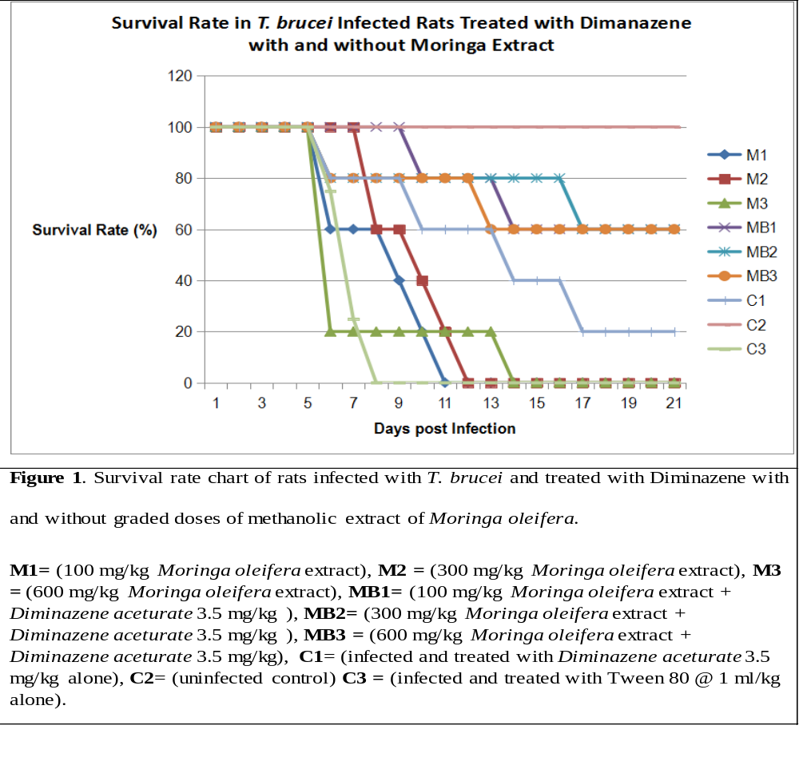
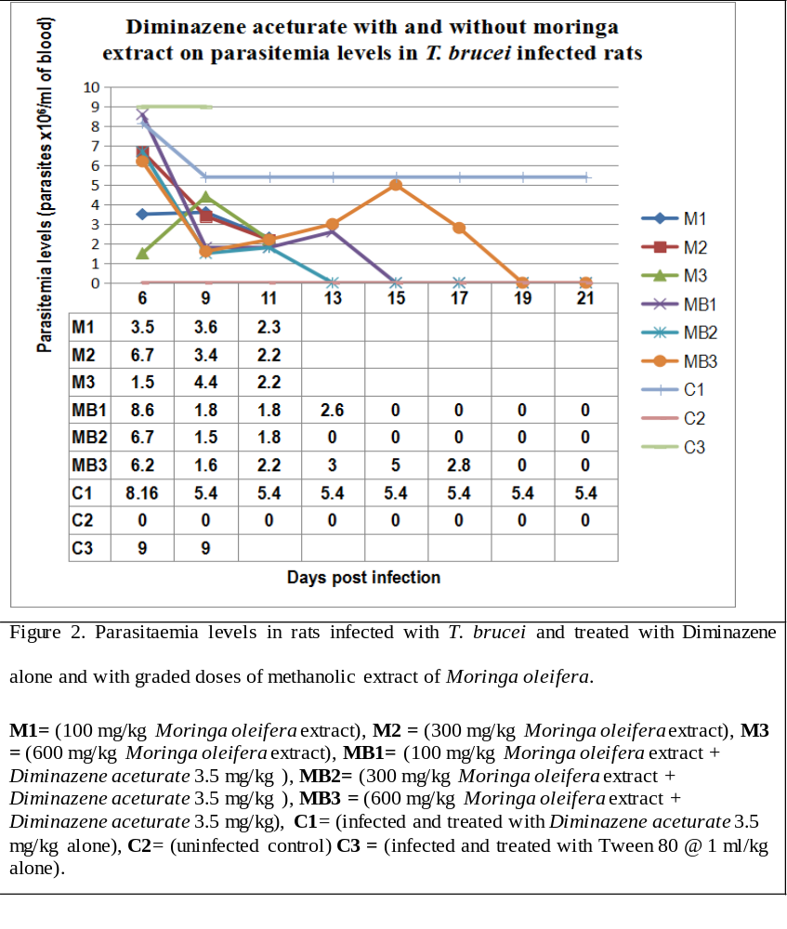
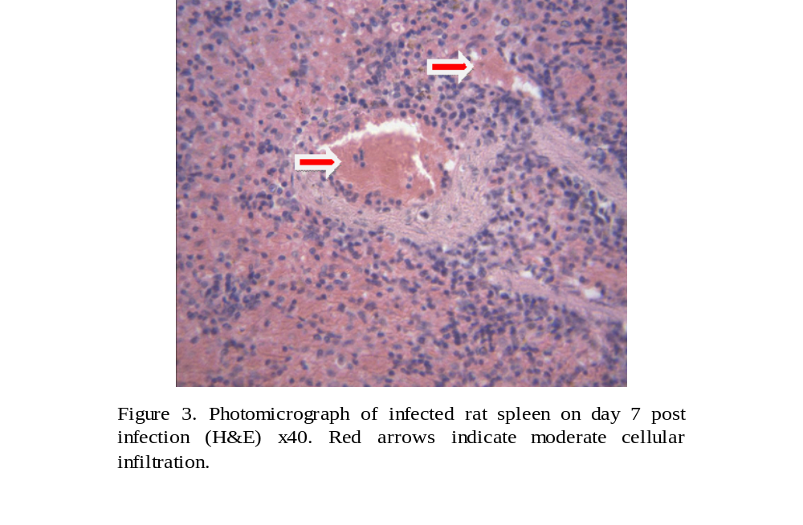
Methanolic Leaf Extract of Moringa oleifera Improved Survival Rate and Enhanced the Efficacy of Diminazene Aceturate in Murine Experimental T. brucei Infection.
Kingsley I. Eghianruwa and Kalu Anya.
Department of Veterinary Pharmacology and Toxicology, University of Ibadan, Nigeria
Abstract
The efficacy of diminazene against T. brucei infection with and without methanolic leaf extract of Moringa oleifera was evaluated in this study. Eight groups of five rats per group were infected with TRIUN 0814 strain of T. brucei. Each rat in three of the infected groups received daily moringa extract at 100 mg^{-kg} (M1), 300 mg^{-kg} (M2) and 600 mg^{-kg} (M3) starting from day 5 post infection (PI). Each rat in another three infected groups received a single dose of diminazene 3.5 mg^{-kg} intraperitoneally followed with daily oral doses of the extract at 100 mg^{-kg} (MB1), 200 mg^{-kg} (MB2) and 400 mg^{-kg} (MB3) for 14 days. One infected group was treated with diminazene 3.5 mg^{-kg} alone (C1) while one uninfected group received Tween 80 1 mg^{-kg} orally (C2). The ninth group (C3) was infected and untreated. Survival rate, parasitemia, haematocrit, erythrocyte count and changes in the weights and histology of spleen and liver were evaluated. Survival rates by day 21 post infection (PI) i.e. 16 days post treatment (PT) were 100% in C2; 60% in MB1, MB2, MB3; 20% in C1; 0% in C3, M1, M2 and M3. Parasitaemia levels on day 21 PI (16 days PT) was 5.4 x 10⁶ per ml of blood in group C1. Parasites were not detected in groups MB1, MB2, MB3 and C2 by day 21 PI (day 16 PT). Haematocrit and erythrocyte counts were significantly reduced by days 5 and 12 PI in all groups except C2. However, haematocrit and erythrocyte counts returned to normal levels in MB1, MB2 and MB3 but not in C1. By day 21 PI, the livers of survivors in groups MB1, MB2 and MB3 and C1 had histopathological lesions while the spleens from the same groups were free of lesions. These results showed that moringa may not possess antitrypanocidal action but its combination of diminazene enhances the efficacy of the later.
Materials and methods
Plant Materials and Extract. Moringa oleifera leaves were collected in July, 2019, identified and authenticated at the Botany department, University of Ibadan, Nigeria with voucher specimen UIH 22485. The methanol extract was obtained using standard methods and analytical grade of methanol (Aldrich). The dried extract was dissolved in Tween 80 for the study.
Experimental Animals and Trypanosomes
Albino rats of Wistar strain, mixed sexes and weighing 120 - 150g were housed in standard rat cages accommodated in a well-ventilated fly proof house. Animals were humanely cared for in compliance with The Principles of Laboratory Animal Care. The institution’s ethics committee approved and monitored the protocol. Animals were fed and watered ad libitum. Infection was with T. brucei brucei (Strain TRIUN 0814).
The rats were randomly placed in nine groups of five rats per group. Each rat in eight groups was infected intraperitoneally with T. b. brucei (1.6 x 10⁶ trypanosomes). Each rat in three of the infected groups received daily moringa extract orally at 100 mg-kg (M1), 300 mg-kg (M2) and 600 mg-kg (M3) starting from day 5 post infection (PI). Each rat in another three infected groups received a single dose of diminazene 3.5 mg-kg intraperitoneally followed with daily oral doses of the extract at 100 mg-kg (MB1), 200 mg-kg (MB2) and 400 mg-kg (MB3) for 14 days. One infected group was treated with diminazene 3.5 mg-kg alone (C1) while one uninfected group received Tween 80 1 mg-kg orally (C2). The ninth group (C3) was infected and untreated. Haematological parameters, parasitaemia, survival rate, liver and spleen weight and histology were evaluated before infection, 14 days after infection and in surviving animals at the end of the study period.
Conclusion
There are numerous reports of the nutritional and medicinal benefits of moringa but none has linked moringa with the synergistic effect on diminazene treatment of trypanosomosis observed in this study. Moringa did not show antitrypanocidal action but its combinations with diminazene enhanced the efficacy of the trypanocide.
Introduction/Objectives
African Trypanosomosis is one of the major parasitic diseases of humans and animals in Sub Sahara Africa for which control is yet to be achieved even after more than one century since it was first described.
The disease is characterized by fever, anaemia, cacchexia, immunodepression etc.
Chemotherapy remains the mainstay of trypanosomosis control especially as other measures including vaccine production have fallen short of expectations.
However, currently available drugs are old, toxic and with widespread resistance.
In the absence of new synthetic drugs, the screening of natural products for trypanocidal action has become paramount.
This study was undertaken to screen Moringa oleifera for trypanocidal action and to evaluate the efficacy of diminazene in the presence of moringa.
Results
Survival Rates. Survival rates in all groups were 100% for the first five days post infection (PI). Deaths were recorded from day 6 PI (day 1 PT) at which time survival rates were 60% (M1), 100% (M2), 20% (M3), 100% (MB1), 80% (MB2), 80% (MB3), 80% (C1), 100% (C2) and 20% (C3) (Figure 1). There were no survivors in group C3 by day 2 PT; M1 by day 6 PT; M2 by day 7 PT and M3 by day 9 PT. At the end of the observation period at 21 days PI (16 days PT), survival rates were 60% in each of groups MB1, MB2, MB3 and 20% in C1. Moringa extract alone did not significantly enhance survival rates of the animals but a combination of moringa and diminazene gave higher survival rates than diminazene alone.
Parasitaemia. Parasites were observed in the blood of infected rats by day 3 pi. Treatment with moringa extract alone had no consistent effect on parasitemia levels. Treatment with diminazene alone did not significantly (p < 0.05) reduce parasitemia by day 6 pi (24 hours after treatment) compared to groups MB1, MB2 and MB3. By day 4 PT, parasitemia in the C1 group (diminazene alone) was significantly lower than the C3 group (infected and untreated) but was significantly (p < 0.05) higher than parasitemia in the groups treated with combinations of diminazene and graded doses of moringa extract. There were no significant (p < 0.05) differences in the reduction rates of parasitemia among the groups treated with diminazene/moringa combinations (MB1, MB2 and MB3). No parasites were detected in the MB2 group by day 13 pi (8 days PT) and rats in the group remained aparasitemic till the end of the 21 days observation period. Although parasites were still being detected in the blood of rats in the MB3 group till day 17 pi (12 days PT), the levels were significantly (p < 0.05) lower than in the C1 (diminazene) group. At the end of the observation period, all animals in the diminazene/moringa groups (MB1, MB2, MB3) were aparasitemic while the C1 (diminazene alone) group were still parasitemic (Figure 2).
Haematology. Trypanosoma brucei infection caused significant decreases in haematocrit and erythrocyte count (Table 1). Treatment with moringa alone (M1, M2, and M3) did not restore PCV and RBC counts to normal levels by day 21 PI (16 days PT). However, by day 14 PI (9 days PT) PCV and RBC levels had returned to normal in the groups treated with combinations of diminazene and moringa (MB1, MB2 and MB3).
Organ Pathology. The liver and spleen of infected rats were significantly enlarged. The liver from surviving rats showed cellular infiltration at the portal canal area by mostly macrophages and mild portal congestion while the spleen showed mild generalized congestion (Figure 3).
References
Adamu, U.O., Haruna, M.K., Ovbagbedia, R.P., Bizi, R., Benjamin, W., Malala, U.A., Nwezor, F.N.C. and Muhammed, M., 2011, ‘Control of African Trypanosomiasis in Nigeria: Time to Strengthening Integrated Approaches (A Review)’, International Journal of Animal and Veterinary Advances, 3, 138-143.
Eghianruwa, K. I. and Obidike, R. I. (2011). Effects of antioxidants on the efficacy of diminazene aceturate treatment of experimental murine Trypanosoma congolense infection. Animal Production Research Advances. 7(2): 134 – 140.
.
Eghianruwa, K. I. and Anika, S. M. (2012). Effects of DMSO on diminazene efficacy in experimental murine T. brucei infection. International journal of Animal and Veterinary Advances. 4 (2): 93-98.
Eghianruwa K. I. and Eghianruwa, Q. A. (2018). Development of New Drugs against Trypanosomes – A Review of Desirable Properties of the Drugs and Potential Drug Targets in the Parasite. Tropical Veterinarian. 36(1): 24-41
Eghianruwa K. I. and Oridupa, O. A. (2018). Chemotherapeutic control of trypanosomosis - a review of past measures, current status and future trend. Veterinarski Arhive. 88(2): 245-270.
Geerts, S., Holmes, P.H., Eisler, M.C. & Diall, O., 2001, ‘African bovine trypanosomiasis, the problem of drug resistance’, Trends in Parasitology, 17, 25-28.
Biography
Dr K. I. Eghianruwa obtained DVM and PhD degrees from the University of Nigeria, Nsukka and a Master of Science degree from the University of Guelph, Ontario Canada. His specialty is Veterinary Pharmacology. He has published extensively on the chemotherapy of Trypanosomosis. He is also the author of Rational Drug Therapy in Veterinary Practice. He is currently an Associate Professor at the University of Ibadan, Nigeria. Dr Eghianruwa can be reached at keghianruwa@gmail.com.
Dr Ayan K. is a graduate of the Faculty of Veterinary medicine at the University of Nigeria, Nsukka. He undertook his MSc project under the supervision of Dr Eghianruwa.

