Slide 1



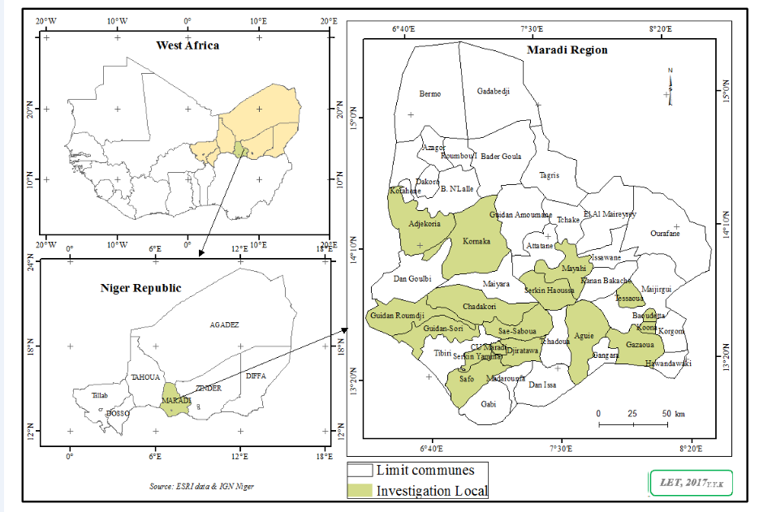
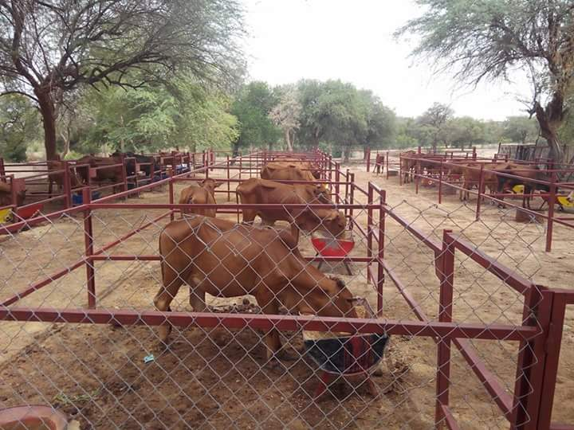
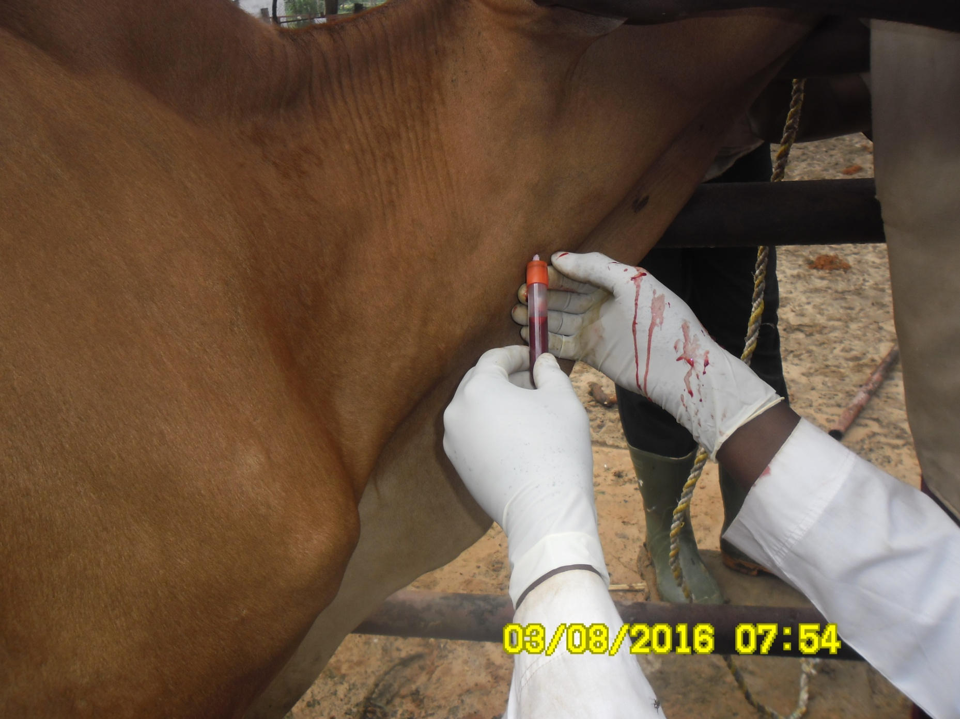
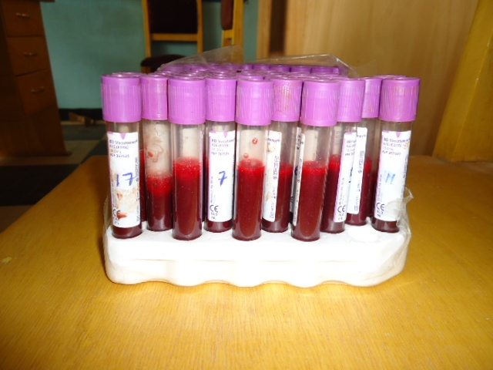
COMPARISON OF TIME FRAME CRITICAL FOR FEED SUPPLEMENTATION ON REPRODUCTIVE HORMONES OF AZAWAK CATTLE BREED IN SEMI–ARID ZONE OF NIGER REPUBLIC
^{* 1,} ²Alassan, N. A., ²Muhammad, I. R., ³Maigandi, S. A. and ¹Issa, S.
¹Department of Animal Production, National Institute for Agricultural Research from Niger
²Department of Animal Science, Bayero University, Kano, Kano State
³Department of Animal Science, Usmanu Danfodiyo University, Sokoto
*Corresponding author: adoalassannourou@yahoo.fr +227 96152433
STUDY AREA / RESEARCH OBJECTIVES
RESULTS
To determine a time frame critical for utilization of supplement by Azawak Cattle in addition to rangeland grazing and to evaluate the effect of inorganic minerals supplementation on male and female reproductive hormones of Azawak Cattle.
Figure 1: Average daily weight gain between treatments
MATERIALS AND METHODS
Feed Ingredient and Composition
The composition of experimental diet contained 35, 15, 10, 15 and 1% of millet stalk, cotton seed cake, Faidhebia albida pod, wheat bran and salt. Also, added to it were cowpea fodder (13%), urea (1%), phosphorus (5%) and calcium (5%).
Experimental Design
The animals were allocated into six treatment groups of three replicates per sex each containing 6 cattle (3 males and 3 females). There were thus 6 cattle per group in the Completely Randomized Design experiment. The treatments were evaluated by time of supplementation of the diet to the experimental animals. NS: No supplementation (control); SMD: Supplementation early (8:00 am); SED: Supplementation in evening (5:00 pm); SMED: Supplementation in the morning (8:00 am) and in the evening (5:00 pm) daily; S2DM: Supplementation once every two days in the morning (8:00 am) before morning out for grazing and S2DE: Supplementation once every two days in the evening (5:00 pm)
Feed Ingredient and Composition
The composition of experimental diet contained 15, 10, 15 and 1% of cotton seed cake, Faidhebia albida pod, wheat bran and salt. Also, added to it were cowpea fodder (13%), urea (1%), phosphorus (5%) and calcium (5%).
Experimental Design
The animals were allocated into six treatment groups of three replicates per sex each containing 6 cattle (3 males and 3 females). There were thus 6 cattle per group in the Completely Randomized Design experiment. The treatments were evaluated by time of supplementation of the diet to the experimental animals. T1: No supplementation (control); T2: Supplementation early (8:00 am); T3: Supplementation in evening (5:00 pm); T4: Supplementation in the morning (8:00 am) and in the evening (5:00 pm) daily; T5: Supplementation once every two days in the morning (8:00 am) before morning out for grazing and T6: Supplementation once every two days in the evening (5:00 pm).
Figure 2: Mean value of testosterone between treatments per sex
Figure 3: Mean value of progesterone between treatments per sex
Plate 1: Experimental animals allocated to individual pens
Plate 2: Taking blood samples via jugular vein
Plate 3: Blood samples collection
Figure 4: Mean value of estradiol E2 between treatments per sex
Figure 5: Mean value of FSH between treatments per sex
Statistical Analysis
Differences in mean percentages and concentrations of the variables between to a time frame critical for utilization of supplement were analyzed by one-way analysis of variance and subsequent Duncan’s multiple comparisons Test (post-hoc). Differences in mean percentages and concentrations of the variables between male and female animals were determined by Paired-Samples t-test .
CONCLUSION
It could be concluded that inorganic minerals in feed supplementation has beneficial effect on reproductive hormones of Azawak cattle breed. This study further need to evaluate the effects of semen quality parameter and libido of bulls.

