Slide 1

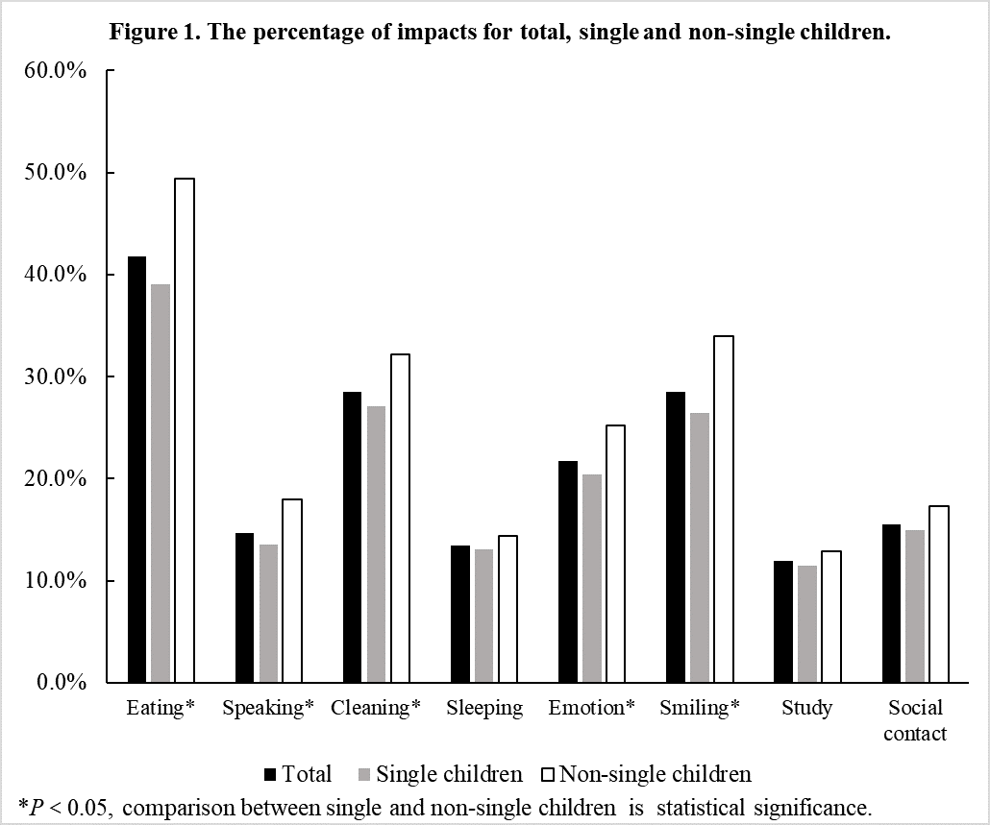
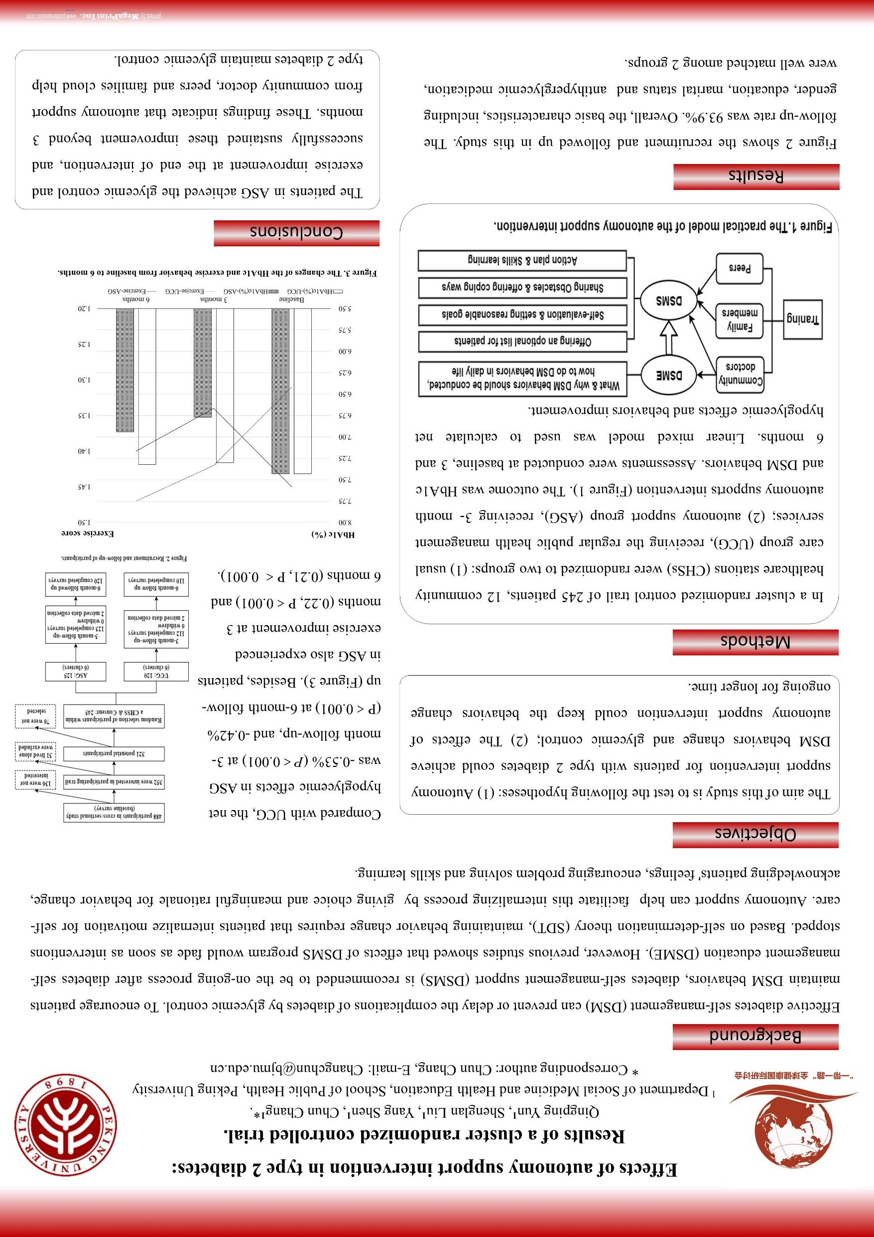
Oral Health-Related Quality of Life in Chinese School Children:
Do Child Siblings Matter?
Qingping Yun¹, Min Liu¹, Mei Zhao¹, Hui Zhang, Wei Hou, Chun Chang¹*.
¹ Department of Social Medicine and Health Education, School of Public Health, Peking University
2. Department of Preventive Dentistry, Beijing Stomatological Hospital, Capital Medical University
* Corresponding author: Chun Chang, E-mail: Changchun@bjmu.edu.cn
Background
The quantity-quality trade-off theory indicates that an increase of siblings might decrease a child’s well-being, but little evidence shows the impacts of sibling number on children’s Oral Health-Related Quality of Life (OHRQoL).
Objectives
This study aims to investigate the effects of presence of siblings on children’s OHRQoL, and to further exam whether there is an interaction effect between presence of siblings and place of residence on children’s OHRQoL.
Methods
The 12-year-old oral health survey data were from the 4th survey conducted in 2015 and 2016 in Beijing, China. OHRQoL was assessed by the child Oral Impacts on Daily Performance (OIDP). OIDP prevalence was served as the indicator of OHRQoL. Children with and without siblings were recorded as single or non-single children. Place of residence (rural/urban) was found using the children’s household registration type. A synergy index (S) was used to assess the possible interaction effect.
Results
1. In total, 2158 school children were surveied, and 60% of them reported OIDP. OIDP prevalence for non-single and single children were 68.3% and 56.9%, respectively. Figure 1 shows each impact for single and non-single children.
Table 1. The effects of socio-demographical characteristics and oral health problems on OIDP
Variables | OR (95%CI)
Female | 1.25 (1.05, 1.49) *
Rural | 1.42 (1.13, 1.80) **
Maternal education
High school | 0.81 (0.63, 1.06)
College school | 0.67 (0.50, 0.90) **
University and above | 0.71 (0.54, 0.93) **
Non-single children | 1.31 (1.05, 1.63) *
Active caries | 1.42 (1.11, 1.82) **
Bleeding | 1.00 (0.77, 1.29)
*P < 0.05, ** P < 0.01, *** P < 0.001.
2.Female, rural, non-single children, and children with less educated mothers were more likely to report OIDP (Table 1).
3. The synergy index between sibling number and place of residence on OIDP was 2.09 (Table 2), indicating that an excessive risk increase for OIDP was observed in non-single and rural children.
Table 2. The interaction effect between presence of siblings and place of residence on OIDP
 |  | Total | OIDP, | OR | S
 |  |  | n (%) | (95% CI) ª | (95%, 85% CI) ª
Single | Urban | 1324 | 734 (55.4%) | 1 | 2.09
 | rural | 251 | 162 (64.5%) | 1.28 (0.96, 1.71) | (0.71, 6.16),
Non-single | urban | 319 | 199 (62.4%) | 1.22 (0.93, 1.58) | (1.56, 4.26)
 | rural | 264 | 199 (75.4%) | 2.03 (1.47, 2.80)
a: adjusted for gender, maternal education, and oral health problems.
Conclusions
Children with siblings are more likely to report a lower OHRQoL, especially those from rural areas. These findings indicate that oral health interventions should be given the priority to non-single and rural children.

