Slide 1
The Clinical Impact of the DNA Sequencing Revolution on Cancer
David I Smith, Ph.D.
Professor
Laboratory Medicine and Pathology

Slide 2
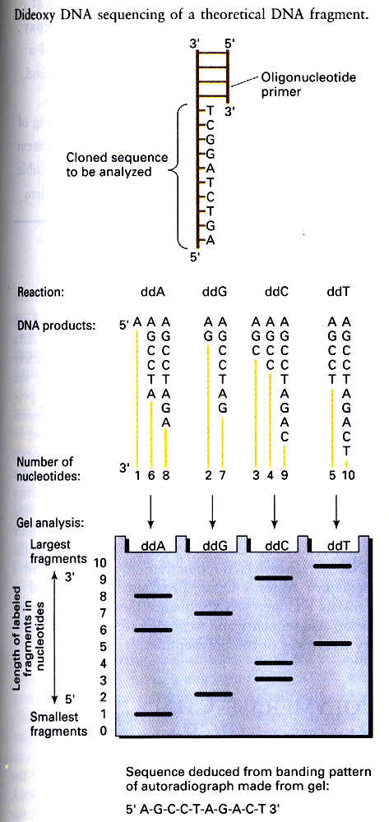

Slide 3
Sanger Sequencing
Clone individual pieces into E coli plasmids
Produce at least 10¹³ copies of each template
Do 10 ul reactions with big dye terminators
Generate 800-1,000 bp of sequence per template
However, with radioactive ddNPTs and 10 ul reactions it is still very expensive to sequence large numbers of templates

Slide 4
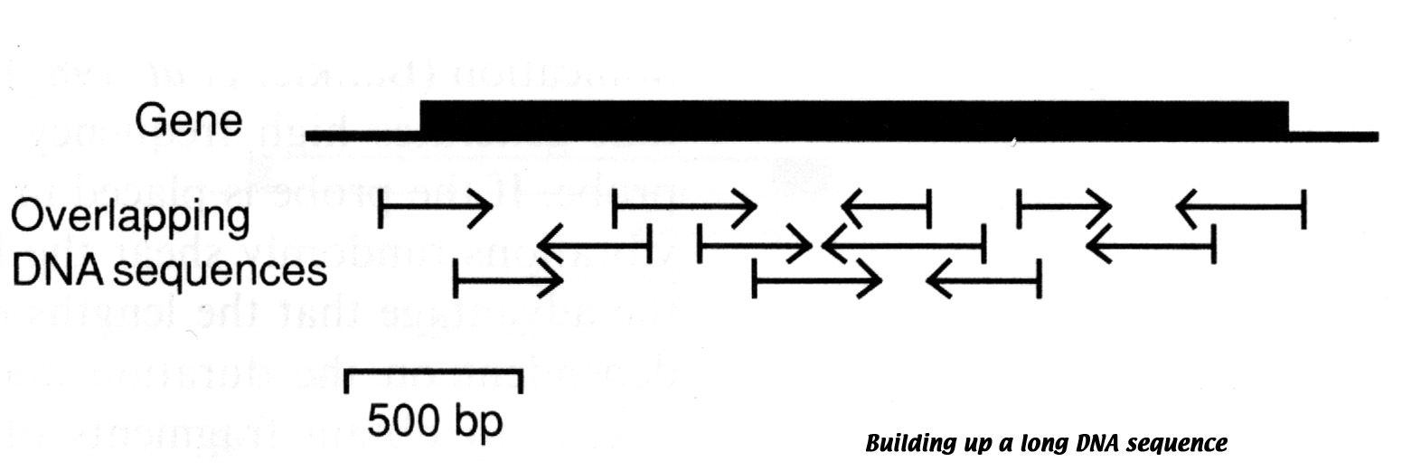

Slide 5
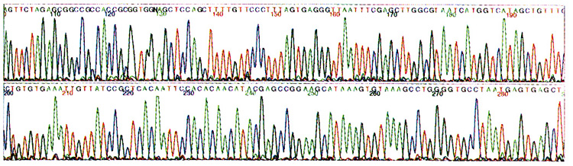

Slide 6
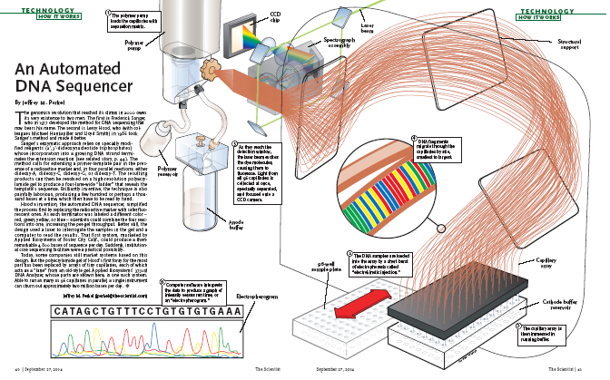

Slide 7
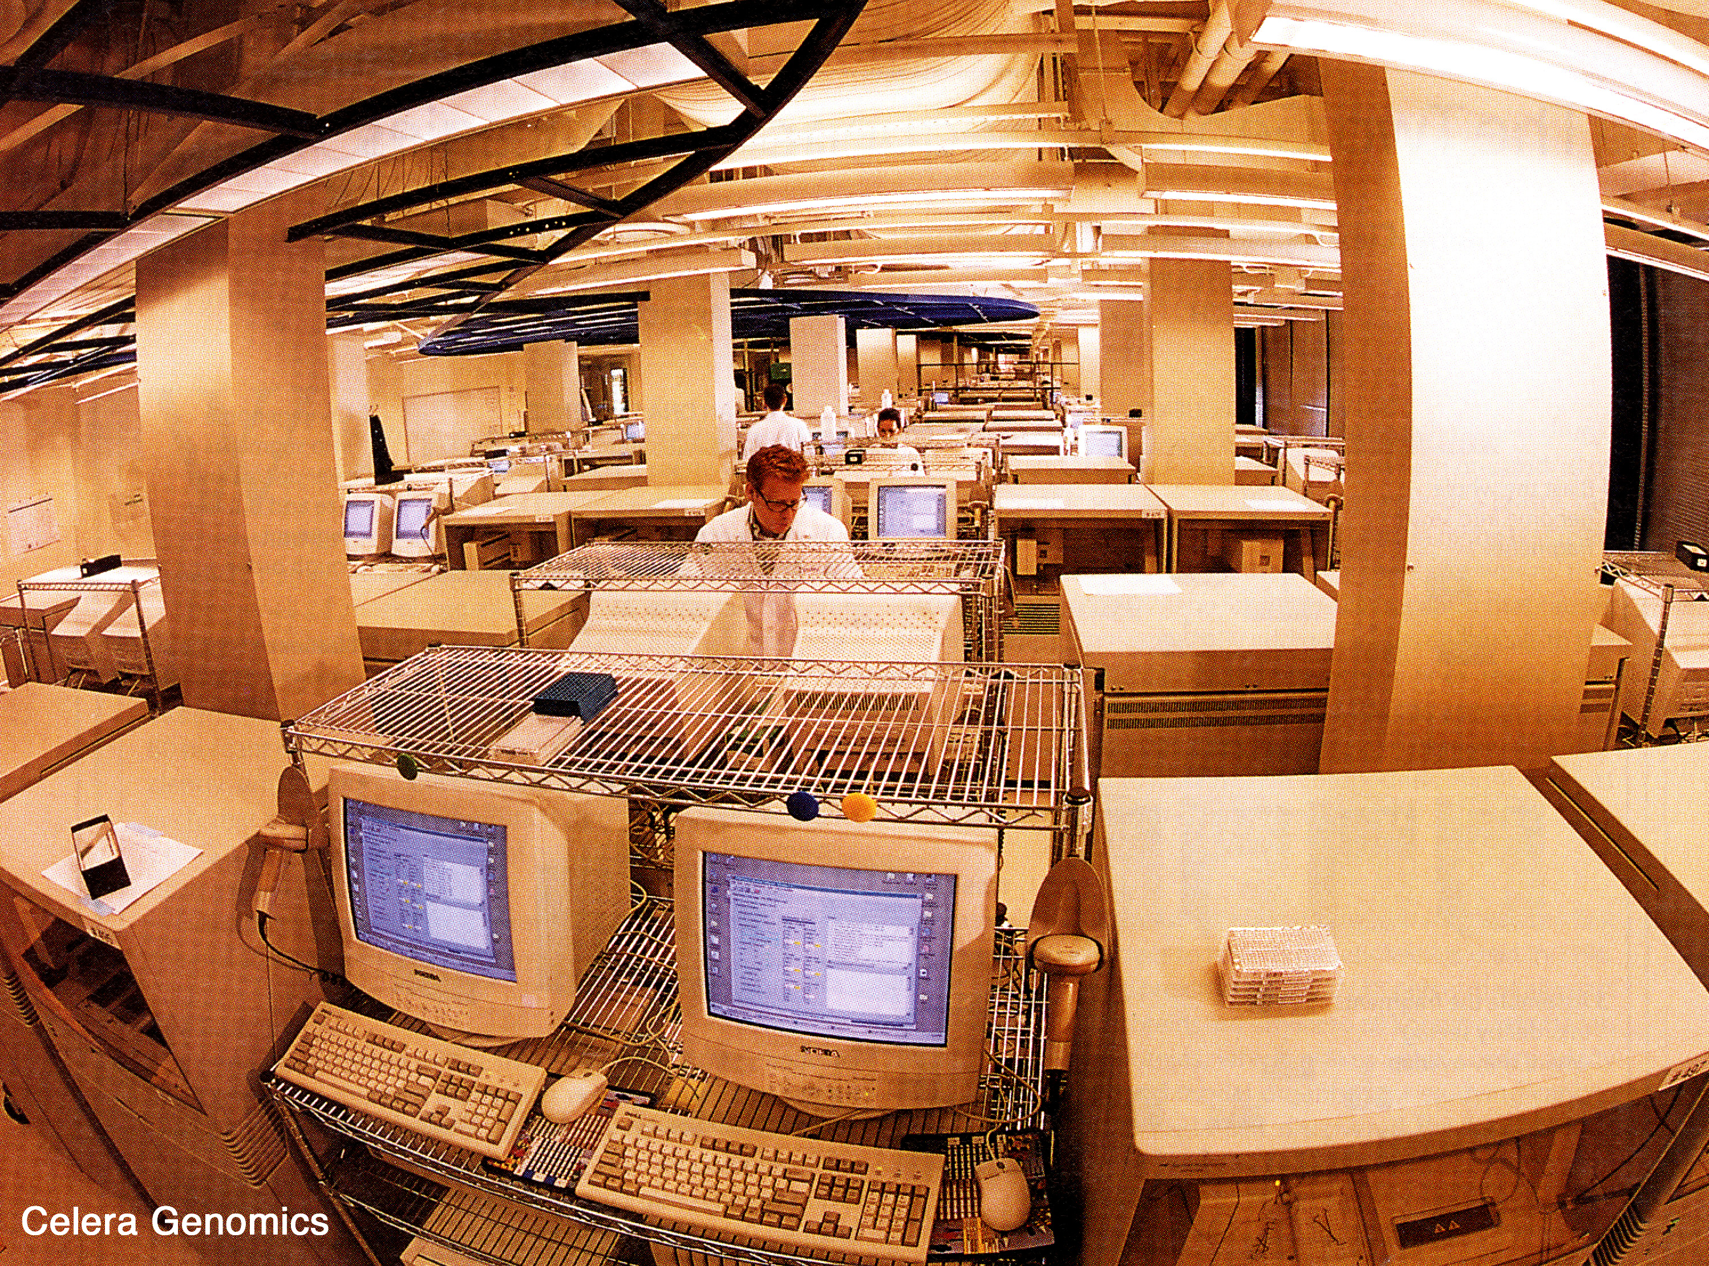

Slide 8
Cost To Sequence The Human Genome Using CE
Automated sequencers reduced the cost/base of sequencing dramatically
However, you still had to clone every piece to be sequenced in E. coli
You also had to use 10 ul individual reactions for each sequencing.
All told it cost almost 3 billion dollars to sequence the first human genome

Slide 9
How To Decrease Sequencing Costs?
Find a solution to having to clone individual fragments into E. coli
Decrease sequencing reaction volume
Increase the number of simultaneous sequences

Slide 10
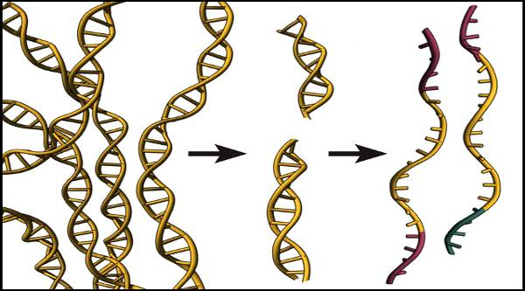
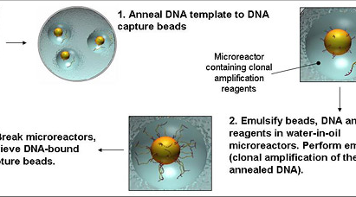
(A) Clonal Amplification: Emulsion PCR

Slide 11
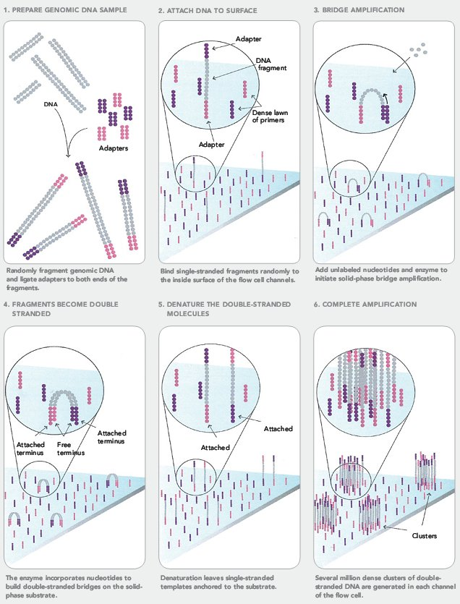
(B): Bridge Amplification

Slide 12
Reduce reaction volume
10 ul reactions in CE sequencing uses considerable amounts of reagents
How to decrease the reaction volume?
Strategy #1- Clusters on slide surfaces
Strategy #2- Small beads on a slide surface or within wells

Slide 13
Massively parallel sequencing
Use technologies analogous to massively parallel computing
Run hundreds of thousands to millions of simultaneous sequencing reactions
Picotitre plates contain 1.5 million wells

Slide 14
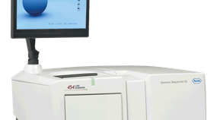
The first Next Generation DNA sequencer- 454 GS 20

Slide 15
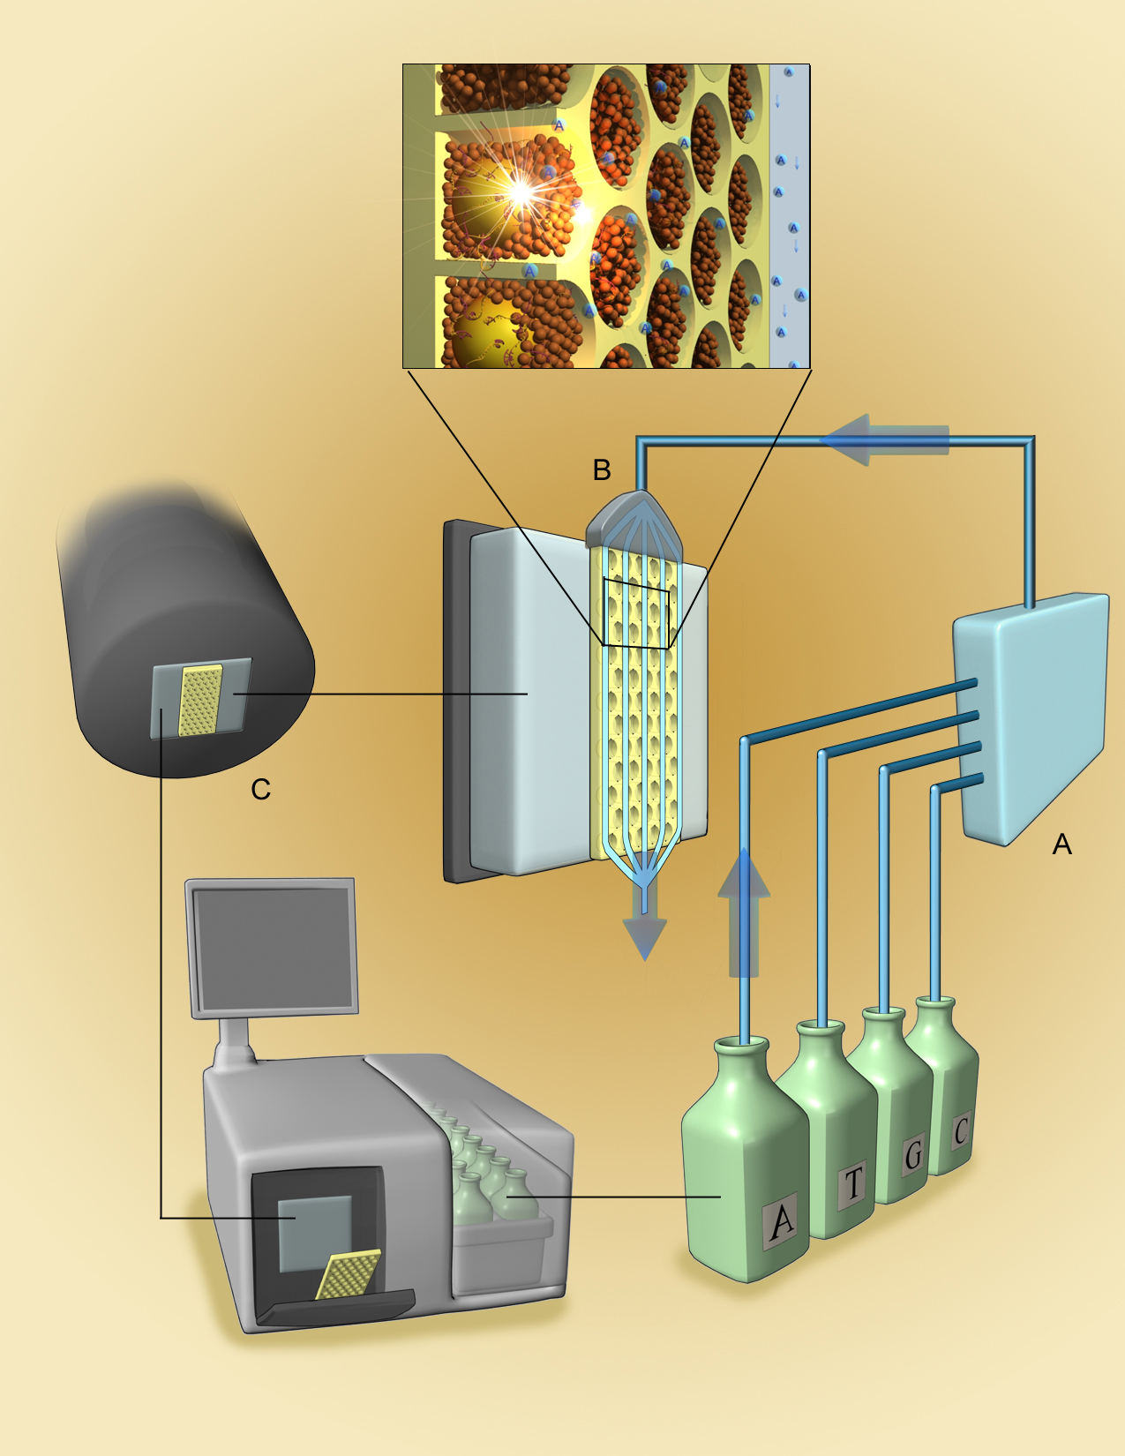
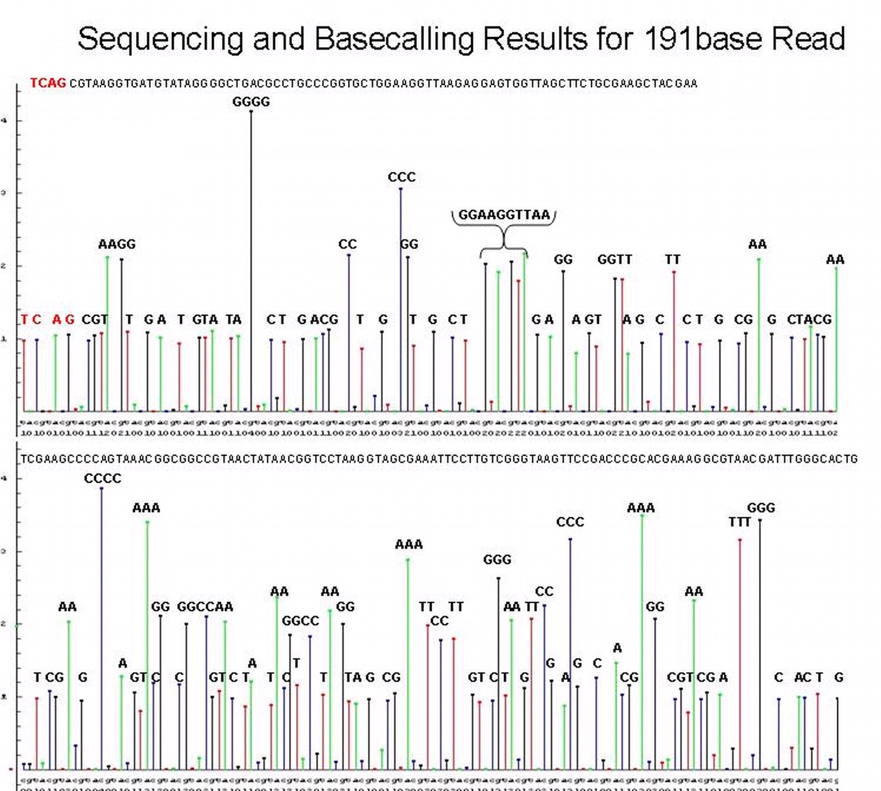
454 Technology - Sequencing Instrument
Notes:
15

Slide 16
Strengths and Weaknesses of the 454
Long (400 bp+) reads
Improvements!
Emulsion PCR
Homopolymers
Limited headroom for further increases in sequence output

Slide 17
Evolution of the GS Series
Initially Genome Sequencer 20 (for 20 Mbs of sequence/run)
Soon became a 100 Mb sequencer (more active wells, longer reads), changed name to GS FLX (flexible)
Current Generation- Titanium coated plates - GS FLX Titanium- 500 Mbs/run, 8 hours, $6,000. But, no room for further improvement!
Sequenced the Watson genome at a cost of $1,000,000- 2007

Slide 18
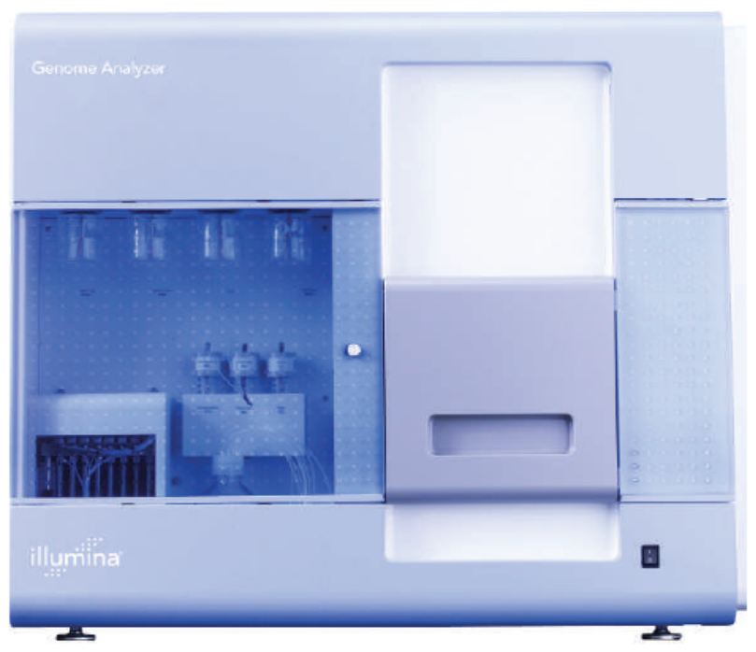
Illumina Genome Analyzer
From: Blow, N. et al. Nature: 2007: 449, 627-630.
Notes:
18

Slide 19
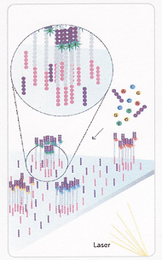
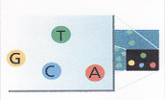
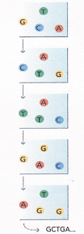
Illumina GA: polymerase-based sequencing with reversible terminators

Slide 20
Advances on the Illumina Platform
Original machine (2006) could generate about 1 Gb of sequence information. 48 million clusters and 31 base pair reads
Over the next three years increased the number of clusters and read length increased to over 100 base pairs- Resulted in an increase in the number of gigabases sequenced and at higher accuracy

Slide 21
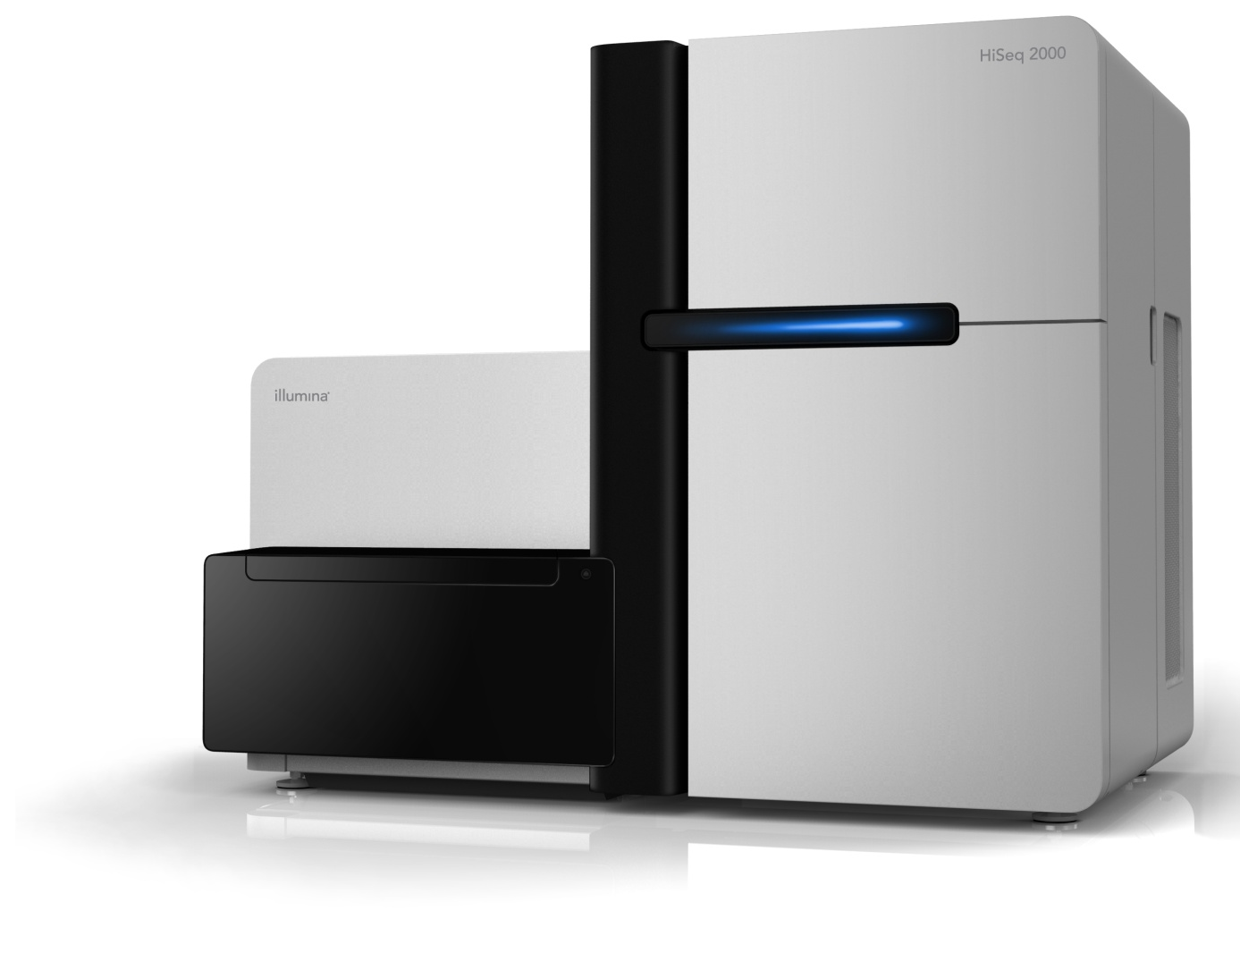
HiSeq 2000

Slide 22
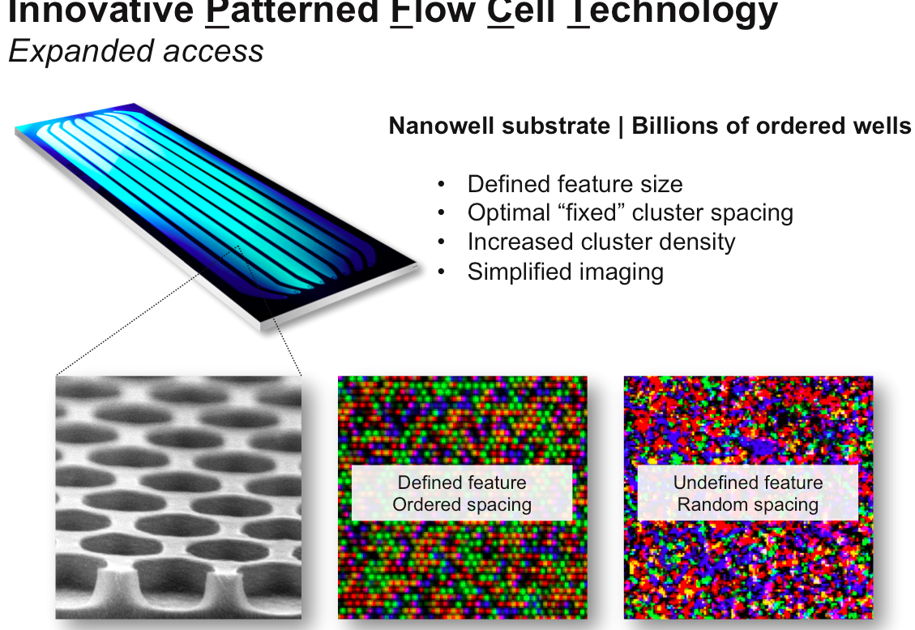

Slide 23
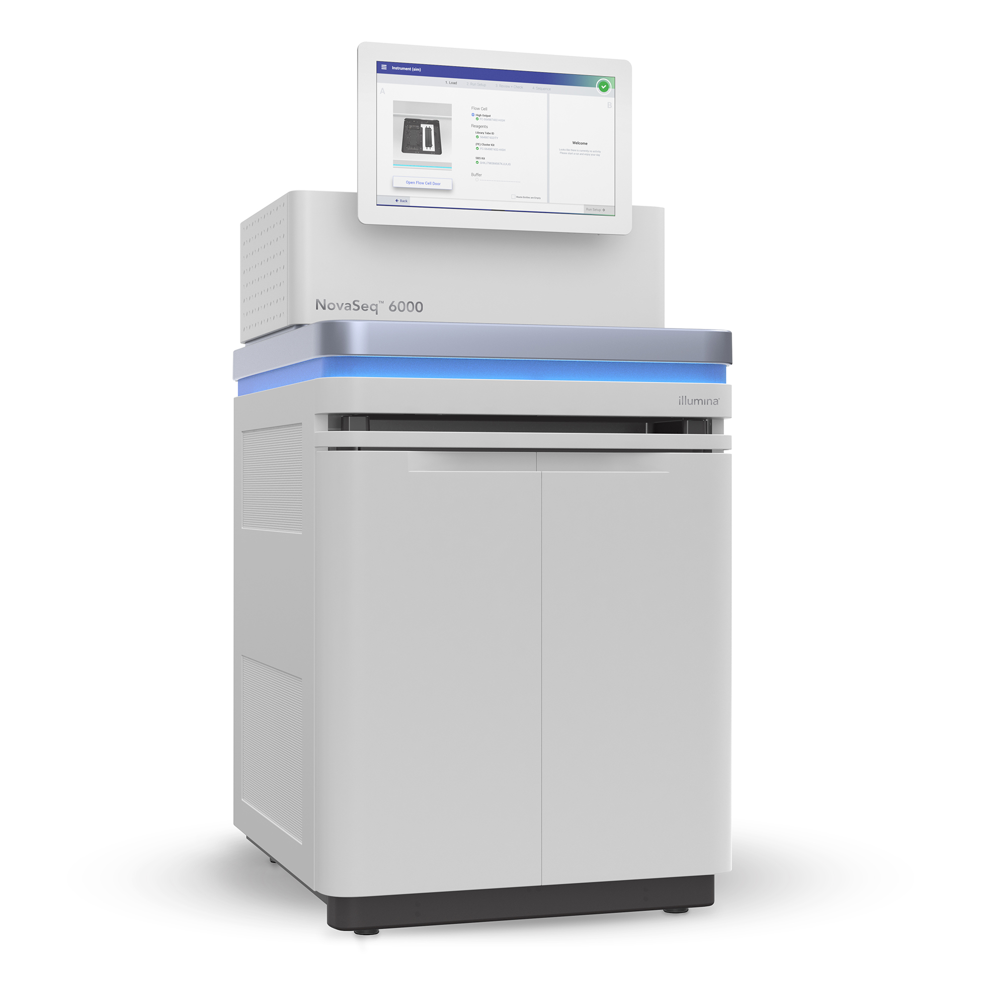
￼

Slide 24
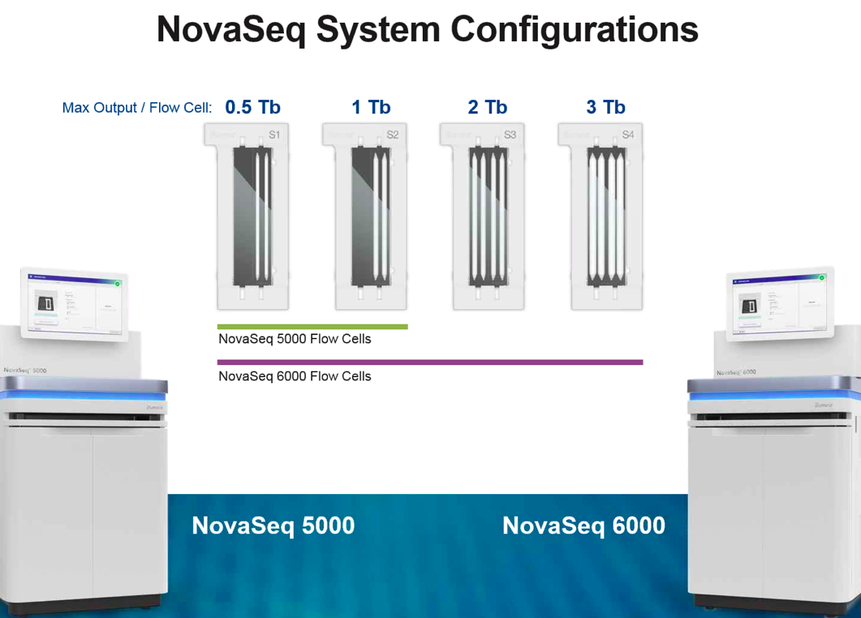

Slide 25
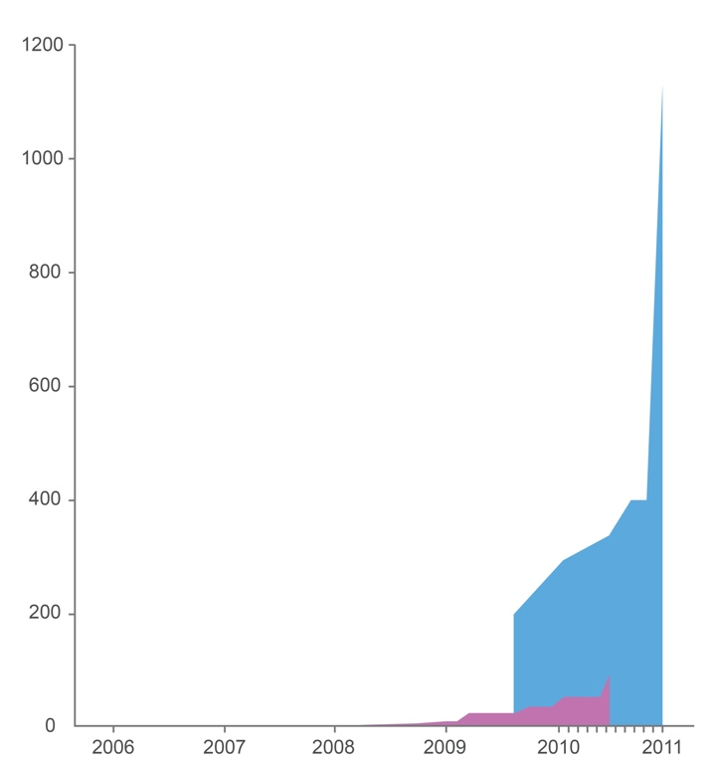
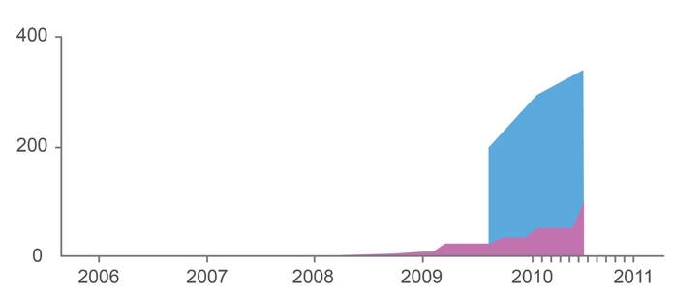
Evolution of Instrument Performance
Sequencing Run Parameters
Gb/run
Run format: 2x150 bp
Gb/run
Output full run | 1.13Tb
Output per day | 81Gb
Data passing filter
88.9%
GA
HiSeq 2000

Slide 26
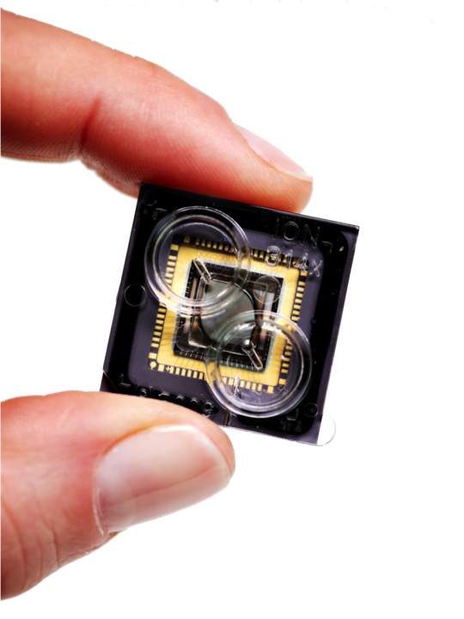
Ion Torrent-The Chip is the Machine™
Scalability
Simplicity
Speed
Notes:
The three key elements of the PGM are
Scalability
Simplicity
Speed
Scalability: leveraging the $1 Trillion investment in semiconductor mfg over the last 25 years
Simplicity : incredibly simple chemistry delivers highly accurate runs with extremely uniform genome coverage
Speed : fast run times deliver data quickly and enable fast research cycles

Slide 27
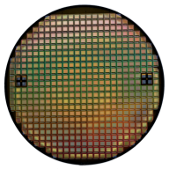
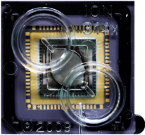


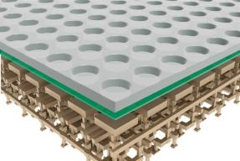
Transformative Technology, Unprecedented Progress
Scalable Semiconductor Technology plus Simple Chemistry
Wafer
Semiconductor Manufacturing
Chip
Semiconductor Packaging
H⁺
∆ pH
Sensing Layer
Sensor Plate
∆ V
TCGTACC…
Source
Single Sensor
Chemical to Digital Sequence
Millions of Sensors
Semiconductor Design
Bulk
Drain
Silicon Substrate
Notes:
Read clockwise from Wafer.
Ion Torrent chip manufacturing process leverages the cumulative investment in semiconductor manufacturing over the last 30 years. Chips are produced in std semiconductor factories (a.k.a. foundries) and are similar in design to CMOS image sensor chips found in iPhones and Blackberry’s. Wheras the image sensors collect photons. Ion Torrent chips collect Protons
Cross sectional view shows the Ion sensitive layer in green with the microwells on the top surface (3um) with the transistor stack underneath

Slide 28
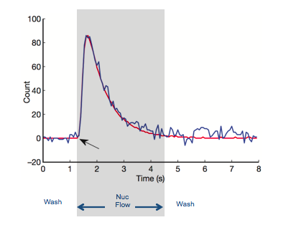
Fast Direct Detection
dNTP
H⁺
∆ pH
∆ Q
Sensing Layer
Sensor Plate
∆ V
Bulk
Drain
Source
To column
receiver
Silicon Substrate
Rothberg J.M. et al Nature doi:10.1038/nature10242
  Nucleotides flow sequentially over Ion semiconductor chip
  Direct detection of natural DNA extension
  A few seconds per incorporation
Notes:
Schematic representation of one microwell on the surface of a chip
High signal to noise
Enables high raw accuracy
One sensor per well per sequencing reaction
Orange circle is an Ion Sphere Particle onto which is clonally amplified the sequence fragment resulting from library preparation or amplicon PCR
Release of H+ ions as nucs incorporate generates a pH change inside the well which in turn causes charge accumulation in the Ion sensitive layer which then in turn causes a voltage increase mediated through the transistors directly underneath each well. Voltage signals are turned into base calls and output either as Ionograms (SFF files) or bases (FastQ) files
Sample at variable frame rate across pre-wash, nuc-flow, and post-wash

Slide 29
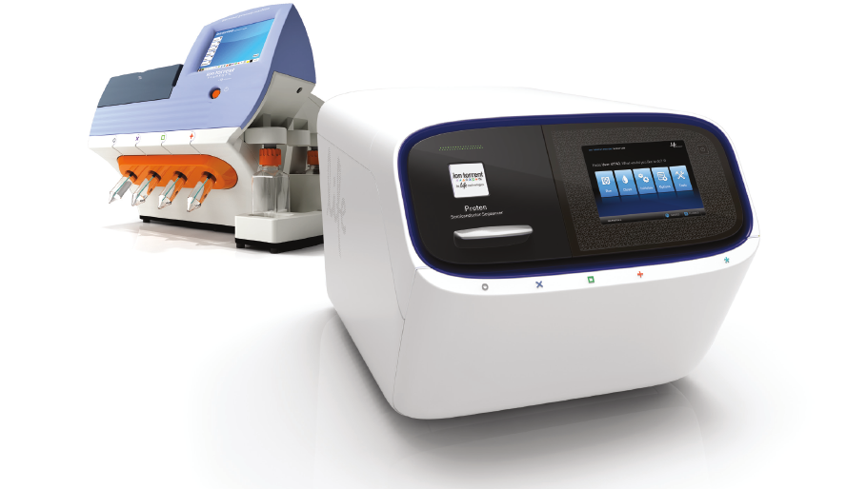

Slide 30
Weaknesses of the Ion Torrent Platform
Emulsion PCR
Homopolymers
Trying to play catch-up to Illumina- not working
Anything Ion Torrent can do, Illumina can also do
Illumina currently controls the sequencing space (90-95% of all sequencing is on this platform)

Slide 31
Strengths of the Ion Torrent Platform
Turn-around time
Lower input amount of DNA necessary for selection protocols. NCI chose PGM over MiSeq specifically due to this one fact!
Viable solutions to simplify emulsion PCR (Ion Chef)
Flexible output with different chips on the same machine

Slide 32
Impediments To New NGS Technologies
No platform that is just an incremental improvement to Illumina will be competitive
Need a real game-changer: For example: WGS for $100 cost (all in) with a system that at least has the accuracy of Illumina
A large problem is that once clinical labs have adopted a platform, very difficult for them to change

Slide 33
Different Types of NGS
WGS
Small gene panels
WES
RNAseq
Methylation Sequencing
Liquid Biopsies

Slide 34
WGS
Extremely powerful tool to examine changes across the genome
Detects point mutations
Copy number variations
Translocations
Deletions

Slide 35
Problems with WGS
Total cost- sub-$1,000, but this is just the cost for the sequencing
Analysis. Cost and what do alterations outside the coding portion of the genome even mean?
Finding alterations that are actionable.
Turn-around time

Slide 36
What Will It Take For WGS To Take Off?
First depends upon which patients are getting WGS- Cancer care and treatment versus everyone
Total cost must come down. Library prep under $50. Sequencing at or around $100 (eventually possible with the NovaSeq). Analysis and interpretation at or around $250. Storage! $100-200. Real Goal: The $100 (all in) Genome

Slide 37
Accurate and phased $100 de novo genome sequencing using low cost co-barcoded reads generated on DNA nanoball arrays
Rade Drmanac
Scientific founder and CSO of Complete Genomics
SVP of BGI

Slide 38




BGI’s Million Genome Initiatives
Millions Plant-Animal Genomes
Million Newborn Cohort
CNGB
Millions Microorganism Genome
20 million sample storage
1000+ sequencing machines
8PB data generation/day

Slide 39
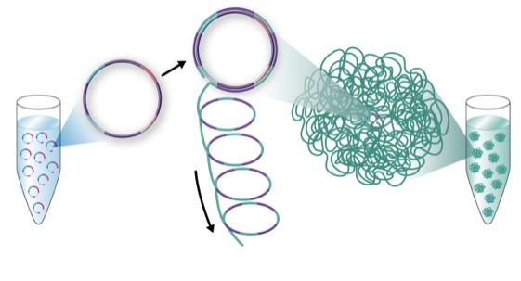
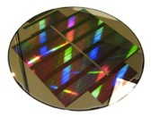




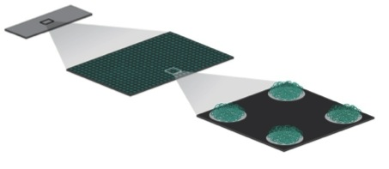
Nanoarrays of DNA nanoballs (DNBs): Advanced massively parallel sequencing without PCR issues
Linear amplification (no clonal errors)
Natural DNA
No amplification
DNA Nanoball (DNB)
is a single molecule
Replicate
by RCR
>100B DNBs/ml
Ad-
Inserted
ssDNA
Circle
Nx
3x
4B+ spots per slide <600nm spot separation
2x
1x
300 copies /
200nm DNB
DNA circles
from a genome
DNBs-self
assemble
High quality (no amplification errors/bias)
Low cost to make (amplified in solution)
Low cost to assay (low reagent volume)
Low cost to image (fewer pixels, faster)
1”x3” Slide
Patterned Substrates (Nanoarrays)
>95% of Sites Contain
a Single DNB
-Origins of mass. par. seq. in 1988 (www.rdrmanac.com)
-Drmanac et al, several U.S. patents on DNB arrays (priority to 2005)
-Drmanac et al., Science 2010

Slide 40
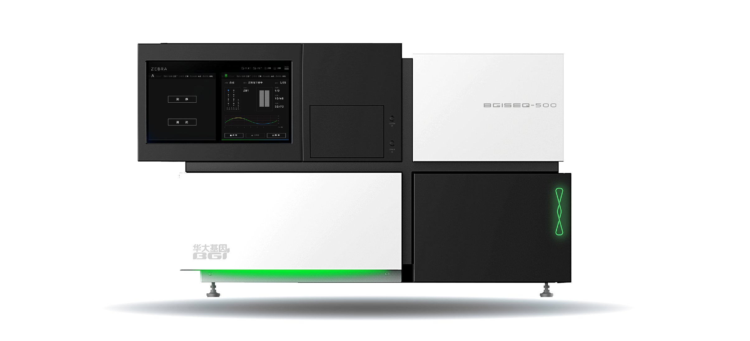
BGISEQ-500:
DNA nanoball based efficient benchtop sequencer
-Accurate and cost effective
-Approved by China FDA
-Uses stepwise sequencing by polymerase
-Up to 300Gb/run for PE100
-Over 400 BGISEQ-500 is deployed
-Similar smaller and larger instruments (e.g. BGISEQ-50)
Over 2 million NIPT (NIFTY) sequencing tests performed on DNA nanoball arrays

Slide 41
So How Does the BGI-Seq 500 Compare to Illumina
Do WGS on both the Illumina and BGI platforms
Compare the resulting data for SNP detection, CNV detection, and for complex genome rearrangements

Slide 42

PE150 VVN Kit YH genome
Whole Genome Sequencing
BGISEQ-500 HiSeq X Ten
BGISEQ-500 HiSeq X Ten
247,523
6.65%
146,582
3.94%
194,641
21.80%
164,835
18.50%
3,330,773
533,365
Venn of SNPs between two platforms
Venn of INDELs between two platforms
©2017 BGI-Shenzhen All Rights Reserved
More variants detected by BGISEQ500

Slide 43
BGI Seq 500 Sequencing
Can today do WGS for a total cost of $600
BGI plans to reduce this to just $200 by the end of 2018!
Targeting the $100 genome (total all in cost) by the end of 2019!

Slide 44
Competition is Good!
As BGI ramps towards providing a $100 (all in) human genome Illumina will have no choice but to try to compete
We have seen a reduction in WGS sequencing cost from 3 billion dollars to $600 in just 19 years!
Once we have the $100 genome, how long until we have the $10 genome?

Slide 45
WGS For Cancer
Easy library prep
Ultimately less expensive than any other NGS approach
Provides complete genome information
SNPs
CNVs
Translocations
Foreign DNA

Slide 46
WGS Data And Cancer
First can be used to molecularly characterize each cancer
Different sub-types will most definitely have different treatment strategies (already employed with lung and breast cancer)
Helps to identify actionable mutations

Slide 47
Problems With WGS For Cancer
Most alterations detected will be outside the coding portion of the genome. What do they even mean?
Only a very small fraction of alterations that are in the coding portion of the genome are currently actionable
Need many more drugs for mutated genes to really be useful
Will also need to have more information about how multiple drugs (for mutated targets) work in combination
Huge amount of data. Way too expensive to store the full sequence

Slide 48
However, WGS Provides Information On Cancer-Specific Mutations
Cancer-specific mutations are valuable markers for monitoring cancer
Can be used as a potential diagnostic tool for cancer screening- Strategy being employed by Grail!
More importantly, can potentially be used to detect the presence of cancer cells (and potentially the amount of cancer present in an individual undergoing clinical treatment for cancer)

Slide 49
The Liquid Biopsy
Metastatic solid tumors secrete tumor cells into the bloodstream
Circulating tumor-free DNA can be detected in the blood
The half-life of this DNA is very short
But the concentration of cf tumor DNA may be very low and only a fraction as compared to cf normal DNA
How to detect such rare DNAs?

Slide 50
Digital Droplet PCR
Very powerful technology to identify very rare sequence variants
For example, rare molecules with mutations such as those from circulating tumor DNA
Two major platforms currently available
(1) BioRad QX200 Droplet Digital PCR system
(2) Raindance RainDrop Digital PCR system
Both now owned by BioRad!

Slide 51
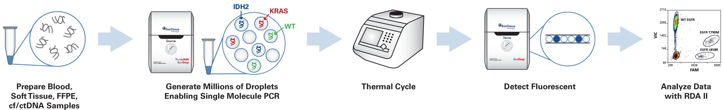

Slide 52
Using ddPCR To Monitor Cancers
Identify tumor-specific markers. Could be mutation in the tumor, or novel junctions (which could be detected by mate-pair sequencing)
In metastatic tumors there will be circulating tumor DNA present in the blood (but it will be at a low concentration relative to normal DNA)
Isolate this DNA from blood that is optimized for circulating DNA (by double centrifugation to remove normal while blood cells)

Slide 53
ddPCR To Monitor Therapy
Identify cancer-specific alterations from WGS data
Construct PCR primers for these cancer-specific alterations (also patient-specific)
Do ddPCR on blood samples to monitor patient post-surgery as well as post other treatment modalities

Slide 54
WGS Thus Has The Potential To Completely Change How We Treat Cancer Patients
When the total cost of WGS is $100 it will become the technique of choice for characterizing cancers
Cheaper (and easier) than gene panels, or WES
Comprehensive way of examining genome-wide alterations
Focus on those alterations that are actionable and also use the data to molecularly classify each cancer
Use the liquid biopsy to follow cancer treatments in real-time

Slide 55
So When Will WGS Be A Routine Part of Cancer Care?
Focus first on the alterations in the coding portion of the genome
Which alterations are actionable? Hopefully this will increase in the next few years
What about the data storage problem? Only store alterations? Store nothing? Cheaper storage solutions?
Clinical trials already underway to evaluate the power of WGS for cancer care
My prediction is that WGS will be used more and more and could be the standard of care within 5 years

