Slide 1


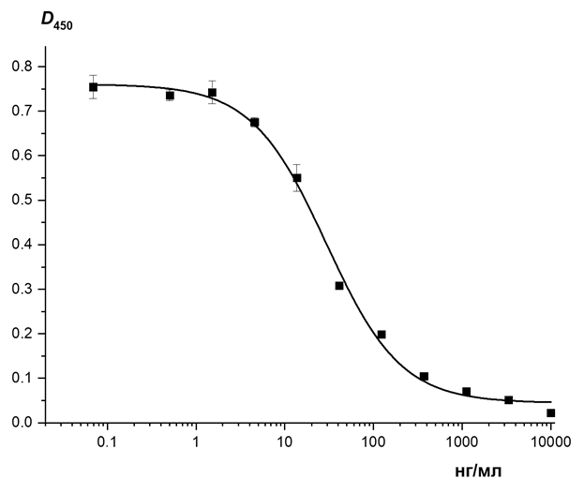



Immunochemical methods for control of
authenticity and composition of meat products
Zvereva E.A., Hendrickson O.D., Smirnova N.I., Zherdev A.V., Dzantiev B.B.
A.N. Bach Institute of Biochemistry, Research Center of Biotechnology of the Russian Acad. Sci.,
Moscow, Russia
Introduction
Materials & Methods
Graphs
Identification of raw materials used in food production and composition of meat products is essential to ensure their safety and inform consumers. In this connection, reliable and productive analytical methods are needed that will allow researchers to detect individual ingredients and biomarkers reflecting the content of different types of raw materials in the finished product. Immunochemical methods provide such a characteristic with high selectivity and productivity.
The reliability and information output of the assay results highly depend on the choice of controlled biomarkers.
Enzyme-linked immunosorbent assays (ELISA) and immunochromatographic assay (ICA) have been developed and characterized. Conjugates of antibodies with biotin and gold nanoparticles were synthesized and used for the assays. Gold nanoparticles with an average diameter of 30 nm were synthesized by reducing chloroauric acid using sodium citrate,
a
b
a: Calibration curve for soybean trypsin inhibitor detection (ELISA);
b: Calibration curve for Troponin I detection (ICA)
Results & Discussion
Conclusion
The assay development included synthesis and characterization of conjugates between specific antibodies and biotin or gold nanoparticles, choice of regimes for immunoreagents interactions and finding the assay conditions for the lowest detection limit of the markers and the absence of nonspecific interactions. Sample preparation protocols were developed for revealing the chosen biomarkers in meat and products of its processing.
The developed test-systems were successfully applied to characterize meat and meat-based products, including various kinds of thermally processed sausages. Their use may be considered as efficient tools for controlling the authenticity and composition of meat products.
Aim
The study was focused on immunodetection of such proteins as skeletal troponin I, myoglobin, immunoglobulins, soybean trypsin inhibitor.
Acknowledgements
This investigation was supported by the Russian Science Foundation (project 19-16-00108).

