Slide 1

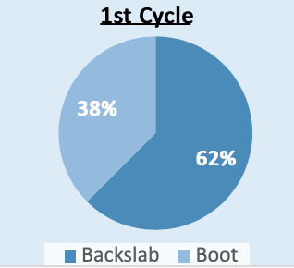
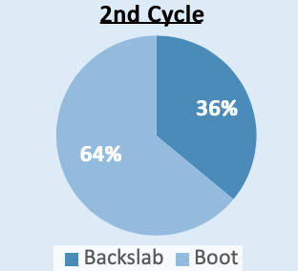
The Initial Management of Stable Ankle Fractures
Referred to Orthopaedic On-Call Service.
Authors: Dr. Kimberley Davies, Mr Karshe Yusuf, Mr Avinash Vajramani
Background
Methods
The study was performed as it was evident that the initial treatment of stable Weber B fractures was flawed thus causing sub-optimal outcomes. The objectives were to have evidenced based proof of the correct initial treatment with a view to improving treatment and education surrounding stable Weber B fractures and their treatment.
The study comprised of a two loop audit. During the first loop stable Weber B fractures that presented were analysed to see if they were discharged correctly. After the first audit was concluded teaching was held for hospital staff to educate regarding correct management. The second loop was conducted in a similar manner and these two audit loops were compared to see whether teaching had a positive or negative effect.
Results
Conclusions
In the first audit loop 41 patients were diagnosed with a stable Weber B fracture, 9 of which had to be excluded for various reasons. The final results were that 20 (62.5%) out of the 32 remaining were treated by applying a cast and referring to the virtual fracture clinic. In comparison to the second loop where 41 patients were diagnosed with stable Weber B fractures, 17 ( 41.46%) of these patients were discharged in a cast with virtual fracture clinic follow up.
This study showed that treatment education concerning Weber B fractures is vital. In practice an improvement in treatment of Weber B fractures was evident. The study also showed that further education is needed for improvement of patient treatment.

