Slide 1
Development of Sphingosine Kinase Selective Inhibitors for Cancer Therapy
Zuping Xia
College of Pharmacy
Washington State University
Notes:
Today I am going to talk one of my most interest research projects. That is the development of Spingosine Kinase Inhibitors for Cancer Therapy.

Slide 2
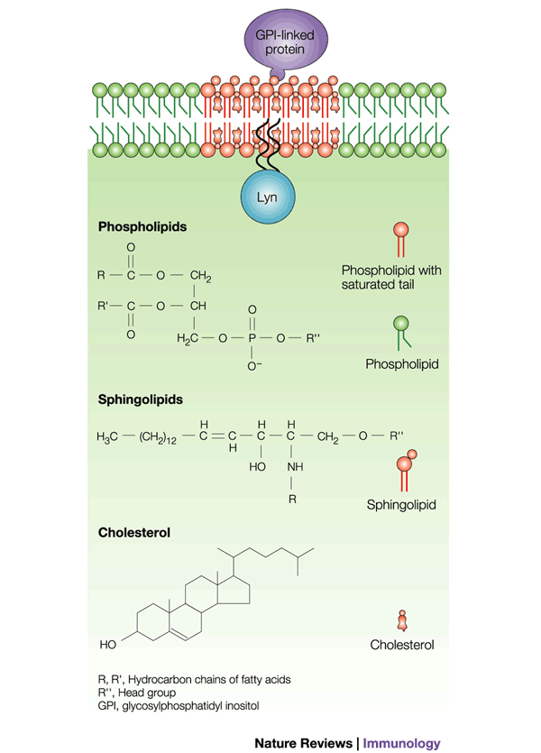
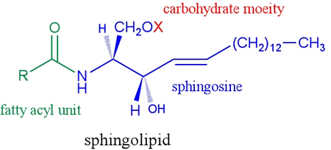
Sphingolipids, similar to phospholipids, are composed of a polar head group and two nonpolar tails. The core of sphingolipids is the sphingosine.
Sphingolipids are one of the lipids forming the plasma bilayer membrane.
They play important roles in cell signal transmission and recognition.
X = H, Ceramide
= Phosphate, Ceramide-1-phosphate
= Glucose, Glucosylceramide
Notes:
Sphingolipids, like the phospholipids, are composed of a polar group and two nonpolar tails. The core of sphingolipids is the sphingosine. This is the structure of sphingolipid. The blue part of the structure is the sphingosine.

Slide 3
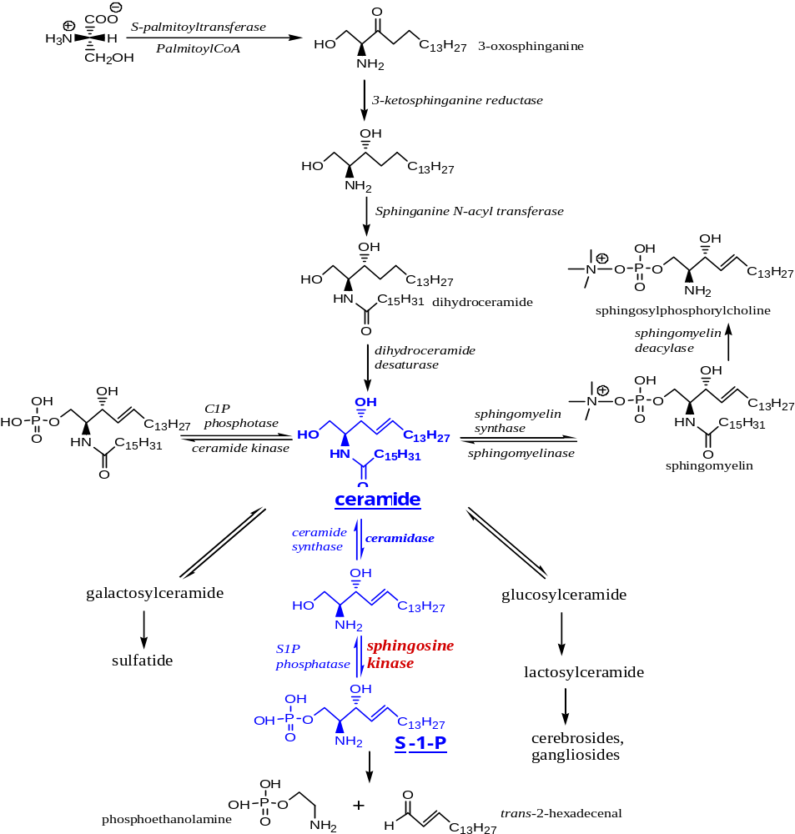
Sphingolipid Anabolism and Catabolism
Sphingosine Kinase (SK) is one of the critical enzymes in sphingolipid biosynthesis.
SK catalyzes sphingosine phosphorylation.
There are two isoforms of sphingosine kinase (SK): SK1 and SK2.
The convincing evidences have shown that SK, especially SK1, connects with human diseases, such as cancer.

Slide 4
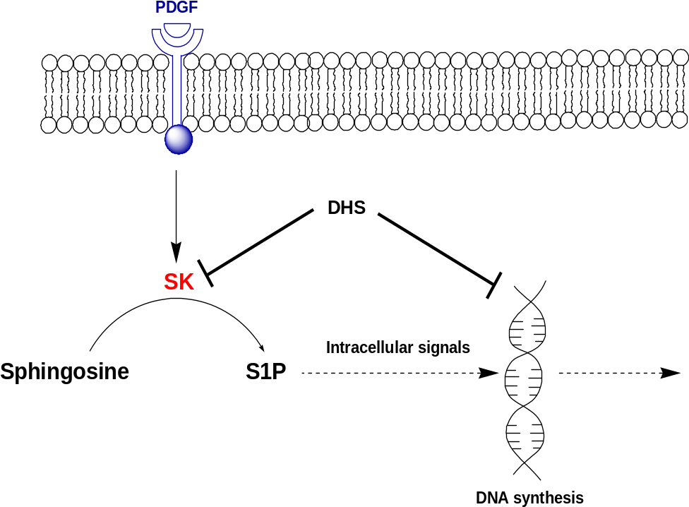
Validation of SK as a druggable target for cancer therapy
1. Inhibition of SK lowered the DNA synthesis in NIH3T3 cells.
GF activated SK in 3T3 cell, which stimulated the production of S1P.
DHS not only inhibited SK and reduced S1P but also lowered DNA synthesis in the cell.
S1P is a second messenger to promote the cell proliferation.
Nature, 1993, 365:557

Slide 5
2. SK1 plays an oncogenic role in NIH3T3 cells.
SK1-transfected 3T3 cells acquired the tumorigenic phenotype:
(1) To proliferate in serum-free medium.
(2) To form fibrosarcomas when transplanted into nude mice.
(3) The above effects were absent for 3T3 cells expressing inactive SK1 (SK1G82D mutant) or SK1-transfected 3T3 cells treated with DMS, a non-specific SKI.
Current Biology 2000, 10(23), 1527
3. SK1 KO Mice displayed no abnormalities.
J. Biol. Chem. 2004, 279, 52487

Slide 6
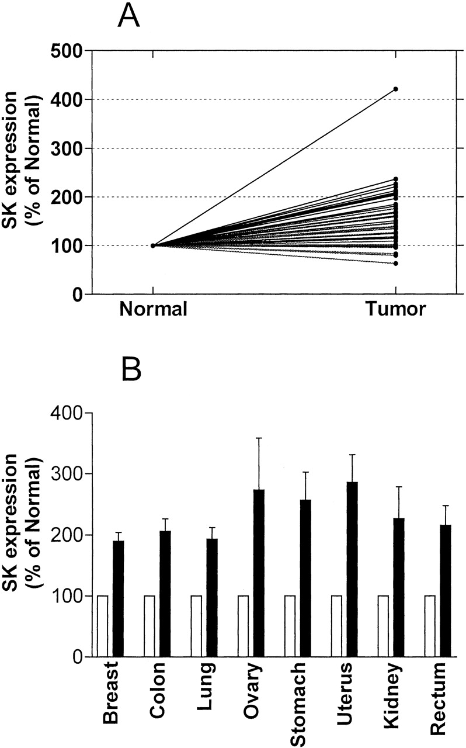
3. SK mRNA was significantly higher in tumor
tissues than in the adjacent normal tissues
Cancer Res 2003, 63:5962

Slide 7
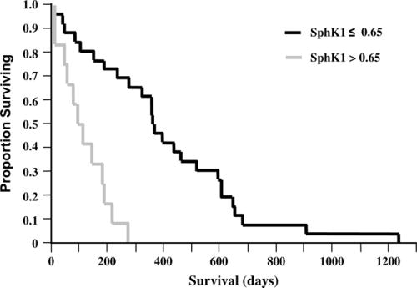
4. SK1 expression was related to the survival of the patients with glioblastoma multiforme (GBM).
GBM patients with low levels of SK1 expression had a median survival of 357 days.
GBM patients with high levels of SK1 expression had a median survival of 102 days.
J Neuropathol Exp Neurol, 2005, 64(8), 695

Slide 8
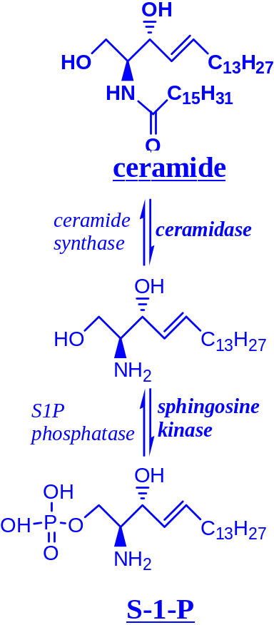
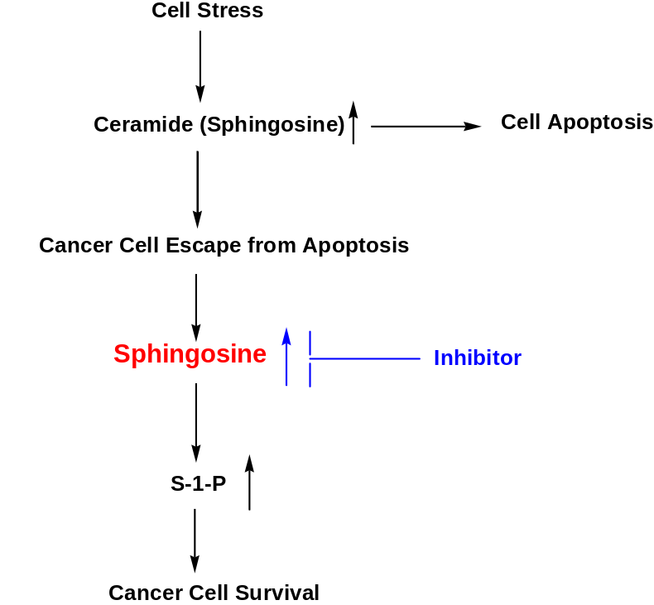
5. SK1 overexpression related to the resistance of anticancer treatments.
Ceramide/S1P Biostat
Pro-apoptotic
Anti-apoptosis,
Angiogenisis
SK1 overexpression could markedly inhibit cell death induced by (i) anthracyclines in MCF7 cells (Exp Cell Res 2002, 281,115); (ii) doxorubincin and etoposide in HL60 cells (Leukemia 2006, 20, 95); (iii) camptothecin and docetaxel in PC3 and LNCaP cells (Cancer Res 2005, 65, 11667).

Slide 9
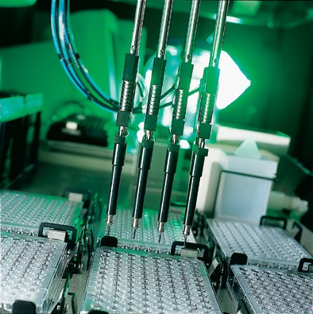
High-throughput Screening (HTS) and Hit Identification
We did small molecule HTS and a few of hits were identified.
Cancer Res 2003, 63:5962

Slide 10
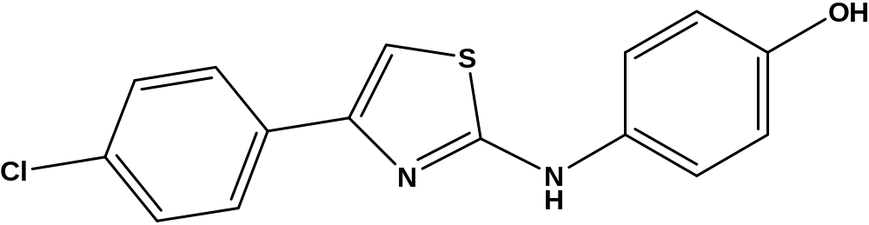
SKI-2 (4-[4-(4-Chlorophenyl)thiazol-2-ylamino]phenol)
Potent inhibitor
Selective inhibitor
3. Lipinski’s Rule
Molecular Weight: 302.78
CLogP: 4.25604
Compound | SK (IC50 μM) | ERK2 | PI3K | PKC
SKI-2 | 0.5 ± 0.3 | None | None | None
J Pharmacol Exp Ther 2006, 318:596

Slide 11
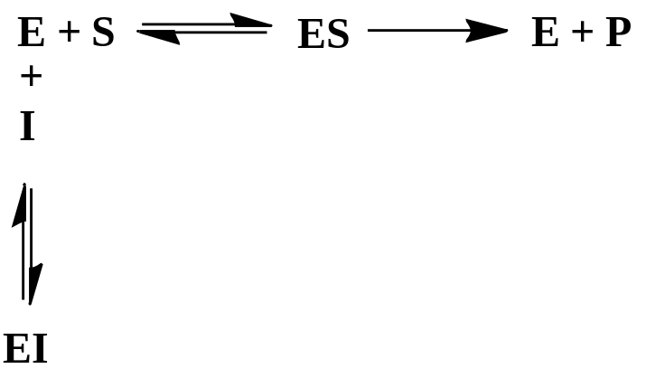

SKI-2 Binding Constant Ki
Enzyme | Ki of SKI-2 (µM) | Ki of DMS (µM)
SK1 | 0.69 ± 0.24 | 52 ± 10
SK2 | 0.13 ± 0.02 | 22 ± 9
The binding constant Ki is a parameter to measure the potency of an enzyme inhibitor.
$\frac{\left[E\right][S]}{[EI]}$ = Ki
Unpublished Data

Slide 12
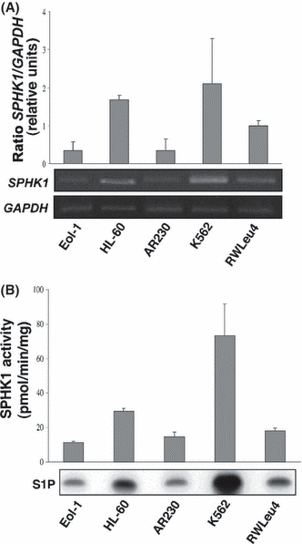
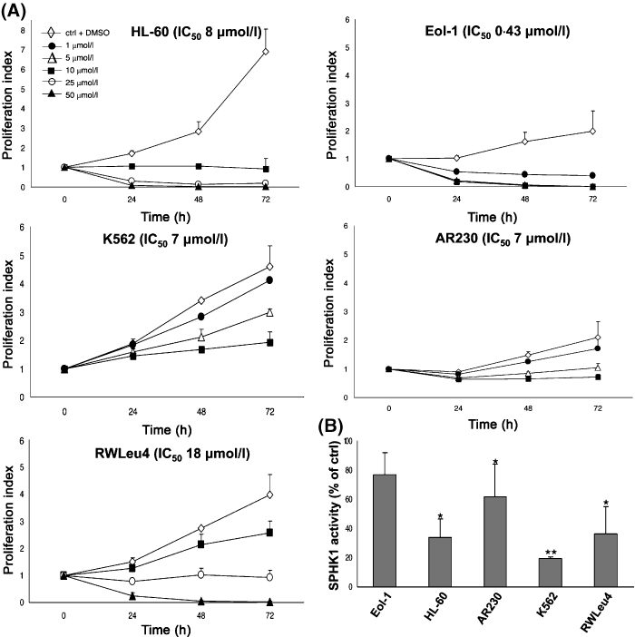
1. SKI-2 against SK1 in Chronic Myeloid Leulemia
Fig 1. SK1 expression and activity in different myeloid leukaemia cell lines. (A) SK1 expression; (B) The S1P is correlated with SK1 activity.
Fig 2. Effect of SKI-2 against SK1on the survival of CML cells. (A) cells were treated with SKI-2; (B) SK1 activity was after exposure to SKI-2 at 48 h.
There was a correlation between the cell proliferation and SK1 activity.

Slide 13
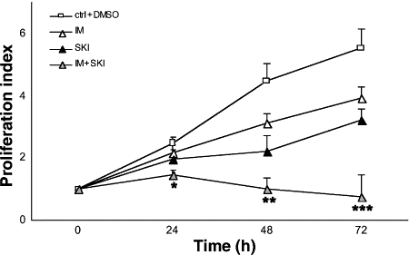
In Vitro Combination Therapy Using SKI-2 with Imatinib
Fig 3. Effect of the simultaneous exposure of K562 cells to SKI-2 and IM (imatinib mesylate). Either alone or in combination. There was a synergistic effect of the combination therapy. CI = 0.061 calculated at 24 h
BJH 2008, 144, 350

Slide 14
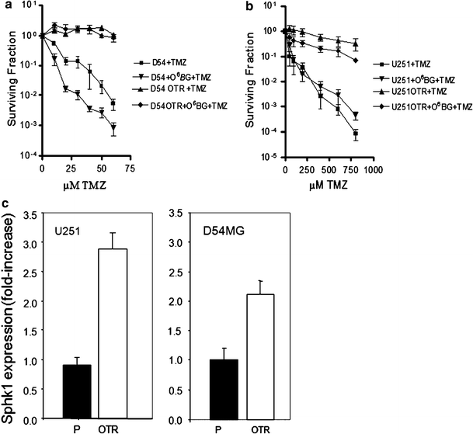
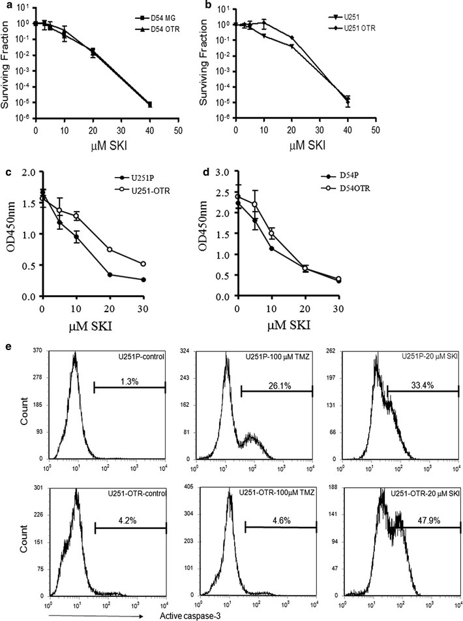
2. SKI-2 aganist TMZ resistant glioblastoma
Mol Cancer Ther 2009;8(4):809
The temozolomide (TMZ) has shown to provide a survival benefit for Glioblastoma patients. While the initial treatment of many GBM with TMZ shows dramatic results, virtually all tumors recur and become resistant to TMZ.
An increase of SK1 gene expression has been observed to the TMZ-resistant GBM cells. SKI-2 was very effective in the treatment of the TMZ-resistant glioblastoma cells.
Fig. 2. Effect of SKI-2 on cell proliferation were shown on both sensitive and resistant to TMZ cells.
e Caspase-3 activation in U251 cells upon SKI treatment was measured using flow cytometry.
Fig. 1 Cells with TMZ resistances were correlated with the increase of SK1 expression.

Slide 15
SKI-2 drawbacks
(1) Low bioavailable (J Pharmacol Exp Ther 2006, 318, 596)
(2) In vivo toxic and unstable (unpublished data)
(3) Non-selective between SK1 and SK2

Slide 16
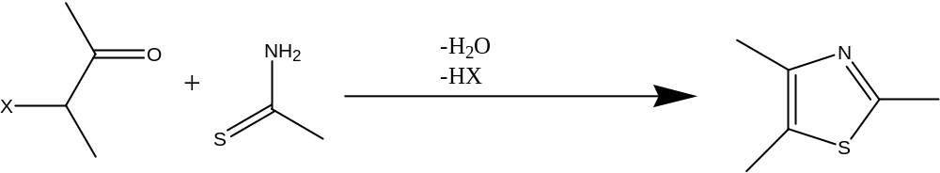
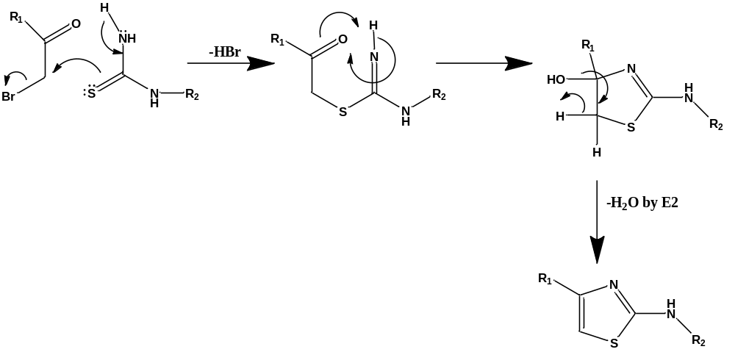
SKI-2 Optimization
1. Synthesis of analogs: Hantzsch Thiazole Synthesis
The reaction goes by the way of an SN2 reaction. It begins an attack at α-carbon bearing the halogen by sulfur rather than nitrogen to form an intermediate, which was then undergoing ring formation, followed by E2 elimination to remove a molecule of water.

Slide 17
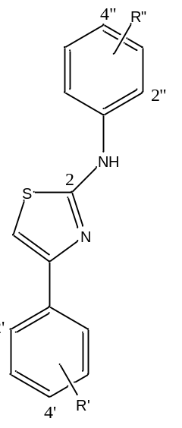
Compound | 5-C | R’2 | R’4 | R’6 | R”2 | R”3 | R”4 | SK1 IC50 | SK2 IC50
BB090420 | Ph | H | H | H | H | H | CH3 | >100 | 1.8
BB090421 | Ph | H | H | H | H | H | OH | 3.7 | <0.8
BB090422 | Ph | H | CF3 | H | H | H | OC2H5 | 2.3 | <0.8
BB090430 | Ph | H | F | H | H | H | OH | 1.3 | <0.8
BB090501 | Ph | H | F | H | H | H | H | >100 | <0.8
BB090528 | Ph | H | CH3 | H | H | H | OH | 1.5 | <0.8
BB090529 | 2-Na |  |  |  | H | H | OH | 6.5 | <0.8
BB090601 | Ph | H | CH3 | H | H | H | CH3 | >100 | <0.8
BB090602 | 2-Na |  |  |  | H | H | CH3 | >100 | 15
BB090603 | Ph | H | CH3 | H | H | H | OCH3 | >100 | <0.8
BB090604 | 2-Na |  |  |  | H | H | OCH3 | >100 | 3.3
BB090608 | Ph | H | CH3 | H | H | H | Cl | >100 | 3
BB090609 | 2-Na |  |  |  | H | H | Cl | >100 | 8.2
BB090610 | Ph | H | CH3 | H | H | H | CN | >100 | 1
BB090611 | 2-Na |  |  |  | H | H | CN | >100 | 2.3
BB090615 | Ph | H | CH3 | H | H | H | COCH3 | >100 | 2.7
BB090616 | 2-Na |  |  |  | H | H | COCH3 | >100 | 1.4
BB090617 | Ph | OH | H | H | H | H | OH | 1.2 | <0.8
BB090618 | Ph | OH | OH | H | H | H | OH | 4.4 | 1
BB090622 | Ph | H | H | H | OH | H | H | 4.5 | <0.8
BB090623 | Ph | H | H | H | H | OH | H | 15 | 1.5
BB090625 | Ph | H | CH3 | H | H | H | NO2 | >100 | 6.5
BB090626 | Ph | OH | OH | H | H | H | NO2 | 21 | 5
BB090629 | Ph | H | NO2 | H | H | H | OH | 1.2 | <0.8
BB090630 | Ph | H | NO2 | H | H | H | NO2 | >100 | <0.8
BB090701 | Ph | OH | H | F | H | OH | H | 23 | <0.8
BB090707 | Ph | OH | H | H | OH | H | H | 3 | <0.8
BB090713 | Ph | NO2 | H | H | OH | H | H | 1.9 | <0.8
BB090714 | Ph | NO2 | H | H | H | H | OH | 0.9 | <0.8
BB090716 | Ph | NO2 | H | H | H | OH | H | 8 | <0.8
BB090722 | Ph | OH | H | H | H | H | OCH3 | 62.5 | <0.8
BB090723 | Ph | OH | OH | H | H | H | OCH3 | 75 | <0.8
BB090727 | Ph | OH | H | H | H | H | COOH | >100 | <0.8
BB090728 | Ph | OH | OH | H | H | H | COOH | 78 | <0.8
BB090825 | Ph | NH2 | H | H | H | H | OH | <0.8 | <0.8
BB090831 | Ph | H | Cl | H | H | H | OH | 0.9 | <0.8
BB090702 | Ph | OH | H | F | H | H | OH | <0.8 | <0.8
BB090708 | Ph | OH | H | F | OH | H | H | 2.5 | <0.8
BB090504 | Ph | H | F | H | H | H | CH3 | >100 | 4.7
SAR Analysis
4”- or 2”-OH is essential to inhibit SK1.
Substitution on ‘-ring has no significant influence for SK inhibition.
Nearly all SKI-2 analogs are good SK2 inhibitors

Slide 18
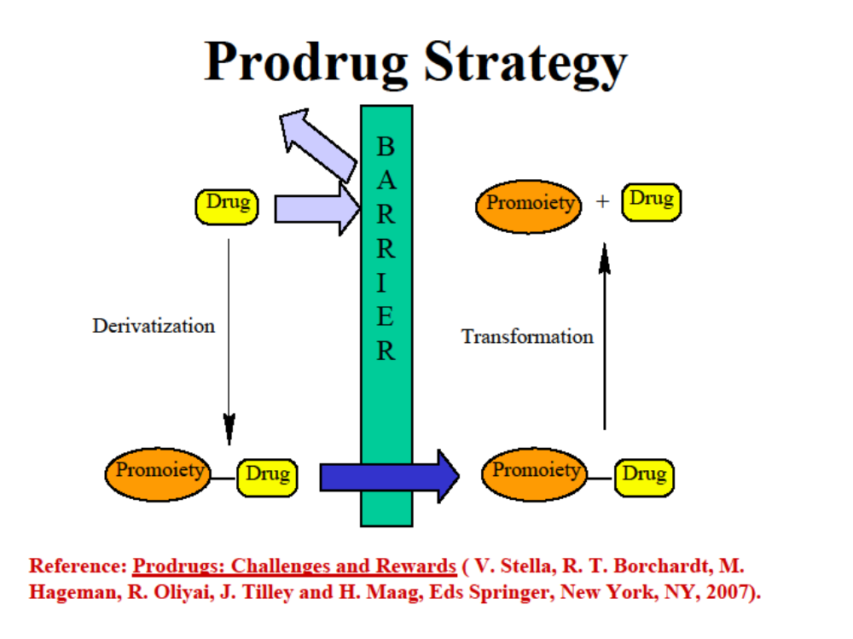
Prodrug Approach
The prodrug: a covalent link between a drug and a chemical promoiety which are chemically or enzymatically labile in vivo. It is designed to circumvent the pharmaceutical or PK barriers of the parent drug, such as low bioavailability, toxicity and stability.

Slide 19
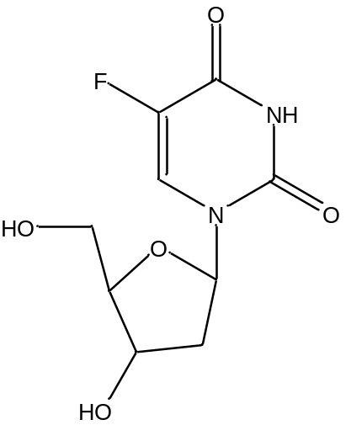
EX. to use Ester-prodrug to improve PK and therapeutic effect.
FDU: (1) a very potent anticancer drug in vitro.
(2) having been used in the clinic, such as colon cancer, pancreatic cancer, liver cancer, breast cancer and metastatic renal cancer.
(3) Due to its poor bioavailability (too hydrophilic), FDU is not suitable for PO administration.
(4) Owing to its rapid elimination (T_{1/2} = 7 min), FDU is most administered by intra-arterial infusion.
(5)There are other problems for FDU, such as metabolic unstable.
To make ester prodrug of FDU, we anticipated that the ester prodrug may act as a depot to release the active drug in vivo to improve the PK of the parent drug.

Slide 20
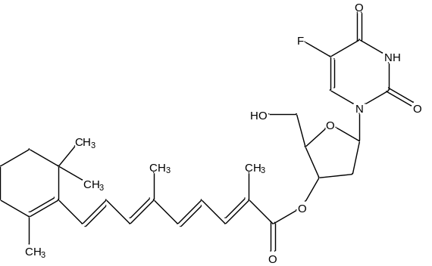
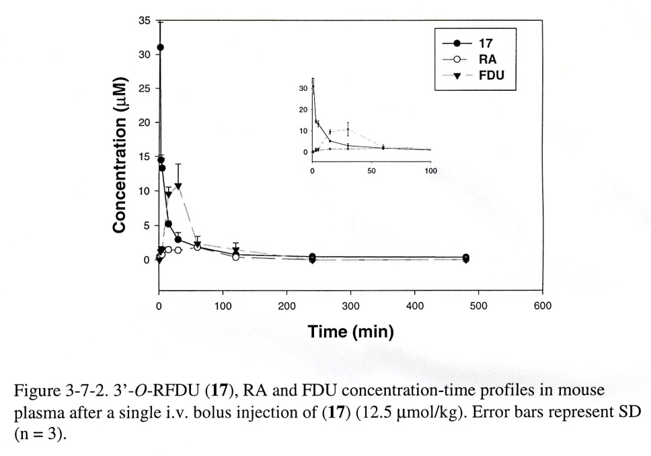
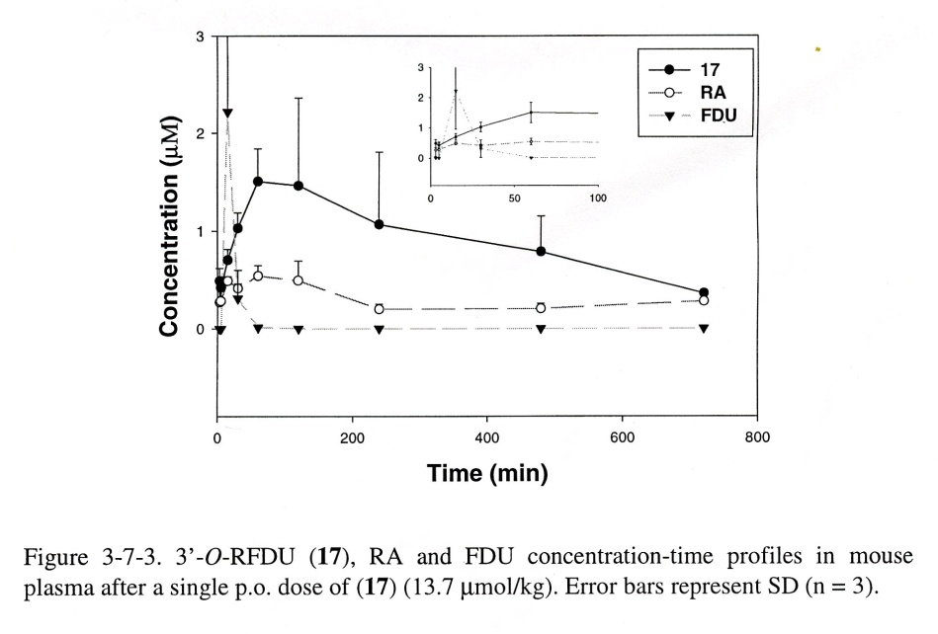
3’-O-RFDU (17) showed good properties.
It had no acute or chronic toxicity to the mice under the therapeutic doses.
(Fig 3-7-2) It was hydrolyzed in vivo to produce the parent drugs.
(Fig 3-7-3) The PK was improved. The bioavailability was 90%.
It showed higher anticancer potency than that of the parent drug used alone both in vitro and in vivo.

Slide 21
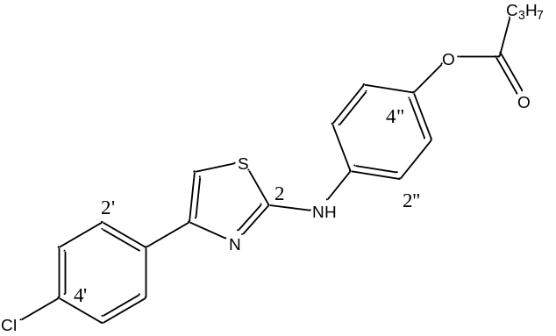
SKI-2 Ester Prodrugs
The prodrugs are the prodrug only for SK1. They are potent inhibitors for SK2.
The prodrug development is a iterative process.
Compound | 5-C | R’2 | R’4 | R’6 | 2-N | R”2 | R”3 | R”4 | SK1 IC50 | SK2 IC50
BB090908 | Ph | H | Cl | H | OCOCH3 | H | H | OCOCH3 | >100 | <0.8
BB090909-1 | Ph | H | Cl | H | H | H | H | OCOC3H7 | >100 | <0.8
BB090909-2 | Ph | H | Cl | H | OCOC3H7 | H | H | OCOC3H7 | >100 | <0.8
BB090917 | Ph | H | Cl | H | H | H | H | OCOCH3 | 75 | <0.8

Slide 22
3. Fragment-based drug design:
An approach that uses small and simple molecules (fragments) to look for SK-inhibitor pharmacophores that may assist to design SK-selective inhibitor.
SKI-2
Look for affinity
Lead
inhibitor
Fragments
SK1 or SK2
Design potential
SK1-selective
Molecules

Slide 23
Pharmacophore
Enzymes are proteins. The active site is usually small and specific.
It may be only a small part of the SKI-2 that involves in the critical interaction with either SK1 or SK2. The relevant part on SKI-2 responsible for the activity of the inhibition is its pharmacophore.
The other parts in SKI-2 may be extraneous, even interfering with the binding of the pharmacophore.

Slide 24
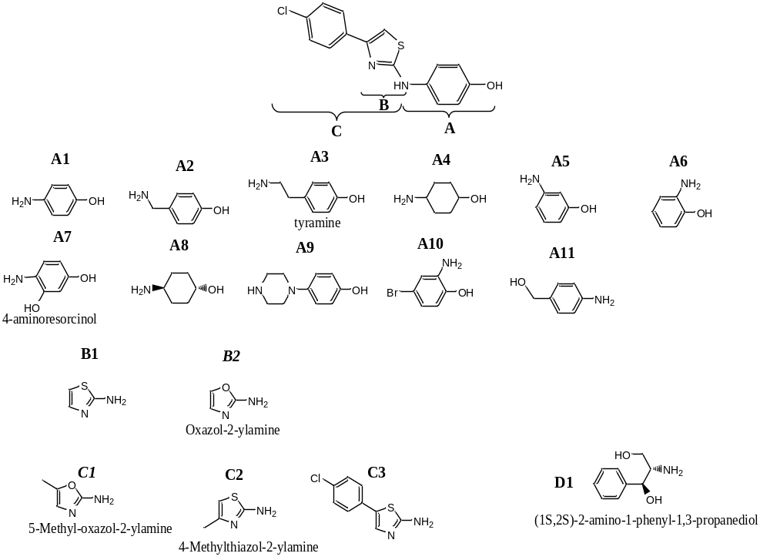
SKI-2

Slide 25
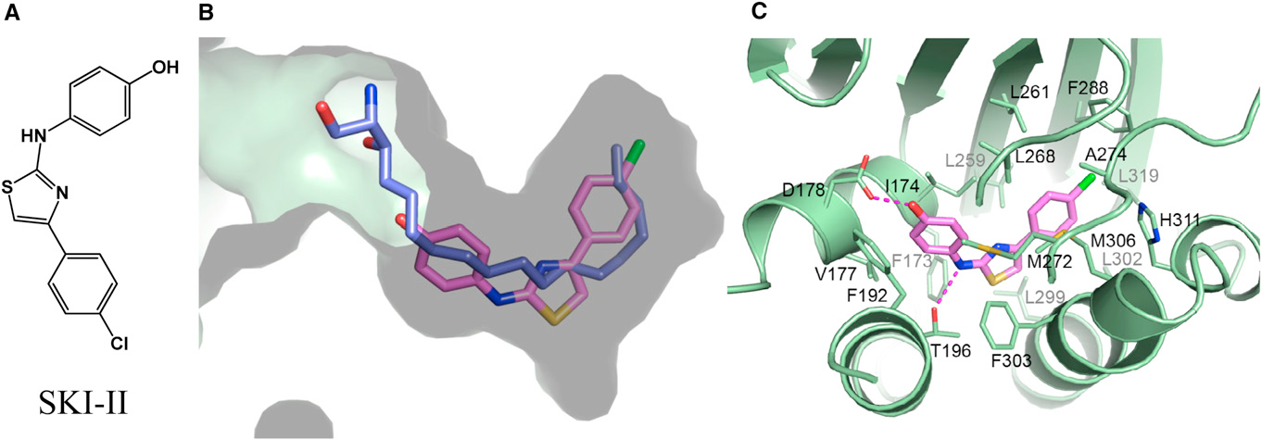
Crystal Structures of SK1, SK1-Sphingosine and SK1-SKI-2 have been resolved.
Chemical structure of SKI-II.
SKI-II binding in the lipid-binding pocket of SK1 with overlaid sphingosine.
Detailed ligand-protein interactions between SKI-II and SK1.
These structures will lead to better understanding of the small molecules binding with SK1 and hopefully to develop better therapeutic molecules.
Structure 2014, 21, 798–809

Slide 26
Summary
We have found SK2-selective inhibitor.
Although we have not found SK1-selective inhibitor yet, we are getting closer.
We believe cancers have complicated signaling survival pathways. Currently, the most effective treatment for cancer commonly require target multiple pathways. So we will test and optimize the combination therapy using SK-selective inhibitors with other anticancer drugs or therapies.

Slide 27
Acknowledgments
Dr. Charles Smith
Keven French
Christian Knaak
Frank Wang
Vlad Beljanski
Jeremy Draper
Peng Gao
Staci Keller
Xia Wen
Joanne Gold
Supported by NIH
Grant.

