Slide 1


Frequency of Oral lesions with Human Papilloma Virus and its Genotypes in Tobacco Chewers
Dr Zil-e-Rubab
MBBS, M Phil
Ziauddin University
Karachi, Pakistan

Slide 2
Prevalence in Pakistan
40% of the adolescence from squatter settlement use chewable tobacco on a daily basis (Khawja et al, 2005)
8.5 to 10 times increase in the risk of oral cancers due to chewable tobacco (Merchant et al, 2000)
Oral cancer , the second most common cancer in both genders (http://www.who.int/ncd)

Slide 3

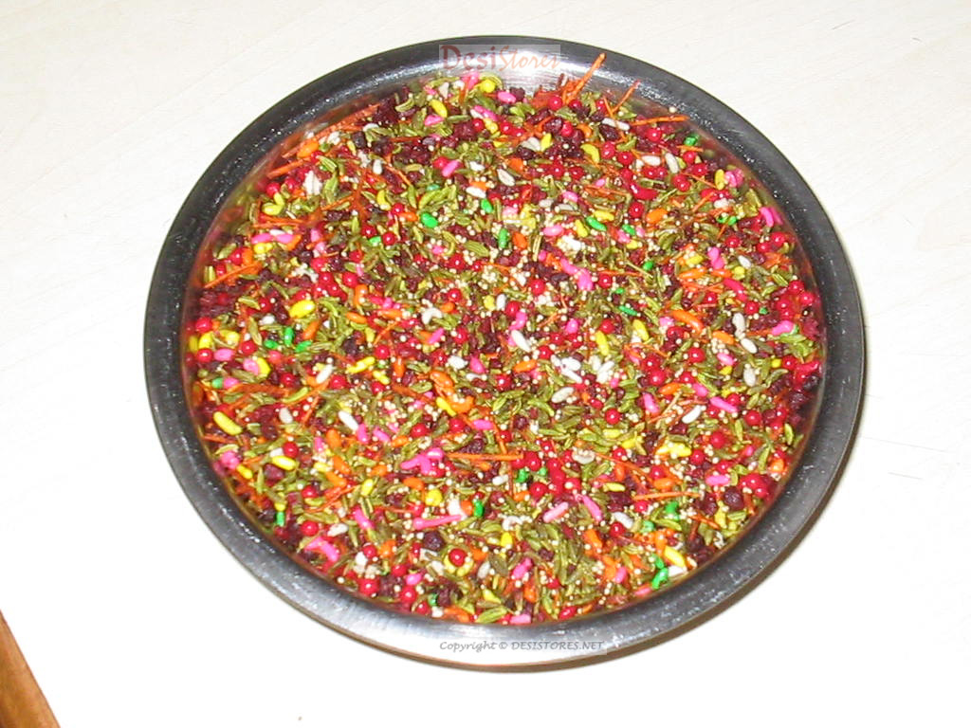
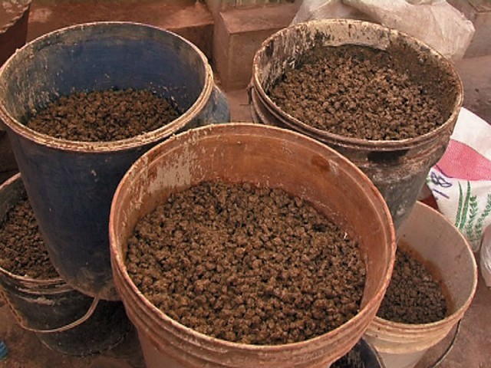
Type Of Chewing Mixtures
Name of Mixtures | Components
Betel Quid | Areca Nut, Tobacco, Fresh Betel Leaf, Slaked Lime and Catechu
Pan Masala | Areca Nut, Slaked Lime, Catechu and Condiments, Tobacco
Gutka | Pan Masala and Tobacco

Slide 4
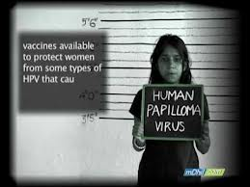
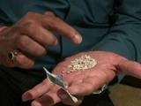
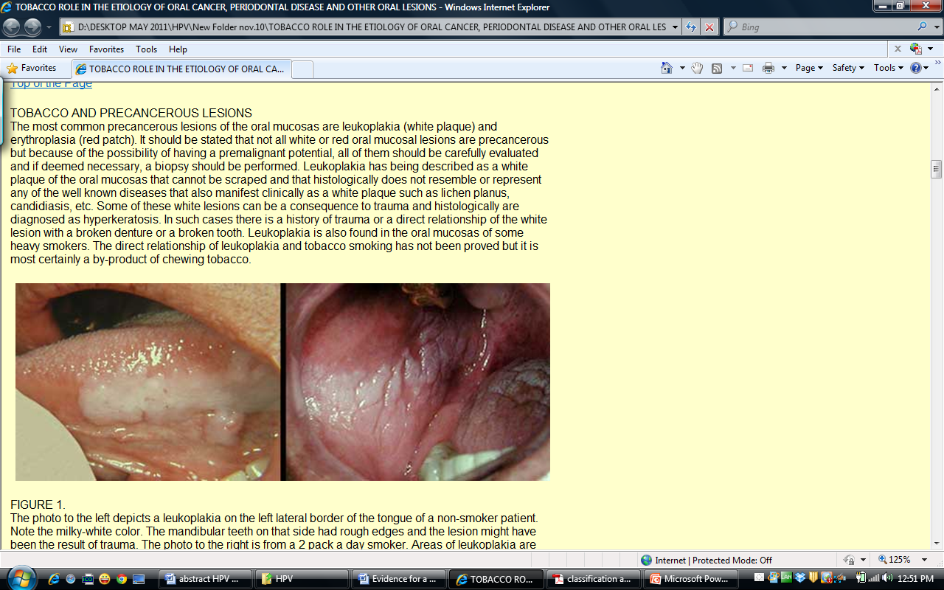
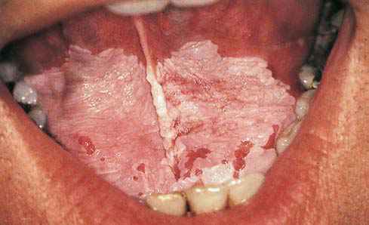
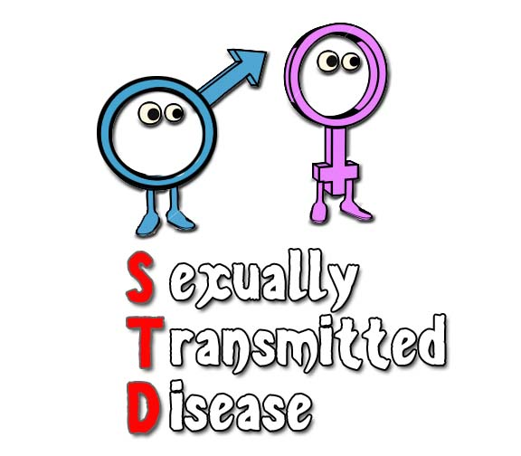
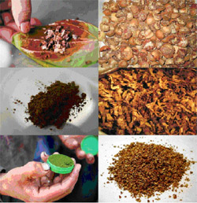
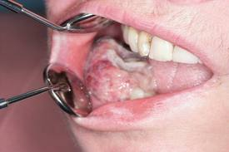
Risk Factors of Oral Lesions

Slide 5
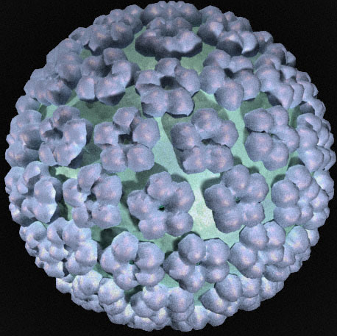
Human Papilloma Virus

Slide 6
The Circular Organization of HPV DNA Episome
E6,E7,
E1
E2,E4, E5
L2
L1
LCR

Slide 7
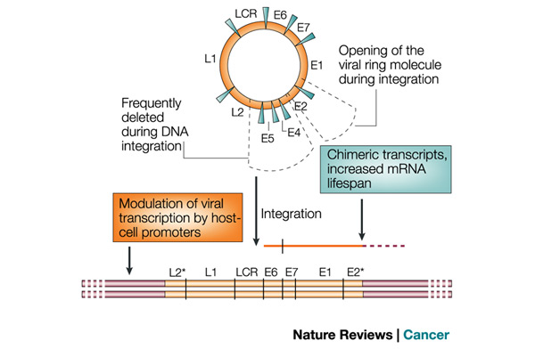
Integration of HPV-DNA into Host-cell DNA
Opening of Viral Ring
Frequently Deleted during Integration
Chimeric transcripts, Increased mRNA life span
E6,E7,
E1
E2,E4, E5
L2
L1
LRR
Modulation of viral transcription by host cell promoters
Integration
L2 L1 LCR E6 E7 E1 E2

Slide 8
Abrasions by chewable tobacco
Penetration of HPV into the squamous epithelium
Leukoplakia
Chewable Tobacco
Oral Sex
HPV in Environment
Normal Epithelium
Chronic Inflammation
DNA Damage
Cell Proliferation
OSCC
Submucous Fibrosis
Collagen Overproduction and Collagenase Inhibition by Areca nut
Fibrogenesis
Oxidative Stress

Slide 9
Objective
To detect the presence of HPV and its genotypes 16, 18 in premalignant and malignant lesions of oral cavity

Slide 10
Materials & Methods
Collection of Buccal wash
522 Patients
Age 18 and above
premalignant and malignant oral lesions
Tobacco Chewers
DNA Extraction
Genotyping (16/18)

Slide 11
DNA Extraction and PCR
DNA extraction with Omni-Pure™ DNA Purification System kit
DNA amplification in a conventional thermocycler (BIOFLUX)
A HPV positive control, human ß-globin gene and a blank were used

Slide 12
Primer Sequences Used for HPV Genotyping
Primers | Sequences | Product
ß-globin | PCO3: 5’-acacaactgtgttcactagc-3’ PCO4: 5’-caacttcatccacgttcacc-3’ | 268bp*
HPV GP5+/GP6+ | HPV-GP5+ : 5’-tttgttactgtggtagatactac-3’ HPV-GP6+ : 5’-gaaaaataaactgtaaatcatattc-3’ | 150bp*
HPV 16 | Forward Primer: 5’-aagggcgtaaccgaaatcgg-3 Reverse Primers: 5’-tatgcacagagctgcaaac-3’ | 140bp*
HPV18 | Forward primer: 5’-aagggcgtaaccgaaatcgg-3’ Reverse Primers: 5’-gtgttcgttccgtgcaca-3’ | 147bp*
*^{base pair}

Slide 13
Results
Distribution of
Oral Lesions
HPV
HPV 16 and 18

Slide 14
Distribution of Oral Lesions According to Gender
Oral Lesions | Male n(%) | Female n(%) | Total Number of Cases n=522
Leukoplakia | 149(86) | 24(14) | 173
Erythroplakia | 43(72) | 17(28) | 60
SMF* | 169(88) | 23(12) | 192
L/E/SMF | 60(90) | 07(10) | 67
OSCC** | 19(63) | 11(37) | 30
^{* SMF- submucous fibrosis}
**OSCC- oral squamous cell carcinoma

Slide 15
Distribution of HPV in Oral Lesions According to Gender
Oral Lesions | Total Number of HPV Positive Cases n=148 | HPV
 |  | Male n(%) | Female n(%)
Leukoplakia | 26 | 26(100) | 0
Erythroplakia | 9 | 7(78) | 2(22)
SMF | 82 | 75(91 ) | 7(9)
L/E/SMF | 11 | 10(91) | 1(9 )
OSCC | 20 | 13(65 ) | 7(35 )

Slide 16
Distribution of HPV 16 & 18 in Oral Lesions According to Gender
Oral Lesions | Total number of HPV Positive Cases n=148 | HPV 16 |  | HPV 18 |  | Other Genotypes
 |  | Male n(% ) | Female n(%) | Male n(% ) | Female n(%) | n(% )
Leukoplakia | 26 | 1(4 ) | 0 | 1(4) | 0 | 24(92)
Erythroplakia | 09 | 2(22) | 0 | 4(45) | 0 | 03(33)
SMF | 82 | 11(14) | 1(1) | 8(10) | 1 (1) | 61(74)
L/E/SMF | 11 | 1(9) | 0 | 0 | 0 | 10(91)
OSCC | 20 | 5(25) | 4(20) | 6(30) | 5(25) | 0

Slide 17
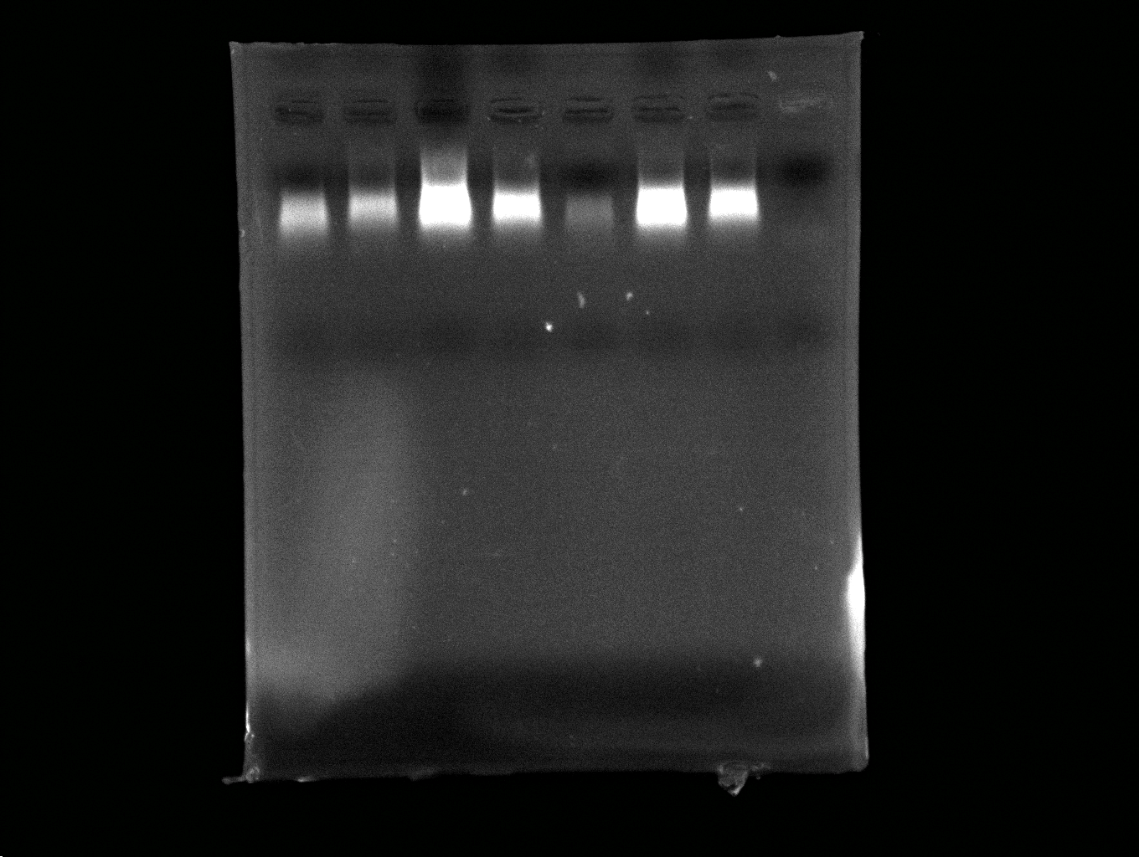
Detection of HPV Infection by PCR in Pre- malignant and OSCC Cases
1 2 PC 3 4 5 6 NC

Slide 18
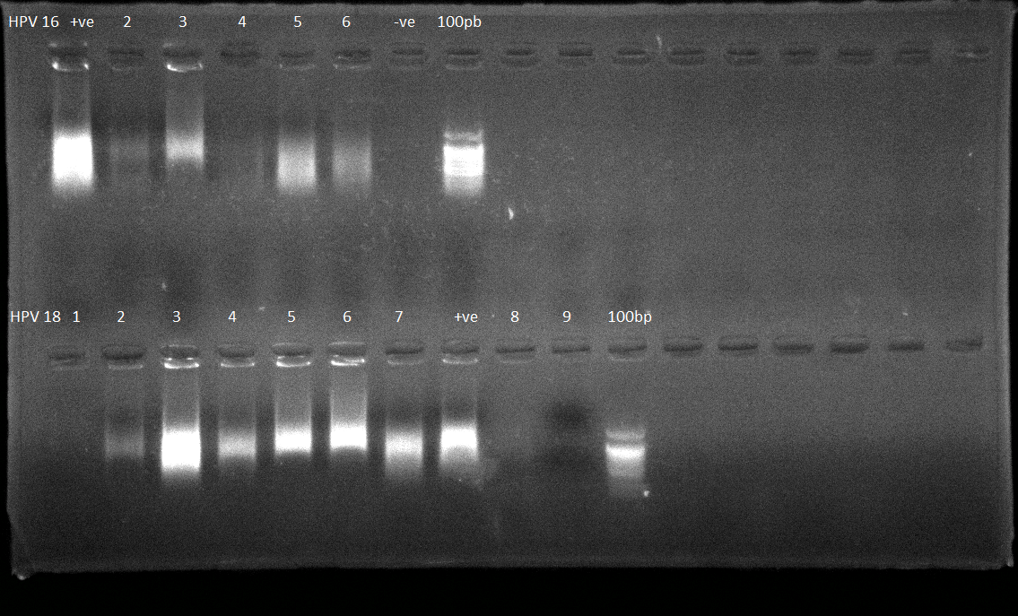
Detection of HPV 16 Infection by PCR in Pre malignant and OSCC Cases
HPV 16
PC 1 2 3 4 5 NC 100bp

Slide 19
Detection of HPV 18 Infection by PCR in Pre malignant and OSCC Cases
HPV 18
NC 1 2 3 4 5 6 PC 100bp

Slide 20
Conclusion
The patients with SMF were more likely to have HPV infection
HPV was more frequent in males
HPV 16 and 18 were more frequently seen in malignant lesions as compared to pre malignant lesions
Possibility of other HPV genotypes causing pre malignant lesions requires further investigation

Slide 21
Significance of the Study
First study from Pakistan linking HPV genotypes with oral lesions
All subjects were tobacco chewers
DNA extraction from Buccal Wash

Slide 22
Future Research
Source of HPV in oral mucosa?
May be the future research would target this issue

Slide 23
Acknowledgement
Professor Dr Saeeda Baig
Ziauddin University, Karachi,
Pakistan
Mr.Mohammad Haris Lucky
Ziauddin University, Karachi,
Pakistan

Slide 24
References
Secretan B, Straif, K., Baan, R., Grosse, Y., and El Ghissassi, F. (2009) A review of human carcinogen—Part E: tobacco, areca nut, alcohol, coal smoke, and salted fish. Lancet Oncol. 10(11), 1033–1034
Merchant, A., Husain, S.S., Hosain, M., Fikree, F.F., Pitiphat, W., and Siddiqui, AR. (2000) Paan without tobacco: an independent risk factor for oral cancer. Int J Cancer. 86,128-131
Gupta, P.C., Ray, C.S. (2004) Epidemiology of betel quid usage. Annals of the Academy of Medicine.33(Suppl)4,31-36
Nair, U., Bartsch, H., Nair, J. (2004) Alert for an epidemic of oral cancer due to use of the betel quid substitutes gutka and pan masala:a review of agents and causative mechanisms. Mutagenesis.19,251-62
Khawaja, M.R.., Mazahir, S., Majeed, A., and Malik, F. (2005) Knowledge, attitude and practices of a Karachi slum population regarding the role of products of betel, areca and smokeless tobacco in the etiology of head and neck cancers. J Pak Med Assoc.S41
D’Souza, G., Kreimer, A.R., and Viscidi, R. (2007) .Case–control study of human papillomavirus and oropharyngeal cancer. N Engl J Med.356(19),1944–56
Warnakulasuriya, S., Johnson, N.W., and Van der Waal, I. (2007) Nomenclature and classification of potentially malignant disorders of the oral mucosa. J Oral Pathol Med. 36,575–580

Slide 25
Thank You

