Slide 1

Synthesis of novel composite based on carbon nanotube for electrochemical application
2nd International Conference and Expo on Ceramics and Composite Materials
Presenter: Zih-Jyun Chen
Co-author: Dr. Chiung-Fen Chang
Notes:
Electrooxidation of Phenol in (Acidic) Aqueous Solution using Pt Composite Electrode

Slide 2
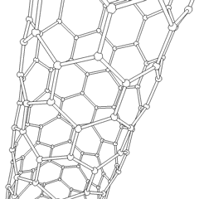

Outline
Introduction
Method and Experiments
Results and Discussion
Conclusion
References

Slide 3

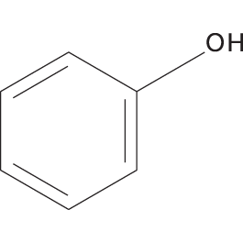
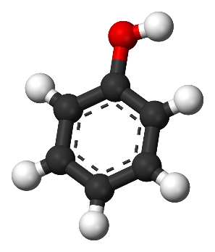
Phenol
Table 1 SDS of phenol
Formula | C₆H₆O
Molecular weight, g mol⁻¹ | 94.11
CAS# | 108-95-2
Melting point, ºC | 40.0- 42.0
Log K_{ow} (octanol–water partitioning) | 2.45
Vapor pressure at 25 ºC, mmHg | 0.35
Solubility at 20 ºC, g L⁻¹ | 83
Source
Textiles , paint, coal-gas
Coal-coking, petroleum
Pharmaceutical industries
Properties
  Highly polar
  Highly volatile
  Biodegradation resistance
(Olmez-Hanci and Arslan-Alaton, 2013)
Phenol is a ‘priority’ contaminant found in industrial wastewater resulting from the textiles, paint, coal-gas, coal-coking, petroleum, and pharmaceutical industries, as well as in wastes from processes involving the use of phenol as a raw material.
Notes:
Phenol is a ‘priority’ contaminant found in industrial wastewater resulting from the textiles, paint, coal-gas, coal-coking, petroleum, and pharmaceutical industries, as well as in wastes from processes involving the use of phenol as a raw material.
Phenol belongs to the recalcitrant pollutants to conventional
physicochemical and biological treatments.(Pimentel et al., 2008)
The electrochemical method for the mineralization of organic pollutants is a new technology and has attracted a great deal of attention recently.

Slide 4

Definition
The generation of the ·OH in the process, resulting in the destruction of the target contaminant.
Fenton
Ozone
Advanced Oxidation Processes
(AOPs)
Electrochemical Oxidation
Photodegradation
Advantage
No addition of chemicals
Lower operational risk
Only electrical energy consumed
Notes:
The electrochemical technology is interesting for the treatment and it is in competition with the process of chemical oxidation using strong oxidants.
The main advantage of this technology is that chemicals are not used. In fact, only electrical energy is consumed for the mineralization of organic pollutants. (Kapałka et al., 2008)
AOPs have been defined broadly as those aqueous phase oxidation processes which are based primarily on the intermediacy of the hydroxyl radical in the mechanism(s) resulting in the destruction of the target pollutant or xenobiotic or contaminant compound.(Esplugas et al.,2002 )
dilute wastewater (COD < 5 g/L)
(The electrochemical method for the mineralization of organic pollutants is a new technology and has attracted a great deal of attention recently.)
File: T. Tendency/ Echem. /G-C paper

Slide 5
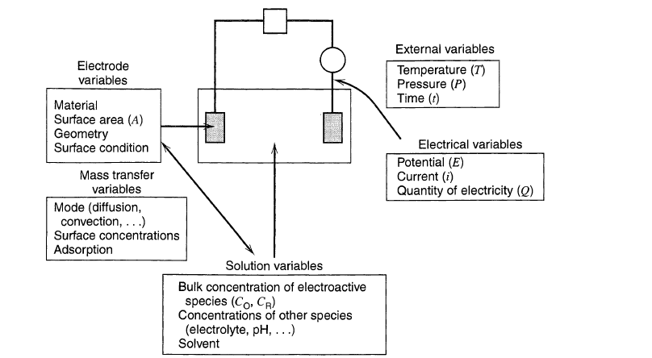
Factors affecting the electrode reaction rates
(Bard et al., 1980)
Notes:
Here we interest in the electrode reaction of anode where oxidation reactions take place.

Slide 6
Binary alloy catalysts based on Pt
Pt
CO
tolerant
The way to reduce the negative impact of this CO impurity is to develop CO-tolerant anode catalyst.
Platinum has high activity for organic compound oxidation.
Pt–Ru
alloy
The most promising type of catalysts has been identified as bimetallic heterogeneous catalysts such as carbon-supported Pt–Ru alloy catalysts.
However, Pt catalyst will be poisoned by the intermediate of oxidation, such as CO_{ads}.
(He et al., 2004; Deivaraj and Lee, 2005)
Notes:
Binary platinum alloy catalyst(e.g. Pt-Ru) was developed, the improved activity of which is related to its enhanced facility toward the oxidation of CO at relatively low electrode potentials if compared to pure Pt, rather than to CO tolerance in the precise meaning of the term.

Slide 7
Objectives
Synthesizing carbon fiber supported by RuPt alloy catalysts as anodes
Investigating its application on electrochemical oxidation.
Using the active anodes to degrade phenol and achieve mineralization.
Synthesizing of anode
Degradation processes optimization
Assessment of lifetime and cost

Slide 8
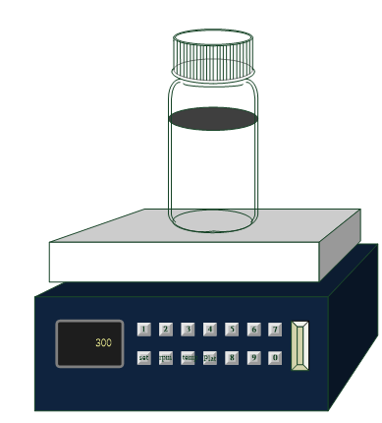

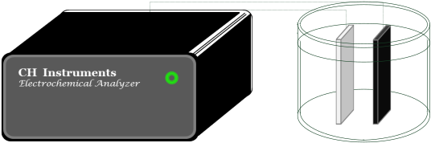

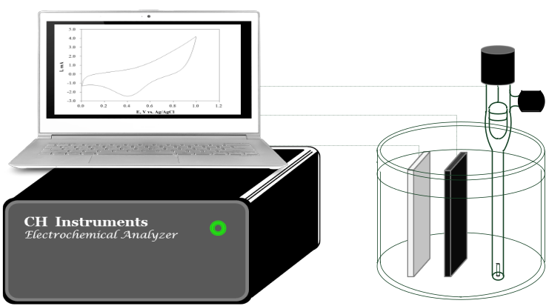
Methods and Experiment
Preparation of electrocatalysts
Preparation of basic electrode
Synthesis of anode
Characterization of anodes
Electrochemical oxidation of phenol

Slide 9
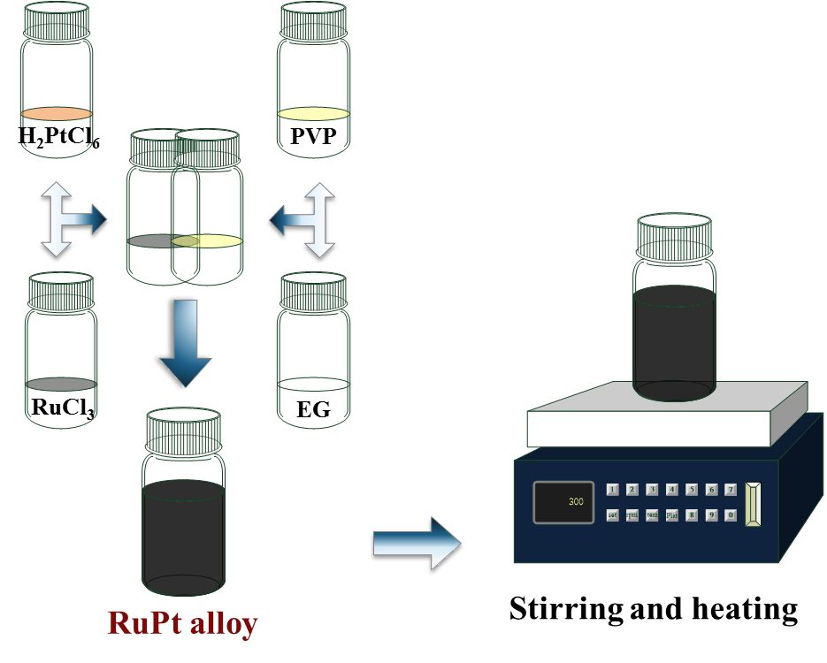
Preparation of catalysts
Notes:
Polyvinylpyrrolidon (PVP)
https://de.wikipedia.org/wiki/Polyvinylpyrrolidon
Ethylene glycol(EG)
Hexachloroplatinic (H2PtCl6)
We employed carbon fiber supported Ru-Pt alloy catalyst for anode as Anode.

Slide 10
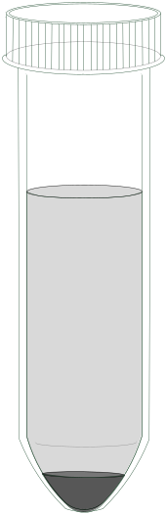
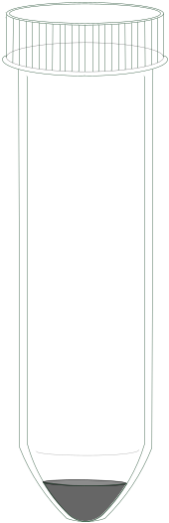
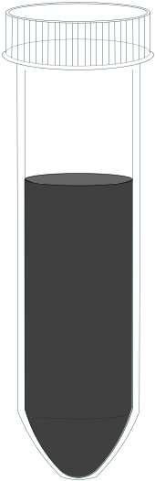

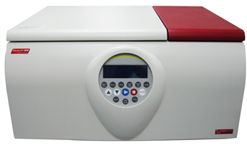

Purification of catalyst
RuPt alloy 1:1 NPs were dispersed in acetone .
Carry out Low speed centrifugation at 2000 rpm for 5 min.
After supernatant removal.
RuPt alloy 1:1 NPs were re-dispersed in 18 mL EtOH.
Acetone
5g RuPt alloy NPs
High speed centrifugation
(17500 rpm for 99 min.)
Supernatant
removal.
Catalysts were re-dispersed in EtOH.
Micro centrifuge tube.
Notes:
We employed carbon fiber supported Ru-Pt alloy catalyst for anode as working electrode.
Characteristics of each electrode will been analyzed in cyclic voltammetry to distinguish their differences.
In Cyclic voltammetry , a given potential range is scanned starting at the Initial potential and ending at the Final potential .
But how do we observe an oxidation reaction occurred? The Current result from this scan experiment will show us .

Slide 11
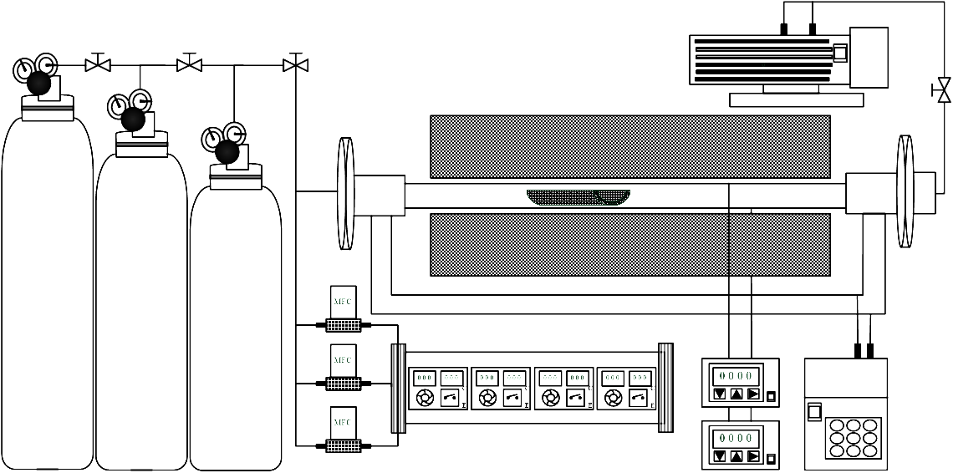
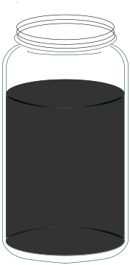
Carbon fiber supported Pt, RuPt alloy, Ru@Pt alloy
E-gun/ Ti and Ni
CNTs/CF
Carbon Fiber
(1 cm × 3 cm)
Thermal CVD processes grown CNTs
RuPt
alloy
RuPt-CNTs/CF
Immersed and dried
Repeat four times.
Annealed with heating rate
30 K min⁻¹
Notes:
Carbon Nanotubes Grown on the Surface of Fibers (J. García,et al,2008)
The growth of carbon nanotube via chemical vapor deposition.

Slide 12
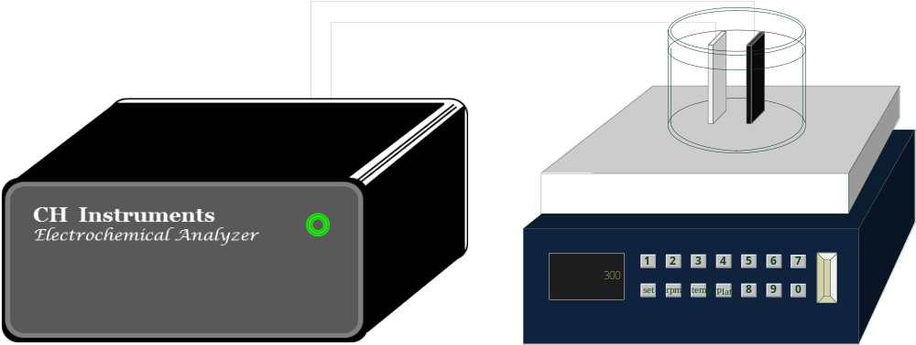
Electrochemical analysis
Cyclic Voltammetry
Reference electrode
Electrochemical Impedance Spectroscopy
Working electrode
Counter electrode
Electrochemical equipment
Electrochemical Oxidation
Anode
Cathode
Notes:
There will be a triple electrode system. The triple-electrode system consisted of a working electrode, Counter electrode, a reference Ag/AgCl H2SO4(0.01M) and auxiliary platinum electrode.
We employed carbon fiber supported Ru-Pt alloy catalyst for anode as working electrode.
Characteristics of each electrode will been analyzed in cyclic voltammetry to distinguish their differences.
In Cyclic voltammetry , a given potential range is scanned starting at the Initial potential and ending at the Final potential .
But how do we observe an oxidation reaction occurred? The Current result from this scan experiment will show us .

Slide 13
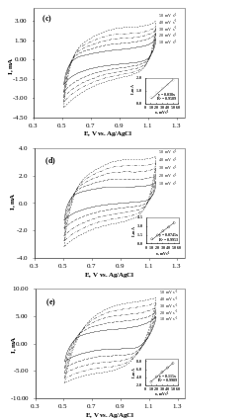
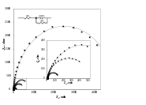
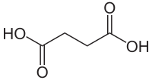
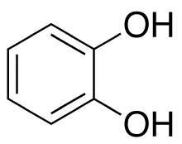
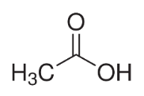
Results and Discussion
Physicochemical properties
SEM
TEM
Electrochemical performance
CV
EIS
XRD
Processes optimization of phenol oxidation
Modeling with pseudo-first kinectics
Quantitative analysis of intermediates
Lifetime and the cost of anodes
Notes:
鄰苯二酚 + 丁二酸

Slide 14
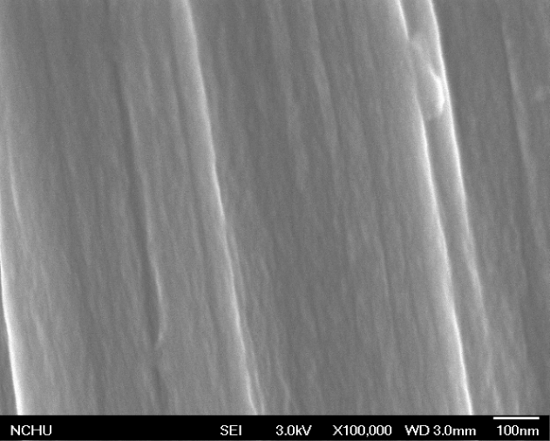
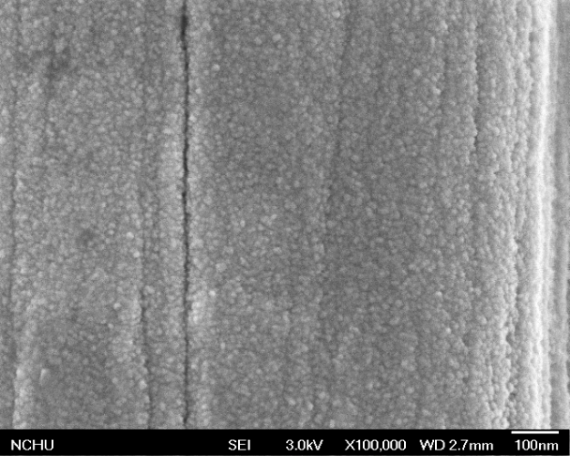
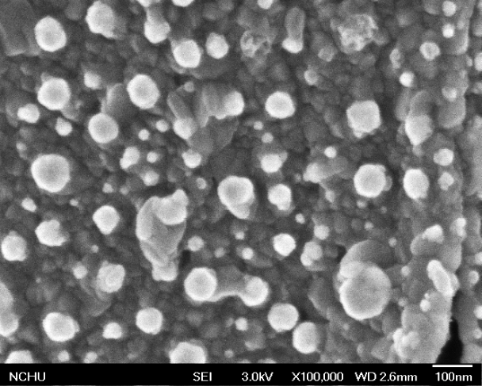
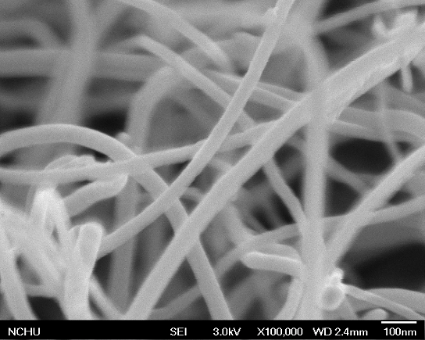
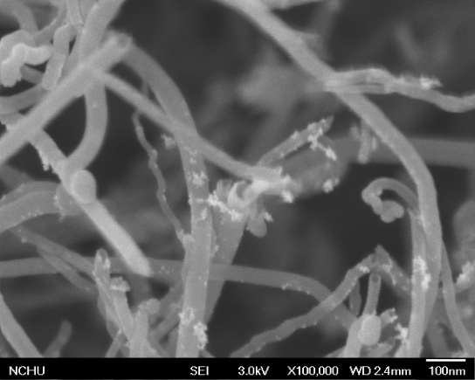
SEM morphology
(a)
(b)
(c)
Fig. 1 SEM morphology for (a) Original CF, (b) NiTi-CF, (c) NH₃ treated NiTi-CF ×100k.
(a)
(b)
Fig. 2 SEM morphology for (a) CNTs/CF and (b) RuPt-CNTs/CF ×100k.
Notes:
Pt: 8- 15 nm, RuPt: 5.5- 12 nm, Pt single particles

Slide 15
TEM morphology
(a)
(b)
Fig. 3 TEM morphology for RuPt (a) ×400k and (b) ×800k nanoparticles.
Table. 1 Particle size of RuPt alloy catalysts
 | Catalyst | D_{F min}, nm | D_{F max}, nm | D_{F average}, nm | SD
 | RuPt alloy | 4.976 | 13.521 | 9.128 | 2.073
Notes:
Pt: 8- 15 nm, RuPt: 5.5- 12 nm, Pt single particles

Slide 16
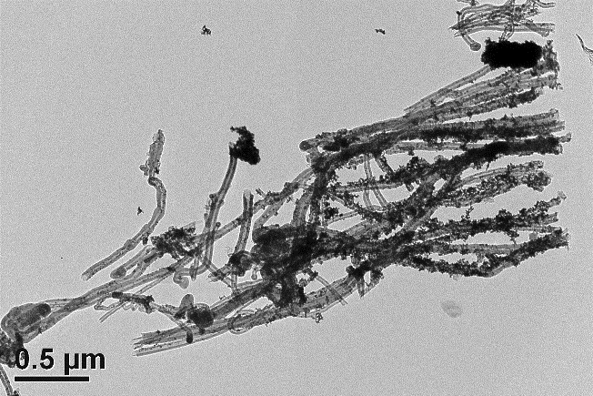
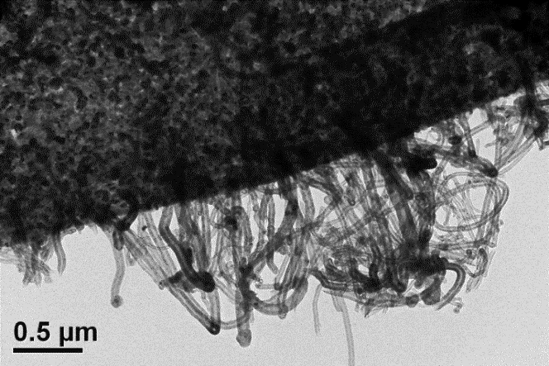
TEM morphology
(a)
(c)
(e)
(b)
(d)
(f)
Fig. 4 TEM morphology for CNTs/CF which grown at 750 ºC for 25 min (a) ×10k; (b) ×50k; (c) ×100k; (d) ×400k and RuPt-CNTs/CF (e) ×50k; (f) ×400k .
Notes:
with diameters around 35- 70 nm
頂部生長模式
In this report, we describe the finding that bamboo‐structured carbon nanotubes (CNT) showed superior electrocatalytic activity toward hydrogen peroxide.

Slide 17
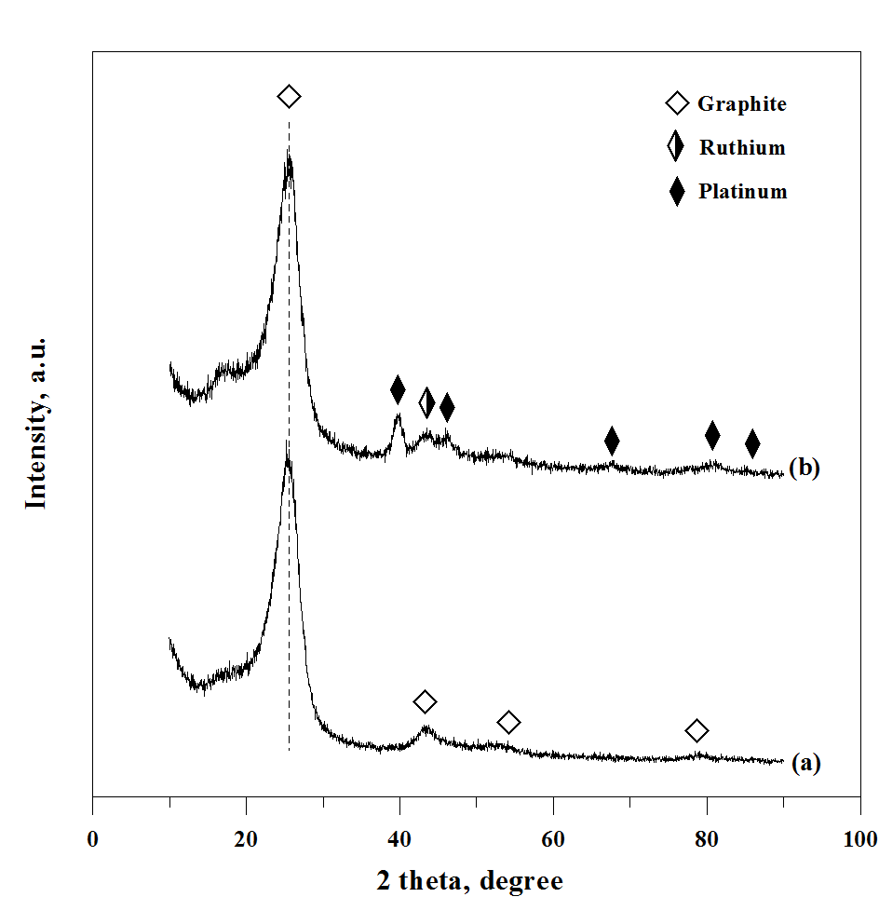
Result of XRD
Fig. 5 X-ray diffraction pattern of (a) CNTs/CF and (b) RuPt-CNTs/CF annealed with a heating rate of 30 K min⁻¹

Slide 18
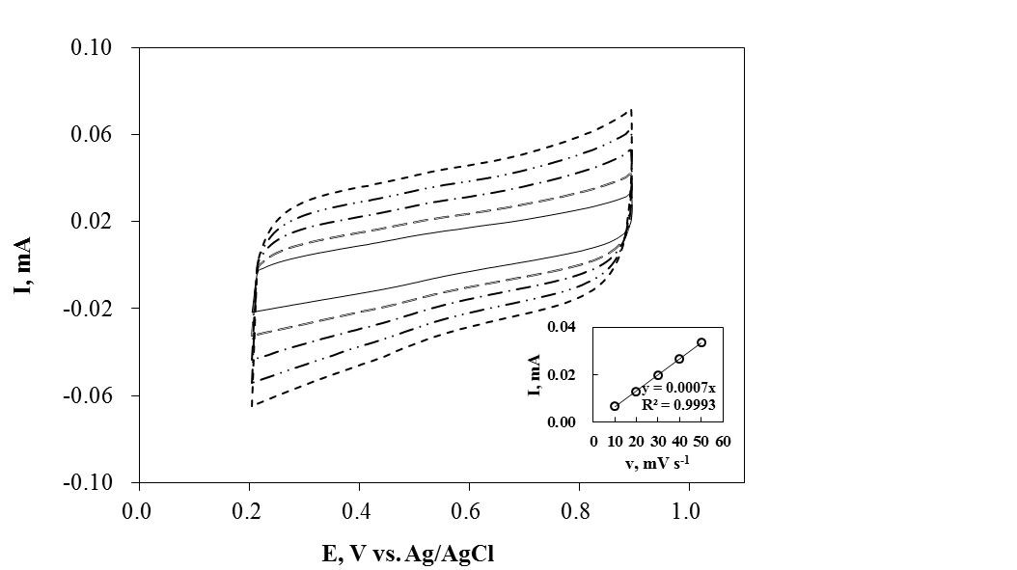
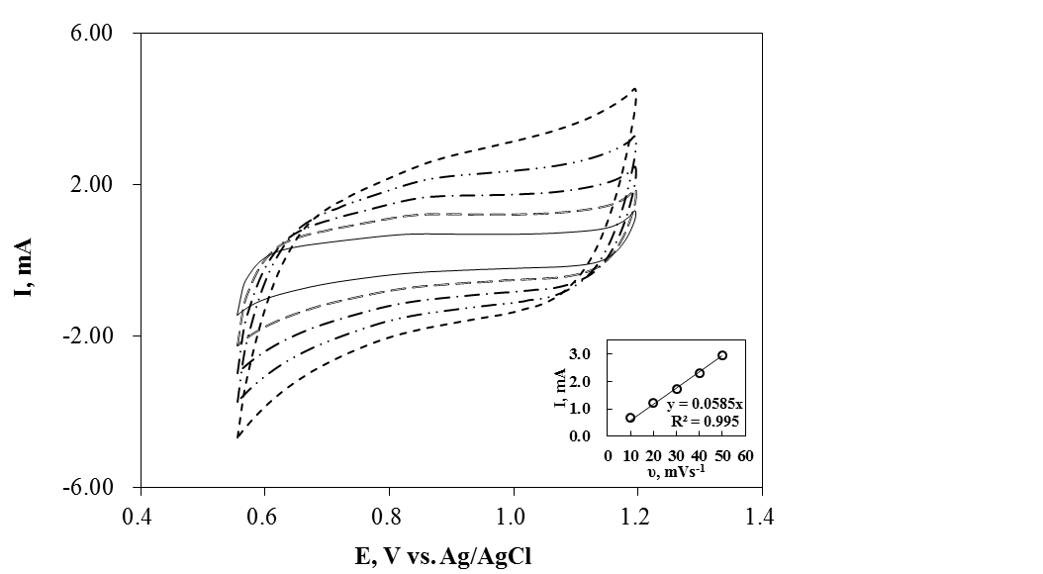
Cyclic Voltammetry
(a) CNTs/CF
(b) RuPt-CNTs/CF
Fig. 6 Cyclic Voltammogram and area normalized capacitation (C) of carbon supported anodes with 30 K min⁻¹ at scan rate of 10 to 50 mV s⁻¹ in 0.03 M H₂SO₄ solution, Counter electrode: Pt .
Electrodes | CNTs/CF | RuPt-CNTs/CF
C , F cm⁻² | 2.33E-04 | 2.48E-02
Notes:
The original CNTs/CF have a wider potential window than those carbon supported catalysts ones.

Slide 19
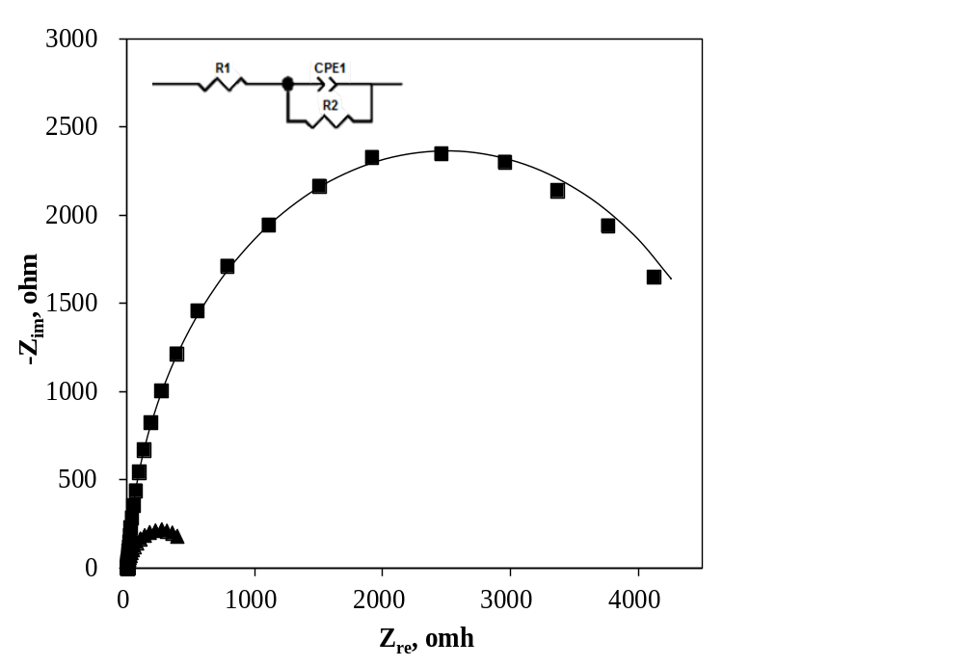
Result of EIS
Fig. 7 Nyquist plot of (■) CNTs/CF and (◆) RuPt-CNTs/CF anodes synthesized under a heating rate of 30 K min⁻¹ in 0.1 M H₂SO₄, counter: Pt; reference: Ag/AgCl. Solid lines represent the fitting result.
Table 2 Impedance fitting result of anodes
 | Electrode | R_{s}, Ω | CPE-T | CPE-P | R_{p}, Ω
 | CNTs/CF | 5.678 | 1.057 × 10⁻² | 0.9663 | 4987
 | RuPt-CNTs/CF | 6.632 | 3.756 × 10⁻³ | 0.8912 | 518.6

Slide 20
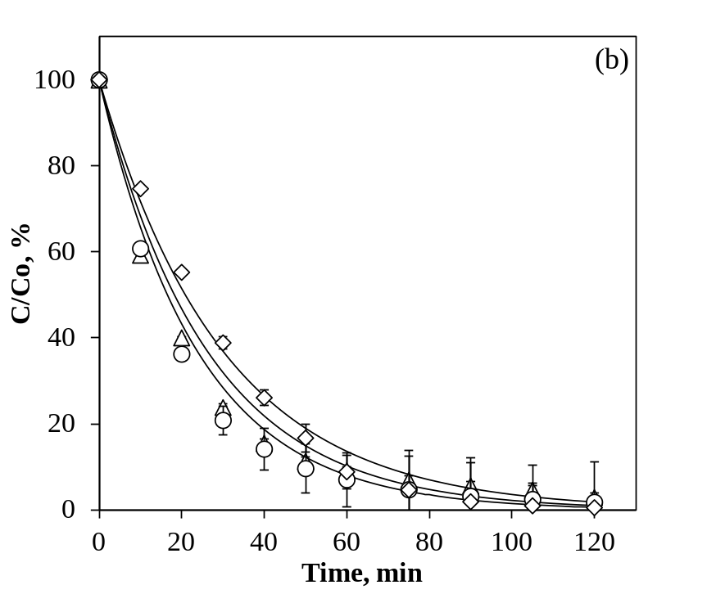
Concentration of electrolyte
◇: 0.01 M
○: 0.05 M
△: 0.10 M
Table 3 Degradation efficiency by HPLC and 1st order rate coefficient (k) of 10 mg L⁻¹ phenol oxidation using RuPt-CNTs/CF anodes
Concentration of electrolyte, M |  | k, min⁻¹ | r² | Degradation efficiency, %
 | 0.10 | 0.0332 | 0.8889 | 97.14
 | 0.05 | 0.0380 | 0.9308 | 98.17
 | 0.01 | 0.0419 | 0.9845 | 99.43

Slide 21
Various anodes
△: CNTs/CF
○: RuPt-CNTs/CF
Table 4 Degradation efficiency by HPLC and 1st order rate coefficient (k) of 10 mg L⁻¹ phenol oxidation in 0.01 M H₂SO₄ using CNTs/CF anodes
Electrodes |  | k, min⁻¹ | r² | Degradation efficiency, %
 | CNTs/CF | 0.0283 | 0.9973 | 96.43
 | RuPt-CNTs/CF | 0.0419 | 0.9859 | 99.43

Slide 22
Various anodes
Mineralization current efficiency
○: RuPt-CNTs/CF
△: CNTs/CF
Fig. 8 The mineralization current efficiency (MCE) of phenol oxidation using CNTs/CF and RuPt-CNTs/CF in 0.01 M H₂SO₄ for 120 min, initial concentration of phenol: 10 mg L⁻¹.
Table 5 Mineralization efficiency by TOC and 1st order rate coefficient (k) of 10 mg L⁻¹ phenol oxidation in 0.01 M H₂SO₄ using CNTs/CF and RuPt-CNTs/CF anodes
Electrodes |  | k, min⁻¹ | r² | Mineralization efficiency, %
 | CNTs/CF | 0.0038 | 0.9754 | 48.07
 | RuPt-CNTs/CF | 0.0076 | 0.9691 | 71.34
23 % ↑

Slide 23
Intermediate
Generation of 1,4-BQ
◇: CNTs/CF
△ : Ru@Pt-CNTs/CF
－ 2.05 mg L⁻¹
－ 1.50 mg L⁻¹
－ 0.2 mg L⁻¹
－ 0.01 mg L⁻¹
Fig. 9 Generation and degradation of 1,4-BQ during the phenol oxidation reaction using CNT/CF and RuPt-CNT/CF in 0.01 M H₂SO₄ for 120 min, initial concentration of phenol: 10 mg L⁻¹.

Slide 24
Cost and lifetime assessment
Table 6 Estimated cost for synthesizing 100 piece of electrodes (1 cm× 3 cm)
Project cost |  | CNTs/CF | RuPt-CNTs/CF
 | Carbon fiber (1 cm× 3 cm) | $ 77.40 | $ 77.40
 | E-Beam Gun Ti and Ni | $ 9.29 | $ 9.29
 | Catalytic CVD Ar, C₂H₂ and NH₃ | $ 1.42 | $ 1.42
 | Preparation of RuPt catalysts | - | $ 163.56
 | Total cost, USD$ / 100piece | $88.11 | $ 251.67
Table 13 Estimated cost for synthesizing an electrode (1 cm× 3 cm)
Project cost |  | CNTs/CF | RuPt-CNTs/CF
 | Carbon fiber 1 cm× 3 cm | $ 25 | $ 25
 | E-Beam Gun Ti and Ni | $ 3 | $ 3
 | Catalytic CVD Ar, C₂H₂ and NH₃ | $ 0.46 | $ 0.46
 | Preparation of Pt series catalysts | - | $ 52.83
 | Total cost, USD$ / piece | $ 28.5 | $ 81.3
Table 7 Degradation efficiency of the 8 times repeat experiment (R8) using CNTs/CFs anodes, R1 represent the first time of experiment
Electrodes |  | Degradation Efficiency _{R1}, % | Degradation Efficiency _{R8}, % | Relative error, %
 | CNTs/CF | 97.41 | 96.01 | 1.45
 | RuPt-CNTs/CF | 99.63 | 98.56 | 1.08

Slide 25
Conclusions
The performance of RuPt-CNTs/CF anode possessed the more normalized capacitance but the less impedance in CV and EIS analyses respectively.
The optimal electrolyte concentration was proved to be 0.01 M of H₂SO₄ for phenol oxidation.
Anodes synthesized in this study displayed high repeatability for the 1st and 8th degradation experiments, of which the relative errors were within 2 %.
Overall, the RuPt-CNTs/CF anode showed the higher performance with the degradation efficiency of 99.43%, mineralization efficiency of 71.34% and the reaction rate coefficient of 0.0419 min⁻¹ than CNTs/CF.
The effective and stable anodes of CNTs/CF and RuPt-CNTs/CF for phenol treatment were synthesized at an economic price in this study.
Notes:
At the same conditions, the results of cyclic voltammetry will display differently due to the organic pollutant is present or not.

Slide 26


Thank you for your attention
Your Questions & Comments
Welcome

Slide 27



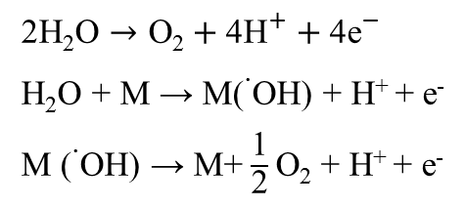
Activation of Water
H₂O
Oxygen
‧ $\text{O}\text{H}$
Hydrogen
Chemically Bond
Hydroxyl radicals
+ e⁻
+ e⁻
$$→$$
+
+ e⁻
+ e⁻
Hydroxyl radicals
Physisorbed
☞ Dissociative Adsorption
☞ Electrolytic Discharge
H₂O + M → M-OH + M-H
M-H → M+ H⁺ + e⁻
H₂O + M → M-OH + H⁺ + e⁻
2H$\text{2}\text{O}→\text{O}\text{2}+\text{4}{\text{H}}^{+}+{\text{4}\text{e}}^{−}$
H₂O + M → M(˙OH) + H⁺ + e⁻
M (˙OH) → M+$\frac{\text{1}}{\text{2}}$O₂ + H⁺ + e⁻
Notes:
Hydroxyl radicals is a well-known strong oxidants. But where does it made from ? The answer is Water .
In general, anodic oxidation reactions are accompanied by transfer of oxygen from water to the reaction products. This is the so-called electrochemical oxygen transfer reaction (EOTR).
However, in order to achieve the EOTR, water should be activated. Depending on electrode material, there are two main possibilities for the electrochemical activation of water in acid media.
(Kapałka et al., 2008)
Water is dissociative Adsorption on the electrode followed by hydrogen discharge resulting in the formation of chemically bonded) hydroxyl radicals on the anode surface .
Water oxidation to molecular O2. Hydroxyl radicals here is intermediated and physisorbed. In short, it’s a reaction intermediates for O₂ evolution .

Slide 28
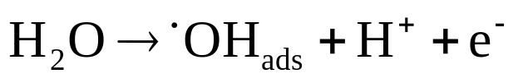
Introduction (3/4)
Anodic oxidation
Anodic oxidation is achieved by electro-generated hydroxyl radical (˙OH) from oxidation of water at the anode surface.
Cathode
Contaminants
Hydroxyl radical
Anode
(Hou et al., 2009)
Notes:
analysis the cyclic voltammetry characteristics
In order to discover an anode material with high stability and high activity
towards organic oxidation, several electrodes have been tested.(Panizza and Cerisola, 2005)

Slide 29
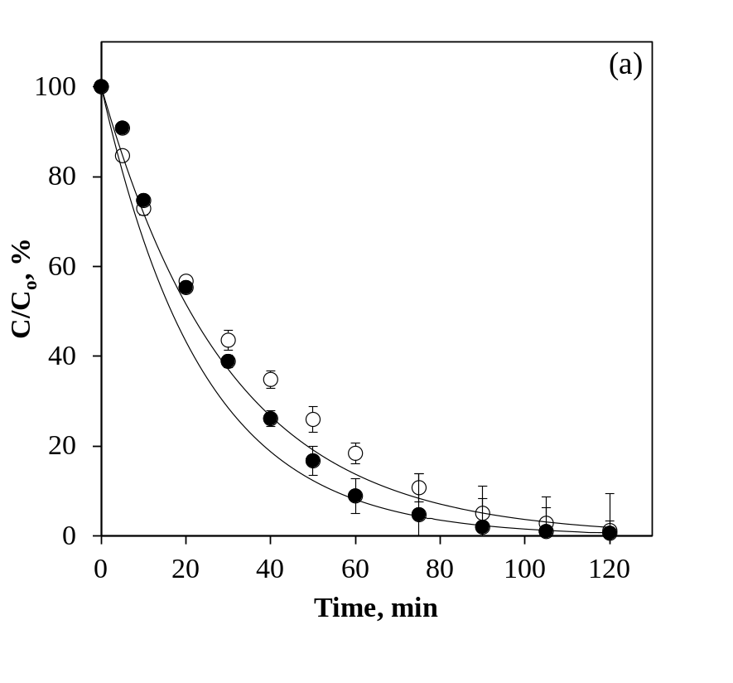
Heating rate effect
Table 4 Degradation efficiency by HPLC and 1st order rate coefficient (k) calculated from electrochemical oxidation of 10 mg L⁻¹ phenol in 0.01 M H₂SO₄
Heating rate, K min⁻¹ |  | k, min⁻¹ | r² | Degradation efficiency, %
(a) RuPt-CNTs/CF
 | (○) 10 | 0.0311 | 0.9737 | 98.84
 | (●) 30 | 0.0419 | 0.9859 | 99.43

Slide 30
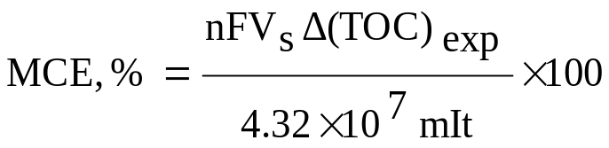
Heating rate effect
Fig. 14 The mineralization current efficiency (MCE) of phenol oxidation using RuPt-CNTs/CF in 0.01 M H₂SO₄ for 120 min, initial concentration of phenol: 10 mg L⁻¹.
Table 7 Mineralization efficiency by TOC and 1st order rate coefficient (k) of 10 mg L⁻¹ phenol oxidation in 0.01 M H₂SO₄ using RuPt-CNTs/CF
Heating rate, K min⁻¹ |  | k, min⁻¹ | r² | Mineralization efficiency, %
 | (○) 10 | 0.0068 | 0.9892 | 54.99
 | (●) 30 | 0.0076 | 0.9691 | 71.34

Slide 31
Conclusion
Result of TEM indicated lower heating rate in annealing process improve the dispersion of catalyst on basic electrode. However, anodes performance higher normalized capacitance in CV and lower impedance in EIS.
The bi-metallic of RuPt alloy catalysts improve electron transfer or exchange so as to promote degradation of phenol.
The degradation of phenol by the synthesized anodes in this study was able to be adapted to pseudo first-order kinetics model. In addition, the highest reaction rate coefficient of 0.0507 min⁻¹ was obtained in Ru@Pt-CNTs/CF, of which electrochemical characteristics was also confirmed by EIS and CV results.
CNTs/CFs have lower oxygen evolution overpotential, these anode was disabled for predict the mineralization kinetics using limited current density.
The maximum concentration of 1,4-BQ increased proportionally with initial concentration of phenol increased. Thus, deduce there are more intermediates generation cause the degradation/mineralization efficiency decrease.
Notes:
At the same conditions, the results of cyclic voltammetry will display differently due to the organic pollutant is present or not.

