Slide 1

4th International Conference on Geology and Geoscience, Dubai, UAE
Mechanisms and potential of terrestrial phytolith carbon sequestration: A case study of China
  Zhaoliang Song
  Institute of the Surface-Earth System Science
  Tianjin University, China
  songzhaoliang78@163.com
April 27, 2017
1

Slide 2
Outline
1
Terrestrial biogeochemical cycles of Si and C
2
Characteristics of phytoliths
3
Storage and stability of phytoliths in soil profiles
4
Phytolith C sequestration in ecosystems of China
5
Conclusions and perspectives
2

Slide 3
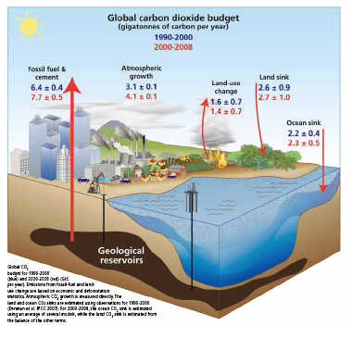
1. Terrestrial biogeochemical cycles of Si and C
1.1 Biogeochemical C cycle
Carbon cycle plays an important role in the regulation of global climate change
There are many limits in current global C cycle models
Based on carbon itself
Lack of impacts from silicon and other elements
Global C cycle and its change
Le Quere, Global Biogeochemical Cycles, 2010
3

Slide 4
1.2 Interactions of silicate weathering, phytolith dynamics, and aluminosilicate accumulation
Si release and CO₂ consumption during silicate weathering
Transport-limited
Plant Si uptake
Weathering-limited
Phytolith and PhytOC accumulation in plants and soils
Soil accumulation of aluminosilicates and protected C
Possitive feedback
Negative feedback
Feedback among processes of terrestrial biogeochemical Si and C cycles
Song et al,. Earth-Science Reviews, 2012
4

Slide 5
Outline
1
Terrestrial biogeochemical cycles of Si and C
2
Characteristics of phytoliths
3
Storage and stability of phytoliths in soil profiles
4
Phytolith C sequestration in ecosystems of China
5
Conclusions and perspectives
5

Slide 6
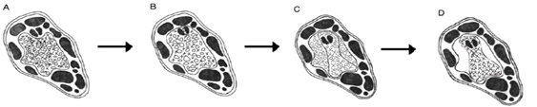
2. Characteristics of phytoliths
2.1 Formation and morphotypes of phytoliths
Dissolved silicon in soil solution is taken up by plant roots and eventually deposited within cell or between cells to form phytoliths (Piperno, 1988).
A hypothetical model of how C becomes occluded during phytolith formation
Carter, Quaternary International, 2009
6

Slide 7
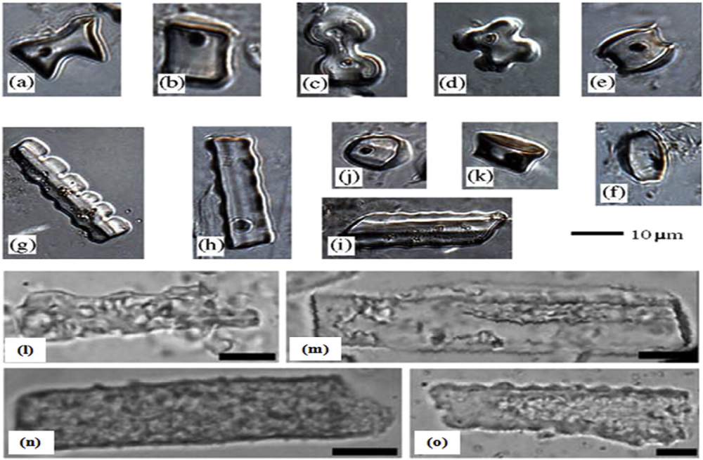
Selected phytoliths from modern grasses (a)–(k) and phytoliths in soils with different weathering degrees (l)–(o).
Lü et al., Quat. Sci. Rev. 2016; Borrelli et al., J. Soils Sediments, 2010
7

Slide 8
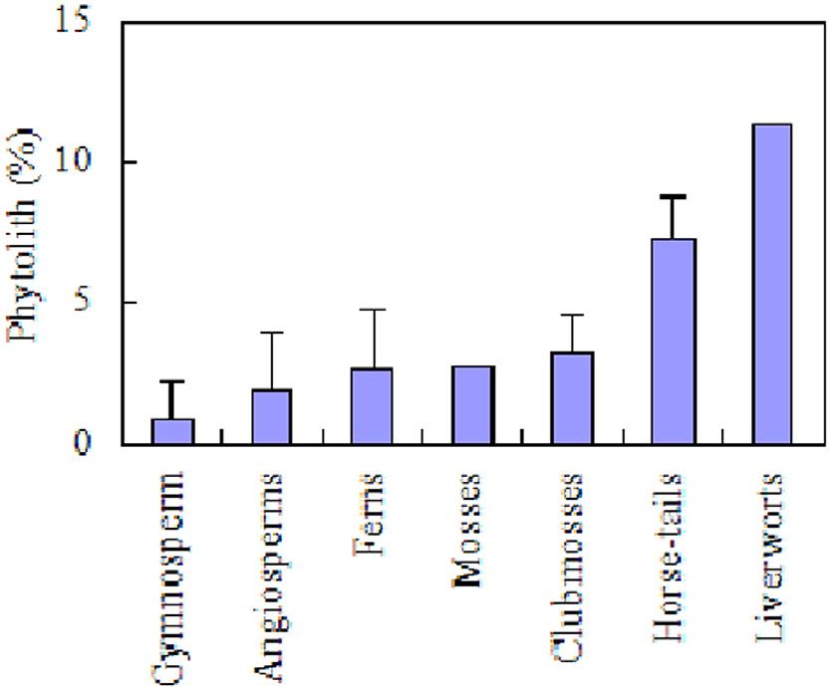
2. Characteristics of phytoliths
2.2 Distribution of phytoliths in different plants
Phytolith (%)
Phytolith (%)
Phytolith (%)
Gymnosperm
Angiosperm
Liverworts
Ferns
Mosses
Club mosses
Horse-tails
Contents of phytoliths in different plant groups
Hodson, et al., Ann. Bot. 2005; Song et al., Earth-Science Reviews, 2016
8

Slide 9
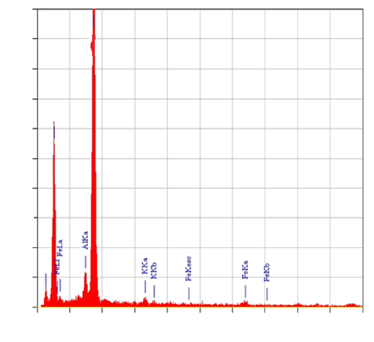
2. Characteristics of phytoliths
2.3 Elemental composition of phytoliths
1000
Phytoliths consist mainly of SiO₂ (66 to 91%) with minor amounts of other elements such as C, Fe and Al.
Phytoliths can occlude 0.2–6% of organic C.
900
SiKa
800
700
OKa
Counts
600
500
400
300
200
CKa
100
0
8
0
1
2
3
4
5
6
7
9
10
Kev
Si, O, C in phytolith (SEM-EDS)
Anala, et al., Paddy Water Environ. 2015
9

Slide 10
Outline
1
Terrestrial biogeochemical cycles of Si and C
2
Characteristics of phytoliths
3
Storage and stability of phytoliths in soil profiles
4
Phytolith C sequestration in ecosystems of China
5
Conclusions and perspectives
10

Slide 11
3. Storage and stability of phytoliths in soil profiles
Phytoliths accumulate near surface and decrease with depth.
Significant positive correlation between phytolith content and SOC content in bamboo, fir, chestnut forest soils
The distribution and correlation of phytolith and SOC in soil profiles
(Zhang et al., Journal of Soils and Sediments, 2015)
11

Slide 12
3. Storage and stability of phytoliths in soil profiles
3.1 Storage of phytoliths in soil profiles
Soil phytolith storage depends on plant phytolith input flux and soil stability of phytoliths.
The storages of phytolith in different climate zones
Zhang et al., Journal of Soils and Sediments, 2015, 2016
12

Slide 13
3.Storage and stability of phytoliths in soil profiles
3.2 Stability of phytoliths in soils depends on:
Phytolith properties, e.g. water content and element composition.
Soil properties, e.g. soil pH, moisture.
Climate, e.g. precipitation and temperature.
Tropical
Temperate
Phytolith turnover rate in soils
Song et al., Earth-Science Reviews, 2016; Reference cited
13

Slide 14
Outline
1
Terrestrial biogeochemical cycles of Si and C
2
Characteristics of phytoliths
3
Storage and stability of phytoliths in soil profiles
4
Phytolith C sequestration in ecosystems of China
5
Conclusions and perspectives
14

Slide 15
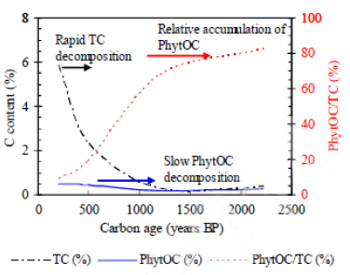
4. Phytolith C sequestration in ecosystems of China
4.1 Mechanisms of PhytOC formation and accumulation
Phytosynthesis CO₂
Harvest
Vegetation subsystem
Occlusion of C by Si
Biomass C change
Production of PhytOC
Respiration CO₂
Litterfall
Soil C change
Soil PhytOC accumulation
Slow PhytOC decomposition
Soil subsystem
Carbon leaching
The mechanism and stability of PhytOC sink
Parr et al., Soil Biol. Biochem, 2005; Song et al., Global Change Biology, 2013
15

Slide 16

4. Phytolith C sequestration in ecosystems of China
4.2 Phytolith C sequestration in grasslands
Grasslands in China:
cover nearly one third of the country’s area
Show different degree of degradation from human activities
Distribution of the five grassland types of China at a scale of 1 : 1 000 000
Song et al., Global Change Biology, 2012
16

Slide 17
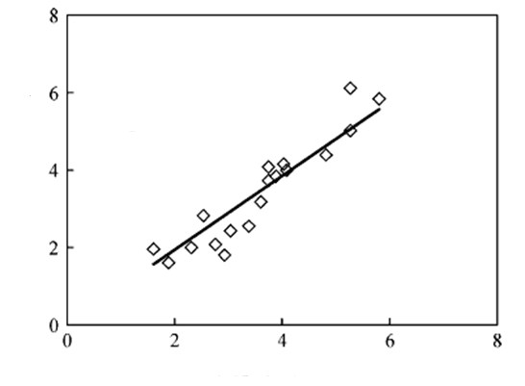
PhytOC production flux of grassland plants can be estimated as:
PhytOC production flux = PhytOC content × SRO production flux
where PhytOC content is estimated from C content of phytolihts (1-4%) and phytolith content. SRO represents Si-rich organs.
y=0.965x, R²=0.8722
p<0.01
Silica-phytolith content transfer function for grassland plants:
Phytolith content = 0.965×silica content
Phytolith content (%)
SiO₂ content (%)
Correlation of phytolith and SiO₂ in different grasses
Song et al., Global Change Biology, 2012
17

Slide 18
There is significant difference in phytolith production flux among the five types of China’s grasslands.
Phytolith production flux in meadow steppe and typical steppe is higher than other grasslands.
Estimated grassland phytolith production flux and rate
Grassland type | ANPP (g m⁻² yr⁻¹) | Phytolith production flux (g m⁻² yr⁻¹) | Phytolith production rate (10⁶ t yr⁻¹)
Desert steppe | 58.6 | 1.6 | 0.3
Typical steppe | 109.2 | 3.8 | 1.5
Meadow steppe | 218.6 | 9 | 0.7
Alpine steppe | 46 | 1.6 | 1.1
Alpine meadow | 105 | 2.9 | 1.7
Song et al., Global Change Biology, 2012
18

Slide 19
The PhytOC production flux of China’s grasslands is much lower than that in other areas mainly due to its lower ANPP.
Aboveground phytolith C sequestration flux and rate in grasslands
Region | SRO production flux (t ha⁻¹ yr⁻¹) | Phytolith C sequsetration flux (kg CO₂ ha⁻¹ yr⁻¹) | Phytolith C sequsetration rate (Tg CO₂ yr⁻¹) | Reference
China | 1 | 1.8(0.3) | 0.6(0.1) | Song et al. 2012
North America | 2.5 | 8.2(2.6) | 1.0(0.3) | Blecker et al. 2006
World | 6.5 | 11.8(1.8) | 41.4(6.3) | Song et al. 2012
*SOR: Si-rich organs.
Song et al., Global Change Biology, 2012
19

Slide 20
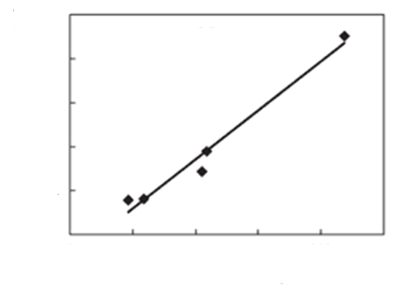
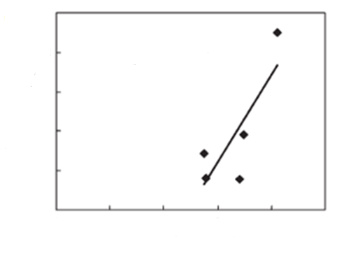
Management to maximize ANPP has great potential to enhance phytolith C sequestration in China’s grasslands.
10
(a)
10
(b)
y=0.045x-1.006
R²=0.974
y=4.37x-10.67
R²=0.658
8
8
6
6
Phytolith production
flux (g m⁻² yr⁻¹)
Phytolith production
flux (g m⁻² yr⁻¹)
4
4
2
2
0
0
0
50
100
150
200
250
0
1
2
3
4
5
ANPP (g m⁻² yr⁻¹)
Phytolith content (%)
Correlation of grassland phytolith production flux with: (a) above-ground net primary productivity (ANPP), (b) phytolith content.
Song et al., Global Change Biology, 2012
20

Slide 21
4. Phytolith C sequestration in ecosystems of China
4.3 Phytolith C sequestration in forest
China has 142.8 million ha of forested land including 7.2 million ha of bamboo.
China’s forests range from boreal forests in the north to tropical forests in the south.
Distribution of the eight Chinese forest types at a scale of 1 : 1000000
Song et al., Global Change Biology, 2013
21

Slide 22
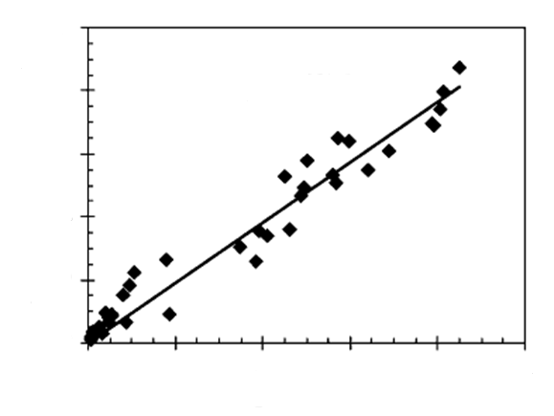
Silica content-phytolith content transfer function in forests:
Phytolith content=0.953×silica content
10
y = 0.953 x,
R²=0.955, p < 0.01
8
6
Phytolith content (%)
4
2
0
0
2
4
6
8
10
SiO₂ content (%)
Correlation of phytolith and SiO₂ in different plants of forests
Song et al., Global Change Biology, 2013
22

Slide 23
Subtropical and tropical bamboo (STB) has much higher phytolith production flux than other forests.
Estimated phytolith production in China’s forests
Forest type | ANPP (t hm⁻¹ yr⁻¹) | Phytolith production flux (Kg CO₂ hm⁻¹ yr⁻¹) | Phytolith production rate (Tg CO₂ yr⁻¹)
CTC | 5.19 | 7.54 | 0.18
STC | 5.06 | 6.6 | 0.19
CB | 6.6 | 9.01 | 0.04
DBS | 6.03 | 8.55 | 0.36
SEDB | 8.05 | 21.7 | 0.27
SEB | 8.6 | 12.89 | 0.28
T | 10.89 | 30.06 | 0.03
STB | 7.37 | 81.63 | 0.59
CTC, cold-temperate and temperate coniferous forest; STC, (sub)tropical coniferous forest; CB, coniferous and broad-leaf mixed forest; DBS, deciduous broad- or small-leaf forest; SEDB, subtropical evergreen and deciduous broad-leaf forest; SEB, subtropical evergreen broad-leaf forest; T, tropical forest; and STB, subtropical and tropical bamboo.
Song et al., Global Change Biology, 2013
23

Slide 24
30% of the phytolith C sink in China’s forests is from bamboo which occupies only 5% of the area for China’s forests.
Aboveground phytolith C sequestration flux and rate in forests
Region | SRO production flux (t ha⁻¹ yr⁻¹) | Phytolith C sequestration flux (kg CO₂ ha⁻¹ yr⁻¹) | Phytolith C sequestration rate (Tg CO₂ yr⁻¹)
China forest | 6.4 | 13.6(3.1) | 1.94(0.44)
China bamboo | 7.37 | 81.63(7.11) | 0.59(0.05)
World bamboo | 7.37 | 81.63(7.11) | 2.05(0.17)
*SOR: Si-rich organs.
Song et al., Global Change Biology, 2013
24

Slide 25
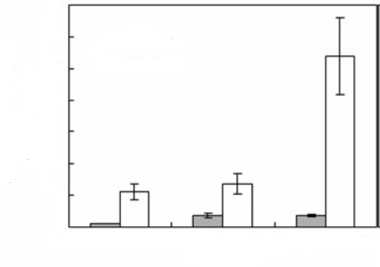
Management practices such as bamboo afforestation and reforestation may significantly enhance phytolith carbon sink.
35
30
Present
Potential
25
20
Phytolith carbon sink
(Tg CO₂ yr⁻¹)
15
10
5
0
China’s bamboo
China’s forest
World’s bamboo
Forests
Phytolith C sink in China’s bamboo, China’s forests, and world’s bamboo
Song et al., Global Change Biology, 2013
25

Slide 26
4. Phytolith C sequestration in ecosystems of China
4.4 Phytolith carbon sequestration in croplands
China has 160 million ha croplands including 91 million ha cereal croplands (e.g., rice, wheat and corn).
Cultivation intensity decreases from south to north in China.
Distribution of arable crops across China and sampling sites
Song et al., European Journal of Agronomy, 2014
26

Slide 27
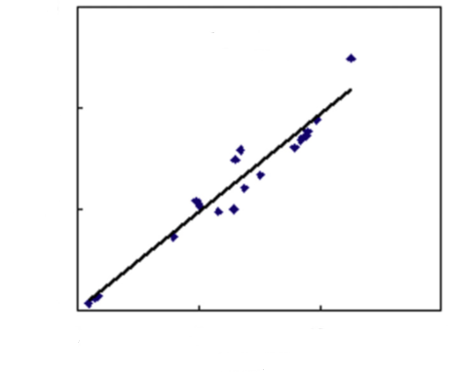
Silica content-phytolith content transfer function in crops:
Phytolith content (wt %) = silica content (wt %) × 0.967
15
y = 0.967 x
R² = 0.94, p < 0.01
10
Phytolith content (%)
5
0
0
5
10
15
SiO₂ content (%)
Correlation of phytolith content and SiO₂content in different crops
Song et al., European Journal of Agronomy, 2014
27

Slide 28
4. Phytolith C sequestration in ecosystems of China
The predominant crop species for PhytOC production are rice (40%), wheat (18%) and corn (30%).
Estimated PhytOC production by Chinese crops
Farm crops | SRO production flux (kg ha⁻¹ yr⁻¹) | PhytOC production flux (kg CO₂ ha⁻¹ yr⁻¹) | PhytOC production rate (Tg CO₂ yr⁻¹)
Rice | 7356 | 68（19） | 2.04（0.58）
Wheat | 6225 | 38（17） | 0.91（0.41）
Corn | 7771 | 44（17） | 1.49（0.57）
Other cereal | 2329 | 14（8） | 0.09（0.05）
Cotton | 19101 | 17（6） | 0.08（0.03）
Sugarcane | 10575 | 96（26） | 0.19（0.05）
Total | 6144 | 36（13） | 4.88（1.73）
*SOR: Si-rich organs.
Song et al., European Journal of Agronomy, 2014
28

Slide 29
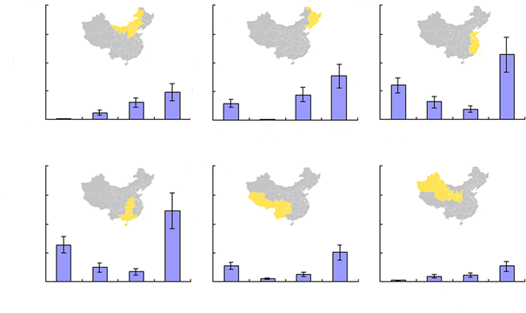
4. Phytolith C sequestration in ecosystems of China
The largest crop phytolith C sequestration in China occurs in the midsouthern, and northeastern regions due to intensive rice production with frequent fertilization and irrigation.
2.0
a
2.0
b
2.0
c
1.5
1.5
1.5
1.0
1.0
1.0
0.5
0.5
0.5
0
0
Rice
Wheat
Corn
Total
0
Rice
Wheat
Corn
Total
Rice
Wheat
Corn
Total
Phytolith C sequestration
(Tg CO₂ yr⁻¹)
Crops
Crops
Crops
2.0
d
2.0
e
2.0
f
1.5
1.5
1.5
1.0
1.0
1.0
0.5
0.5
0.5
0
0
0
Rice
Wheat
Corn
Total
Rice
Wheat
Corn
Total
Rice
Wheat
Corn
Total
Crops
Crops
Crops
Phytolith C sink rate of arable crops in different regions of China in 2011
Song et al., European Journal of Agronomy, 2014
29

Slide 30
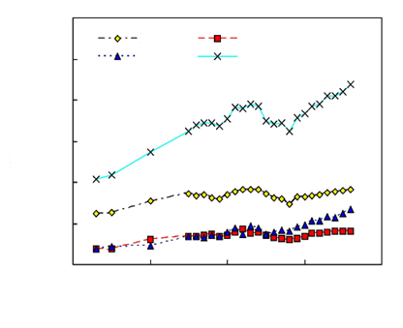
4. Phytolith C sequestration in ecosystems of China
Phytolith C sink of China’s croplands has doubled since 1978.
Cropland phytolith C sink can be enhanced by cropping system optimization, rational fertilization and irrigation.
6
Rice
Rice
Wheat
Wheat
5
Corn
Total
4
Phytolith C sequestration
(Tg CO₂ yr⁻¹)
3
2
Cropland phytolith C sequestration change with time
1
0
1975
1985
1995
2005
2015
Year
Song et al., European Journal of Agronomy, 2014
30

Slide 31
4. Phytolith C sequestration in ecosystems of China
4.5 Comparison of different ecosystems
Cropland phytolith C sink contributes about one half of terrestrial ecosystems in China.
The increasing potential of phytolith C sink in forests and grasslands are also large.
PhytOC production of different ecosystems in China
 | Area (10⁶ha) | PhytOC production fluxes (kg CO₂ ha⁻¹ a⁻¹) | PhytOC production rate (Tg CO₂ a⁻¹)
Shrubland | 215 | 4.77–7.13 | 1.28(0.25)
Croplands | 134.5 | 23–49 | 4.88(1.73)
Forests | 142.8 | 10.5–16.7 | 1.94(0.44)
Grasslands | 331 | 1–2 | 0.60 (0.17)
Song et al., Global Change Biology, 2012, 2013; Song et al., European Journal of Agronomy, 2014; Ru et al., Silicon, 2016
31

Slide 32
Outline
1
Terrestrial biogeochemical cycles of Si and C
2
The characteristics of phytoliths
3
Storage and stability of phytoliths in soil profiles
4
Phytolith C sequestration in ecosystems of China
5
Conclusions and perspectives
32

Slide 33
Conclusions
Phytolith C sequestration in terrestrial ecosystems is a promising biogeochemical C sequestration mechanism and may contribute to the mitigation of global climate warming.
Management practices that can significantly enhance phytolith C sequestration include:
Grassland management to maximize ANPP
Forest management practices (e.g. bamboo afforestation)
Optimizing crop structures, rational fertilization and irrigation.
33

Slide 34
Perspectives
Understanding factors controlling the turnover and stability of phytoliths in different environment is necessary.
Contribution of grasslands and other ecosystems to the global phytolith C sequestration needs to be quantified.
Cost and potential of each measure deserve investigation to enhance terrestrial biogeochemical C sequestration.
Phytolith C sequestration and related biogeochemical C sequestration processes should be incorporated into carbon-climate feedback models.
34

Slide 35

Thank you for your attention!
35

