Slide 1


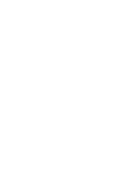
Semiconducting SWCNTs:
from materials to thin film transistors
Information, data and drawings embodied in this document are strictly confidential and are supplied to the team members of the Printable Electronics Consortium participating in this Project on the understanding that they will be held confidentially and not disclosed to third parties without the prior written consent of the NRC Executive Director responsible for the Printable Electronics Program.
Zhao Li, Patrick R. L. Malenfant, Jianfu Ding, Jacques Lefebvre
Security and Disruptive Technologies Portfolio, National Research
Council Canada, Ottawa, ON, Canada
Nov. 16, 2015, Nanotek San Antonio

Slide 2
Outline
Single wall carbon nanotubes (SWCNTs)
  Introduction of SWCNTs
  Purification and application
  Our hybrid process: high yield and high purity materials
Fabrication of high performance TFTs with organic SWCNT dispersion
  Substrates surface treatment
  Effect of Polymer/tube ratio
  Multiple soaking process for high density uniform network
Raman microscopy mapping for SWCNTs network purity assessment
  Introduction of the Raman mapping method
  Two samples with different purity

Slide 3
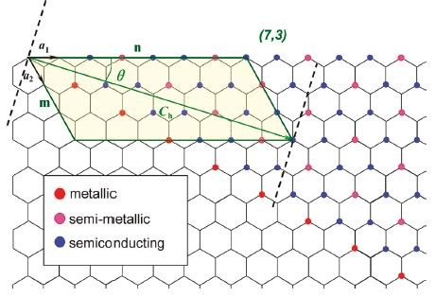
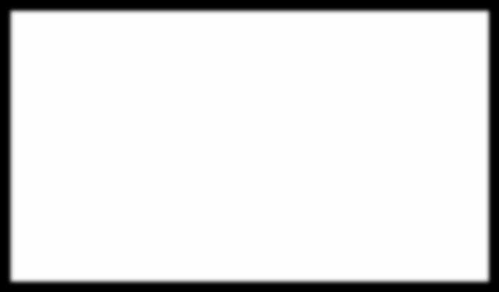
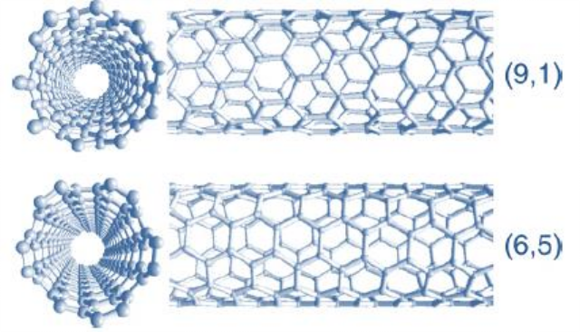

Structure and electrical properties of SWCNTs
(6,6)
Diverse distribution of chirality and diameter
n-m =3q: metallic; n-m ≠3q: semiconducting
Raw as grown materials contain tubes with sc/m=2/1
Applications:
Metallic: transparent conductor
Semiconductor: TFT

Slide 4
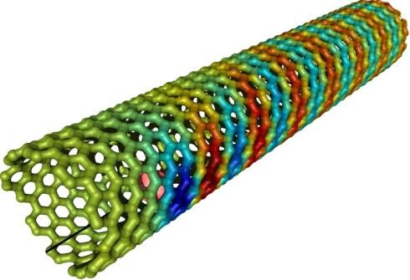
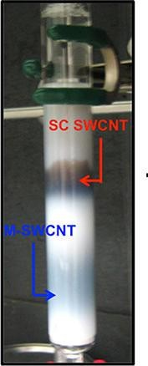
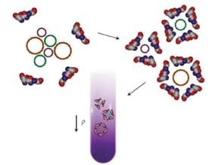
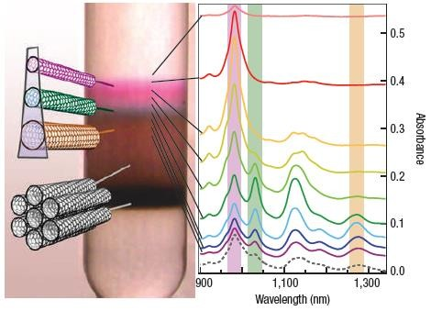
Purification and Enrichment of SWCNTs
Density Gradient
Ultracentrifugation

Slide 5
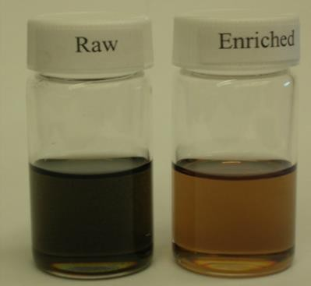
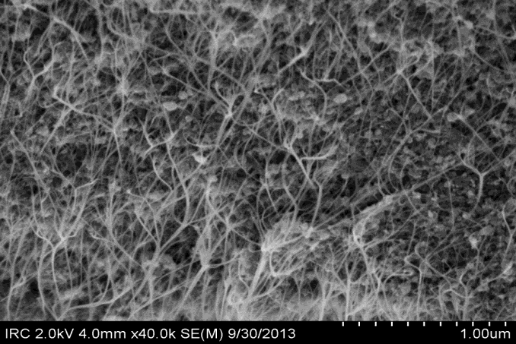
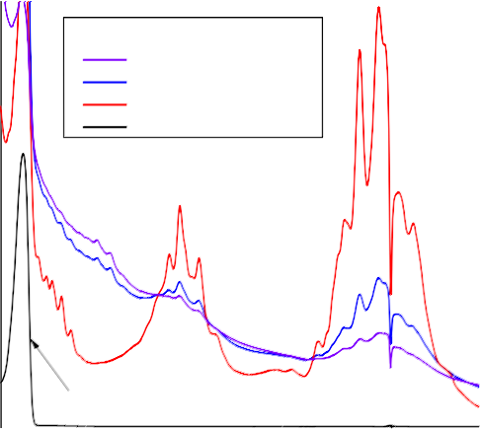
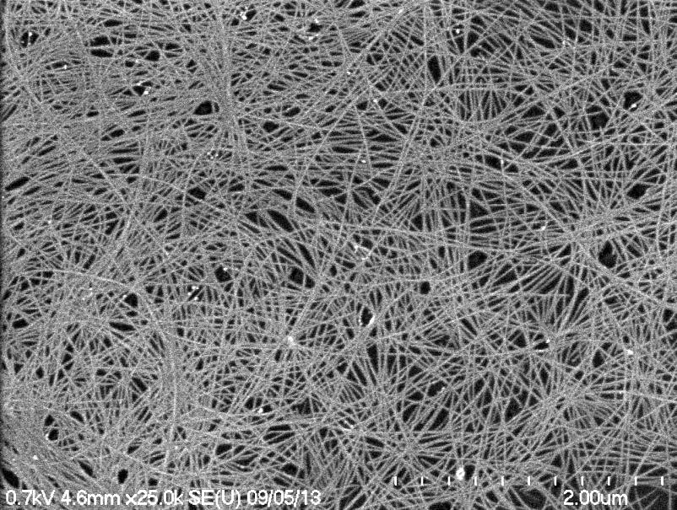
sc-SWCNTs Enrichment ---- by PFDD Extraction
Raw Plasma CNTs
100k
16k
12k
Raw Enriched
Raman intensity (a.u.)
RBM
75k
8k
M
4k
50k
0
100
150
200
250
300
25k
1.2
Sample
Sediment Raw(x1/20) sc-SWCNT
φ
0.047
0.082
0.406
^{S}11
0
0
1000 2000
Wavenumber (cm⁻¹)
3000
Absorbance (a.u.)
Filtrate(x1/20) ------
^{S}22
Enriched CNTs
0.8
M
11
0.4
^{S}33
0.0
PFDD
400 800 1200 1600
Wavelength (nm)
Single extraction
yield: ~2%
Purity: >99%
2000
Nanoscale, 2014, 6, 2328

Slide 6
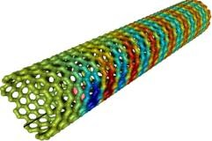
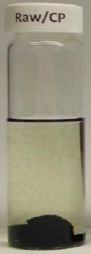
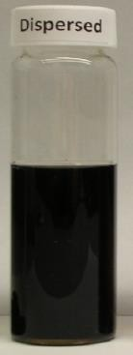
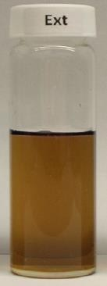
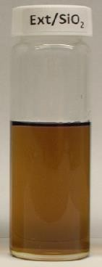
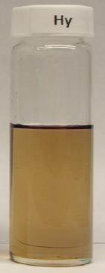
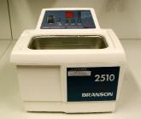
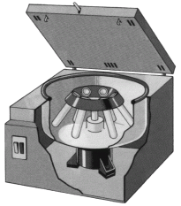
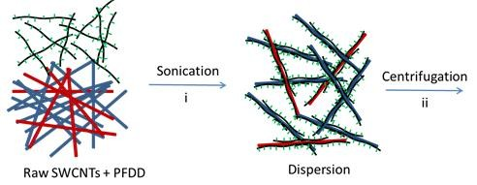
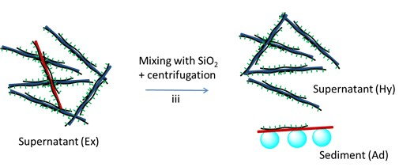
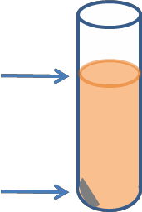
sc-SWCNTs Enrichment ----Hybrid Processing

Slide 7
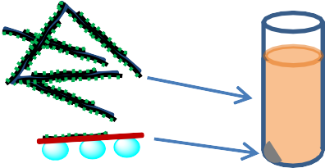
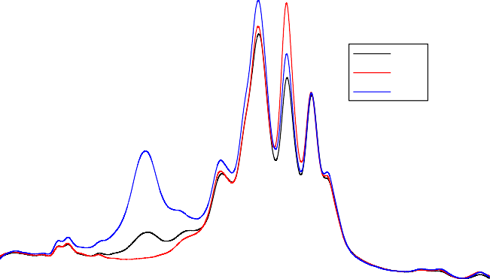
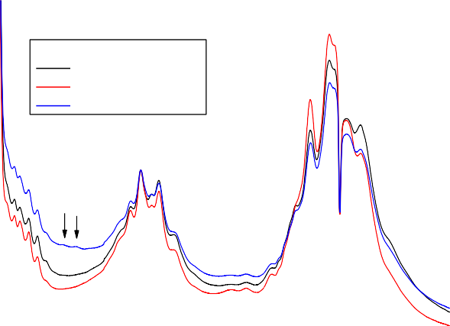
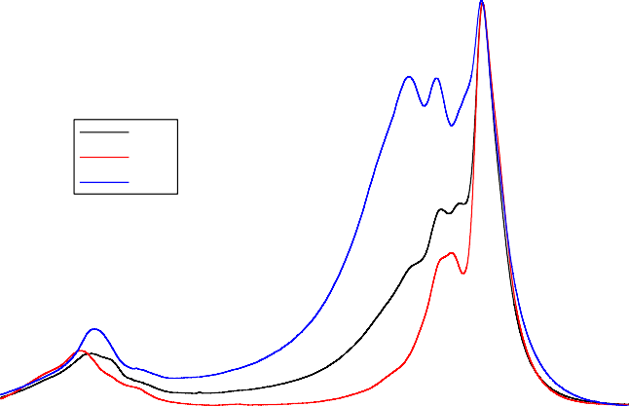
sc-SWCNTs Enrichment ---- SiO₂ Adsorption
600k
b-2
PFDD/CNT = 8/1 Ex: 785 nm, RBM
Ex2 Hy2 Ad2
Adding SiO₂ +
centrifugation
Raman intensity (count)
400k
Supernatant (Hy)
Supernatant (Ex)
Sediment (Ad)
For a single extraction
200k
Yield: 10% vs. 2%
Purity: >99%
0
b: PFDD/CNT=8/1
Sample φ η(%) Ex2 0.356 11.0
Hy2 0.413 10.0
Ad2 0.255 0.72
100
150
200
250
300
1.2
600k
Wavenumber (cm⁻¹)
a-2
PFDD/CNT = 8/1
Ex: 633 nm,
D and G band
_{G}+
Absorbance (a.u.)
Raman intensity (count)
G
−
m
_{G}−
sc
0.8
S
400k
22
Ex2 Hy2 Ad2
^{M}11
0.4
200k
0.0
400
600
800
1000 1200 1400 1600
Wavelength (nm)
1800
2000
0
1300
1400 1500
Wavenumber (cm⁻¹)
1600
1700

Slide 8
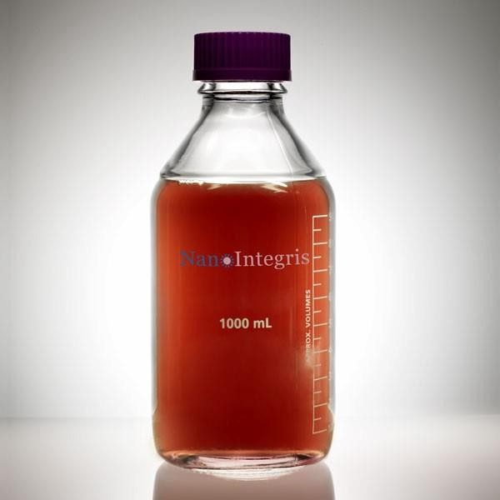
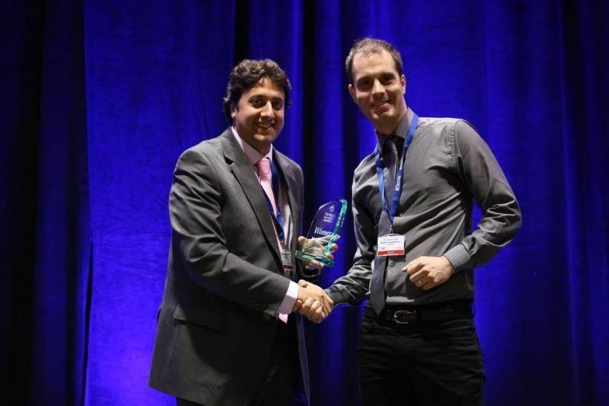
sc-SWCNTs Enrichment by Hybrid Processing---- Commercialized by Raymor NanoIntegris
Patent:
USP 61/867,630.WO 2015024115 A1
IsoSol-S100®:
The highest-ever purity semiconducting carbon nanotube ink that is produced using a simple, cost-effective, truly scalable route,
Award:
Best New Materials Award at IDTechEx’s PE USA 2014.
.

Slide 9
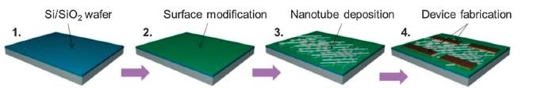
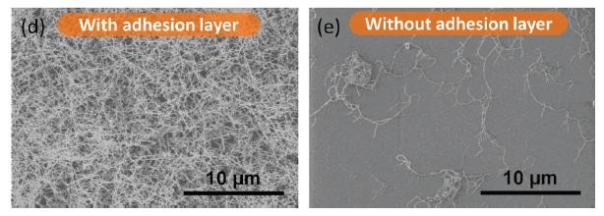
TFT device fabrication and characterization
Deposit electrodes
O
H N
For aqueous SWCNT solution, PLL has to be used for adhesion
n
PLL
NH₂
Nano Lett. 2009, 9, 4285
How to get a high density uniform
network with an organic ink system?

Slide 10
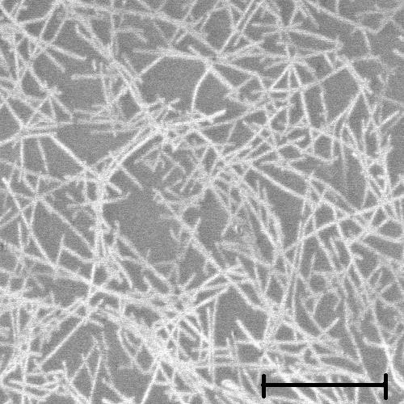
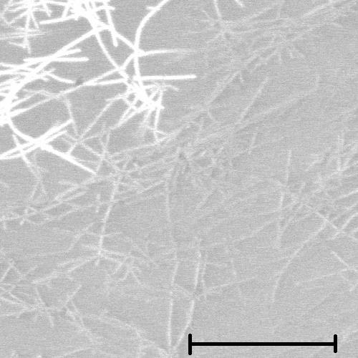
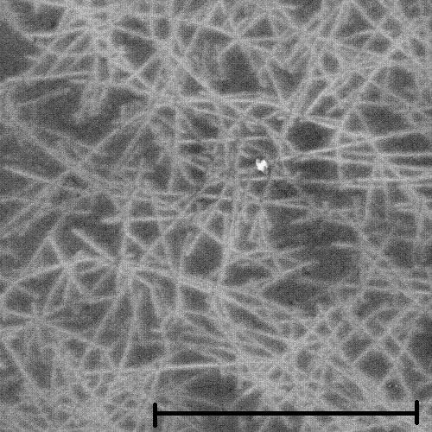
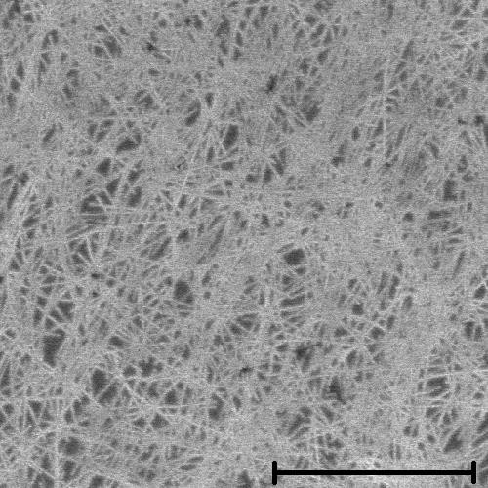
SWCNT network on SiO₂: with or without PLL
C_{SWCNT} (mg/L) 2.6
26.4
With PLL
Without PLL
Clean SiO₂ without PLL shows better adhesion to SWCNT/CP organic dispersion, especially at high concentration.

Slide 11
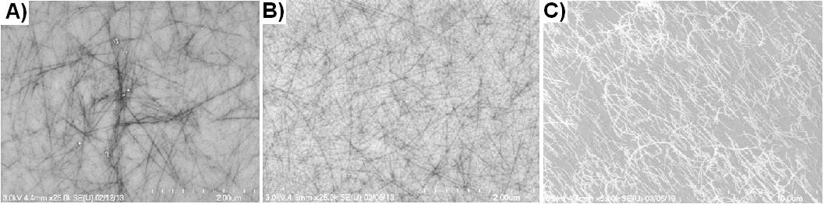
SWCNT network on SiO₂: CP/SWCNTs weight ratio
1:1
5:1
30:1
CP/SWCNTs weight ratio | Solution stability | Adhesion | Network
1:1 | poor | Good | bundles
5:1 | Good | Good | Good
30:1 | Very good | poor | alignment
Choose 5/1 weight ratio in the following study
Organic Electronics, 2015, 26, 15

Slide 12





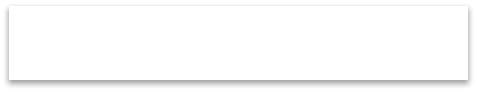


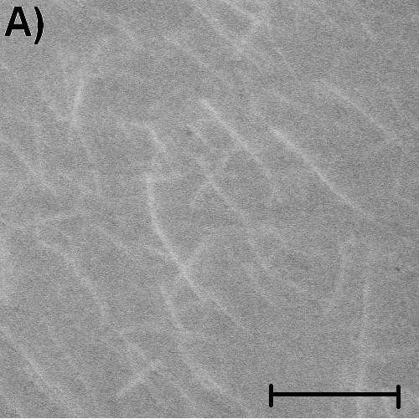
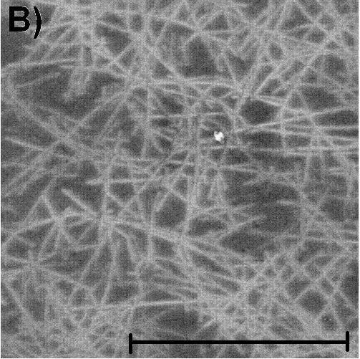
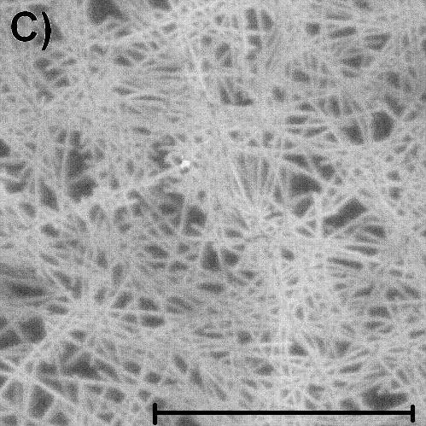
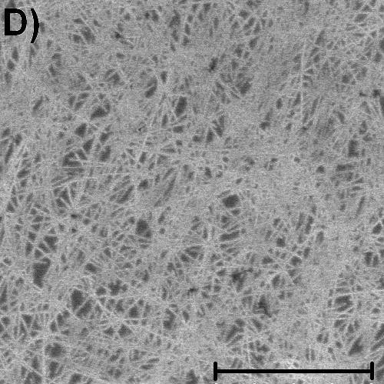
SWCNT network on SiO₂: concentration and density
SWCNT solution (mg/L) | Tube density /μm² | Mobility cm²/Vs | On/off ratio
1.0 | 3.8 | Under percolation threshold
3.0 | 31 | 4.8±1.5 | 7.4x10⁵
9.0 | 68 | 18±1.6 | 1.6x10⁶
27 | 87 | 25±3.8 | 7.3x10⁵
Source
Drain
SC-SWCNT
SiO2
Gate (Doped Si)
5:1
CP:SWCNT
Good control of network density and device performance

Slide 13
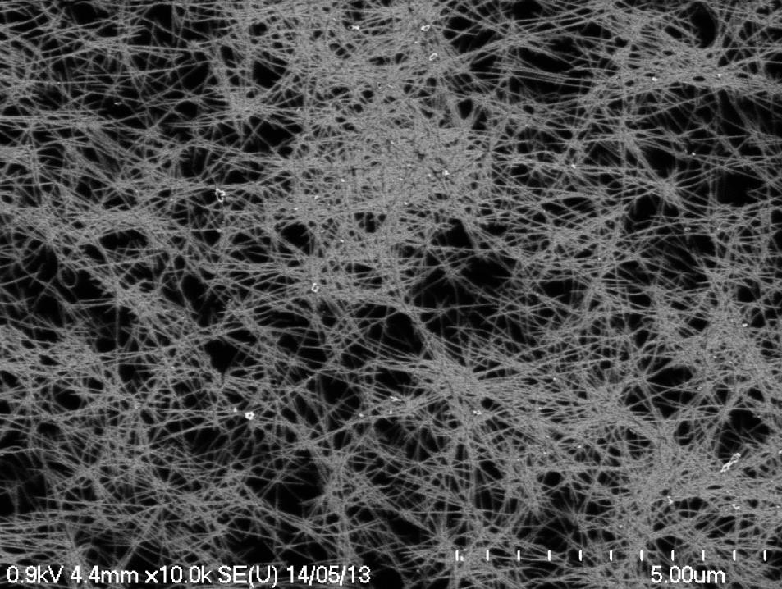
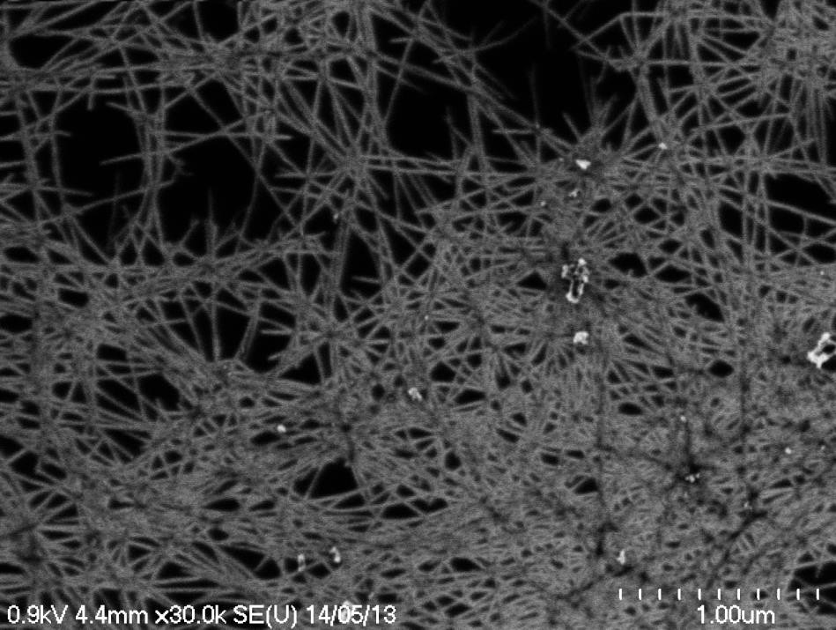
Network density: higher concentration
C_{SWCNT} = 80 mg/L (5/1 CP/SWCNT), mobility decreased to 10 cm²/Vs
Non-uniform network
Dispersion: gel-like behaviour
Stronger tube-tube interaction
Stacked frame structure

Slide 14



Network density: multiple layer coating
Soaking, rinsing
annealing
Repeat 3-5 times with 27 mg/L solution

Slide 15
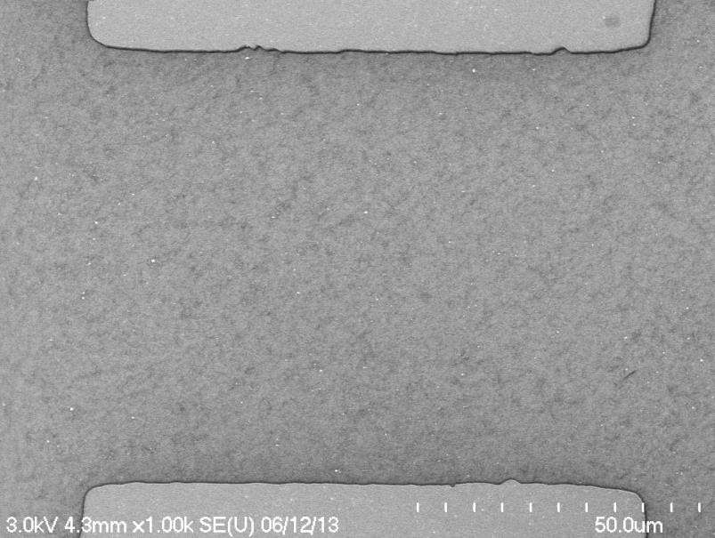
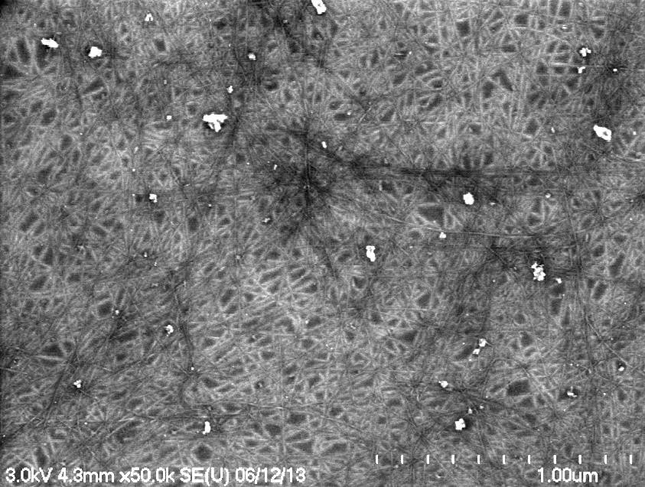
Multi-layer coating for high density network
55 | 56 | 60 | 58 |  | 58
54 | 56 | 59 | 58 |  | 60
57 | 60 | 53 | 56 |  | 61
64 | 66 | 65 | 63 |  | 60
69 | 64 | 66 | 61 |  | 64
On-current distribution of 25 TFTs
covering 5X5 mm² area: 60±4 µA
Other methods for high density network: Chemical self-assembly
Langmuir-Schaefer assembly
Nat. Nanotechnol. 2012, 7, 787
Nat. Nanotechnol. 2013, 8, 180

Slide 16
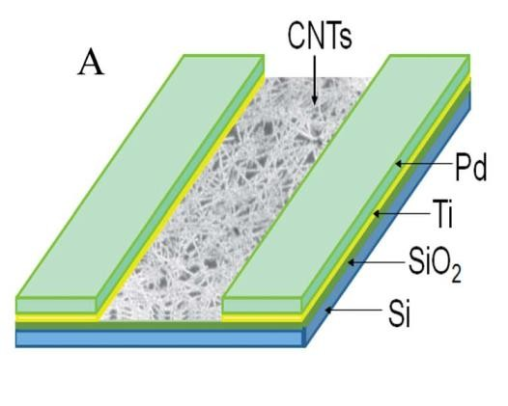
TFT device performance
Uniform SWCNT network
High purity sc-tubes
• μ= 39 ± 3.7 cm²/Vs
• On/off = 10^{5.0±0.4}
2E-4
7E-5
6E-5
2E-4
V_{G}=-5 V
-4 V
-3 V
-2 V
-1 V
0 V
2E-5
5E-5
2E-6
4E-5
1E-4
I_{SD} (A)
I_{SD} (A)
I_{SD} (A)
2E-7
3E-5
2E-5
5E-5
2E-8
1E-5
2E-9
0E+0
0E+0
-10 -8 -6 -4 -2 0
V_{G} (V)
2 4 6 8 10
0
-2
-4
V_{SD} (V)
-6
-8
-10

Slide 17
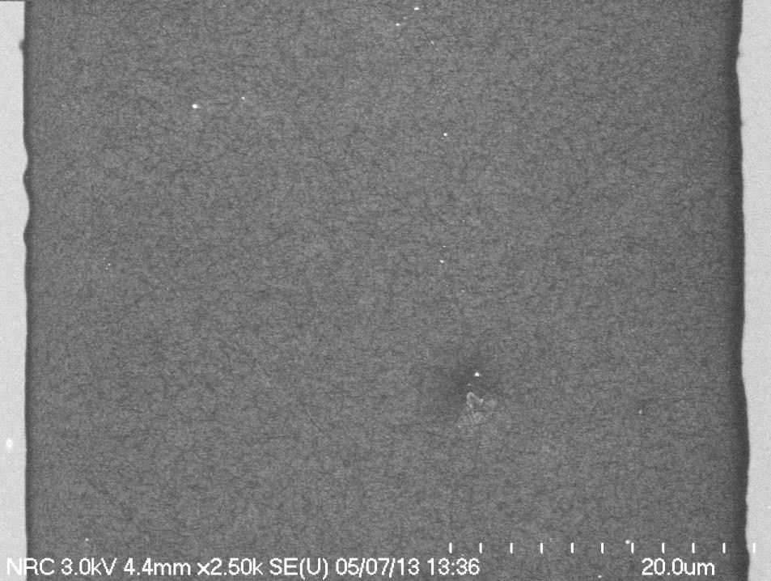
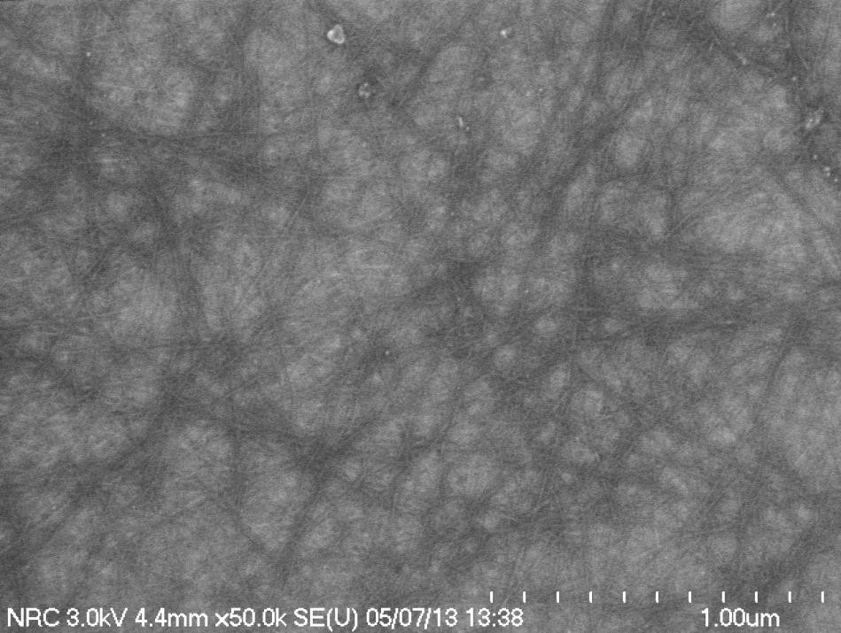
SWCNT network: dip-coating without rinsing
C_{SWCNT}=26.5 mg/L, uniform SWCNT network buried in CP matrix (80% wt)
• μ= 35 cm²/Vs, on/off=1.3 x 10⁴
Attractive due to this process is compatible with printing process

Slide 18
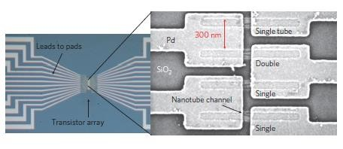
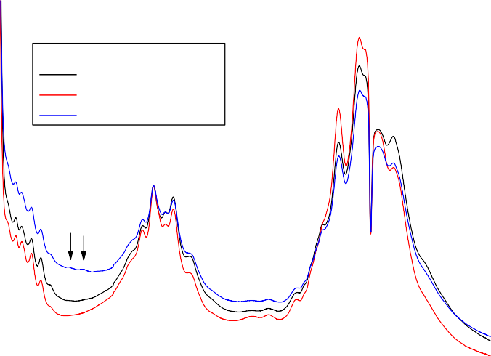

Purity assessment of SWCNT materials
UV absorption spectrum
Massive device testing
1.2
b: PFDD/CNT=8/1
Sample φ
Ex2 0.356
Hy2 0.413
Ad2 0.255
η(%) 11.0
10.0
0.72
Absorbance (a.u.)
0.8
S
22
^{M}11
0.4
0.0
400
600
800
1000 1200 1400 1600
Wavelength (nm)
1800
2000
Qualitative information
Solution samples
Hard to access instrument
Tedious device fabrication and testing
Nature Nano. 2012, 7, 787

Slide 19


Raman spectroscopy for SWCNTs
RBM band: diameter
D band: defects
G band: m or sc
Physics Reports 2005, 409, 47

Slide 20

Kataura plot
514 nm laser:
2.41 eV
_{E22}sc
633 nm laser:
1.96 eV
^{E}33
sc
_{E11}sc
^{E}11^{m}
Plasma or laser tube:
~1.3 nm

Slide 21




Raman microscopy mapping method
SEM
Renishaw inVia confocal Raman microscopy

Slide 22




Raman spectra and maps at 514 nm
16 X 16 µm²
Nano Research, 2015, 8, 2179

Slide 23





Raman spectra and maps at 633 nm
(15, 6)
(16, 4)
(14, 5)
Counted 21 m-tubes

Slide 24

Two samples with different sc-purity: UV and Raman
1
1000
0.8
SC1
800
Absorption (a.u.)
SC1 SC2
0.6
SC2
Intensity
600
0.4
400
0.2
200
0
0
400
800 1200 1600
Wavelength (nm)
2000
1200
1300 1400 1500 1600 1700 1800
Raman Shift (cm⁻¹)
UV and regular Raman only give qualitative purity information

Slide 25


Two samples with different sc-purity: Raman G⁻ map
SC1
SC2
 | SC1 | SC2
m-tubes | 135 | 20
m-tube content | 1.0% | 0.2%
sc-purity | 99.0% | 99.8%

Slide 26
Two samples with different sc-purity: TFT performance
25
SC1SC1
1E+8
1E+7
20
Mobility (cm²/Vs)
1E+6
15
On/off ratio
1E+5
1E+4
10
1E+3
1E+2
5
SC1 SC2
2.5 5.0 2.5 5.0
Channel Length (µm)
1E+1
SC1 SC2
2.5 5.0 2.5 5.0
Channel Length (µm)
0
1E+0

Slide 27
Conclusion
Conjugated polymer extraction can provide high purity, organic solvent based SWCNT materials. Hybrid process can further improve yield.
High density and uniform SWCNT networks were fabricated on SiO₂
surface which shows high TFT performance.
A Raman microscopy mapping method was developed to assess the sc-purity of SWCNT networks.
Thank you, question?

