Slide 1
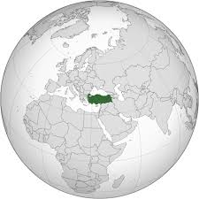
FRAMEWORK AGREEMENT
ON CLIMATE CHANGE &
HUMAN RESPONSIBILITIES
Zeynep Zaimoğlu¹ Orhan Altürk¹ Reyhan Erdoğan²
¹Cukurova University, Faculty of Engineering, Department of Environmental Engineering, Adana,Turkey
² Akdeniz University Department of Landscape Architecture, Antalya, Turkey

Slide 2
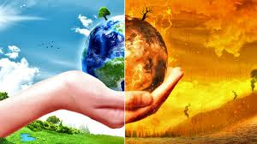
CLIMATE CHANGE
Climate change, which emerges as a result of global warming, is one of the main problems human being faces in 21st century
Notes:
Climate change, or global warming, refers to the rise in average surface temperatures on Earth.
The Earth's climate has changed throughout history. However, most changes were due to small variations in Earth’s orbit that change the amount of solar energy our planet receives.
The current global warming trend is very significant and creates a threat to our planet because most of it is caused by human activities. Also, it is occurring at a great rate, a rate not seen in the past 1,300 years.

Slide 3
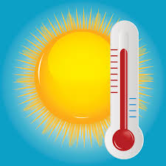
CLIMATE CHANGE
Are humans responsible for most of the global temperature rise of the past century or so, or is the increase just a typical fluctuation in global temperature?
If most of the temperature rise can be attributed to increases in anthropogenic CO₂ emissions, what are the likely consequences if no action is taken to curb these emissions?
Notes:
Unfortunately, what we are facing today is not a typical fluctuation in global temperature.
Climate change has resulted in sea level rise, shrinking ice sheets, ocean acidification, decreased snow cover, declining Arctic Sea ice, glacial retreat, severe weather events, droughts and wildfires.

Slide 4
CLIMATE CHANGE
Human activities contribute to climate change by causing changes in Earth’s atmosphere in the amounts of greenhouse gases, aerosols (small particles) and cloudiness
The largest known contribution comes from the burning of fossil fuels, which releases carbon dioxide gas to the atmosphere
Notes:
A scientific consensus has been reached to conclude that climate change is primarily due to the human use of fossil fuels, which releases carbon dioxide and other greenhouse gases into the air.
The gases released into the air trap heat within the atmosphere, and thus have wide range of influences on ecosystems.

Slide 5
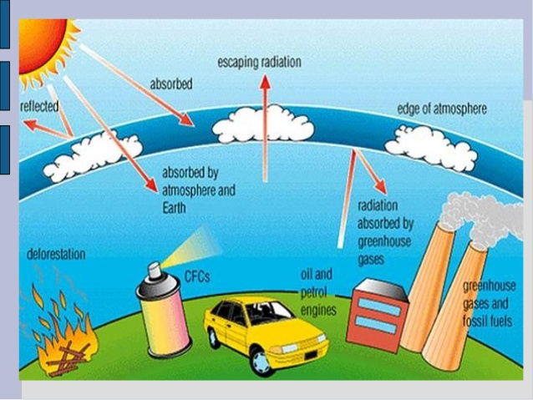
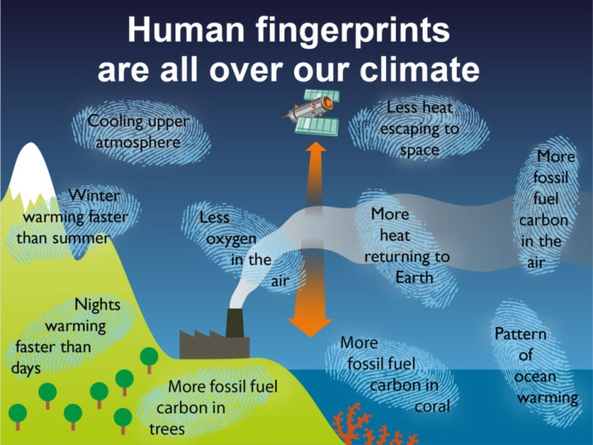
CLIMATE CHANGE
Notes:
These two diagrams clearly show the causes and effects of climate change.

Slide 6
PARIS AGREEMENT
The aims of the convention are described in Article 2 as:
to hold the increase in the global average temperature to well below 2 °C above pre-industrial levels and to pursue efforts to limit the temperature increase to 1.5 °C above pre-industrial levels
to increase the ability to adapt to the adverse impacts of climate change
to make finance flows consistent with a pathway towards low greenhouse gas emissions and climate resilient development
Notes:
The main aim of the Paris Agreement is to hold the increase in global average temperature below 2 degrees centigrade.

Slide 7
WILL THE PARIS AGREEMENT SAVE THE PLANET?
IS THIS GOAL REALISTIC AND ATTAINABLE?
  Unenforcable agreement terms
  No framework to explain what each country do for its INDC
  Requirement for a wide coverage of renewables, other fossil fuel-free energy sources and large-scale emissions reduction technologies
Notes:
The Framework Agreement was a good start to finally address the big problem of climate change on an inernational level.
The goals of the summit are really noteworthy, but are they realistic?
First of all, the terms of the agreement are unenforcable.
Also, there is no framework that explains what each country will do to meet its commitment targets.. like what technologies they will adopt.. or what reductions they will make in their consumptions.
Yes, we can say that the global energy supply is moving toward clean technology, but at a very slow speed.. at a dangerously low speed.
Holding the increase in global average temperature below 2 degrees centigrade will certainly reduce the risks and impacts of climate change, but it requires a significantly wide coverage of renewables and other fossil fuel free energy resources… and not only that… it also requires large-scale emissions reduction technologies..
Therefore, it does not look like an attainable goal in the short and most probably in the medium term.

Slide 8
PARIS AGREEMENT AND CLIMATE COMMITMENT OF TURKEY
Within the scope of the Framework Agreement, Turkey declared its Intended Nationally Determined Contribution (INDC) as:
  “A contribution to the collective efforts of the signing countries to avoid dangerous climate change by limiting global warming in line with the country’s overall circumstances and capabilities”
Notes:
Turkey declared its Intended Nationally Determines Contribution as ‘a contribution to the collective efforts towards mitigation of climate change in line with the country’s circumstances and capabilities.

Slide 9
TURKEY’S NATIONAL POLICY TOWARDS MITIGATION OF CLIMATE CHANGE
10th National Development Plan
National Strategy on Climate Change
National Climate Change Action Plan
National Strategy on Industry
Strategy on Energy Efficiency
National Strategy and Action Plan on Recycling
National Legislation on Monitoring, Reporting and Verification of GHG emissions
National Smart Transportation Systems Strategy Document (2014-2023) and its Action Plan (2014-2016)
Notes:
Here is a list of Turkey’s strategies and plans to contribute to the global actions for climate change.

Slide 10
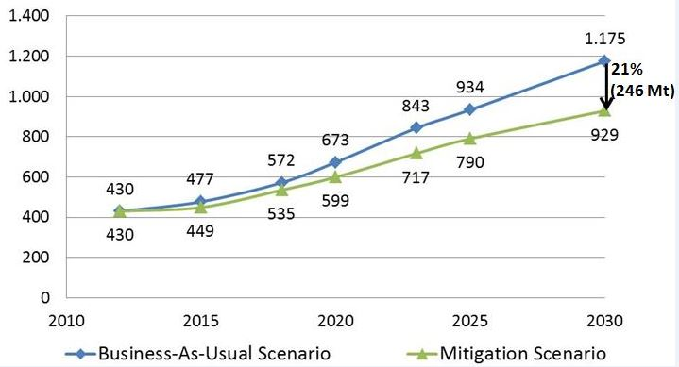
TURKEY’S INDC PLANS AND POLICIES
Notes:
The figure shows the Business-As-Usual Scenario and the Mitigation Scenario. As seen in the graph, the gap between the business-as-usual scenario and the mitigation scenario increases steadily and by 2030, total greenhouse gas emissions are estimated to be reduced by 21%.

Slide 11
TURKEY’S INDC PLANS AND POLICIES
INDC plans and policies will be implemented in the following sectors:
Energy
Industry
Transport
Buildings and Urban Transformation
Agriculture
Waste
Forestry
Notes:
Turkey has made a commitment to implement its INDC plans and strategies in these sectors.
Energy is the foremost among these sectors, yet it is the most challenging sector for an effective implementation of strategies towards mitigation of climate change.
The reason is that the energy demand of the country is growing continuously due to growing population, increasing industrialization and rapid economic expansion.

Slide 12
TURKEY’S INDC PLANS AND POLICIES
Coal is an essential source of power in Turkey and its role in meeting energy requirements in the short and medium term is significant.
The Turkish government aims to transform the identified mines into coal-fired power plant projects using legally and politically acceptable feasible models.
Notes:
Coal continues to be an essential source of power in Turkey.
By adopting legally and politically acceptable models, the Turkish government aims at coal-fired power plant projects because coal still has a significant role in meeting energy requirements of the country.

Slide 13
TURKEY’S INDC PLANS AND POLICIES
The government claims that this aim will not conflict with Turkey’s climate change mitigation objectives and targeted carbon emission reductions.
Thus, it can be concluded that the Paris Agreement will not actually affect the coal-fired power plant projects in Turkey’s energy sector.
Notes:
The Turkish government claims that these projects will not conflict with their INDC strategies and plans to reduce carbon emissions.
Therefore, it seems that the Paris Agreement will not actually affect Turkey’s power plant projects and current plans in the sector.

Slide 14
HUMAN RESPONSIBILITIES
Paris Agreement has sparked proactive thinking
to get more responsible about saving our planet
to leave a healthier future to next generations
to take preventive measures before problems become unpreventable
Notes:
Going back to the aims of the Paris Agreement, we can conclude that the convention has provided a big nudge to us humans as well.
It has reminded us of our responsibility of addressing problems concerning climate change, which is the biggest threat to our planet.
We should seriously take necessary precautions before the problems are no longer preventable.

Slide 15
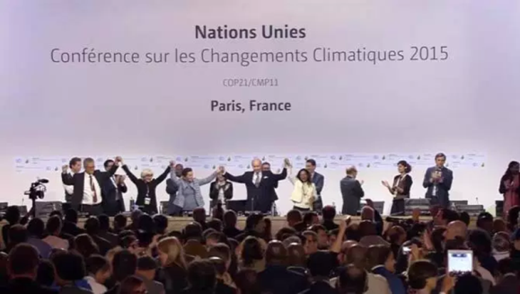
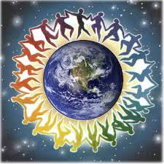
HUMAN RESPONSIBILITIES
Intended Nationally Determined Contribution
Intended Individually Determined Contribution
Notes:
The Paris Agreement is the ultimate convention to collect the efforts of nations towards combating climate change.
Each country has submitted declared its Intended Nationally Determined Contribution in good faith, but as we said before, the terms of the agreement are not enforcable.
The agreement also assigns tasks to the signing countries, like supervising each other and supporting underdeveloped and developing countries.
It is evident that not all countries will be able to show 100% commitment to their contribution plans.
It will also be difficult to impose climate change mitigation implementations on other countries.
Here, the role of individuals should be emphasized once again.
Individuals make up a nation and together they can be as powerful as their government.
Each individual should have an Intended Individually Determined Commitment plan.
We should stop thinking “the amount of hot water or aerosols I use will not change the climate.” Instead, we should think about the accumulation of our AMOUNTS!! And the impact of these amounts.

Slide 16
WHAT CAN YOU DO?
Simple everyday actions against climate change:
  Cycling, walking, using public transport
  Recycling your home’s waste newsprint, cardboard, glass and metal
  Saving hot water by taking a shower instead of a bath (four times less energy)
  Buying food and other products with reusable or recyclable packaging
Notes:
There are many simple measures we can take individually to help mitigate climate change. Some of these measures involve small changes to our daily routine like cycling, using public transport or at least carpooling whenever possible.
Recycle-Reuse-Reduce… These 3 R’s should be part of our daily lives if we want to be environmentally responsible consumers.
Saving water at home and buying food with environment friendly packaging are other actions that we can easily adopt in daily life.

Slide 17
WHAT CAN YOU DO?
Simple and cost-efficient changes to make at home:
Installing a solar heated system to provide your hot water
Replacing regular lightbulbs with compact fluorescent ones
Insulating your home, cleaning your air conditioning filters and installing energy efficient showerheads
Notes:
In addition to the daily activities, there are some simple but very important things that we can do at home.
Like installing a solar heated system for hot water, replacing lightbulbs with eco-friendly ones, cleaning air conditioner filters regularly, insulating the home.

Slide 18
WHAT CAN YOU DO?
Replacing your current home appliances with high-efficiency models
Planting trees and shrubs around your home and outdoor air conditioning unit
Using an electric or push mower instead of a gasoline-powered mower to cut your lawn
Notes:
Old appliances at home could be replaced with energy efficient new models.
Around our house we can plant trees and shrubs.
If we have a garden, we can use an electric or better a push lawn mower instead of one that works with fuel.

Slide 19

WHAT CAN YOU DO?
The least you can do is to adopt a low carbon diet:
eat food grown locally and seasonally
eat less processed and packaged foods
consume less meat and dairy
consume less industrially produced food in general
reduce waste from food by proper portion size, recycling or composting
Notes:
A carbon diet basically involves consuming less industrially produced food and eating locally grown food. A low carbon diet is an effective contribution to help reduce greenhouse gas emissions resulting from our consumption decisions. A carbon diet reduces carbon emissions in food production, packaging, processing, transportation and preparation stages. It also helps minimize waste of food. Research has shown that US food system is responsible for around 20 percent of greenhouse gases. Estimations in many other countries would not give a better result. It is our hope that all countries will adopt the ‘Farm to Table’ concept, which has gained increasing popularity in the US over the last few years.

Slide 20

WHAT CAN YOU DO?
You can simply reduce your carbon footprint!
Notes:
Our Intended Individually Determined Contribution should be to reduce our carbon footprint as much as possible by taking measures in our daily routine and life in general. Most of the things we can do are very simple and they are actions which will help us stay healthy. We should not underestimate our individual contributions, which when combined can help save our planet.

