Slide 1
The distribution of diabetes mellitus and obesity in Saudi adolescents and adult population
Arjumand Warsy, Mohsen ElHazmi, Zaineb Babay

Slide 2
Common adult onset Multifactorial Disorders in Saudi Population
Multifactorial disorders with an adult onset occur were frequently encountered in Saudi population.
Being chronic in nature, accounted for a major proportion of morbidity and mortality in Saudi adults.
Include:
    Diabetes mellitus:
      T2DM
    Hypertension.
    Obesity
    Coronary artery disease.
    Others.

Slide 3
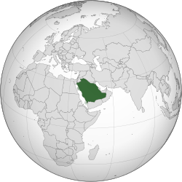
Saudi Arabia
Objectives
To investigate the prevalence of T2DM and obesity Saudi population
To identify genetic and bio-markers biomarkers that could predict the susceptibility to develop these disorders in Saudi population

Slide 4

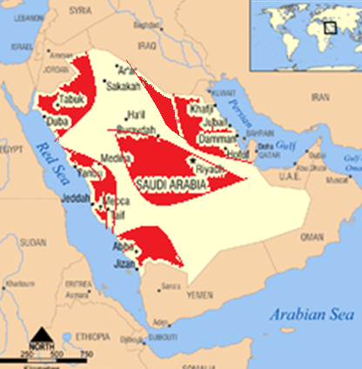


To screen the five Provinces [According to a statistically designed protocol]
Areas (cities, towns, villages) screened: 34
Riyadh
Jeddah

Slide 5
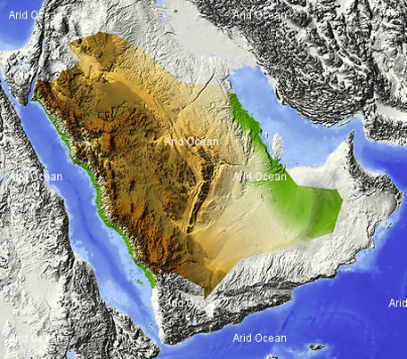








Slide 6





No one lives there
Rub al Khali-Intentionally left out from screening

Slide 7
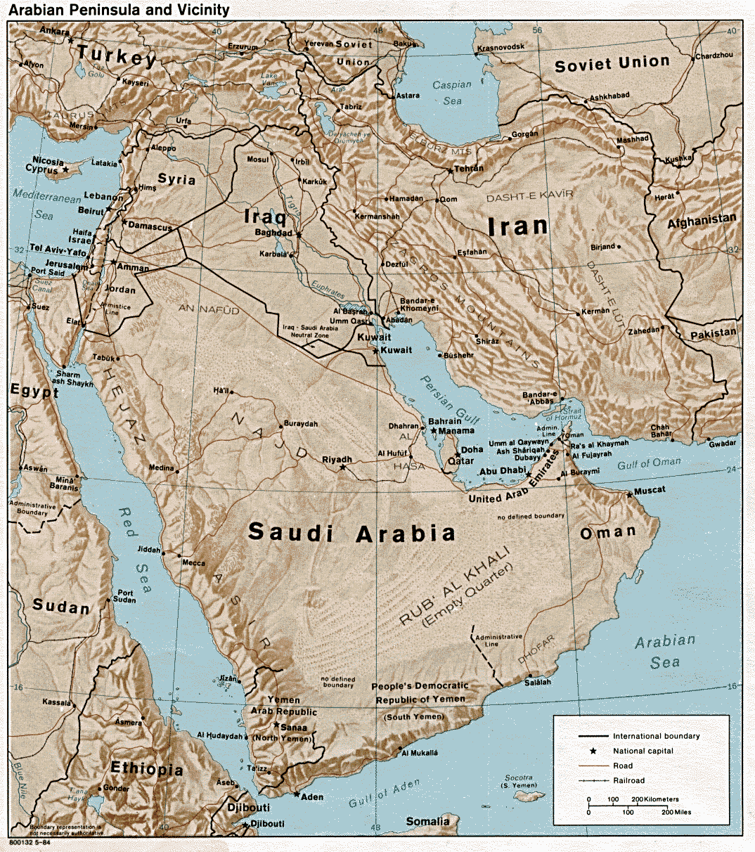
Study design
i) Prevalence
Population Screened:
No. screened (adults):14,660
    Males: 6162
    Females: 8498
Age range: 14-70 yrs

Slide 8
Choice of diagnostic test
Limited choice
Marker of the disease---could show the change
  Could be done easily, even in basically equipped labs
  Did not require sophisticated equipments or expertise
  Easily to perform
  Could be done at a large scale
  Specific
  Sensitive
  Cost effective
  Reproducible
  Differential diagnosis of the multifactorial disorders (under study) was possible
Ever Friendly: Traditional Markers

Slide 9
Diagnostic Tests
Based on WHO recommendations (using the traditional diagnostic markers)
Diabetes mellitus (based on blood glucose level)
  Fasting venous blood glucose > 6.7 mmol/l
  and 2 hr post glucose-load > 10.0 mmol/l
  Obesity (based on Quatelet Index or BMI)
    Normal Weight BMI = <25 Wt/ m²
    Overweight: BMI = 25 – 29.9 Wt/ m²
  Obesity: BMI = > 30 Wt/ m²

Slide 10





Overnight Fasting state
Adult males and females
Blood
  Information Recorded
  Informed consent
  Family/medical history
  Age (years)
  Height (m)
  Weight (kg)
  BMI (Kg/m²)
Remainder of blood was stored after centrifugation as plasma, buffy coat, red cells
  Aliquot used for fasting and 2 hr. post-glucose load blood glucose.
Using commercially available kits

Slide 11

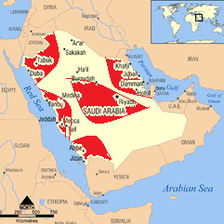
Results
The prevalence of each disorder was calculated in (a) the total Saudi population, (b) in different age groups and in five different provinces
(a)
(c)
NP
EP
(b)
Age Groups (years)
NWP
CP
14 - 19
20 - 29
30 - 39
40 - 49
>50
SWP

Slide 12
(a) Overall prevalence of T2DM and overweight and obesity in Saudi population
Disorders Prevalence (%)
Males Females
Diabetes mellitus
  T2DM 9.50* 6.82*
Overweight 27.23* 25.20*
Obesity 13.05* 20.26*
*p < 0.005
Overall prevalence (%)
%

Slide 13
(b) Prevalence of obesity and overweight in different age groups
Years
Obesity
Overweight

Slide 14
(b) Prevalence of T2DM in different age groups in Saudi population
%
T2DM

Slide 15
(c) Prevalence of T2DM in different provinces of Saudi Arabia

Slide 16
(c ) Prevalence of Overweight and Obesity in different provinces of Saudi Arabia
Obesity and overweight

Slide 17

Conclusion
T2DM, overweight and obesity constitute a major health problem in Saudi Populations and occurr in all provinces of Saudi Arabia
Control was necessary to prevent the associated morbidity and complications
Control and prevention were only possible by identification of the high risk individuals presymptomatically
Steps were necessary for early and presymptomatic diagnosis in an attempt to control the disease onset by modification of the life style and other environmental factors.
Objective 2:
Search for genetic and biochemical markers

Slide 18
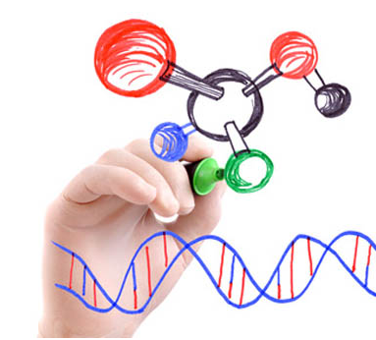
Objective no.2
To identify genetic and biomarkers for diagnosis of these multifactorial states
Biomarkers: related to variations in levels of Biomolecules
Genetic Biomarkers: related to the variations in the DNA

Slide 19
Biomarkers and Genetic markers included in the study
T2DM, Obesity
ACE, S_{A} gene polymorphism.
Lp(a),
Leptin,
The traditional risk factors, insulin, C-peptide, BMI

Slide 20

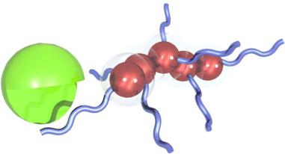
Study Group:
Studies on Biomarkers and Genetic Markers
Diagnosis | Number
T2DM | 421
Obesity | 214
Biomarkers:
Lp(a), leptin, lipids, insulin and c-peptide
Genetic markers : polymorphisms in angiotensin converting enzyme (ACE) gene and S_{A} gene.

Slide 21

Blood
Red cells
Plasma
Buffy coat
Leptin,
Lp(a),
Coagulation factors,
Lipids and lipoproteins
Insulin and
c-peptide
ACE gene and
S_{A} gene
PCR
PCR-RFLP
Using autoanalyser or specific kits

Slide 22
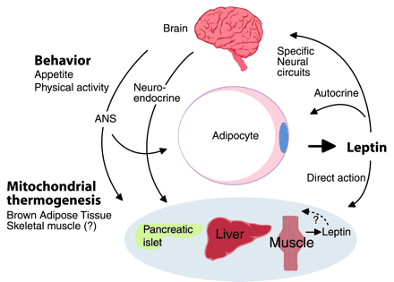
Leptin
Leptin- a Greek word, derived from “leptos” meaning thin.
A polypeptide hormone.
Synthesised and secreted by the adipose tissue.
Travels via blood to hypothalamus & influences the appetite.
Acts on several target tissues.
A satiety factor
Involved in appetite regulation
Effects energy homeostasis (i.e. the physiological balancing act that regulates food intake, storage and expenditure of energy)
Influences carbohydrate metabolism,
Influences reproduction.
Plays a role in bone formation.
Decreases body fat, body weight, appetite, glucose and insulin.
Correlates with level of obesity

Slide 23
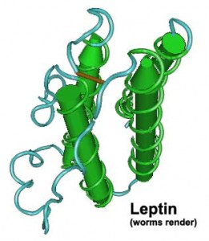
Leptin levels (ng/ml) in T2DM and obesity compared to the control Group
 | Males | Females | P*
Controls | 2.5± 1.2 | 13.7± 7.1
T2DM | 13.7± 16.7 | 32.5±29.2 | 0.0001
Obesity | 11.7 ±6.5 | 35.1± 14.2 | 0.0001
Leptin levels were raised significantly in all the disorders investigated
* P value compared to the control group

Slide 24
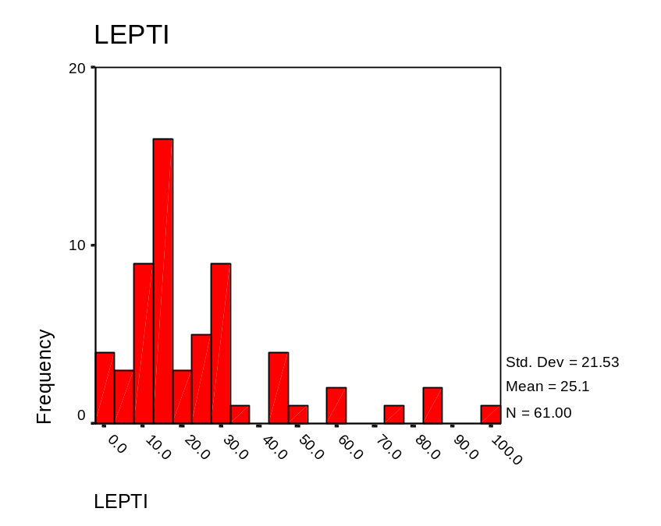
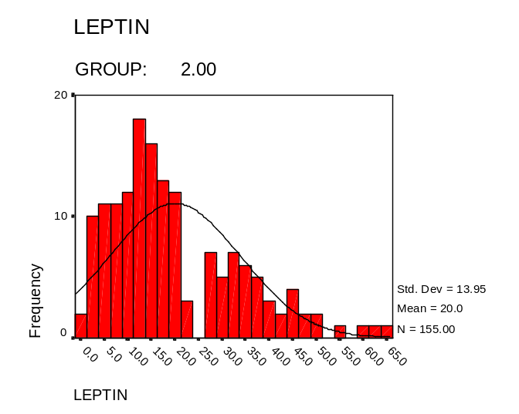
Frequency Distribution histogram of Plasma Leptin in multifactorial disorders
Normal range:
Males : 2.5 ± 1.2 ng\ml
females: 13.7 ± 7.1 ng\ml
Leptin levels should wide variations in the multifactorial disorders investigated
T2DM
Obesity
HT

Slide 25
Leptin levels (ng/ml) in T2DM and Obesity
 | Males | Females
Controls | 2.49± 1.24 | 13.7± 7.1
T2DM | 13.7± 16.7* | 32.5±29.2*
T2DM+obesity | 16.9± 23.7* | 35.1±14.2*
Obesity | 11.73 ±6.5* | 33.4± 16.5*
HT+Obesity | 22.7± 20.1* | 34.7± 23.4*
Leptin is not a good marker for differential diagnosis of T2DM and Obesity as it is raised in both disorders

Slide 26
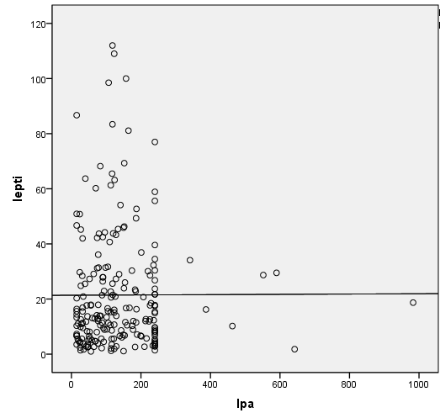
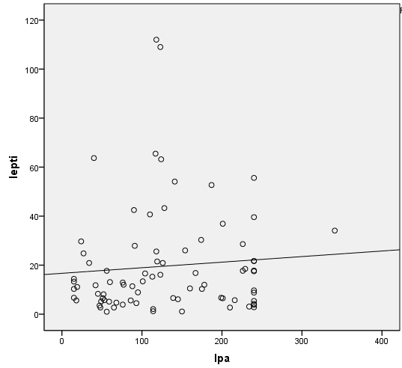
Correlation between leptin and some demographic and biochemical parameters in the control group
The biomarkers frequently correlate with each other in control group, but the correlation may or may not exist in T2DM and obesity.
Correlation between leptin and | Correlation coefficient (r) | p
Age | 0.299 | 0.013*
Bodyweight | 0.260 | 0.026*
BMI | 0.601 | 0.0001**
Cholesterol | 0.449 | 0.001*
Triglycerides | 0.172 | 0.209
Fasting glucose | - 0.292 | 0.47
Lp(a) | 0.429 | 0.010*
Leptin vs Lp(a) in DM
Pattern of interaction changes in T2DM disorders

Slide 27
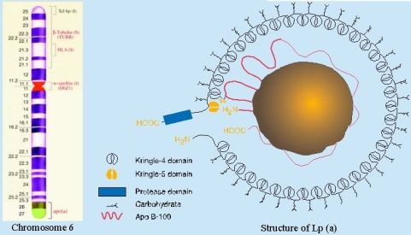
Lipoprotein (a) [Lp(a)]
Most atherogenic lipoprotein in man.
Composed of a high molecular weight glycoprotein designated apo(a), linked to apo B-100 of LDL.
Binds to LDL receptors.
Interacts with macrophages to stimulate atherogenesis.
Competitively binds with plasminogen and inhibits fibrinolysis.
An independent predictor of atherosclerotic risk that is genetically controlled.
Lp(a) levels are not affected by life style attributes such as diet, smoking, and physical activity.
Age and gender has no effect on Lp(a) levels.
Several studies suggested using Lp (a) as a marker for CHD
As early as 1993 the structure and functional relationships between Lp(a) and the primary cellular interactions of atherosclerosis was suggested (M. Tennant and J. K. McGeachie. Lipoprotein(a) and its role in occlusive vascular disease. Ann R Coll Surg Engl. 1993; 75(1): 3–7)

Slide 28
Lp(a) elevation reported in
Patients with:
Atherosclerosis
CHD
Stenosis
Myocardial
Infarction
Acute
Stroke
Familial
Hyper-
cholesterolaemia
Cerebral and
peripheral
vascular
disease.
Notes:
7

Slide 29
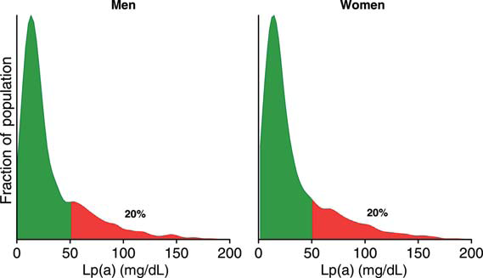
Lp(a) distribution in healthy individuals
Nordestgaard BG et al Lipoprotein(a) as a cardiovascular risk factor: current status. Eur Heart J 2010 Dec;31(23):2844-53

Slide 30
Lp(a) levels (ng/ml)in T2DM and obesity in Saudis
 | Males | Females | P*
Controls | 26.5± 11.8 | 25.7± 14.0
DM | 138.2± 113.7 | 162.2±121.2 | 0.0001
Obesity | 227.0 ±290 | 183.4± 64.4 | 0.0001
Lp(a) levels were elevated in T2DM and obesity; obesity having the highest levels

Slide 31
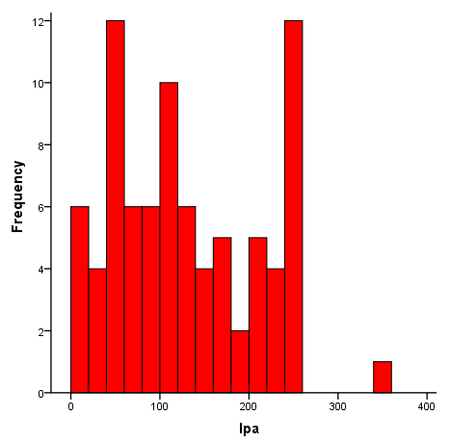
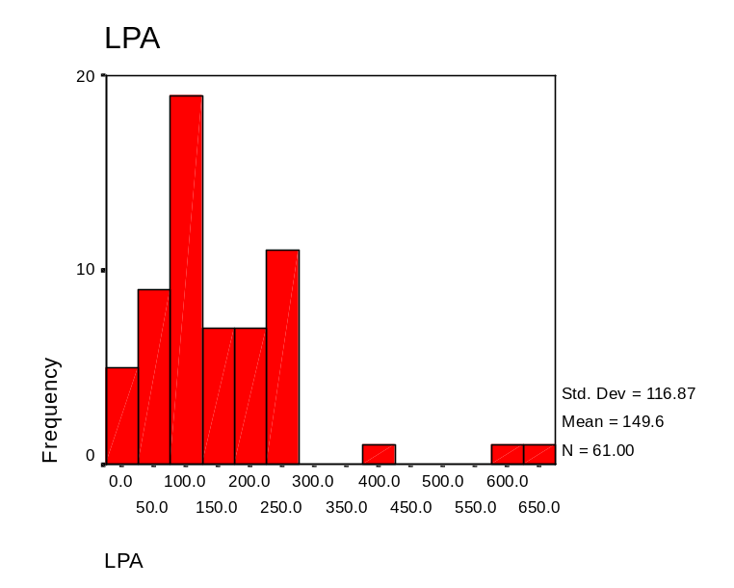
Frequency Distribution Histogram of Plasma Lp(a) in T2DM and obesity
Obesity
T2DM
Normal:
26.5± 11.8 mg/dl
Lp(a) levels showed wide variations in the multifactorial disorders

Slide 32
Insulin levels in Saudi T2DM and obesity, compared to Control Group
 | Insulin
Control | 21.5 ±6.0
T2DM | 36.9± 68.4
Obesity | 130.9±25.2
 | C-peptide
Control | 22.5± 6.25
T2DM | 25.5± 9.5
Obesity | 32.1± 10.1

Slide 33
Genetic markers in T2DM and Obesity in Saudis
Jordan
North
Arabian Gulf
East
West
Central
U.A.E
South
Rab Al Khali
Oman
Red Sea
Yemen
Arabian Sea

Slide 34
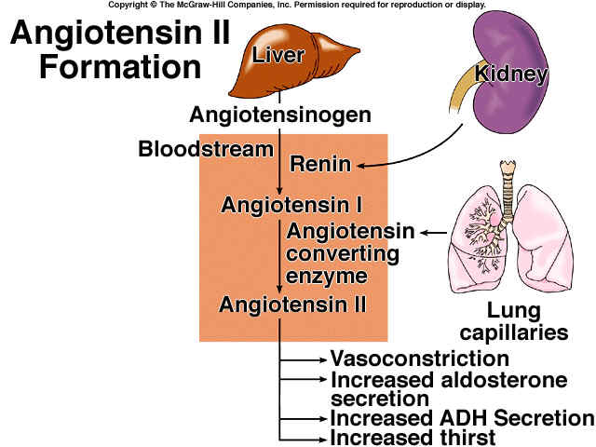
Polymorphism in Angiotensin Converting Enzyme gene(ACE)
Angiotensinogen
Renin *
Angiotensin I
ACE
Angiotensin II + 2 a.a
Aminopeptidase
Angiotensin III + 1a.a
Aminopeptidase
Degradation Product

Slide 35
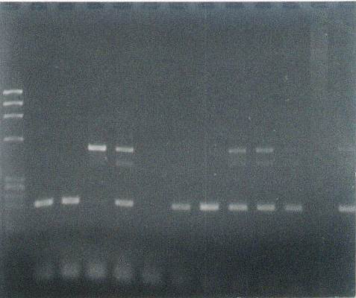
I/D Polymorphism of ACE Gene
5’ Exon 16 Intron 16 Exon 17 3’
Deletion (D variant)
Insertion (I variant)
Increased gene expression
Lower level of ACE
Silencer
Decreased gene expression
DNA
I
490 bp
PCR
D
190 bp
Electrophoresis in agarose gel
Visualization by ethidium bromide

Slide 36
ACE gene polymorphism in T2DM, overweight and obesity
Patients | Genotype frequency (%) |  |  | Allele frequency |  | χ2 | p
 | DD | ID | II | D | I
Control | 56.03 | 41.84 | 2.13 | 0.759 | 0.231
T2DM | 50.0 | 45.1 | 4.88 | 0.726 | 0.274 | 0.5 | >0.05
Overweight | 73.5* | 24.86* | 1.62 | 0.86* | 0.14 | 8.6 | 0.013
Obese | 76.9* | 19.66* | 3.42 | 0.87* | 0.13 | 7.2 | 0.03
ACE gene polymorphism in T2DM with and without nephropathy
Population | Genotype |  |  | Allele |  | p
 | DD | ID | II | I | D
T2DM (nephropathy) | 54.3 | 37.1 | 8.6 | 0.271 | 0.728 | <0.05
T2DM (without nephropathy | 46.8 | 61.06 | 2.13 | 0.276 | 0.723

Slide 37
I/D Polymorphism of ACE in different healthy populations
Population | Prevalence (%) of genotype |  |  | Allele frequency
 | II | ID | DD | I | D
Saudis | 1.14 | 44.3 | 54.5 | 0.233 | 0.767
UK | 18.4 | 49.2 | 32.0 | ---- | -----
Korean | 41.0 | 41.0 | 17.0 | 0.551 | 0.449
Kuwait | 2.0 | 41.0 | 52.9 | 0.25 | 0.75
Turkey | 13.3 | 57.3 | 29.4 | 0.507 | 0.493
Germany | 14.1 | 55.4 | 30.4 | 0.418 | 0.582
Japan | 43.0 | 43.0 | 14.0 | 0.58 | 0.42
Greece | 15.0 | 40.0 | 29.0 | 0.42 | 0.58
Croatia | 24.0 | 52.0 | 24.0 | 0.5 | 0.5
Denmark | 23.4 | 49.7 | 24.7 | 0.487 | 0.513
Italy | 13.1 | 44.1 | 42.8 | ------ | ------
Finland | 12.0 | 45.0 | 43.0 | 0.35 | 0.65

Slide 38
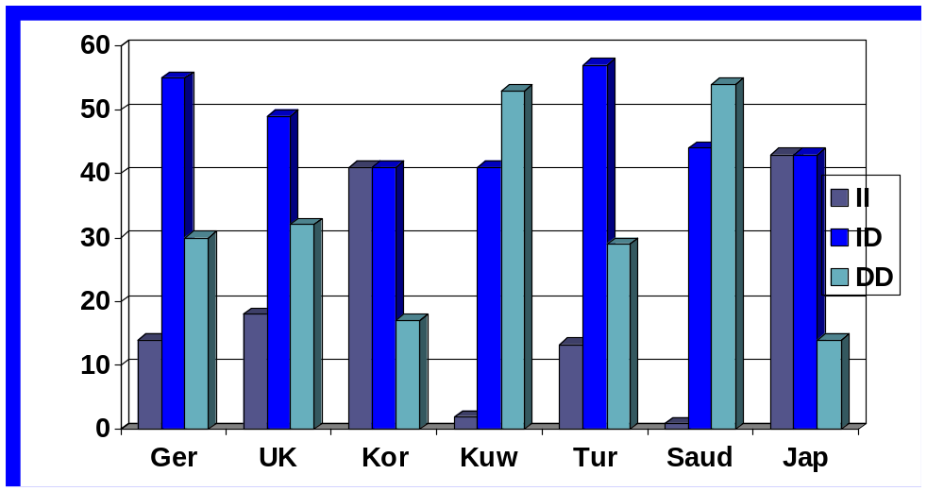
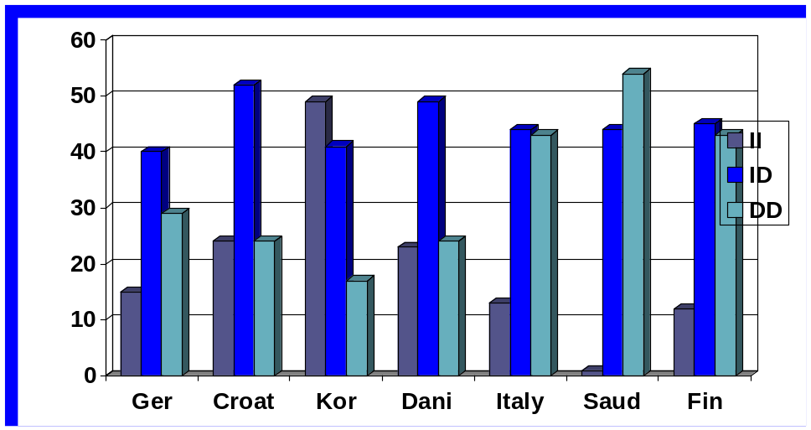
Comparison of frequency of ACE genotypes in different populations

Slide 39
SA gene
SA gene was first reported in 1992 as a candidate gene responsible for high blood pressure spontaneously hypertensive in rats, and was highly expressed in the kidney of the rats (Iwai N1, Inagami T. Identification of a candidate gene responsible for the high blood pressure of spontaneously hypertensive rats. J Hypertens. 1992 Oct;10(10):1155-7)
Later shown as a candidate gene in humans (Iwai N, et al. Human SA gene locus as a candidate locus for essential hypertension. Hypertension. 1994:23:375-80)
Studies from UK, Poland failed to show any link between SA gene expression, abnormal functioning of the kidneys and hypertension (Harrap SB et al. The SA gene: predisposition to hypertension and renal function in man. Clin Sci (Lond). 1995;88:665-70; Gumprecht J,et al. Human SA gene Pst1 polymorphism and chronic renal failure: results of the family-based study. Nephrol Dial Transplant. 2001;16:387-90.

Slide 40
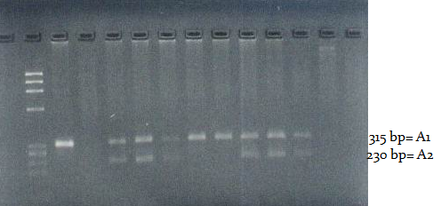
Agarose gel electrophoretic pattern of S_{A} gene A1 and A2 alleles

Slide 41
Frequency of S_{A} gene genotypes and A1 and A2 alleles in the T2DM, overweight and obesity compared to controls
 | Genotype frequency |  |  | Allele frequency
 | A1A1 | A1A2 | A2A2 | A1 | A2 | χ2 | p
Control | 38.13 | 59.2 | 2.31 | 0.704 | 0.319
T2DM | 52.38 | 44.05 | 3.57 | 0.744 | 0.256 | - | NS
Obese | 30.8 | 69.0 | 3.16 | 0.654 | 0.346 | - | NS
OW | 33.3 | 55.6 | 4.4 | 0.647 | 0.353 | - | NS
NS: not significant

Slide 42
Genetic and biochemical markers in T2DM and obesity in Saudis
Can be determine with high degree of reproducibility
Require expertise
Cannot be carried out in small hospital laboratories
A whole battery of biomarkers is required before a confirmatory diagnosis can be made
Significant overlap in the levels of the biomarkers between the T2DM and overweight and obesity so differential diagnosis was not easily possible
Suitable for early diagnosis of a disease was not possible as the levels were normal except in the disease state.
Useful in determining the prognosis of a disease within an individual
Possible use in monitoring progression of a disease or response to treatment
Genetic markers (polymorphisms) showed significant overlap between the results in health controls and patients group.
  A SNP would be useful if it only increases or decreases in the patients group.
Significant population variations exist, where a variant is linked to a disease in some populations and not in others.
  Even within the healthy control group populations differ significantly in the genotype and allele frequencies.

Slide 43

Pros and Cons of using the markers
We are all still looking for that specific Biomarker or genetic marker for T2DM and obesity that is specific, sensitive, confirmatory for early diagnosis and follow-up on prognosis

Slide 44
Acknowledgements
King Saud University
King Abdulaziz city for Science and Technology
Ministry of Health
Clinics of MOH
Our research teams
All the individuals who contributed by inclusion in the study

Slide 45
Thank you for listening

