Slide 1


The Use of Liquid Smoke Condensate in Foods and Its Effect on Health
Zayde Ayvaz¹ and Hasan Huseyin Atar²
¹Canakkale Onsekiz Mart University, Department of Marine Technology Engineering, Canakkale 17100, Turkey
²Ankara University, Department of Aquaculture Engineering, Ankara 06110, Turkey

Slide 2
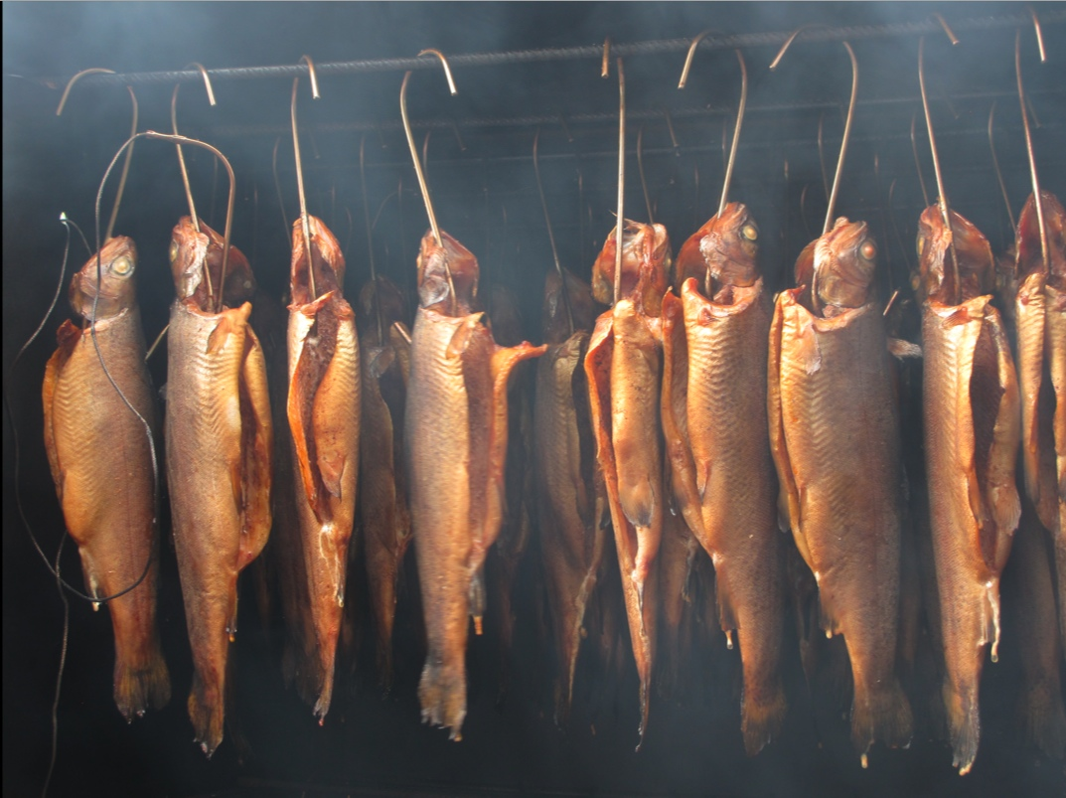
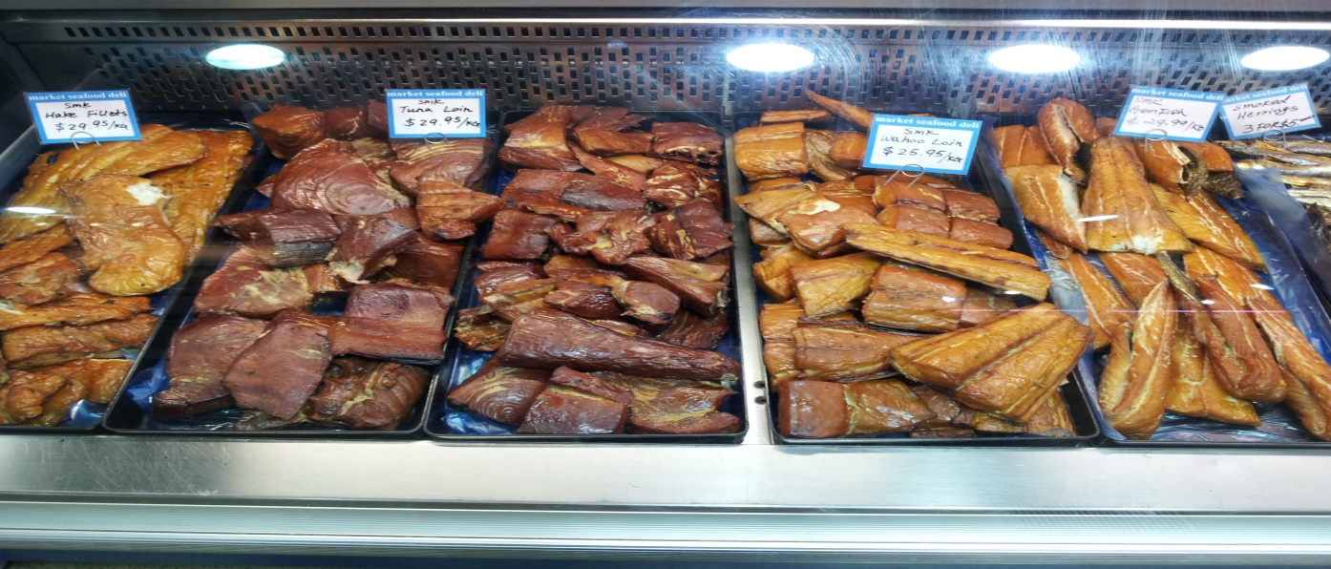
What is traditional smoked food?
Traditional smoking has been used as a preservation technique for centuries.
Smoking is the process of flavoring, cooking (hot or cold smoked), or preserving food especially meat and meat products (also cheese and some vegetables) by exposing it to smoke from burning wood.
Source: Google image

Slide 3
The purpose of smoking are:
Color
Flavor
Preservation
The preservative effects provide some antimicrobial (phenols, formaldehyde etc.) and antioxidant compounds in smoke gas and also provide special colour and flavour.

Slide 4
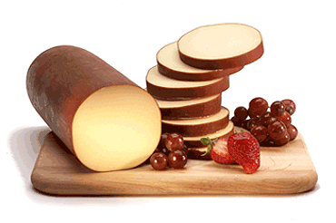

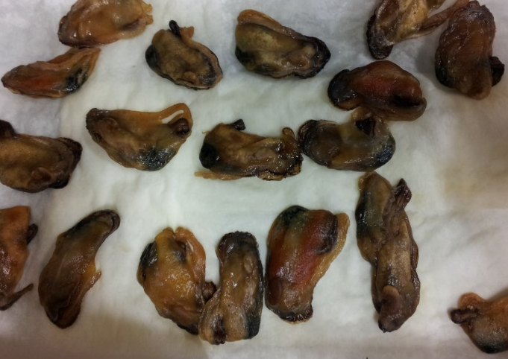
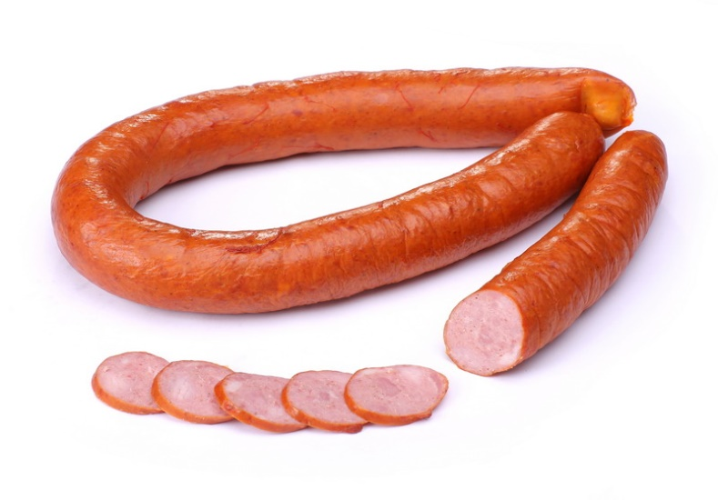
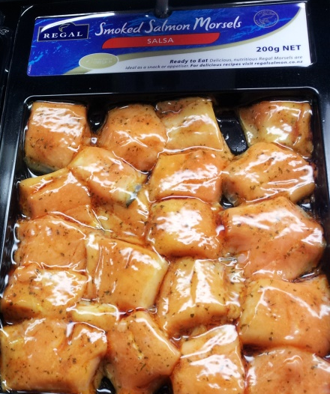
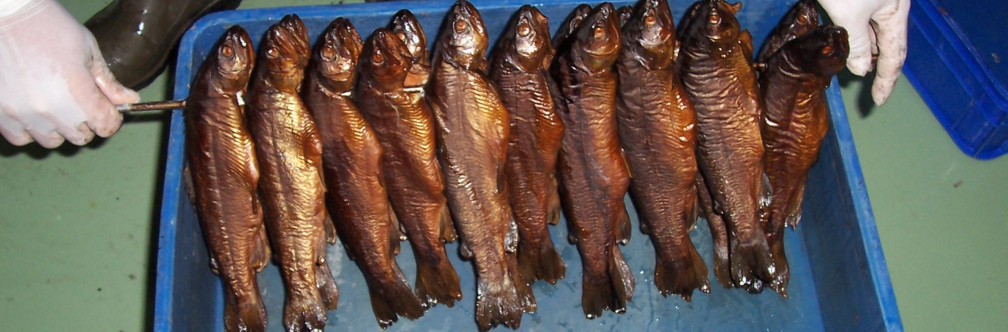
www.brestmeat.by

Slide 5
Wood pyrolysis: occurrence of favorable and unfavorable compounds

Slide 6
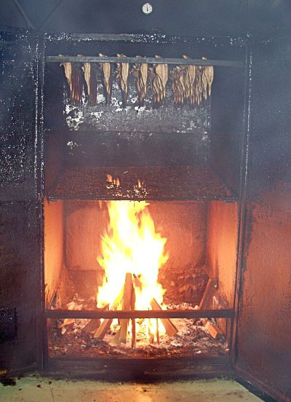
PAHs
500-900 C
1- Water evaporation
4- Lignin pyrolysis (300-500 C)
Phenols
Carboxylic acids
2- Lignin decomposition
3- Cellulose and hemicellulose pyrolysis (180-350 C)
Carbonyl compounds
Lingbeck et al. 2014

Slide 7
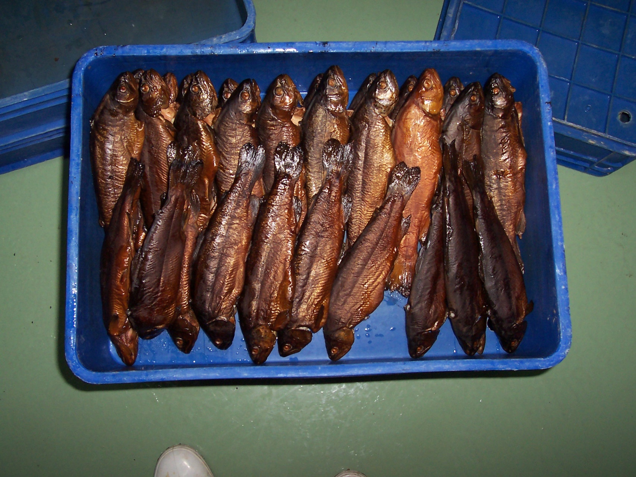
What are PAHs?
PAHs are formed during pyrolysis of wood, depending on temperature, degree of smoking and source of wood. There are several hundred PAHs, the best known is benzo[a]pyrene (BaP).
They are easily deposited on and can penetrate the food surface during traditional smoking process. (There are also some other sources that had PAH such as sugar and sweets, cereals, oils, fats and nuts).

Slide 8

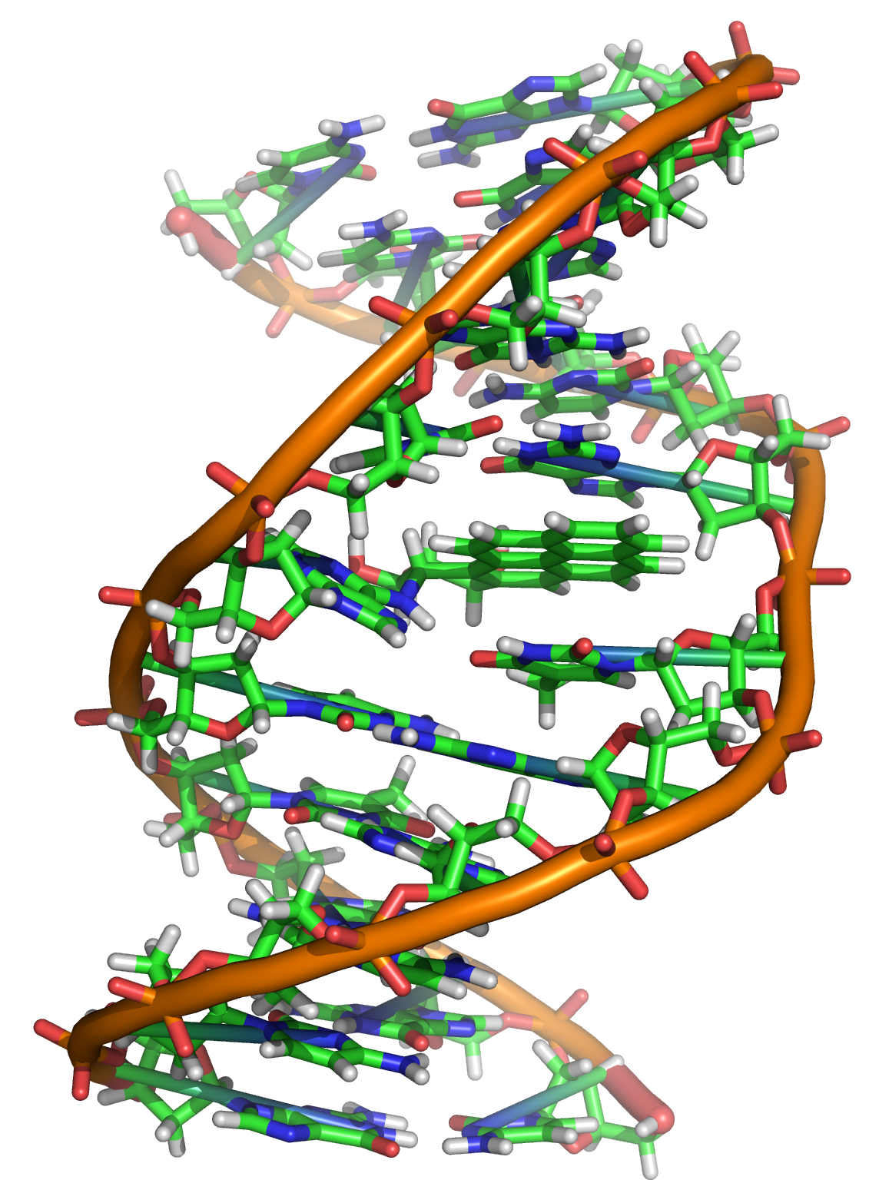
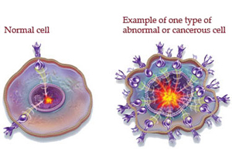
PAHs are clasified as human carcinogens.
BaP’s metabolites are mutagenics and highly carcinogenic and it is listed as a Group 1 carcinogen by the IARC (International Agency for Research on Cancer).
Wenzl et al. 2006
https://upload.wikimedia.org/wikipedia/commons/d/d8/Benzopyrene_DNA_adduct_1JDG.png

Slide 9
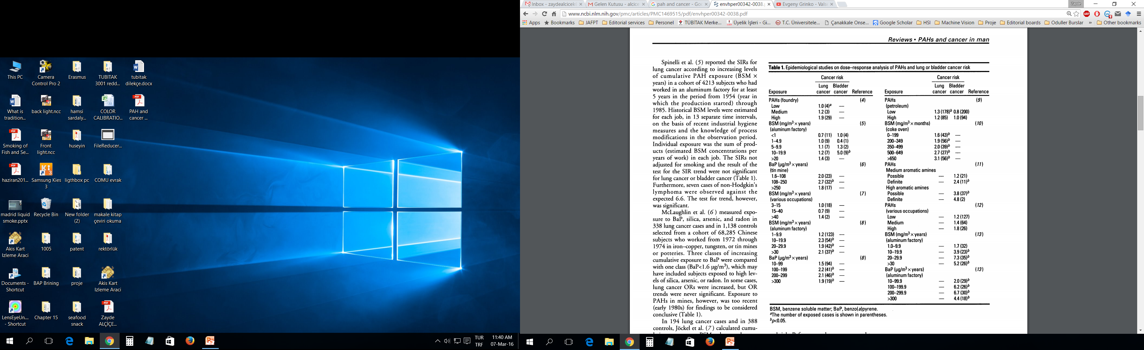
- The carcinogenicity of high-dose B[a]P has been extensively reported
- Toxic equivalent factors (TEFs) of BaP
Benzo(a)pyrene (BaP)= 1TEF
Mastrangelo et al. 1996

Slide 10
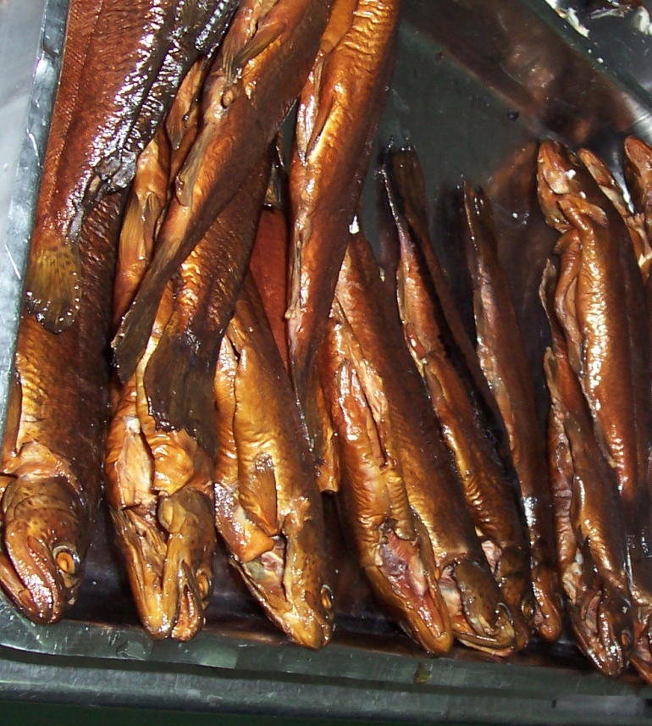
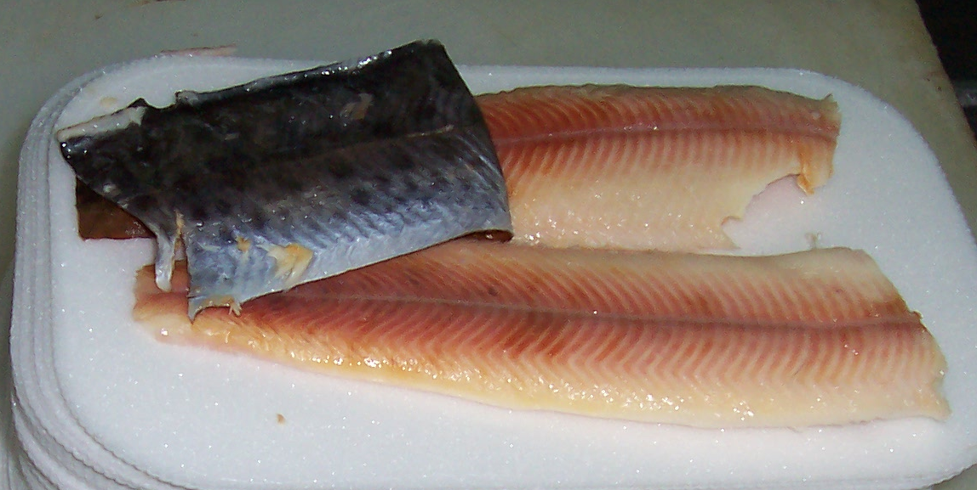
According to Garcia Falcon et al. (2010) BaP found in smoked foods (µg/kg):
Thai smoked foods: ND-1200
Nigerian Kundi: 10.5-66.9
Smoked ham and belly fat: 0.02-0.67
Smoked fish
- edible part: 0.3-0.78
- skin part: 4.9-16.8

Slide 11
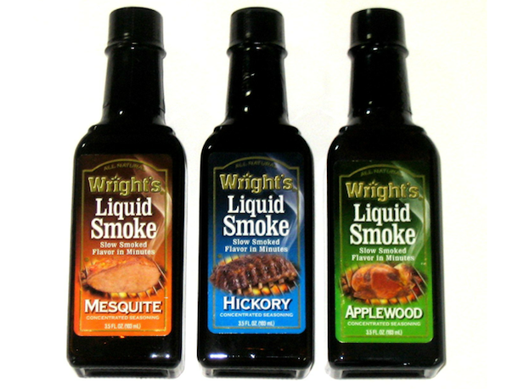
Liquid smoke condansates
During traditional smoking the deposition of PAHs on the food is difficult to control. Over the past three decades, liquid smoke flavours have been increasingly used as an alternative to smoking (Alçiçek et al. 2010).
Liquid smoke flavours have some advantages over traditional smoking methods, such as
easy application,
lower cost,
and environmental friendliness.
It is also easier to control smoke contaminants like polycyclic aromatic hydrocarbons (PAHs), which are considered carcinogenic, and mutagenic molecules produced during pyrolysis of wood (Alçiçek 2011).
[Photograph: Amazon]

Slide 12
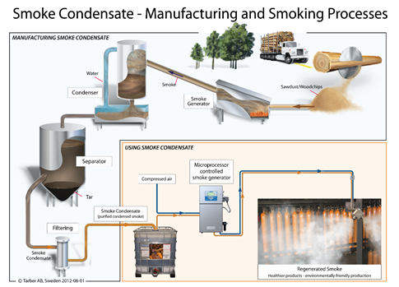
Source: Red Arrow International (http://www.redarrowinternational.com/images/smoke_condensate_process.pdf)

Slide 13
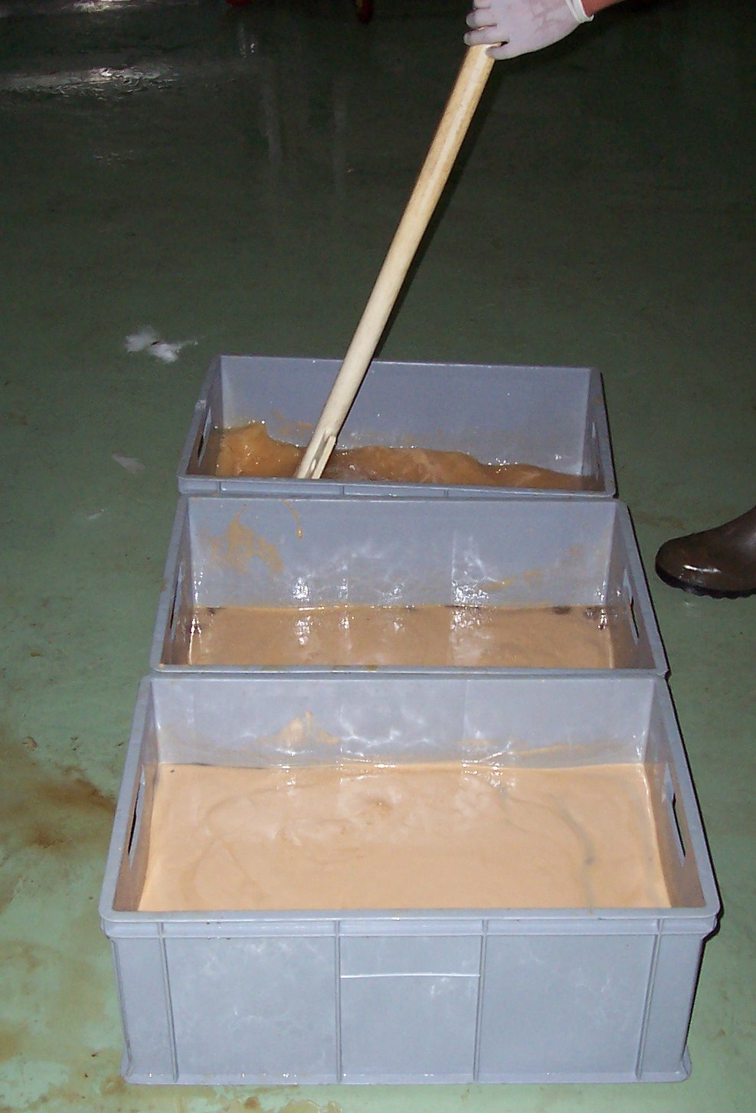
Using liquid smoke condansates
During brining
Spraying
Dipping
Coating

Slide 14
Conclusion
Since BaP has been shown to be detrimental to health it is regulated by food safety agencies and maximum allowable levels are set.
Many countries have allowable limits for BaP. In European Union will drop the limits for BaP from 0.005 to 0.002 ppm in 2014. This limit is 150.000 times below the levels known to cause birth defect (Lingbeck et al. 2014).

Slide 15
Consumer acceptability is the main challenge with the liquid smoke condansate used industrial food products due to its taste (similar to pasteurized and UHT milk)
If the taste issue is solved, people will get exposed to minimum or no PAH at all since several filtering steps used during the preperation of liquid smoke condansates

Slide 16
Thank you

