Slide 1



Occupational Exposure of Pesticides Plays a Role in Developing Cardiovascular Disease
World Heart Congress Conference
May 24, 2017
Dr. Zara Kuhnhausen Berg
Biomedical Science – Clinical Research Program
John A. Burns Medical School of the
University of Hawaii at Monoa

Slide 2
Topics of Discussion
Occupational Pesticide Exposure and CVD
Specific Aim of Study
Honolulu Heart Program study population
Literature Review of Occupational Studies of HHP
Analysis Plan and Statistical Methods
Results
Discussion
Conclusion
Acknowledgments

Slide 3
How Do Occupational Pesticides Potentially Impact Cardiovascular Disease
Occupational Medicine and Environmental Cardiology
Pesticides and Cardiovascular Diseases
  Chemical Class Dependent
  Dosage dependent and route of exposure
  Acute or Chronic
  Gender Specific
  Lifestyle factors
    e.g. nutrition, smoking, alcohol consumption
Conclusion: mixed results and pesticides on the job may contribute to different types of cardiovascular diseases

Slide 4
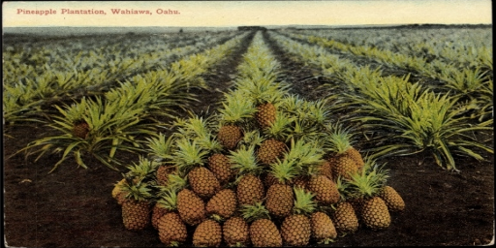
Specific Aim
The purpose of this study is to determine if there is an association between occupational exposure of pesticides and the incidence of cardiovascular diseases (CVD), including coronary heart disease (CHD) and stroke (CVA) in men of Japanese - Ancestry

Slide 5
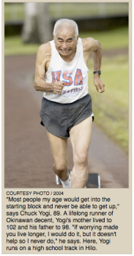
Study Population
Kuakini Honolulu Heart Program (HHP)
  Purpose: to study CVD, CHD, and CVA
  Started in 1965 on the island of Oahu, Hawaii
  8,006 Japanese–American men ages 45-68 years at baseline
  For this analysis, 8,006 men were followed for 34 years (through December 1999) for CVD outcomes

Slide 6
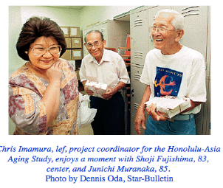
Literature Review of
Kuakini HHP and Occupation
Occupational Studies and the Kuakini Honolulu Heart Program:
  Mortality
  Bone Fractures
  Hand Grip Strength
  Movement Abnormalities
  Parkinson’s disease
  Dementia
  Cancer

Slide 7
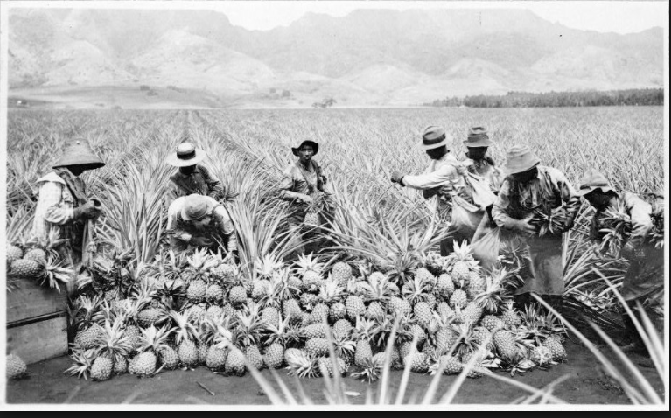
Occupational Exposure to Pesticides, Metals, and Solvents: the Impact on Mortality Rates in the Kuakini Honolulu Heart Program
Occupational chemical exposure in relation to mortality
28% died from cardiovascular diseases
Broken down into every five year lag time periods
Exposure to pesticides and solvents contributed to CVD mortality, especially 15 years prior to death

Slide 8
Analysis Plan
Baseline risk factors compared among those with and without incident CVD
Baseline characteristics of CVD risk factors comparing groups by intensity of pesticide exposure
Calculate incidence rates of CVD by levels of intensity of pesticide exposure (none, low-moderate, and high)
Calculate the Rate Ratios of CVD by level of intensity for various lag times of follow-up

Slide 9
Statistical Methods
Excluded from this analysis:
  All prevalent cases of CVD, CHD, & CVA at baseline
  No occupational exposure data available
Analytic Sample: n = 7,557 participants
Independent Variables – occupational exposure to pesticides across the levels of intensity scores
Dependent Variable – CVD incidence
Cox proportional hazards models used to calculate relative risks of CVD outcomes among pesticide exposure groups

Slide 10
Risk Factors at Baseline
Age, education, glucose, alcohol, smoking, triglycerides, cholesterol, physical activity, systolic blood pressure (SBP), diastolic blood pressure(DBP) and body mass index(BMI)
Multivariate models adjusted for above co-variates
Lag time from baseline:
  1st ten years
  2nd ten years
  last 14 years
  overall 34 years

Slide 11
OSHA Scale That Determined Intensity Levels of Exposure
Developed by National Institute for Occupational Safety and Health (NIOSH)
These methods assessed the potential for pesticides exposure in each reported occupation and how many years in workforce
Originally developed for the Honolulu Heart Program to analyze Parkinson’s Disease and Dementia
Intensity Levels:
0 = no exposure
1 = low exposure
2 = medium exposure
3 = for potential high exposure based on occupation
  They used conservative estimates to insure that those in the high group were truly exposed to high levels of pesticides

Slide 12
Adjusted Models
Models | Variables
Unadjusted | Pesticide Exposure Only
Age | Pesticide Exposure + Age
Risk Factors (BMI & SBP not included) | Pesticide Exposure + (Age, education, glucose, alcohol, smoking, triglycerides, cholesterol, physical activity, smoking, alcohol)
Risk Factors (SBP included) | Pesticide Exposure + (Age, education, glucose, alcohol, smoking, triglycerides, cholesterol, physical activity, smoking, alcohol and SBP)
Risk Factors (BMI included) | Pesticide Exposure + (Age, education, glucose, alcohol, smoking, triglycerides, cholesterol, physical activity, smoking, alcohol and BMI)
Adjusted for All Risk Factors | Pesticide Exposure + (Age, education, glucose, alcohol, smoking, triglycerides, cholesterol, physical activity, smoking, alcohol, SBP and BMI)

Slide 13
Results
Risk Factors at Baseline For Those With and Without CVD
Variables | NO CVD n=5028 | CVD n=2549 | p-value
Age (years) | 54.20 ± 5.52 | 54.59 ± 5.60 | 0.0038
BMI (kg/m²) | 23.55 ± 3.11 | 24.36 ± 3.04 | <0.0001
SBP (mm Hg) | 131.02 ± 19.73 | 139.10 ± 21.68 | <0.0001
DBP (mm Hg) | 80.74 ± 11.18 | 84.85 ± 11.89 | <0.0001
Cholesterol (mg/dL) | 214.91 ± 36.83 | 223.52 ± 39.48 | <0.0001
Triglyceride (mg/dL) | 223.79 ± 188.54 | 260.81 ± 228.18 | <0.0001
Glucose (mg/dL) | 157.20 ± 54.26 | 168.50 ± 64.01 | <0.0001
Physical Activity Index | 32.96 ± 4.56 | 32.79 ± 4.49 | 0.1389
Smoking (pack years) | 23.30 ± 24.43 | 24.63 ± 24.40 | 0.0269
Alcohol (oz/month) | 14.77 ± 25.15 | 12.65 ± 23.49 | 0.0004
Education (>=HS) | 48.87% | 49.84% | 0.422

Slide 14
Baseline Characteristics by Exposure Levels to Pesticides
Variables | No Exposure | Low-Mod. Exposure | High Exposure | p-value
Age (years) | 54.18 ± 5.49 | 55.14 ± 5.46 | 56.61 ± 5.99 | <0.0001
BMI (kg/m²) | 23.83 ± 3.12 | 24.10 ± 3.11 | 23.63 ± 2.97 | 0.1717
SBP (mm Hg) | 133.67 ± 20.62 | 137.09 ± 22.62 | 133.90 ± 22.36 | 0.8243
DBP (mm Hg) | 82.18 ± 11.54 | 83.27 ± 12.45 | 80.88 ± 12.04 | 0.0202
Cholesterol (mg/dL) | 217.78 ± 38.00 | 215.34 ± 44.60 | 218.81 ± 35.46 | 0.5799
Triglyceride (mg/dL) | 238.18 ± 204.21 | 219.86 ± 163.01 | 210.69 ± 199.86 | 0.0063
Glucose (mg/dL) | 160.80 ± 58.08 | 169.50 ± 55.21 | 162.15 ± 56.69 | 0.6308
Physical Activity Index | 32.80 ± 4.52 | 33.48 ± 4.53 | 34.38 ± 4.60 | <0.0001
Smoking (pack years) | 23.85 ± 24.51 | 25.33 ± 24.24 | 21.86 ± 23.22 | 0.0962
Alcohol (oz/month) | 14.35 ± 24.82 | 12.44 ± 20.43 | 9.83 ± 21.96 | 0.0002
Education (>= HS) | 50.53% | 38.18% | 31.04% | <0.0001

Slide 15
Incident CVD Rates
Incident CVD Rates for the first 10 years of follow-up
Exposure | Sample Size | # with CVD | Unadjusted Rates * | Age-Adjusted Rates *
None | 7016 | 550 | 8.34 | 8.48
Low-moderate | 110 | 5 | 4.74 | 4.28
High | 451 | 51 | 12.2 | 10.74
Incident CVD Rates for 34 years of follow-up
Exposure | Sample Size | # with CVD | Unadjusted Rates | Age-Adjusted Rates
None | 7016 | 2356 | 14.46 | 14.83
Low-moderate | 110 | 32 | 12.93 | 12.61
High | 451 | 161 | 16.04 | 15.28
* Per 1,000 person/years follow-up

Slide 16
Pesticide Exposure and Incident CVD in
First Ten Years of Follow-Up
Cox Proportional Hazards Models
Models | Hazard Ratio Low-Moderate Exposure | p-value | Hazard Ratio High Exposure | p-value | p for trend
Unadjusted | 0.57 (0.24-1.37) | 0.209 | 1.46 (1.10-1.95) | 0.009 | 0.023
Age-adjusted | 0.54 (0.22-1.30 | 0.166 | 1.27 (0.95-1.69) | 0.108 | 0.202
Risk Factors, no BMI or SBP | 0.54 (0.23-1.31) | 0.176 | 1.40 (1.04-1.89) | 0.027 | 0.064
Risk Factors, plus SBP only | 0.49 (0.20-1.19) | 0.116 | 1.42 (1.05-1.91) | 0.022 | 0.064
Risk Factors, plus BMI only | 0.53 (0.22-1.29) | 0.163 | 1.40 (1.04-1.89) | 0.028 | 0.065
Adjusted for all Risk Factors | 0.49 (0.20-1.19) | 0.116 | 1.42 (1.05-1.92) | 0.021 | 0.062

Slide 17
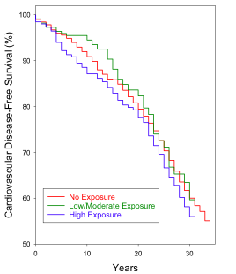
Kaplan-Meier Curves

Slide 18
Discussion
Occupational Exposure of Pesticides in the Kuakini HHP Cohort:
  High levels of pesticide exposure in the first ten years had a significant independent association with incident cardiovascular diseases in the HHP
  Findings are consistent with Hung study for CVD in Taiwan with long term effects organophosphate acute exposure
    During this longitudinal study by Hung, effects seem to be masked with increasing age
  Pesticides have been found to persist in the body after exposure for more than twenty years due to long-halve lives

Slide 19
Hypertension in Kuakini HHP
In the first ten years, hypertension was a predictor of total mortality in the Kuakini HHP Cohort
  Causes of death in the first 10 years:
  36% cancer and 34% CVD mortality
SBP was associated with CHD and CVD mortality
DBP was associated with stroke mortality
Agricultural studies of field workers have found an increase of hypertension and CVD – Slazenger, Yi, & Areola
We found an association with DBP in the Kuakini HHP

Slide 20

How do Pesticides
Potentially Lead to CVD ?
Disruption of autonomic function that controls the neurotransmitters of the cardiac rhythm
PON1 gene and production of HDL
Inhibit enzyme detoxification activity
Good nutrition can decrease pesticide effects
  Antioxidant
Notes:
Mention routes and doasge depency and gender

Slide 21
Study Limitations and Strengths
  Strengths:
    Overall large sample size
    Homogenous ethnic population
    All men
    Long-term study and only 1% lost to follow-up
  Limitations:
    Specific pesticides and exact dosages not known
    Medium exposure level was combined with low exposure because sample size was small
    Exposure and occupations were self-reported

Slide 22
Conclusion
This study gives insight to occupational pesticide exposure in middle-aged men
We found a statistically significant association between high pesticide exposure and incident CVD after 10 years of follow-up
Consistent with other studies that suggest that high pesticide exposure leads to CVD
These findings justify the implementation of prevention measures for cardiovascular diseases among subjects with occupations at risk of exposure to pesticides

Slide 23
Acknowledgments
The Kuakini Honolulu Heart Program
Kuakini Medical Center and its team of statisticians
Graduate Committee – Dr. Beatriz Rodriguez, Dr. Kamal Masaki, Dr. James Davis, Dr. Robert Cooney, and Dr. Alan Katz
My fellow Peers - Amhed Abdelkarim , Carmen Campbell, Cyndy Endrizal, Kealoha Fox, EmmaKate Friedlander, Carolina Polo & Mary Tschann

Slide 24
References
The Worldwide Health Organization http://www.who.int/mediacentre/factsheets/fs317/en/
Abbott, Robert D.; Environment, Life-Style & Physical Precursors of Clinical Parkinson’s Disease: Recent Finding From the Honolulu – Asia Aging Study; Journal of Neurology; 2003; Vol. 250[suppl 3]; pages 11130 – 11139; dol 10.1007/s00415-003-1306-7
Agirbasli, M.; Multifactor Dimensionality Reduction Analysis of MTHRF, PAI – I; ACE; PON1, and eNOS gene polymorphisms in patients with early onset Coronary Artery Disease; European Journal of Cardiovascular Prevention and Rehabilitation; vol. 18 no.6; pp. 803-809; 2011
Akerstedt T.; Shift Work and Cardiovascular disease; Scandivian Journal of Work and Environmental Health; Vol 10(6): 409-414; 1984
Arcury, Thomas; A Lifetime and Current Pesticide Exposure Among Latino Farmworkers in Comparison to Other Latino Immigrants; American Journal Ind. Med.; Vol. 57(7): [g 776-787; July 2014
Arreboola; Historical Exposure to Persistent Organic Pollutants and Risk of Incident Hypertension; Environmental Resource; Issue 138: 217-23; 2015
Beaumont; James J.; Mortality in Agricultural Workers After Compensation Claims For Respiratory Disease Pesticide Illness and Injury; Mortality & Agricultural Illness & Injury Journal; pages 160; 1991
Bhatnagar; Aruni; Environmental Cardiology – Study Mechanistic Links Between Pollution and Heart Disease; Circulation Research; pages 692-705; 2006
Boeffetta, P.; Mortality From Cardiovascular Diseases and Exposure to Inorganic Mercury; Occupational Environmental Medicine; 2001; vol. 58; pages 461-466
Bohme, Susanne; Critical Assessment/Perspective: EPA’s proposed worker protection standard International Journal of Occupational and Environmental Health; Vol. 21 No. 2; 2015
Capewell Simon; Cardiovascular Risk Factors Trends & Potential for Reducing Coronary Heart Disease Mortality in The United States of America: Bulletin of the World Health Organization; 2010; vol. 88; pages 120-130; doi: 10.2471/BLT
Center for Disease Control; Mortality Among Aerial Pesticide Applicators and Flight Instructors: Follow-up From 1965-1988; American Journal of Industrial Medicine; Vol. 36; pages 239-247
Charles, L.E.; Occupational and Other Risk Factors for Hand-Grip Strength: the Honolulu-Asia Aging Study; Occupational Environmental Medicine; 2006; Vol. 63; pages 820-827. Doi: 10.1136/oem.2006.027813
Charles L.E.; Occupational Exposure and Movement Abnormalities Among Japanese-American Men: The Honolulu-Asia Aging Study; Neuroepidemiology; volume 26, No. 3; 2006 DOI: 10.1159/000091178
Charles, Luenda E.; Occupational Exposure to Pesticides, Metals, & Solvents: The Impact on Mortality Rates in the Honolulu Heart Program; Occupational Exposure & Mortality; pages 205-215; April 2009
CDC; Acute Pesticide Related Illness Resulting from Occupational Exposure to A; CroleinCenter for Disease Control and Prevention MMWR weekly vol.62 no. 16;
Clark; Mortality Among Aerial Pesticide Applicators and Flight Instructors: Follow up from 1965 – 1988. Division of Public Health “ The State of Aging and Health in America 2013 provided by the National Center for Chronic Prevention & Health Promotion

Slide 25

MAHALO EVERYONE!

