Slide 1
Side effects of Antioxidants over Cancer Therapy
Zafer AKAN^{1*}, Talha Muezzinoğlu²
^{1*}CBU, School of Medicine, Dept. of Biophysics, Manisa Turkey
²CBU, School of Medicine, Dept. of Urology, Manisa Turkey
Akan Z, Garip AI, "Antioxidants may protect cancer cells from apoptosis signals and enhance cell durability", Asian Pac J Cancer Prev (ISI) , 4611-4614 pp., 2013

Slide 2
Cancer: One of the biggest life threatened problem
Cancer is occur after DNA damage of cancer precursor genes (oncogene) such as p53, Ras and BCL genes.
Radiation, Toxic metals, Viruses, and excessive metabolic free radical generation may lead to DNA damage and cancer.
Cancer is second life threatened illness after cardiovascular diseases on the world.
So, Cancer patients intends to use traditional medicine. Especially, uses of therapeutic herbs is very popular,
At this point Uncontrolled uses of herbs and fruit extracts are really safe?

Slide 3
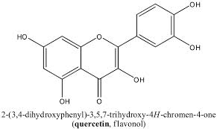
Antioxidants and Quercetin as free Radical scavenger
Quercetin is one of the most abundant dietary flavonoids. It can be found in apples, black, green and buckwheat tea, onions, raspberries, red grapes, cherries, citrus fruits as well as in some well known medical plants (ginkgo biloba, cranberries and St John’s wort) (Hertog and Hollman, 1996; Terao, 2009).
In previous in vitro studies has shown that quercetin acts as an antioxidant and anti-inflammatory agent and that it has potent anticarcinogenic properties as apoptosis inductor .
Apoptosis: Programmed cell death,

Slide 4
Free radical scavengers and Hydrogen peroxide
In the normal conditions, herbal sourced antioxidant intakes could be beneficial for cancer prevention (Gerhauser, 2008; Murakami et al., 2008), coronary artery disease prevention (Siu, 2010) and moderation of aging process.
But what will happen if cancer patient takes concentrated herbal sourced antioxidants such as quercetin which is abundantly present in many herbs, fruits and grains during cancer therapy. Will it facilitate cancer therapy or not?
To examine that, a simple study was designed. Erythroleukemia cell line (K562) was induced to apoptosis by hydrogen peroxide and effect of quercetin over the apoptosis and viability of erythroleukemia cells was observed with flow cytometer.
Note: Hydrogen peroxide produces during cancer radiotherapy and chemotherapy, and it is one of the important keys to start apoptosis processes in the cell companents

Slide 5
Reactive oxygen species (ROS)
Reactive oxygen species (ROS) are highly reactive molecules generated predominantly during cellular respiration and normal metabolism. These side products can damage many biological molecules; they can change protein functions, damage DNA material and cause lipid peroxidation of cell membranes (Kulbacka et al., 2009).
In general, the reducing environment inside cells helps to prevent free radical mediated damage. This reducing environment is maintained by the action of antioxidant enzymes and substances, such as superoxide dismutase (SOD), catalase, glutathione peroxidase, vitamins C and E (Bayir, 2005; Schafer et al., 2001).
Due to DNA damagin effect, Reactive oxygen species are key companents to destroy cancer cells via radiotherapy and chemotherapy

Slide 6
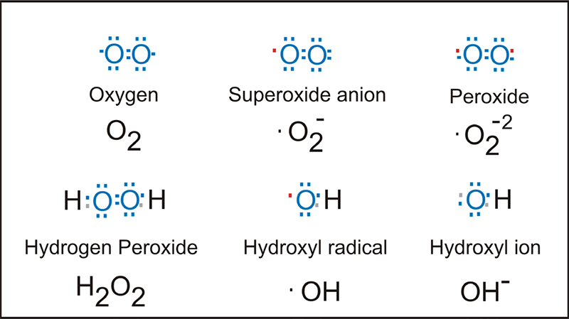
Reactive oxygen species (ROS)
Excessive production of ROS may lead to programmed cell death and may accelerate the process of aging (Chamond et al., 1999).
For a long time, reactive oxygen species (ROS) have been considered harmful mediators of inflammation owing to their highly reactive nature. However, there are an increasing number of findings suggesting that ROS can play role in anti-inflammatory and prevent autoimmune responses

Slide 7
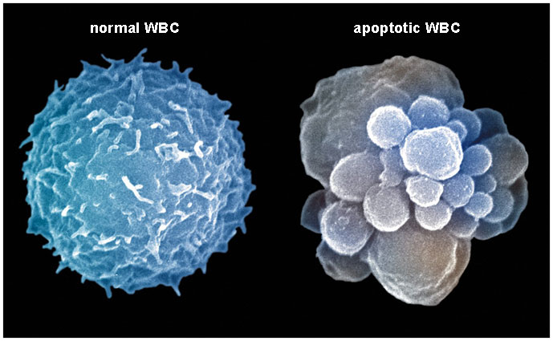
Material and Methods
Apoptosis induction by quercetin
Effect of quercetin (Sigma-Aldrich, St. Louis, MO, USA) on the erythroleukemia cell viability was evaluated with different Quercetin concentration (5-500 μM) through 3 hours with Flow cytometer (Becton-Dickinson, San Jose, CA, USA). Toxic dose of Quercetin concentrations (100- 500 μM) was evaluated through 24 hours.
Apoptosis induction by hydrogen peroxide
erythroleukemia cells (K562) were induced to apoptosis by the hydrogen peroxide (H2O2 Riedel de Haen, D3016, Seelzel, Germany) in different concentration (150, 300, 600 μM) and protective effect of Quercetin (100 μM) was analyzed through 24 hours. For this aim, protective dose of Quercetin (100 μM) was added on to K562 cell (10^6 cells in 10 mL RPMI 1640, 10% FCS, penicillin/ streptomycin), Then hydrogen peroxide were added in to RPMI cell culture medium.

Slide 8
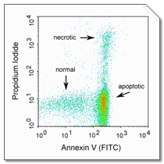
FITC-Annexin V staining assay for apoptosis detection
After induction with H2O2 and Quercetin, K562 cells were washed twice with PBS and suspended in 1x binding buffer (10 mM HEPES, 140 mM NaCl, and 5 mM CaCl2 at pH 7.4) at a concentration of approx 10⁵ cells/ml. Five μl of FITC-Annexin V and 10 μl of propidium iodide (Sigma, A2214, 1;100) was added to both control and induced cell suspension from the 50 μg/ml stock. After incubation at room temperature for 10 minutes at dark, the fluorescence of the cells was determined immediately with a flow cytometer (FACS Calibur, Becton-Dickinson, San Jose, CA, USA).
Statistical analysis
Measurements were repeated more than 3 times and student t-test was used for statistical analysis.

Slide 9
Results
For the time-course and dose-response experiments, K562 erythroleukemia cells were treated with different concentration of quercetin (5, 10, 20, 40, 80, 100, 200, 300, 400 and 500 μM of quercetin) for 3 hours. Figure 1 shows that quercetin (In the 5-200 μM doses for 3 hours) caused slight increase of K562 cells viability (number of alive cells ) (Figure 1) but high doses of quercetin (over than 200 μM) caused to increase of apoptotic cell death (p<0.01).
Some of previosly studies were indicate to apoptotic effect of quercetin even if low quercetin doses such as 5 to 100 μM in the literature !
As we expected, Contrary to the literature , quercetin has protective potential over the cells in the normal environment
For second experiment K562 cells were treated with 100, 200, 300, 400 and 500 μM of quercetin for 24 h. Toxic doses of quercetin (doses higher than 100 μM, 24 hours) resulted with decrease of K562 cell viability as expected (p<0.01) (Figure 2).
Thus, 50-100 μM of quercetin was determined as the protective quercetin dose range for the cells

Slide 10
Figure 1. Effect of Quercetin Over the Viability of K562 Cells for 3 Hours. Non-apoptotic cell rate (% viable cells) was assessed by FITC-Annexin V/PI flow cytometer assay. *p<0.05
Figure 2. Effect of Quercetin Toxic Doses Over the K562 Cells Viability for 24 Hours. Non-apoptotic cells rate (% viable cells) was assessed by FITC-Annexin V/PI flow cytometer assay. *p<0.05, **p<0.01, ***p<0.001

Slide 11
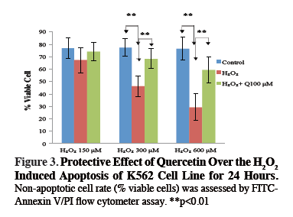
In third probe, hydrogen peroxide (H2O2) was applied in dose 150, 300 and 600 μM for 24h. Kind of ROS, hydrogen peroxide (H2O2) induced apoptosis of K562 cells had been shown previously and similar results was obtained in our study (p<0.01) (Figure 3).
To determine preventive role of quercetin (free radical scavenger flavonoid) against to H2O2 (ROS) induced apoptosis, 100 μM of quercetin was added into cell culture medium, 20 minute before the 150, 300, 600 μM H2O2 treatment.
K562 cells viability were maintained by the Quercetin from the H2O2 induced apoptosis (p<0.01), (Figure 3).

Slide 13
Discussion
In previous studies quercetin was implied as an apoptotic activator and antioxidant as well as protective agent against various types of cancer (Jung et al., 2010). It was shown that quercetin can inhibit proliferation of tumor cells and reduce the number of aberrant crypt foci in colon tumors (Van Erk et al., 2005) that it can facilitate programmed cell death in lung carcinoma (Nguyen et al., 2004) and colonorectal tumor cells (Richter et al., 1999). Other researchers had showed that quercetin acts as a free radical scavenger and protects cells from oxidizier molecules (Orsolic et al., 2007; Benkovic et al., 2009).
As known, oxidative stress and free radicals are important activators for apoptosis (Rinaldi et al., 2009).
On the other hand, studies conducted in last ten years showed that quercetin can act as an antiapoptotic agent as well (Ishikawa and Kitamura, 2000). In a few studies it has been shown that quercetin can partially prevent H2O2 - induced apoptosis (Chow et al., 2005) and it was suggested that protective effects of quercetin against oxidative injuries of some cells may be achieved via modulation of mitochondrial dysfunction and inhibition of caspase activity (Park et al., 2003).

Slide 14
In this study, our results showed that higher dose of quercetin than 200 μM reduce cell viability (which considered as toxic doses by Cao et al. (2007) but low doses of quercetin (<200 μM) can increase cell viability and considered as therapeutic dose.
As it known, hydrogen peroxide is an important apoptotic mediator over mitochondrial dependent apoptotic mechanism; we also showed protective effect of quercetin over the K562 cells which induced to apoptosis with H2O2.

Slide 15
Free radical generation and inactivation’s are under the strict control of oxidoreductive reactions. Excessive superoxide production can accelerate cell death, DNA damage and can lead to cancer, also excessive inactivation of superoxides can disturb apoptosis signals.
Inactivation of radiation and environmental sourced superoxides by the herb sourced flavonoid free radical scavengers seems beneficial for cancer prevention (Murakami et al., 2008) but if cancer is already present, as known as free radicals are important for apoptosis signals.

Slide 16
For this reason, uncontrolled consumption of flavonoid free radical scavengers such as quercetin during chemotherapy and radiotherapy may weaken the effect of chemotherapeutics and radiotherapy rather then help it.
It has been theorized that cancer risk reduction may be achieved by greater consumption of phytochemical-rich fruits and vegetables (Davis et al., 2009; Rinaldi et al., 2009). However, results of our research suggest that antioxidants can interfere and attenuate success of anticancer therapy so antioxidant intakes should be strictly controlled in the cancer diagnosed patients.

Slide 17
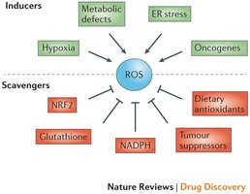
The production of reactive oxygen species (ROS) can be induced by hypoxia, metabolic defects, endoplasmic reticulum (ER) stress and oncogenes. Conversely, ROS are eliminated by the activation of the transcription factor nuclear factor
Chiara Gorrini, Isaac S. Harris & Tak W. Mak. Modulation of oxidative stress as an anticancer strategy, Nature Reviews Drug Discovery 12, 931–947 (2013) doi:10.1038/nrd4002

Slide 18
All over that, we could say, cancer prevention and therapy are totaly different processes and aproaches should be different
Three important point may be life saver with cancer struggle
The right diet for cancer prevention; intake of natural antioxydant flanovoids
Early detection and Rapid Intervention of Cancer
The right diet during cancer therapy with Sugar and antioxydant free feedings and Protein enriched products

Slide 19
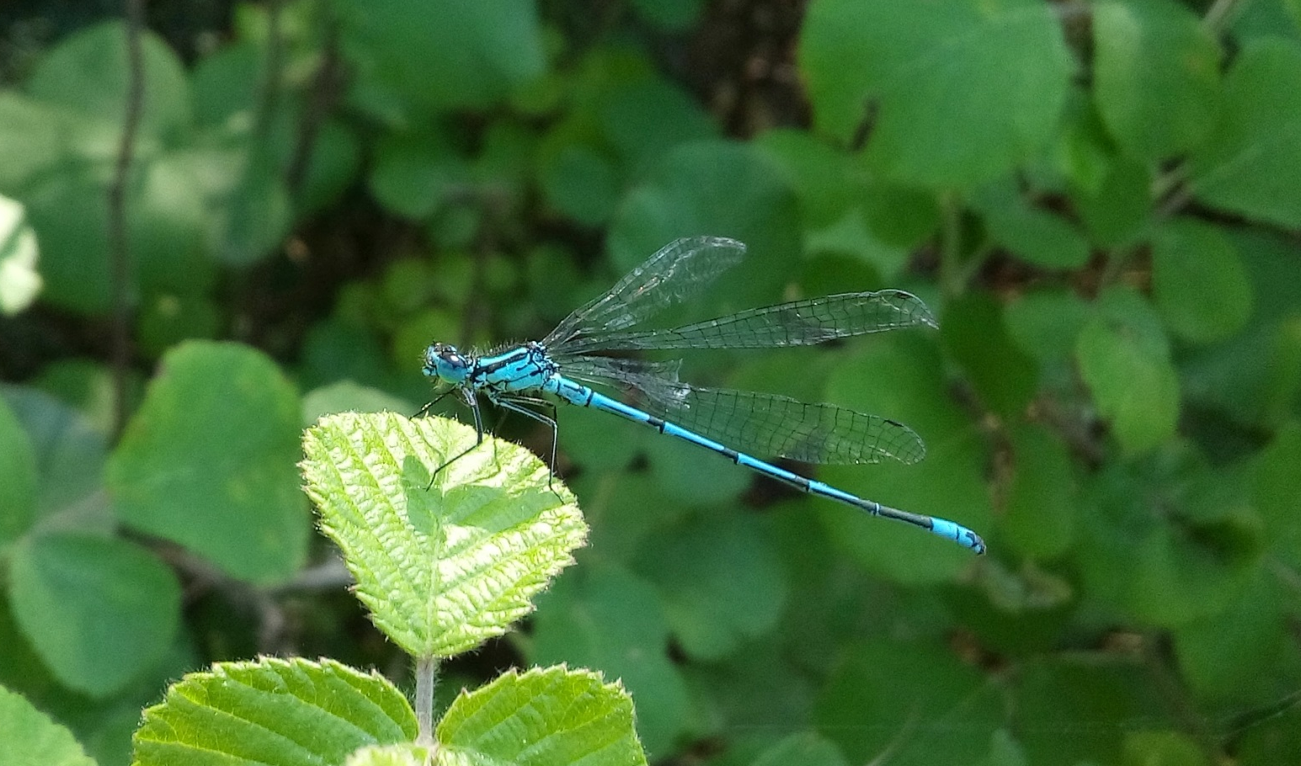
THANKS
Z Akan, et al,. Antioxidants may protect cancer cells from apoptosis signals and enhance cell viability. Asian Pacific Journal of Cancer Prevention 14 (8), 4611-4614

Slide 20
References
Bayir H (2005). Reactive oxygen species. Crit Care Med, 33, 498-501.
Benkovic V, Knezevic AH, Dikic D, et al (2009). Radioprotective effects of quercetin and ethanolic extract of propolis in gamma-irradiated mice. Arh Hig Rada Toksikol, 60, 129-38.
Cao XG, Li XX, Bao YZ, et al (2007). Responses of human lens epithelial cells to quercetin and DMSO. Invest Ophthalmol Vis Sci, 48, 3714-8.
Chamond RR, Anon JC, Guerra P, et al (1999). Apoptosis and disease. Alergol Immunol Clin, 14, 367-74.
Chow JM, Shen SC, Huan SK (2005). Quercetin, but not rutin and quercitrin, prevention of H2O2-induced apoptosis via anti-oxidant activity and heme oxygenase 1 gene expression in macrophages. Biochem Pharmacol, 69, 1839-51.
Davis JM, Murphy EA, Carmichael MD (2009). Effects of the dietary flavonoid quercetin upon performance and health. Curr Sports Med Rep, 8, 206-13.
Formica JV, Regelson W (1995). Review of the biology of Quercetin and related bioflavonoids. Food Chem Toxicol, 33, 1061-80.
Gerhauser C (2008). Cancer chemopreventive potential of apples, apple juice, and apple components. Planta Med, 74, 1608-24.
Hertog MG, Hollman PC (1996). Potential health effects of the dietary flavonol quercetin. Eur J Clin Nutr, 50, 63-71.
Hultqvist M, Olsson LM, Gelderman KA, et al (2009). The protective role of ROS in autoimmune disease. Trends Immunol, 30, 201-8.
Ishikawa Y, Kitamura M (2000). Anti-apoptotic effect of quercetin; intervention in the JNK- and ERK-mediated apoptotic pathways. Kidney Int, 58, 1078-87.
Jung JH, Lee JO, Kim JH, et al (2010). Quercetin suppresses HeLa cell viability via AMPK-induced HSP70 and EGFR down-regulation. J Cell Physiol, 223, 408-14.
Kopani M, Celec P, Danisovic L, et al (2006). Oxidative stress and electron spin resonance. Clin Chim Acta, 364, 61-6.
Kulbacka J, Saczko J, Chwilkowska A (2009). Oxidative stress in cells damage processes. Pol Merkur Lekarski, 27, 44-7.

Slide 21
Murakami A, Ashida H, Terao J (2008). Multitargeted cancer prevention by quercetin. Cancer Lett, 269, 315-25.
Nguyen TT, Tran E, Nguyen TH, et al (2004). The role of activated MEK-ERK pathway in quercetin-induced growth inhibition and apoptosis in A549 lung cancer cells. Carcinogenesis, 25, 647-59.
Orsolic N, Benkovic V, Horvat-Knezevic A, et al (2007). Assessment by survival analysis of the radioprotective properties of propolis and its polyphenolic compounds. Biol Pharm Bull, 30, 946-51.
Park C, So HS, Shin CH, et al (2003). Quercetin protects the hydrogen peroxide-induced apoptosis via inhibition of mitochondrial dysfunction in H9c2 cardiomyoblast cells. Biochem Pharmacol, 66, 1287-95.
Rinaldi S, Landucci F, De Gaudio AR (2009). Antioxidant therapy in critically septic patients. Curr Drug Targets, 10, 872-80.
Richter M, Ebermann R, Marian B (1999). Quercetin-induced apoptosis in colorectal tumor cells; possible role of EGF receptor signaling. Nutr Cancer, 34, 88-99.
Schafer FQ, Buettner GR (2001). Redox environment of the cell as viewed through the redox state of the glutathione disulfide/ glutathione couple. Free Radic Biol Med, 30, 1191-212.
Siu D (2010). A new way of targeting to treat coronary artery disease. J Cardiovasc Med (Hagerstown), 11, 1-6.
Terao J (2009). Dietary flavonoids as antioxidants. Forum Nutr, 61, 87-94.
Ueno I, Kohno M, Haraikawa K, et al (1984). Interaction between quercetin and superoxide radicals. Reduction of the quercetin mutagenicity. J Pharmacobiodyn, 7, 798-803.
Van Erk MJ, Roepman P, van der Lende TR, et al (2005). Integrated assessment by multiple gene expression analysis of quercetin bioactivity on anticancer-related mechanisms in colon cancer cells in vitro. Eur J Nutr, 44, 143-56.

