Slide 1



3rd International Conference on Hydrology & Meteorology
September 15-16, 2014 HICC, Hyderabad, India
A General Overview on Global Climate Change
Toprak, ZF
A GENERAL OVERVIEW
ON
GLOBAL CLIMATE CHANGE
Z. Fuat TOPRAK
Dicle University Engineering Faculty, Civil Engineering Department 21280 Diyarbakir-Turkey
toprakzey@itu.edu.tr , +90 533 490 16 09
CONTENTS ABSTRACT INTRO 1 2 REV 3 4 5 6 7 8 9 10 CONC&DISC THANKS

Slide 2

CONTENTS
3rd International Conference on Hydrology & Meteorology
September 15-16, 2014 HICC, Hyderabad, India
A General Overview on Global Climate Change
Toprak, ZF
Abstract
Introduction
Numerical Comparison of Scientific Studies Made on the Subject with the Perspective of Years
Reflection of the Problem to the Masses of Ordinary People Who Live It
A Review on Published Studies Made on Global Climate Change
Conclusions and Recommendations In 15 Questions
CONTENTS ABSTRACT INTRO 1 2 REV 3 4 5 6 7 8 9 10 CONC&DISC THANKS

Slide 3
ABSTRACT
3rd International Conference on Hydrology & Meteorology
September 15-16, 2014 HICC, Hyderabad, India
A General Overview on Global Climate Change
Toprak, ZF
Herein first,
In order to answer the questions
“what happen?”
“why?”
“how?”
“how much?”
“What have to be done?”
the previous researches on the “global climate change” have been abstracted, discussed, and concluded briefly.
CONTENTS ABSTRACT INTRO 1 2 REV 3 4 5 6 7 8 9 10 CONC&DISC THANKS

Slide 4

ABSTRACT
3rd International Conference on Hydrology & Meteorology
September 15-16, 2014 HICC, Hyderabad, India
A General Overview on Global Climate Change
Toprak, ZF
Ozone layer depletion (or the hole in the ozone layer) and then global climate change are the two important issues in the agenda of the world communities since 1980s. In general mostly the two problems are known as the same.
CONTENTS ABSTRACT INTRO 1 2 REV 3 4 5 6 7 8 9 10 CONC&DISC THANKS

Slide 5
ABSTRACT
3rd International Conference on Hydrology & Meteorology
September 15-16, 2014 HICC, Hyderabad, India
A General Overview on Global Climate Change
Toprak, ZF
Although the reasons of them are similar and one triggers the other, however, they are different problems. Due to their serious impacts upon almost all aspects of the life and the environment, the two problems are globally discussed among the members of all the vital sectors of the life.
CONTENTS ABSTRACT INTRO 1 2 REV 3 4 5 6 7 8 9 10 CONC&DISC THANKS

Slide 6
ABSTRACT
3rd International Conference on Hydrology & Meteorology
September 15-16, 2014 HICC, Hyderabad, India
A General Overview on Global Climate Change
Toprak, ZF
In this study, in the light of the recent literature the past, the current, and the future of the global climate change are presented with its all aspects.
CONTENTS ABSTRACT INTRO 1 2 REV 3 4 5 6 7 8 9 10 CONC&DISC THANKS

Slide 7
ABSTRACT
3rd International Conference on Hydrology & Meteorology
September 15-16, 2014 HICC, Hyderabad, India
A General Overview on Global Climate Change
Toprak, ZF
When a problem is tried to be presented in detail, sometimes a few points are off target. So in this paper the problem is not evaluated in detail, main dimensions are only discussed.
CONTENTS ABSTRACT INTRO 1 2 REV 3 4 5 6 7 8 9 10 CONC&DISC THANKS

Slide 8
ABSTRACT
3rd International Conference on Hydrology & Meteorology
September 15-16, 2014 HICC, Hyderabad, India
A General Overview on Global Climate Change
Toprak, ZF
The paper will give to the readers the answers to three specified questions: 1) currently is the human faced with the global climate change or not? 2) “How much we have faced?”, and 3) “Is the reality as terrible as exaggerated or not?
CONTENTS ABSTRACT INTRO 1 2 REV 3 4 5 6 7 8 9 10 CONC&DISC THANKS

Slide 9
INTRODUCTION
3rd International Conference on Hydrology & Meteorology
September 15-16, 2014 HICC, Hyderabad, India
A General Overview on Global Climate Change
Toprak, ZF
As well known, from 1980s, the first issue (OLD) had been discussed at least for two decades among scientists, environmental groups, civil society organizations, politicians, stakeholders, and almost all the sectors of the life.
CONTENTS ABSTRACT INTRO 1 2 REV 3 4 5 6 7 8 9 10 CONC&DISC THANKS

Slide 10
INTRODUCTION
3rd International Conference on Hydrology & Meteorology
September 15-16, 2014 HICC, Hyderabad, India
A General Overview on Global Climate Change
Toprak, ZF
At that time, numerous scientific articles have pointed out the hole or the depletion in ozone layer (Table 1).
CONTENTS ABSTRACT INTRO 1 2 REV 3 4 5 6 7 8 9 10 CONC&DISC THANKS

Slide 11
INTRODUCTION
3rd International Conference on Hydrology & Meteorology
September 15-16, 2014 HICC, Hyderabad, India
A General Overview on Global Climate Change
Toprak, ZF
Furthermore, important news and political opinions or statements could be seen extremely and widespreadly in the past.
CONTENTS ABSTRACT INTRO 1 2 REV 3 4 5 6 7 8 9 10 CONC&DISC THANKS

Slide 12
INTRODUCTION
3rd International Conference on Hydrology & Meteorology
September 15-16, 2014 HICC, Hyderabad, India
A General Overview on Global Climate Change
Toprak, ZF
The ozone layer depletion leads to a significant increase in the surface Ultraviolet levels. The increase in the surface Ultraviolet levels causes many health and environmental consequences (i.e. skin cancer, cataract and immunity suppression, global warming, loss of agricultural products that in turn leads to a loss of farmers and food, changes in the physiology of plants affecting plant growth and crop yield, threaten the survival of certain species such as amphibians and larvae, destruction of phytoplankton affecting aquatic food chains).
CONTENTS ABSTRACT INTRO 1 2 REV 3 4 5 6 7 8 9 10 CONC&DISC THANKS

Slide 13
INTRODUCTION
3rd International Conference on Hydrology & Meteorology
September 15-16, 2014 HICC, Hyderabad, India
A General Overview on Global Climate Change
Toprak, ZF
So, the results of the depletion in the ozone layer are clearly visible in the short term.
CONTENTS ABSTRACT INTRO 1 2 REV 3 4 5 6 7 8 9 10 CONC&DISC THANKS

Slide 14
INTRODUCTION
3rd International Conference on Hydrology & Meteorology
September 15-16, 2014 HICC, Hyderabad, India
A General Overview on Global Climate Change
Toprak, ZF
The second issue (GCC) widely discussed after 1980s.
CONTENTS ABSTRACT INTRO 1 2 REV 3 4 5 6 7 8 9 10 CONC&DISC THANKS

Slide 15
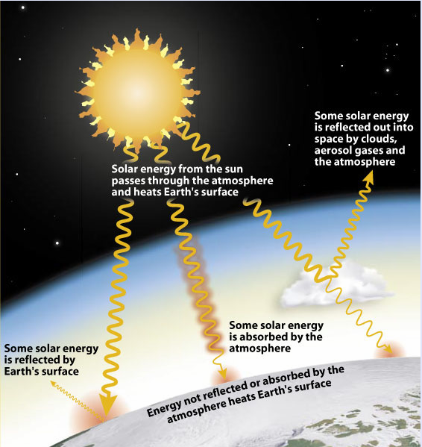
INTRODUCTION
3rd International Conference on Hydrology & Meteorology
September 15-16, 2014 HICC, Hyderabad, India
A General Overview on Global Climate Change
Toprak, ZF
Short-wave radiation that comes from the sun is reflected by the earth surface as long waves (Figure 1).
Figure 1 Short-wave radiation that comes from the sun is reflected by the earth surface as long waves (http://forces.si.edu/atmosphere/02_04_07.html)
CONTENTS ABSTRACT INTRO 1 2 REV 3 4 5 6 7 8 9 10 CONC&DISC THANKS

Slide 16
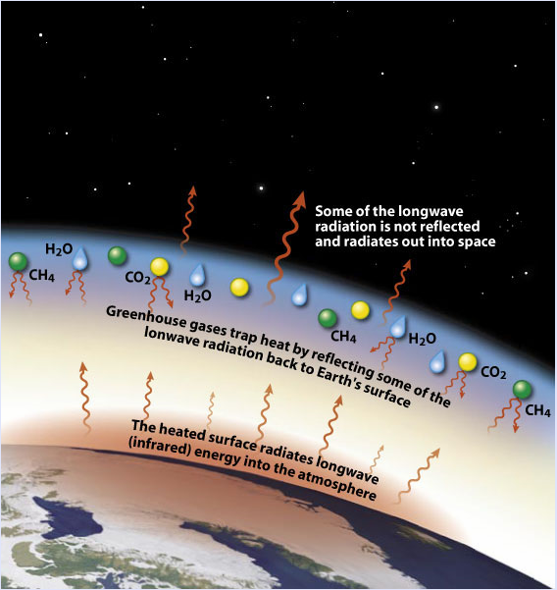
INTRODUCTION
3rd International Conference on Hydrology & Meteorology
September 15-16, 2014 HICC, Hyderabad, India
A General Overview on Global Climate Change
Toprak, ZF
On the other hand, increase in greenhouse gases (i.e. water vapor, CO2, CO, SO2, NOx, CFC, etc.) in the atmosphere restrains reflection of such shortwave solar radiation from the earth surface to the atmosphere (Toprak et al. 2014).
CONTENTS ABSTRACT INTRO 1 2 REV 3 4 5 6 7 8 9 10 CONC&DISC THANKS

Slide 17
INTRODUCTION
3rd International Conference on Hydrology & Meteorology
September 15-16, 2014 HICC, Hyderabad, India
A General Overview on Global Climate Change
Toprak, ZF
Previously (up to the end of the 1980s) the affects of the greenhouse gases were known only on temperature, therefore the problem was called as global warming.
CONTENTS ABSTRACT INTRO 1 2 REV 3 4 5 6 7 8 9 10 CONC&DISC THANKS

Slide 18
INTRODUCTION
3rd International Conference on Hydrology & Meteorology
September 15-16, 2014 HICC, Hyderabad, India
A General Overview on Global Climate Change
Toprak, ZF
Later (after 1980s), it was recognized that the emission of greenhouse gases have effects not only on temperature but also on the other characteristics of both meteorolog (in short term) and climate (in long term) (i.e. rainfall, temperature, pressure, wind speed and its direction; number of flood, storms, and hurricanes; sea water level, snow thickness, snow-melting, glaciers-melting, fresh water resources, hydrological cycle etc.).
CONTENTS ABSTRACT INTRO 1 2 REV 3 4 5 6 7 8 9 10 CONC&DISC THANKS

Slide 19
INTRODUCTION
3rd International Conference on Hydrology & Meteorology
September 15-16, 2014 HICC, Hyderabad, India
A General Overview on Global Climate Change
Toprak, ZF
Therefore the problem was re-defined. The emission of greenhouse gases led changes in the atmospheric, meteorological and climatic conditions locally or globally in the short and long-term horizons, which are called today as global climate change. This definition is more realistic than the previously made (global warming).
CONTENTS ABSTRACT INTRO 1 2 REV 3 4 5 6 7 8 9 10 CONC&DISC THANKS

Slide 20
INTRODUCTION
3rd International Conference on Hydrology & Meteorology
September 15-16, 2014 HICC, Hyderabad, India
A General Overview on Global Climate Change
Toprak, ZF
The use of fossil energy sources produces the greenhouse gases, and consequently, IPCC reports claim that emission of such gases mostly depends on human activities at high percentages of 98% or 99% (IPCC, 2007; IPCC, 2013).
CONTENTS ABSTRACT INTRO 1 2 REV 3 4 5 6 7 8 9 10 CONC&DISC THANKS

Slide 21
INTRODUCTION
3rd International Conference on Hydrology & Meteorology
September 15-16, 2014 HICC, Hyderabad, India
A General Overview on Global Climate Change
Toprak, ZF
Türkeş et al (2000) says that 1998 included abnormal and extreme meteorological and natural events. It was the warmest year of the last 140 years. Furthermore, 240 strong storms, 170 floods, 190 forest fire, numerous severe droughts and the warm as well as cold weather waves occurred in the same year (Turkeş et. al., 2000).
CONTENTS ABSTRACT INTRO 1 2 REV 3 4 5 6 7 8 9 10 CONC&DISC THANKS

Slide 22
INTRODUCTION
3rd International Conference on Hydrology & Meteorology
September 15-16, 2014 HICC, Hyderabad, India
A General Overview on Global Climate Change
Toprak, ZF
The GCC has serious impacts upon the atmosphere, earth, and ocean. Therefore, the issue becomes internationally disputable subject among climatologists, atmospheric researchers, oceanographers, hydro-meteorologists, agriculturalists, and in particular, among local administrators including politicians as well as the people at different walks of life as Toprak et al. (2013) says.
CONTENTS ABSTRACT INTRO 1 2 REV 3 4 5 6 7 8 9 10 CONC&DISC THANKS

Slide 23
INTRODUCTION
3rd International Conference on Hydrology & Meteorology
September 15-16, 2014 HICC, Hyderabad, India
A General Overview on Global Climate Change
Toprak, ZF
Such serious impacts of the GCC triggered the scientists, the governments, and the social organizations to make further researches as to measure and predict the consequences of the global climate change impacts.
CONTENTS ABSTRACT INTRO 1 2 REV 3 4 5 6 7 8 9 10 CONC&DISC THANKS

Slide 24
INTRODUCTION
3rd International Conference on Hydrology & Meteorology
September 15-16, 2014 HICC, Hyderabad, India
A General Overview on Global Climate Change
Toprak, ZF
United Nations Framework Climate Change Convention (UNFCCC) and then Kyoto Protocol were signed in 1992 and 1997, respectively to alleviate the current situation. In addition to the protocols, Intergovernmental Panels on Climate Change (IPCC) are organized and their reports are periodically published (Batan et al., 2013; Toprak et al., 2013; Toprak, 2013; Toprak, 2011).
CONTENTS ABSTRACT INTRO 1 2 REV 3 4 5 6 7 8 9 10 CONC&DISC THANKS

Slide 25
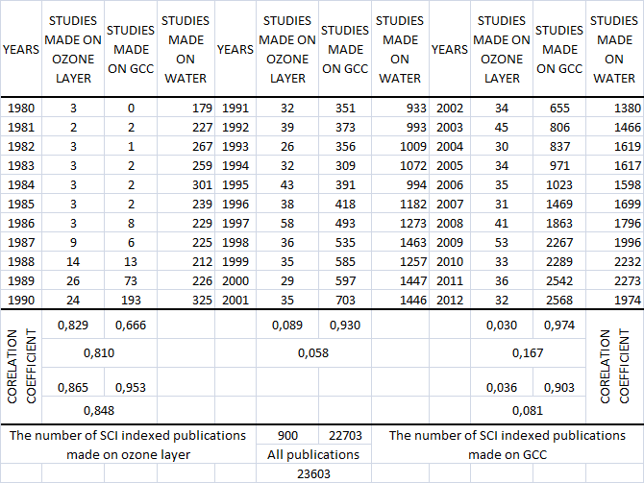
NUMERICAL COMPARISON OF SCIENTIFIC STUDIES MADE ON THE SUBJECT WITH THE PERSPECTIVE OF YEARS
3rd International Conference on Hydrology & Meteorology
September 15-16, 2014 HICC, Hyderabad, India
A General Overview on Global Climate Change
Toprak, ZF
In light of the above consideration, the Table 1 and Figure 2 can be concluded without any interpretation as follows:
CONTENTS ABSTRACT INTRO 1 2 REV 3 4 5 6 7 8 9 10 CONC&DISC THANKS

Slide 26
NUMERICAL COMPARISON OF SCIENTIFIC STUDIES MADE ON THE SUBJECT WITH THE PERSPECTIVE OF YEARS
3rd International Conference on Hydrology & Meteorology
September 15-16, 2014 HICC, Hyderabad, India
A General Overview on Global Climate Change
Toprak, ZF
Although the problem in ozone layer was recognized by the scientists in 1980, however in this year the GCC was not yet.
CONTENTS ABSTRACT INTRO 1 2 REV 3 4 5 6 7 8 9 10 CONC&DISC THANKS

Slide 27
NUMERICAL COMPARISON OF SCIENTIFIC STUDIES MADE ON THE SUBJECT WITH THE PERSPECTIVE OF YEARS
3rd International Conference on Hydrology & Meteorology
September 15-16, 2014 HICC, Hyderabad, India
A General Overview on Global Climate Change
Toprak, ZF
For the first 11 years, the scientists have interested in both two topics with an increase trend year by year. This increase is more significant for GCC.
CONTENTS ABSTRACT INTRO 1 2 REV 3 4 5 6 7 8 9 10 CONC&DISC THANKS

Slide 28
NUMERICAL COMPARISON OF SCIENTIFIC STUDIES MADE ON THE SUBJECT WITH THE PERSPECTIVE OF YEARS
3rd International Conference on Hydrology & Meteorology
September 15-16, 2014 HICC, Hyderabad, India
A General Overview on Global Climate Change
Toprak, ZF
After 1990 the scientists have left the ozone layer depletion and instead they have preferred to interest in GCC.
CONTENTS ABSTRACT INTRO 1 2 REV 3 4 5 6 7 8 9 10 CONC&DISC THANKS

Slide 29
NUMERICAL COMPARISON OF SCIENTIFIC STUDIES MADE ON THE SUBJECT WITH THE PERSPECTIVE OF YEARS
3rd International Conference on Hydrology & Meteorology
September 15-16, 2014 HICC, Hyderabad, India
A General Overview on Global Climate Change
Toprak, ZF
In the next decades, this interest has increased significantly in GCC.
CONTENTS ABSTRACT INTRO 1 2 REV 3 4 5 6 7 8 9 10 CONC&DISC THANKS

Slide 30
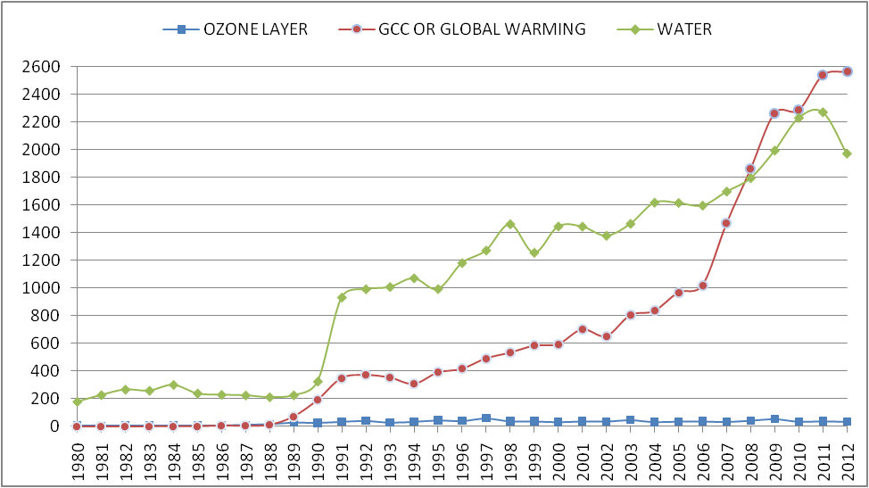
NUMERICAL COMPARISON OF SCIENTIFIC STUDIES MADE ON THE SUBJECT WITH THE PERSPECTIVE OF YEARS
3rd International Conference on Hydrology & Meteorology
September 15-16, 2014 HICC, Hyderabad, India
A General Overview on Global Climate Change
Toprak, ZF
Another interesting result can be extracted from the table as well as from the figure is fact that the studies made on GCC are more then those made on water after 2008.
CONTENTS ABSTRACT INTRO 1 2 REV 3 4 5 6 7 8 9 10 CONC&DISC THANKS

Slide 31
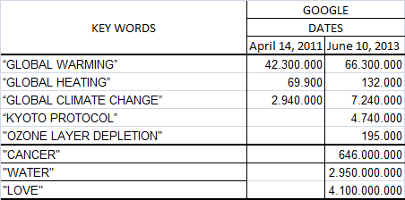
REFLECTION OF THE PROBLEM TO THE MASSES OF ORDINARY PEOPLE WHO LIVE IT
3rd International Conference on Hydrology & Meteorology
September 15-16, 2014 HICC, Hyderabad, India
A General Overview on Global Climate Change
Toprak, ZF
Table 2 searching several important key words in GOOGLE engine
In order to investigate the reflection of the problem to masses of ordinary people who live it, the same keywords together with the “low” and “cancer” were searched in Google engine (April 14, 2011 and June 10, 2013).
CONTENTS ABSTRACT INTRO 1 2 REV 3 4 5 6 7 8 9 10 CONC&DISC THANKS

Slide 32
REFLECTION OF THE PROBLEM TO THE MASSES OF ORDINARY PEOPLE WHO LIVE IT
3rd International Conference on Hydrology & Meteorology
September 15-16, 2014 HICC, Hyderabad, India
A General Overview on Global Climate Change
Toprak, ZF
Table 2 searching several important key words in GOOGLE engine
The results are presented comparatively for two different dates in Table 2. The key words were searched in English. Table 2 can be concluded without any interpretation as follows:
CONTENTS ABSTRACT INTRO 1 2 REV 3 4 5 6 7 8 9 10 CONC&DISC THANKS

Slide 33
REFLECTION OF THE PROBLEM TO THE MASSES OF ORDINARY PEOPLE WHO LIVE IT
3rd International Conference on Hydrology & Meteorology
September 15-16, 2014 HICC, Hyderabad, India
A General Overview on Global Climate Change
Toprak, ZF
Table 2 searching several important key words in GOOGLE engine
The masses of ordinary people who live GCC still mainly mention the problem as “global warming”. “Global climate change” has not been adopted among people yet.
CONTENTS ABSTRACT INTRO 1 2 REV 3 4 5 6 7 8 9 10 CONC&DISC THANKS

Slide 34
REFLECTION OF THE PROBLEM TO THE MASSES OF ORDINARY PEOPLE WHO LIVE IT
3rd International Conference on Hydrology & Meteorology
September 15-16, 2014 HICC, Hyderabad, India
A General Overview on Global Climate Change
Toprak, ZF
Table 2 searching several important key words in GOOGLE engine
According to the data obtained in 2013, “global warming”, “global heating”, and “global climate change” have been mentioned 378 times more than “ozone layer depletion”
CONTENTS ABSTRACT INTRO 1 2 REV 3 4 5 6 7 8 9 10 CONC&DISC THANKS

Slide 35
REFLECTION OF THE PROBLEM TO THE MASSES OF ORDINARY PEOPLE WHO LIVE IT
3rd International Conference on Hydrology & Meteorology
September 15-16, 2014 HICC, Hyderabad, India
A General Overview on Global Climate Change
Toprak, ZF
Table 2 searching several important key words in GOOGLE engine
According to the table from April 2011 to June 2013 33 Billion of pages about the first three key words have been added to the web (16.5 Billion of pages/year).
CONTENTS ABSTRACT INTRO 1 2 REV 3 4 5 6 7 8 9 10 CONC&DISC THANKS

Slide 36
REFLECTION OF THE PROBLEM TO THE MASSES OF ORDINARY PEOPLE WHO LIVE IT
3rd International Conference on Hydrology & Meteorology
September 15-16, 2014 HICC, Hyderabad, India
A General Overview on Global Climate Change
Toprak, ZF
Table 2 searching several important key words in GOOGLE engine
Globally masses of ordinary people who live the problem still more interests in or talks about “low”, “water”, and “cancer”, respectively.
CONTENTS ABSTRACT INTRO 1 2 REV 3 4 5 6 7 8 9 10 CONC&DISC THANKS

Slide 37
REFLECTION OF THE PROBLEM TO THE MASSES OF ORDINARY PEOPLE WHO LIVE IT
3rd International Conference on Hydrology & Meteorology
September 15-16, 2014 HICC, Hyderabad, India
A General Overview on Global Climate Change
Toprak, ZF
Table 2 searching several important key words in GOOGLE engine
The Kyoto Protocol has globally taken place in the people agenda.
CONTENTS ABSTRACT INTRO 1 2 REV 3 4 5 6 7 8 9 10 CONC&DISC THANKS

Slide 38
A REVIEW ON PUBLISHED STUDIES MADE ON GLOBAL CLIMATE CHANGE
3rd International Conference on Hydrology & Meteorology
September 15-16, 2014 HICC, Hyderabad, India
A General Overview on Global Climate Change
Toprak, ZF
Classification of Published Studies Based on Time Slices
The previous studies can be classified into three main categories on the basis of time slices.
CONTENTS ABSTRACT INTRO 1 2 REV 3 4 5 6 7 8 9 10 CONC&DISC THANKS

Slide 39
A REVIEW ON PUBLISHED STUDIES MADE ON GLOBAL CLIMATE CHANGE
3rd International Conference on Hydrology & Meteorology
September 15-16, 2014 HICC, Hyderabad, India
A General Overview on Global Climate Change
Toprak, ZF
Classification of Published Studies Based on Time Slices
The first lots of studies concerning global climate change are completed prior to 1990.
These works can be regarded as pioneering works for the attraction of attention by scientists, administrators, and politicians all over the world at different countries.
CONTENTS ABSTRACT INTRO 1 2 REV 3 4 5 6 7 8 9 10 CONC&DISC THANKS

Slide 40
A REVIEW ON PUBLISHED STUDIES MADE ON GLOBAL CLIMATE CHANGE
3rd International Conference on Hydrology & Meteorology
September 15-16, 2014 HICC, Hyderabad, India
A General Overview on Global Climate Change
Toprak, ZF
Classification of Published Studies Based on Time Slices
The works published between 1990 and 2000 can be accounted in the second category.
They concentrate on the question what might happen on different sectors such as energy, environment, water resources, food security, agriculture, etc.
CONTENTS ABSTRACT INTRO 1 2 REV 3 4 5 6 7 8 9 10 CONC&DISC THANKS

Slide 41
A REVIEW ON PUBLISHED STUDIES MADE ON GLOBAL CLIMATE CHANGE
3rd International Conference on Hydrology & Meteorology
September 15-16, 2014 HICC, Hyderabad, India
A General Overview on Global Climate Change
Toprak, ZF
Classification of Published Studies Based on Time Slices
Works published after 2000 can be mentioned in the last class.
They have the target to interrogate the questions “why”, “how”, and “how much”.
CONTENTS ABSTRACT INTRO 1 2 REV 3 4 5 6 7 8 9 10 CONC&DISC THANKS

Slide 42
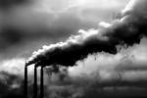
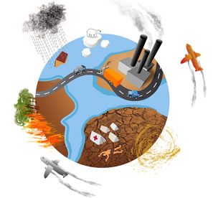


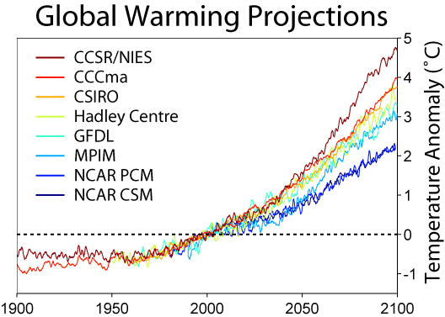


A REVIEW ON PUBLISHED STUDIES MADE ON GLOBAL CLIMATE CHANGE
3rd International Conference on Hydrology & Meteorology
September 15-16, 2014 HICC, Hyderabad, India
A General Overview on Global Climate Change
Toprak, ZF
WHY?
BACK
CONTENTS ABSTRACT INTRO 1 2 REV 3 4 5 6 7 8 9 10 CONC&DISC THANKS

Slide 43
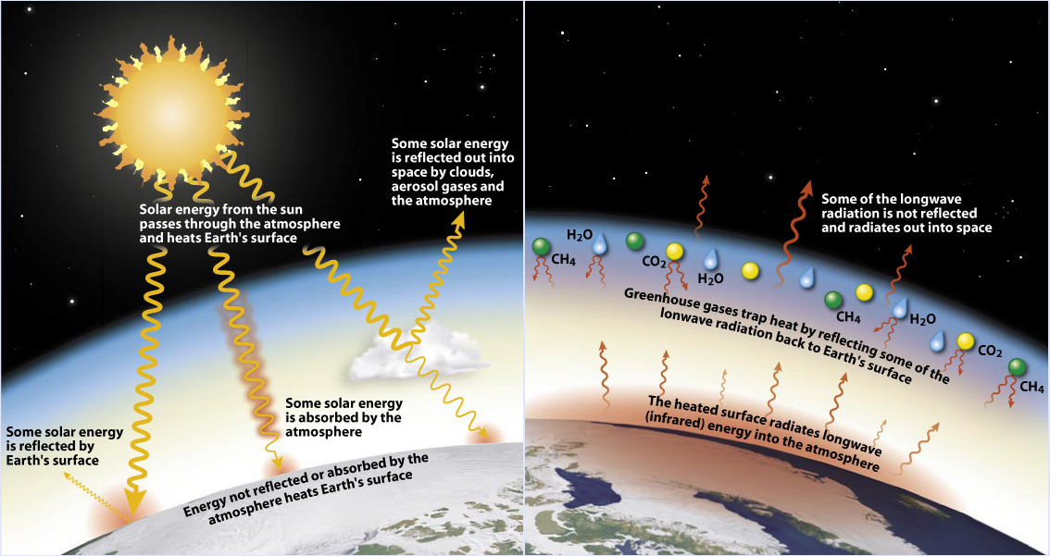
A REVIEW ON PUBLISHED STUDIES MADE ON GLOBAL CLIMATE CHANGE
3rd International Conference on Hydrology & Meteorology
September 15-16, 2014 HICC, Hyderabad, India
A General Overview on Global Climate Change
Toprak, ZF
HOW?
BACK
CONTENTS ABSTRACT INTRO 1 2 REV 3 4 5 6 7 8 9 10 CONC&DISC THANKS

Slide 44




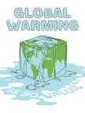


HOW MUCH?
3rd International Conference on Hydrology & Meteorology
September 15-16, 2014 HICC, Hyderabad, India
A General Overview on Global Climate Change
Toprak, ZF
CONTENTS ABSTRACT INTRO 1 2 REV 3 4 5 6 7 8 9 10 CONC&DISC THANKS

Slide 45


A REVIEW ON PUBLISHED STUDIES MADE ON GLOBAL CLIMATE CHANGE
3rd International Conference on Hydrology & Meteorology
September 15-16, 2014 HICC, Hyderabad, India
A General Overview on Global Climate Change
Toprak, ZF
Approaches on Believing in GCC
According to most researches “the earth has a fever”. Among all the publications about 90% of the scientific articles put forward evidences on the existence of the global warming or global climate change (Toprak et al. 2013).
CONTENTS ABSTRACT INTRO 1 2 REV 3 4 5 6 7 8 9 10 CONC&DISC THANKS

Slide 46
A REVIEW ON PUBLISHED STUDIES MADE ON GLOBAL CLIMATE CHANGE
3rd International Conference on Hydrology & Meteorology
September 15-16, 2014 HICC, Hyderabad, India
A General Overview on Global Climate Change
Toprak, ZF
Approaches on Believing in GCC
On the other hand, “why”, “how”, and “how much” questions are among the second set of questions. Almost all scientists believe that the problem is present, but there is not a clear or strong agreement on the sizes, depths, dimensions and the effects as well as the reasons of the existing global problem says Toprak et al. (2013).
CONTENTS ABSTRACT INTRO 1 2 REV 3 4 5 6 7 8 9 10 CONC&DISC THANKS

Slide 47
A REVIEW ON PUBLISHED STUDIES MADE ON GLOBAL CLIMATE CHANGE
3rd International Conference on Hydrology & Meteorology
September 15-16, 2014 HICC, Hyderabad, India
A General Overview on Global Climate Change
Toprak, ZF
Approaches on Believing in GCC
Therefore the published works or the researchers first should be classified into three groups:
CONTENTS ABSTRACT INTRO 1 2 REV 3 4 5 6 7 8 9 10 CONC&DISC THANKS

Slide 48
A REVIEW ON PUBLISHED STUDIES MADE ON GLOBAL CLIMATE CHANGE
3rd International Conference on Hydrology & Meteorology
September 15-16, 2014 HICC, Hyderabad, India
A General Overview on Global Climate Change
Toprak, ZF
Approaches on Believing in GCC
First group published studies or researchers put forward evidences on the existence of the global warming or global climate change.
CONTENTS ABSTRACT INTRO 1 2 REV 3 4 5 6 7 8 9 10 CONC&DISC THANKS

Slide 49
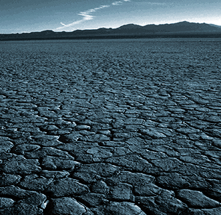
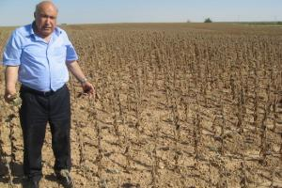
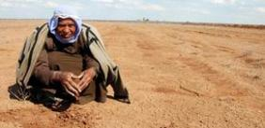
A REVIEW ON PUBLISHED STUDIES MADE ON GLOBAL CLIMATE CHANGE
3rd International Conference on Hydrology & Meteorology
September 15-16, 2014 HICC, Hyderabad, India
A General Overview on Global Climate Change
Toprak, ZF
Approaches on Believing in GCC
These researchers believe that the problem is big just as it is reflected today.
WE LIVE IT
CONTENTS ABSTRACT INTRO 1 2 REV 3 4 5 6 7 8 9 10 CONC&DISC THANKS

Slide 50
A REVIEW ON PUBLISHED STUDIES MADE ON GLOBAL CLIMATE CHANGE
3rd International Conference on Hydrology & Meteorology
September 15-16, 2014 HICC, Hyderabad, India
A General Overview on Global Climate Change
Toprak, ZF
Approaches on Believing in GCC
Second group researchers or published works believe that the problem exists, however they have several doubts in its results and reasons.
CONTENTS ABSTRACT INTRO 1 2 REV 3 4 5 6 7 8 9 10 CONC&DISC THANKS

Slide 51
A REVIEW ON PUBLISHED STUDIES MADE ON GLOBAL CLIMATE CHANGE
3rd International Conference on Hydrology & Meteorology
September 15-16, 2014 HICC, Hyderabad, India
A General Overview on Global Climate Change
Toprak, ZF
Approaches on Believing in GCC
The third group researchers or published works have doubts in existence of the problem.
CONTENTS ABSTRACT INTRO 1 2 REV 3 4 5 6 7 8 9 10 CONC&DISC THANKS

Slide 52
A REVIEW ON PUBLISHED STUDIES MADE ON GLOBAL CLIMATE CHANGE
3rd International Conference on Hydrology & Meteorology
September 15-16, 2014 HICC, Hyderabad, India
A General Overview on Global Climate Change
Toprak, ZF
Approaches on Believing in GCC
Kickert and Krupa (1990), Kondratyev (1991), Schwartz (1992), Fields et al. (1993), şen (2009), Toprak et al. (2009), Buyukyildiz et al. (2010), Culley (2010), Davis et al. (2010), Ekholm et al. (2010), Falk (2010), Kreuzwieser and Gessler (2010), Maynard et al. (2010), Schreurs (2010), Thompson (2010), Şen et al. (2011), Toprak et al. (2011), Toprak et al. (2013), Batan and Toprak (2014), Batan (2014), and many others can be accounted among the publications put forwards evidences on existence of the GCC which can be mentioned in the first group.
CONTENTS ABSTRACT INTRO 1 2 REV 3 4 5 6 7 8 9 10 CONC&DISC THANKS

Slide 53
A REVIEW ON PUBLISHED STUDIES MADE ON GLOBAL CLIMATE CHANGE
3rd International Conference on Hydrology & Meteorology
September 15-16, 2014 HICC, Hyderabad, India
A General Overview on Global Climate Change
Toprak, ZF
Approaches on Believing in GCC
Accordingly, the Kyoto Protocol and IPCC establishment in 1992 can be mentioned among the outcomes of such a belief.
CONTENTS ABSTRACT INTRO 1 2 REV 3 4 5 6 7 8 9 10 CONC&DISC THANKS

Slide 54
A REVIEW ON PUBLISHED STUDIES MADE ON GLOBAL CLIMATE CHANGE
3rd International Conference on Hydrology & Meteorology
September 15-16, 2014 HICC, Hyderabad, India
A General Overview on Global Climate Change
Toprak, ZF
Approaches on Believing in GCC
In the second group, Kempton (1991), Hammerle et al. (1991), Horness (1991), Feldman (1991), Jutro (1991), Runge (1992), Jamieson (1992), and Read et al. (1994) Beckerman and Malkin (1994), Krupa (1997), Karl and Trenberth (2003), Lukac et al. (2010), Kreuzwieser and Gessler (2010), Boretti and Watson Thomas (2011), and Budzianowski (2011) can be mentioned.
CONTENTS ABSTRACT INTRO 1 2 REV 3 4 5 6 7 8 9 10 CONC&DISC THANKS

Slide 55
A REVIEW ON PUBLISHED STUDIES MADE ON GLOBAL CLIMATE CHANGE
3rd International Conference on Hydrology & Meteorology
September 15-16, 2014 HICC, Hyderabad, India
A General Overview on Global Climate Change
Toprak, ZF
Approaches on Believing in GCC
A few researchers have doubts on the existence of the problem. Çelik (2011) mentioned such ideas this group (for detail please see the given referee).
CONTENTS ABSTRACT INTRO 1 2 REV 3 4 5 6 7 8 9 10 CONC&DISC THANKS

Slide 56
A REVIEW ON PUBLISHED STUDIES MADE ON GLOBAL CLIMATE CHANGE
3rd International Conference on Hydrology & Meteorology
September 15-16, 2014 HICC, Hyderabad, India
A General Overview on Global Climate Change
Toprak, ZF
Approaches on Believing in GCC
It is now possible to say that humans live global climate change and environment and the globe warms up. However, there is not any consensus on its reasons, sizes, and effects.
CONTENTS ABSTRACT INTRO 1 2 REV 3 4 5 6 7 8 9 10 CONC&DISC THANKS

Slide 57
A REVIEW ON PUBLISHED STUDIES MADE ON GLOBAL CLIMATE CHANGE
3rd International Conference on Hydrology & Meteorology
September 15-16, 2014 HICC, Hyderabad, India
A General Overview on Global Climate Change
Toprak, ZF
Approaches on Believing in GCC
Here in there is no need to discuss the approaches of first group researchers have not any doubts on the issue, because the majority of scientists are in this group and their opinion is well known.
CONTENTS ABSTRACT INTRO 1 2 REV 3 4 5 6 7 8 9 10 CONC&DISC THANKS

Slide 58
A REVIEW ON PUBLISHED STUDIES MADE ON GLOBAL CLIMATE CHANGE
3rd International Conference on Hydrology & Meteorology
September 15-16, 2014 HICC, Hyderabad, India
A General Overview on Global Climate Change
Toprak, ZF
Approaches on Believing in GCC
On the other hand, due to the fact that there are numerous studies in the literature, it is almost impossible to mention such researchers one by one.
CONTENTS ABSTRACT INTRO 1 2 REV 3 4 5 6 7 8 9 10 CONC&DISC THANKS

Slide 59
A REVIEW ON PUBLISHED STUDIES MADE ON GLOBAL CLIMATE CHANGE
3rd International Conference on Hydrology & Meteorology
September 15-16, 2014 HICC, Hyderabad, India
A General Overview on Global Climate Change
Toprak, ZF
Approaches on Believing in GCC
However, it is necessary to give place to the second group researchers have doubts on the issue, because they are in minority and they are not well known.
CONTENTS ABSTRACT INTRO 1 2 REV 3 4 5 6 7 8 9 10 CONC&DISC THANKS

Slide 60
A REVIEW ON PUBLISHED STUDIES MADE ON GLOBAL CLIMATE CHANGE
3rd International Conference on Hydrology & Meteorology
September 15-16, 2014 HICC, Hyderabad, India
A General Overview on Global Climate Change
Toprak, ZF
Approaches on Believing in GCC
Hammerle et al. (1991) indicates that currently there is very limited evidence that man's activity has caused global warming. Additionally, the authors says that mathematical models of the earth's heat balance predict warming and associated climate changes, but their predictions have not been validated with actual data.
CONTENTS ABSTRACT INTRO 1 2 REV 3 4 5 6 7 8 9 10 CONC&DISC THANKS

Slide 61
A REVIEW ON PUBLISHED STUDIES MADE ON GLOBAL CLIMATE CHANGE
3rd International Conference on Hydrology & Meteorology
September 15-16, 2014 HICC, Hyderabad, India
A General Overview on Global Climate Change
Toprak, ZF
Approaches on Believing in GCC
Jutro (1991) says that human activities are currently responsible for a species loss rate that is the most extreme in millions of years, and an alarmingly increasing rate of transformation and fragmentation of natural landscapes as suggested.
CONTENTS ABSTRACT INTRO 1 2 REV 3 4 5 6 7 8 9 10 CONC&DISC THANKS

Slide 62
A REVIEW ON PUBLISHED STUDIES MADE ON GLOBAL CLIMATE CHANGE
3rd International Conference on Hydrology & Meteorology
September 15-16, 2014 HICC, Hyderabad, India
A General Overview on Global Climate Change
Toprak, ZF
Approaches on Believing in GCC
Jamieson (1992) claims that the expected results of the global climate change are not scientific, but they are ethic and politic.
CONTENTS ABSTRACT INTRO 1 2 REV 3 4 5 6 7 8 9 10 CONC&DISC THANKS

Slide 63
A REVIEW ON PUBLISHED STUDIES MADE ON GLOBAL CLIMATE CHANGE
3rd International Conference on Hydrology & Meteorology
September 15-16, 2014 HICC, Hyderabad, India
A General Overview on Global Climate Change
Toprak, ZF
Approaches on Believing in GCC
Beckerman and Malkin (1994) indicate that IPCC reports have not been interrogated sufficiently, the reports represent several intellectual’s idea, the media effects the civil society organizations and governments; the reality is not as terrible as exaggerated.
CONTENTS ABSTRACT INTRO 1 2 REV 3 4 5 6 7 8 9 10 CONC&DISC THANKS

Slide 64
A REVIEW ON PUBLISHED STUDIES MADE ON GLOBAL CLIMATE CHANGE
3rd International Conference on Hydrology & Meteorology
September 15-16, 2014 HICC, Hyderabad, India
A General Overview on Global Climate Change
Toprak, ZF
Approaches on Believing in GCC
Krupa (1997) indicates that our knowledge of global climate change has many uncertainties.
CONTENTS ABSTRACT INTRO 1 2 REV 3 4 5 6 7 8 9 10 CONC&DISC THANKS

Slide 65
A REVIEW ON PUBLISHED STUDIES MADE ON GLOBAL CLIMATE CHANGE
3rd International Conference on Hydrology & Meteorology
September 15-16, 2014 HICC, Hyderabad, India
A General Overview on Global Climate Change
Toprak, ZF
Approaches on Believing in GCC
Boretti and Watson Thomas (2011) says that the individual analysis of the raw temperature data from different measuring stations clearly shows that there is no warming globally occurring, with warming being conversely very well localized in time and space.
CONTENTS ABSTRACT INTRO 1 2 REV 3 4 5 6 7 8 9 10 CONC&DISC THANKS

Slide 66
A REVIEW ON PUBLISHED STUDIES MADE ON GLOBAL CLIMATE CHANGE
3rd International Conference on Hydrology & Meteorology
September 15-16, 2014 HICC, Hyderabad, India
A General Overview on Global Climate Change
Toprak, ZF
Approaches on Believing in GCC
Budzianowski (2011) concludes his/her work with an interesting statement: The effect of GHGs warms climate and simultaneously suspends the glaciation/glaciation cycles that periodically occurred in the past.
CONTENTS ABSTRACT INTRO 1 2 REV 3 4 5 6 7 8 9 10 CONC&DISC THANKS

Slide 67
A REVIEW ON PUBLISHED STUDIES MADE ON GLOBAL CLIMATE CHANGE
3rd International Conference on Hydrology & Meteorology
September 15-16, 2014 HICC, Hyderabad, India
A General Overview on Global Climate Change
Toprak, ZF
Approaches on Believing in GCC
On the other hand, it can be easily understood that the other guess reasons of global warming can be accounted by El Nino, climatic period, astronomic processes, volcanoes, and natural and man-made greenhouse effect.
CONTENTS ABSTRACT INTRO 1 2 REV 3 4 5 6 7 8 9 10 CONC&DISC THANKS

Slide 68
A REVIEW ON PUBLISHED STUDIES MADE ON GLOBAL CLIMATE CHANGE
3rd International Conference on Hydrology & Meteorology
September 15-16, 2014 HICC, Hyderabad, India
A General Overview on Global Climate Change
Toprak, ZF
Approaches on Believing in GCC
It should be noted herein that Kempton (1991), Hammerle et al. (1991), Horness (1991), Feldman (1991), Jutro (1991), Runge (1992), Jamieson (1992), and Read et al. (1994), Beckerman and Malkin (1994), and Krupa (1997) were published at the beginning of the understanding the problem, so they should be more interrogated.
CONTENTS ABSTRACT INTRO 1 2 REV 3 4 5 6 7 8 9 10 CONC&DISC THANKS

Slide 69
A REVIEW ON PUBLISHED STUDIES MADE ON GLOBAL CLIMATE CHANGE
3rd International Conference on Hydrology & Meteorology
September 15-16, 2014 HICC, Hyderabad, India
A General Overview on Global Climate Change
Toprak, ZF
Approaches on Problem Solution
It is possible to say that there is a global (intergovernmental) agreement on solving the problem on the basis of IPCC recommendations.
CONTENTS ABSTRACT INTRO 1 2 REV 3 4 5 6 7 8 9 10 CONC&DISC THANKS

Slide 70
A REVIEW ON PUBLISHED STUDIES MADE ON GLOBAL CLIMATE CHANGE
3rd International Conference on Hydrology & Meteorology
September 15-16, 2014 HICC, Hyderabad, India
A General Overview on Global Climate Change
Toprak, ZF
Approaches on Problem Solution
For instance, Kyoto Protocol is generated after the Third Assessment Report (TAR) of IPCC. As of October 2010, 191 states and one supranational union (the EU) have signed and ratified the Kyoto Protocol to the United Nations Framework Convention on Climate Change, which aims at combating global warming collectively.
CONTENTS ABSTRACT INTRO 1 2 REV 3 4 5 6 7 8 9 10 CONC&DISC THANKS

Slide 71
A REVIEW ON PUBLISHED STUDIES MADE ON GLOBAL CLIMATE CHANGE
3rd International Conference on Hydrology & Meteorology
September 15-16, 2014 HICC, Hyderabad, India
A General Overview on Global Climate Change
Toprak, ZF
Approaches on Problem Solution
As previously stated that although it is possible to say that humans live global climate change environment and the globe warms up, however, there is not any consensus on its reasons, sizes, and effects.
CONTENTS ABSTRACT INTRO 1 2 REV 3 4 5 6 7 8 9 10 CONC&DISC THANKS

Slide 72
A REVIEW ON PUBLISHED STUDIES MADE ON GLOBAL CLIMATE CHANGE
3rd International Conference on Hydrology & Meteorology
September 15-16, 2014 HICC, Hyderabad, India
A General Overview on Global Climate Change
Toprak, ZF
Approaches on Problem Solution
Concerning these points the related approaches on the problem solution can be classified into two categories as follows:
CONTENTS ABSTRACT INTRO 1 2 REV 3 4 5 6 7 8 9 10 CONC&DISC THANKS

Slide 73
A REVIEW ON PUBLISHED STUDIES MADE ON GLOBAL CLIMATE CHANGE
3rd International Conference on Hydrology & Meteorology
September 15-16, 2014 HICC, Hyderabad, India
A General Overview on Global Climate Change
Toprak, ZF
Approaches on Problem Solution
1) Reduction in the greenhouse gases (this is an approach of the Kyoto Protocol seems to be a reason of the believing in human activities that affect the global climate change as reported by IPCC).
2) Adaptation to the Blue Planet’s new conditions (this approach seems to be a reason of the believing in natural events (phenomenon) that affect the global climate change).
In 2007 IPCC report, it is indicated that man's activity has caused 98% of global warming.
CONTENTS ABSTRACT INTRO 1 2 REV 3 4 5 6 7 8 9 10 CONC&DISC THANKS

Slide 74
A REVIEW ON PUBLISHED STUDIES MADE ON GLOBAL CLIMATE CHANGE
3rd International Conference on Hydrology & Meteorology
September 15-16, 2014 HICC, Hyderabad, India
A General Overview on Global Climate Change
Toprak, ZF
Approaches on Problem Solution
However, as mentioned previously, the scientists are not sure that man's activity has caused global warming with such high percentage.
CONTENTS ABSTRACT INTRO 1 2 REV 3 4 5 6 7 8 9 10 CONC&DISC THANKS

Slide 75
A REVIEW ON PUBLISHED STUDIES MADE ON GLOBAL CLIMATE CHANGE
3rd International Conference on Hydrology & Meteorology
September 15-16, 2014 HICC, Hyderabad, India
A General Overview on Global Climate Change
Toprak, ZF
Approaches on Problem Solution
Kyoto Protocol seems to be a reason of the believing in the human activities that affect the global warming or global climate change. However, it should be noted that behind all global or regional reliable problems, it is possible to see one or more global or regional self-seekers, who exaggerate the problems bigger than usual, more effectible, and more dangerous.
CONTENTS ABSTRACT INTRO 1 2 REV 3 4 5 6 7 8 9 10 CONC&DISC THANKS

Slide 76
A REVIEW ON PUBLISHED STUDIES MADE ON GLOBAL CLIMATE CHANGE
3rd International Conference on Hydrology & Meteorology
September 15-16, 2014 HICC, Hyderabad, India
A General Overview on Global Climate Change
Toprak, ZF
Approaches on Problem Solution
Scientists should present a systematic effort, to build a bridge between science and policy as well as among different sectors (i.e. civil society organizations, governments, politicians, and people) in global or regional climate change.
CONTENTS ABSTRACT INTRO 1 2 REV 3 4 5 6 7 8 9 10 CONC&DISC THANKS

Slide 77
A REVIEW ON PUBLISHED STUDIES MADE ON GLOBAL CLIMATE CHANGE
3rd International Conference on Hydrology & Meteorology
September 15-16, 2014 HICC, Hyderabad, India
A General Overview on Global Climate Change
Toprak, ZF
Classification of the Published Works
Climate Change and Environment
Kickert and Krupa (1990), Schwartz (1992), Fields et al. (1993), Davis et al. (2010), Culley and Angelique (2010), Şen et al. (2011), Grasso et al. (2011), Buyukyildiz, Marti, and Yilmaz (2009), Toprak et al. (2013), Toprak et al. 2014 and many other are the works published on the impacts of the GCC on the environment.
CONTENTS ABSTRACT INTRO 1 2 REV 3 4 5 6 7 8 9 10 CONC&DISC THANKS

Slide 78
A REVIEW ON PUBLISHED STUDIES MADE ON GLOBAL CLIMATE CHANGE
3rd International Conference on Hydrology & Meteorology
September 15-16, 2014 HICC, Hyderabad, India
A General Overview on Global Climate Change
Toprak, ZF
Classification of the Published Works
Climate Change and Environment
According to the above mentioned published works it can be say that the climate change can be accepted among the greatest environmental problems from the increasing energy consumption, urbanization, and deforestation events threatening the healthy life of people and environment.
CONTENTS ABSTRACT INTRO 1 2 REV 3 4 5 6 7 8 9 10 CONC&DISC THANKS

Slide 79
A REVIEW ON PUBLISHED STUDIES MADE ON GLOBAL CLIMATE CHANGE
3rd International Conference on Hydrology & Meteorology
September 15-16, 2014 HICC, Hyderabad, India
A General Overview on Global Climate Change
Toprak, ZF
Classification of the Published Works
Climate Change and Glaciers
Mendelssohn and Dinar (2009), Buyukyildiz et al. (2009), Thompson (2010), Şen et al. (2011), Toprak et al. (2013), Toprak et al. 2014 are a few of numerous published works made on the relationship between climate change and glaciers as well as climate change and snow melts.
CONTENTS ABSTRACT INTRO 1 2 REV 3 4 5 6 7 8 9 10 CONC&DISC THANKS

Slide 80
A REVIEW ON PUBLISHED STUDIES MADE ON GLOBAL CLIMATE CHANGE
3rd International Conference on Hydrology & Meteorology
September 15-16, 2014 HICC, Hyderabad, India
A General Overview on Global Climate Change
Toprak, ZF
Classification of the Published Works
Climate Change and Regions
Schreurs (2010), Brunettia et al. (2003), Chen et al. (2003), López-Moreno and García-Ruiz (2008), Schönfelda and de Abreu (2003), Gosselin and Mareschal (2003), Sertel et al. (2011), Al-Nuaimi and Nagelkerke (2011) and Şen et al. (2011) are the valuable works on the regional impacts of climate change.
CONTENTS ABSTRACT INTRO 1 2 REV 3 4 5 6 7 8 9 10 CONC&DISC THANKS

Slide 81
A REVIEW ON PUBLISHED STUDIES MADE ON GLOBAL CLIMATE CHANGE
3rd International Conference on Hydrology & Meteorology
September 15-16, 2014 HICC, Hyderabad, India
A General Overview on Global Climate Change
Toprak, ZF
Classification of the Published Works
Climate Change and Modeling
There are numerous published works or reports to model regionally or globally changes in climate in the current literature. Şen (2009), Giannakopoulos et al. (2009), SAR, TAR and other IPCC reports, Toprak et al. (2009), Milanovich et al. (2010), and Toprak et al. (2013) are a few of such works.
CONTENTS ABSTRACT INTRO 1 2 REV 3 4 5 6 7 8 9 10 CONC&DISC THANKS

Slide 82
A REVIEW ON PUBLISHED STUDIES MADE ON GLOBAL CLIMATE CHANGE
3rd International Conference on Hydrology & Meteorology
September 15-16, 2014 HICC, Hyderabad, India
A General Overview on Global Climate Change
Toprak, ZF
Classification of the Published Works
Climate Change and Climate Identity
In order to determine and follow the existence and the local impacts of global climate changes for any country or region, reliable data in a comparative, illustrative, and visual format are essential preliminary requirements. It will be more appropriate to use internationally common format in the meteorological observations and measurements records.
CONTENTS ABSTRACT INTRO 1 2 REV 3 4 5 6 7 8 9 10 CONC&DISC THANKS

Slide 83
A REVIEW ON PUBLISHED STUDIES MADE ON GLOBAL CLIMATE CHANGE
3rd International Conference on Hydrology & Meteorology
September 15-16, 2014 HICC, Hyderabad, India
A General Overview on Global Climate Change
Toprak, ZF
Classification of the Published Works
Climate Change and Climate Identity
For this aim, Toprak et al. (2011) introduced to the “climatic identity” concept and the concept was detailed in Toprak et al. (2013). In the Toprak et al. (2013) “Climatic Identity” is defined as “the distinction of a region from any other based on the climatic properties at a certain time or duration (period, cycle)”.
CONTENTS ABSTRACT INTRO 1 2 REV 3 4 5 6 7 8 9 10 CONC&DISC THANKS

Slide 84
A REVIEW ON PUBLISHED STUDIES MADE ON GLOBAL CLIMATE CHANGE
3rd International Conference on Hydrology & Meteorology
September 15-16, 2014 HICC, Hyderabad, India
A General Overview on Global Climate Change
Toprak, ZF
Classification of the Published Works
Climate Change and Climate Identity
“Climatic Identity” has been defined concerning which information should be reported in the commonly formatted records for further discussion and data base preparation prior to climate change modeling (Table 3).
CONTENTS ABSTRACT INTRO 1 2 REV 3 4 5 6 7 8 9 10 CONC&DISC THANKS

Slide 85
A REVIEW ON PUBLISHED STUDIES MADE ON GLOBAL CLIMATE CHANGE
3rd International Conference on Hydrology & Meteorology
September 15-16, 2014 HICC, Hyderabad, India
A General Overview on Global Climate Change
Toprak, ZF
Classification of the Published Works
Climate Change and Climate Identity
The changes in climate are expressed by the climatic parameters such as temperature, wind speed, rainfall, humidity, evaporation, snow, and snow melt etc. The climate change processes vary according to both location and the time period, which necessitates local identifications.
CONTENTS ABSTRACT INTRO 1 2 REV 3 4 5 6 7 8 9 10 CONC&DISC THANKS

Slide 86
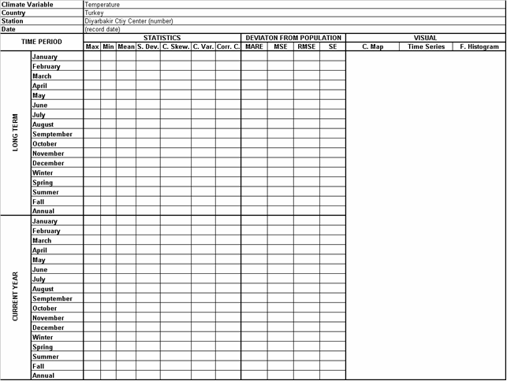
Table 3 An example for climatic identity
3rd International Conference on Hydrology & Meteorology
September 15-16, 2014 HICC, Hyderabad, India
A General Overview on Global Climate Change
Toprak, ZF
CONTENTS ABSTRACT INTRO 1 2 REV 3 4 5 6 7 8 9 10 CONC&DISC THANKS

Slide 87
CONCLUSIONS AND RECOMMENDATIONS IN 15 QUESTIONS
3rd International Conference on Hydrology & Meteorology
September 15-16, 2014 HICC, Hyderabad, India
A General Overview on Global Climate Change
Toprak, ZF
As the conclusion, it is possible to say according to most researches “the earth has a fever”. Although almost all scientists believe that the problem is present, however there is not a clear or strong agreement on the sizes, the effects as well as the reasons of the existing global problem. Therefore, “why”, “how”, and “how much” questions can be listed among unanswered questions.
CONTENTS ABSTRACT INTRO 1 2 REV 3 4 5 6 7 8 9 10 CONC&DISC THANKS

Slide 88
CONCLUSIONS AND RECOMMENDATIONS IN 15 QUESTIONS
3rd International Conference on Hydrology & Meteorology
September 15-16, 2014 HICC, Hyderabad, India
A General Overview on Global Climate Change
Toprak, ZF
Accordingly the published works or the related researchers can be classified into three groups: 1) who put forward evidences on the existence of the global warming or global climate change, 2) who believes that the problem exists, however has several doubts in its results and reasons, and 3) who has doubts in existence of the problem.
CONTENTS ABSTRACT INTRO 1 2 REV 3 4 5 6 7 8 9 10 CONC&DISC THANKS

Slide 89
CONCLUSIONS AND RECOMMENDATIONS IN 15 QUESTIONS
3rd International Conference on Hydrology & Meteorology
September 15-16, 2014 HICC, Hyderabad, India
A General Overview on Global Climate Change
Toprak, ZF
Similarly mainly two different ways for the problem solution are proposed: 1) reduction in the greenhouse gases (this is an approach of the Kyoto Protocol seems to be a reason of the believing in human activities that affect the global climate change as reported by IPCC), 2) adaptation to the Blue Planet’s new conditions (this approach seems to be a reason of the believing in natural events (phenomenon) that affect the global climate change).
CONTENTS ABSTRACT INTRO 1 2 REV 3 4 5 6 7 8 9 10 CONC&DISC THANKS

Slide 90
CONCLUSIONS AND RECOMMENDATIONS IN 15 QUESTIONS
3rd International Conference on Hydrology & Meteorology
September 15-16, 2014 HICC, Hyderabad, India
A General Overview on Global Climate Change
Toprak, ZF
On the other hand the problem should be discussed in the following 15 questions:
CONTENTS ABSTRACT INTRO 1 2 REV 3 4 5 6 7 8 9 10 CONC&DISC THANKS

Slide 91
CONCLUSIONS AND RECOMMENDATIONS IN 15 QUESTIONS
3rd International Conference on Hydrology & Meteorology
September 15-16, 2014 HICC, Hyderabad, India
A General Overview on Global Climate Change
Toprak, ZF
Was there any hole or depletion in ozone layer in the past?
If yes, who repaired it and when was it repaired?
If no, why is it not globally in people’s agenda?
Does the OLD danger for human, other living, and environment in close, medium, and long term as much as GCC?
Are the effects of the depletion in the ozone layer clearly visible in the short term?
OLD has local or global effects?
Why the scientists have given “global warming” up?
CONTENTS ABSTRACT INTRO 1 2 REV 3 4 5 6 7 8 9 10 CONC&DISC THANKS

Slide 92
CONCLUSIONS AND RECOMMENDATIONS IN 15 QUESTIONS
3rd International Conference on Hydrology & Meteorology
September 15-16, 2014 HICC, Hyderabad, India
A General Overview on Global Climate Change
Toprak, ZF
Does global warming could not be proven?
Is the "global climate change" more meaningful, accurate, and inclusive?
Is it possible to forget the "Global climate change" just as "ozone depletion"?
Is it possible to discuss later another global problem?
Why still people talk more on love, water, and cancer after 30 years?
Could not the people be convinced yet?
CONTENTS ABSTRACT INTRO 1 2 REV 3 4 5 6 7 8 9 10 CONC&DISC THANKS

Slide 93
CONCLUSIONS AND RECOMMENDATIONS IN 15 QUESTIONS
3rd International Conference on Hydrology & Meteorology
September 15-16, 2014 HICC, Hyderabad, India
A General Overview on Global Climate Change
Toprak, ZF
Is it possible to see one or more global or regional self-seekers, who exaggerate the problems bigger than usual, more effectible, and more dangerous?
Is it possible to obviate such a concern? Can the scientists do this?
CONTENTS ABSTRACT INTRO 1 2 REV 3 4 5 6 7 8 9 10 CONC&DISC THANKS

Slide 94
THANK YOU VERY MUCH
FOR
YOUR ATTENTION
3rd International Conference on Hydrology & Meteorology
September 15-16, 2014 HICC, Hyderabad, India
A General Overview on Global Climate Change
Toprak, ZF
MANY THANKS
TO
Prof. Zekai ŞEN
CONTENTS ABSTRACT INTRO 1 2 REV 3 4 5 6 7 8 9 10 CONC&DISC THANKS

