Slide 1
About Omics Group
OMICS Group International through its Open Access Initiative is committed to make genuine and reliable contributions to the scientific community. OMICS Group hosts over 400 leading-edge peer reviewed Open Access Journals and organize over 300 International Conferences annually all over the world. OMICS Publishing Group journals have over 3 million readers and the fame and success of the same can be attributed to the strong editorial board which contains over 30000 eminent personalities that ensure a rapid, quality and quick review process.

Slide 2
About Omics Group conferences
OMICS Group signed an agreement with more than 1000 International Societies to make healthcare information Open Access. OMICS Group Conferences make the perfect platform for global networking as it brings together renowned speakers and scientists across the globe to a most exciting and memorable scientific event filled with much enlightening interactive sessions, world class exhibitions and poster presentations
Omics group has organised 500 conferences, workshops and national symposium across the major cities including SanFrancisco,Omaha,Orlado,Rayleigh,SantaClara,Chicago,Philadelphia,Unitedkingdom,Baltimore,SanAntanio,Dubai,Hyderabad,Bangaluru and Mumbai.

Slide 3
September 10, 2014
Optics-2014, Philadelphia
3
The A,B,C’s
of
Mid-Infrared Quantum Well Lasers
A
C
B
Yves Rouillard, Guilhem Boissier and Grégoire Narcy
IES Laboratory
Université Montpellier 2
France

Slide 4
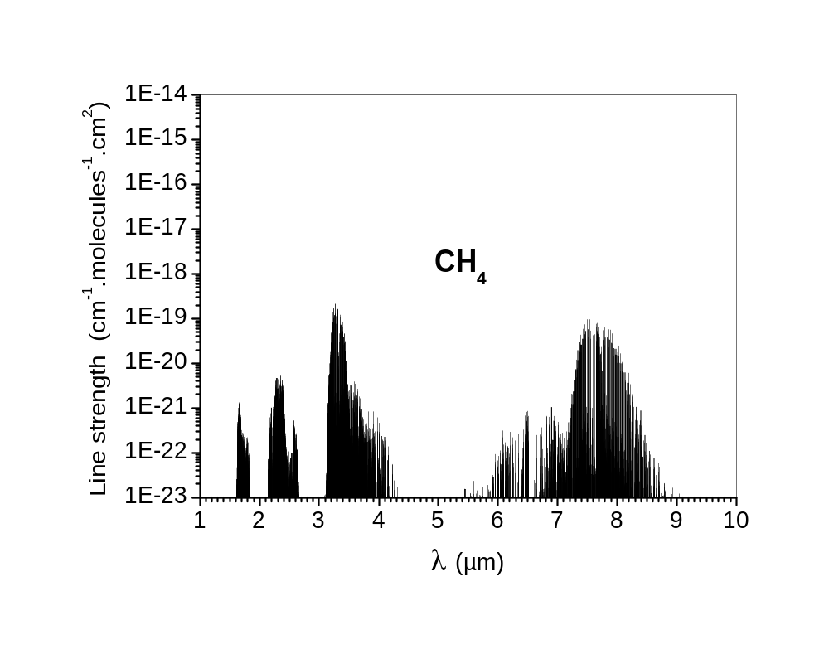
Absorption spectroscopy: The case of methane
4
1.65 µm
2.31 µm
3.31 µm
7.53 µm
Stretching
Overtone
Stretching
+ Bending
Stretching
Fundamental
Bending
Fundamental
3.31 µm (Mir Infrared):
. Fundamental vibration
. Maximum of absorption
2.31 µm:
. Linear combination of vibrations
. Absorption 40 times weaker
1.65 µm (Near Infrared):
. Overtone of 3.31 µm vibrations
. Absorption 200 times weaker
(Hitran database)

Slide 5
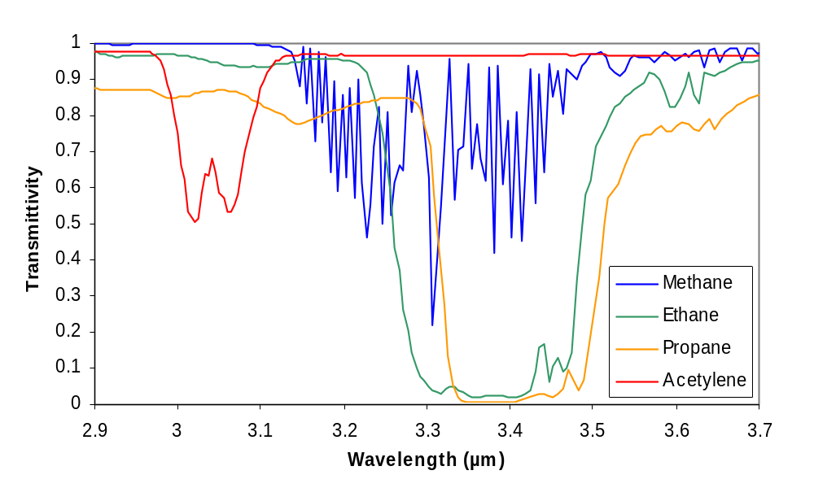
Some interesting ranges for other hydrocarbons
5
Methane:
Peak at 3.31 µm
Ethane:
Half maxima at 3.28 µm
and 3.49 µm
Propane:
Half maxima at 3.31 µm
and 3.51 µm
Acetylene:
2 peaks at 3.03 and 3.06 µm
(Chemistry WebBook, NIST)
The 3.0-3.1 µm range is interesting for Acetylene sensing
The 3.3-3.4 µm range is interesting for natural gas sensing

Slide 6
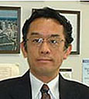
A History of GaInAsSb/AlGa(In)AsSb Laser diodes
6
1980: DH laser at 1.8 µm in pulsed mode at 20°C (NTT, S. Kobayashi)
1988: DH laser at 2.0 µm in cw mode at 20°C (Ioffe, A. Baranov)
1988: DH laser at 2.34 µm in cw mode at 20°C (Lebedev, A. Bochkarev)
2004: QW laser at 3.04 µm in cw mode at 20°C (Univ. Munich, C. Lin)
2005: QW laser at 3.26 µm in pulsed mode at 20°C (Univ. Munich, M. Grau)
2010: QW laser at 3.40 µm in cw mode at 20°C (S. Univ. New York, T. Hosoda)
Soichi Kobayashi
The history of mid-infrared laser diodes can be summarized as a race toward long wavelengths
Notes:
6

Slide 7
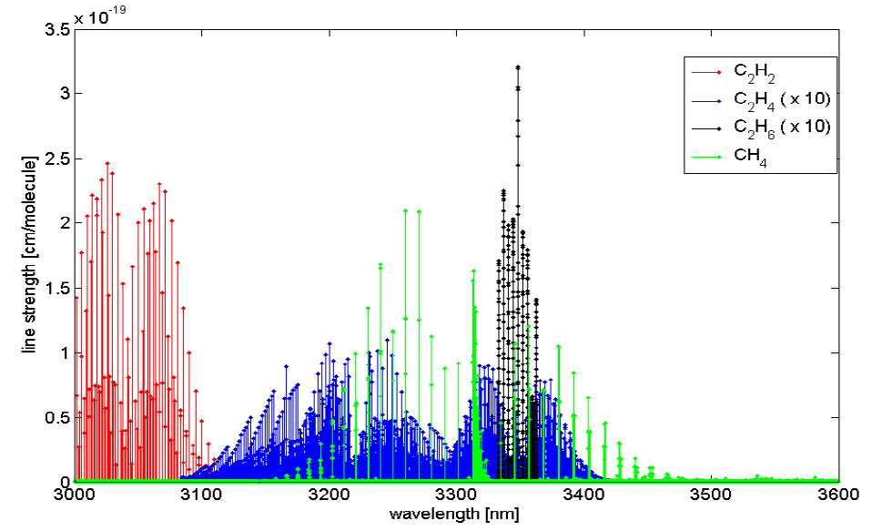
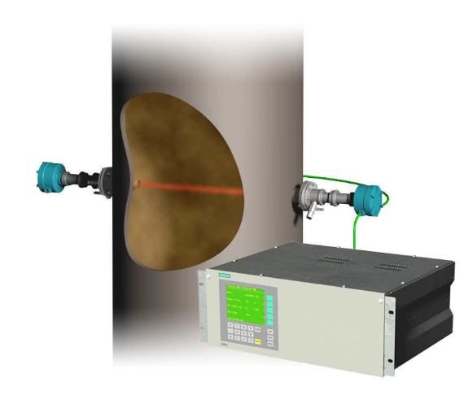
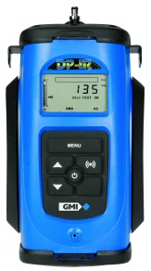
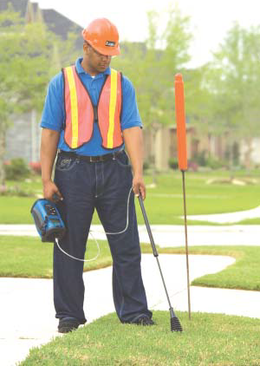
Mid Infrared lasers: Spectroscopic applications
7
QW DFB at 3.06 µm:
For measuring C₂H₂ in C₂H₄
(polyethylene plants, 40% of plastics)
S. Belahsene et al.
Phot. Tech. Lett. 22-15, 1084 (2010)
U. Montpellier + Nanoplus
Siemens Laser Analytics - LDS 6
QW DFB at 3.37 µm:
Useful for measuring CH₄ and C₂H₆
(portable detectors able to discriminate between naturally occuring methane and natural gas)
Requirement for a portable detector: P_{elec} < 1 W
With a DFB at 3.37 µm at 10°C :
P_{el}= 0.15 A x 1.6 V + 0.1 W (µ-Peltier)
= 0.34 W
L. Naehle et al.
Electron. Lett. 22, 47-1 (2011)
U. Montpellier + Nanoplus
GMI – DPIR
(device at 3.37 µm was a prototype)

Slide 8
Record Threshold Current Densities (J_{th})
8
Results by:
Turner 1998 (50 A/cm² at 2.05 µm )
Vizbaras 2011 (120 A/cm² at 2.6 µm)
Belenky 2011 (545 A/cm² at 3.3 µm)
Vizbaras 2012 (1450 A/cm² at 3.7 µm)
…and many others…
From 2.05 µm to 3.7 µm, J_{th} is multiplied by 30 !

Slide 9
Best Characteristic Temperatures (T₀)
9
At 2.3 µm, T₀ equals 95 K but plummets to 25 K at 3.3 µm !

Slide 10
Searching for the culprit in degradation of performances
10
The Auger recombination coefficient C is multiplied by 44 from 2.3 µm to 3.54 µm in bulk materials
Auger is the most likely culprit !

Slide 11
Why does Auger increase at long wavelength (small E_{g})?
11
. Auger coefficient depends on an activation energy, E_{a}:
. The activation energy E_{a} is proportional to the bangap energy E_{g}:
. In the CHCC process, E_{a} is the minimal possible kinetic energy of the hole involved in the process:
High E_{g}
Small E_{g}
Small E_{g} => Small E_{a}

Slide 12
What is the value of the activation energy ?
12
. Calculated values for lasers at 2.6 µm made from GaInAsSb:
lattice matched GaInAsSb (such as in a heterostructure laser) :
E_{g} = 0.47 eV, m_{c} = 0.025 m₀, m_{hh} = 0.270 m₀
+1.5 % strained GaInAsSb (such as in a QW laser) :
m_{hh} = 0.044 m₀
Calc. CHCC
Strain increases the activation energy and allows the operation of QW lasers in the mid-infrared
. Experimental values for QW lasers at 2.3 µm and 2.6 µm made from GaInAsSb:
D. Garbuzov et al.
Appl. Phys. Lett. 74, 2990 (1999)
CHCC is the most likely process in QW lasers
emitting in the mid-infrared

Slide 13
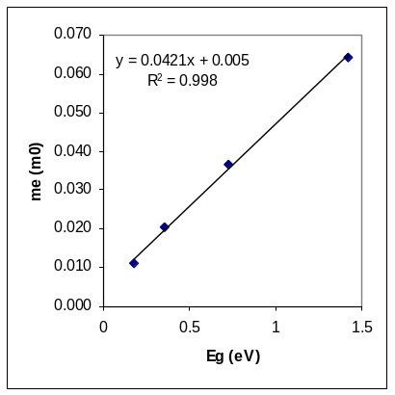
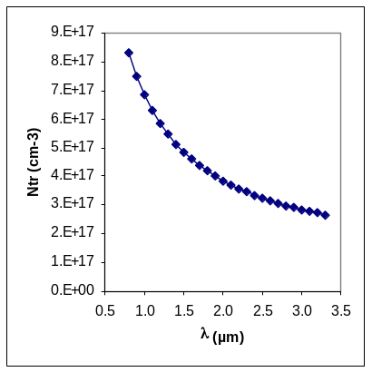
How does Auger impact the threshold current ?
13
Threshold current density:
. N_{w}: number of quantum wells (typically, 2)
. L_{w}: thickness of quantum well (≈ 10 nm)
. η_{i}: internal quantum efficiency (≈ 75 % at 2.3 µm)
. A: monomolecular recombination coefficient (≈ 1.10⁸ s⁻¹ at 2.3 µm)
. B: radiative recombination coefficient (≈ 4.10⁻¹⁰ cm³.s⁻¹ at 2.3 µm)
. C: Auger recombination coefficient (≈ 2.10⁻²⁸ cm⁶.s⁻¹ at 2.3 µm)
Threshold carrier density:
Transparency carrier density:
Effective carrier density:
. N_{tr}: transparency carrier density (≈ 3.10¹⁷ cm⁻³ at 2.3 µm)
. α_{i}: internal loss (≈ 5 cm⁻¹ at 2.3 µm)
. α_{m}: mirror loss (≈ 12 cm⁻¹ for a 1 mm-long diode)
. g_{o}: (≈ 30 cm⁻¹ )
The threshold current density depends on
10 parameters !

Slide 14
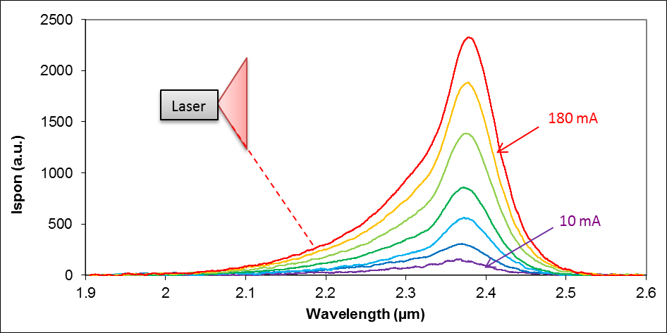
A quantity proportional to the radiative current density
14
Spontaneous emission observed from the tilted facet of a laser emitting at 2.38 µm below threshold:
Spontaneous emission rate:
Integrated spontaneous emission rate:
The integrated spontaneous emission rate
R_{spon} is proportional to J_{rad} = q N_{w} L_{w} BN² !

Slide 15
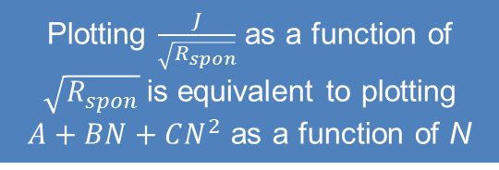
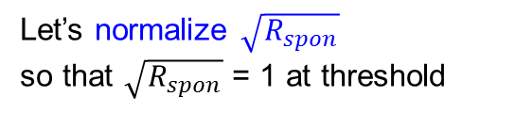
In search of the A, B, C coefficients
15
We have:
Let’s normalize$\sqrt{R_{spon}}$
sothat$\sqrt{R_{spon}}$ = 1 at threshold
Therefore:
Plotting $\frac{J}{\sqrt{R_{spon}}}$ as a function of $\sqrt{R_{spon}}$is equivalent to plotting $A+BN+CN^{2}$as a function of N
On this plot, a laser dominated by,
. monomolecular recombination
will be shown as a flat line
y = A
. radiative recombination, as a slope
y = BN
. Auger recombination, as a power
function y = CN²

Slide 16
Determining the proportion of Auger at threshold
16
There are many things to be learned from the parabolas:
. For example, the proportion of the Auger recombination current at threshold:
Lambda (µm) | Parabola (A/cm²) | Jth (A/cm²) | JAuger(A/cm²) | JRad (A/cm²) | JMono (A/cm²) | Proportion of Auger
2.38 | y = 33x² + 87x + 6 | 126 | 33 | 87 | 6 | 26%
2.83 | y = 147x² + 119x + 8 | 275 | 147 | 119 | 8 | 54%
3.23 | y = 653x² + 91x + 272 | 1017 | 653 | 91 | 272 | 64%
. And more than that, the value of the A, B & C coefficients !
J_{th} depends on 10 parameters,
Let’s use J_{tr} instead…
…because the transparency carrier density N_{tr} depends only on the electron and hole masses

Slide 17
Determining the A, B, C coefficients
17
After calculating N_{tr}, we can determine A, B, C:
Lambda (µm) | Jtr (A/cm²) | JAuger(A/cm²) | JRad (A/cm²) | JMono (A/cm²) | Ntr (cm-3) | A (s-1) | B (cm3.s-1) | C (cm6.s-1)
2.38 | 31 | 5 | 24 | 3 | 3.3E+17 | 4.5E+07 | 1.1E-09 | 6.8E-28
2.83 | 52 | 19 | 29 | 4 | 2.9E+17 | 4.7E+07 | 1.2E-09 | 2.5E-27
3.23 | 356 | 153 | 35 | 168 | 2.7E+17 | 1.4E+09 | 1.1E-09 | 1.8E-26
From 2.4 to 3.2 µm, the Auger coefficient is multiplied by 25 in QW lasers

Slide 18
Conclusion
18
We have developped a method based on
recording the spontaneous emission from the tilted facet of a laser
We determined the A, B, C coefficients of mid-infrared quantum well lasers
from our experiments:
. At 2.4 µm, the Auger coefficient C equals 6.5E-28 cm⁶.s⁻¹
. At 2.8 µm, C = 2.5E-27 cm⁶.s⁻¹
. At 3.2 µm, C = 1.8E-26 cm⁶.s⁻¹
This exponential rise explains
the increase of the threshold currents of mid-infrared quantum wells

Slide 19
Let Us Meet Again
We welcome all to our future group conferences of Omics group international
Please visit:
www.omicsgroup.com
www.Conferenceseries.com
http://optics.conferenceseries.com/

