Slide 1
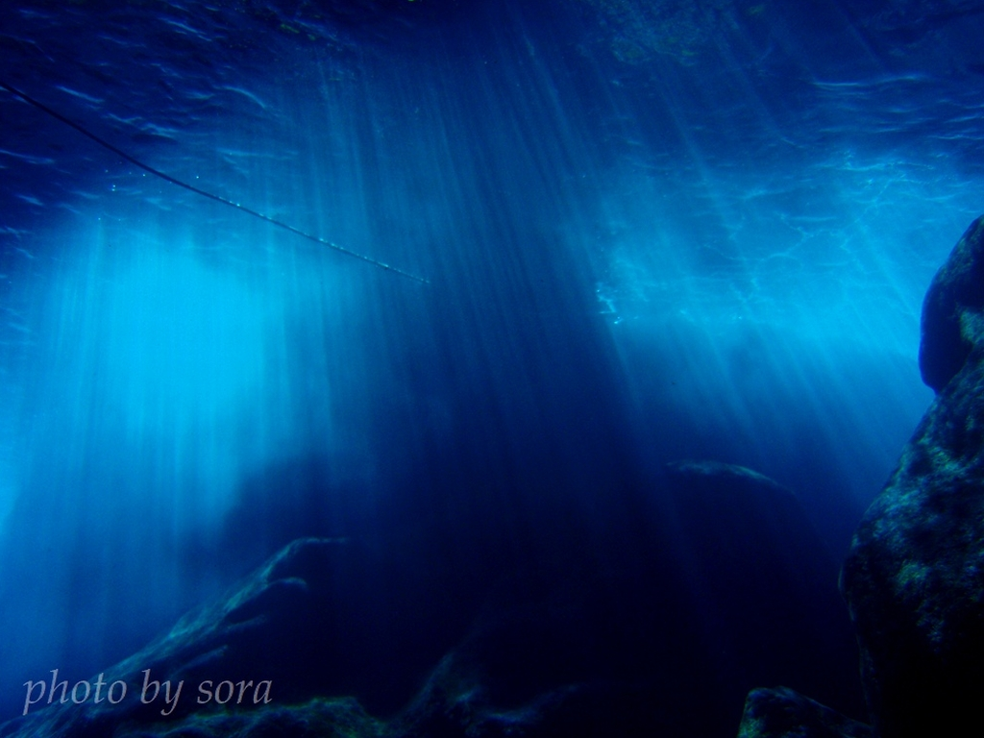

Fermentation technology to recover energy and high-value added products from seaweed
Yutaka Nakashimada
Hiroshima University
Bioprocess and Biosystems Engineering 2016
Supported by

Slide 2
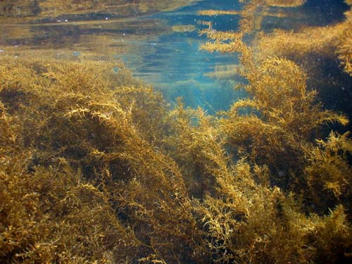



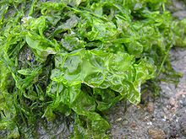

Marine biomass as energy and material feedstock
Land biomass
・Agricultural crops (1st gen.)
（Sweet potato、Cane etc.）
・Non-edible biomass (2nd gen.)
Marine Biomass (3rd gen.)
Crop straws
Forest remaining mat.
Problems for use
・Competition among food demand
・Costly pretreatment of lignocellulosic materials
Advantage of use of marine algae
・Less competition among food demand
・Huge abundance all over the world
・Easy pretreatment due to low lignin contents
Notes:
We think marine biomass is third generation as the feedstock for biomass refinery.
Use of marine biomass has several advantages compared to that of Land Biomass such as lsee competition among food demand, huge abundance all over the world and easy pretreatment due to low lignin contents.

Slide 3
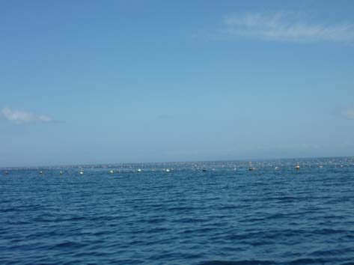

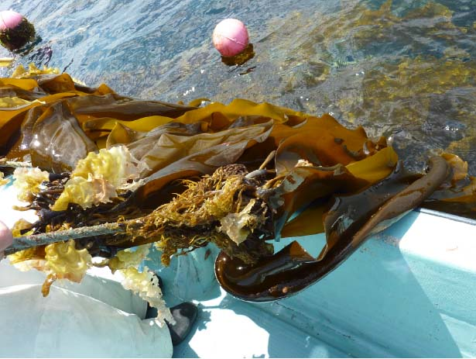
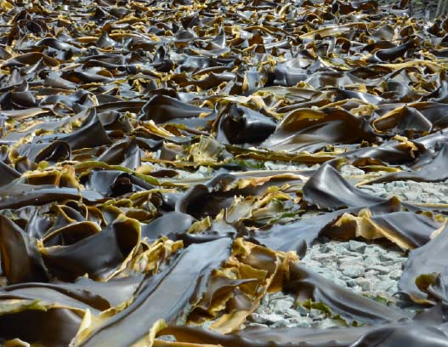
The most popular seaweed in Japan
Brown algae, Laminaria Japonica (Makonbu)
Hakodate, Hokkaido
The most harvested and cultivated site of Makkonbu in Japan
Aquafarming site of seaweed
Tokyo
Hiroshima
Cultured seaweed
Drying seaweed

Slide 4
Biomass yield of marine algae
 | Yield (t-DW/ha/yr) | Ref.
Brawn algae
Laminaria japonica | 30 | 1
Macrocystis pyrifera | 40 | 1
2nd generation of land biomass
Napiergrass | 85 | 2
Parennial ryegrass | 27 | 2
Sorgam | 47 | 2
Switchgrass | 15 | 2
1st generation of land biomass
Sugarcane | 50 | 2
1) Yokoyama et al. 2007
2) Asia biomass handbook
Notes:
Furthermore, marine biomass, especially brawn algae has the yield competitive to 1st and 2nd generation of biomass feedstocks.

Slide 5
Element composition of marine biomass with high salt content
Ex）Brawn algae (Laminaria Japonica, Makonbu)
Feedstock for methane fermentation
, and oil production?
High salt content
（ca.2〜3% in wet algae）
but contains valuable metals
Notes:
海藻は、ワカメ等の褐藻類、ノリに代表される紅藻類、アオサ等の緑藻類に大別されます。
紅藻類および、緑藻類については、すでにエネルギー開発が盛んに行われておりますが、褐藻類については、ほとんどされておりません。
その大きな理由として、海藻に特異的な多糖であるアルギン酸を分解するためには、特別な酵素であるアルギン酸リアーゼが必要であり、その酵素を持っている微生物は限られているからです。
そこで、本研究では褐藻類からの燃料生産を目的としました。
まず、褐藻類からのメタン生産技術には二段発酵法の検討を行いました。次に、エタノール生産技術開発におきましては、アルギン酸を資化し、エタノール生産可能な微生物の探索から行いました。時間の都合上、本発表ではアルギン酸資化エタノール生産菌叢の解析および単離について報告致します。

Slide 6

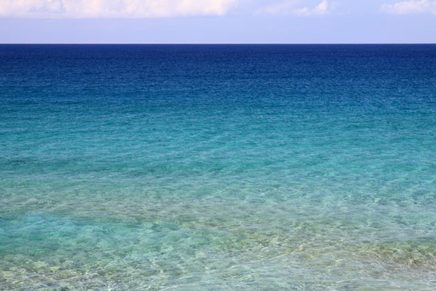
Development of key technologies for complete utilization of macro algae as energy and material resources with unique metabolism of marine microorganisms
Methane
Valuable inorganic matters
Energy
Salt-tolerant methane fermentation
Marine algae
Recovery of useful materials
with
waste treatment
Green effluent
methanogenic consortium
photosynthetic bacteria
Pretreatment of algal biomass
Marine microorganisms
Materials
Oil producing microorganisms
Valuable organic matters
Valuable oil fermentation
Characteristics of marine seaweeds
・High salinity（〜 3%）
・Particular polysaccharides
（Alginate、agalose etc.）
・Accumulation of valuable metals
Valuable organic matters
（EPA, DHA, carrotenoids）

Slide 7
Developing key fermentation technologies of seaweeds
Salt-tolerant methane fermentation by marine microorganisms
Valuable oil fermentation from specific carbohydrates of seaweed
Metal recovery and oil production from residue after fermentation of seaweed

Slide 8
Presentation
Salt-tolerant methane fermentation by marine microorganisms
Valuable oil fermentation from specific carbohydrates of seaweed
Metal recovery and Oil production from residue after fermentation of seaweed

Slide 9
Restriction of biogas production from marine seaweed
Inhibited methane formation under high salinity
☞ to overcome high salinity:
i. Dilution of feedstock with pure water.
x need large system for fermentation and wastewater treatment
ii. Acclimation of methanogenic microbial community to high salinity
x It takes long time for acclimation
ii. Use of salt tolerant microbial community in sea environments

Slide 10
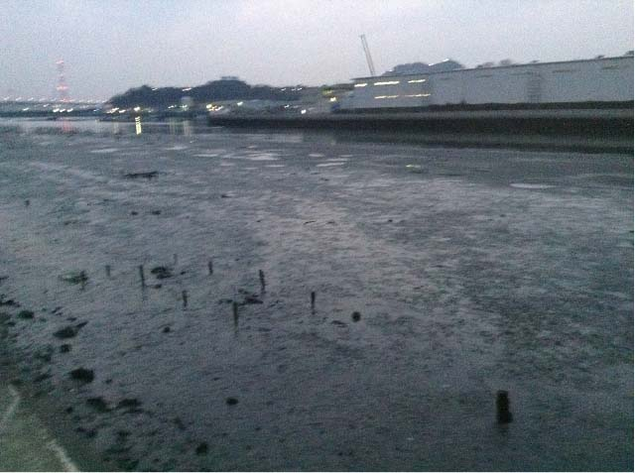
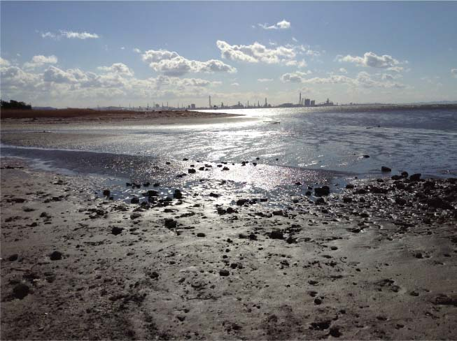
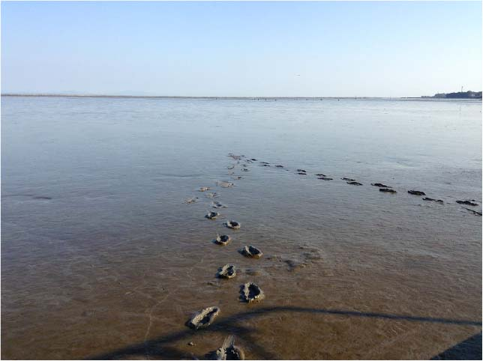
Tidal-flat as microbial resources under saline condition
3. Tidal-flat, Hiroshima Bay, Hiroshima
2. Tidal-flat, Tokyo Bay, Bhiba
1. Tidal-flat, Sea of Aliake, Saga

Slide 11
High methanogenic activity from brawn algae under salinity condition of marine microorganisms from tidal-flat in Japan
Hydrolysis/acidogenesis
Acetogenesis
Methanogenesis
H2
Seaweed
（Laminaria
Japonica）
Butyrate,
Propionate
Methane
Acetate
Microbial source | NaCl | Conversion activity (mg-COD/g-VS in sediment/d)
 |  | Hydrolysis/ acidogenesis | Acetogenesis |  | Methanogenesis
 |  |  | Propionate | Butyrate | H₂-CO₂ | Acetate
Conventional mesophilic granule | − | 1,735 | 17 | 184 | 3,250 | 54
 | + | 608 (35.0)ª | ND^{b} (0) | 27 (14.7) | 2,940 (90.5) | ND (0)
MS^{c} -1 | + | 405 | 79 | 121 | 1,170 | 48
MS-2 | + | 617 | ND | 719 | 1,130 | 45
MS-3 | + | 697 | 35 | 315 | 1,040 | 30
T. Miura, et al.; Biores. Technol. 169, 362-366 (2014)

Slide 12
Stable methane production from undiluted seaweed using the sludge acclimated from marine sediments
Semi-continuous culture
+
Undiluted
brown algae-
derived salts
Undiluted
brown
algae
Semi-continuous
operation
Fed-batch
acclimated culture
Condition 1
2.0
39
Condition 2
2.9
28
Condition 3
1.7
46
OLR (gVS/kg/day):
HRT (days):
Methane
Optimum organic loading rate
= 1.7 kg-VS/m³/d
（HRT=45d, salinity =ca. 2.0% NaCl eq.）
Acetate
Propionate
T. Miura et al., Bioresour. Technol. (2016).
Notes:
Marine macroalgae contain salts in addition to water, and salts are inhibitory to microbes involving in biomethane production.
Furthermore, for efficient methane production, organic matter content in water-containing macroalgae should be high.
So, macroalgae should be used under undiluted conditions.
So, by using fed-batch acclimated miarine sediment-derived culture, which had high activity under high salinity, we examined whether methane was produced continuously from undiluted brown algae as macroalgae.
We were able to produce methane semi-continuously from undiluted brown algae under three conditions although methane production became slightly unstable during a high organic loading rate in condition 2.
Methane was produced continuously and stably during a decreased OLR in condition 3.

Slide 13
Comparison of methane production from various species of brown algae
Substrate | OLR (g VS/L/day)ª | Methane yield (mL/g VS) | HRT (days) | Methane production rate (mL/L/day)^{b} | Ref.
Diluted conditions
Laminaria hyperborea | 1.65 | 280 | 24 | 462 | Hanssen, 1987
Laminaria saccharina | 1.65 | 230 | 24 | 380 | Hanssen, 1987
Ascophyllum nodosum | 1.75 | 110 | 24 | 193 | Hanssen, 1987
Laminaria hyperborea | 1.00 | 230 | 20 | 230 | Hinks, 2013
Undiluted conditions
Saccharina latissima | 1.73 | 238 | 38 | 412 | Jard, 2012
 | 2.17 | 137 | 33 | 297 | Jard, 2012
Saccharina japonica | 2.00 | 358 | 39 | 695 | This study
 | 2.87 | 335 | 28 | 961 | This study
 | 1.74 | 346 | 46 | 602 | This study
Methane was produced under mesophilic conditions.
^{a,b}The unit of OLR and methane production rate in this study were g VS/kg/day and mL/kg/day, respectively.
^{b}The rate was calculated by multiplying the OLR by the methane yield.
T. Miura et al., Bioresour. Technol. (2016).
Notes:
Achievable methane production rate in the stable methane production in this study, which was calculated by multiplying OLR by methane yield, was higher than any other cases containing diluted and undiluted conditions.
So, semi-continuous culture in this study can highly produce methane from undiluted brown algae.

Slide 14




Characteristics of microbial consortia developed during anaerobic digestion under high salinity (3-5% NaCl) of dried algal biomass with marine sediments
Bacteria
Archaea
Original sediment
After acclimation
Original sediment
After
acclimation
18.42% (Methanomicrobia class)
14.94% (Piscirickettsiaceae family)
Methanosarcinaspp. (11.07%)
Methanosarcinaspp. (0.16%)
Unique
Fusobacteriaceae
family
67.09%
Methanosaeta
spp. (0.25%)
Halotolerant Methanosaeta spp. (41.54%)
Methanogeniumspp. (0.2%)
Unassigned
(33.51%)
Methanogeniumspp. (20.25%)
Unassigned (4.61%)
Unassigned (4.24%)
5.93% (Methanomicrobiaceae family)
Unassigned (0.02%)
Miura et al., Biores. Technol. 187, 275 (2015)

Slide 15
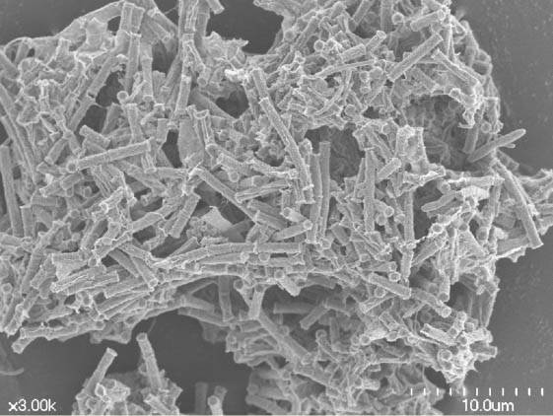
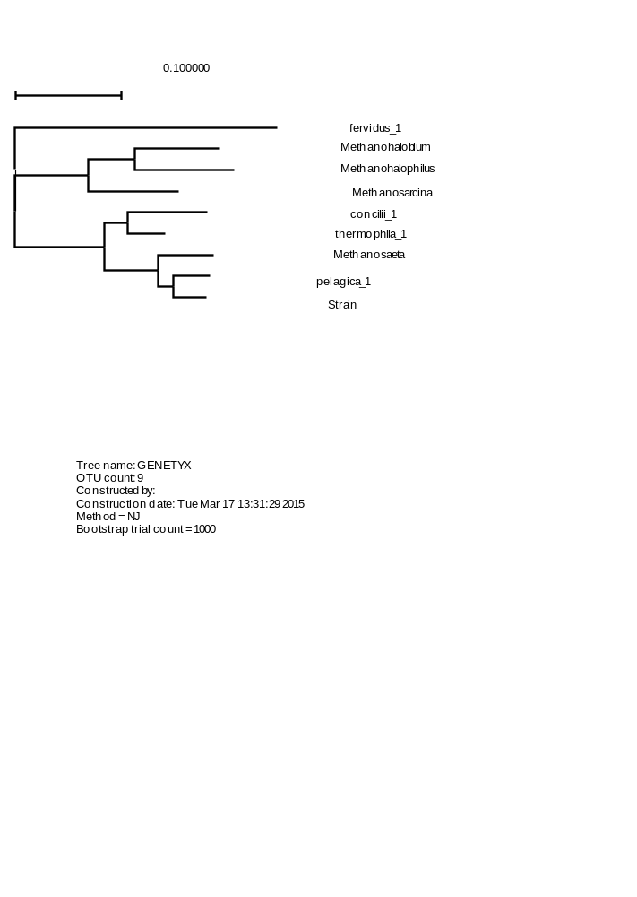
Halotolerant methanogens in marine sediments
Figure 6, Kita et al.
Halotolerant Methanosaeta H_{A}
Strain H_{A}
Conventional
M. Concilii
Phylogenetic tree of based on McrA sequences
0.1
Methanothermus fervidus (J03375)
99
Methanohalobium evestigatum (CP002069)
99
Methanohalophilus mahii (CP001994)
Methanosarcina barkeri (CP000099)
96
Methanosaeta concilii NBRC 103675^{T} (AB679170)
100
Methanosaeta thermophila PT (CP000477)
100
Methanosaeta harundinacea 6Ac (CP003117)
88
Methanosaeta pelagica 03d30q^{T}(AB679169)
Kita et al., J. Biosci. Bioeng., 121(2), 196 (2016)
Methanosaeta strain H_{A} (LC033612)

Slide 16
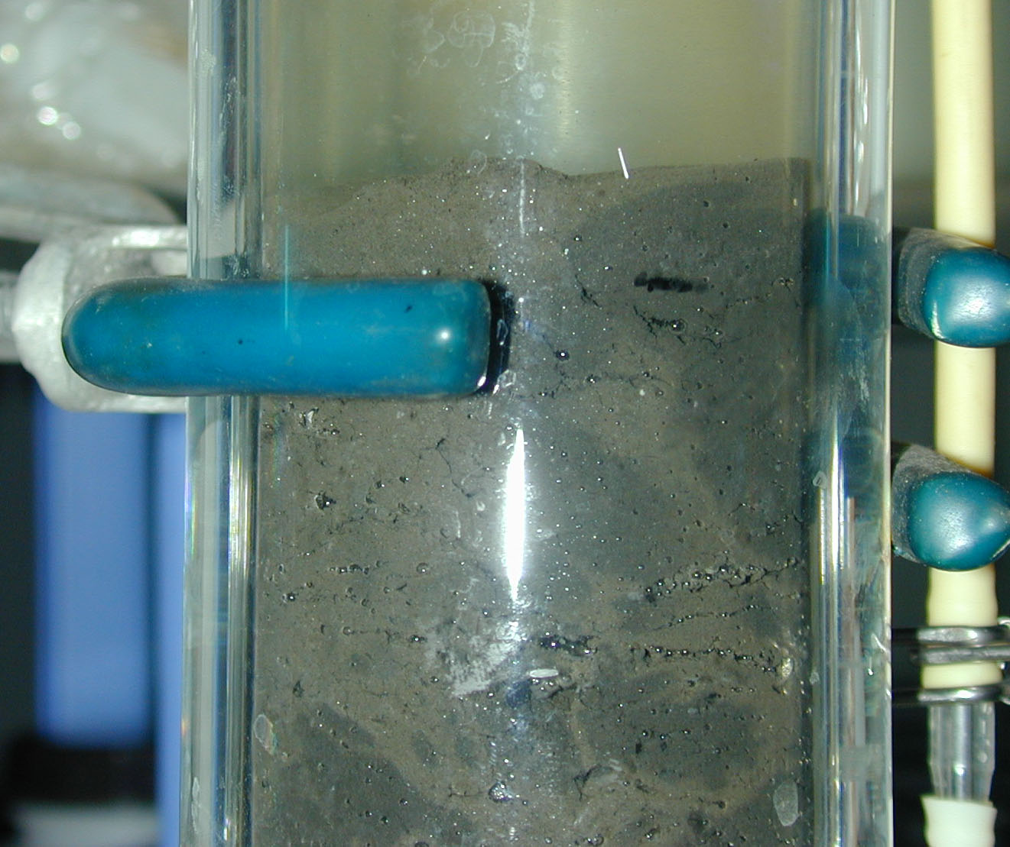
High-rate methane production from acetate by acetoclastic methanogens from marine sediments
CH₄
Eff.
Fixed bed by marine sediment
Max. methane production rate：
760mol/m³/d = 12.2 kg/m³/d = 619MJ/m³/d
=18L-oil eq./m³/d = 0.64 kg--oil eq./m³/h
Water
bath
Pump
Kita et al., J. Jpn. Petrol. Inst., 59 (1), 9-15 (2016)
Marine sediment
Resovoir
Na.Acetate 5 g/L
NaCl 30 g/L
Fixed bed-reactor

Slide 17
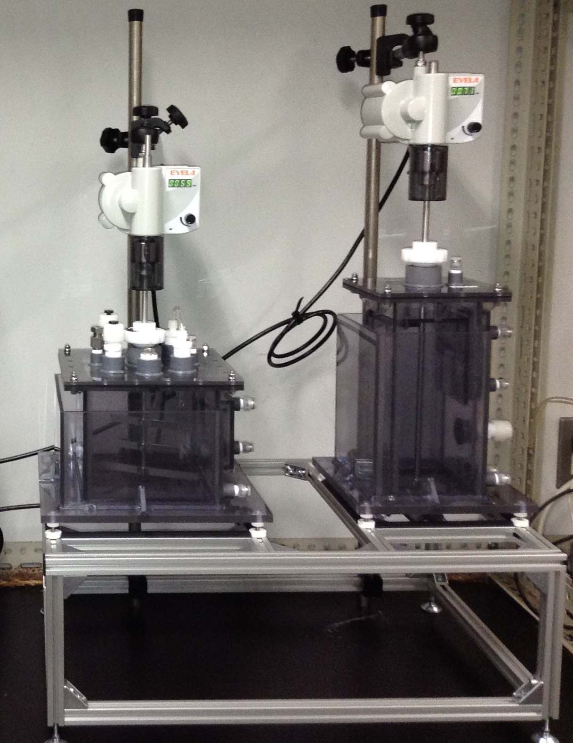
Two-stage methane fermentation process of seaweed
Methane
ca. 57 kg-dry mass/m³/d
(available VS: 80%)
ca. 44 kg-VS/m³/d
〜20 Nm³/m³/d
750 MJ/m3/d
Methanogenesis
(fixed bed)
47 kg-COD_{CH4}/m3/d
with marine sludge acclimated
Hydrolysis/
acidogenesis
47 kg-COD_{CH4}/m3/d
Seaweed
Acids
Organic
subst.

Slide 18
Developing key technologies
Salt-tolerant methane fermentation by marine microorganisms
Valuable oil fermentation from specific carbohydrates of seaweed
Metal recovery and oil production from residue after fermentation of seaweed

Slide 19
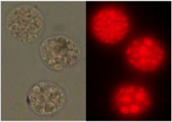
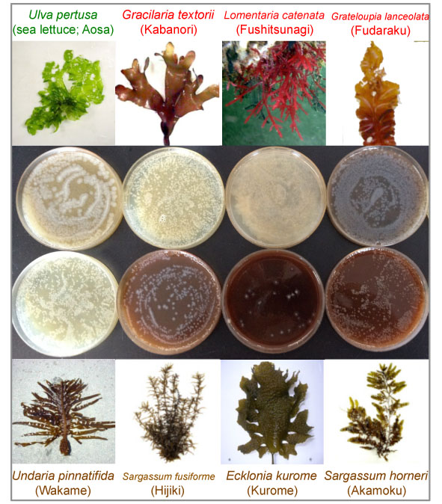

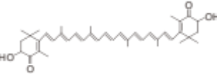
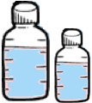

Valuable oil fermentation by from specific carbohydrates of seaweed
Valuable oil producing
Labyrinthulea
（Aurantiochytrium spp.）
Molecular breeding for enhancement of lipid production
Acetyl-CoA
palmitic acid
Eicosapentaenoic acid (EPA)
fatty acid synthesis
Docosahexaenoic acid (DHA)
Polyketide synthesis
Mevalonate
Astaxanthin
Squalene
No fermentation ability for specific carbohydrates of seaweed
Brawn algae: Mannitol, Alginate
Red algae: Agar

Slide 20
Valuable oils and carotenoids production from mannitol by two-stage fermentation of Gluconobacter and Aurantiochytrium spp.
Dried algae
Mannitol
Fructose
EPA, DHA
Astaxanthin
Squarene
Extraction by water
Salt
addition
Gluconobacter sp.
Mannitol converter
Growth
Inhibition
Salt addition
Marine Aurantiochytrium
Single reactor
K.H.V. Arafiles, et al., Appl. Microbiol. Biotechnol. 98, 9207 (2014)

Slide 21
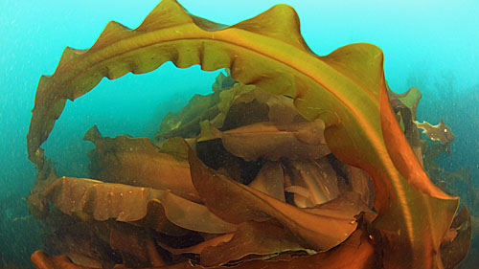
“Sugar converters” for production of value-added lipids from marine algae by Aurantiochytrium
Arafiles, Unpublished
Brown algae Laminaria japonica
Lipids
2%
Carbohydrates 52%
Proteins
15%
Ash 31%
Mannitol
30%
Alginate
25%
Cellulose
17%
Fucoidan
etc.
Laminaran
Cellulophaga
Lindra
Gluconobacter
Dysgonomonas
Gluconobacter
Production of value-added lipids from marine algae by Aurantiochytrium
Notes:
Chemical methods for the analysis of sulphated galactans from red algae
A new procedure for the separation of water-soluble polysaccharides from brown seaweeds
Zvyagintseva, Tatiana N., et al., Carbohydrate Research, 322.1, 32-39, (1999)
特定
Monthly Determination of Alginate, M/G Ratio, Mannitol, and Minerals in Cultivated Laminaria japonica
Direct fermentation of Laminaria japonica for biohydrogen production by anaerobic mixed cultures
Zvyagintseva, Tatiana N., et al., Carbohydrate Research, (1999)
Honya, Masura, et al., Bulletin-Japanese Society of Scientific Fisheries, 59, 295-295, (1993)
Shi, Xueqing, et al., international journal of hydrogen energy, 36.10, 5857-5864, (2011)

Slide 22
Valuable oil fermentation by from specific carbohydrates of seaweed
Valuable oil producing
Labyrinthulea
（Aurantiochytrium spp.）
Molecular breeding for enhancement of lipid production
Acetyl-CoA
palmitic acid
Eicosapentaenoic acid (EPA)
fatty acid synthesis
Docosahexaenoic acid (DHA)
Polyketide synthesis
Mevalonate
Astaxanthin
Squalene
fermentation of seaweed via converter microorganisms without genetic engineering for application to food industry

Slide 23
Developing key technologies
Salt-tolerant methane fermentation by marine microorganisms
Valuable oil fermentation from specific carbohydrates of seaweed
Metal recovery and oil production from residue after fermentation of seaweed

Slide 24
Metal amount absorbed on Kelp
 | (ppm)* | Ocean (ppm) | Condense (time) |  | (ppm)* | Ocean (ppm) | Condense (time)
K | 18720 | 3.90E+02 | 48 | Ni | 2.00 | 5.00E-04 | 4.00E+03
Na | 1710 | 1.08E+04 | 0.16 | B | 1.5 | 4.50E+00 | 4.00E+03
Mg | 1624 | 1.30E+03 | 1.25 | Mn | 1.1 | 3.00E-05 | 3.67E+04
Ca | 2544 | 4.10E+02 | 6.20 | Ti | 0.98 | 1.00E-05 | 9.80E+04
P | 912 | 6.50E-02 | 1.40 | Zn | 0.96 | 3.20E-04 | 3.00E+03
Fe | 21.6 | 6.00E-05 | 3.60E+05 | Cu | 0.25 | 2.00E-04 | 1.25E+03
Al | 13.0 | 3.00E-04 | 4.33E+04 | Co | 0.21 | 1.20E-06 | 1.75E+05
Y | 12.7 | 1.50E-05 | 8.47E+05 | Cd | 0.00049 | 7.00E-05 | 7
Cr | 5.6 | 2.50E-04 | 2.24E+04
Okamura et al., unpublished
*0.5 g of dried kelp was dissolved in nitric acid and heated.
Metal concentration was calculated based on moisture content of fresh alga (90%) and specific gravity (1.0).
Minor metal
Rare earth
Heavy metal

Slide 25
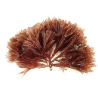
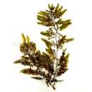
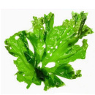
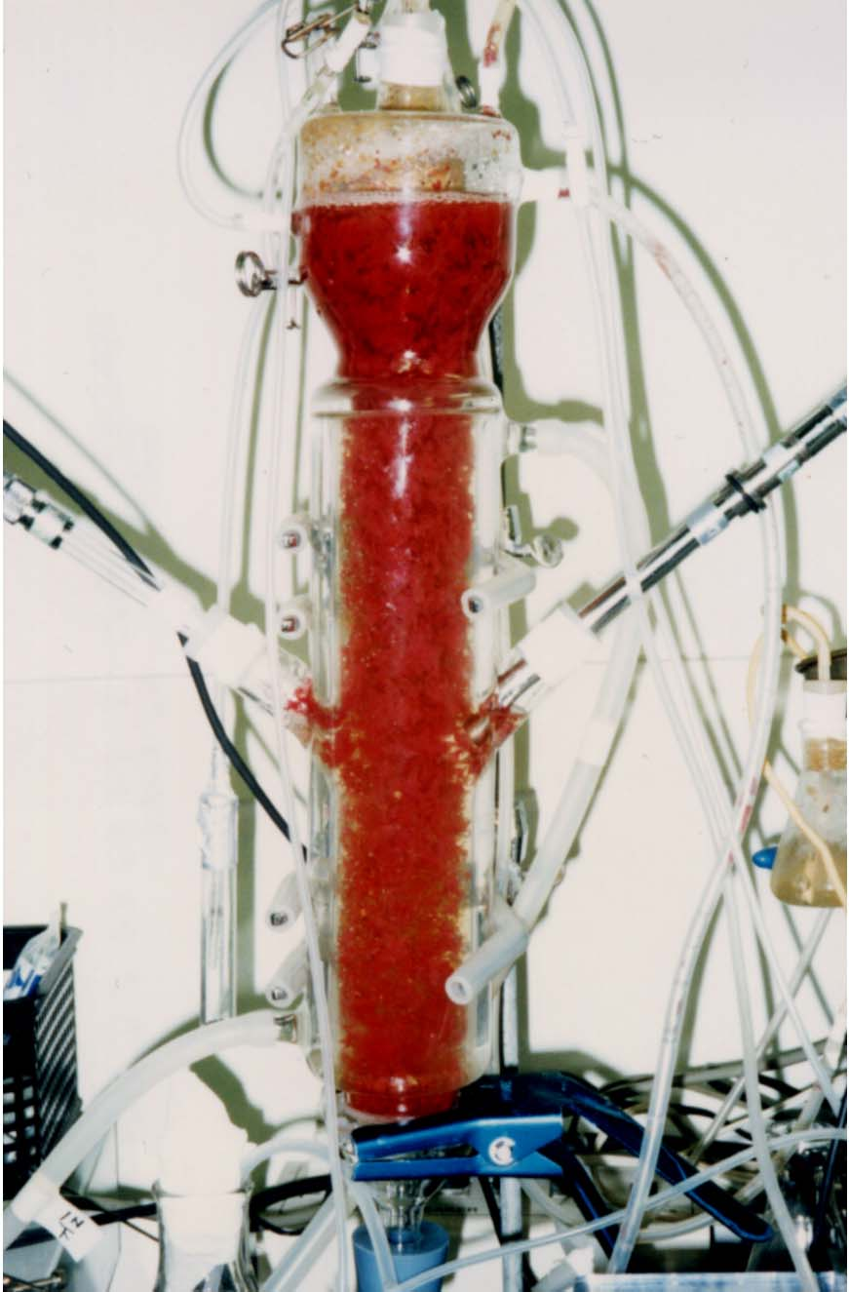



Schematic diagram of metal removals from fermentation residues by photosynthetic bacteria
Metal concentrating
Heavy, minor metals,
rare earths
Metals and organics in fermentation residues
High-functional photosynthetic bacteria
with metal resistance and recovery
clean water
Screening of Marine bacteria
Liquid fuel producer
from residual organic carbon
Liquid fuels

Slide 26
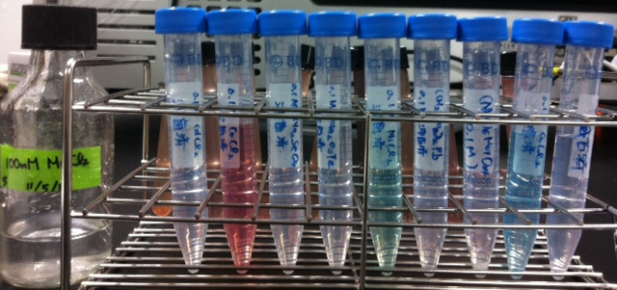
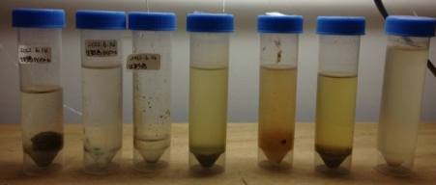
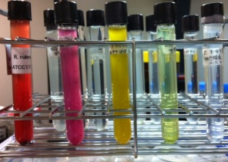
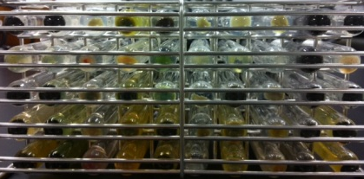
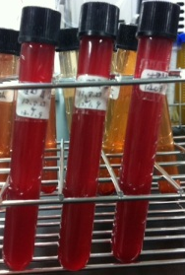
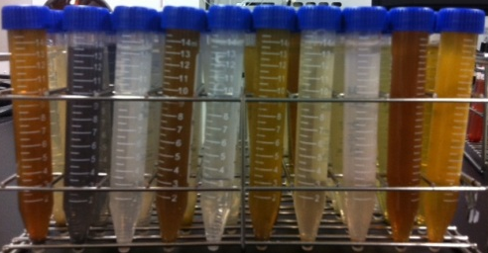
Screening of photosynthetic bacteria (PSB) capable to recover various metal ions
Accumulation of PSB
in sea water
（Mn,Cd,Co,Se,Te,Ni,Pb,Mo,Cu,Zn）
Subculture in
PSB medium
Accumulation in PSB medium
with１mM metals（10 sp.）
Subculture of PSB medium
with１mM metals（10）
Subculture

Slide 27
Metal removal by Photosynthetic Bacteria
 | Initial conc. (ppm) | Spent medium (ppm) | Harvested cells (ppm) | Recovery* (%) | In kelp** (ppm)
Co | 0.4 | 0.217 | 0.127 | 32.1 | 0.21
Cd | 1.1 | 3.22x10⁻² | 1.00 | 91.5 | 0.00049
Cu | 0.77 | 0.111 | 0.615 | 80.1 | 0.25
Y | 128 | 4.38 | 123.55 | 96.5 | 12.7
Metal ion was added into medium individually.
*Recovery (%) = The amount of ion in harvested cells / Sum of ion amounts X 100.
** actual measured value
Minor metal
Rare earth
Heavy metal
Okamura et al., unpublished
Notes:
Using this cocktail, cobalt, cupper and cadmium were recovered at high efficiency and rare earth element are also recovered using other cocktail.
These recovery rates promise to remove the metals from kelp wastewater completely.

Slide 28
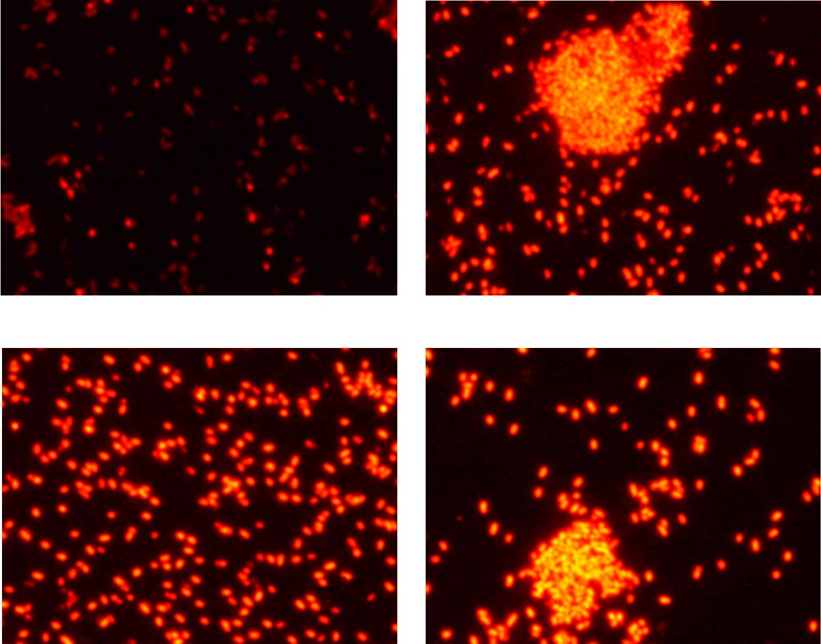

Oil-producing bacteria from acetic and propionic acids
Seaweed
Anaerobic
digestion
Pre-treatment
Wastewater treatment
Effluent
In wastewater
acetate
propionate
Oil production by newly isolated marine microorganism
10mM NH₄Cl
(C) 0.1mM NH₄Cl
Hydrocarbons (Oil)
Total lipid / DCW [mg/g]
(B) 1mM NH₄Cl
(D) N starvation
10
1.0
0.1
0
NH₄Cl [ mM ]
Oil content 70%
Mainly (50%) 2-butenoic acid 1-methylethyl ester
Okamura et al. (2016) Bioresour. Technol., 201, 215-221.

Slide 29
Research achievement
Seaweed
Hydrothermal
treatment
・ 80% of solid fraction in L. Japonica is solubilized by hydrothermal treatment with and without salt between 150 and 190 ºC
・ It was developed novel two-stage fermentation process to produce valuable oil and from algae carbohydrates with Aurantiochytrium and specific converter.
・Whole genome of Aurantiochytrium was sequenced.
・ Over expression of CrtBY accelerated carotenoid production by Aurantiochytrium
Valuable lipid production
Undiluted salt tolerant
methane fermentation
・ Salt tolerant methanogenic communities were discovered in marine sediments.
・ Microbial community with stable methane formation at 4.5%NaCl was developed.
・ Continuous methane fermentation with undiluted seaweed at HRT 45 day was possible
Waste water treat.
Valuable metal recovery
・ Several photosynthetic bacteria communities possessing the ability to recover heavy and rare metals was screened.
・Oil-producing bacteria from acetic and propionic acids (main VFAs in the fermentation residue) was discovered.
Green water

Slide 30
Acknowledgements
Prof. T. Aki (Hiroshima University)
Prof. Matsumura (Hiroshima University)
Assoc. Prof. Y. Okamura (Hiroshima University)
This study is financially supported by CREST, JST, Japan.

