Slide 1

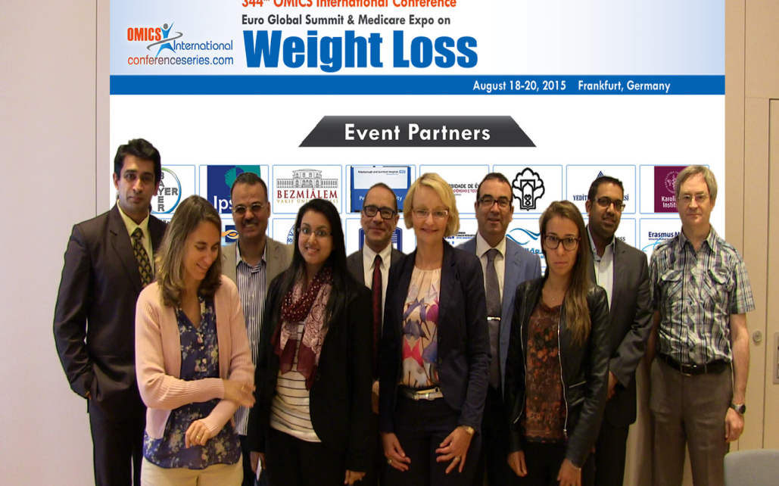

Euro Weight Loss-2015
Frankfurt, Germany
August 18 – 20, 2015
Yusuf Öztürk

Slide 2
Obesity, Diabetes and Metabolic Syndrome in Terms of Preventive Medicine and Healthcare
YUSUF ÖZTÜRK
PROFESSOR OF PHARMACOLOGY, ANADOLU UNIVERSITY FACULTY OF PHARMACY, ESKISEHIR TURKEY
I want to dedicate this speech for the 80th Birthday of my mom

Slide 3
Plan of presentation
Definition preventive medicine (PM) and health care
Levels of PM
Importance of PM
The approach of WHO for PM
Measures of PM
Plants and plant products as measures of PM (Scientific aspect)
The approach of WHO for plants and plant products
Plants officially recommended against obesity
Plants officially recommended against diabetes
Plants officially recommended against hyperlipidemia
Plants recommended/investigated against metabolic syndrome
Research on plant and plant products
Conclusion

Slide 4

Life is a fine balance of homeostasis

Slide 5
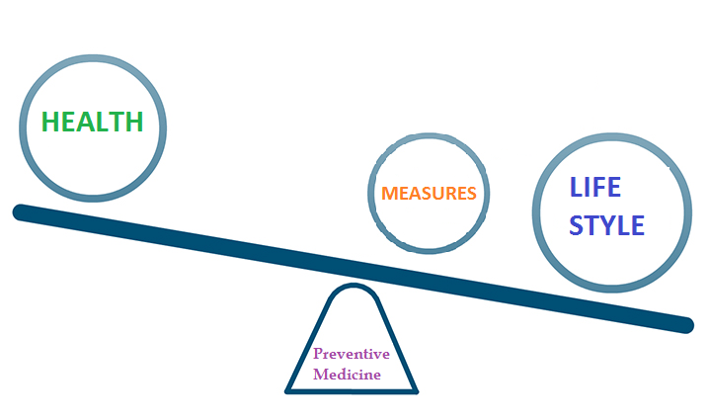
Achieving balance

Slide 6
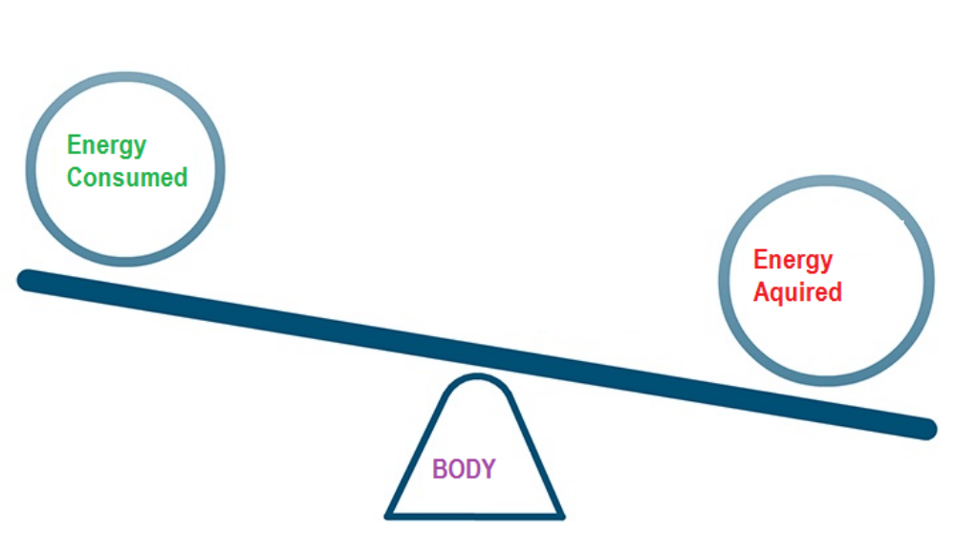
Achieving balance in metabolism

Slide 7
What is preventive medicine (PM) ?
As is apparent in the term, it focuses on the protections of diseases rather than their treatments
To realize healthcare, PM may be applied in certain levels

Slide 8
Levels of PM
PM may be applied in three levels
Primary prevention
Secondary prevention
Tertiary prevention
Katz & Ali (2009)

Slide 9
What are the levels of PM?
Primary Prevention
To avoid happening of disease either through eradicating disease cause(s) or increasing resistance to disease. Examples are:
    Immunization against diseases,
    Having healthy diets and/or
    Physical Exercise regimens
    Avoiding smoking, etc

Slide 10
What are the levels of PM?
Seconary Prevention
To detect and/or address an existing disease prior to the visibility of symptoms. Examples are:
    Cancer screening,
    Treatment of hypertension,
    Treatment of obesity, etc.

Slide 11
What are the levels of PM?
Tertiary Prevention
To decrease negative impact of symptomatic disease, such as disability or death, through rehabilitation and treatment. Examples are:
    Surgical procedures that halt the spread or progression of disease, etc.

Slide 12
What is the importance of PM?
Major causes of preventable deaths in USA (2000)
Cause | Deaths caused | % of all deaths
Tobacco smoking | 435,000 | 18.1
Poor diet and physical inactivity | 400,000 | 16.6
Alcohol consumption | 85,000 | 3.5
Infectious diseases | 75,000 | 3.1
Toxicants | 55,000 | 2.3
Traffic collisions | 43,000 | 1.8
Firearm incidents | 29,000 | 1.2
Sexually transmitted infections | 20,000 | 0.8
Drug abuse | 17,000 | 0.7
Mokdad et al., 2004

Slide 13
What is the importance of PM?
Major causes of preventable deaths in the World (2001)
Cause | Deaths caused (millions per year)
Hypertension | 7.8
Smoking | 5.0
High cholesterol | 3.9
Malnutrition | 3.8
Sexually transmitted infections | 3.0
Poor diet | 2.8
Overweight and obesity | 2.5
Physical inactivity | 2.0
Alcohol | 1.9
Indoor air pollution from solid fuels | 1.8
Unsafe water and poor sanitation | 1.6
Lopez et al., 2006

Slide 14
What is the importance of PM?
In ideal conditions,
Minimizes major health risks
Maximizes quality of life
Facilitates the treatment of diseases
Minimizes the direct and indirect cost of diseases
Minimizes the health expenditure
Minimizes the loss of labor helping to increase productivity, etc.
However, recent reports on health economics have more cautious approaches esp., stating the cost of secondary and tertiary types of prevention
Cohen et al., 2008

Slide 15
How is the approach of WHO for PM?
According to estimates of the World Health Organization (WHO), about 55 million people died worldwide in 2011, most of this group from diseases, like cancer, diabetes, and chronic cardiovascular and lung diseases
Obesity and overweight are among the health priorities of WHO in terms of PM
There are many technical reports and books on PM initiated by WHO

Slide 16
What are the measures of PM?
They include:
Periodical health screens and controls for dangerous disesaes
Cessation, withdraw and reduction of the exposure of harmful factors for the health
Substitution and support with beneficial factors the health
Of course they are closely related to life styles

Slide 17
Substitutions and Supports for PM?
Immunization against communicable diseases
Use of certain prescription drugs
Dietary and nutritional factors
Over-the-counter (OTC) drugs

Slide 18
Differences between prescription and OTC drugs
Prescription drugs:
Prescribed by a doctor
Bought at a pharmacy with pharmacist’s advise
Prescribed for and intended to be used by one person
Regulated through the Drug Application process
OTC drugs:
Not require a doctor's prescription
Bought in stores do not require pharmacist’s advise
Can be used more than one person
Regulated mainly through OTC Drug monographs.

Slide 19
Medicinal Plants for PM
Most of them are used both as OTC drugs and as dietary and nutritional factors
They may be used both in traditional medicine and official health systems
Some of them are prescription drugs only
There are plants used for the supply of dietary and nutritional factors
There are many data on their usage
There are info pollution on medicinal plants

Slide 20
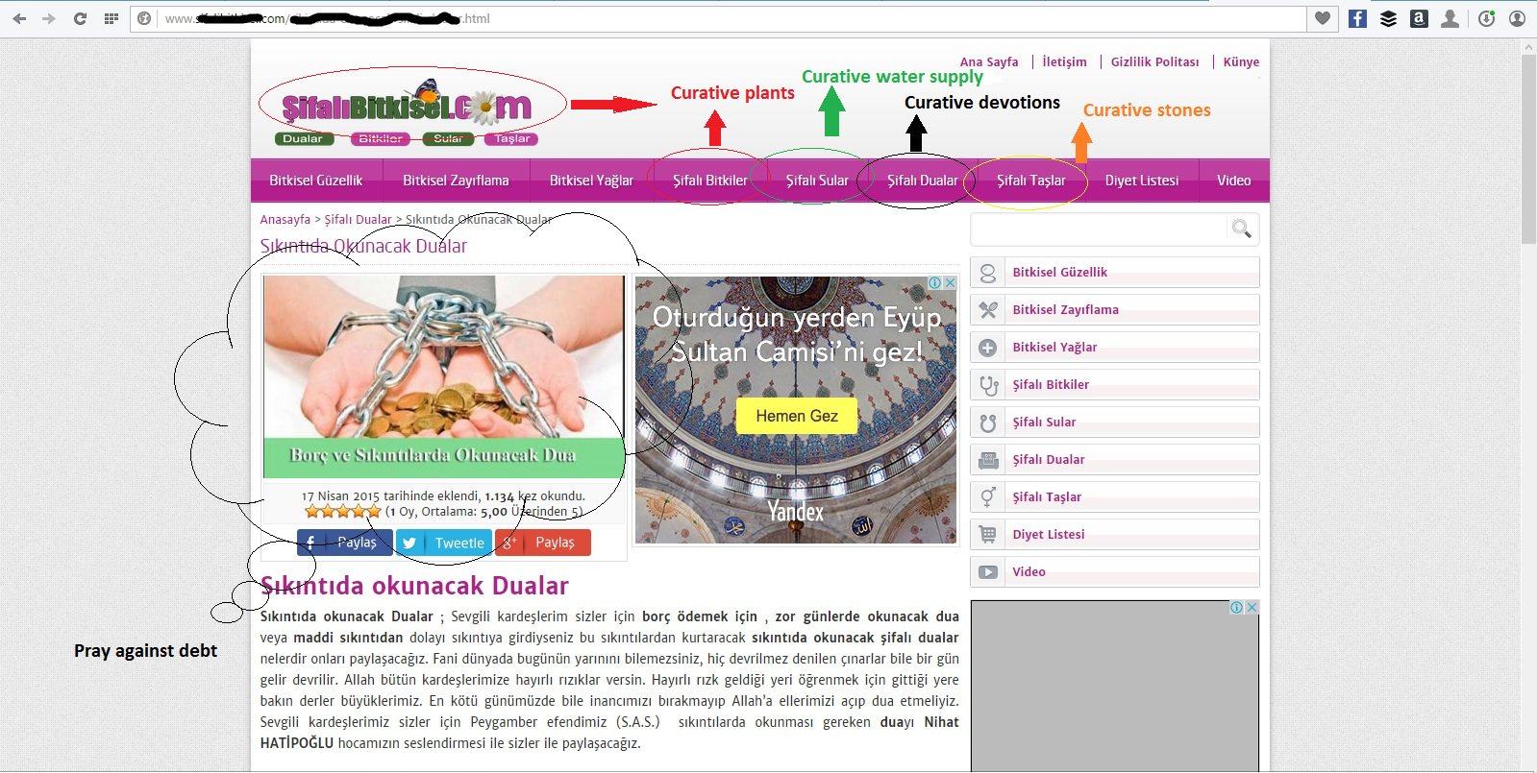
A typical example of info pollutant on medicinal plants

Slide 21
What is official attitude of WHO for Medicinal Plants
Supportive for the use of medicinal plants for PM
Trying to provide scientific basis for traditional uses of plants for PM
Publications on Medicinal Plants such as monographs etc.

Slide 22


What is official attitude of WHO for Medicinal Plants
WHO Monographs on Selected Medicinal Plants Vol. 1-4 (1999-2009)
WHO Monographs on Medicinal Plants Commonly Used in the Newly Independent States (NIS) (2010)
http://apps.who.int/medicinedocs/en/d/Js2200e/

Slide 23
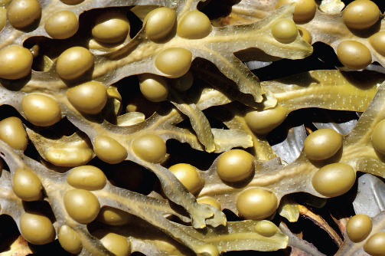
Plants Indicated against Obesity
Kelp (Fucus sp.; Brown algae) Seaweed. Mechanical effect (swelling)
M.Side Effect: Anaemia, toxicity due to heavy metals in prolonged uses
Contrindications: Thyroid diseases
Drug Interaction: Not known
Safety in Pregnancy & Lactation: Should not be used

Slide 24
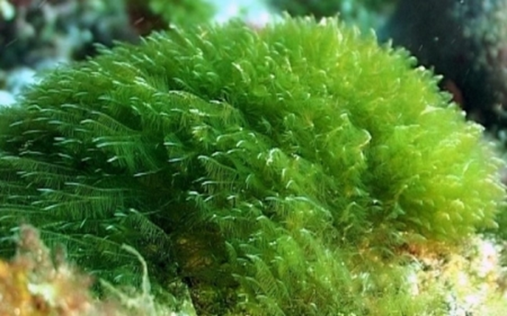
Plants Indicated against Obesity
Spirulina (Spirulina sp.) Algae used as food. Mechanical effect (swelling)
Side Effect: Not reported
Contrindications: Not reported
Drug Interaction: Not reported
Safety in Pregnancy & Lactation: Not known but possibly safe

Slide 25
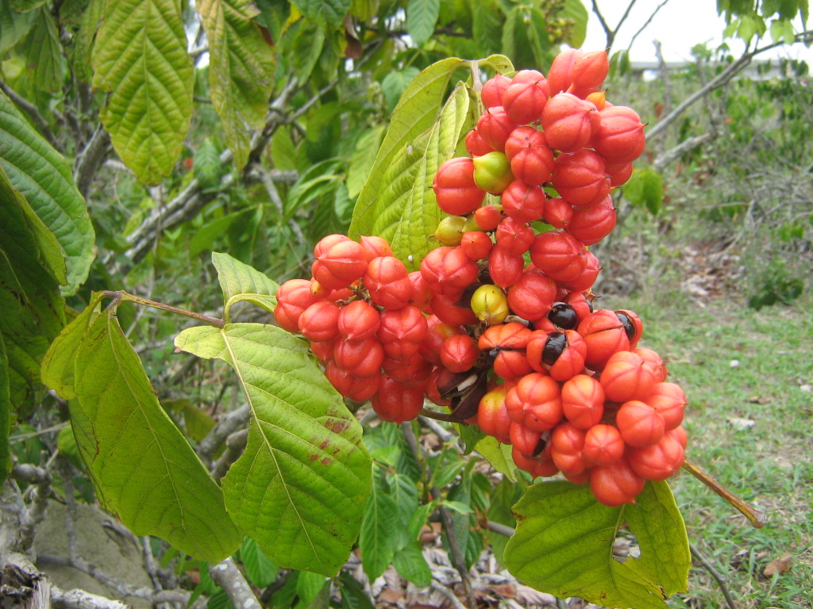
Plants Indicated against Obesity
Guarana (Paullinia cupana; Brasilan Cacao) Seeds are used.
Side Effects: diarrhoea, headache, hypertension, insomnia, nausea, restlessness, tremors, and vomiting (due to caffeine)
Contraindications: cardiovascular and bleeding disorders (esp. arrythmias), anxiety, peptic ulcer, renal impairment, cirrhosis, hyperthyroidism, and glaucoma
Drug Interactions: Amiodarone
Safety in Pregnancy & Lactation: Not recommended to use

Slide 26
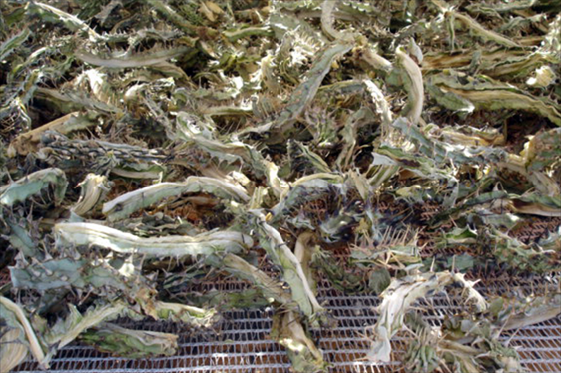
Plants Indicated against Obesity
Hoodia (Hoodia gordonii) Stem, root, latex used. Apetite supressant.
M.Side Effect: Slight liver toxicity
Contrindications: Not known
Drug Interactions: Not known
Safety in Pregnancy & Lactation: Not recommended to use

Slide 27
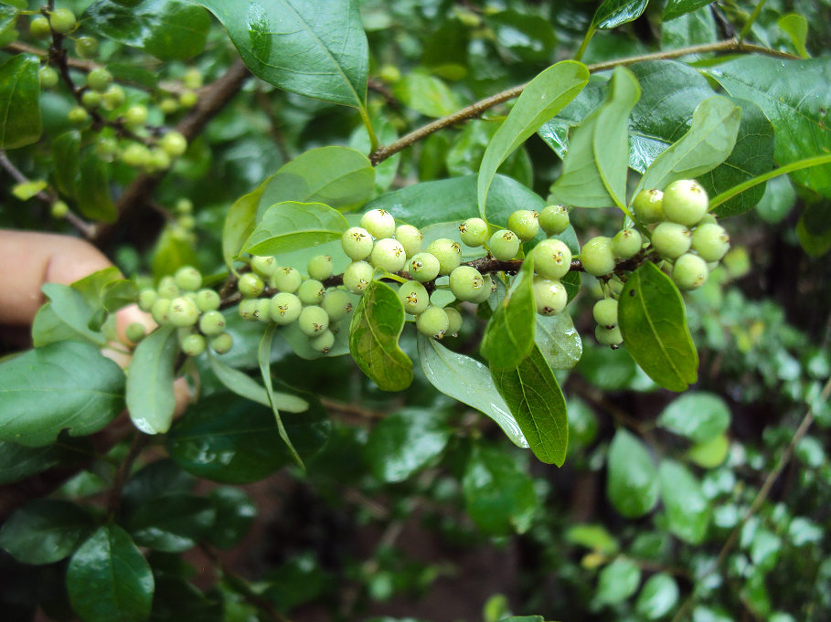
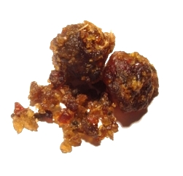
Plants Indicated against Obesity
Gugul (Commiphora wightii) Oleo gum resin of the stem and branches used. Regulates blood lipid levels similar to cholestyramine
M.Side Effect: Not reported
Contrindications: Thyroid diseases and at risk of bleeding
Drug Interactions: Diltiazem and propranolol. Possibly anticoagulants
Safety in Pregnancy & Lactation: Contraindicated

Slide 28
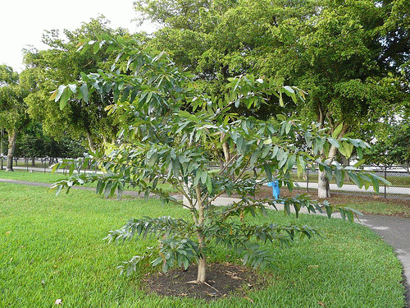
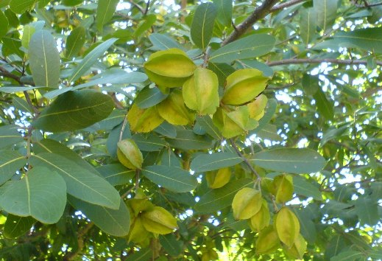
Plants Indicated against Obesity
Arjuna (Terminalia arjuna) Bark, leaves and fruits used. Regulates blood lipid levels and insulin secretion
Side Effect: Headache, constipation and gastritis (mild)
Contrindications: Thyroid diseases and at risk of bleeding
Drug Interactions: Not known. Possibly antihypertensive
Safety in Pregnancy & Lactation: Not recommended

Slide 29
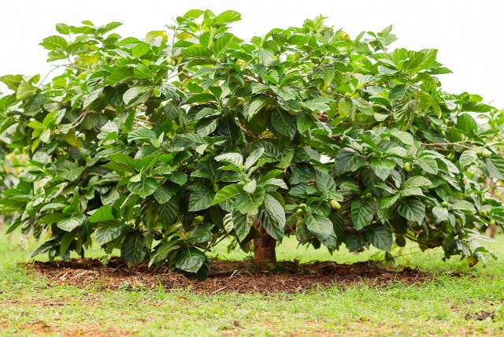
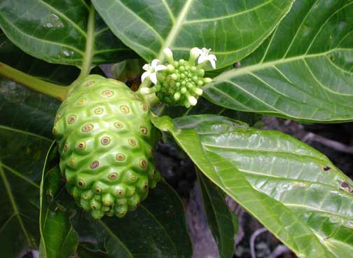
Plants Indicated against Obesity
Noni (Morinda citrifolia) Leaves and fruits used. Used as food. Regulates blood lipid levels and insulin secretion
Side Effect: Not reported
Contrindications: Not known (Caution for liver and renal diseases)
Drug Interactions: Not known. Possibly warfarin (inhibits CYP3A4)
Safety in Pregnancy & Lactation: Possibly safe, but not recommended

Slide 30

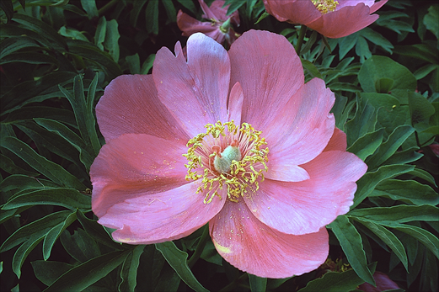
Plants Indicated against Obesity
Peony (Paeonia lactiflora) Roots and flowers used. Petals are used as food. Regulates blood lipid levels and glucose absorption
Side Effect: Mild gastro-intestinal complaints
Contrindications: Persons who have bleeding risks
Drug Interactions: Warfarin, midazolam, etc. (inhibits CYP3A4)
Safety in Pregnancy & Lactation: Contraindicated in pregnancy, not recommended in lactation

Slide 31
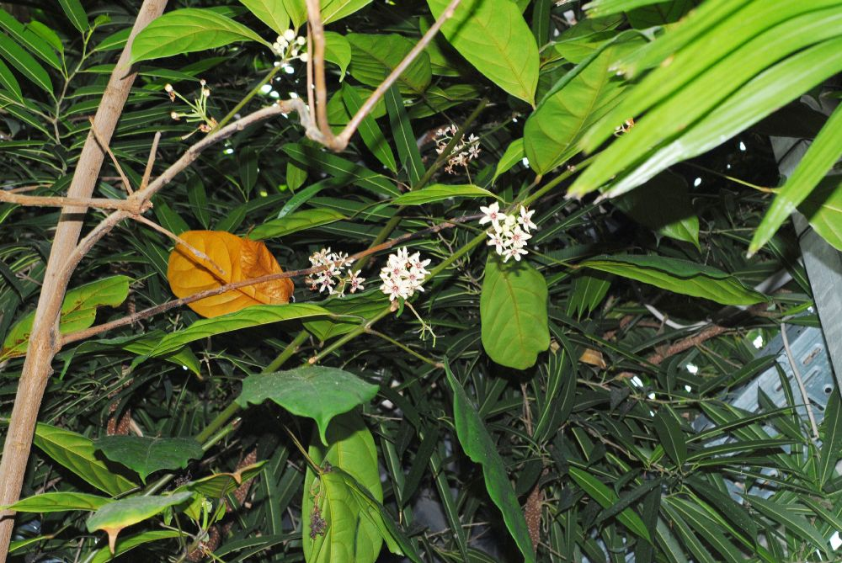
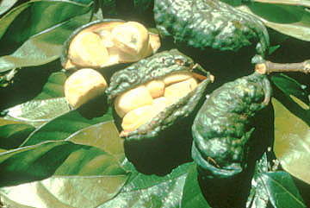
Plants Indicated against Obesity
Cola (Paeonia lactiflora) Seeds are used. Decreases appetite and increases lipolysis
Side Effect: CNS stimulation, mild stimulation of cardiac functions, etc
Contrindications: Stomach and/or duodenal ulcers (due to gastric secretion)
Drug Interactions: Not known
Safety in Pregnancy & Lactation: Contraindicated in pregnancy, not recommended in lactation

Slide 32
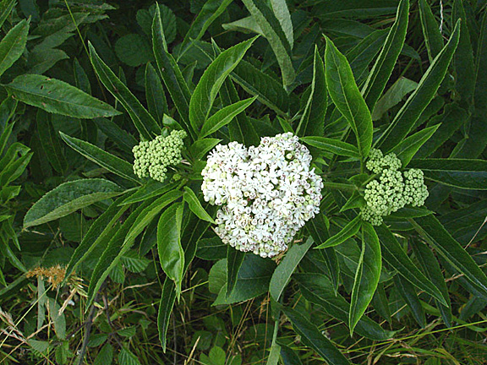
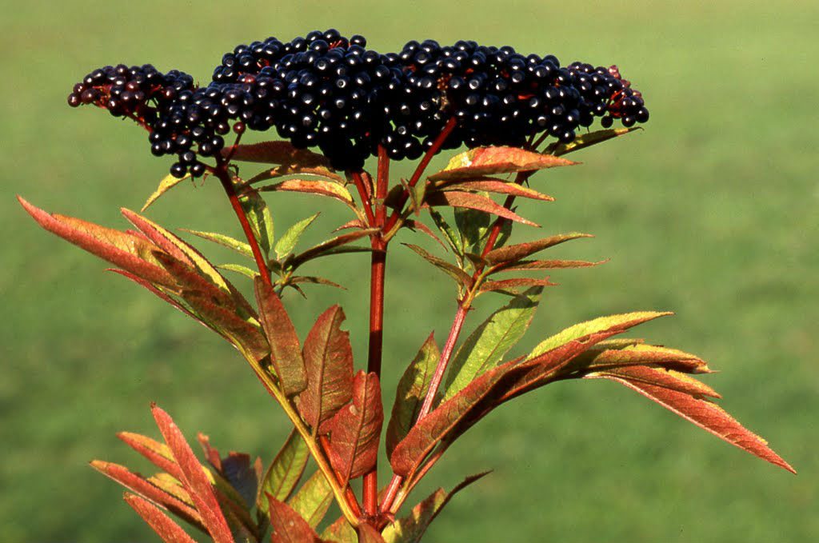
Plants Indicated against Obesity
Dwarf Elder (Sambucus ebulus) Leaves, fruits and roots are used. Decreases appetite
Side Effect: Vomiting, diarrhea, cyanosis, headache reported due to overdosage
Contrindications: Not known
Drug Interactions: Not known
Safety in Pregnancy & Lactation: Not recommended during pregnancy and lactation

Slide 33
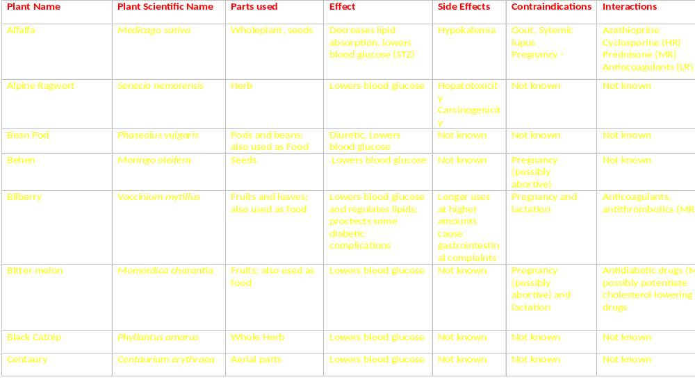
Plants Indicated in Diabetes

Slide 34
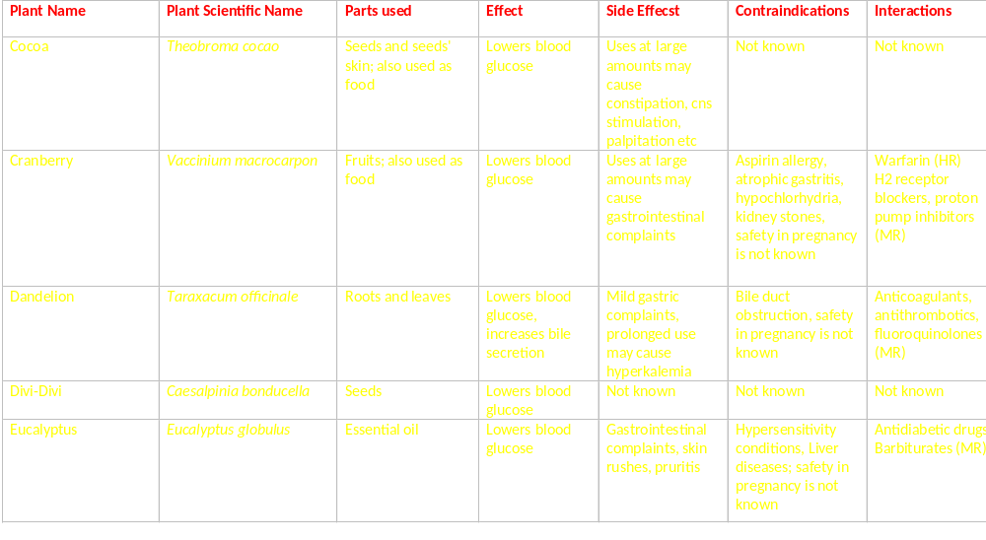
Plants Indicated in Diabetes

Slide 35
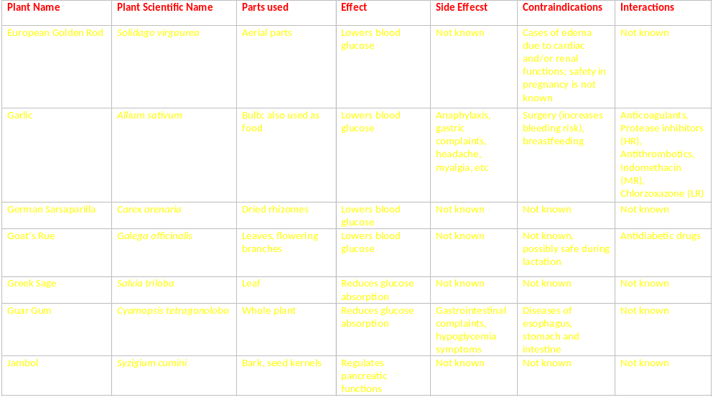
Plants Indicated in Diabetes

Slide 36
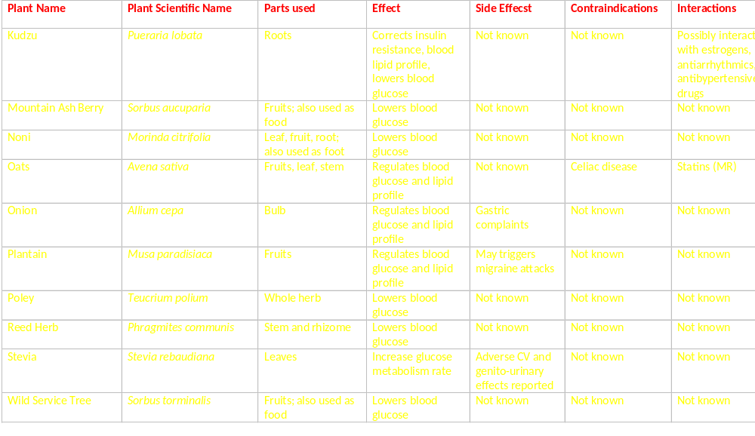
Plants Indicated in Diabetes

Slide 37
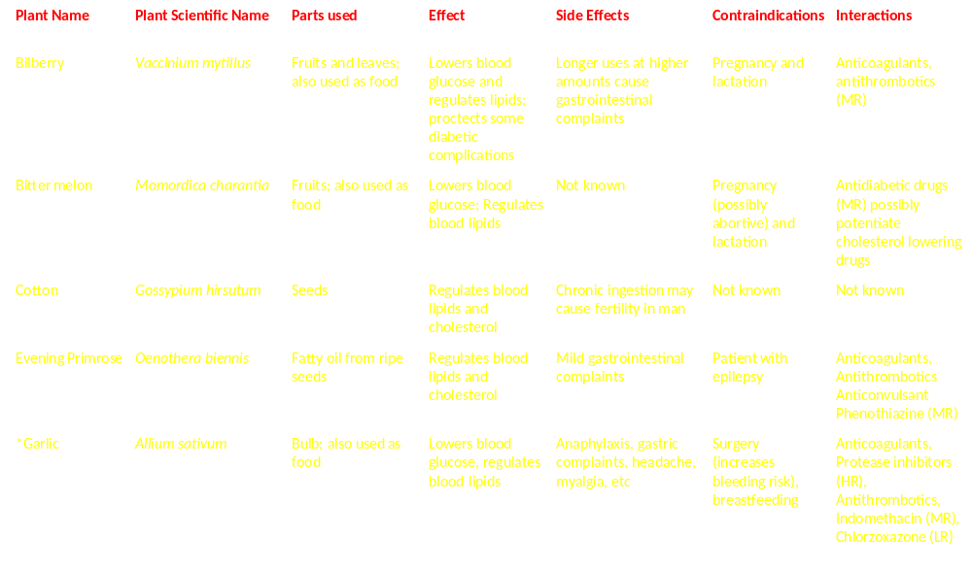
Plants Indicated in Hyperlipidemia
*Recommended by Commission E

Slide 38
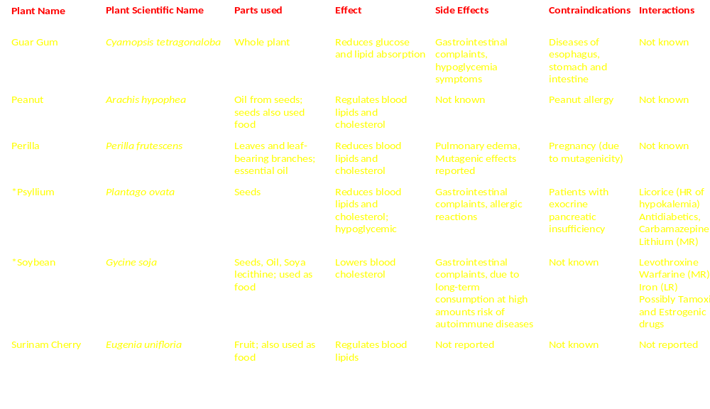
Plants Indicated in Hyperlipidemia
*Recommended by Commission E

Slide 39
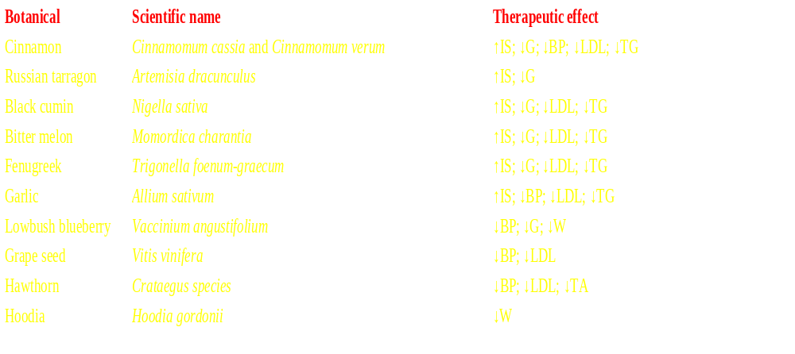
Plants Recommended/Investigated for Metabolic Syndrome
BP blood pressure, G blood glucose, IS insulin sensitivity, TA thrombocyte aggregation TG triglycerides, W body weight

Slide 40
Plants Investigated for Metabolic Syndrome in my Lab
St. John’s Wort
Origanum water under distillate

Slide 41
CONCLUSION
Obesity and metabolic syndrome are diseases are insidious (!) health problems which develop slowly due to life style
Long-term solution and prevension one of the best approaches as PM and health care
Plants provides almost ideal measures for PM
However, cautions are necessary to use them

Slide 42

Meet the eminent gathering once again at
Euro Weight Loss-2016
Vienna, Austria
September 19-21, 2016
Euro Weight Loss – 2016
website:http://weightloss.global-summit.com/europe/

Slide 43

THANK YOU FOR YOUR PATIENCE

